Slide 1
Effect of water temperature management on the hatching rate and larvae production of white leg shrimp (Litopenaeus vannami) in shrimp hatcheries of Sistan & Baluchistan province, South-east of Iran
Javad Ghasemzadeh^{1*}, Hamid Reza Nasiri²
1* Chabahar Maritime University, School of Marine Sciences, Department of Fisheries
2 Iranian Fisheries Organisation, Division of Aquaculture Management, Chabahar, Iran

Slide 2
Introduction:
Although Sturgeon (Acipenseridae) caviar is the most significant and famous fishery product of Iran from the Caspian Sea, in the last three decades the country has gained some significant success with other fishery and aquaculture products.
Iranian fisheries and aquaculture production reached 620,000 metric tons in 2014, of which 70% originated from capture fishery and 30% from aquaculture activities.
In Iran, aquaculture started with sturgeon breeding and rainbow trout farming in 1929 and 1959, respectively.

Slide 3
There are five main aquaculture activities: warm-water fish farming (mostly carp), cold-water fish farming (mainly rainbow trout), fish farming in natural and semi-natural water resources, fish stock enhancement, and shrimp farming.
The ways in which Iran has been able to make progress in developing aquaculture are as follows:
a) optimising the use of climatic diversity in developing both freshwater and saltwater aquaculture activities.
b) establishing the required infrastructures for development and extension of aquaculture activities.
c) training skilful manpower and educating specialists in the different fields of aquaculture.
d) increasing per capita consumption of aquatic products through sensitising public opinion (11 kg).

Slide 4
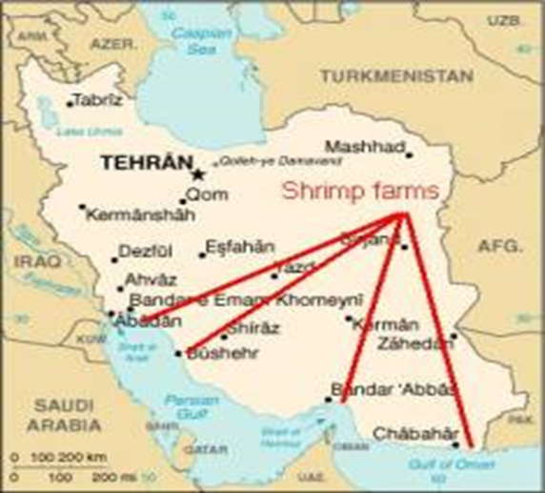
Shrimp farming operations in Iran, started in 1992 with a rapid extension of farms along 1800 kilometres of flat coastal regions bordering Persian Gulf and Oman Sea.

Slide 5
So far almost 200,000 hectares of land suitable for shrimp farming is surveyed along the Persian Gulf and Oman Sea and more than 50,000 hectares are distributed among interested farmers.
At present there are 10,000 hectares of active farms, producing in average 2500 kg/hectare.
In the Sistan & Baluchistan province (South-east of Iran) along 300 kilometres of Oman Sea coast 20 sites with a total area of 55000 hectares were identified for shrimp culture, of which 30,000 hectares are located in Gowater site.
In Gowater site we have 4000 hectares of active farms.

Slide 6
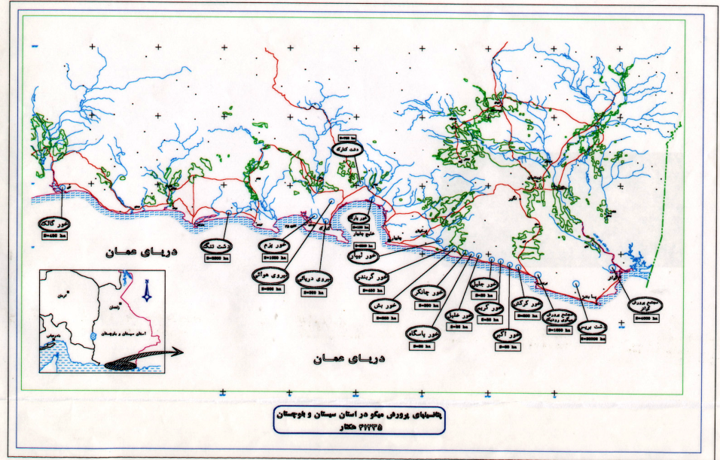
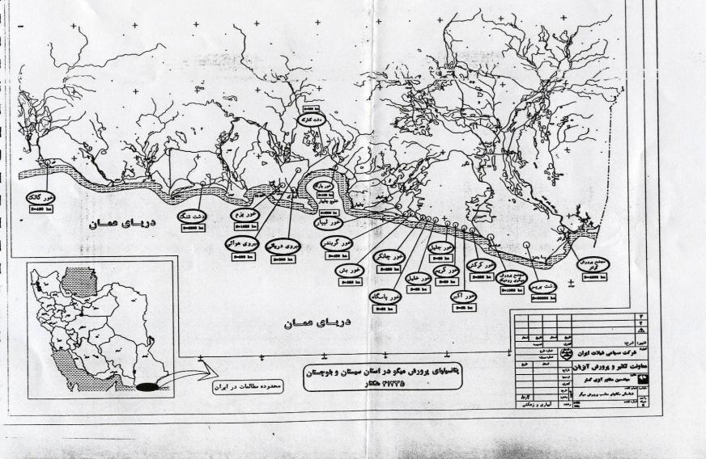
Map of suitable areas designated for Shrimp farming along the Iranian coast of the Oman Sea.

Slide 7
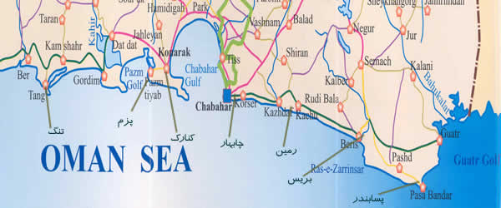

Slide 8
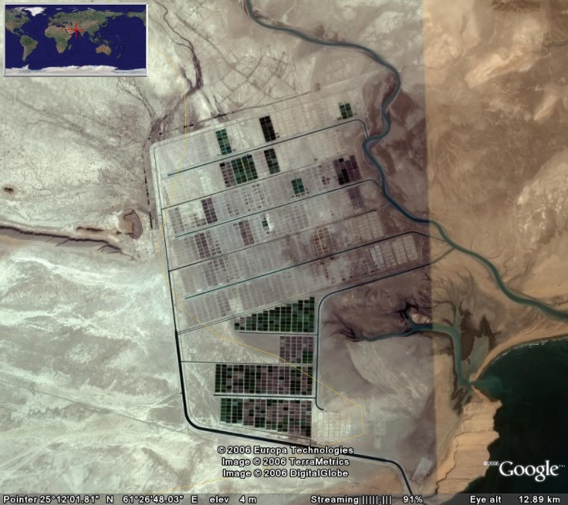
Bahukalat River
Northern Site farms
Mangrove area
Southern site farms
Gowater Bay
Main drainage channel

Slide 9
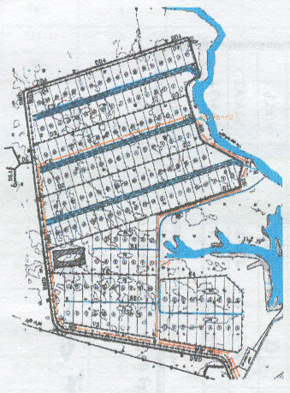
GOWATER, CHABAHAR

Slide 10
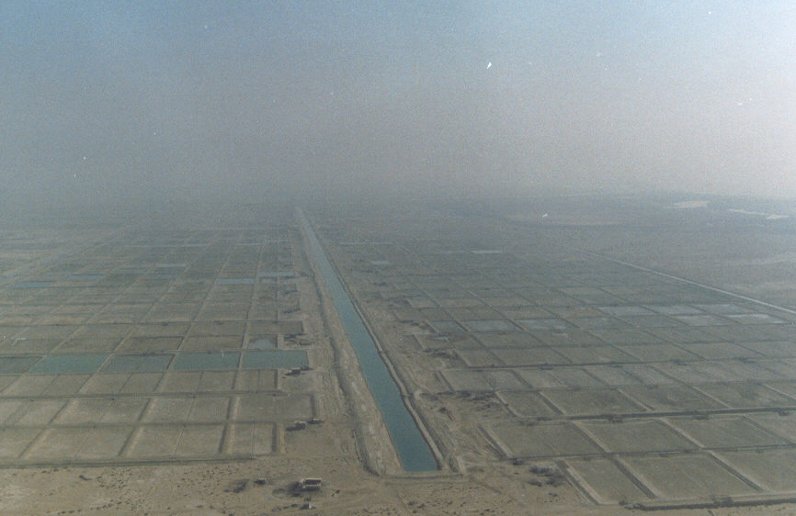

Slide 11
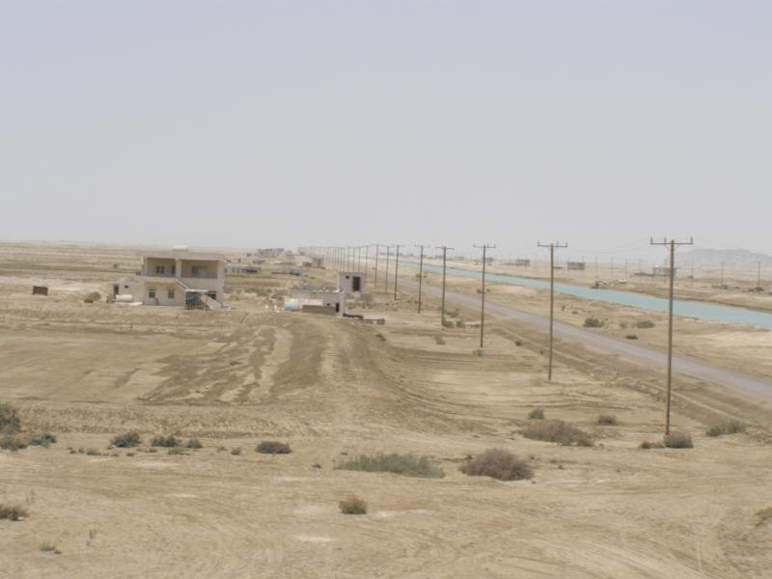

Slide 12
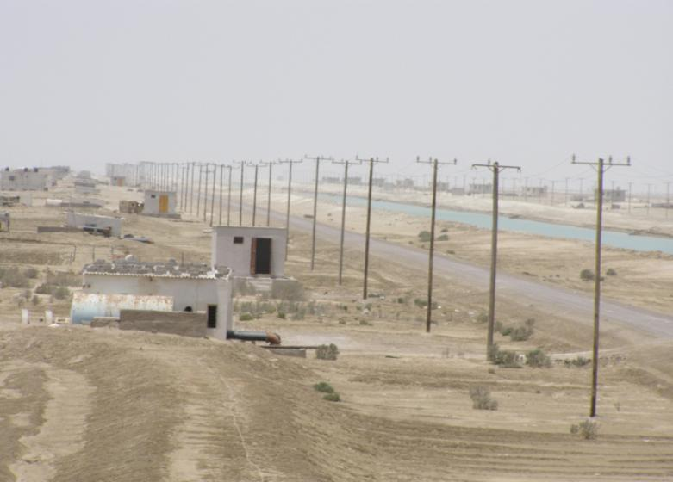

Slide 13
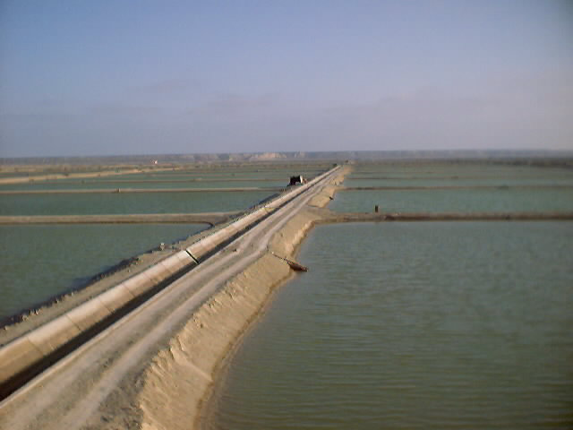

Slide 14
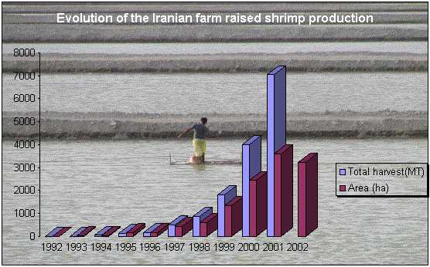

Slide 15
This industry was flourishing by producing high quality protein, creating employment, job opportunities and income for the coastal communities until the first outbreak of white spot syndrome (WSSP) disease in 2001. This disease started in Choeibdeh area of Abadan with subsequent occurrences in Bushehr and Hormozgan provinces, causing a massive loss and decline in shrimp production.
These incidents ceased the farming activities in these areas for a few years until 2006 when the Iranian Fisheries Organisation introduced a new species, white leg shrimp (Litopenaeus vannami) to replace Indian white shrimp.

Slide 16
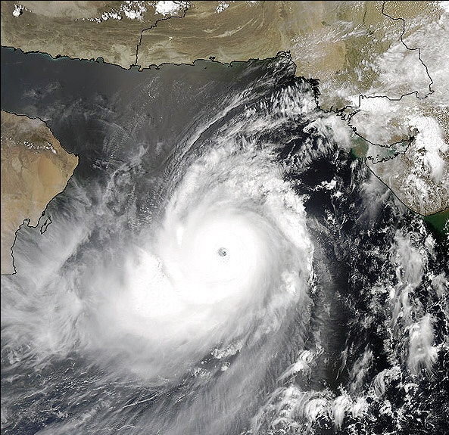
Gono Typhoon in Oman Sea, 2006
Gowater shrimp farms

Slide 17
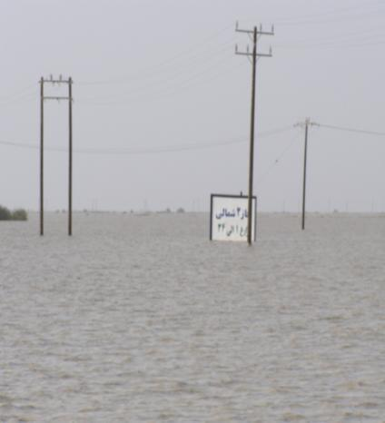
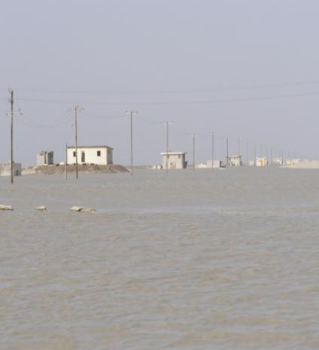
Flooding and inundation of the site

Slide 18
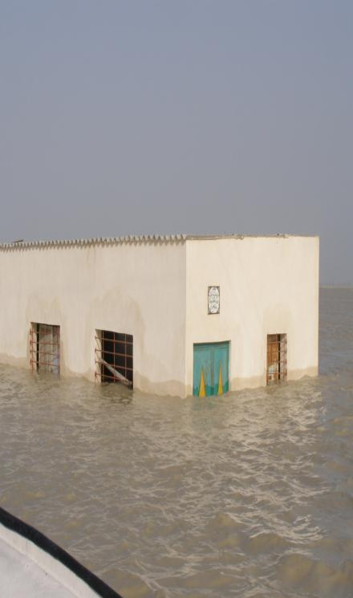
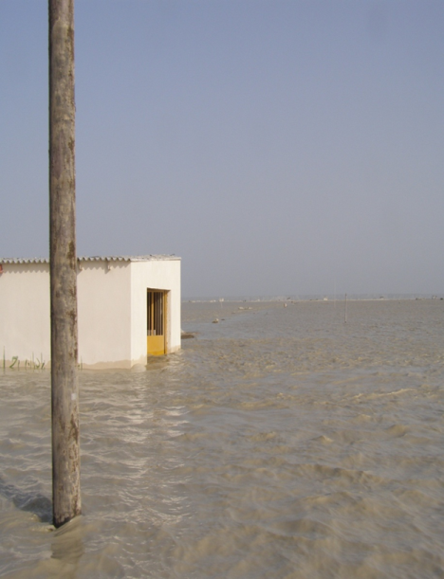

Slide 19
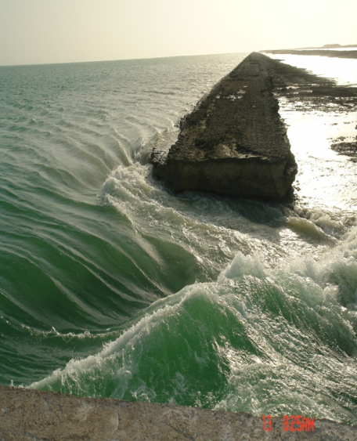
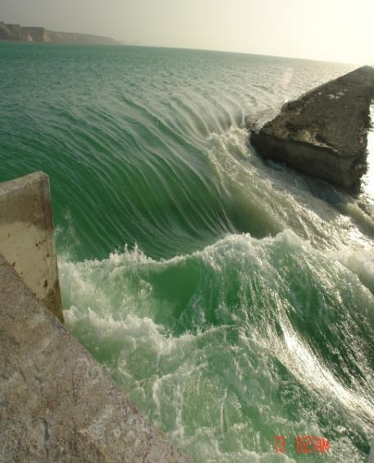

Slide 20
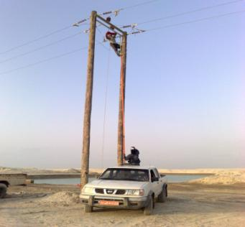
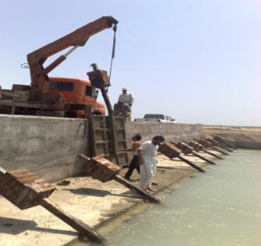
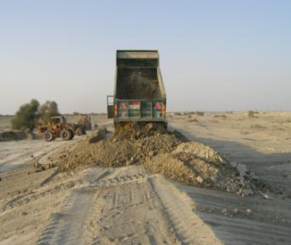
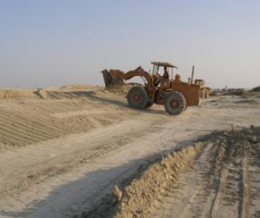

Slide 21
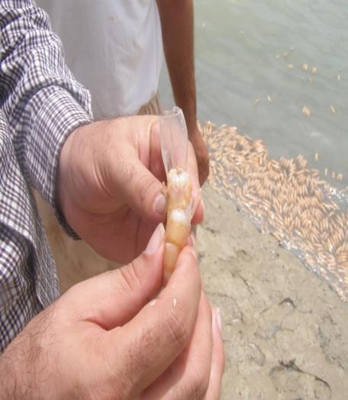
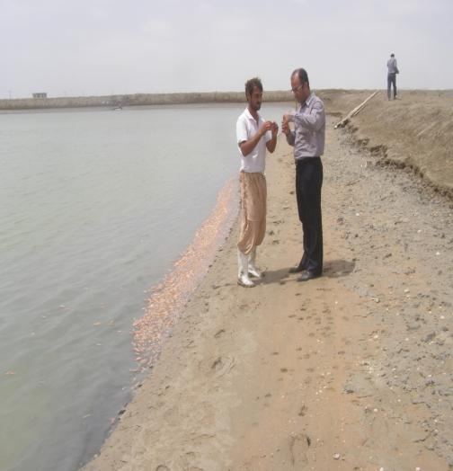
White spot outbreak in 2007

Slide 22
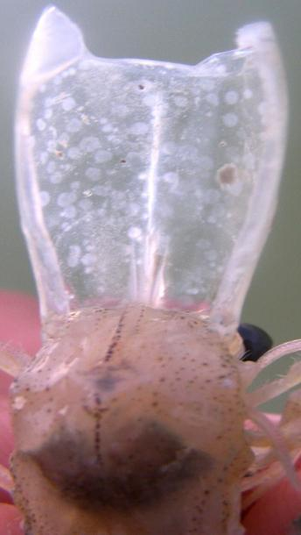
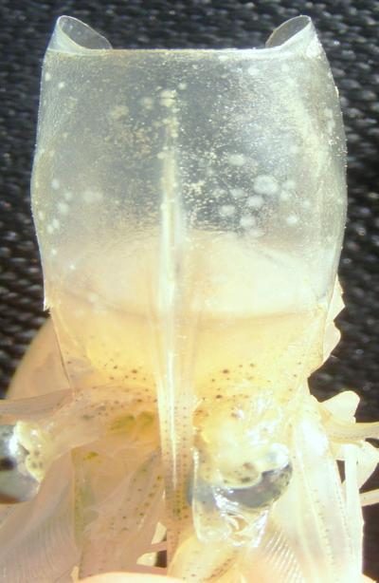
White spot symptoms on carapace

Slide 23
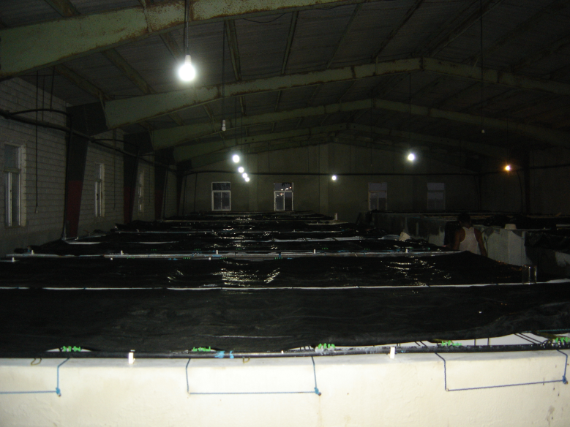

Slide 24
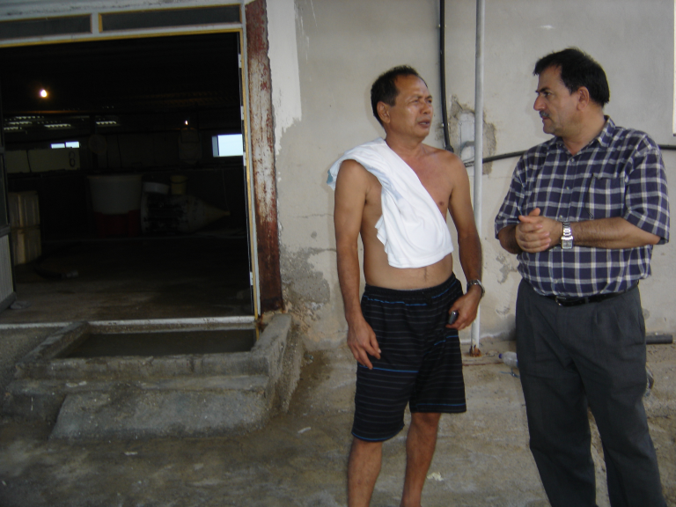

Slide 25
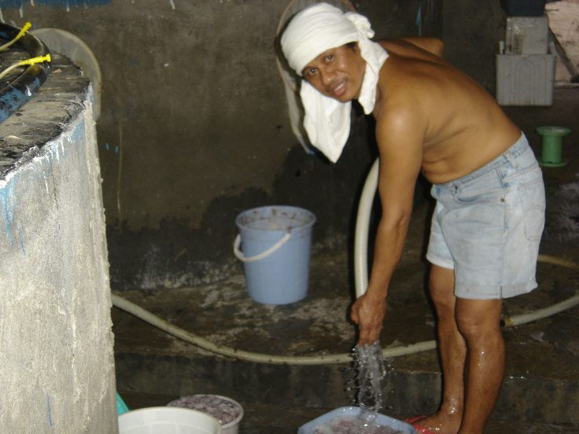

Slide 26
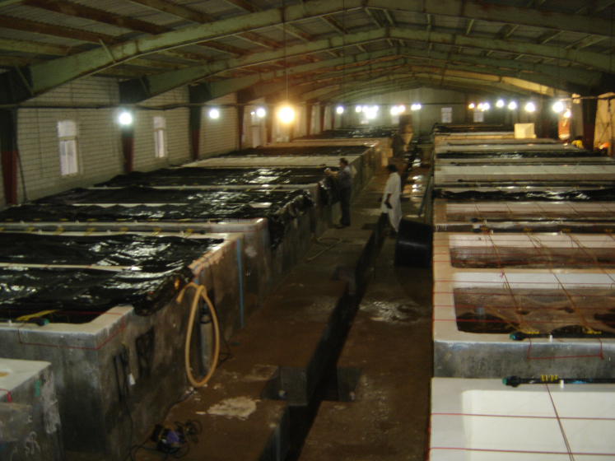

Slide 27
Three experimental hatcheries
Groups | Name of hatchery | Location | Number and nationality of technical officers | Methods of monitoring water temperature
Group A | Meigoo kesht | Konarak | 3- Philippno | Isolation of broodstock, using air conditioner and adding ice to the holding tanks
Group B | Chabahar Abzi parvar | Konarak | 1 Indonesian and 2 Indian | Only air conditioner
Group C | Bahar Abziparvar | Between Beris and Pasabandar | 3 Thai (Thailand) | Water without cooling and temperature adjustment

Slide 31
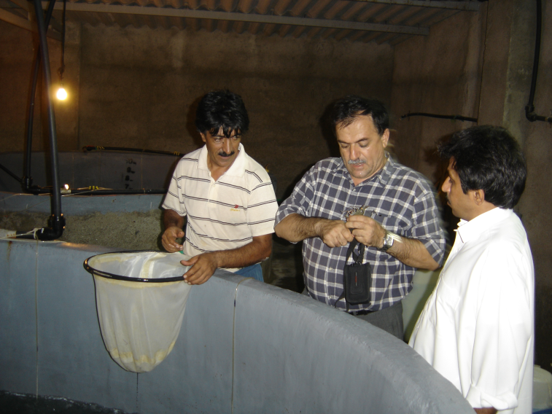

Slide 32
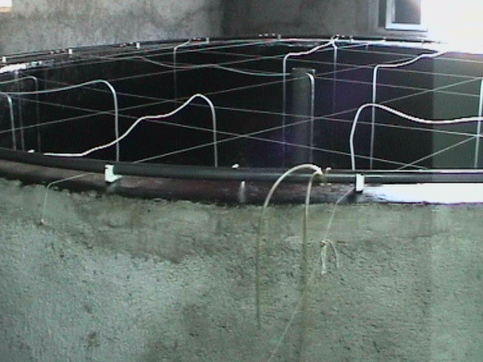

Slide 33
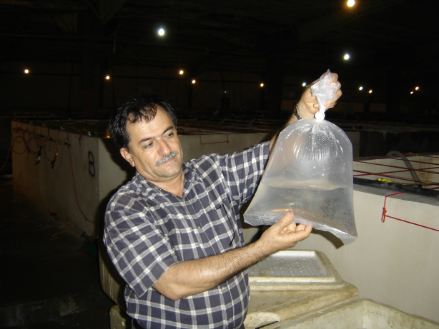

Slide 34

THANK YOU!
A.F.T.M.

