Slide 1

Screening of male and female plants and genetic diversity studies in Jojoba [Simmondsia chinensis (Link) Schneider] employing PCR based molecular markers
Jatin Kumar, Monika Heikrujam and Veena Agrawal*
Department of Botany, University of Delhi,
Delhi-110007

Slide 2
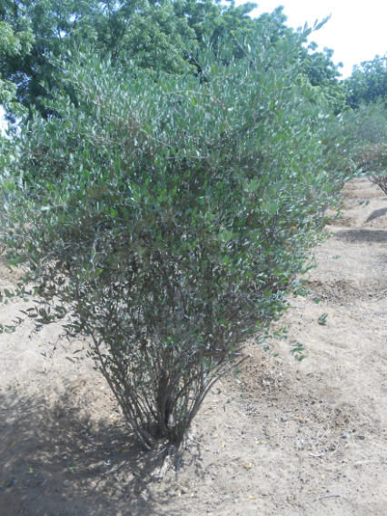
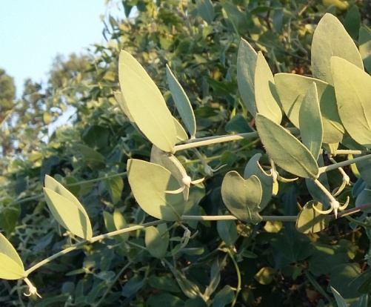
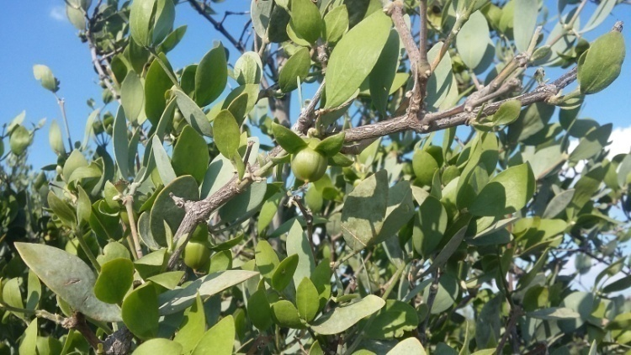
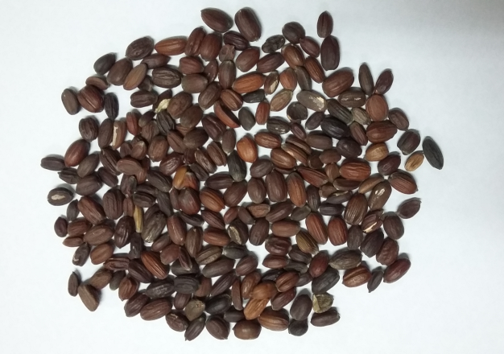

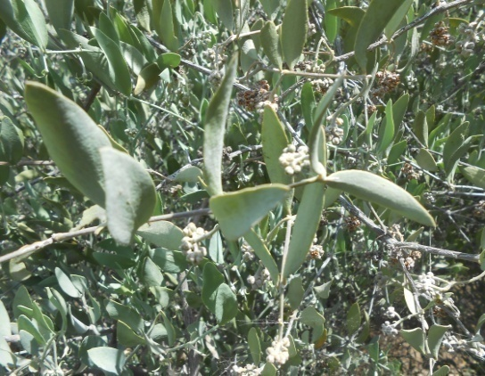

Simmondsia chinenis (JOJOBA)-" the Desert Gold”
Jojoba (Simmondsia chinensis) is a dioecious, woody, evergreen shrub native to the Sonoran and Mojave deserts of Arizona, California and Mexico.
  Mainly cultivated for its oil yielding seeds (40-60%).
Staminate plant
Fruits
Seeds
Pistillate Plant

Slide 3
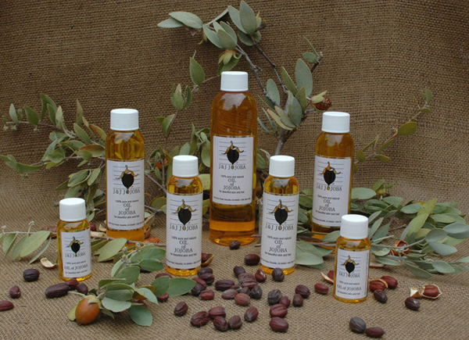
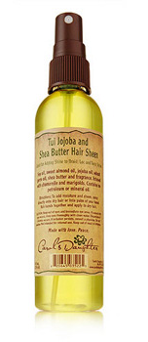


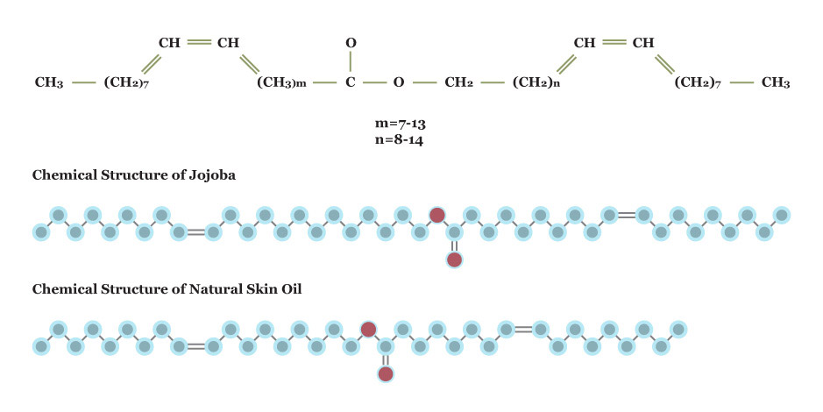
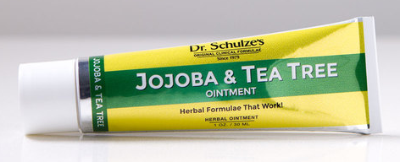
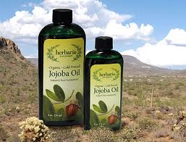

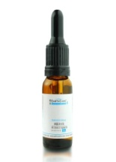
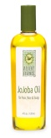
Jojoba Oil - Properties
Jojoba seeds contain liquid waxes (jojoba oil) which are esters of long chain monounsaturated fatty acids and alcohols
Jojoba oil is structurally and chemically similar to the human sebum It is non toxic, non-comedogenic and non – allergenic
Jojoba oil is biodegradable, nontoxic, stable, and resistant to oxidation, high pressure and high temperature
Jojoba oil is substitute of sperm whale oil and utilized in different industries, i.e. cosmetic, pharmaceuticals, toiletries, plastic, leather, etc.
Jojoba oil may be a good source of biodiesel in future

Slide 4
Problem Statements:
Constraints faced during Jojoba cultivation
Its cultivation through seeds is uneconomical as it is male biased crop where ratio of male to female remains (5:1), whereas a reverse of it is required for pollination and seed setting.
Sex of the plant can be known only after flowering which takes 3-5 years. There is no other concrete morphological or cytological parameters which could help in differentiating male from female plants at early seedling stages.
Thus, there is a dire need to develop molecular marker strategies which could help in identifying sex at the seedling stage, thereby, saving cost, labour and other resources spent in rearing the undesired male plants till sexual maturity.

Slide 5
OBJECTIVES
1. a. Generation of PCR-based sex linked markers e.g. RAPD, SRAP , ISSR markers in physiologically matured male and female Jojoba plants for identification of sex.
b. Development of Sequenced tagged sites (STS) markers from identified sex specific markers.
c. Validation of developed STS markers on larger Jojoba populations of different geographical regions.
2. To analyze genetic diversity in male and female plant accessions of Jojoba employing SCoT and CAAT markers.
*RAPD: Random Amplified Polymorphic DNA; SRAP: Sequence Related Amplified Polymorphism ; ISSR: Inter Simple Sequence Repeats; STS: Sequenced tagged sites; SCoT: Start codon targeted polymorphism; CBDP: CAAT box-derived polymorphism (CBDP).
markers

Slide 6
METHODOLOGY
Periodically collection of plant materials of male and female twigs (leaves) of Jojoba
from fields.
Isolation of genomic DNA from leaves of male and female plants of Jojoba and standardization of PCR reaction for amplification of genomic DNA using different primers of different markers (RAPD, ISSR, SRAP, SCoT, CAAT, etc.).
Analysis of PCR products through electrophoresis and cloning and sequencing of the sex specific DNA fragments.
Development of SCAR /STS markers from sex specific markers and analysis of the
sequences through bioinformatics tools.
Validation of developed STS markers on larger populations of different regions.
Screening of seedlings of various Jojoba clones at an early stage of development with sex specific markers for sex identification.
Genetic diversity analysis employing POPGENE (version 1.31) program and construction of dendrograms.

Slide 7
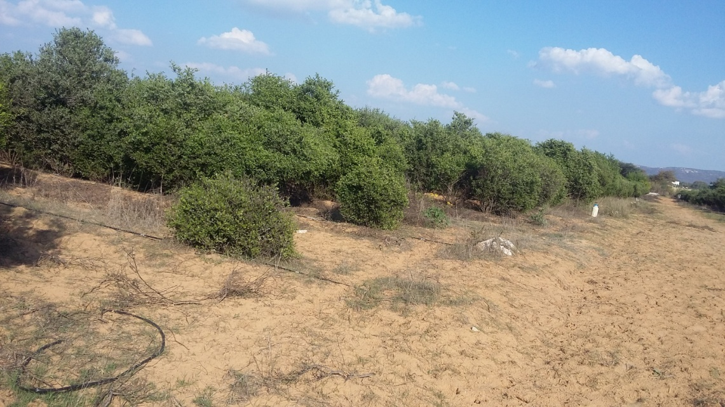
♂♀
No . | Genotypes collected | Male plants | Female plants
1 | Q106 | ♂ | ♀
2 | MS | ♂ | ♀
3 | C-64 | ♂ | ♀
4 | 879-154 | ♂ | ♀
5 | 17-21 | ♂ | ♀
6 | Local | ♂ | ♀
7 | Q104 | ♂ | ♀
8 | 32 | ♂ | ♀
9 | 92 | ♂ | ♀
10 | Forti | ♂ | ♀
11 | 96 | ♂ | ♀
12 | 82-18 | ♂ | ♀
13 | 58-5 | ♂ | ♀
14 | 85 | ♂ | ♀
15 | K-11 | ♂ | ♀
16 | 48-25 | ♂ | ♀
17 | Male cutting | ♂ | --
18 | 16-10 | -- | ♀
189 | C₈R₂₃ | -- | ♀
20 | 12-18 | -- | ♀
21 | 24-8 | -- | ♀
22 | CSMCRI | -- | ♀
23 | CAZRI | -- | ♀
Total 39 Jojoba genotypes were collected from AJORP (17 male, 22 female), Jaipur for the current investigation.
Figure: AJORP, Jaipur

Slide 8
Conclusions
♂♀
Important Findings

Slide 9
RAPD Analysis

Slide 10
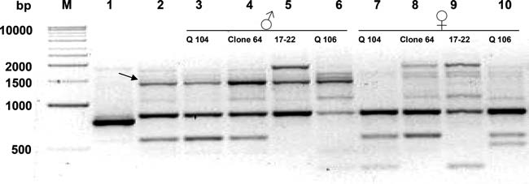
♂♀
The primer OPG-5 generated a male specific marker of 1400bp size in all the male populations
Figure: RAPD banding pattern of male and female jojoba plants obtained by the primer OPG-5. Arrow indicates the unique band of *1,400 bp present in male bulk. M 1 Kb ladder; lane 1 bulk female; lane 2 bulk male; lanes 3–6 male individuals; lanes 7–10 female individuals.

Slide 11
SRAP Analysis

Slide 12
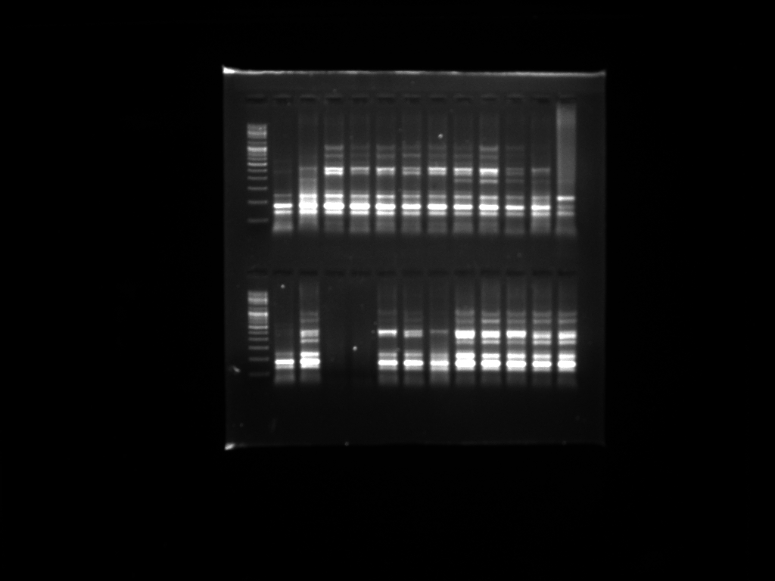
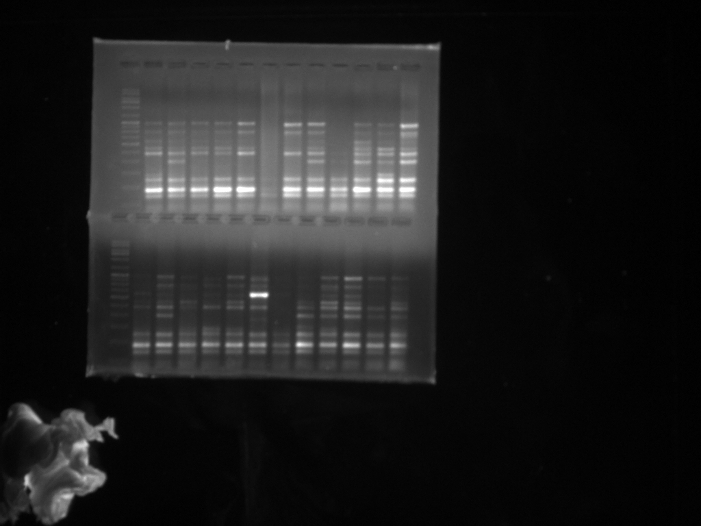
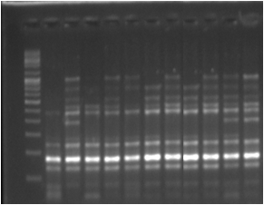
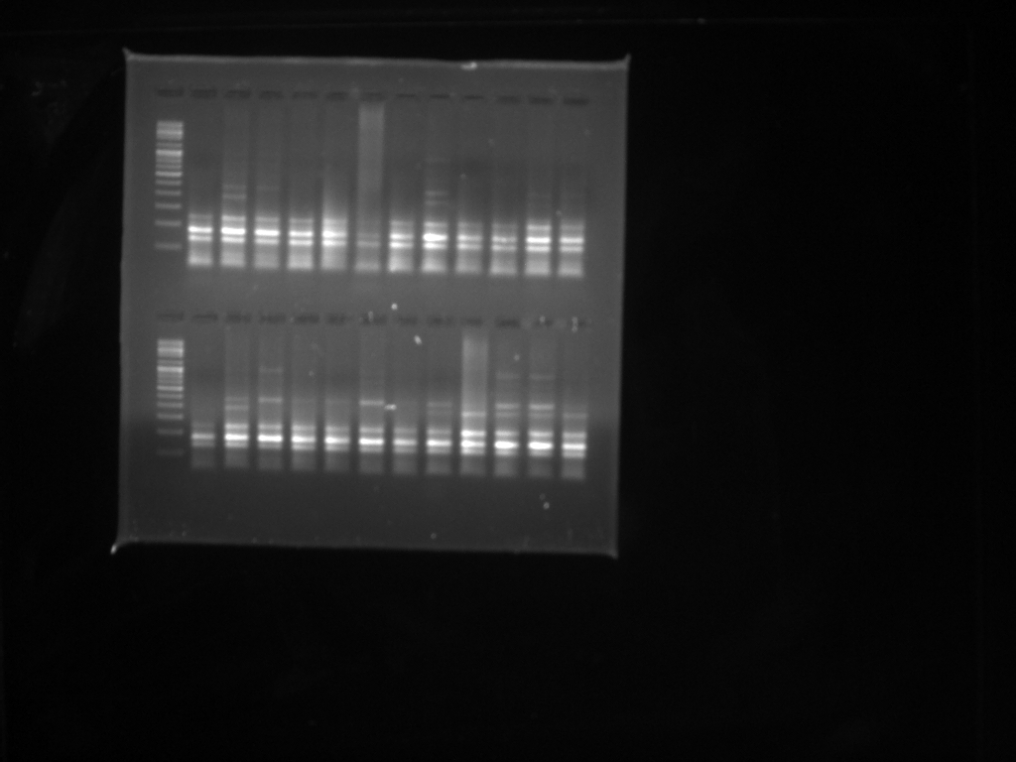
♀
♂
♀
♂
M PF PM 1 2 3 4 5 6 7 8 9 10
M PF PM 11 12 13 14 15 16 17 18 19 20
3000
3000
1500
1500
600
600
400
400
200
200
100
100
♀
♂
♀
♂
M PF PM 21 22 23 24 25 26 27 28 29 30
M PF PM 31 32 33 34 35 36 37 38 39
3000
3000
1500
1500
600
600
400
400
200
200
100
100
Figure: SRAP banding patterns of DNA extracted from 22 female genotypes and 17 male genotypes amplified by primer combination E14/M10.The arrow indicates a male specific band of ~400bp size present in only male bulk and male individuals.

Slide 13
ISSR Analysis

Slide 14
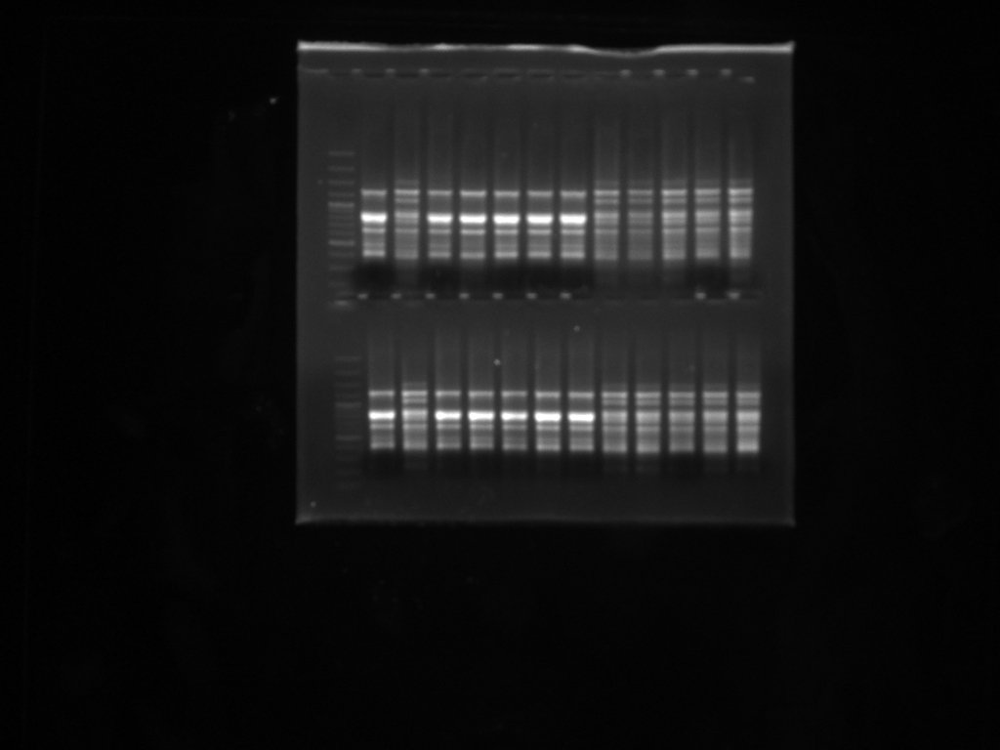
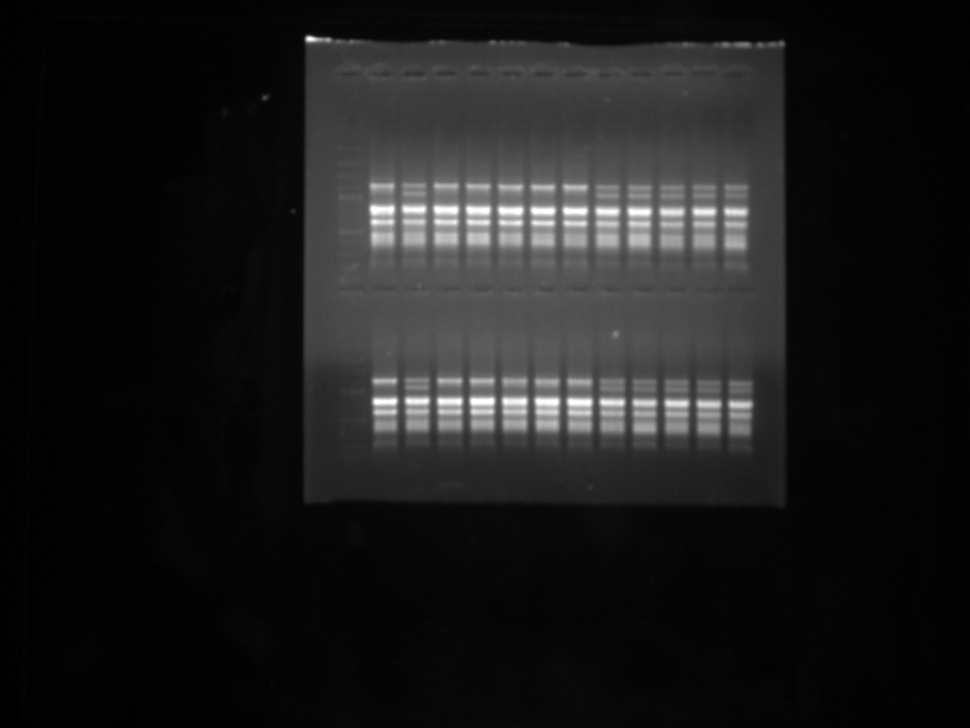
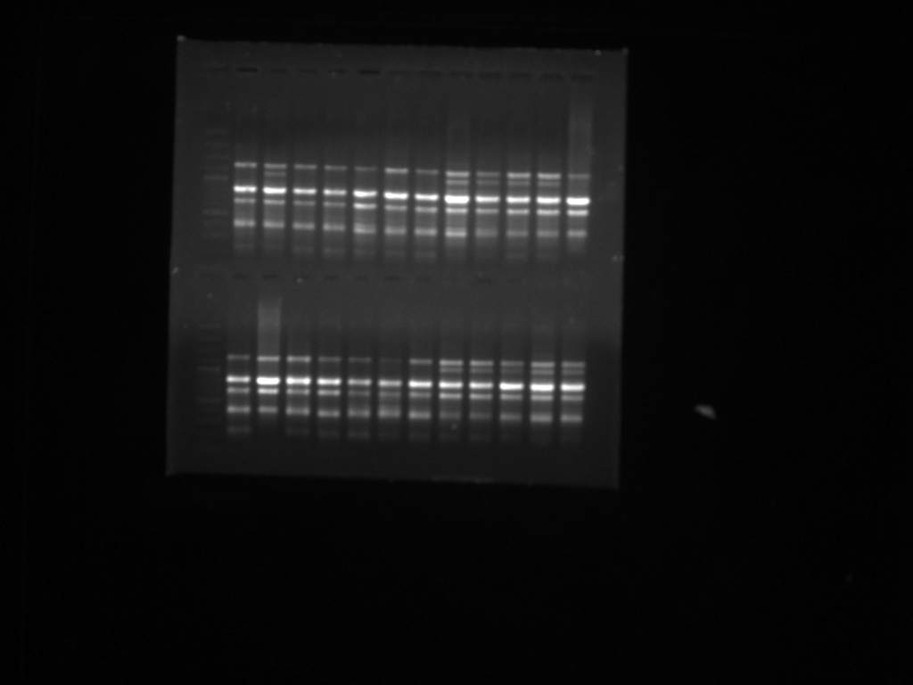
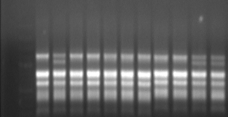
♀
♂
♀
♂
M PF PM 1 2 3 4 5 6 7 8 9 10 M PF PM 11 12 13 14 15 16 17 18 19 20
1200
1200
1200
A
♀
♂
♂
C
♀
M PF PM 21 22 23 24 25 26 27 28 29 30 M PF PM 31 32 33 34 35 36 37 38 39
1200
1200
Figure: Male specific ISSR marker UBC807₁₂₀₀ across 22 female and 17 male genotypes of Jojoba
Sharma K., Agrawal V., Gupta S., Kumar R., Prasad M. Plant Biotechnol Rep (2008) 2:239-243

Slide 15
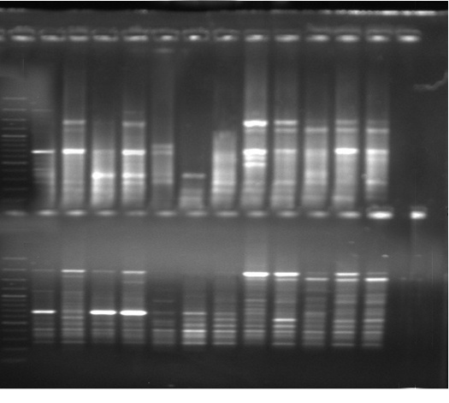
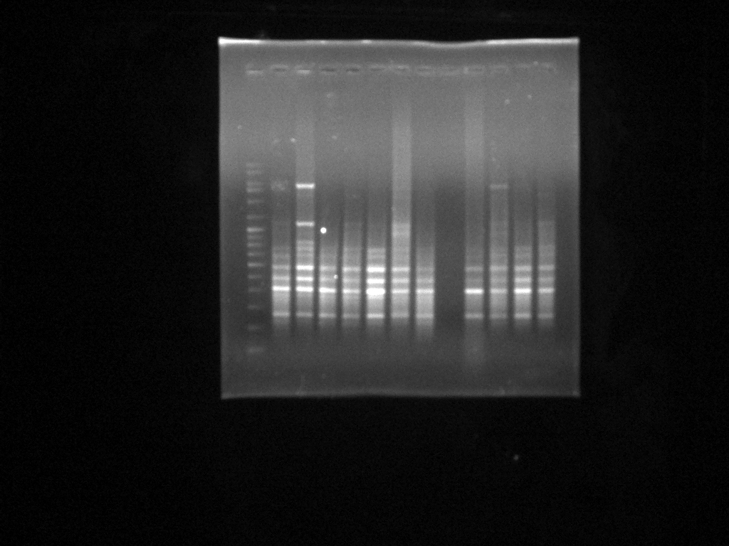
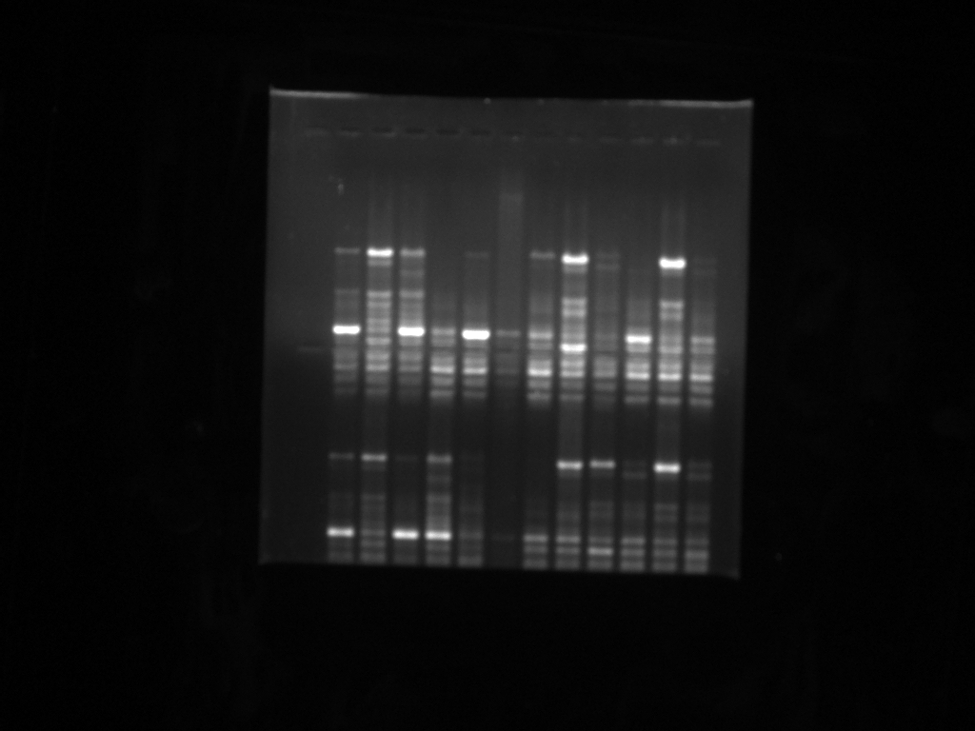
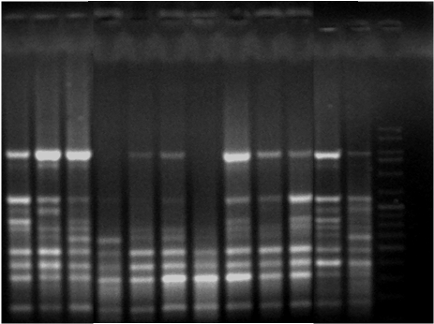
♀
♂
♀
♂
M PF PM 1 2 3 4 5 6 7 8 9 10 M PF PM 11 12 13 14 15 16 17 18 19 20
3000
3000
1500
1500
1031
1031
500
500
200
200
100
100
♀
♂
♀
♂
M PF PM 21 22 23 24 25 26 27 28 29 30
M PF PM 31 32 33 34 35 36 37 38 39
3000
3000
1500
1500
1031
1031
500
500
200
200
100
100
Figure: ISSR banding patterns of male and female Jojoba plants obtained with the primer ISSR848. The arrow indicates the unique band of ~1500 bp present in the male bulk and all the male genotypes but absent in the female bulk and all the female counterparts.
M, 3 Kb ladder; PF, pooled female; PM, pooled male; . A: lane 1, 17-21♀; lane 2, MS♀; lane 3, 32♀; lane 4, 48-25♀; lane 5, Forti♀; lane 6, 17-21♂; lane 7, MS♂; lane 8, 32♂; lane 9, 48-25♂; lane 10, Forti ♂ B: lane 11, 92♀; lane 12, 879-154♀; lane 13, C-64♀; lane 14, Q106♀; lane 15, local♀; lane 16, 92♂; lane 17, 879-154♂; lane 18, C- 64♂; lane 19, Q106♂; lane 20, local♂ C: lane 21, Q104 ♀; lane 22, 96 ♀; lane 23, 82-18 ♀; lane 24, 58-5 ♀; lane 25, 85 ♀; lane 26, Q104 ♂; lane 27, 96 ♂; lane 28, 82-18 ♂; lane 29, 58-5 ♂; lane 30, 85 ♂ D: lane 31, K-11 ♀; lane 32, 16-10 ♀; lane 33,C8R23 ♀ lane 34,12-14 ♀; lane 35, 24-8 ♀; lane 36 CSMCRI ♀; lane 37, CAZRI ♀; lane 38, K-11 ♂; lane 39, male cutting.

Slide 16
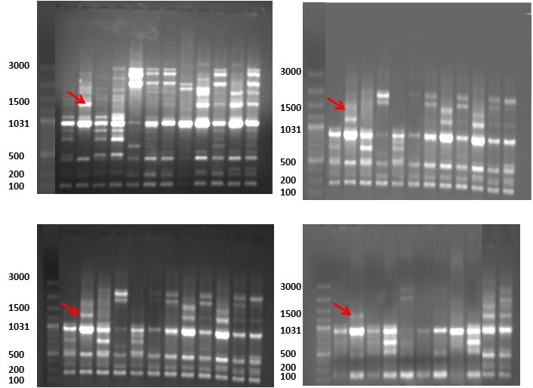
♀
♂
♀
♂
M PF PM 1 2 3 4 5 6 7 8 9 10 M PF PM 11 12 13 14 15 16 17 18 19 20
♀
♂
♀
♂
M PF PM 21 22 23 24 25 26 27 28 29 30 M PF PM 31 32 33 34 35 36 37 38 39
Figure: ISSR banding patterns of male and female Jojoba plants obtained with the primer VIS11. The arrow indicates the unique bands of ~1300 bp present in the male bulk as well as in ten male genotypes but absent in all the female counterparts.

Slide 17
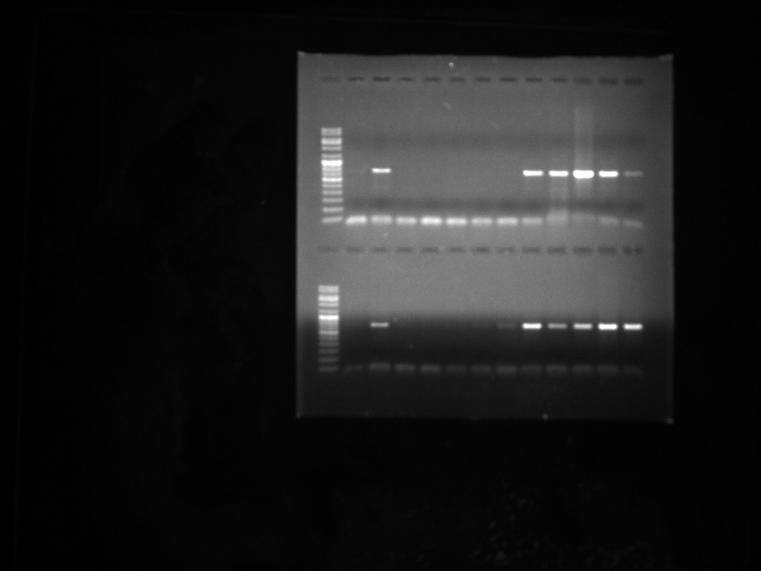
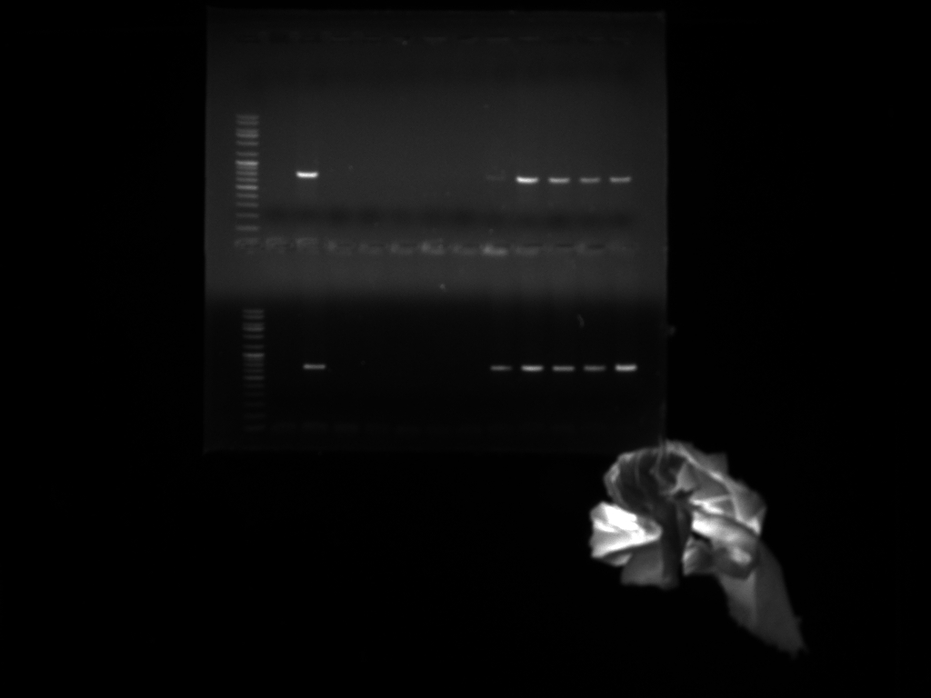
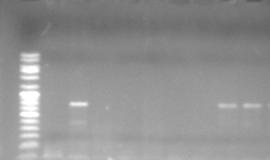
Male specific STS markers
♂
♀
♂
♂
♂
The primer STS 807- F and STS 807-R generated a single male specific band of 800bp..
M PF PM 1 2 3 4 5 6 7 8 9 10
M PF PM 11 12 13 14 15 16 17 18 19 20
800 bp
800 bp
A
B
M PF PM 21 22 23 24 25 26 27 28 29 30
M PF PM 31 32 33 34 35 36 37 38 39
800 bp
800 bp
C
D
Figure: STS profiles of 17 male and 22 female genotypes produced by STS 807- F and STS 807- R primers. The arrow indicates the male specific STS marker (JMSM) of 800 bp in all the male genotypes.

Slide 18
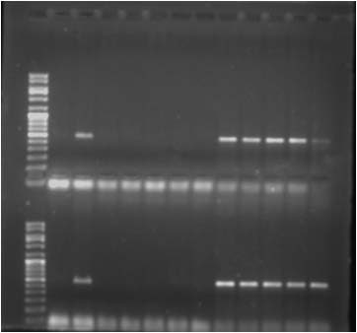
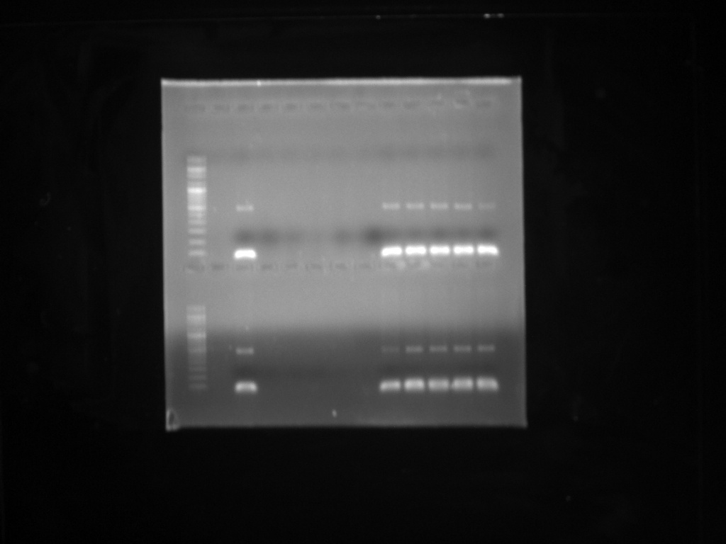
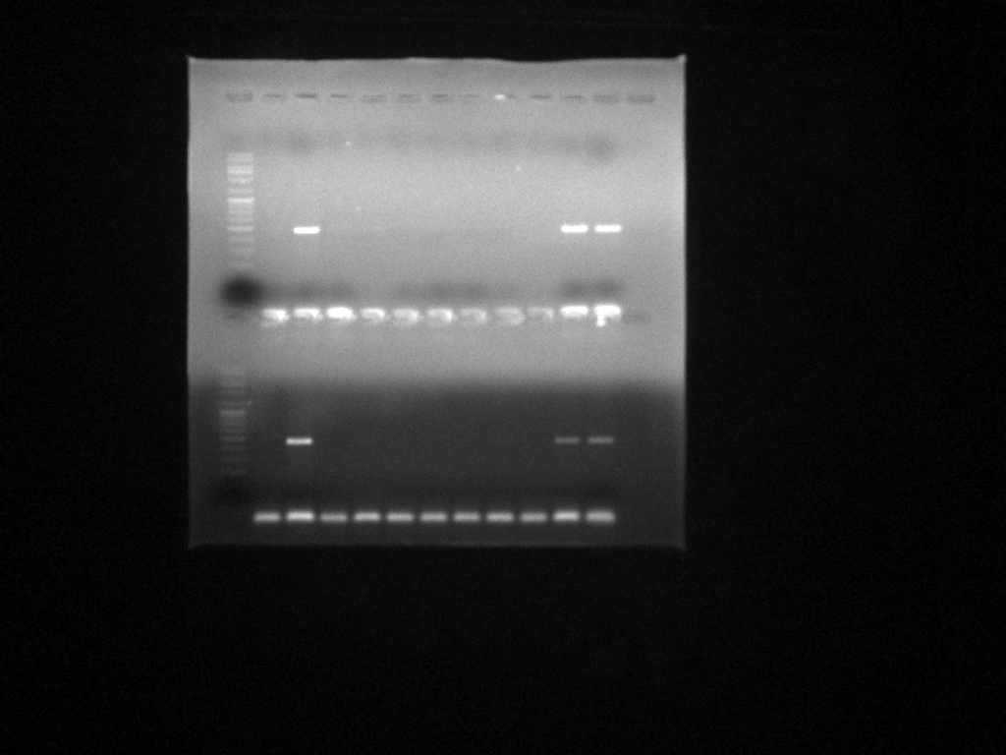
The primer STS VIS11- F and STS VIS11- R generated a single male specific band of 584bp.
♀
♂
♀
♂
M PF PM 1 2 3 4 5 6 7 8 9 10 M PF PM 11 12 13 14 15 16 17 18 19 20
584 bp
584 bp
♂
♀
♀
♂
584 bp
M PF PM 21 22 23 24 25 26 27 28 29 30 M PF PM 31 32 33 34 35 36 37 38 39
584 bp
584 bp
Figure : Representative PCR amplification profile of the male specific STS marker in Simmondsia chinensis. The arrow indicates the unique band of 584 bp present in the pooled male and male individuals from 10 genotypes. This fragment is totally absent in the female bulk as well as all the individuals tested.

Slide 19
Validation of developed STS Markers (807, VIS11) on larger population of different genotypes of different regions (Jaipur, Jodhpur & Gujarat)

Slide 20
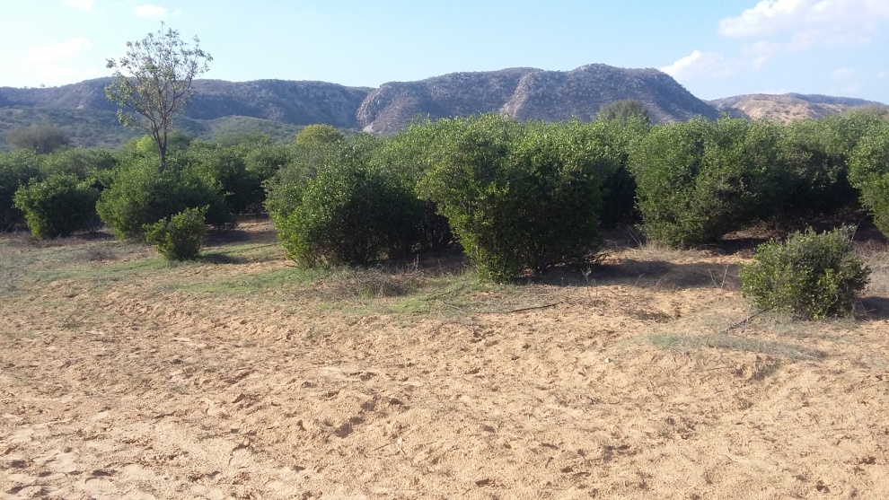
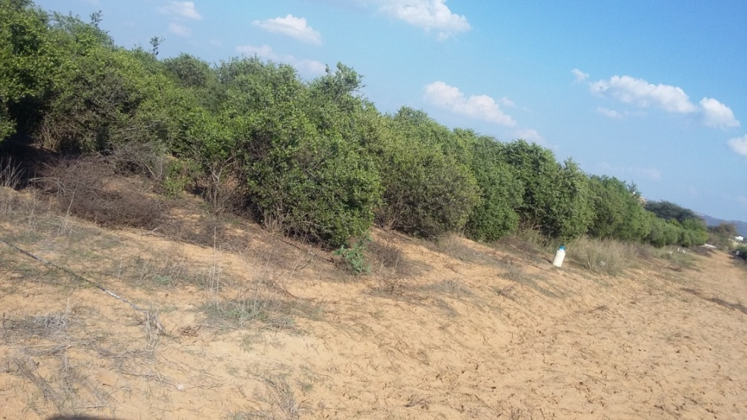
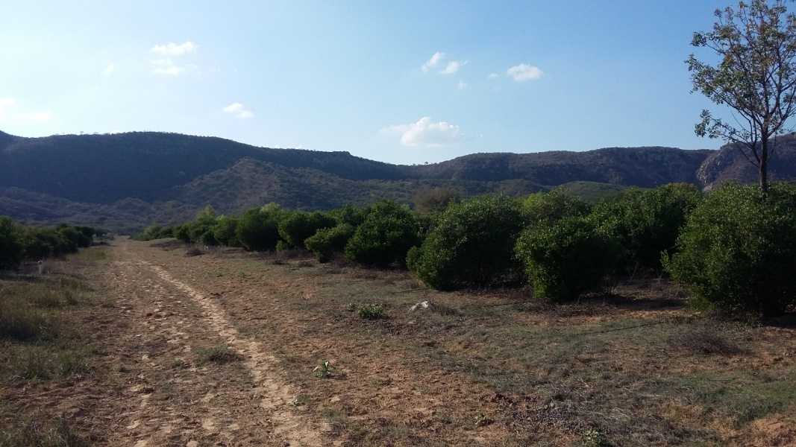
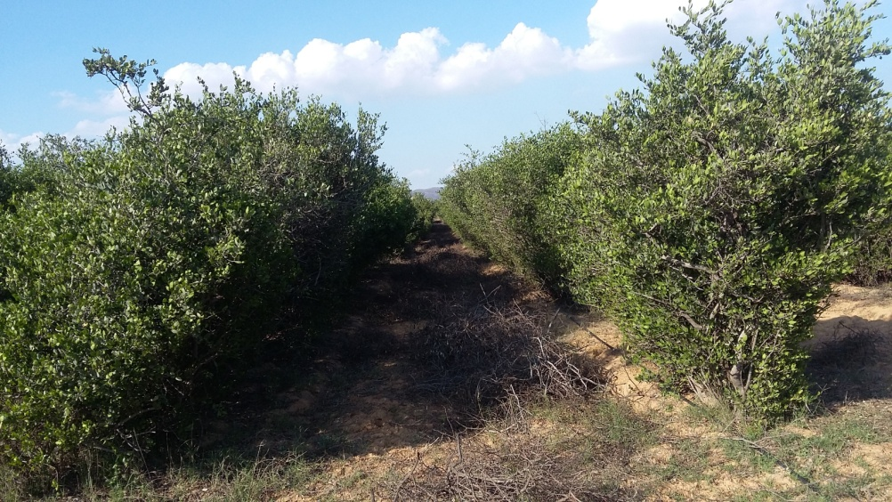
AJORP, Jaipur
Figure: Jojoba cultivation in AJORP, Jaipur

Slide 21
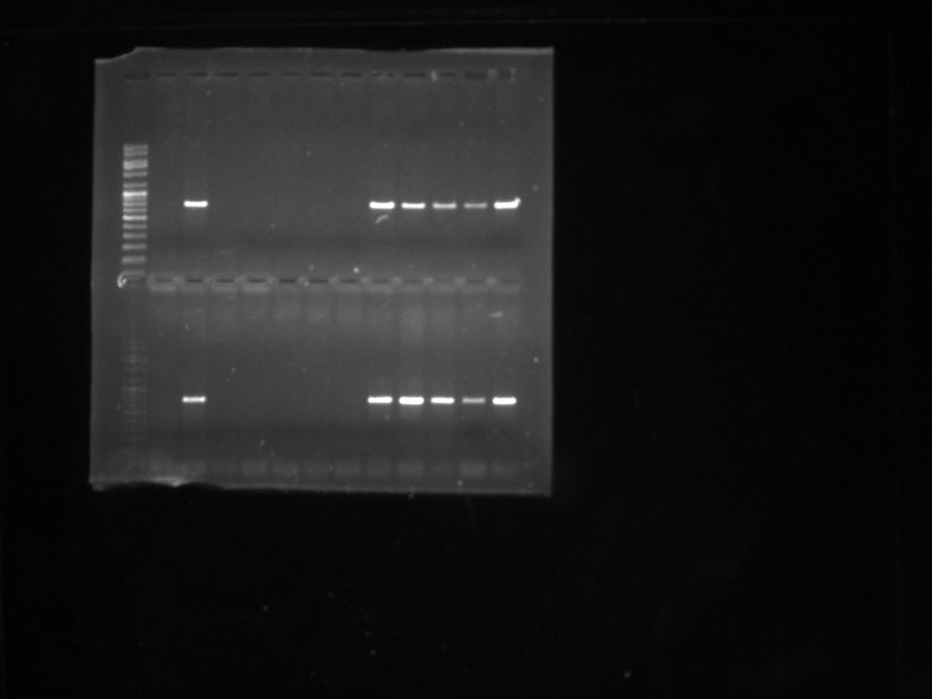
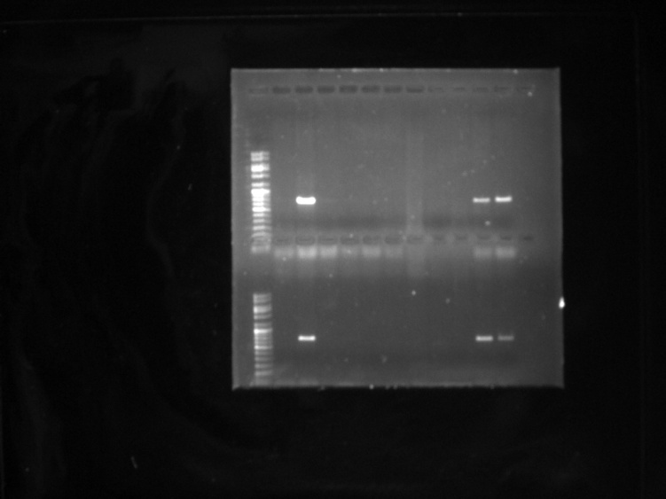
Validation of primer STS 807- F and STS 807-R
♀
♂
♀
♂
M PF PM 1 2 3 4 5 6 7 8 9 10
M PF PM 11 12 13 14 15 16 17 18 19 20
800 bp
17-21
800 bp
A
B
C-64
♀
♂
♀
♂
M PF PM 21 22 23 24 25 26 27 28 29 30
M PF PM 31 32 33 34 35 36 37 38 39
MS
800 bp
800 bp
Local
C
D
32
♀
♂
♀
♂
M PF PM 1 2 3 4 5 6 7 8 9 10 M PF PM 11 12 13 14 15 16 17 18 19 20
48-25
800bp
800bp
Forti
92
♀
♂
♀
♂
Q-106
M PF PM 21 22 23 24 25 26 27 28 29 30 M PF PM 31 32 33 34 35 36 37 38 39
800bp
800bp
Q104

Slide 22

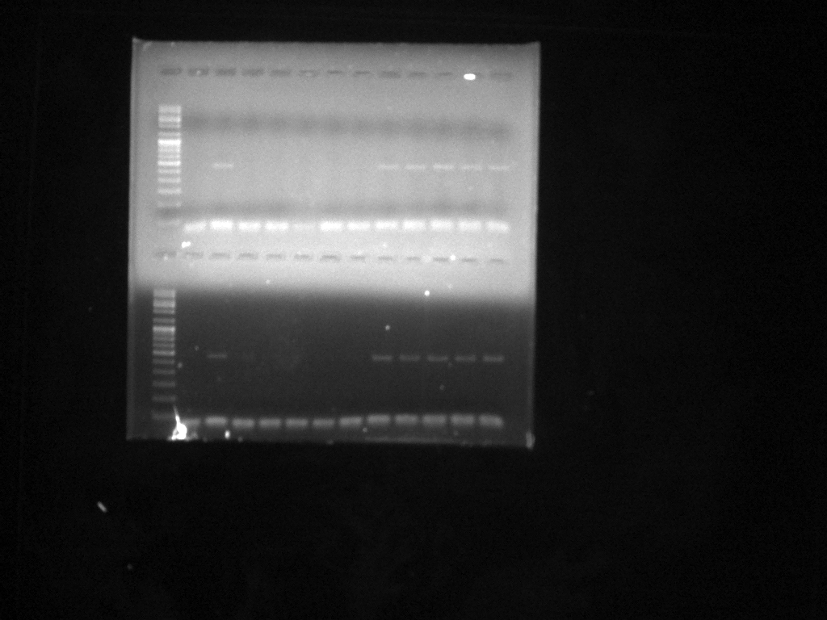
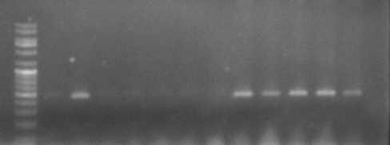
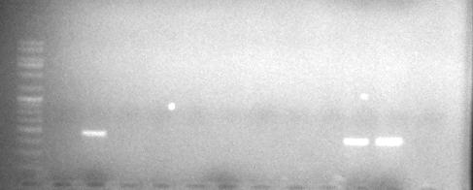
Validation of primer STS VIS11- F and STS VIS11- R
♀
♂
♀
♂
M PF PM 1 2 3 4 5 6 7 8 9 10 M PF PM 11 12 13 14 15 16 17 18 19 20
17-21
584 bp
584 bp
C-64
♀
♂
♀
♂
M PF PM 21 22 23 24 25 26 27 28 29 30
M PF PM 31 32 33 34 35 36 37 38 39
MS
Local
584 bp
584 bp
♀
♂
♀
♂
32
M PF PM 1 2 3 4 5 6 7 8 9 10 M PF PM 11 12 13 14 15 16 17 18 19 20
48-25
584 bp
Forti
584 bp
92
♀
♂
♂
♀
M PF PM 21 22 23 24 25 26 27 28 29 30
M PF PM 31 32 33 34 35 36 37 38 39
Q-106
584 bp
584 bp
Q104

Slide 23
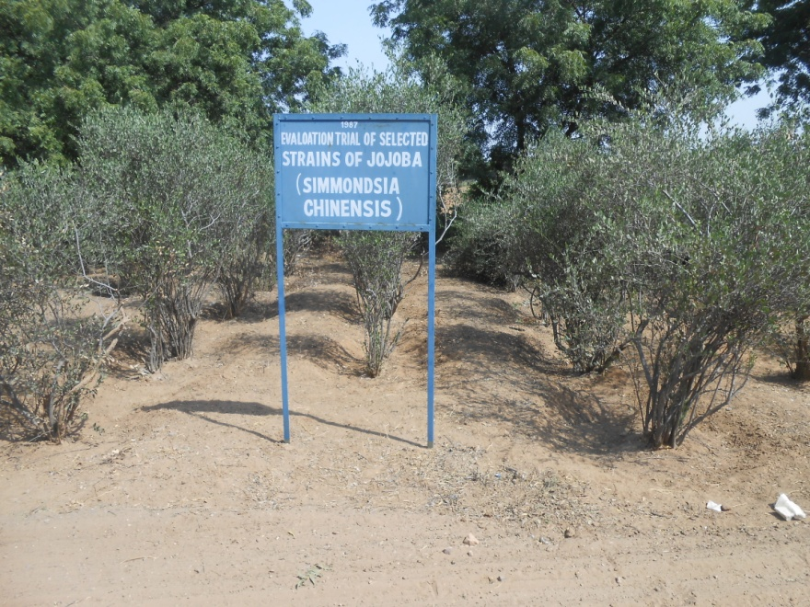
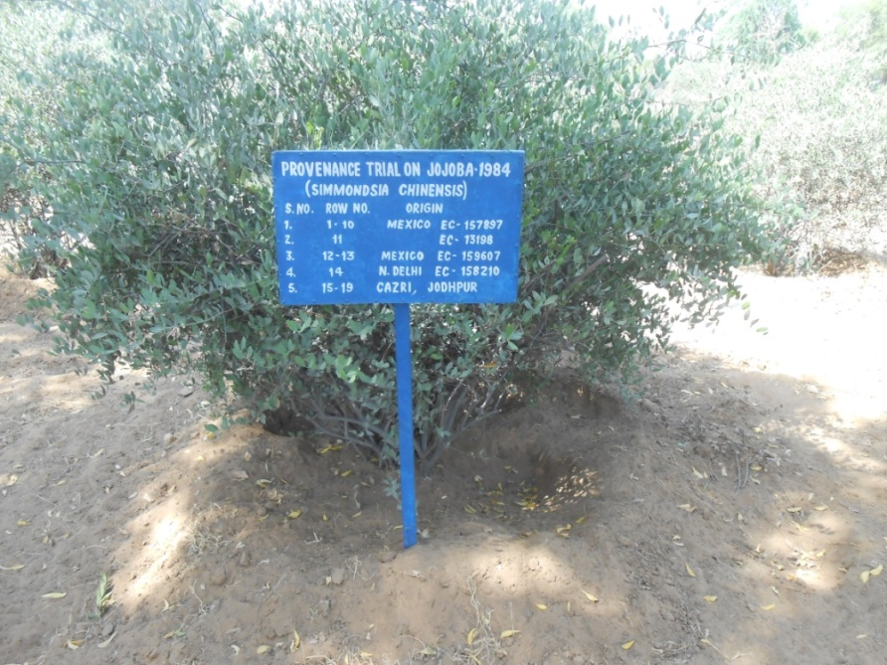
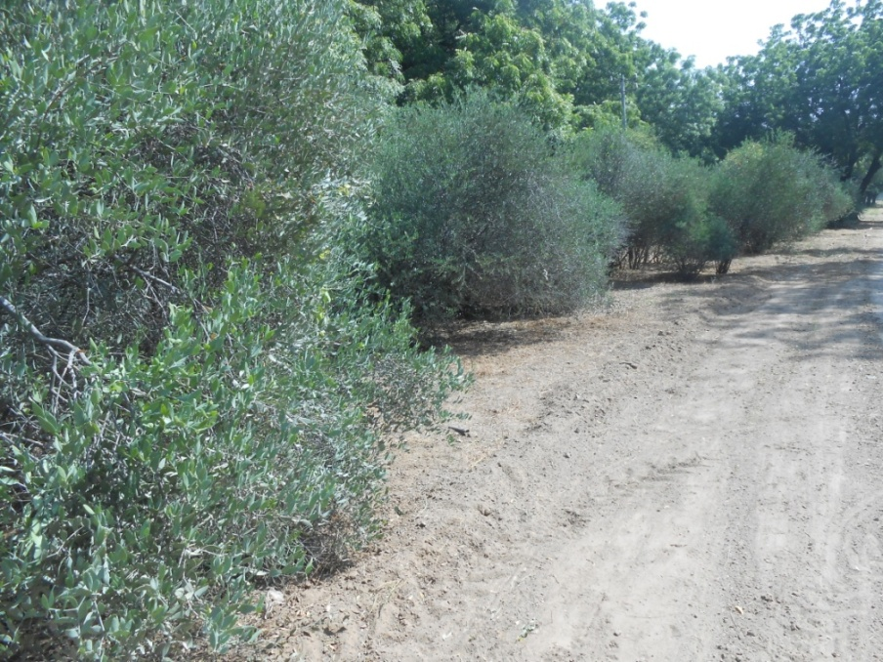
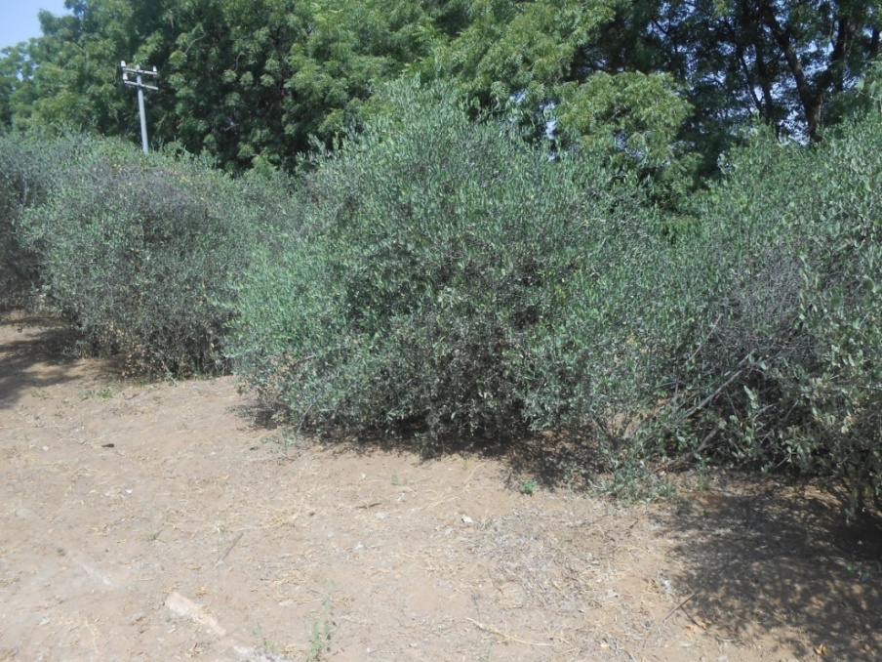
CAZRI, Jodhpur
Figure: Jojoba cultivation in CAZRI, Jodhpur

Slide 24
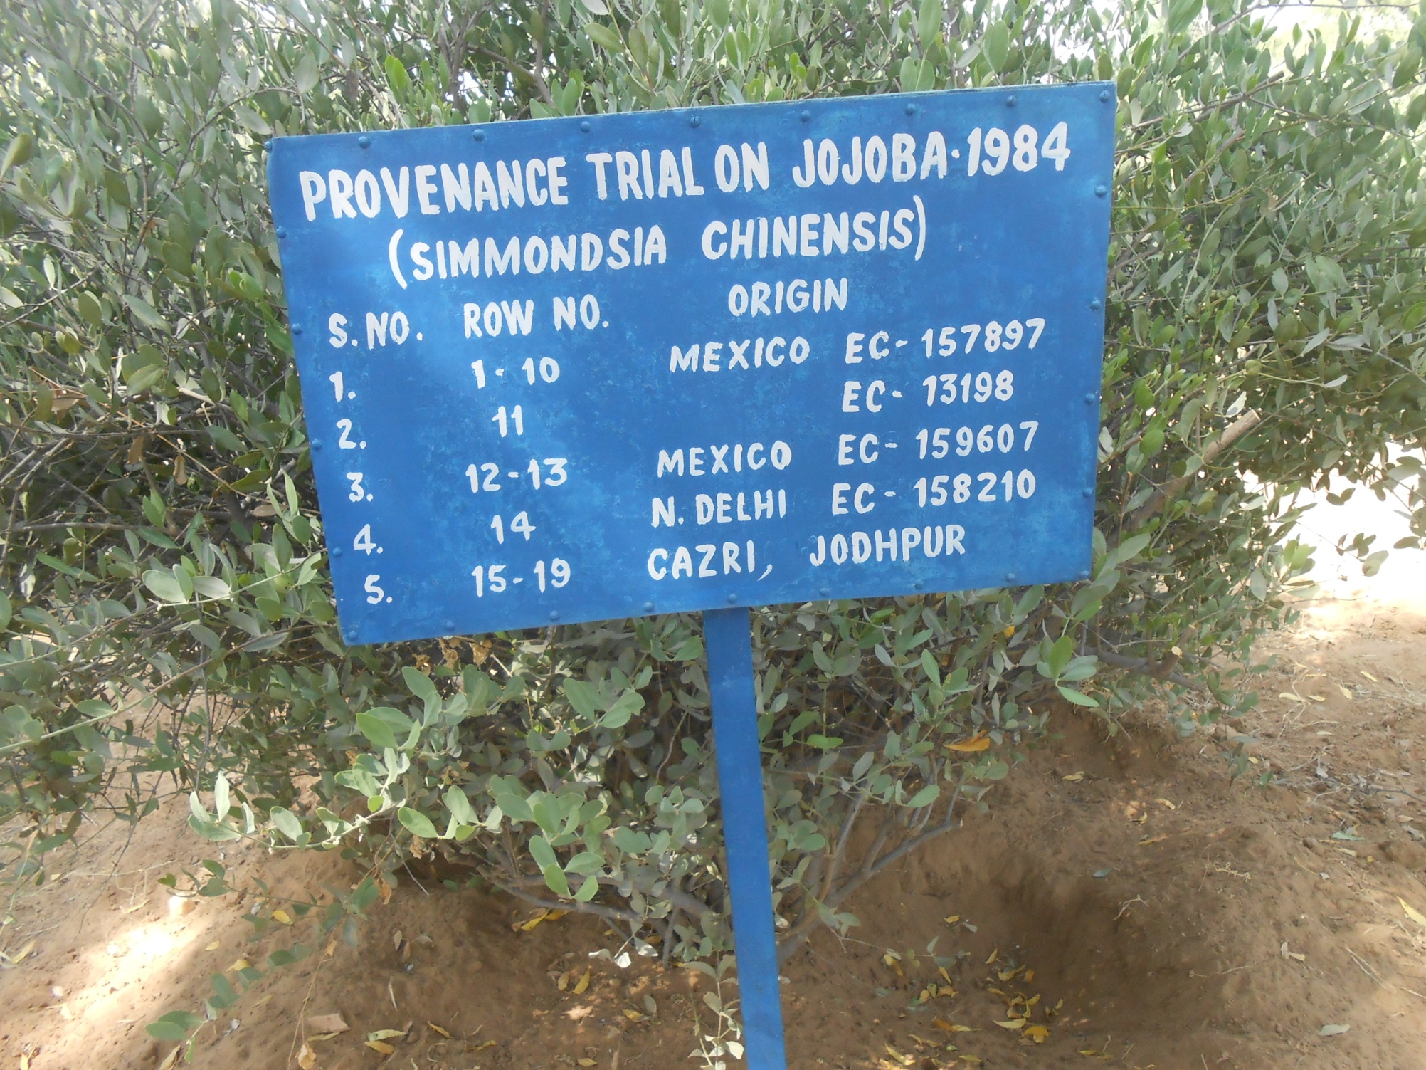
Figure: Different Jojoba cultivars growing in CAZRI, Jodhpur

Slide 25
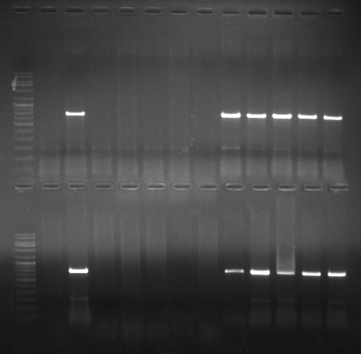
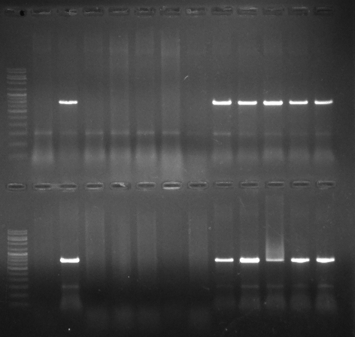
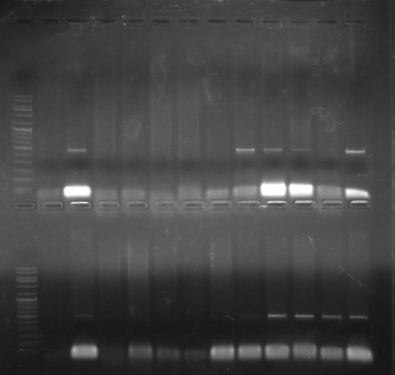


M PF PM 1 2 3 4 5 6 7 8 9 10
M PF PM 1 2 3 4 5 6 7 8 9 10
♀
♂
♀
♂
800 bp
Validation of primer STS 807- F and STS 807-R
M PF PM 11 12 13 14 15 16 17 18 19 20
M PF PM 11 12 13 14 15 16 17 18 19 20
800 bp
M PF PM 1 2 3 4 5 6 7 8 9 10
M PF PM 1 2 3 4 5 6 7 8 9 10
♀
♂
♀
♂
584 bp
Validation of primer STS VIS 11-F and STS VIS 11-R
M PF PM 11 12 13 14 15 16 17 18 19 20
M PF PM 11 12 13 14 15 16 17 18 19 20
584 bp
1,2,3,4,6,7,8,9: Mexican genotypes; 5,10,11,12,13,16,17,18: Cazri, Jodhpur genotypes; 14,15,19,20: New Delhi genotypes

Slide 26




CSMCRI, Bhavnagar, Gujarat
Figure: Jojoba cultivation in CSMCRI, Bhavnagar, Gujarat

Slide 27






Validation of primer STS 807-F and STS 807-R
♀
♂
♀
♂
M PF PM 1 2 3 4 5 6 7 8 9 10 M PF PM 1 2 3 4 5 6 7 8 9 10
800bp
800bp
S.No. | Accessions | Sex
1 | V.E.5-2 | FEMALE
2 | V.W.1-4 | FEMALE
3 | P.1.W.17-4 | FEMALE
4 | P.1.W.5-3 | FEMALE
5 | P.1.W.13-1 | FEMALE
11 | P.3.E.1-11 | FEMALE
12 | J.E.40-4 | FEMALE
13 | J.E.24-14 | FEMALE
14 | J.E.44-1 | FEMALE
15 | J.E.18-5 | FEMALE
6 | J.E.13-2 | MALE
7 | V.E.10-3 | MALE
8 | V.E.8-4 | MALE
9 | V.W.33-3 | MALE
10 | V.W.5-3 | MALE
16 | P.1.W.17-3 | MALE
17 | P.1.W.6-3 | MALE
18 | J.E.17-4 | MALE
19 | J.E.14-4 | MALE
20 | J.E.27-4 | MALE
♀
♂
♀
♂
M PF PM 11 12 13 14 15 16 17 18 19 20 M PF PM 11 12 13 14 15 16 17 18 19
800bp
800bp
M 1 2 3 4 5 6 7 8 9 10 M 1 2 3 4 5 6 7 8 9 10
584 bp
M 11 12 13 14 15 16 17 18 19 20 M 11 12 13 14 15 16 17 18 19 20
Validation of primer STS VIS 11-F and STS VIS 11-R
584 bp

Slide 28
Genetic diversity analysis among male and female Jojoba genotypes employing gene targeted molecular markers; Start codon targeted (SCoT) polymorphism and CAAT
box-derived polymorphism (CBDP)
markers

Slide 29
CBDP markers were more effective than SCoT markers in terms of percentage polymorphism as the former detecting an average of 53.4% and the latter as 49.4%.
Male populations showed more variations over female populations in respect of polymorphic percentage, PIC, MI and Rp values over female populations.

Slide 30

Figure: Dendrogram generated using UPGMA analysis of the SCoT dataset of 39 genotypes (22 female and 17 male) showing genetic relationships among Jojoba genotypes.

Slide 31

Figure: Dendrogram generated using UPGMA analysis of the CBDP dataset of the 39 genotypes (17 male and 22 female) showing genetic relationships across the Jojoba genotypes.

Slide 32
Summary
RAPD analysis: Identified one male specific band of 1400bp size.
ISSR analysis: Developed three male specific marker viz. UBC-8071200, VIS111317 and ISSR8481500.
STS analysis: Primers UBC-8071200, VIS111317 has been successfully converted into two male specific STS marker of 800bp and 584bp respectively.
SRAP analysis: One SRAP primer combination “E14/M10” generated a male specific band of 400bp.
All the generated markers were confirmed and validated on larger
populations of Jojoba.
CBDP markers were found to be more effective than SCoT markers with regard
to average percentage polymorphism which was higher (53.4%) compared to
49.4% in SCoT markers.
Male genotypes were found to be more genetically diverse than females.

Slide 33
Thank you….

