Slide 1
INPATIENT LENGTH OF STAY AND FINANCIAL IMPLICATIONS FOLLOWING ABOVE & BELOW KNEE AMPUTATIONS
Farhan Hussain, Jason George, Ben Banerjee, Paul Dunlop, Klaus Overbeck, Shanmugam Vetrivel, Andrew Brown
Notes:
Good morning ladies and gentlemen
My name is Jason George
I’m a surgical resident from the UK and I’d like to tell you about some work I carried out during my time in the north east of England, relating to peripheral vascular disease and major limb amputations.

Slide 2
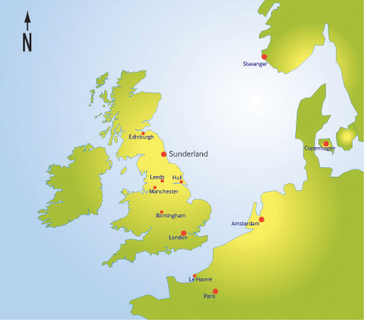
Notes:
Just to help orient yourself, I come from a town called Sunderland in the north east of England. The north east is relatively poor these days compared to much of the rest of the England but in the past you might say it was the beating heart of the country.

Slide 3
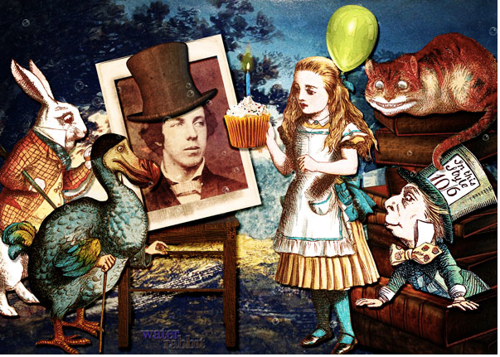
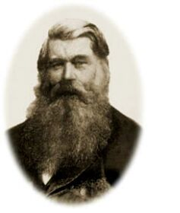
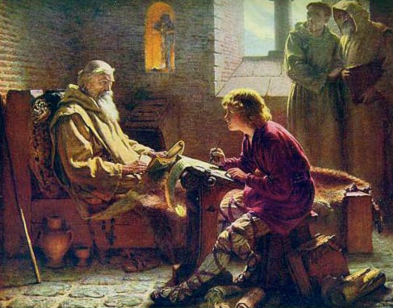
Notes:
Here are a few notable members from the Sunderland area. On the left we have Joseph Swan, inventor of the electric light bulb. On the top right we have a reference to Lewis Carrol - author of Alice in Wonderland - perhaps it would not have worked so well if it was named Alice in Sunderland. Lewis Carrol wrote many of his stories during trips to the region. And on the bottom right corner we have the venerable St Bede who was a scholar and monk, known as the father of English history for his writings.

Slide 4
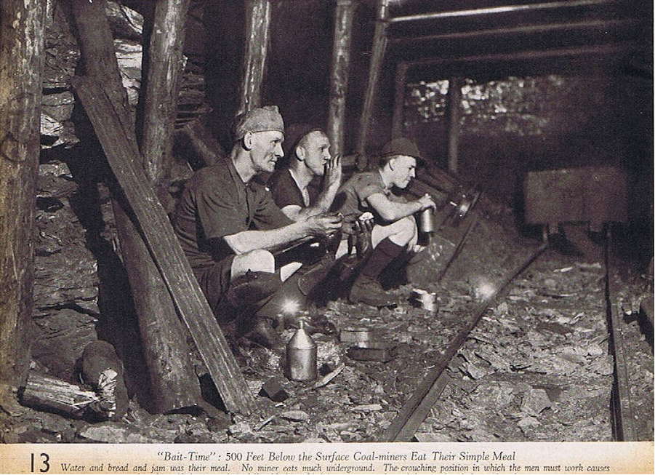
Notes:
In the past the area had a thriving coal mining industry which powered Britain’s Industrial revolution, I’m sure you may recall references to this during the Olympics Opening Ceremony. Even the old transport networks of the country to this day are designed to transport cargo up and down the country as quickly as possible. The coal mining industry is long gone now in this region.

Slide 5
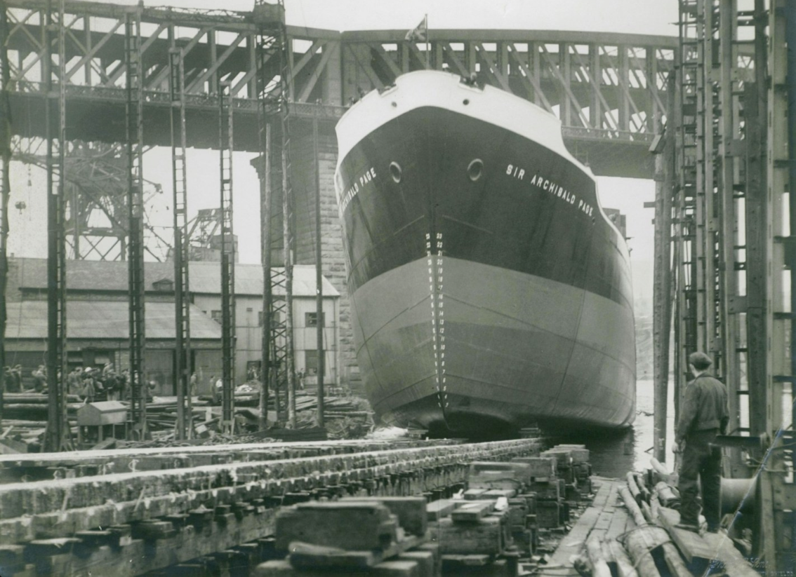
Notes:
The area was also well known for its ship building industry. In fact, at one time Sunderland was regarded as the biggest shipbuilding town in the world.

Slide 6
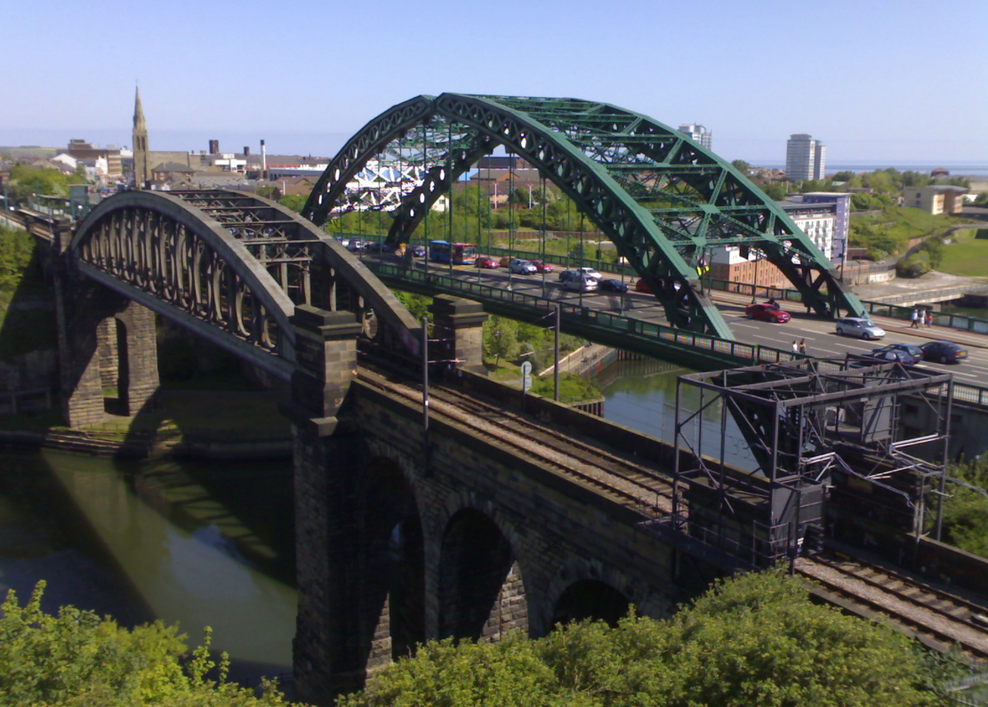
Notes:
These are two of the oldest iron bridges in the world, located in Sunderland. Bridge building also was a skill unique to the people of the north east. Sadly these industries have all disappeared and this has left something of a cultural and industrial vacuum behind. There are high rates of unemployment and social deprivation and the area is perhaps better known these days for its footballing heroes of Sunderland and Newcastle

Slide 7

Notes:
However unlike the well toned athletic physiques you see displayed on the football field the area has some of the fattest people in the UK. In fact Sunderland Hospital has the biggest, busiest bariatric unit in the country. So many of the locals are more likely to look like this

Slide 8
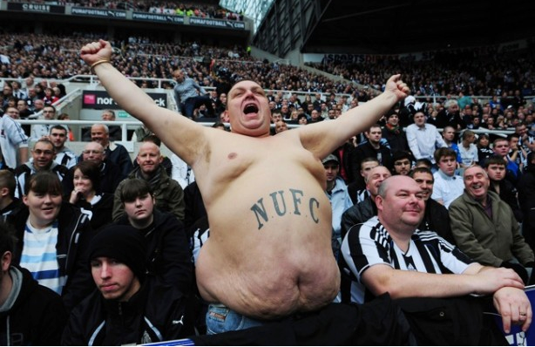
Notes:
as a result heart disease, diabetes are rife. Combined with excessive smoking for many years patients often develop severe peripheral arterial disease and diabetic ulcers at quite a young age. This was quite a shock to me initially when I moved to the area. As I’m sure many of you know this inevitable leads to amputations. Often it starts with toe and forefoot amputations but ultimately it will result in a BKA or AKA.

Slide 9
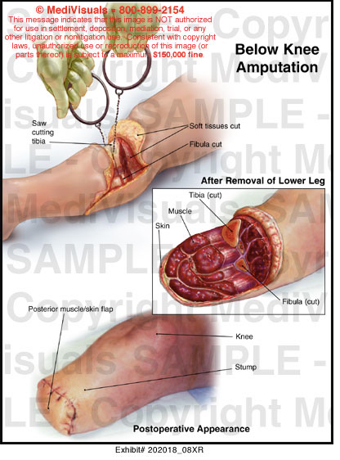
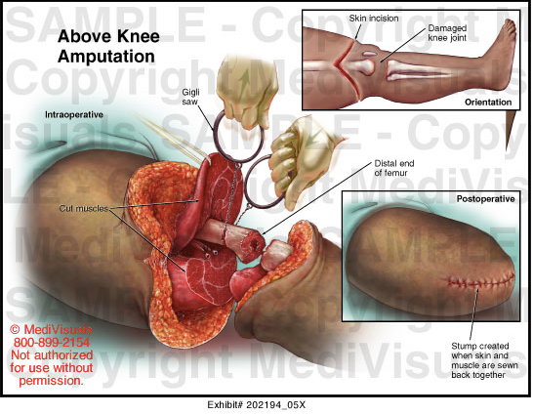
Notes:
Some images courtesy of MediVisual to show the operative technique for each procedure. AKAs and BKAs are done quite commonly on our unit in Sunderland. Once I had gotten over my initial shock at how unhealthy people in Sunderland were, the next thing that concerned me was the length of stay many of these patients stayed in hospital. It occurred to me that many patients were staying in hospital an unnecessarily long time. I work in the NHS and it is a system struggling for resources. The estimated cost of stay in an NHS hospital bed is about £400/day. Therefore, I felt it was important to try and get these patients out of hospital and home for two reasons: 1) to reduce the economic costs for the hospital and the NHS in general 2) to reduce the risk of some of these patients acquiring hospital acquired infections such as urinary tract infections, pneumonias and gastroenteritis.

Slide 10
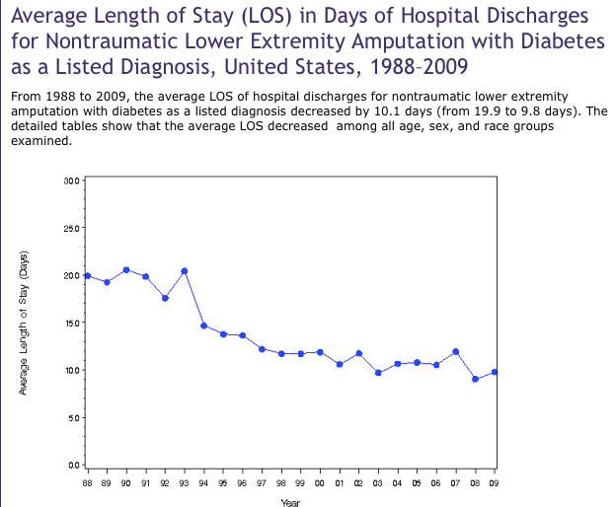
Notes:
This slide shows some American data courtesy of the CDC relating only to diabetes related amputations. In summary you can see that the average length of stay was halved overall over two decades from 20 days to 10 days.

Slide 11
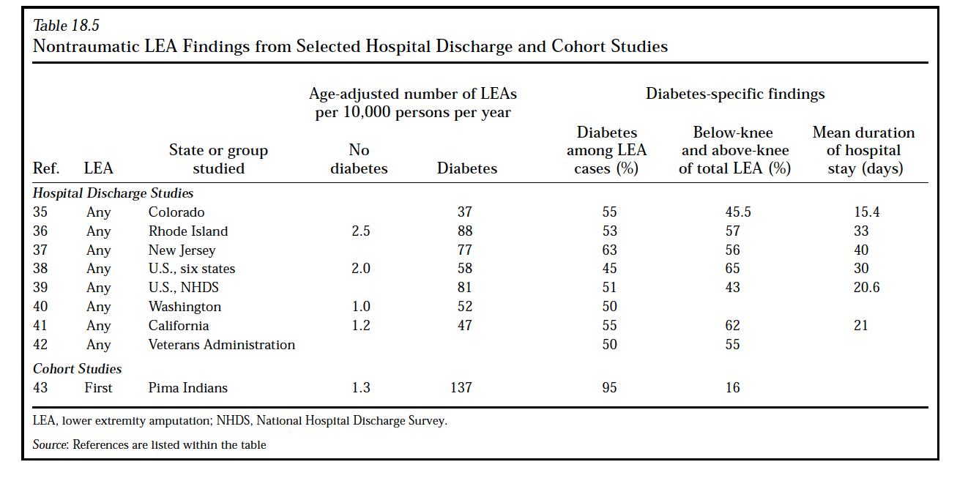
Notes:
Here we have some more data from American hospital discharge surveys. One can seen that the average length of stay is quite variable depending on the state you’re in, ranging from around two weeks to forty days if you’re unlucky enough to live in New Jersey.

Slide 12
Background
No clearly defined length of stay post amputation

Slide 13
More facts and figures…
Royal Derby Hospital (March- November 2009) postoperative LoS 19.6 days (range 5-47)
Duke University Hospital- 1 yr period LoS 11.1+/-7.04 days reduced to 9.61 +/-6.37 increased use of MDT approach/efficiency
Singapore study: able to reduce LoS from 23.16 to 17.8 days through use of the LEAP programme
Notes:
Similar to the rates of a study in tanzania = 41.9% related to DM however they had 38.4% also related to trauma and lower percentage attributed to atherosclerosis http://www.josr-online.com/content/7/1/18
The mean length of hospital stay was 22.4 days and mortality rate was 16.7%.
http://www.ncbi.nlm.nih.gov/pubmed/9638541?dopt=Abstract&holding=f1000,f1000m,isrctn mean length of stay (LOS) was 15.9 days

Slide 14
Aim
Identify factors leading to unnecessarily long postoperative LoS

Slide 15
Selection criteria
AKA
BKA
Last 50 amputations
Exclude current inpatients
Patients died post operatively

Slide 16
Methodology
Total LoS
Post-operative LoS
LoS once medically fit
Post-operative and non-operative issues
Cost of prolonged LoS

Slide 17
Limitations
Only 20 case notes available
Difficult to find reasons for delay e.g. social reasons
Not all data transferred to computerised records

Slide 18
Results
27 AKAs and 23 BKAs
59.54 Total Los and 42.2 days Post op LoS
LoS once medically fit 17.17 days = £2692.76
Total cost £48469.74
Notes:
Identified 50 cases to look into
Average length of stay post op was 6 weeks - confirming my suspicions that we had an unreasonably long length of stay on average. It seemed that patients were staying over two weeks extra for some reasons despite being medically fit for discharge. The total cost of this obtained by liaising with the hospital’s financial team is almost £50 grand.

Slide 19
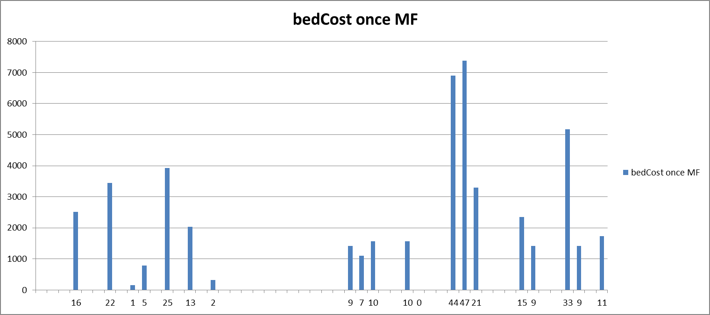

Slide 20
Contributing factors
Surgical Issues
  Complications (60%)
  Further treatment (50%)
  Wound (40%)
Non Operative Issues (dominate once MFFD)
  Housing (40%)
  OT equipment (45%)
  Further rehab (25%)
  Other social/care (25%)

Slide 21
Conclusion
Non-medical issues are the major factors prolonging LoS. Novel and effective strategies are required to minimise delays involving social planning and discharge with the involvement of key stakeholders.

Slide 22
Suggestions
Prolonged LoS multifactorial
Where possible early referral to OT/social work prior to hospital admission
Early referral to pain team to help reduce effect of post operative pain
Build nutrition/strength prior to amputations
Collapsible side arms on chairs to aid transfers

Slide 23
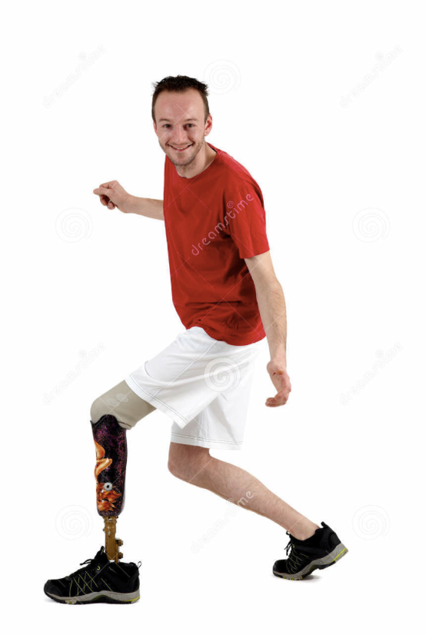

Slide 24
