Slide 1
Low-fat dairy foods improve body composition in overweight/obese postmenopausal women over a 6-month weight loss intervention
Jasminka Ilich, PhD, RD, FACN
Hazel K. Stiebeling Professor
Department of Nutrition, Food and Exercise Sciences

Slide 2



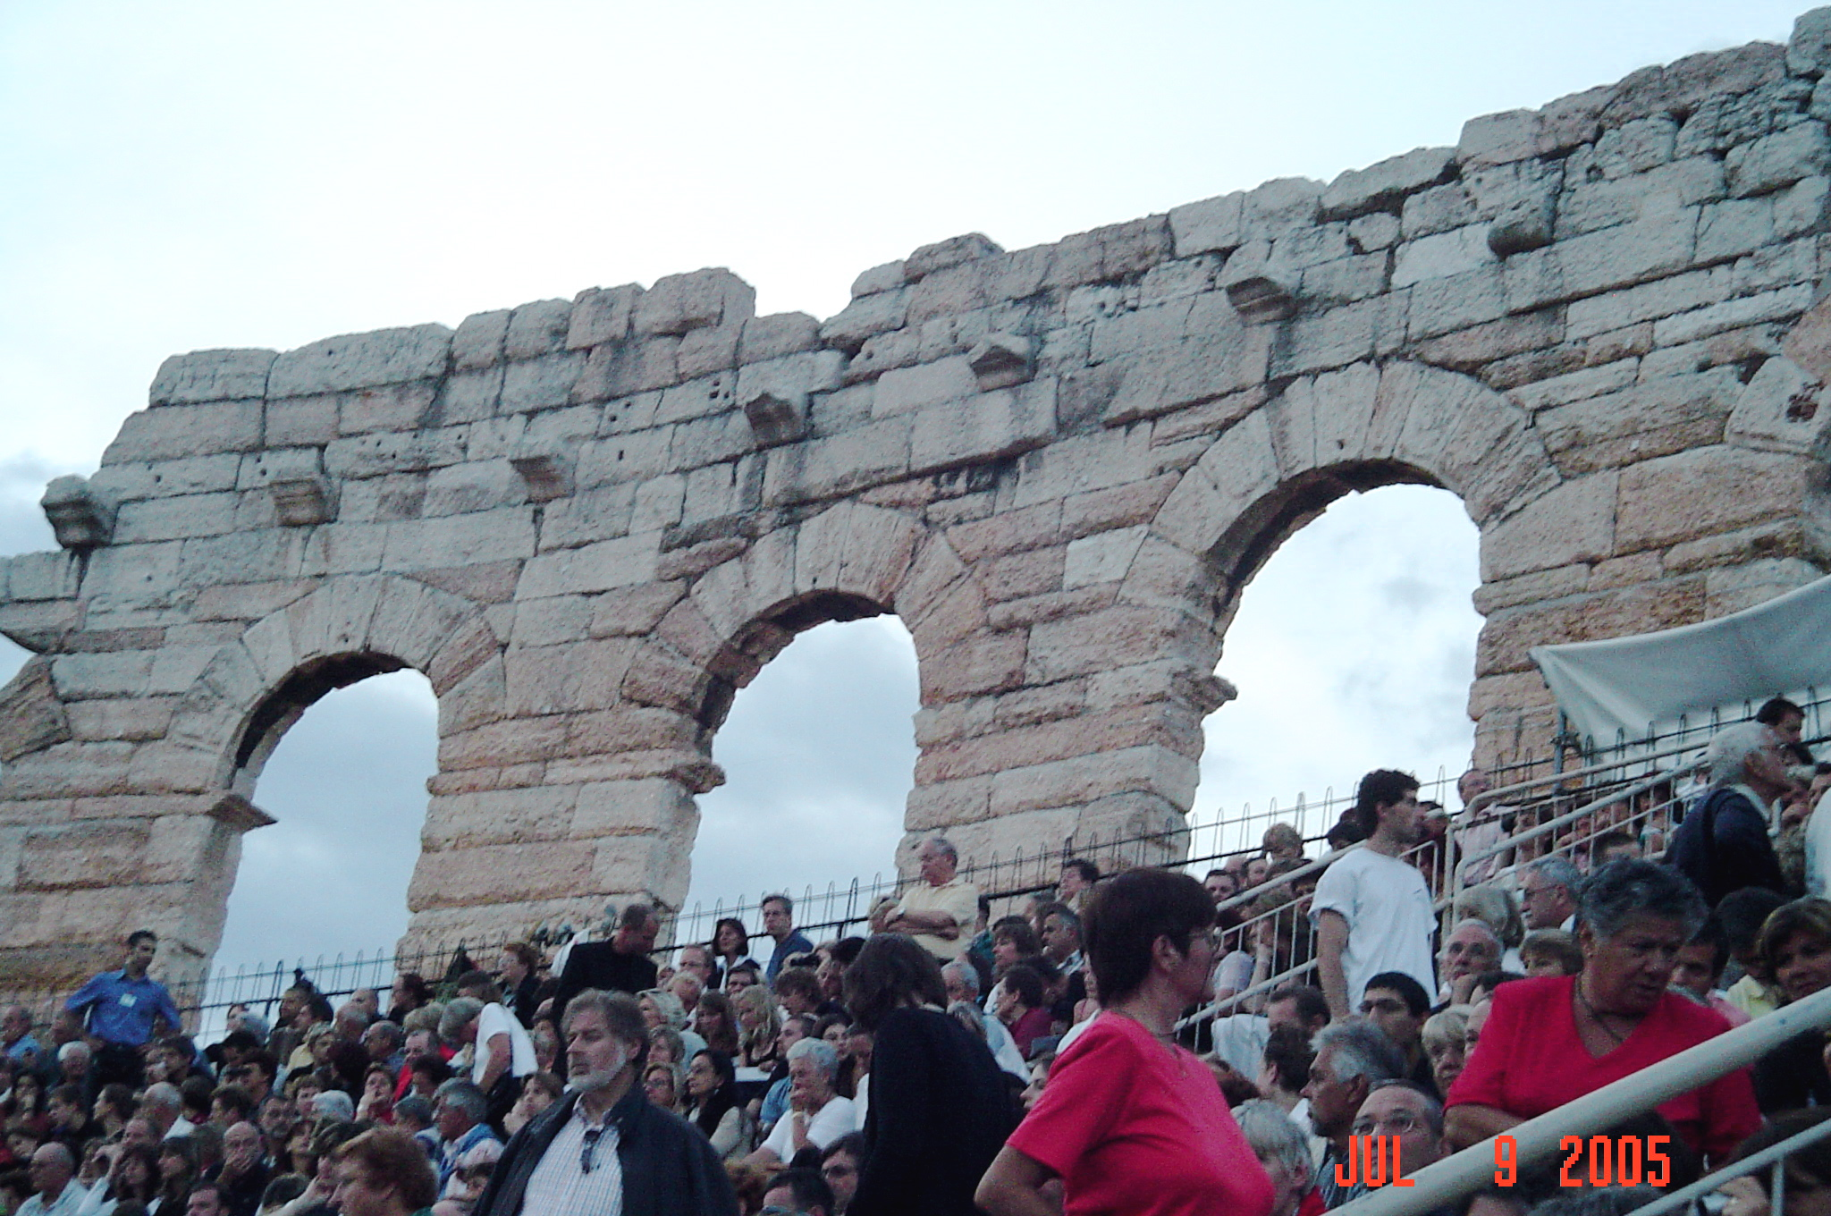


GLOBALIZATION OF OBESITY???
NEW YORK
CROATIA
New York
NEW YORK
AMSTERDAM
CROATIA
AMSTERDAM
ITALY
ITALY
SARAJEVO, BOSNIA
SARAJEVO

Slide 3
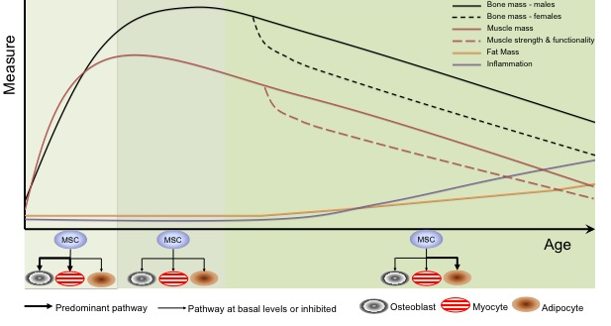
Age related changes in bone, muscle and fat tissues with related factors
Kelly, Gilman, Ilich; Current Aging Science 2016
Notes:
Figure 2 summarises this concept, as we age, inflammation is increased, which contributes to chronic disease and influences MSC lineage commitment, producing more adipocytes in the bone and muscle, and fat tissues

Slide 4
CALCIUM ROLE IN WEIGHT REDUCTION
The evidence: post-hoc studies
Re-examination of previous studies investigating effects of Ca on either bone or blood pressure:
  Effect of dietary or supplemental Ca on weight is subtle and unlikely to produce weight reduction without simultaneous energy modification
  Ca intake explains up to about 10% of variance in body weight
  Davies et al. 2000; Heaney et al. 2002; Parikh & Yanovski 2003; Teegarden 2003; Ilich et al. 2004
Notes:
If you’re not looking for it, you not gona find it

Slide 5
CALCIUM IN WEIGHT REDUCTION
The evidence: Clinical trials
Some reported greater role of dairy foods in weight reduction than could have been predicted from their Ca content alone and greater than from Ca supplements
    Either from synergistic or separate influence of some of the bioactive components of dairy foods
      Whey peptides, conjugated linoleic acid, and/or branched chain amino acids
    Individuals on reduced energy intake lost more weight on Ca supplements and dairy products than controls
      24-week intervention (Zemel et al. Obes Res 2004)
    Isocaloric substitution of yogurt for other foods led to significant loss of weight, body fat and reduced central obesity in obese individuals
      12-week intervention (Zemel et al. Inter J Obes 2005)

Slide 6
CALCIUM IN WEIGHT REDUCTION
The mechanism:
Anti-obesity effect of Ca could be attributed to its intracellular level and its impact on lypogenesis and lipolysis in adipocytes
  Accordingly, low Ca diets stimulate PTH and calcitriol secretion, which both promote Ca influx in adipocytes
  Increased intracellular Ca stimulates lipogenesis and suppresses lipolysis resulting in increased adiposity
  High Ca diets are shown to suppress this hormonal response, resulting in an up-regulation of lipolysis.

Slide 7
Possible mechanism of the anti-obesity effect of dietary calcium
Low Dietary Ca
+
PTH
Ca²⁺
Low
serum Ca
+
1,25(OH)₂D
+
CALCIUM PARADOX
Low
serum Ca
[Ca²⁺]i
Inhibits lipolysis
UCP2 expression
FAS transcription
?
FAS
de novo
lipogenesis
Thermogenesis
Adapted from: Zemel,
J Am College Nutr, 21:1465-1515, 2002
Adipocyte
Notes:
Anti-obesity effect of Ca could be attributed to its intracellular level and its impact on lypogenesis and lipolysis.
Accordingly, low Ca diets stimulate PTH and calcitriol secretion, which both promote Ca influx in adipocytes
Increased intracellular Ca stimulates lipogenic gene expression and lipogenesis and suppresses lipolysis resulting in increased adiposity
High Ca diets are shown to suppress this hormonal response, resulting in an up-regulation of lipolysis.
Ca might also contribute to weight reduction via its capacity to bind fatty acids from the intestinal tract, rendering them unavailable for absorption
UCP2 -- uncoupling protein 2

Slide 8
Objectives
To investigate whether weight loss could be achieved easier with calcium supplements or low-fat dairy products
  both as complements to the underlying hypocaloric diets
  compared to control (only hypocaloric diet)
Emphasis on assessing body composition, fat distribution and changes in visceral fat

Slide 9
Study Design
Controlled weight reduction in overweight/obese Caucasian women over 6 months
  N=97 finished with complete data sets
  BMI range: 26-40 kg/m²
  Early-postmenopausal
    2-10 years after menopause; 47-67 years

Slide 10
Study Design: Participants (cont)
  Generally healthy
    No medications affecting metabolic rate
    No chronic disease, lactose intolerance, food allergies
    No excessive weight change
      No participation in weight-loss programs in last 3 months
    Total Ca intake < 800 mg/day
    Vitamin and mineral supplements recorded/accounted for
    Current smoking: < 1 pack of cigarettes/day (recorded)
    Alcohol consumption: < 2 drinks/day (recorded)
    No excessive exercise
      Moderate/habitual exercise was encouraged and recorded

Slide 11
Intervention
Hypocaloric Diet:
Individualized diet with moderate energy restriction
  ~85% of energy needs, amounting to 500-1000 kcal/day of energy deficit
    The Miffin-St. Jeor equation was used to calculate energy needs of each participant, incorporating weight, height, age (for basal metabolic rate) and phys. Activity

Slide 12
Intervention (cont)
After baseline evaluation, participants were randomized into three groups:
  Supplement (S): with calcium and vitamin D at 630 mg/day and 400 IU/day, respectively + hypocaloric diet
    To amount to 1,500 Ca mg/day and ~400 IU of vitamin D with diet
  Dairy (D): 4-5 servings/day of low-fat dairy foods + hypocaloric diet
    To amount to 1,500 Ca/day and ~400 IU of vitamin D
  Control (C): placebo pills + hypocaloric diet
Compliance was assessed with dietary records and pill count

Slide 13
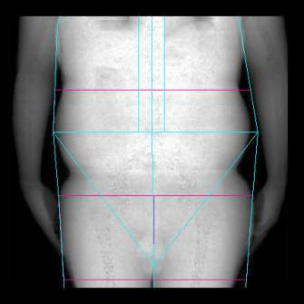
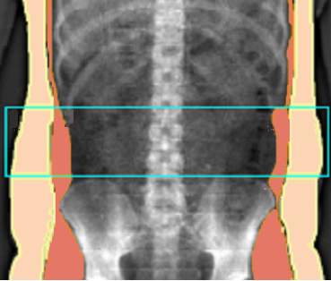
Measurements/Surveys
  Anthropometries
  Bone and body composition by iDXA
    Redistribution of fat around waist and internal organs
      Android and gynoid regions
  Dietary assessment
    3-day dietary records every 3 moths
  Physical Activity
    3-day records every 3 moths
  Smoking and alcohol consumption
  Socio-demographic surveys

Slide 14
Anthropometric measures at baseline and 6 months (mean±SEM)
C S D
C-Control, n=30
S-Supplement, n=37
D-Dairy, n=30
4.6%
5.4%
6.6%
C S D
C S D
C S D
C S D
Significant difference btw baseline and 6 months in all parameters in each group
Significant difference btw control and S/D groups at 6 months in all parameters

Slide 15
Percent difference (mean±SEM) in body fat after 6 months
*
*
*
C S D
C S D
C S D
* p<0.05 compared to C and btw S and D
C-Control, n=30
S-Suppl, n=37
D-Dairy, n=30

Slide 16
Percent difference (mean±SEM) in lean tissue after 6 months
C S D
C S D
C S D
* p<0.05 compared to C and btw S and D
C-Control, n=30
S-Suppl, n=37
D-Dairy, n=30

Slide 17
Conclusions/Implications
  Hypocaloric diets with increased Ca intake, compared to the control hypocaloric diets, were associated with:
    Greater weight and fat tissue loss
    Lower lean tissue loss
  The best outcomes, supporting a healthier body composition, were in a low-fat dairy group
  Increasing low-fat dairy foods to 4-5 servings per day may be beneficial for weight loss/maintenance and lead to more favorable body composition outcomes in postmenopausal women

Slide 18




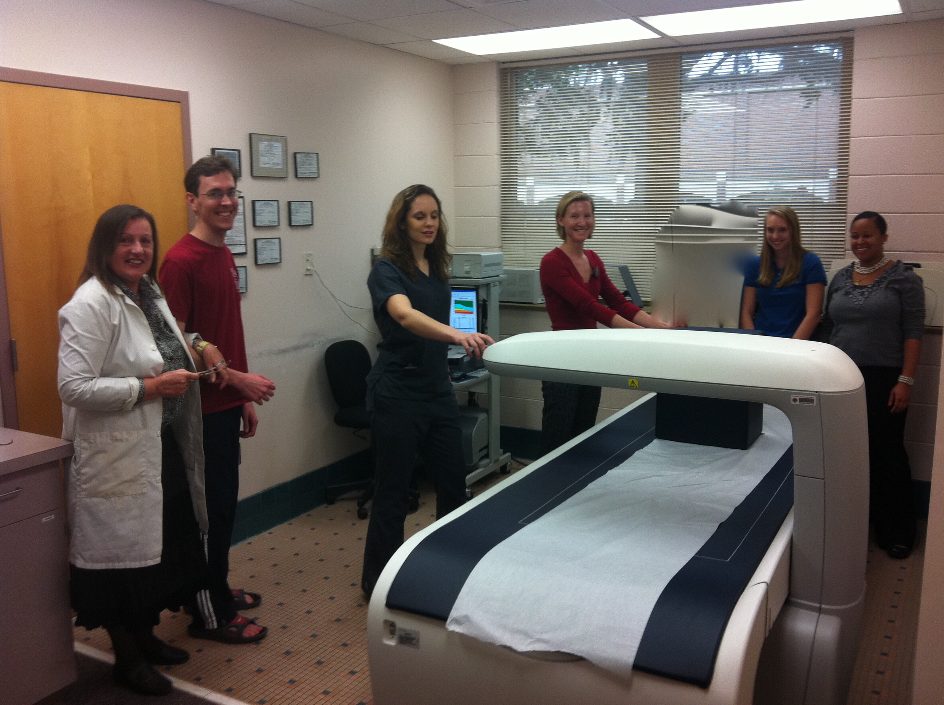
Funded in part by:
USDA/CSREES/NRI
#2004-05287

