Slide 1


SCW
A New Medium for Gasification and Oxidation of Organic Materials
Sonil Nanda¹
Sivamohan N. Reddy²
Ajay K. Dalai³
Janusz A. Koziński¹
¹Lassonde School of Engineering
York University, Canada
²Indian Institute of Technology Roorkee, India
³University of Saskatchewan, Canada

Slide 2
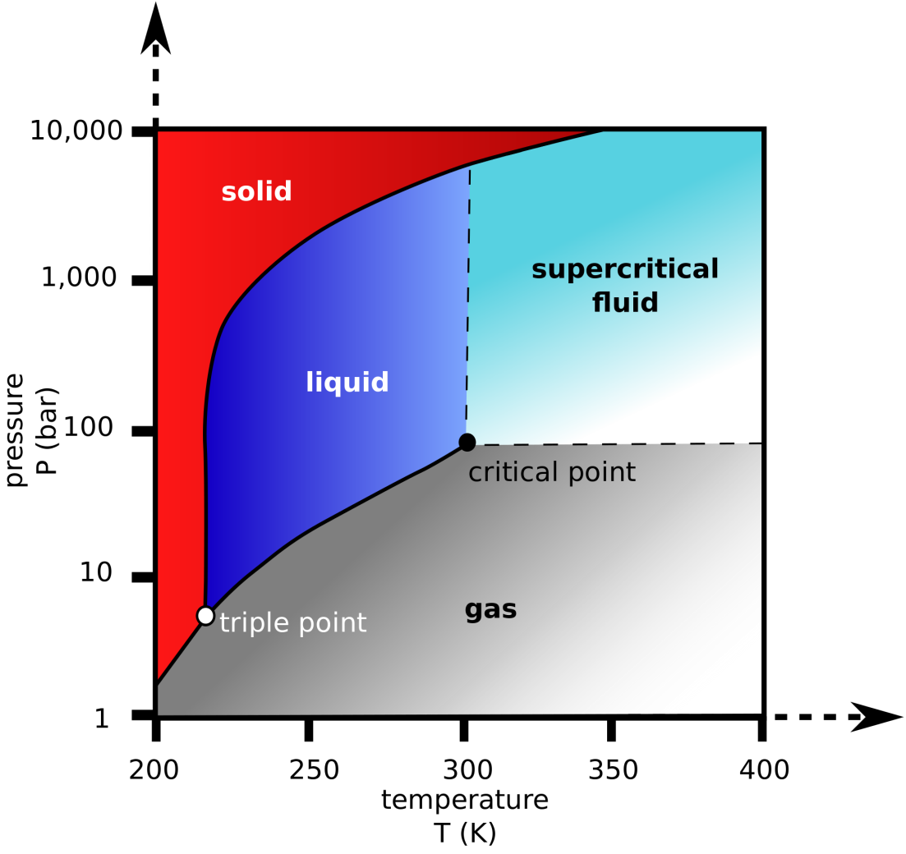
SuperCritical Water (SCW)
Tc > 374°C and Pc > 22.1 MPa
Homogenous medium
Medium and catalyst
High diffusivity and low viscosity
Ionic and free radical mechanism
Oxidation of organics
Ideal green solvent for chemical processes
Flame mode and Flame-less mode

Slide 3
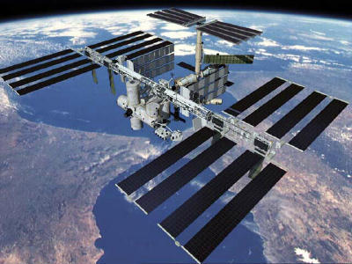

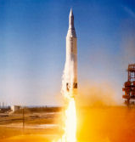


Supercritical Water – Applications
Water recycling in space stations
Extraction in herbal industry
(SC CO₂ 31.1ºC, ~73 atm, possibly SCW)
Fuel production from biomass
Production of nano-materials
Destruction of chemical weapons
Next generation of nuclear reactors (GEN IV)

Slide 4
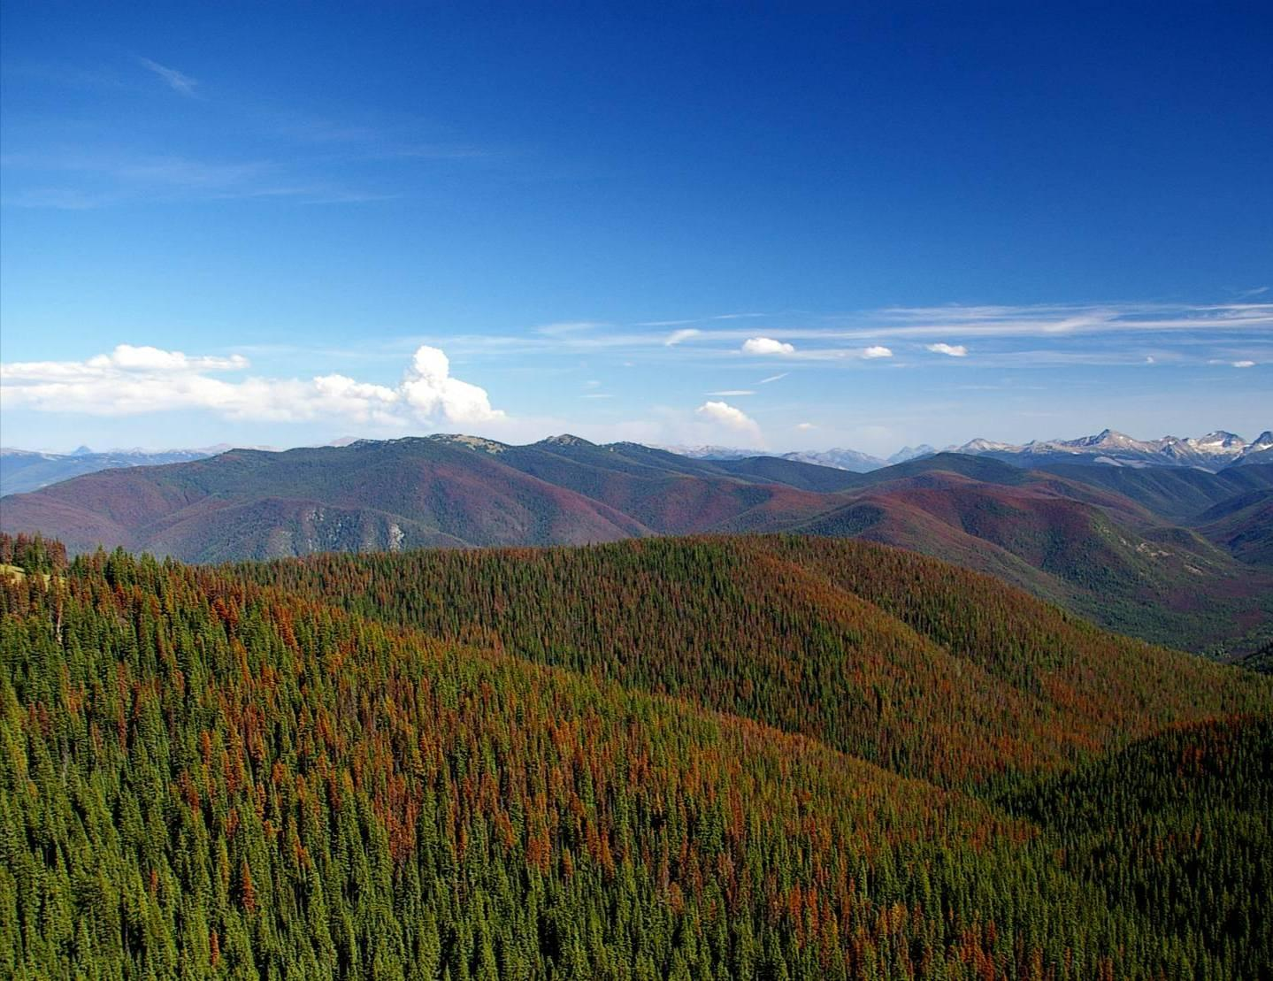
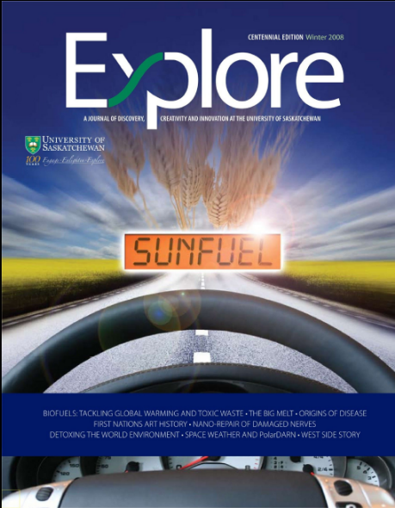
SCW processing
Fuel and value added chemicals
Waste biomass
Notes:
The basic aim: convert waste biomass to fuels in SCW

Slide 5
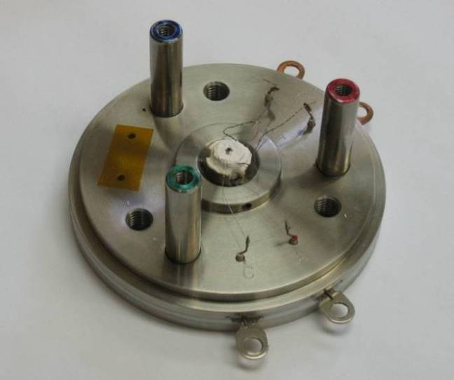
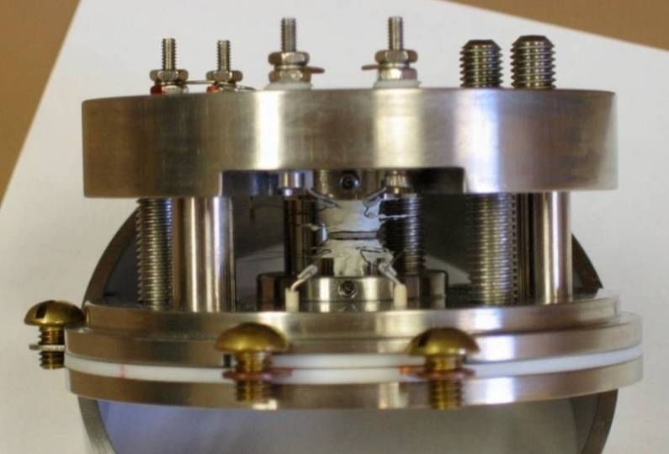
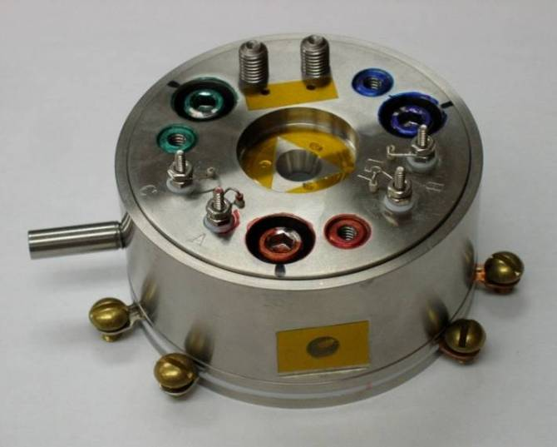
Hydrothermal Diamond-Anvil Cell (HDAC)
Bassett-type HDAC
The cell allows in-situ measurements of reactions at hydrothermal conditions
W.A. Bassett, European Journal of Mineralogy, 2003, 15, 773-780.
R. L. Smith and Z. Fang, Journal of Supercritical Fluids, 2009, 47, 431-446.

Slide 6
Diamond Anvil Cell
Sample
Gasket
Diamond
H₂O/H₂O₂
Anvil

Slide 7
Diamond Anvil Cell
Gasket
Molybdenum
Heaters
Diamond
H₂O/H₂O₂
Anvil

Slide 8
Diamond Anvil Cell
Outer
Cover

Slide 9
Diamond Anvil Cell
Outer
Cover
Thermocouples
Scanner
Computer

Slide 10
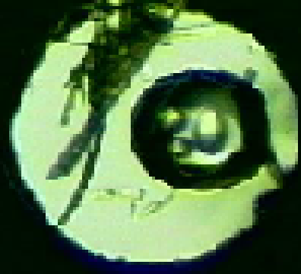
Diamond Anvil Cell
CCD
Camera
Sample
110X Microscope
Video Recorder
Outer
Cover
Ar +1%H₂
Thermocouples
Scanner
Incident Light
Computer

Slide 11
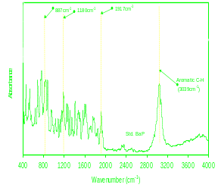
Diamond Anvil Cell
CCD
Camera
Raman/FTIR
Spectra
110X Microscope
Raman/Infrared
Microscope
Outer
Cover
Ar +1%H₂
Thermocouples
Scanner
Raman/IR
Computer

Slide 12
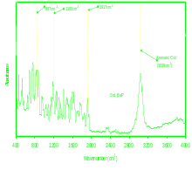
Diamond Anvil Cell
10 μJ/10 ns pulse
Nd:YVO₄ Laser
Argon Ion Laser
Pulse
Ruby Excitation
R1=694.1 nm R2=692.8 nm
Ruby Fluorescence
Spectrometer
Sample
Ruby
1Å→2.75 mbar

Slide 13
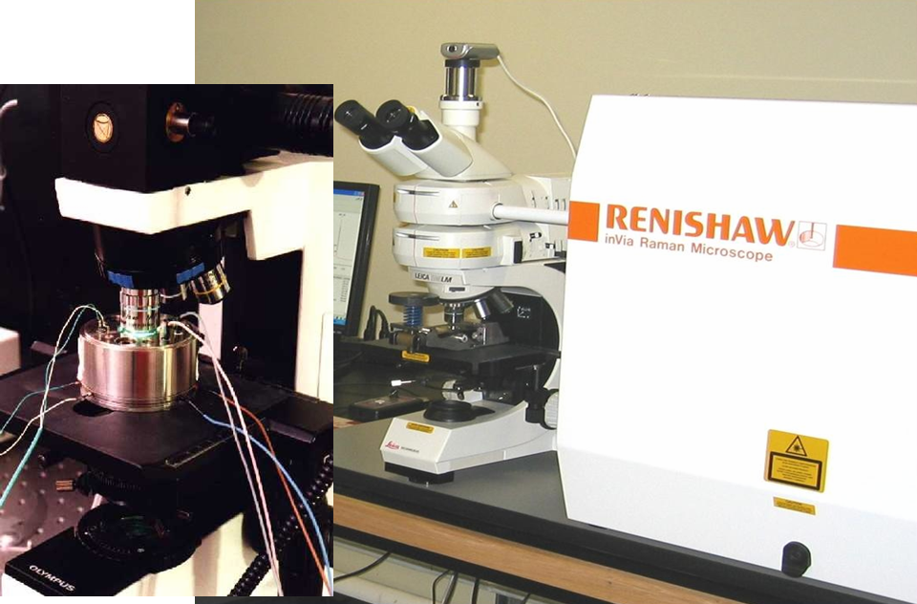

Slide 14
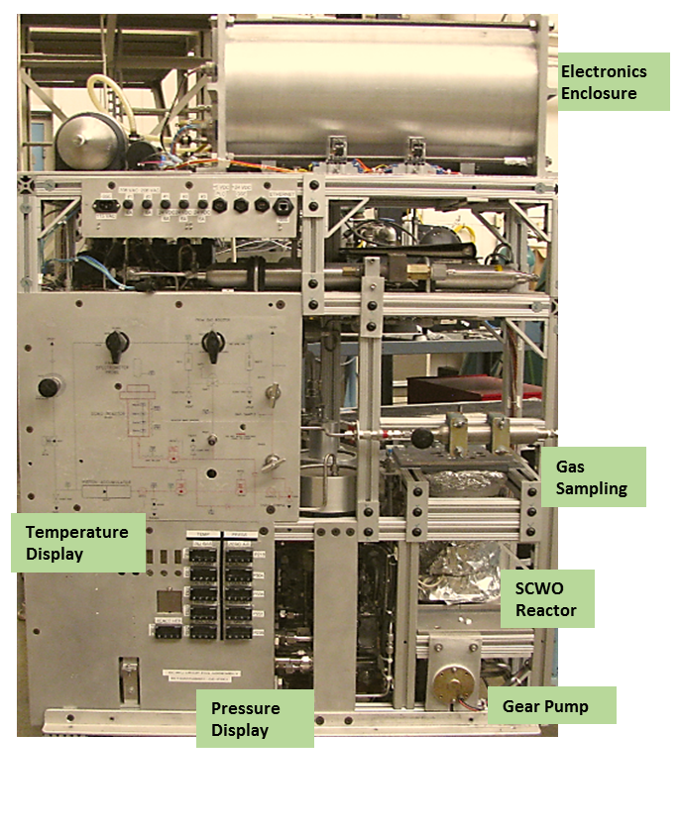
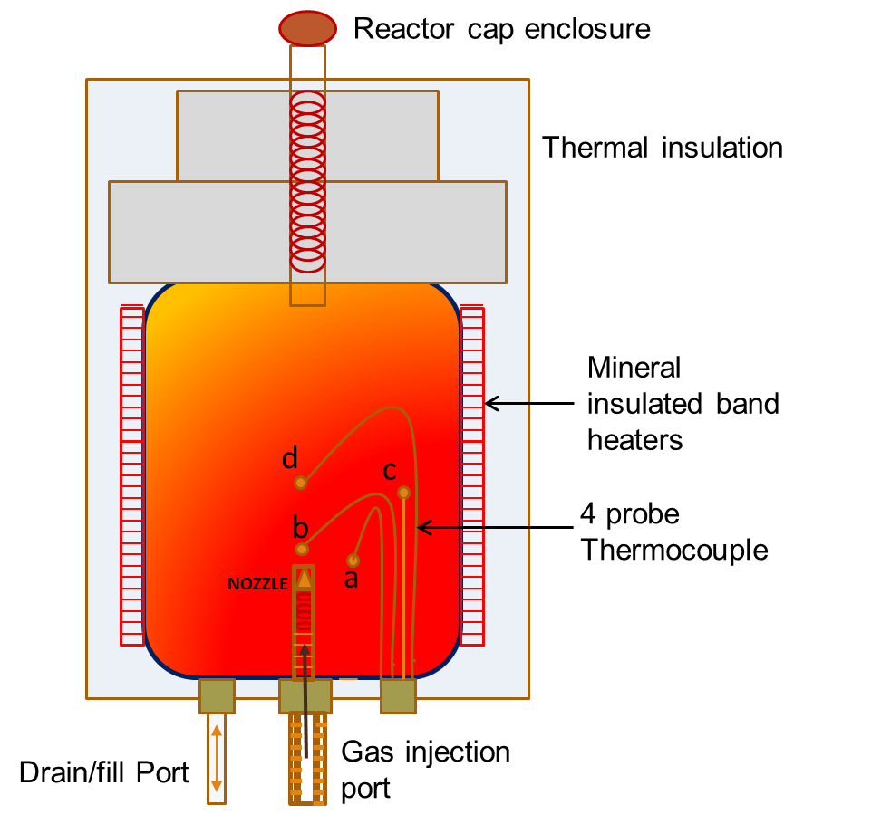
NASA – SCW Flame Machine
Haste Alloy C-276
Max Temperature – 550°C
Max Pressure – 5000 psi
Nozzle – one way flow

Slide 15
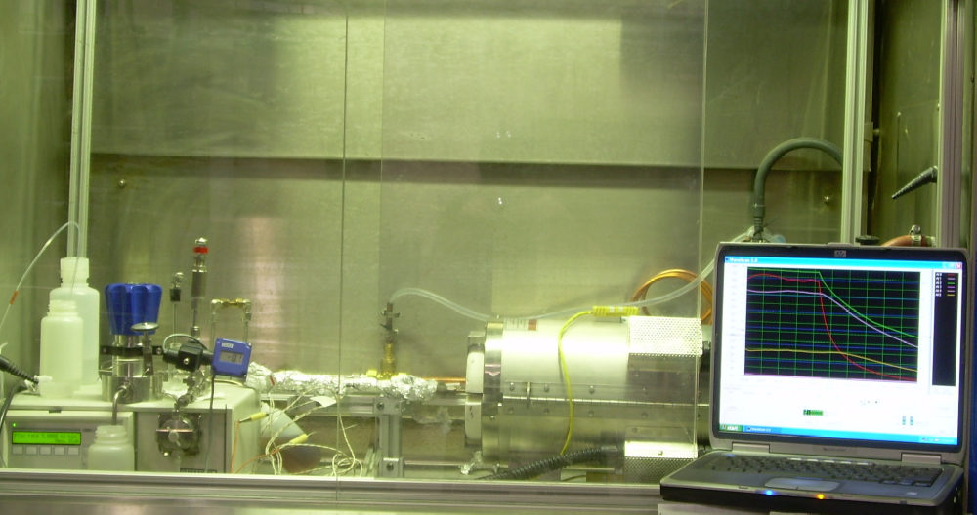
SCW Flow reactor
3/8” OD stainless steel tubing, max. 350 bar at 425 ºC, flow up to 1.5 L/hr
back-pressure regulator
heat exchanger
data collection
pump
furnace
preheater
Experiments in semi-batch & continuous modes

Slide 16
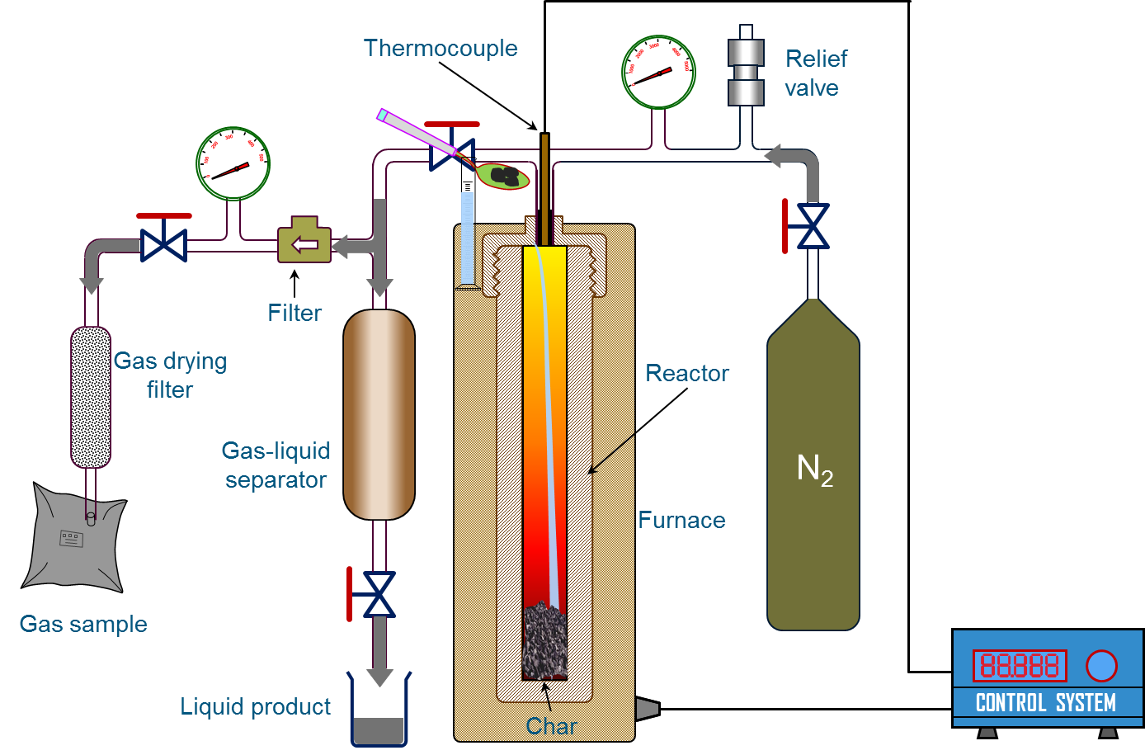
Supercritical water gasification
(batch reactor)

Slide 17
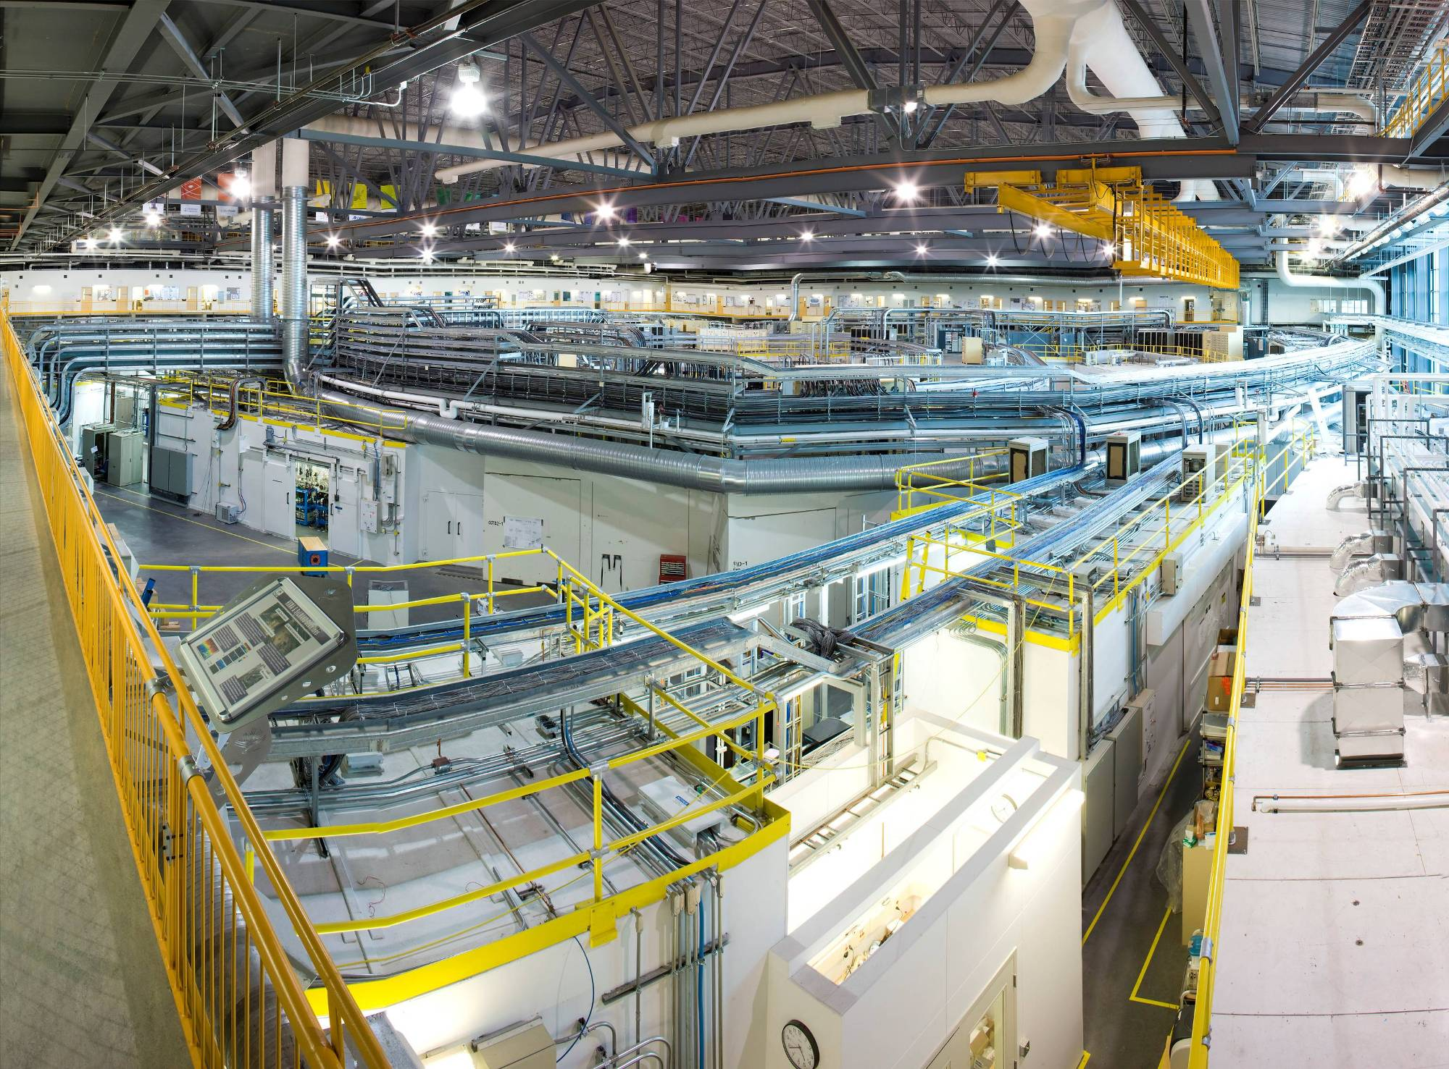
Canadian Light Source Synchrotron

Slide 18
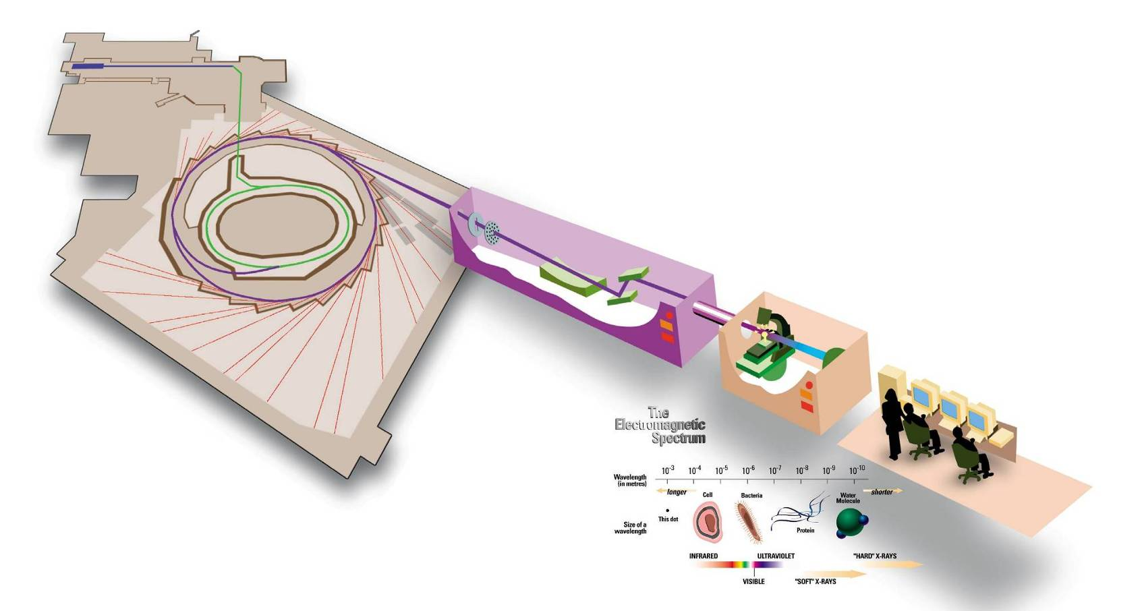

Synchrotron & HDAC
Simultaneous XRD/Raman/IR using synchrotron

Slide 19
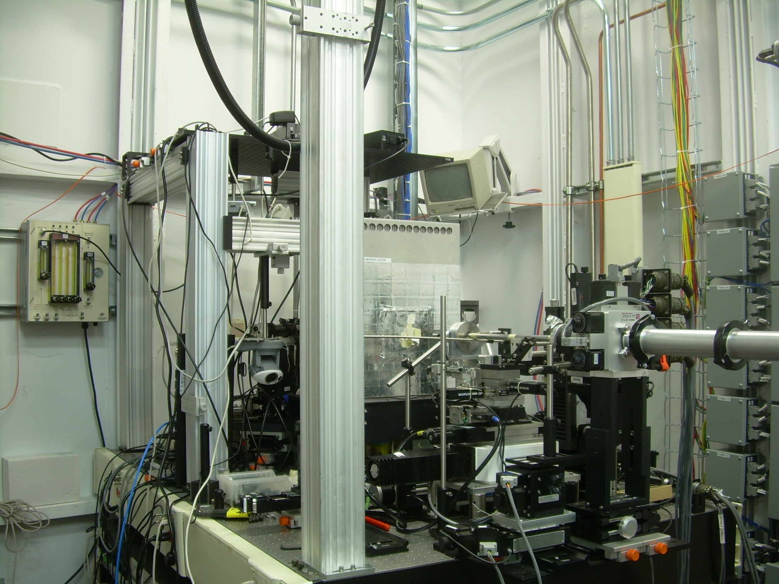
Fiber optic from Raman room for in situ measurement
X-ray beam
High-res camera for monitoring experiment during acquisition
HXMA beamline, Canadian Light Source

Slide 20
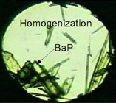
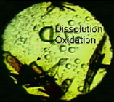
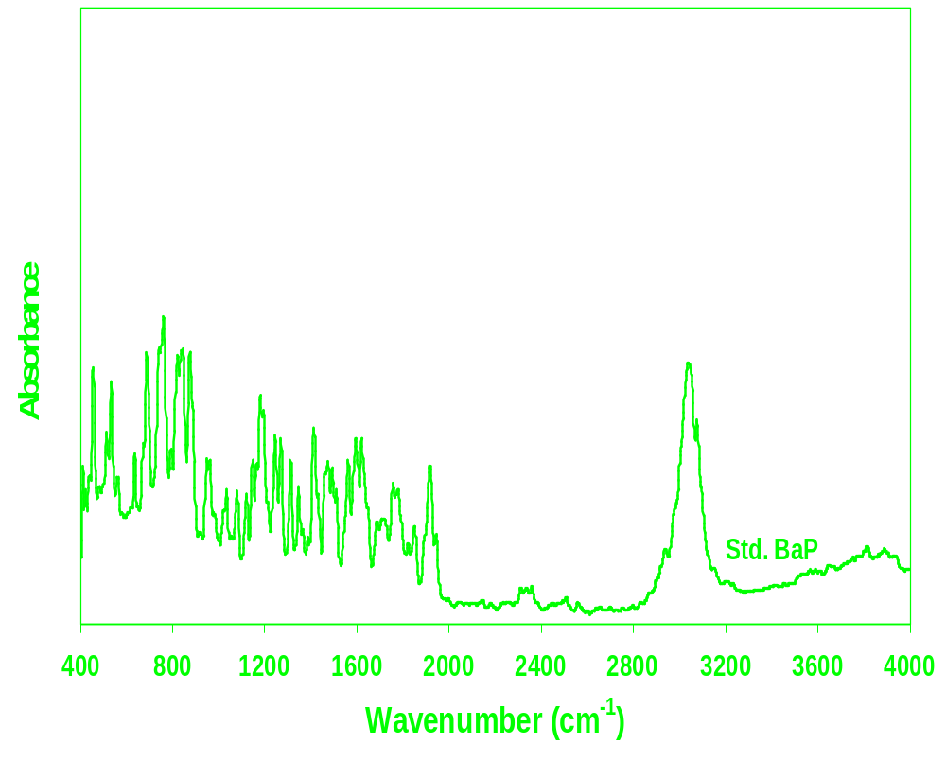

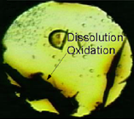
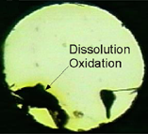
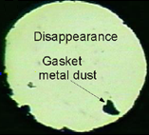
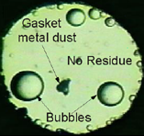
Phase Behavior
Supercritical conversion of BaP
442ºC, 420 MPa (25% H₂O₂)
887 cm⁻¹
23s, T_{h}=48ºC
130s, 305ºC
1917 cm⁻¹
Aromatic C-H (3039 cm⁻¹)
1180 cm⁻¹
131s, 318ºC
132s, 326ºC
Fractional
Change
143s, T_{max}=442ºC
Room Temperature
Visual observation
Residue: IR spectrum

Slide 21
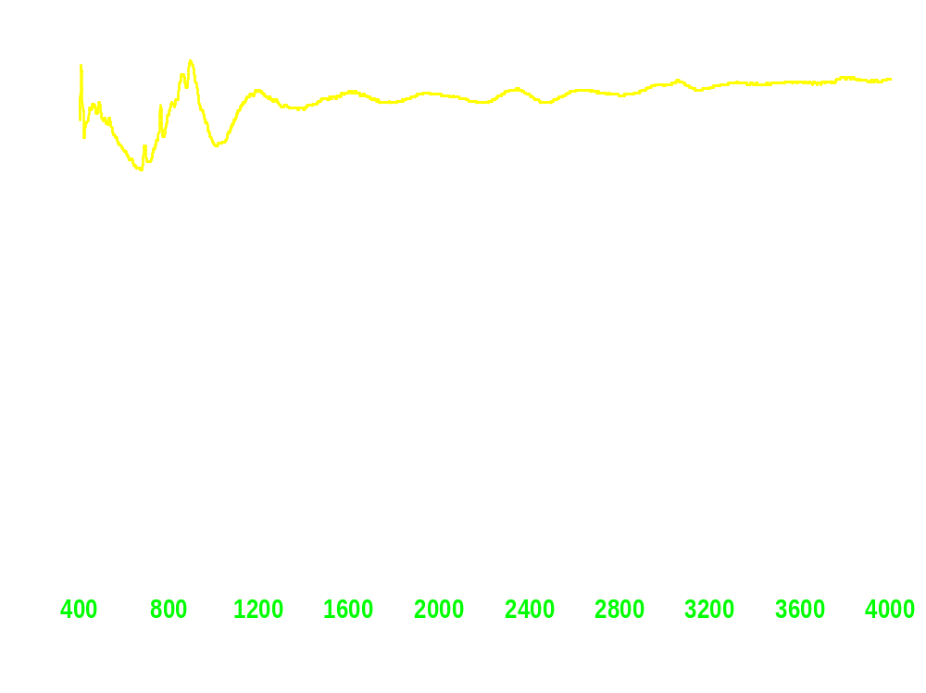
Phase Behavior
Supercritical conversion of BaP
442ºC, 420 MPa (25% H₂O₂)
887 cm⁻¹
100% Conversion
23s, T_{h}=48ºC
130s, 305ºC
1917 cm⁻¹
Aromatic C-H (3039 cm⁻¹)
1180 cm⁻¹
131s, 318ºC
132s, 326ºC
143s, T_{max}=442ºC
Room Temperature
Visual observation
Residue: IR spectrum

Slide 22
Time-Resolved Profiles
BaP
C₂H₄O₂
Acetic Acid
H₂
C₁₄H₁₀ Phenanthrene
Supercritical Region
Acetylene
C₂H₂

Slide 23

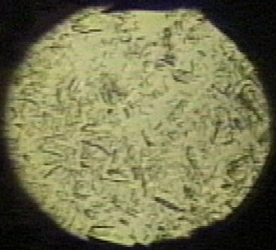
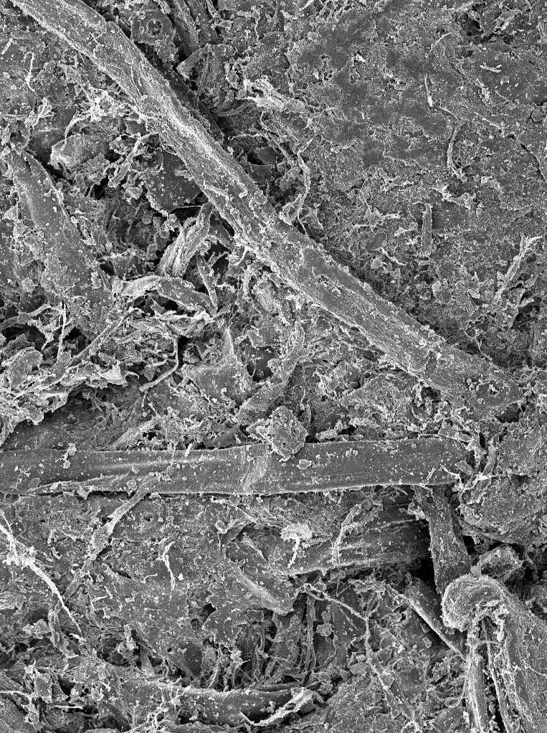
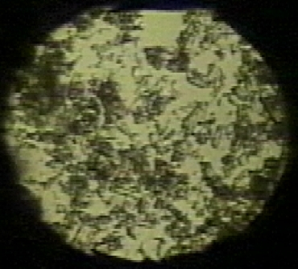
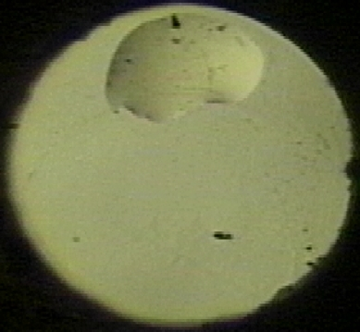
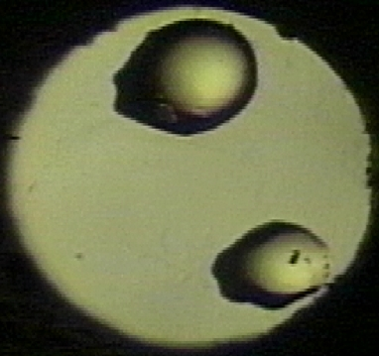
SCW Combustion Pathway
Subcritical Water + O₂
Supercritical Water + O₂
cellulose
oligomers
glucose
cellulose
oligomers
glucose
ketones
saccharic acids
furans
ketones
saccharic acids
furans
HOCH₂
HO
OH
Dissolution
O
Dissolution
Oxidation
Oxidation
HO
O
O
H
n
Decomp.
Hydrolysis
Decomp.
Hydrolysis
heavy HC
quinones
O
heavy HC
quinones
Oxidation
Oxidation
Oxidation
HO
OH
CH₂OH
Decomp.
Decomp.
Cellulose
Decomp.
Cellulose
Cellulose
light acids
acetic acid
light HC
light acids
acetic acid
light HC
light acids
acetic acid
light HC
light acids
acetic acid
light HC
light acids
acetic acid
light HC
Oxdn.
Oxdn.
Breakup
Breakup
naphthalene
Dissolution
naphthalene
Dissolution
CO₂
H₂O
O₂
N₂
CO₂
H₂O
O₂
N₂
CO₂
H₂O
O₂
N₂
CO₂
H₂O
O₂
N₂
SLUDGE
CO₂
H₂O
O₂
N₂
Oxidation
Oxidation
Rearrangements
Rearrangements
Naphthalene
Naphthalene
Naphthalene
phenanthrene
1,300 ppm
C₁₀-C₅₀ aliphatics
7,000 ppm
Formation
phenanthrene
1,300 ppm
C₁₀-C₅₀ aliphatics
7,000 ppm
Formation
Oxidation
Release
Release
Decomposition
Ash
Ash
Ash
Ash
Ash
Benzo(a)-
pyrene
Benzo(a)-
pyrene
Pyrolysis
acetylene
cycloalkenes
with benzylic rings
Cleaving
374 ºC
22 MPa

Slide 24
Observations
In-situ SCW combustion study: not easy but feasible
Plausible mechanism: subcritical → supercritical transformation
SCW combustion of different hydrocarbons: similar in supercritical region
Single homogeneous phase water: reactant & solvent
Simultaneous dissolution, hydrolysis, oxidation and decomposition

Slide 25
SCW Conversion: Pilot-Scale Issues
Corrosion: materials deterioration (if Cl)
Salt precipitation & fouling (char, tar; if no catalysts)
Expensive catalysts (Pt, Ni)
Complex thermodynamics for supercritical fluid phase
Complex process kinetics

Slide 26
-------------

