Slide 1
Cultural Congruency in Evidence-based Practice
Janet H. Davis MSN, MBA, PhD, RN
September 2018
Czech Republic

Slide 2
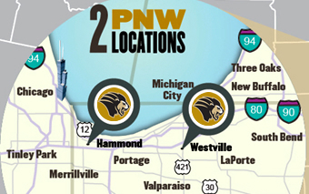
Located on two campuses in Indiana USA
Notes:
Purdue University Northwest is located approximately 1 hour from the city of Chicago IL. We have two campuses – one in Hammond IN and one in Westville IN that are approximately 30 minutes apart

Slide 3
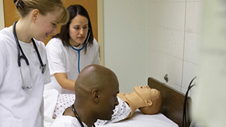

Nursing Degree Programs
Baccalaureate Degree: Professional Option
Baccalaureate Degree: Second Degree Option
RN to BSN (online)
Clinical Nurse Specialist Master’s (Gerontology & Administration)
Family Nurse Practitioner (FNP)
Doctor of Nursing Practice (DNP)

Slide 4

Our Amazing Faculty

Slide 5

College of Nursing Distinctions
NLN Center of Excellence in Nursing Education
Indiana Center for Evidence Based Nursing Practice
Notes:
The CON celebrated its 50th anniversary in October of 2015. It is home to the Indiana
Center for Evidence Based Nursing Practice, an international collaborator with the Joanna
Briggs Institute (JBI) and JBI Center of Excellence and hosts the Northwest Indiana Area
Health Education Center. In 2014, the National League for Nursing recognized the CON as a
Center of Excellence in Nursing Education.

Slide 6
PICO Model
The PICO model is widely accepted for framing evidence-based practice questions.
Population
Intervention
Comparison
Outcome

Slide 7
Evidence-based Practice
Evidence based practice (EBP) is the integration of the best research with clinical expertise and patient values

Slide 8
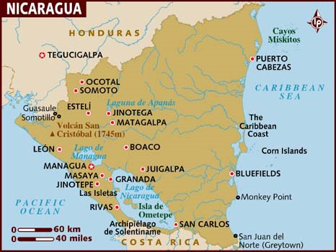
Study Abroad
Notes:
A truly remarkable journey
Our destination

Slide 9
Study Abroad in Nicaragua
In June 2017 , 14 undergraduate nursing students were placed at public clinics, homes and a children’s community center
Over the week long trip they gained hands-on experience with health care providers, patients, and community members

Slide 10
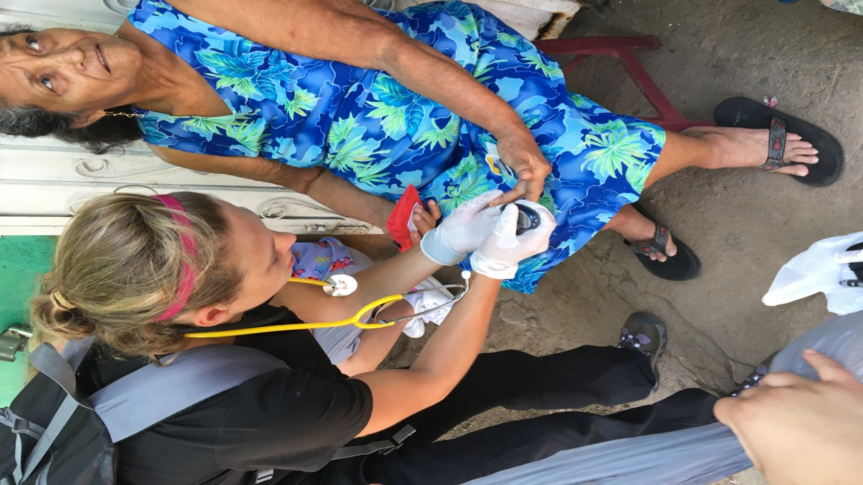
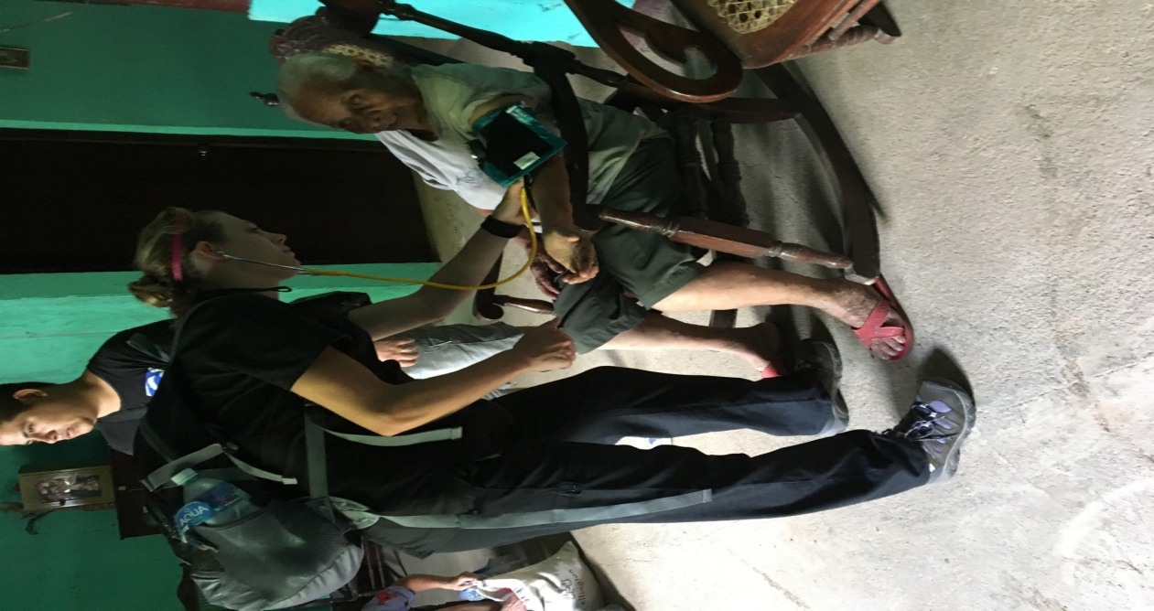

Slide 11

Interventions based on EBP are not available in practice settings around the globe

Slide 12

Does it fit?
EBP may not be the best fit culturally with the patient population

Slide 13

The Goal
Just like evidence-based practice
Culturally competent care = Highest quality

Slide 14
Values, beliefs, and behaviors about health and well-being are shaped by
Ethnicity
Gender
Language
Nationality
Occupation
Physical and mental ability
Race,
Sexual orientation
Socioeconomic status

Slide 15
Cultural Competence
Defined as the ability of healthcare providers to integrate an individual’s
values,
beliefs,
and behavioral factors into EBP interventions

Slide 16
The Gap
Include culturally congruent practice standards reflecting
Cultural background
Language proficiency
Literacy
in the critical appraisal comparison and validation of interventions

Slide 17

Strategies
Develop cultural competence
Engage stakeholders in systematic reviews

Slide 18
Cultural Competence
A set of academic and interpersonal skills that increase the understanding and appreciation of cultural differences and similarities within, among, and between groups

Slide 19
Requires a willingness and ability
To draw on community-based values, traditions, and customs
To work with knowledgeable persons of and from the community in developing targeted interventions

Slide 20
Engaging Stakeholders
For our review, what are important interventions ?
Will the interventions make a difference ?
Can you see a practical application of the review findings ?
Are these findings relevant to you ?
Based on your experience, are any interventions missing ?

Slide 21
Challenges
Means and methods
Gathering stakeholders
Language
Human subjects protection (IRB)

Slide 22
Public demand for nurses who are critical thinkers and good citizens of the world
Nurses know how to develop cultural competence
Nurses know how to engage stakeholders in systematic reviews

Slide 23
References
Guise, J-M., O’Haire, C., McPheeters, M., Most, C., Labrant, L., Lee, K., Cottrell, E.K.B., & Graham, E. (2013). A practice-based tool for engaging stakeholders in future research: A synthesis of current practices. Journal of Clinical Epidemiology, 66, 666-674.
Health Resources and Services Administration Bureau of Health Professions Division of Nursing (2004) Other definitions of cultural diversity. http://bhpr.hrsa.gov/diversity/cultcomp.htm , p.1
Sackett, D.L., Straus,S., Richardson,S. Rosenberg, W., & Haynes, R.B. (2000). Evidence-based medicine: How to practice and teach EBM (2nd ed.). London: Churchill Livingston.
Wale, J. (n.d.) An Introduction to Consumer Involvement in Systematic Reviews. Cochrane Consumer Network. Retrieved from https://training.cochrane.org/resource/introduction-
consumer-involvement-systematic-reviews.

