Slide 1
Food contact materials as source of chemical food contaminants
Dr. Jane Muncke
Food Packaging Forum Foundation, Zürich
jane.muncke@fp-forum.org
Notes:
70-90 Studierende
Interdisziplinär, Geografie, Biologie
Bachelor
40 Minuten
Deutsch
Einführungsveranstaltung zu Umweltnaturwissenschaften Nebenfach

Slide 2


Food contact terms.
Food Contact Articles FCAs
FCAs are made from FCMs:
a conveyor belt for donuts
a bottle with lid
Food Contact Materials FCMs
Food Contact Chemicals
FCCs
foto: Scott Ableman @flickr
foto: Catalytic Technologies @flickr
→ FCCs are the chemicals used to make FCMs and/or present in FCAs

Slide 3
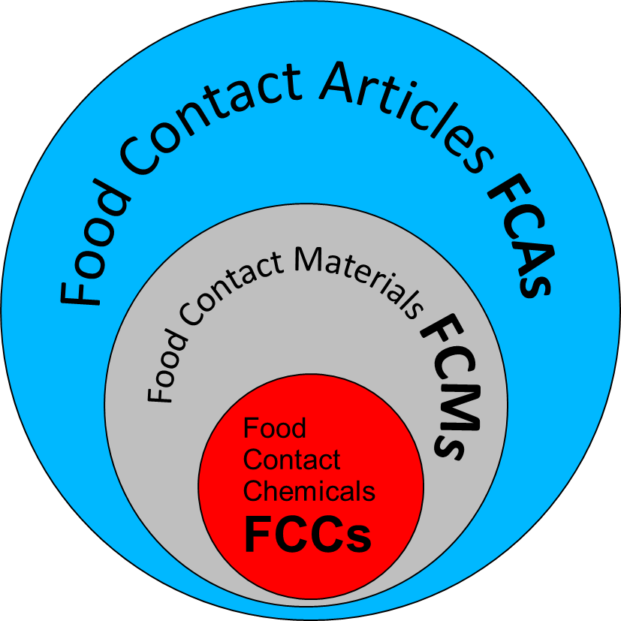
Food contact chemicals.
used in the manufacture of FCMs
  intentional use/presence intended*
  food contact substances
  6500 – 9000 substances
present in the finished FCAs but non-intentional
  non-intentionally added substances NIAS
  number unknown
  chemical identity often unknown
* i.e. intentionally formed from different intentionally used substances

Slide 4

EU Regulation.
foto: Michael Coghlan @flickr
ALL 17 FCMs:
Framework Regulation 1935/2004, Article 3:
  FCMs and FCAs must not transfer their components into food in quantities that could endanger human health
SPECIFIC MEASURES harmonized FOR 5 FCMs:
e.g. Plastics Regulation 10/2011:
  Annex I “Union List”:
  positive list for authorized starting substances, additives
  Art. 19 on NIAS, not specifically authorized FCCs:
  “Compliance with Article 3 … shall be assessed in accordance with internationally recognised scientific principles on risk assessment.”
→ European Parliament report on FCM regulation in October 2016

Slide 5
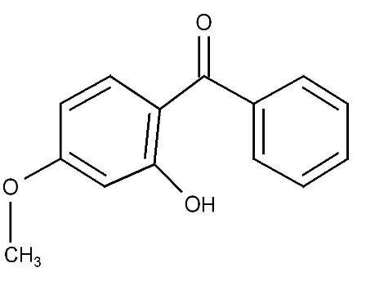
Food contact chemicals safety assessment.
Authorized FCCs: ca. 2000
  Intentionally used substances in plastics (ca. 937)
    Starting substances, additives (EU 10/2011)
    EFSA scientific opinion, COM (DG SANTE) authorizes
  Intentionally used substances in non-harmonized FCMs
    Some Member States require authorization for certain FCMs
Non-Authorized FCCs: more than 4500
  Intentionally used / intentionally formed substances in FCMs
    Industry
  Non-intentionally added substances in plastics and other FCMs
    Industry
    BUT: only possible for known substances
    Bradley and Coulier 2007 UK FSA report FD07/01

Slide 6
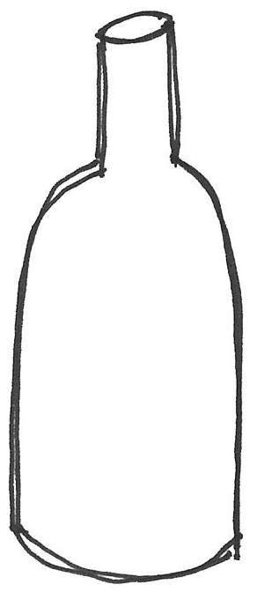
Migration.
foodstuff
bottle
outside
heat higher temperature increases leaching time long storage time increases leaching
food chemistry fatty foods, acidic foods, aqueous foods: it depends on food stuff what chemicals migrate from the packaging
packaging size smaller packaging has proportionally larger surface
area, more migration per volume of food

Slide 7
Chemicals potentially migrating from FCMs: Information sources
EFSA ESCO working group list, 2011
Inventories:
  Plastics: EU regulation 10/2011
  Printing inks: Swiss ordinance
  Council of Europe
  US Food and Drug administration

Slide 8
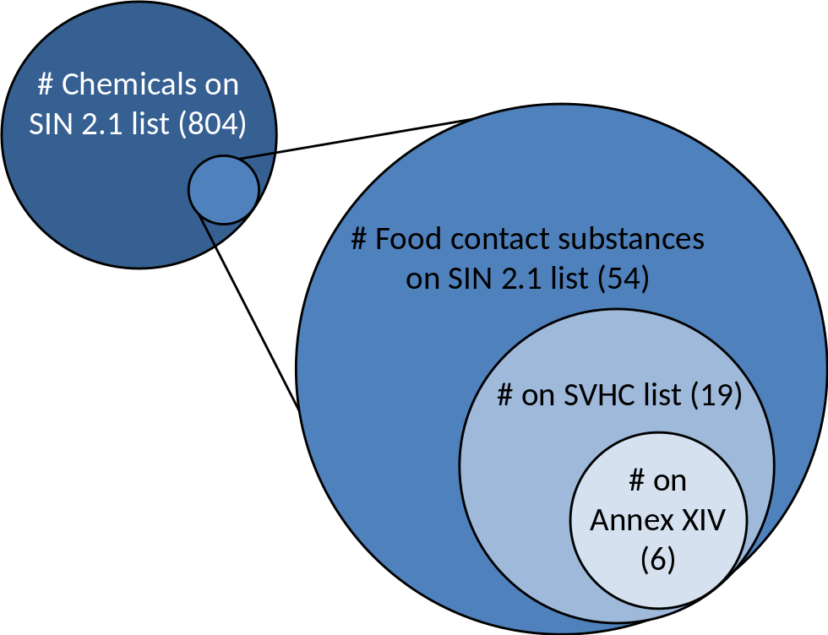
Chemicals of concern in food contact materials 2014.
Comparison of FCM substance inventories Europe and US to TEDX and SIN list databases.
Analysis found 175 chemicals of concern for FCM use.
No assessment of migration.
Geueke et al. (2014) “Food contact substances and chemicals of concern: a comparison of inventories. Food Addit Contam A.31:1438-1450.

Slide 9
Chemicals of concern on FCM lists.
SIN
FACET
ESCO
Union
180
171
54+7
36+2
SVHC
FACET
ESCO
Union
57
52
17+5
11
Annex XIV
FACET
ESCO
Union
10
9
6+1
4
Σ
180
Geueke and Muncke (submitted) “Substances of very high concern in food contact materials: Migration and regulatory background.”

Slide 10
10 FCM substances on Annex XIV.
CASRN | Name | Union list | ESCO list | FACET list | Migration
79-01-6 | trichloroethylene, TCE |  |  | + | no evidence
84-69-5 | diisobutyl phthalate, DiBP |  | + | + | yes
84-74-2 | dibutyl phthalate, DBP | + | + | + | yes
85-68-7 | benzyl butyl phthalate, BBP | + | + | + | yes
101-14-4 | 4,4'-methylenebis[2-chloroaniline], MBOCA |  | + |  | no evidence
101-77-9 | 4,4'-methylenedianiline, MDA |  | + | + | yes
111-96-6 | bis(2-methoxyethyl) ether, Diglyme |  |  | + | no evidence
115-96-8 | tris(2-chloroethyl)phosphate, TCEP | + | + | + | no evidence
117-81-7 | bis(2-ethylhexyl) phthalate, DEHP | + | + | + | yes
3194-55-6 | hexabromocyclododecane, HBCD* |  |  | + | no evidence

Slide 11
Challenges for risk assessment
Chemical analysis
Hazard characterization of migrating substances
Exposure data
Mixture toxicity
Endocrine disruption

Slide 12
1. Chemical analysis
Requires information on the substance of interest: chemical identity
Requires availability of the substance of interest:
pure chemical standard
Requires chemical analytical tool for quantification in relevant matrix: chemical analytical method
Migration modeling: possible for intentionally used substances (level in FCA must be known) in polymeric FCMs

Slide 13
2. Hazard characterization of migrating substance
Same requirements as for chemical analysis
Additional requirement:
  Availability of the substance of interest in sufficient quantity and quality (i.e. with high purity) to perform biological assays

Slide 14
3. Exposure data
  Migration behavior into different food substrates requires knowledge about the use of the substance:
    type of FCM,
    type of food,
    amount of food consumption by specific population groups
  Other sources of exposure:
    Via food
    Via other routes (dermal, inhalatory)
FACET project: Oldring et al. (2014) Food Additives & Contaminants: Part A,
Vol. 31, No. 3, 444–465, http://dx.doi.org/10.1080/19440049.2013.862348

Slide 15
Epidemiology & biomonitoring.
the facts
?
HUMAN
EXPOSURE:
to
?
EPIDEMIOLOGY:
increase of
bisphenol A
nonylphenol
...
allergies
testicular
dysgenesis
syndrome
heart
disease
phthalates
obesity
...
cancer
DiOP
flurocarbons
neuro-
developmental
diseases
♂infertility
DBP
DiNP
...
type 2
diabetes
DEHP
PFOA
PFOS
testis
http://www.cdc.gov/exposurereport/
http://www.eu-hbm.info/cophes
Pouech et al. 2015 J.Chromatography A 1423: 111-123.
ADHD?
breast
Autism?
http://www.who.int/mediacentre/factsheets/fs310/en/index2.html
http://www.who.int/mediacentre/news/releases/2015/noncommunicable-diseases/en/

Slide 16
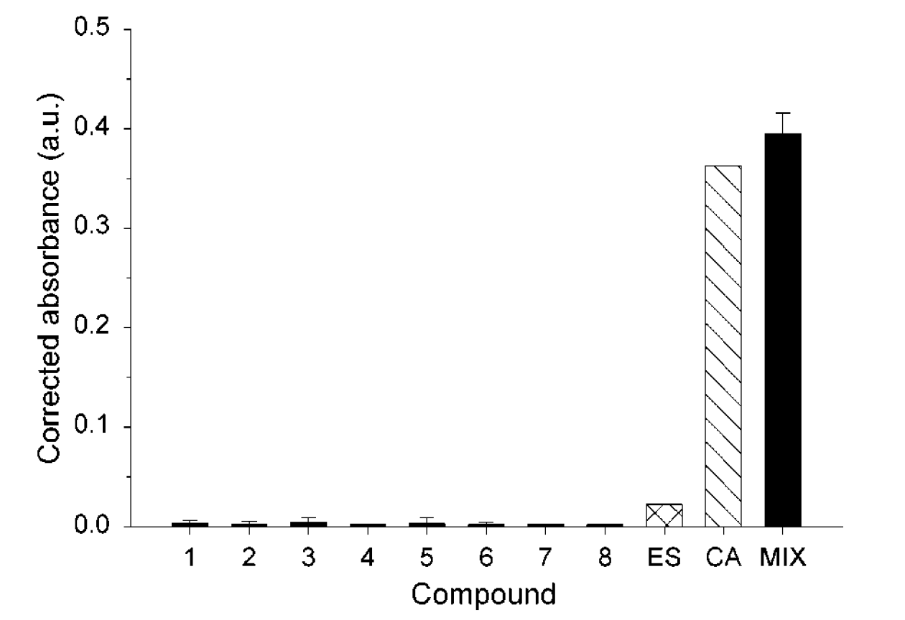
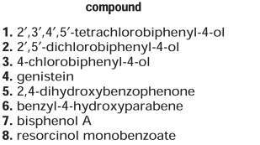
Mixture Toxicity:
„Something from Nothing“
„Estrogenicity“
ES: estimate
MIX: actual mixture
Silva, E. et al. (2002) Env Sci Technol 36(8):1751-1756.

Slide 17
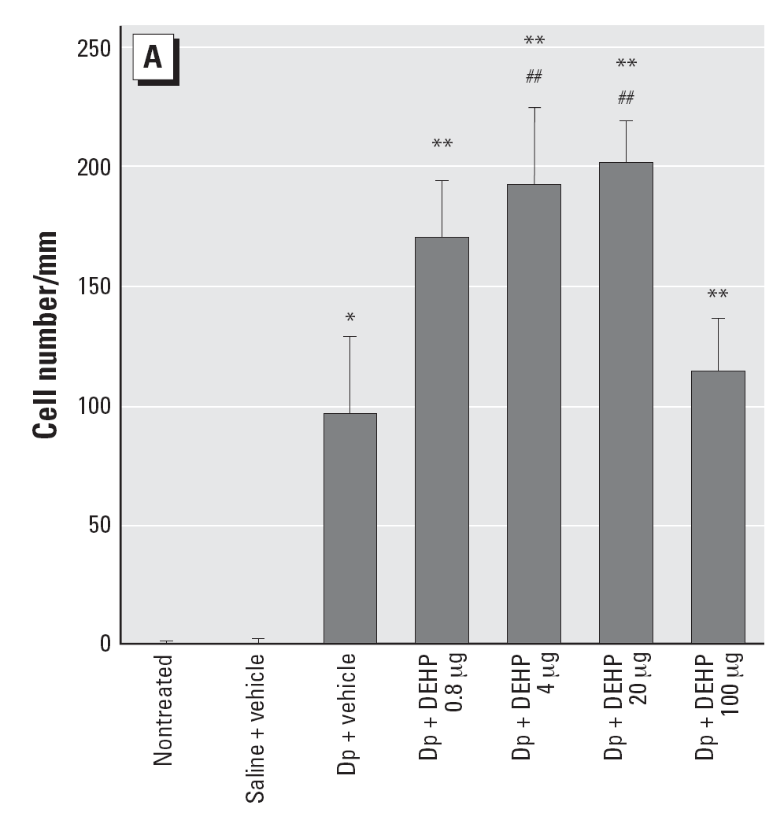
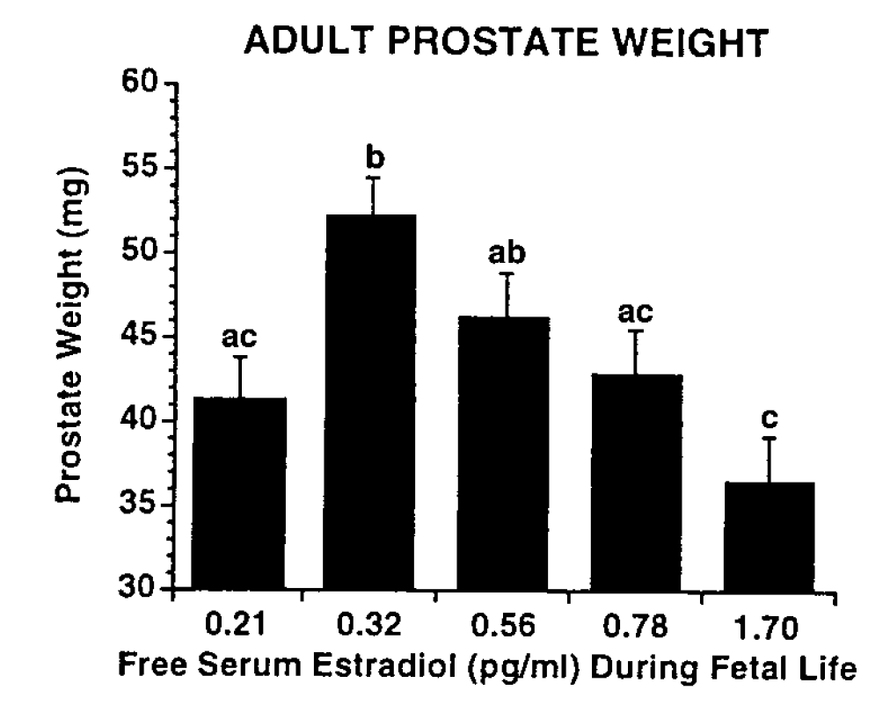
Typical hormone dose-response.
Vom Saal et al. 1997 PNAS
Takano et al. 2006 EHP
Vandenberg et al. 2012 “Hormones and Endocrine-Disrupting Chemicals: Low-Dose Effects and Nonmonotonic Dose Responses” Endocrine Reviews 33(3):378-455

Slide 18
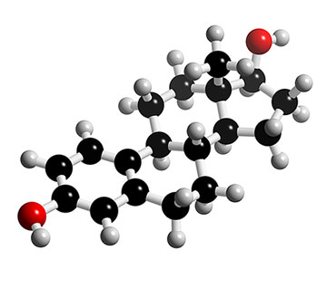
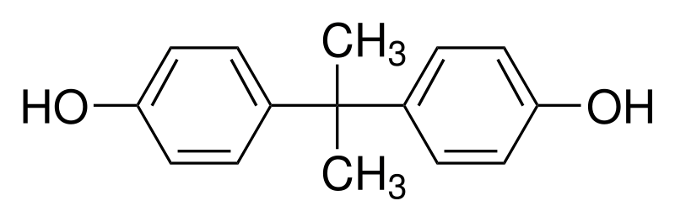
Endocrine Disrupting Chemicals (EDCs).
Mimic biological effects of natural hormones
Also called environmental hormones
„Xeno“ estrogens largest group: mimic estrogen’s effects
Emerging risk, reduce exposure
Most prominent exponent: Bisphenol A
FCCs: 119 known or suspected EDCs used in FCMs
EFSA recommends to further investigate EDC effects for FCCs
UNEP/WHO State of the Science on EDCs 2013. http://www.who.int/ceh/publications/endocrine/en/
Endocrine Disruptors. Risk Management Options. The CRO Forum 2012 http://www.thecroforum.org/endocrine-disruptors/
Geueke et al. 2014 "Food contact substances and chemicals of concern: a comparison of inventories." Food Additives & Contaminants: Part A 31(8): 1438-1450. http://www.ncbi.nlm.nih.gov/pubmed/24999917
Eick et al. 2012 Evolution of minimal specificity and promiscuity in steroid hormone receptors." PLoS Genet 8(11): e1003072.
EFSA 2016 Recent developments in the risk assessment of the chemicals in food and their potential impact on the safety assessment of substances used in food contact materials. http://www.efsa.europa.eu/sites/default/files/scientific_output/files/main_documents/4357.pdf

Slide 19
Conclusions.
Food contact chemicals (FCCs) migrate into foods
Migration affects all FCMs but levels AND types of chemicals that migrate differ
Information on chemical use, migration and exposure data are not publicly available; toxicity data are often missing
Exposures to chemicals of concern from FCMs are avoidable: opportunity for prevention of chronic disease
Room for improvement of current FCM regulations: needs a constructive discussion involving all stakeholders

Slide 20




Thank you!
Birgit Geueke
Ksenia Groh
Greta Stieger
Richard Mikosch
www.foodpackagingforum.org
Free newsletter and background information
Public workshop on 25 October 2016 in Zurich

