Slide 1
TRENDS IN ATMOSPHERIC OZONE
FROM A LONG-TERM OZONE CLIMATOLOGY
Jane Liu^{1,2}, D. W. Tarasick³, V. E. Fioletov³, C. McLinden³,
J. H. Y. Jung¹, T. Zhao⁴, S. Gong³, C. Sioris³, J. J. Jin⁵, G. Liu⁶, and O. Moeini⁷
¹ University of Toronto
² Nanjing University
³ Environment Canada
⁴ Nanjing University of Information Science & Technology
⁵ Universities Space Research Association, NASA
⁶ University of California at Berkeley
⁷ York University
3rd International Conference on Earth Science & Climate Change Earth Science & Climate Change, July 28-30, 2014 San Francisco, USA

Slide 2
INTRODUCTION
Importance
Ozone is an important trace gas in the atmosphere, playing a significant role in atmospheric chemical, dynamical, and radiative processes. Ozone trends in the stratosphere and troposphere have been topics of active studies.
Objective
  To investigate ozone trends in the stratosphere and troposphere, globally and in different regions.
Rationale
Based on a long-term (1965-2008) global 3-dimentional (latitude, longitude, and altitude) ozone climatology.
1/14

Slide 3
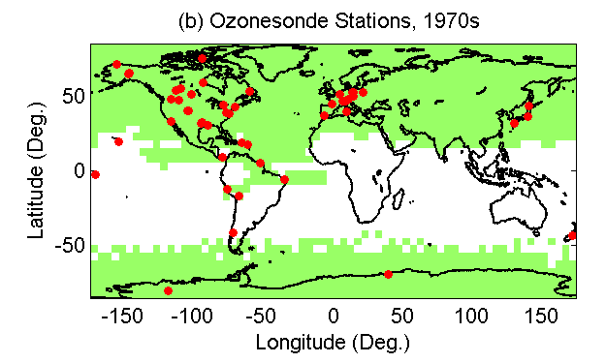
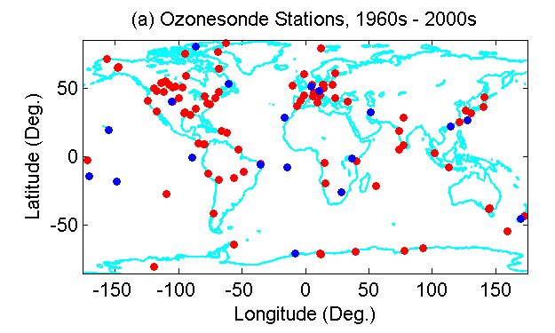
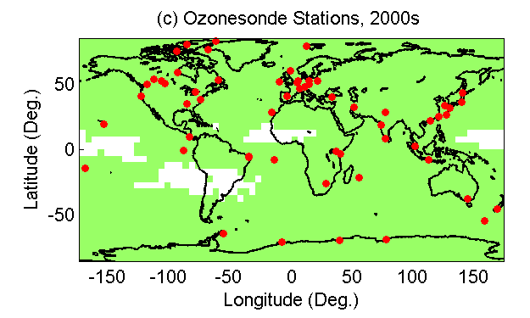
TRAJECTORY-MAPPING
(Liu et al., 2013)
2/14
Notes:
2

Slide 4
GLOBAL OZONE DATABASE
Source: Global Ozonesonde data
51,898 ozone soundings, 116 stations, 44 years (1965-2008)
Developed through trajectory mapping
  HYSPLIT (Hybrid Single Particle Lagrangian Integrated Trajectory Model), NOAA, Air Resources Laboratory
  Driven by NCEP reanalysis data
  Both forward and backward, 96 hours, assuming ozone life time of 4 days
Global ozone climatology
  5 ° lat ×5 ° lon, 1 km vertical resolution, by month, by decade, from 1960s-2000s
  5 ° lat ×5 ° lon, 1 km, yearly mean, 1965-2008
3/14

Slide 5
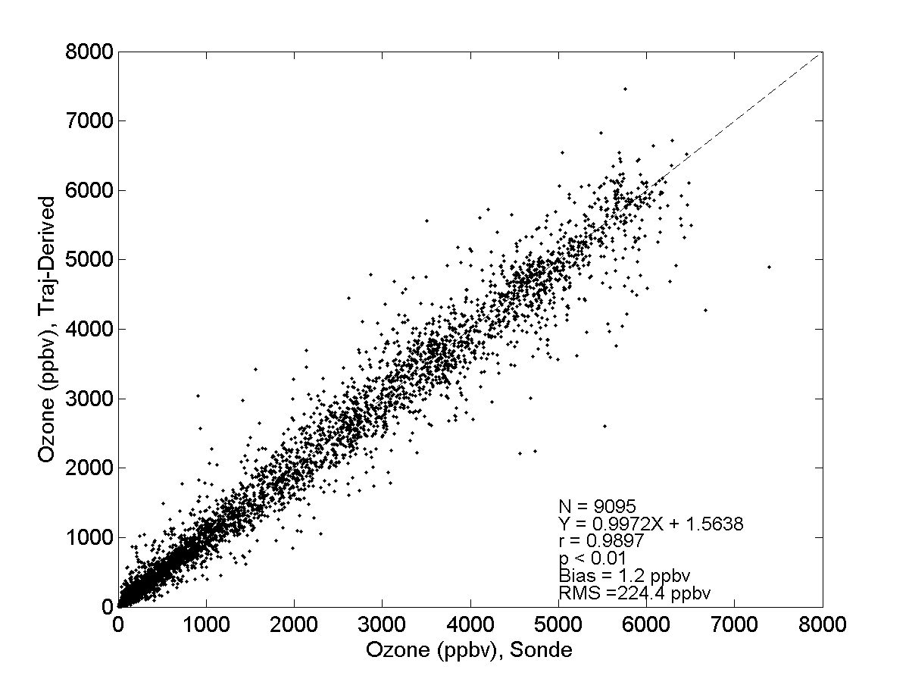
VALIDATION OF THE CLIMATOLOGY
(Liu et al., 2013)
4/14
Notes:
4

Slide 6
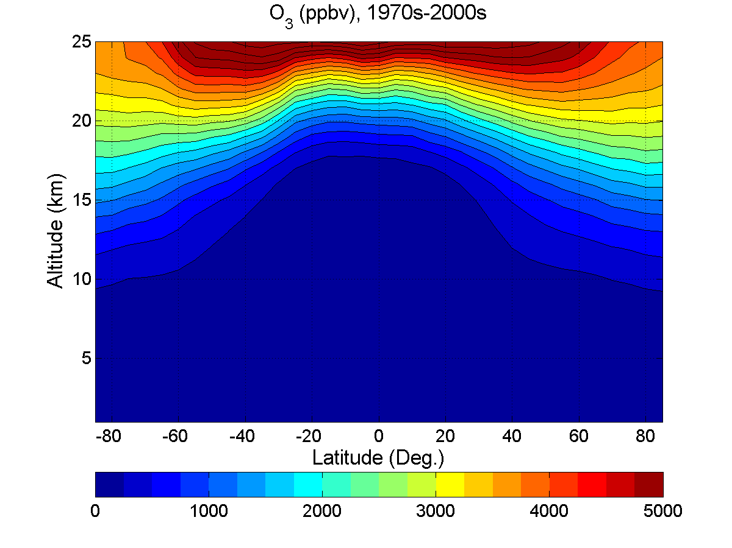
LATITUDINAL VARIATIONS
(Liu et al., 2013)
5/14

Slide 7
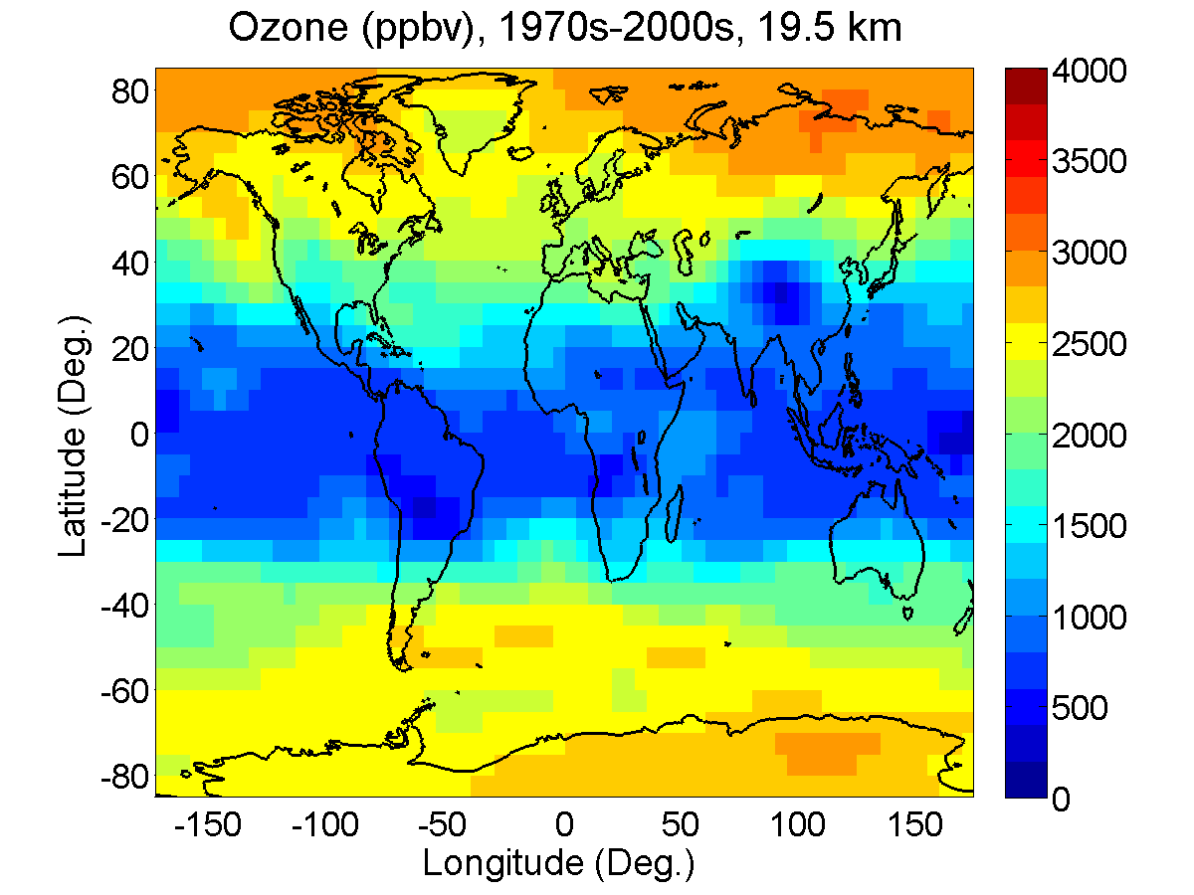
OZONE DISTRIBUTION IN THE LOW STRATOSPHERE
(Liu et al., 2013)
6/14

Slide 8
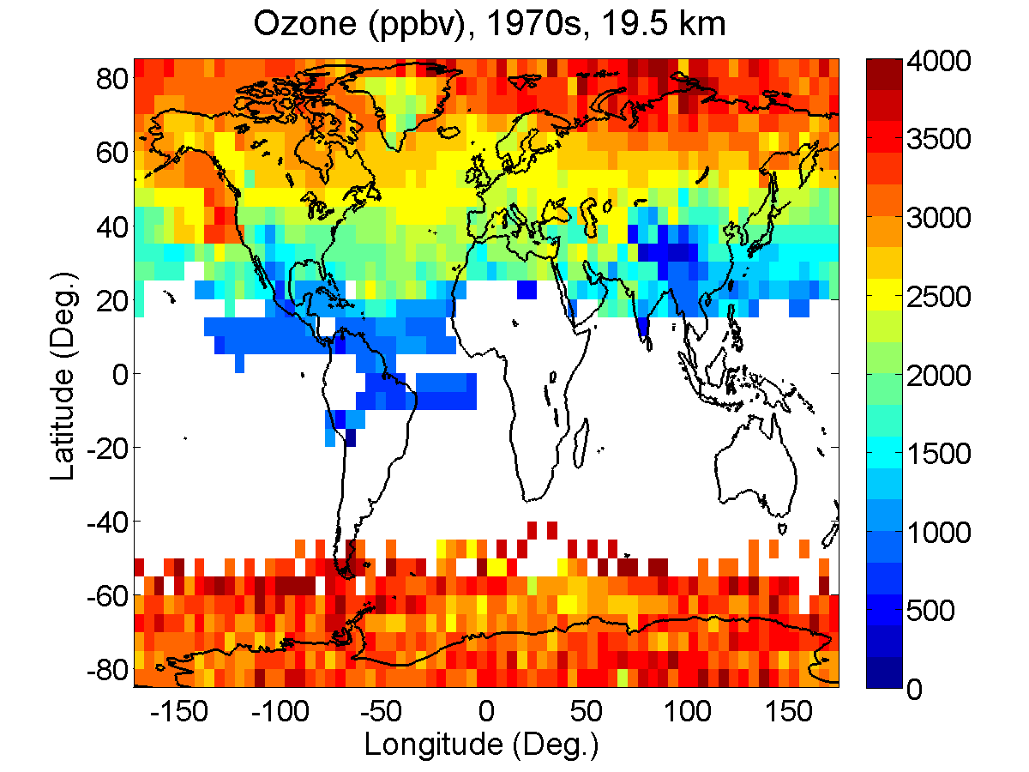
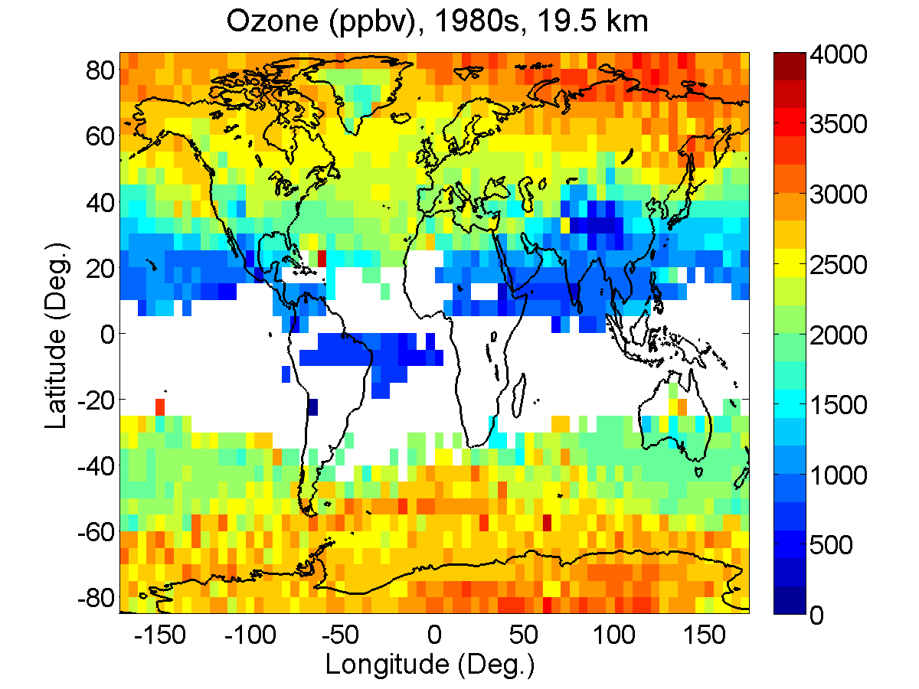
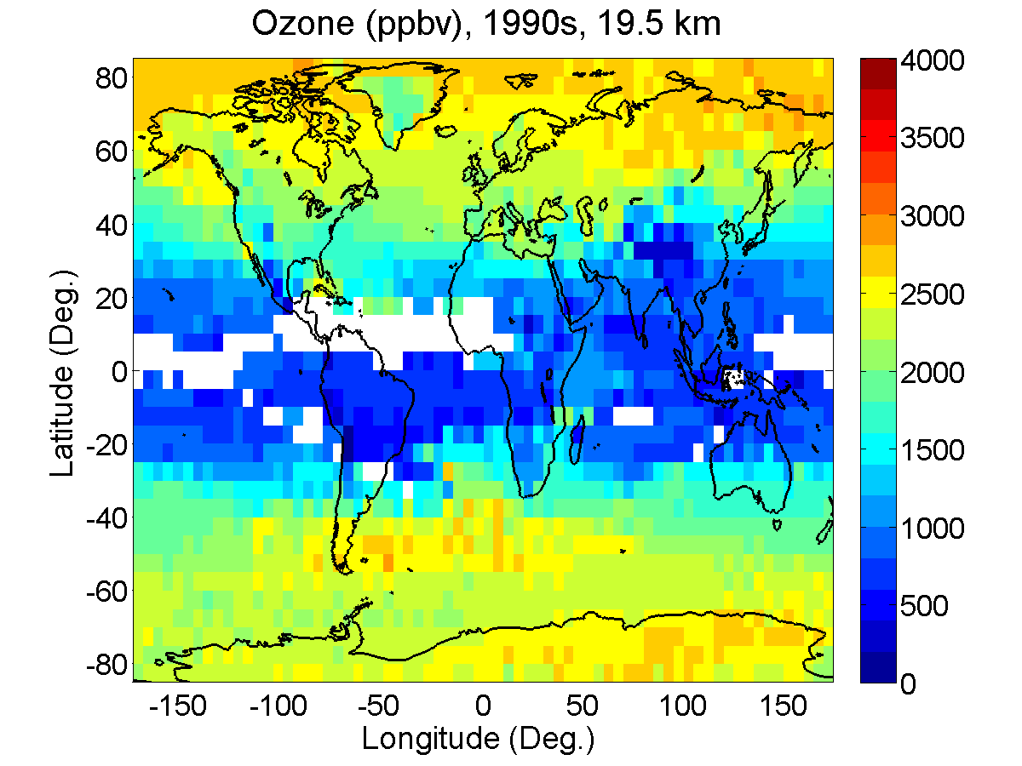
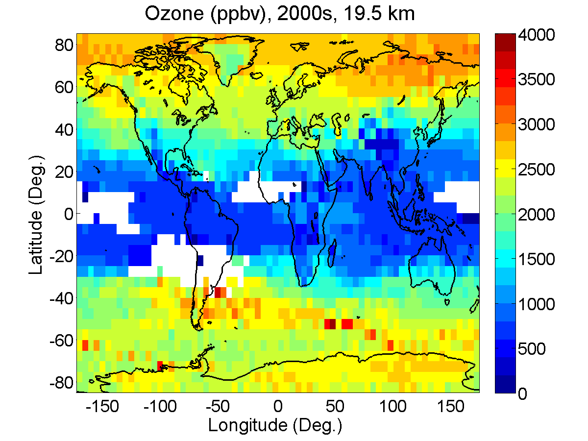
DECADAL VARIATIONS
(Liu et al., 2013)
7/14

Slide 9
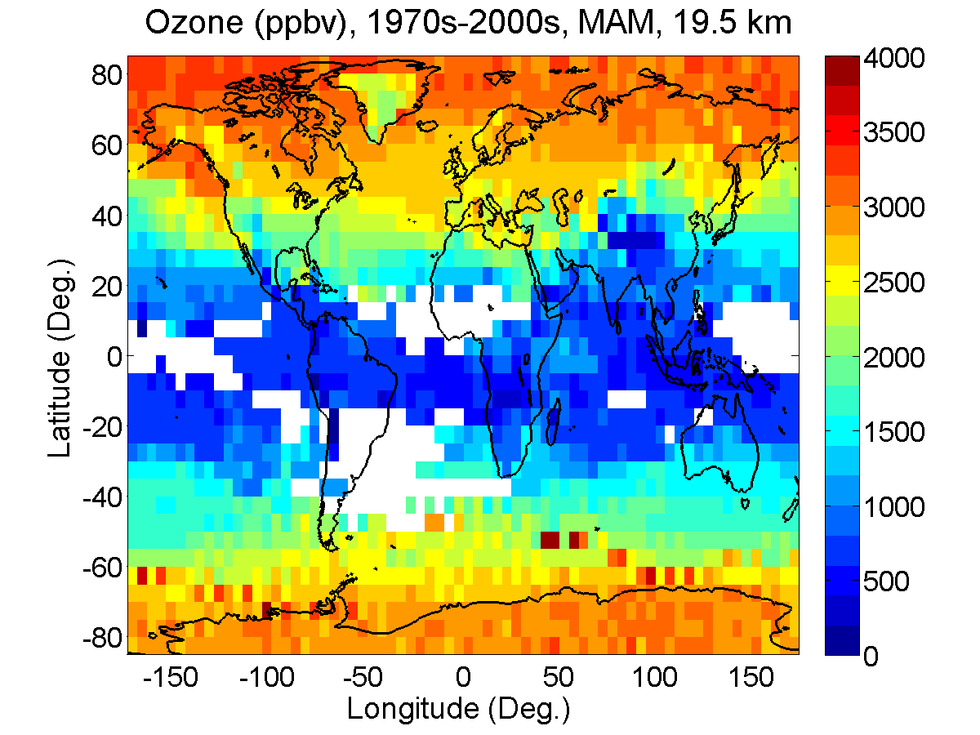
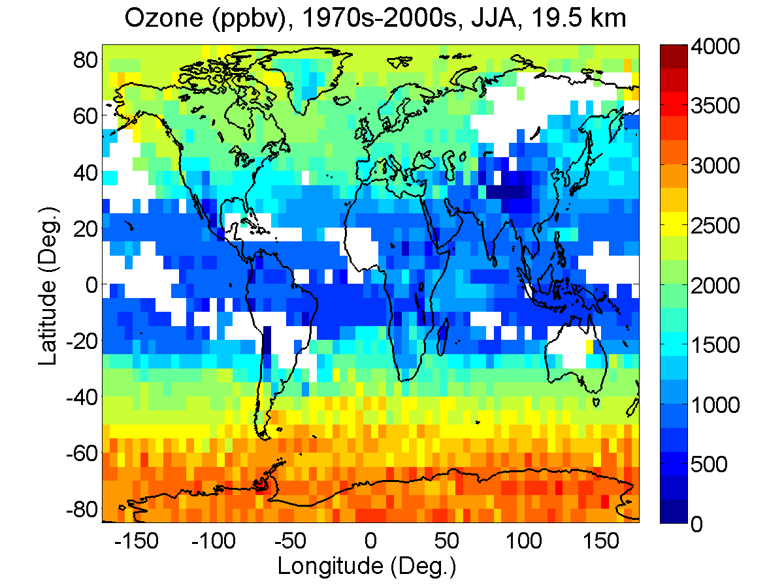
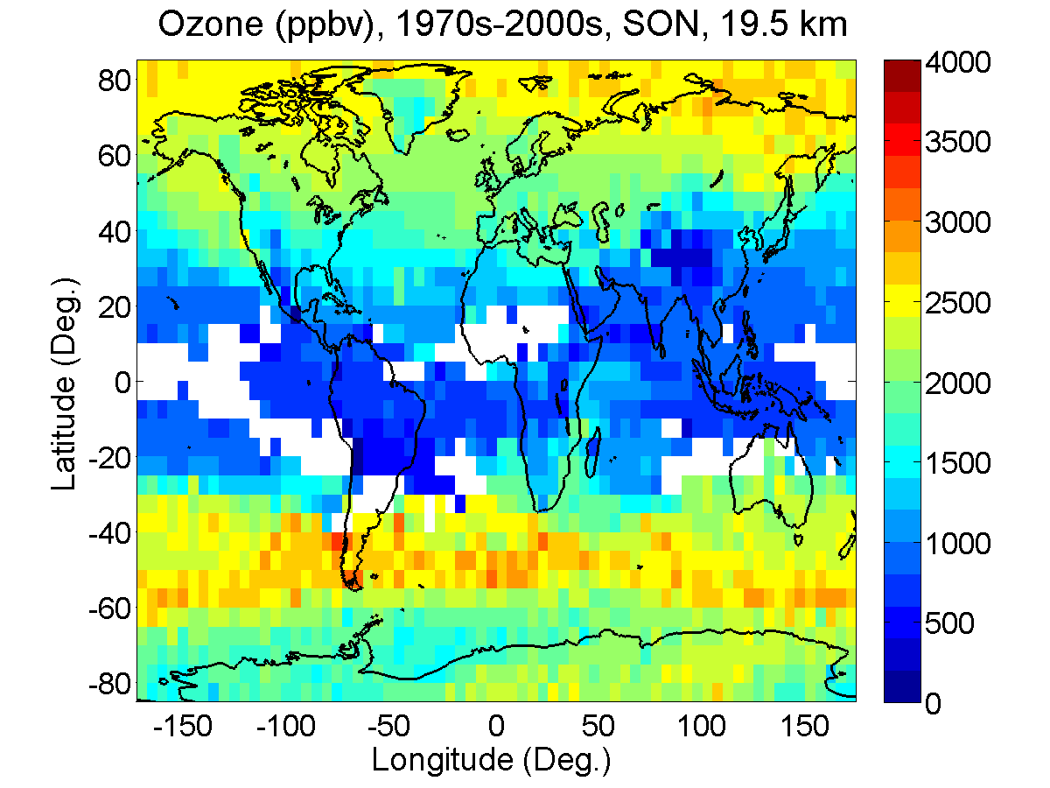
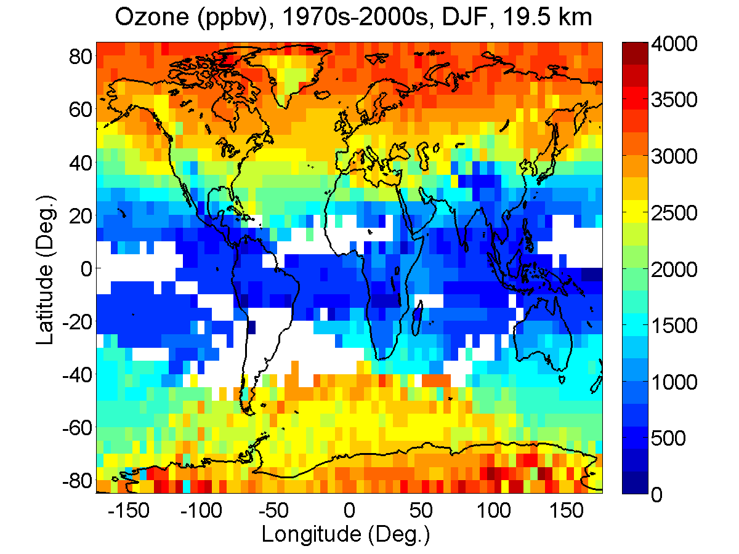
SEASONAL VARIATIONS
(Liu et al., 2013)
8/14

Slide 10
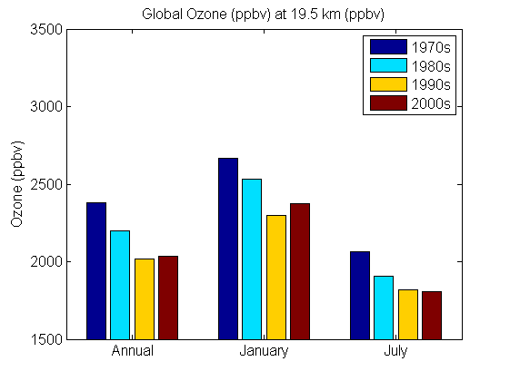
OZONE TRENDS IN THE STRATOSPHERE
9/14

Slide 11
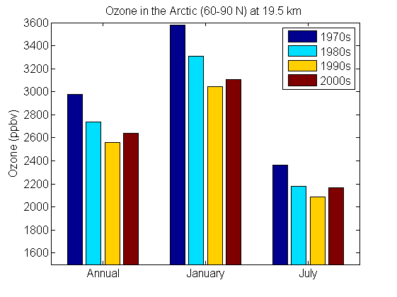
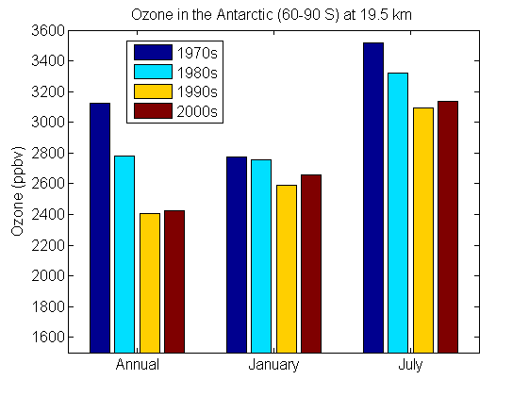
OZONE TRENDS IN THE POLAR REGIONS
10/14

Slide 12
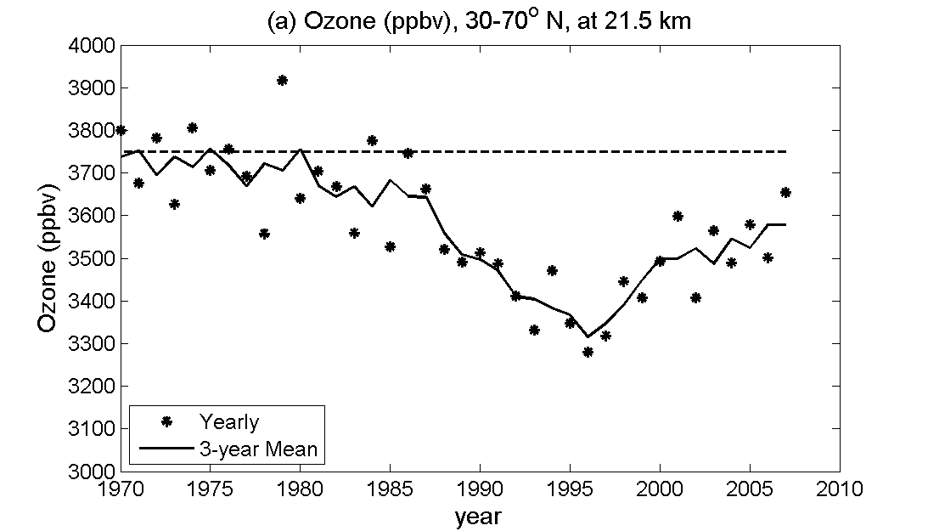
INTERANNUAL VARIATIONS
Liu et al. (2013)
11/14

Slide 13
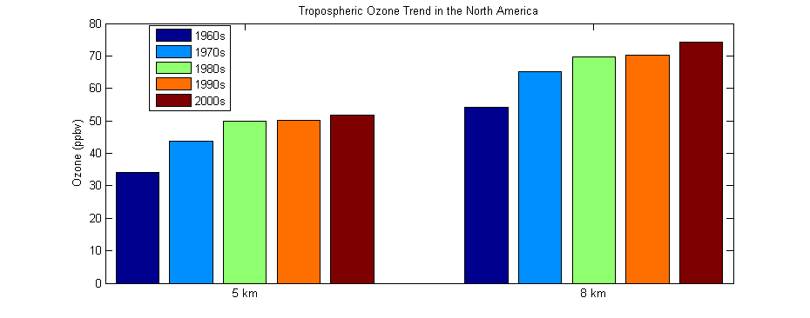
OZONE TRENDS OVER THE NORTH AMERICA
IN THE TROPOSPHERE
12/14

Slide 14
CONCLUSIONS
A new ozone climatology is generated based on the global ozonesonde and trajectory statistics.
This dataset is tested at selected stations using the ozone soundings at all the stations except one being tested. The two sets of profiles are in reasonable agreement.
The dataset reveals interesting features in stratospheric ozone distribution, decadal and seasonal variations.
The climatology clearly shows the depletion of ozone from the 1970s to the mid1990s and ozone increase in the 2000s in the lower stratosphere. The trends are more obviously in the respective winter season in the two hemispheres.
The ozone climatology suggests an increase trend in tropospheric ozone over North America.
13/14

Slide 15
Thank you
Contact: janejj.liu@utoronto.ca

