Slide 1


Development of Pluripotent Stem Cell-Based Therapies for Neurodegenerative Diseases and Cancer
Jane Lebkowski Ph.D.
Asterias Biotherapeutics Inc.
Manchester August 4, 2016

Slide 2
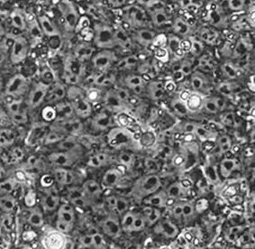

Human Embryonic Stem Cells: The Source Material
Any Cell Type Can Be Produced
Broad Therapeutic Utility
Differentiation of Therapeutic Cells
Pluripotency
Efficient Culture and Differentiation
Scalable Batch Production for Entire Product Life Cycle
Cryopreserved, Off-the-Shelf Distribution
Indefinite
Replicative
Capacity
Production Similar to Traditional Biologicals

Slide 3
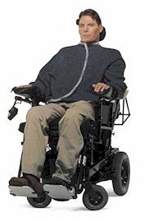
Spinal Cord Injury: Multiple Devastating
Life-Changing Effects
Loss of limb function
Impaired cardiovascular control
Impaired bowel and bladder control
Chronic neurgenic pain
Increase pain sensation
Decreased sexual function
Increased frequency of pressure sores
Urinary tract infections
Spasticity
Debilitating burning/tingling sensations

Slide 4
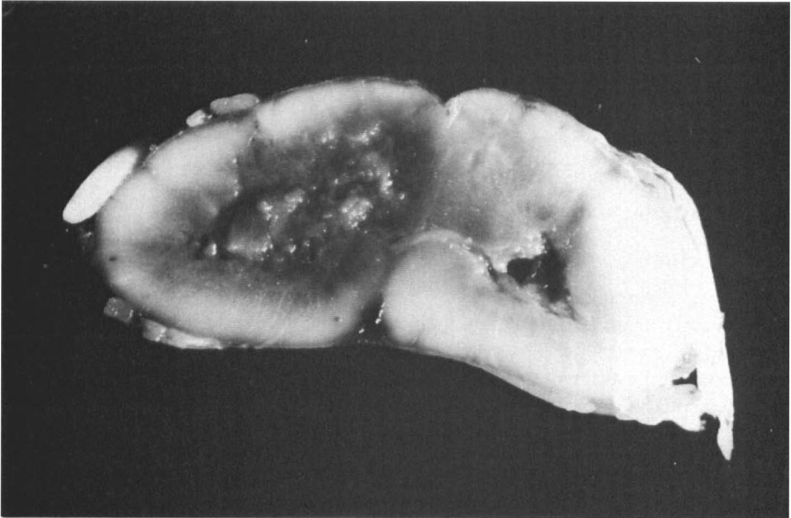
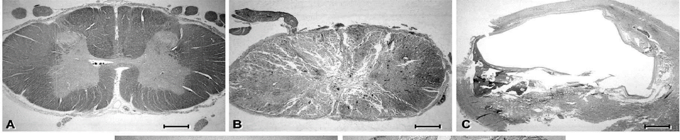
Human Spinal Cord Injury Causes Tissue Destruction and Ectopic Tissue Formation in the Spinal Cord
Trauma to the spinal cord causes hemorrhagic necrosis
Secondary damage includes cell death, cavity formation, demyelination, and scarring
Chronic stage: gray matter replaced by either a lesion cavity or collagenous scar
Typical spared rim of white matter
Cervical SCI at C5; 10 days post-injury
Kakulas, Paraplegia, 25:212-216, 1987
Normal Spinal Cord
Solid Cord Injury
Contusion Cavity
Norenberg et al., J. Neurotrauma, 21(4):429-440, 2004

Slide 5
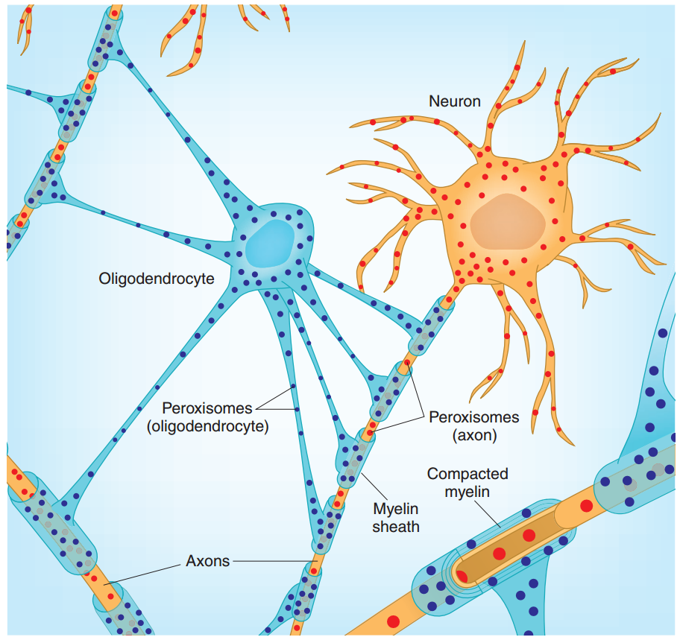
Rationale for Oligodendrocyte Progenitor Cells
Pathology of the lesion provides rationale for oligodendrocyte progenitor transplantation
Cavitation
Aubourg, P., Nature Genetics 2007
Obermair, Schröter and Thallmair, Physiology 2008

Slide 6
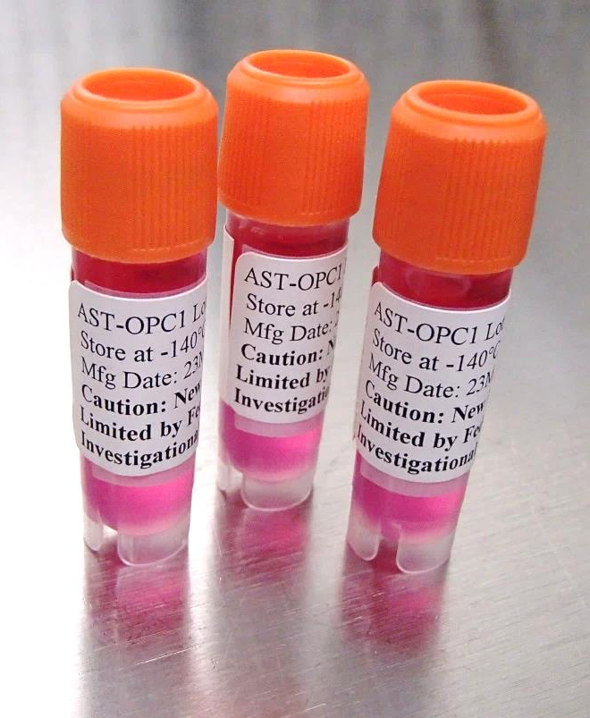
AST-OPC1: hESC-Derived Oligodendrocyte Progenitor Cells (OPCs)
AST-OPC1
Cryopreserved Allogeneic Cell Population
Derived from Human Embryonic Stem Cells (hESCs)
Characterized Composition of Cells:
  Oligodendrocyte progenitors
  Neural progenitors
  Infrequent mature neural cells and
  Rare other characterized cell types
“Off the shelf” administration
First indication: spinal cord injury
Potential line extensions in other neurodegenerative diseases

Slide 7
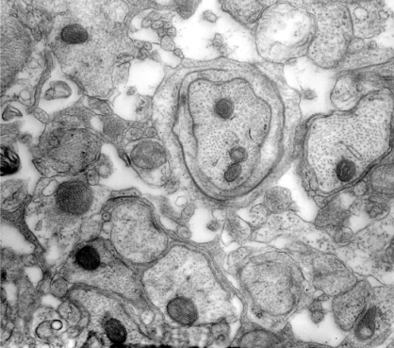

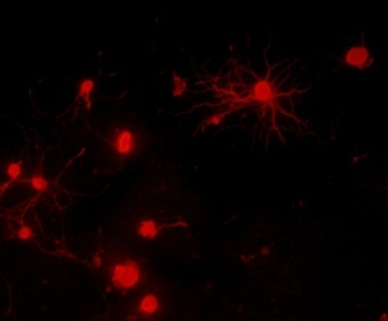
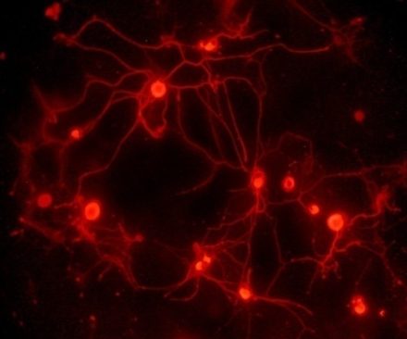
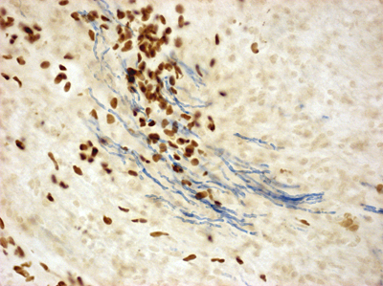
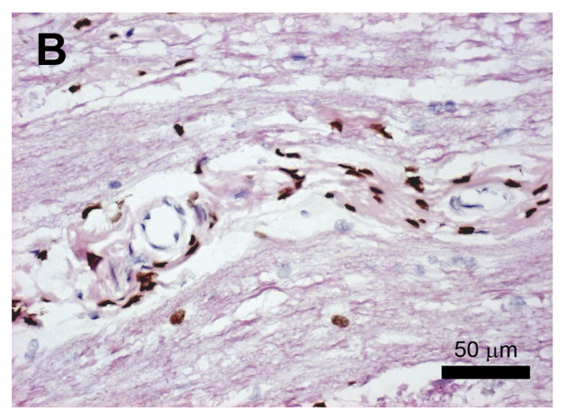

AST-OPC1:
Three Major Physiologically Relevant Functional Activities
1. Wraps host neurons
and forms compact myelin sheaths
2. Produces neurotrophic factors and stimulates neurite outgrowth
shiverer mouse
shi mouse + AST-OPC1
Control Media
AST-OPC1 CM
βTubIII
Promote increased neurite outgrowth
3. Stimulates neovascularization
Host Endothelial Cells
AST-OPC1
Rag2^{-/-} γc^{-/-} /shi mouse + AST-OPC1
Rat spinal cord 9 months post transplantation
Zhang et al Stem Cells and Development (2006) 15: 943; Manuscript in preparation

Slide 8
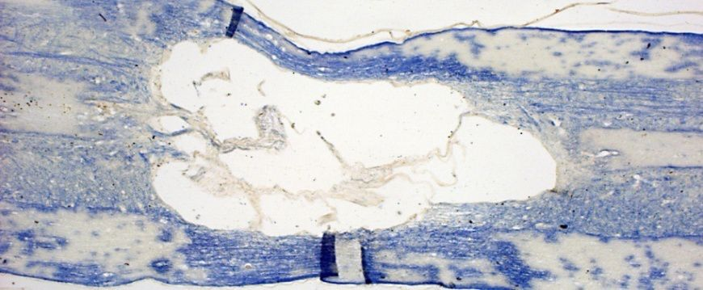
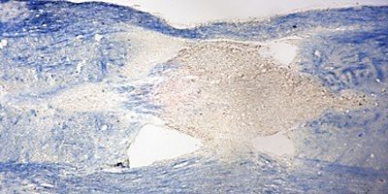
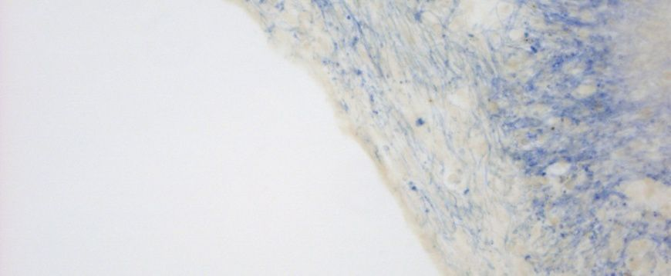
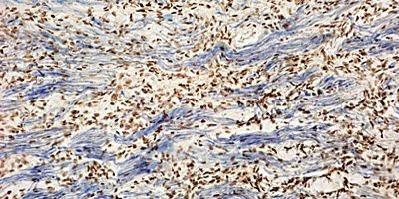
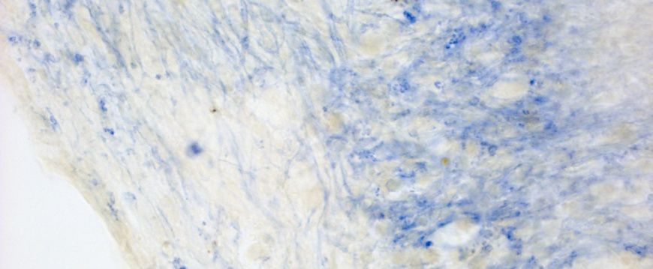
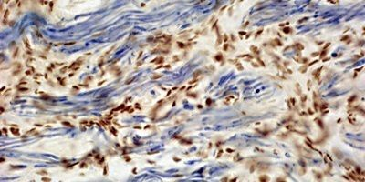
AST-OPC1 Reduces SCI Cavity Formation and Induces Persistent Myelination
Rat Thoracic Spinal Cord Injury Model
9 months vehicle
9 months post-transplant with AST-OPC1
hNuc
EC
hNuc
EC
AST-OPC1 in SCI Lesion; Significantly Reduced Cavity Formation
Cavity forms in untreated SCI lesion
1 mm
1 mm
Robust AST-OPC1 survival (brown)
Myelinated Fibers (blue)
100 µm
100 µm
Myelinated axons do not extend across cavity
50 µm
50 µm
Brown: antibody to human nuclear antigen labels AST-OPC1; Blue: Eriochrome Cyanine stains myelin

Slide 9
Safety/Efficacy Profile of AST-OPC1 in Nonclinical Studies
28 Animal Studies
>3000 Rodents and Pigs
Survives in the Spinal Cord
Predominantly Neural Cell Types
Greatest Activity in Subacute Injury
Improves Locomotor Activity
Reduces Parenchymal Cavitation
Active Doses Established
Migrates Up 5cm in Spinal Cord
No Distribution Outside CNS
Does Not Increase Mortality
Does Not Induce Allodynia
Does Not Induce Systemic Toxicity
Does Not Produce Teratomas
Produces Low Frequency (1-2%) Small Ectopic Tissue at Injury Site
Not Highly Susceptible to Direct Immune Responses
  Activity/ Efficacy
  Biodistribution
  Dosing/Delivery
  Toxicity
  Tumorigenicity
  Ectopic Tissue
  Immune Rejection

Slide 10
Phase 1 Safety Study in Complete Thoracic SCI:
Major Design Considerations
Specifics
Rationale
Patient Population
Neurologically complete (AIS A), thoracic (T3-T11) SCI
7-14 days post-injury
Minimize risk of ascending injuries
Post-inflammatory, prior to onset of glial scar
Dose
FDA requirement (start with absolute cell dose tested in tumorigenicity studies)
2 million cells
Delivery
Custom “syringe positioning device”
Minimize risk of injection procedure
Immuno-
suppression
Low allogenicity of OPC1
Minimize IS risk in vulnerable SCI patients
Short term (60 d) low dose tacrolimus
Follow-up
Frequent MRIs and Neurological Exams
Extensive immune monitoring
Long term (5 yr in person, 15 yr total)
Monitor safety
Evaluate IS regimen
Long term safety data

Slide 11
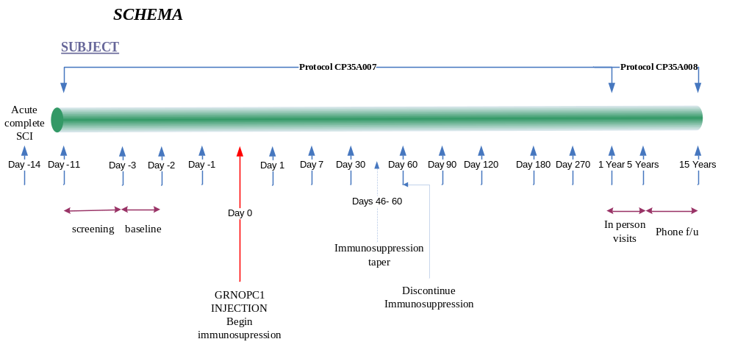
SCI Phase 1 Study Schema
AST-OPC1
Phase 1 Thoracic Trial Study Schema
MRI
MRI
MRI
MRI
MRI
MRI
MRI
MRI
MRI
MRI

Slide 12
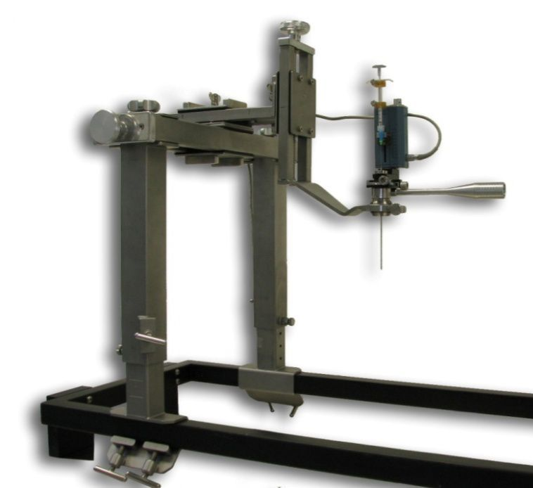
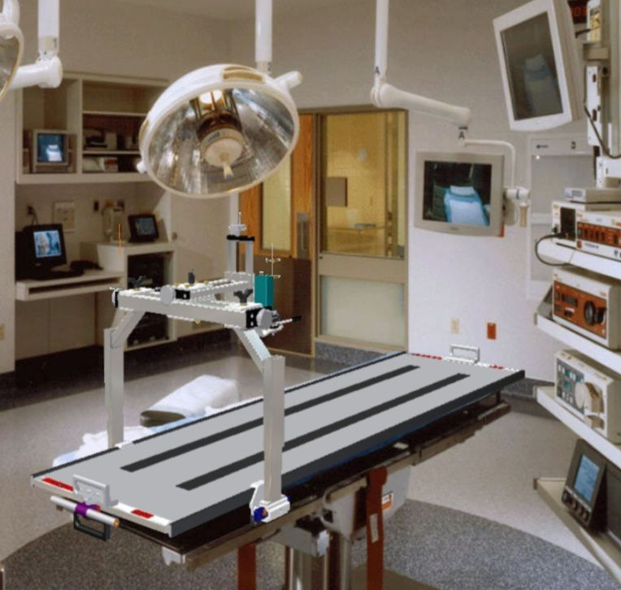
Delivery of AST-OPC1: Elective Surgical Delivery
Delivery
2x10⁶ AST-OPC1
50 uL Injection
5mm Caudal of Injury Epicenter
Injection Performed Using Syringe Positioning Device
  Support Frame
  Microdrive
  Syringe and Needle

Slide 13





AST-OPC1: Subject Demographics
Demographic and Baseline Disease Characteristics – All Treated Subjects
Age (years) | Sex | Level of Injury | Cause of Injury
21 | Male | T6 | Motor vehicle accident
23 | Male | T8 | Restrained driver in rollover motor vehicle collision with ejection
32 | Male | T6 | Motorcross
31 | Male | T7 | Fell 30 feet down rock embankment
23 | Female | T3 | Car accident
Enrolling Sites
Dr. David Apple
Dr. Richard Fessler
Dr. David Chen
Dr. Gary Steinberg
Dr. Steve McKenna

Slide 14
Summary of Findings from First in Human Study of AST-OPC1
All 5 Patients Now Followed for > 4 Years
Well Tolerated
AST-OPC1 well tolerated, with no SAEs to date deemed related to the cells, delivery method, or immunosuppressive regimen
No evidence of immune responses to AST-OPC1, even 10 months after removal of all immunosuppression
Despite significant HLA mismatches between AST-OPC1 and subjects
Suggests low dose, transient immunosuppressive regimen may be sufficient to enable long term engraftment of cells
MRI results consistent with activity at injection site in 4 of 5 subjects
No evidence of significant changes in neurological function
No evidence for ascending loss of function from cells or delivery
Efficacy not anticipated in this study due to low dose (5-10x below predicted efficacious range) and suboptimal patient population (complete thoracic injuries)
No Immune Responses
Engraftment
No Changes Neurological Function

Slide 15
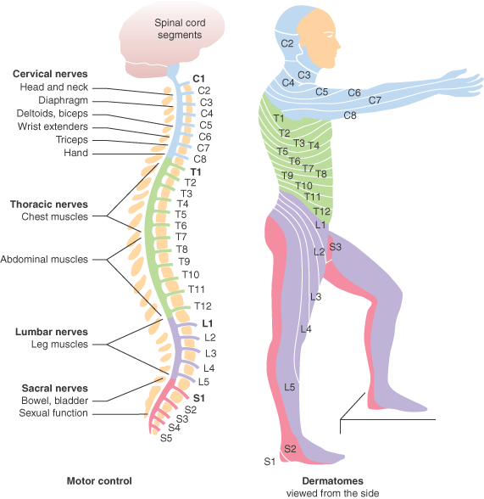
AST-OPC1: Scientific Rationale for Evaluation in Cervical SCI Patients
Repair/regeneration of axons only required over a short distance to reinnervate motor neurons for arms & hands
Better Outcome Measures for Cervical Spinal Cord Injury

Slide 16
AST-OPC1 Clinical Development Plan in Complete Cervical SCI
Confirm low-dose safety in cervical SCI
Confirm mid-dose safety
Efficacy readouts at 6m & 12m
Confirm high-dose safety
Efficacy readouts at 6m & 12m
Cohort 1
3 subjects with C5-C7 cervical SCI
Dose 2x10⁶ AST-OPC1
Cohort 2
5 subjects with C5-C7 cervical SCI
Dose 1x10⁷ AST-OPC1
Cohort 3
5 subjects with C5-C7 cervical SCI
Dose 2x10⁷ AST-OPC1
Dose
Escalation
Dose Escalation
Objectives of Trial
Establish safety of AST-OPC1 in cervical sensorimotor complete SCI
Assess effects on upper extremity motor function
Investigate effects on additional measures of neurological function

Slide 17





Cervical Phase 1/2a Clinical Trial: Enrolling Sites To Date
Enrolling Sites
Dr. Donald Leslie
Dr. Richard Fessler
Dr. Gary Steinberg
Dr. Steve McKenna
Dr. Charles Liu
Dr. Shekar Kurpad
Dr. Eric Horn

Slide 18
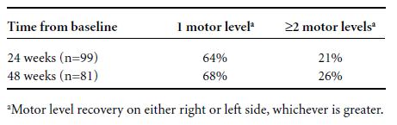
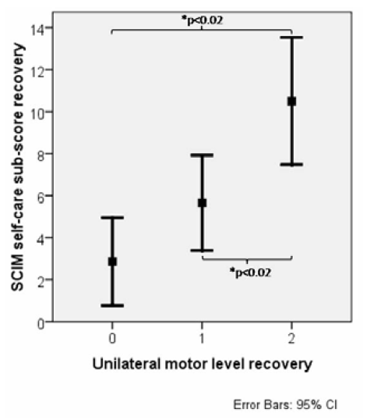
Work of the SCOPE Consortium Has Defined Clinical Development Path in Complete Cervical Spinal Cord Injury
Few complete cervical SCI patients recover >= 2 motor levels with current standard of care
Recovery of ≥2 motor levels leads to significant improvement in self-care ability
Self-care ability could be a clinically meaningful endpoint for a pivotal trial and BLA approval
Analysis by SCOPE (Spinal Cord Outcomes Partnership Endeavor)
Steeves et al., 2012. Top Spinal Cord Inj Rehabil 18:1-14

Slide 19
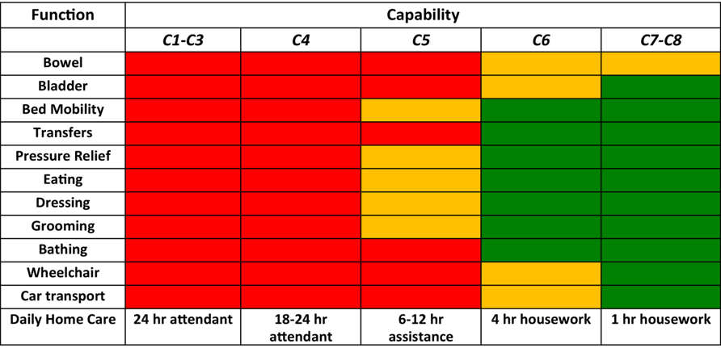

Improvements of Two or More Motor Levels on the ISNCSCI Exam Translate to Highly Significant Improvements in Patients’ Ability to Self-Care
total assist
partial assist
independent
Improvements of two of more motor levels of function translate to:
Clinically significant improvements in ability to self-care
Significant reductions in cost of care
Steeves et al., Top Spinal Cord Inj Rehabil 2012; 18(1): 1-14

Slide 20
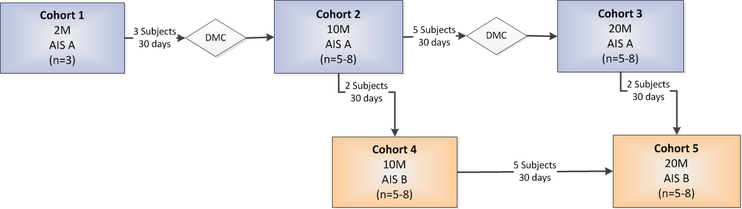
AST-OPC1 Expanded Study Schema
6 and 12 Month Efficacy Endpoints
AIS – ASIA Impairment Scale

Slide 21
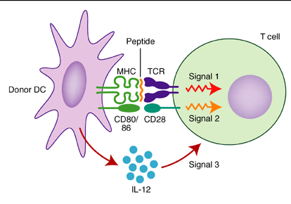
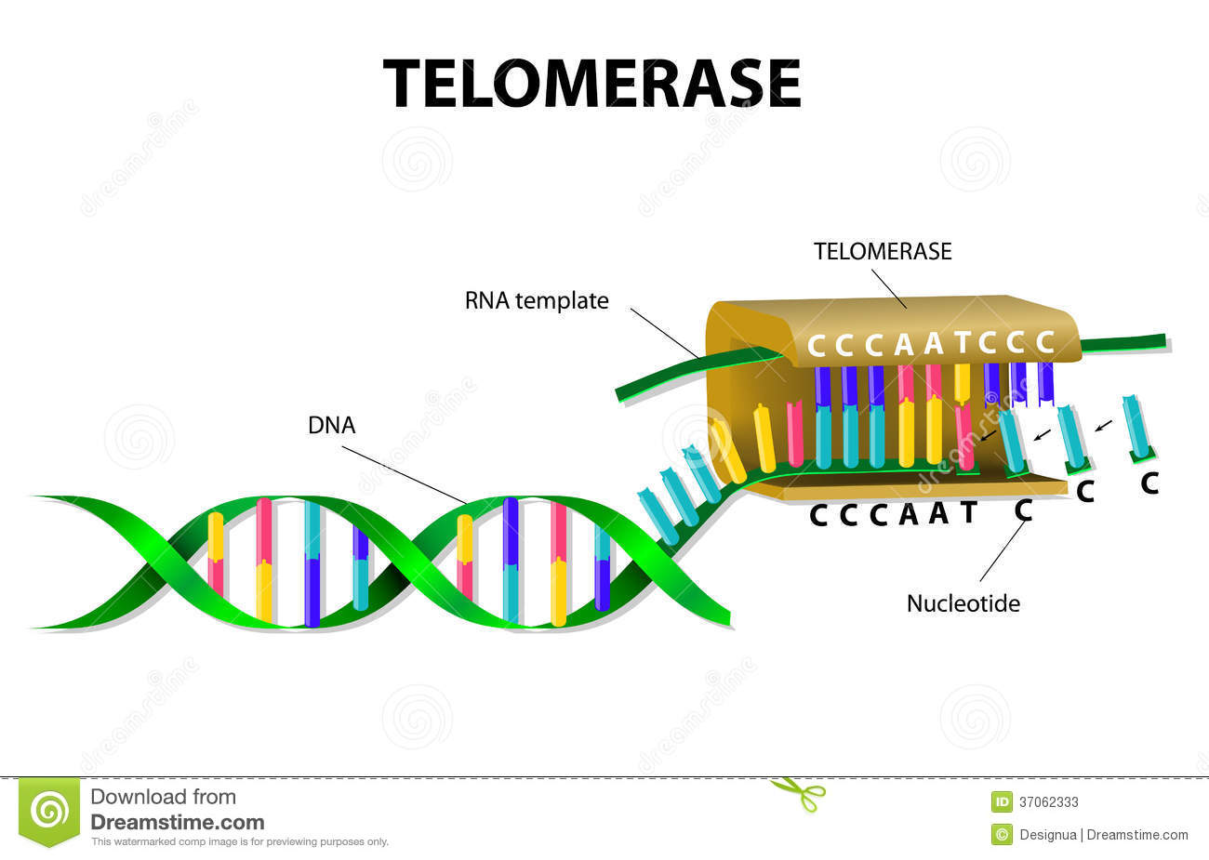
AST-VAC2: hESC-derived Dendritic Cells Pulsed with hTERT mRNA
Dendritic Cells:
Potent Antigen Presenting Cells
Telomerase:
“Universal” Tumor Antigen
AST-VAC2 is an immunotherapeutic product that comprises mature DC transfected with mRNA encoding hTERT and the lysosomal targeting signal, LAMP (4,5) - enhances immunostimulatory capacity
Objective: Stimulate Anti-Tumor Immune Responses in Patients

Slide 22
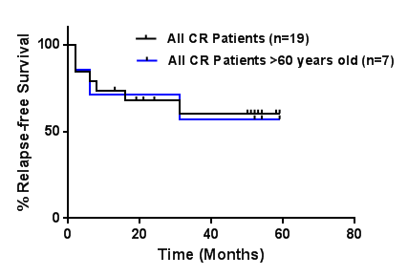
Long-term Relapse Status: Greater Than 50% Of Patients Relapse-free at Median Follow-up 52 Months
Favorable Outcome Compared to Historical Data Especially in Patients
Over 60 years old where 5 year relapse-free survival <10%
 | Long-term Follow-up (2013-2014)
 | % Patients Relapse-free*** | Median (Range) Follow-up (mos) | Relapse-free Patients with hTERT specific T cell responses
All Patients in CR | 11/19* (58%) | 52 (13-59) | 7/11 (64%)
Patients in CR2 | 3/3** (100%) | 50 (24-59) | 2/3 (67%)
Patients >60 years old | 4#/7 (57%) | 54 (52-59) | 4/4 (100%)
*five patients lost to long-term follow-up or relapse data unavailable
**One patient lost to long-term follow-up at 24 months
# One patient Received nilotinib during vaccination period for a secondary Philadelphia chromosome positive abnormality observed in first relapse which was not observed in the vaccination period

Slide 23
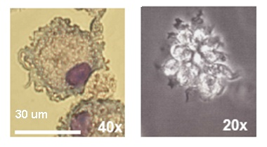
Properties of AST-VAC2
Mature DC Phenotype
Impurities Rare
Activates Allogeneic T Cells
Migrates in Response to Chemokine Stimulation
Stimulates Th1 Cytokine Production
Can Present Antigen Delivered in mRNA, Peptide or Protein Form
Stimulates Class I and II Antigen- Specific T Cells
Primes and Stimulates Naïve Ag Restricted T Cells Even with Only a Single MHC Antigen Match
Cryopreservation and Irradiation Without Alteration of DC Function Feasible
Tseng et al, Regen Med. 2009; 4(4): 513-526

Slide 24

CRUK Partnership to Advance AST-VAC2 Trial in NSCLC
Asterias Has Partnership with Cancer Research UK (CRUK) to Support a Clinical Trial of AST-VAC2 in Non-small Cell Lung Cancer
Asterias performs scale-up and tech-transfer of AST-VAC2 manufacturing process
CRUK provides:
  cGMP manufacture of clinical grade AST-VAC2
  Preparation and filing of regulatory dossier
  24 patient Phase 1/2a trial in non-small cell lung cancer (NSCLC)

Slide 25


Acknowledgements
Funding
Asterias Team
Clinical Advisors
and Investigators
Ed Wirth
Maria Schaefer
Naomi Kautz
Kevin Nishimoto
Madelyn Marino
Rekha Nair
Sherry Hikita
Nate Manley
Casey Case
Sherin Halfon
Dianne Fishwild
Sandra Powell
Jennifer Lin
Katy Spink
Richard Fessler
David Chen
Steve McKenna
Gary Steinberg
David Apple
John Steeves
Dan Lammertse
Adam Flanders
Data Monitoring
Committee
Steering Committee
Geron Team
Linda Jones
Anthony Davies
Kirk Trisler
Sean Cullen
Jerrod Denham
Cathy Priest
Ross Okamura
Anita Reddy

Slide 26

Acknowledgements
Investigators: AST-VAC1
H. Jean Khoury: Emory
Robert Collins: UTSW
William Blum: Ohio State
Patrick Stiff: Loyola
John DiPersio: Washington U
Sponsor
Kevin Nishimoto
Edward Wirth
Anita Reddy
Laurence Elias
Sponsor
Kevin Nishimoto
Rashi Srivastava
Erik Whiteley
Jennifer Lin
Dianne Fishwild
Elham Yeganeh
Investigator: AST-VAC2
Christian Ottensmeier: U Southampton

