Slide 1
Intra-Urban Variation in Air Pollution – Implications for Nutritional Interventions
Jane E. Clougherty, MSc, ScD
Assistant Professor/ Director of Exposure Science
University of Pittsburgh Graduate School of Public Health
Department of Environmental and Occupational Health
Nutrition & Food Sciences Congress Valencia, 23-25 Sept 2014

Slide 2
Motivation
Ambient fine particulate air pollution (PM_{2.5}) has been associated with respiratory and cardiovascular disease, lung cancer, and reduced life expectancy (Pope et al, 2011).
Health effects of air pollution vary spatially within urban areas
  by chemical composition (Bell, 2009)
  and population susceptibility (Jerrett et al, 2005).

Slide 3
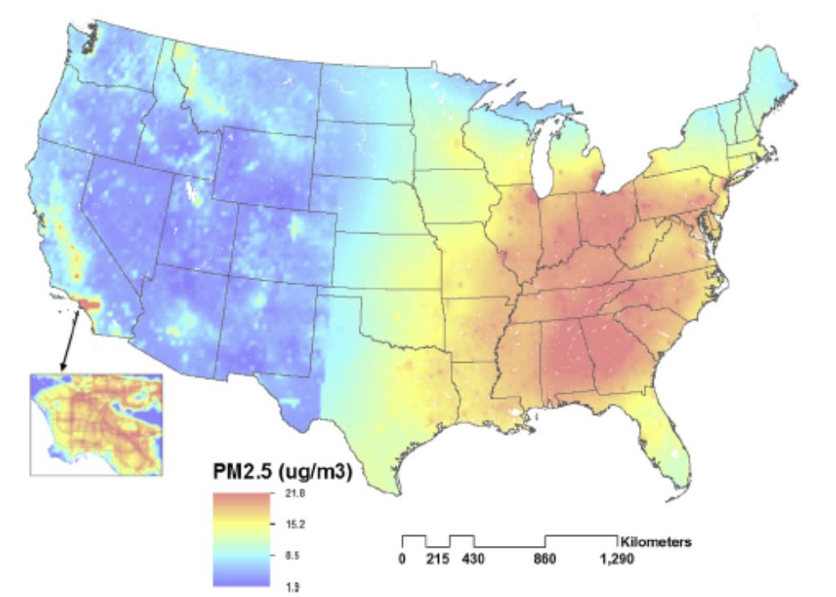
PM_{2.5} exposures vary across regions…
Sampson et al., A regionalized national universal kriging model using Partial Least Squares regression for estimating annual PM_{2.5} concentrations in
epidemiology, Atmospheric Environment 2013

Slide 4
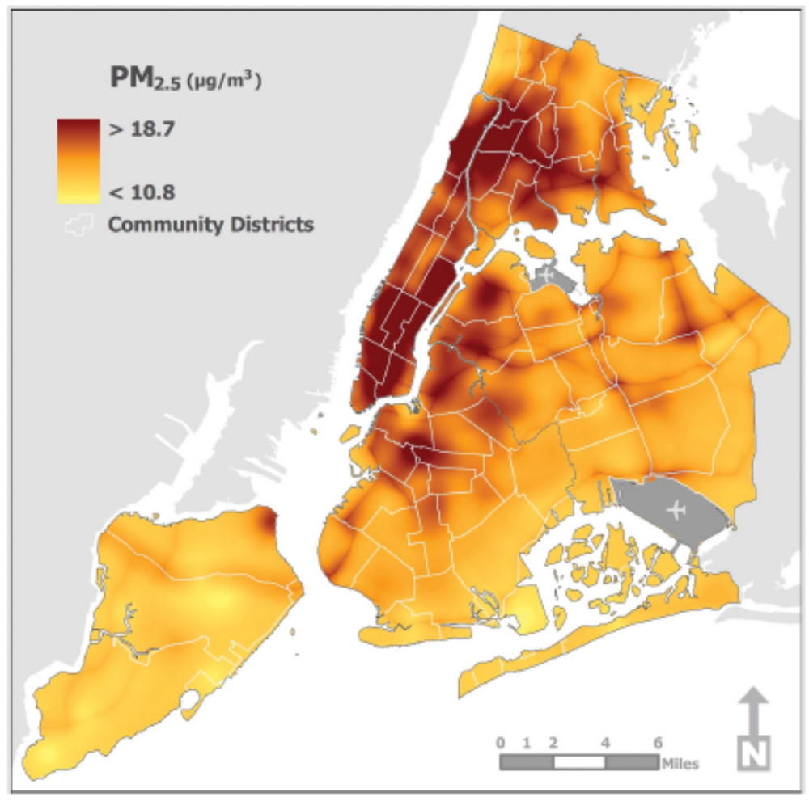
And within urban areas…
Clougherty et al., Intra-urban spatial variability in wintertime street-level concentrations of multiple combustion-related air pollutants: the New York City Community Air Survey (NYCCAS), J Expos Sci Environ Epidem 2013

Slide 5
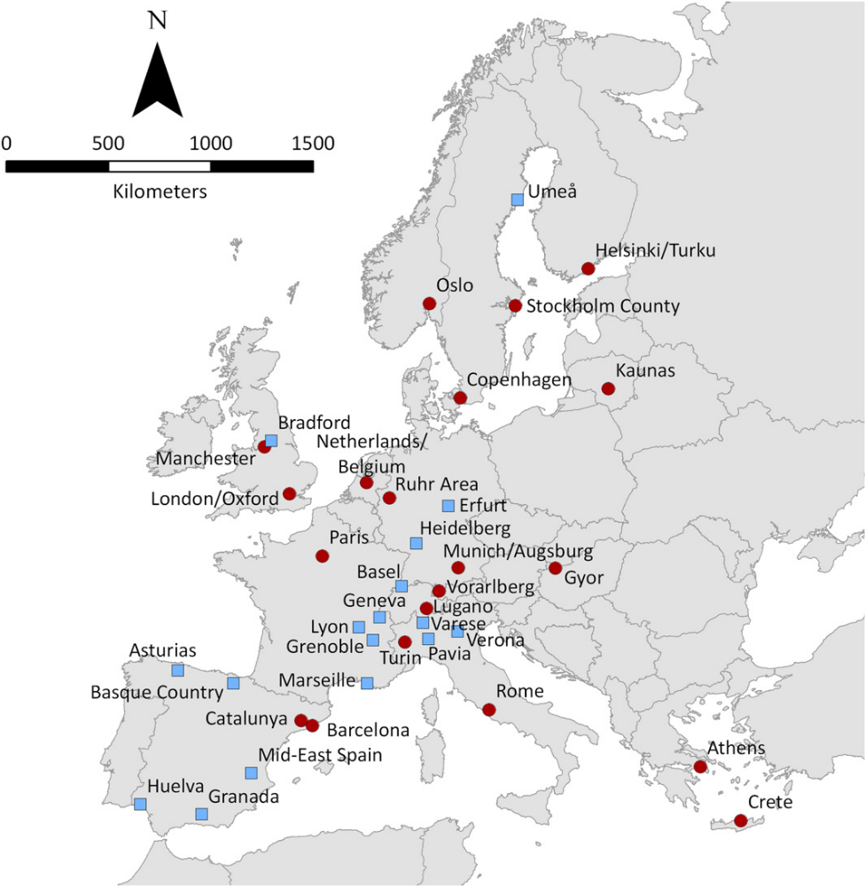

European Study of Cohorts for Air Pollution Effects (ESCAPE)

Slide 6
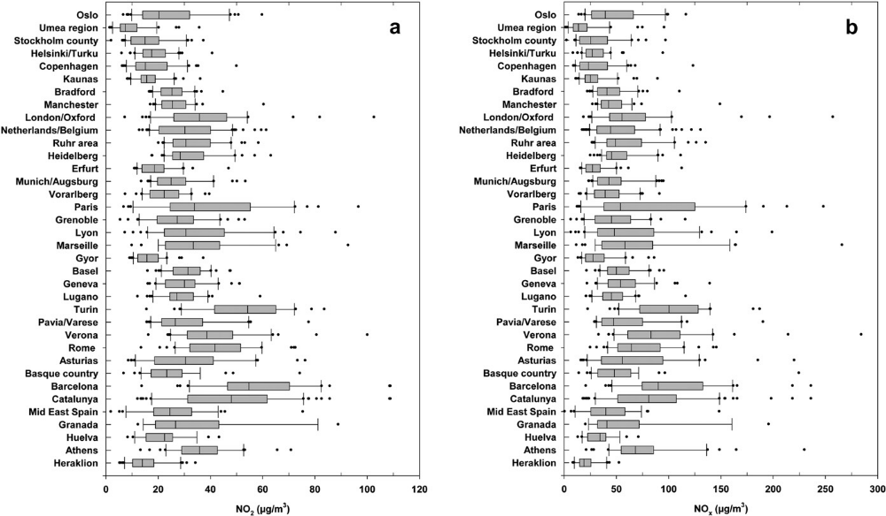
Pollutant concentrations vary within and between European cities
Cyrys et at, Atmos Env 2012

Slide 7
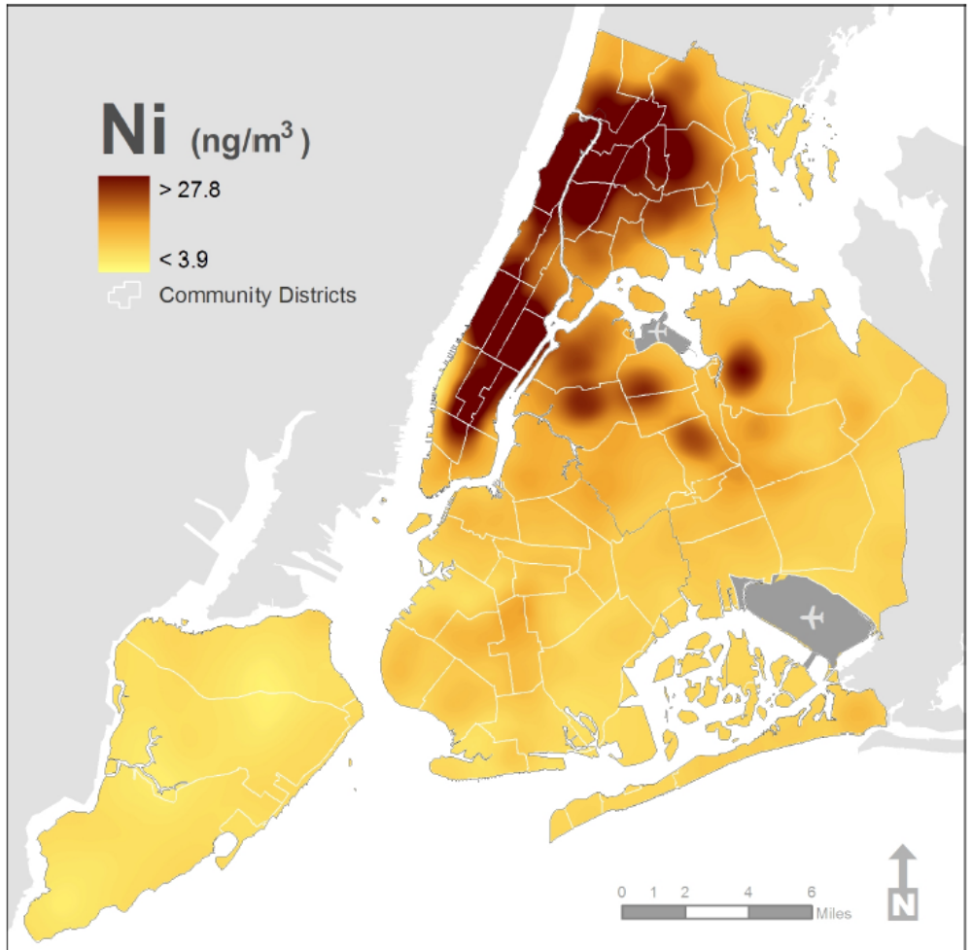
Importantly, PM_{2.5} composition also varies within cities…
http://www.nyc.gov/html/doh/downloads/pdf/eode/nyccas-ni-report0510.pdf

Slide 8
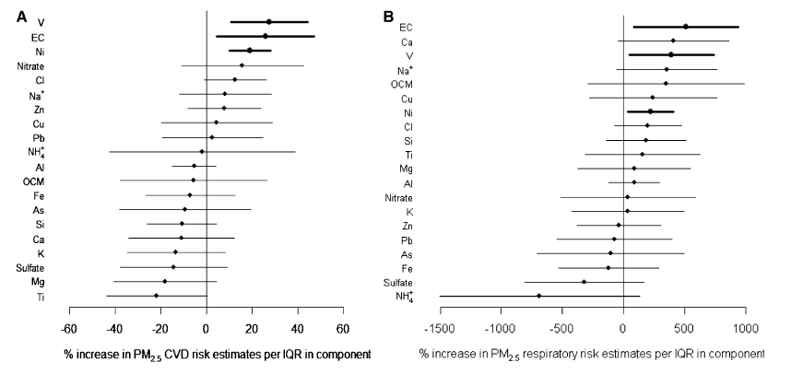
And PM components can differently impact health.
Bell et al, 2009

Slide 9
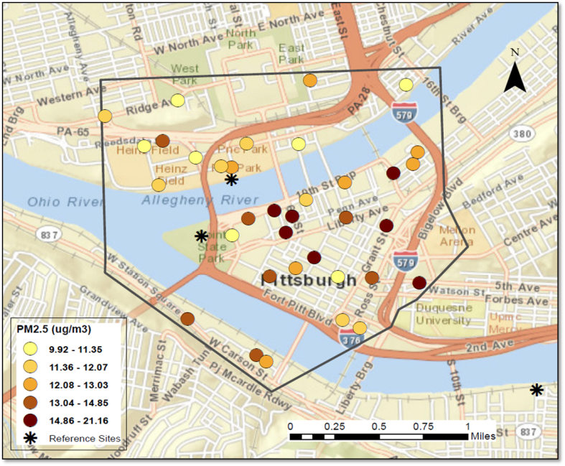
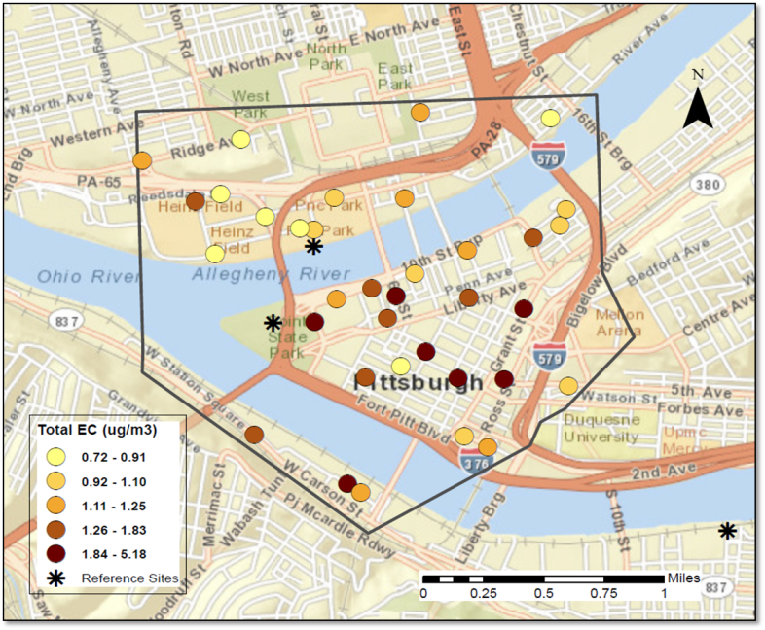
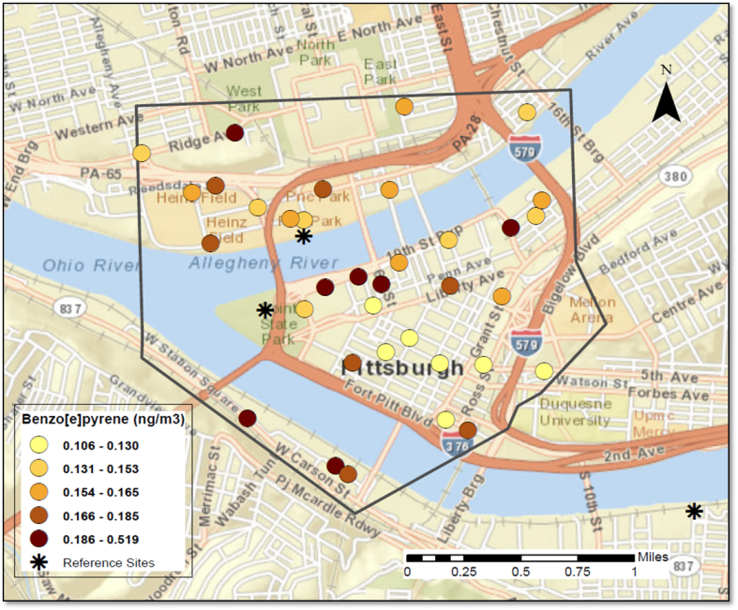
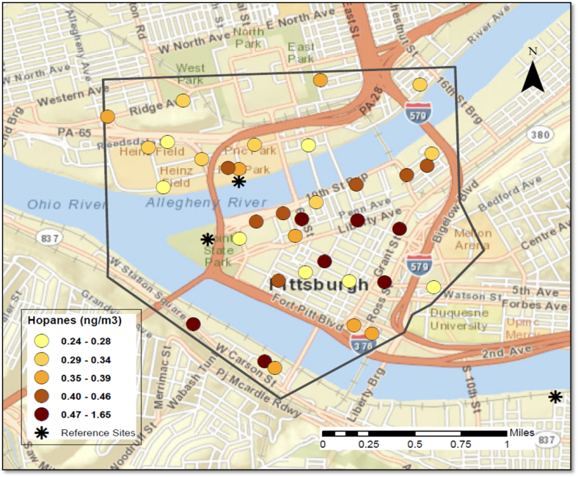
Chemical composition can vary even within small urban areas…

Slide 10
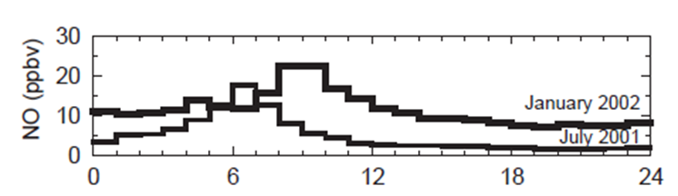
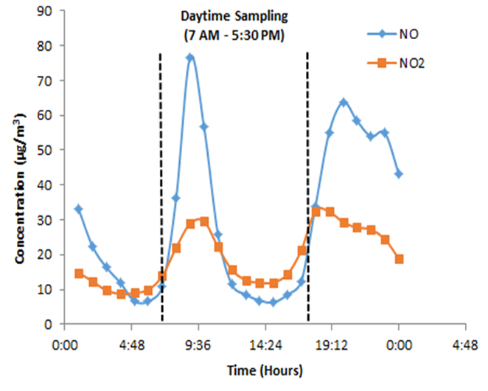
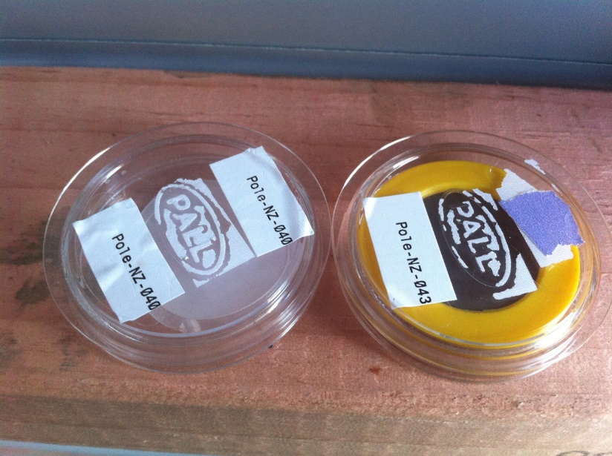
Concentrations and composition can vary by time of day and season
Christchurch, New Zealand
Pittsburgh, PA USA

Slide 11
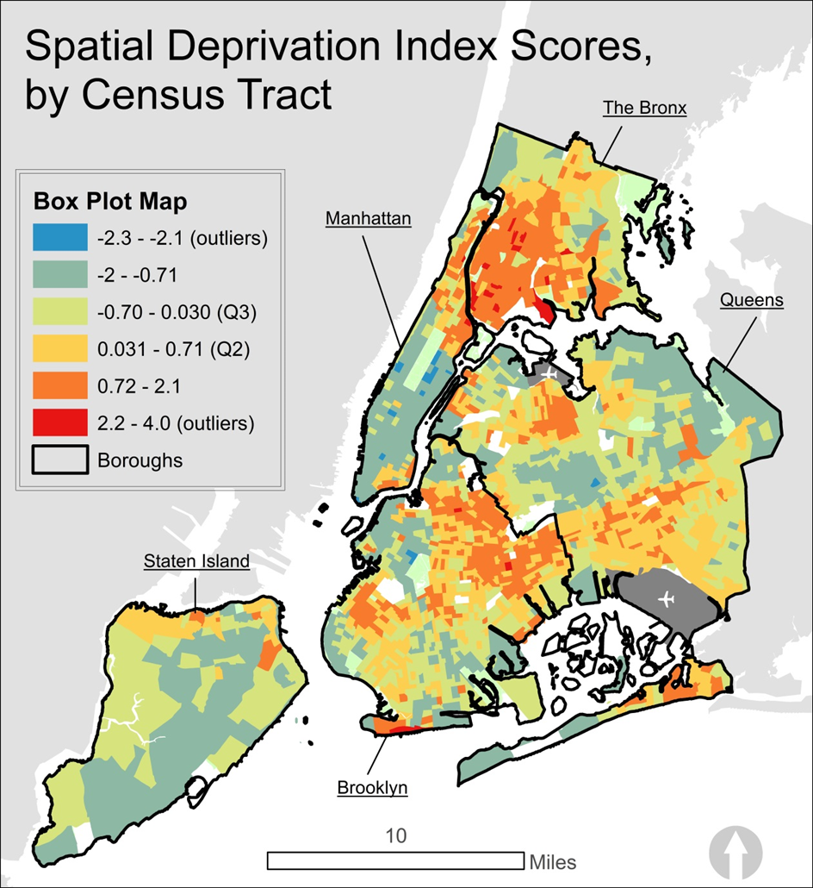
and then there in spatial patterning in susceptibility within cities…
Carr Shmool et al., forthcoming

Slide 12
Why does this matter for understanding air pollution health effects??…
Epidemiologic evidence of greater pollution susceptibility among lower-SEP populations. (Krewski et al., 2000; Jerrett et al., 2004)
  Have not identified “causal components” of SEP.
  Chronic stress may be one important contributor.
  (Clougherty et al., 2006, 2007; Chen et al., 2008)
Stressors (e.g., traffic-related noise) spatially correlated with pollution (e.g., traffic-related air pollution)
  Complicating, confounding the epidemiology
Chronic stress confers broad physiologic changes, known as allostatic load (McEwen 1998)
  HPA-axis function (e.g., cortisol)
  Glucocorticoid receptor alteration
  Sympathetic-adrenal-medullary (SAM) axis
  Early life immune function (e.g., Th-1/Th-2)

Slide 13
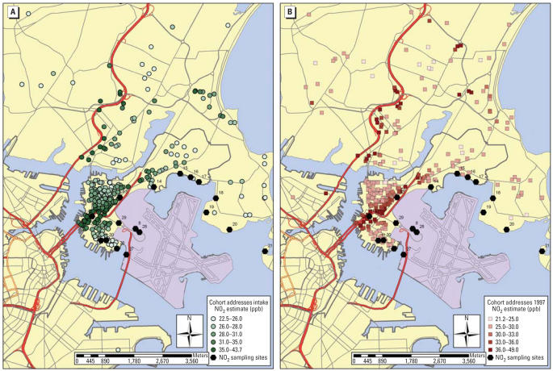
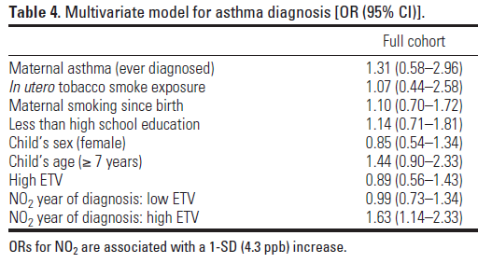
Clougherty JE, et al Environ Health Perspect. 2007 Aug;115(8):1140-6.

Slide 14
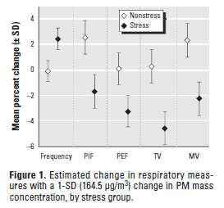

Toxicological results suggest stress-differing respiratory response to PM
Clougherty et al., EHP, 2010

Slide 15
Possible implications for nutritional interventions
May need better understand pollutant mix/ PM_{2.5} chemical composition in target areas
  And susceptibility patterns
Key outcomes to start with?
  Asthma/ respiratory disease? Cardiovascular?
Likely need target pathways impacted by multiple pollutants/ stressors
  e.g., inflammation
Need think about both spatial variation, timing of exposures, and physiologic impacts

Slide 16
Acknowledgements
DSM
  Manfred Eggersdorfer
  Celine Zuber
Funding:
  Allegheny County Health Department (ACHD) 138884
  US EPA RD-83457601
  NIH 1 R01 HL114536-01
  NIH R 21 ES021429-01
  NIH 5 R01 ES19955-3
Collaborators:
  Fernando Holguin, UPMC
  Harvard School of Public Health
  NYC Department of Health & Mental Hygiene
Clougherty lab:
  Leah Cambal
  Jessie Carr, MS
  Lauren Chubb
  Sara Gillooly
  Ellen Kinnee
  Drew Michanowicz, MPH
  Courtney Roper
  R. Tyler Rubright
  Sheila Tripathy
  Brett Tunno, MPH DrPH
  Jiang Zhou, PhD

Slide 17
Thank you very much
Jane E. Clougherty, MSc, ScD
Assistant Professor/ Director of Exposure Science
University of Pittsburgh
Graduate School of Public Health
Pittsburgh, PA USA
jcloughe@pitt.edu
412-624-7494

