Slide 1
Aneurysm mediated release of thrombin into the aqueous humor may be a causative factor of glaucoma.
Janardan Kumar, Ph.D.
Professor & Former chair
Dept. of Natural Sciences
Becker College, Worcester, USA

Slide 2
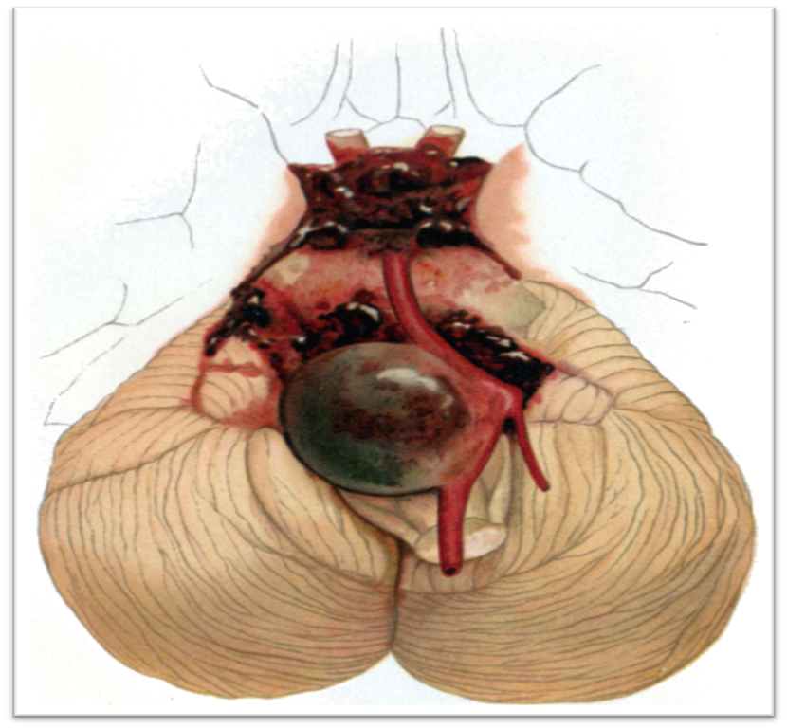
Aneurysm
Aneurysm is defined as an excessive localized enlargement of an artery due to weakening of the arterial wall & can press against nerves that control eyelid position and pupil size.
Evidences have supported the release of thrombin, a Rho kinase activator, is associated with the rupture of aneurysm.
Sign & symptoms: sudden eyelids droop or double vision
Estimated ~5% brain aneurysm among American population
Cerebral Aneurysm

Slide 3
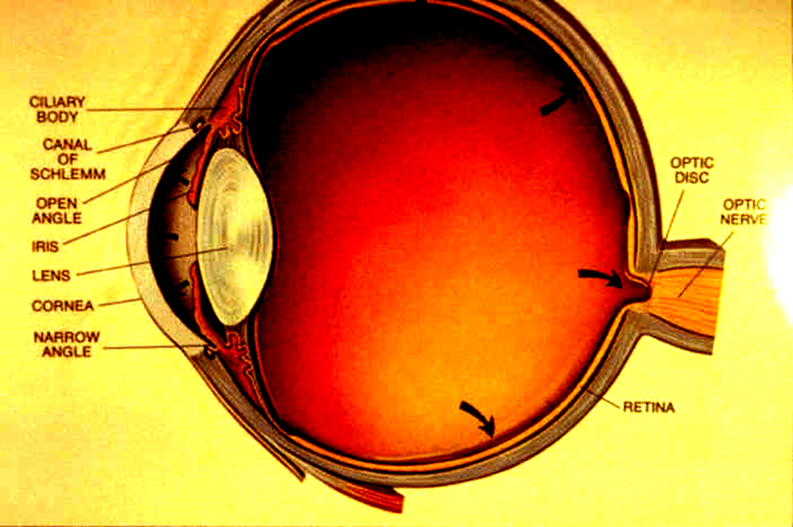
Glaucoma (Silent Thief of Sight)
Glaucoma is the second leading cause of blindness among ~3% Americans, a progressive optic neuropathy often characterized by cupping of the optic nerve, and, commonly associated with increased intraocular pressure (IOP).
Different forms of glaucoma all cause an elevated IOP are due to impairment of drainage of aqueous humor outflow and the rate of aqueous humor formation
Glaucoma is asymptomatic, but eye pain may be the only early symptom.
The loss of vision in glaucoma
due to the damage of the optic
nerve as shown in the box.

Slide 4
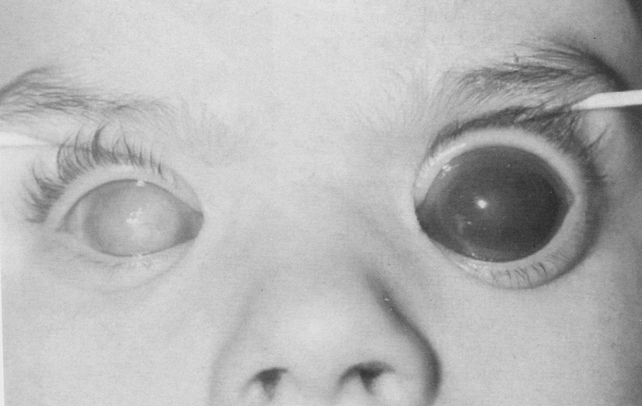
Advanced primary congenital glaucoma

Slide 5


Glaucoma advances gradually from loss of peripheral vision to blindness
Normal vision
Glaucomatous vision

Slide 6
Epidemiology & Etiology of Glaucoma
Based on earlier reports, glaucoma is estimated to affect 70 million individuals worldwide and 3 million Americans have glaucoma at the age of 40 and older, African American are 15 times more likely to be visually impaired from glaucoma than Caucasians.
Increased risk factors:
* High myopia
*diabetes
* Hypertension
*Eye injury; leading to cause traumatic glaucoma

Slide 7
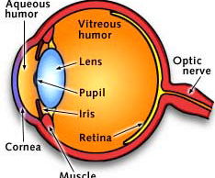
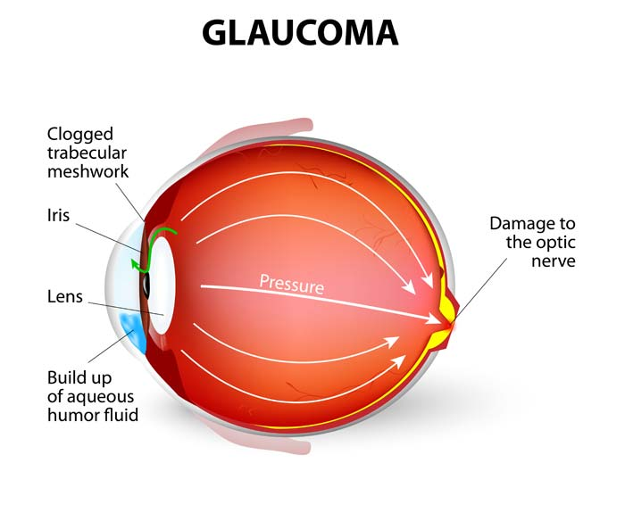
Aqueous Humor outflow pathway modulates ocular pressure

Slide 8
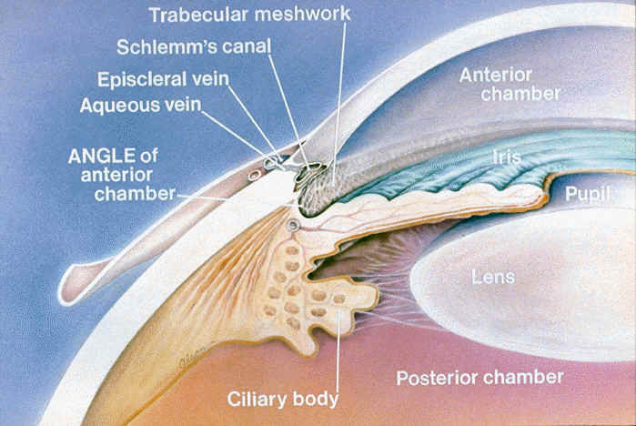
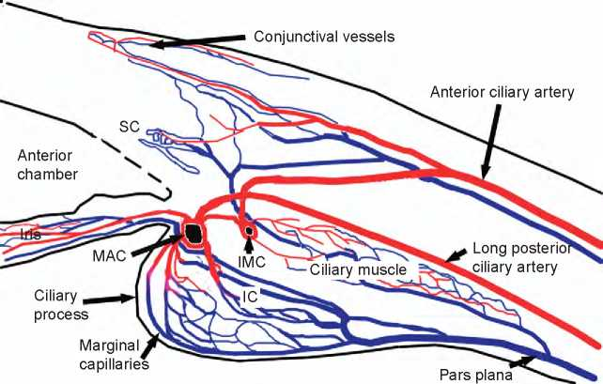
Schematic showing the direction of aqueous and blood flow; possible sites of aneurysm during traumatic glaucoma.
Direction of aqueous humor flow
Direction of blood flow
Ref. http://www.medicalnewstoday.com/articles/9710.php

Slide 9
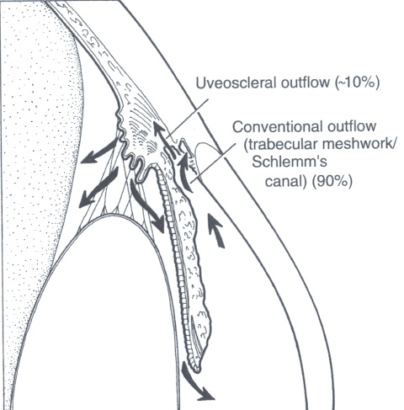
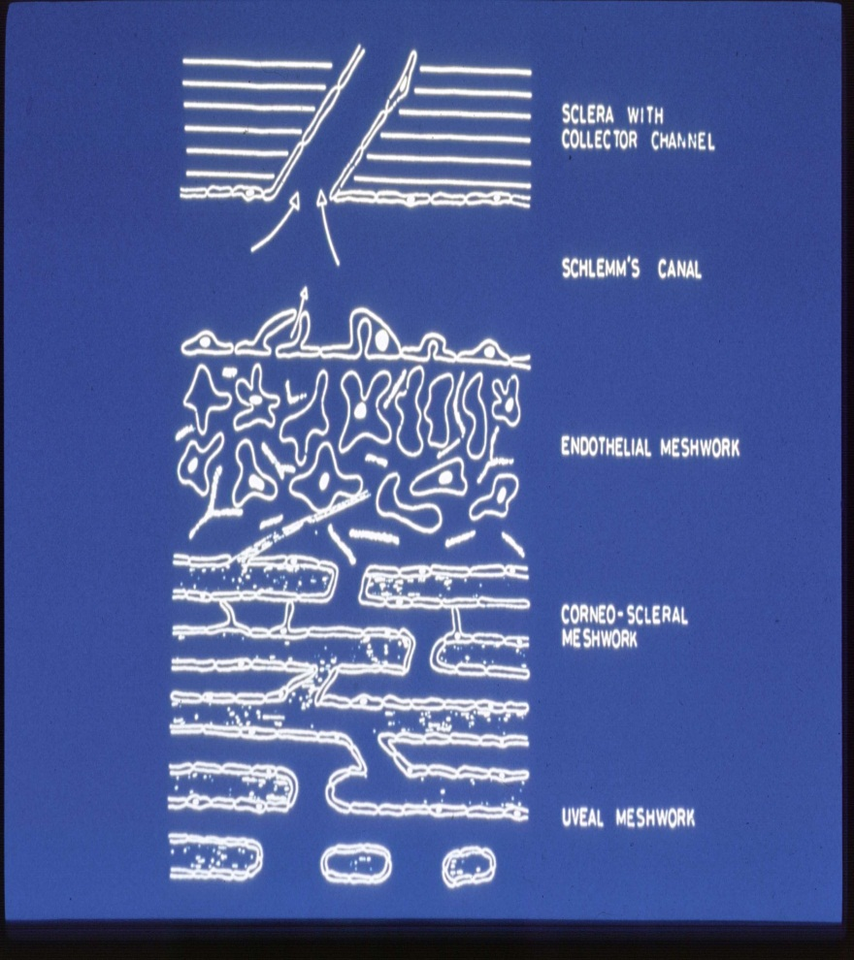
Schematic presentation of fluid flow dynamics & conventional outflow pathway cells in human eyes
Fluid dynamics of aqueous humor outflow pathways
Anatomical views of conventional outflow pathways
It is noteworthy that the conventional outflow pathway; 90 % fluid exit through TM-SC system in human but only 40% fluid exit through TM-SC system in primates. So, primates may not be a suitable model specifically to the glaucoma.

Slide 10
Aqueous humor outflow resistance
The current view is that majority of the aqueous outflow resistance is located in either juxtacanaliculat tissue (JCT) and/or in the inner wall of Schlemm’s canal (SC). However, the contribution of transcellular, pore formations or paracellular pathways to fluid flow across the inner wall of SC is not certain.

Slide 11
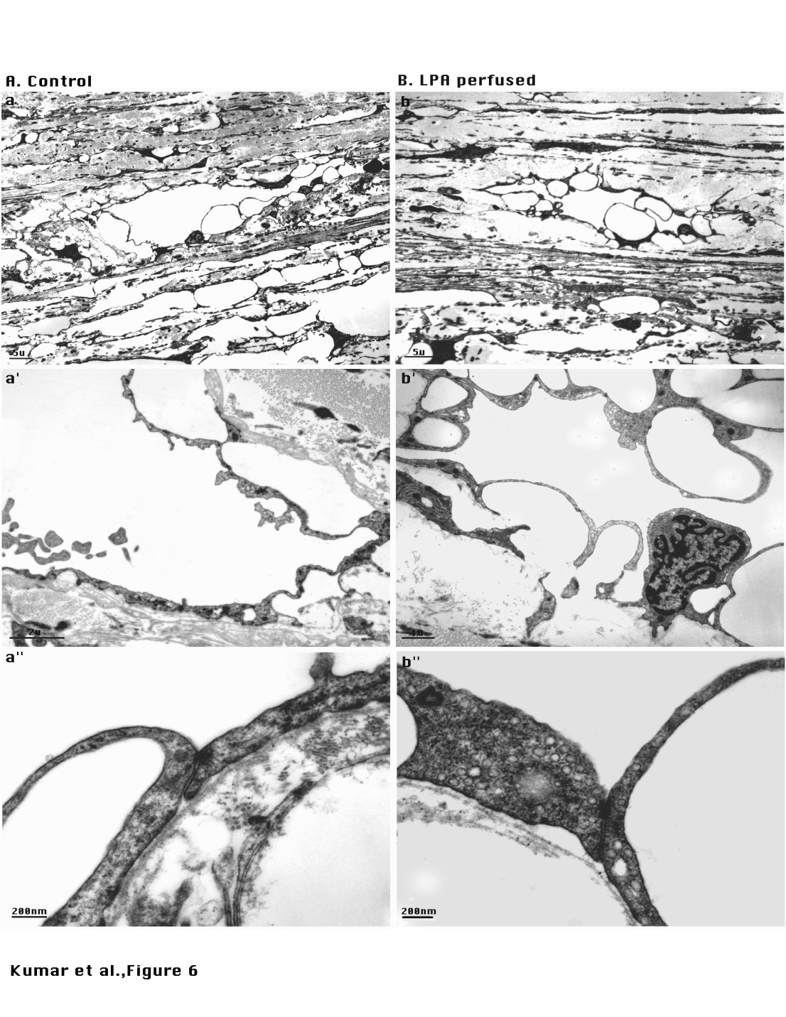
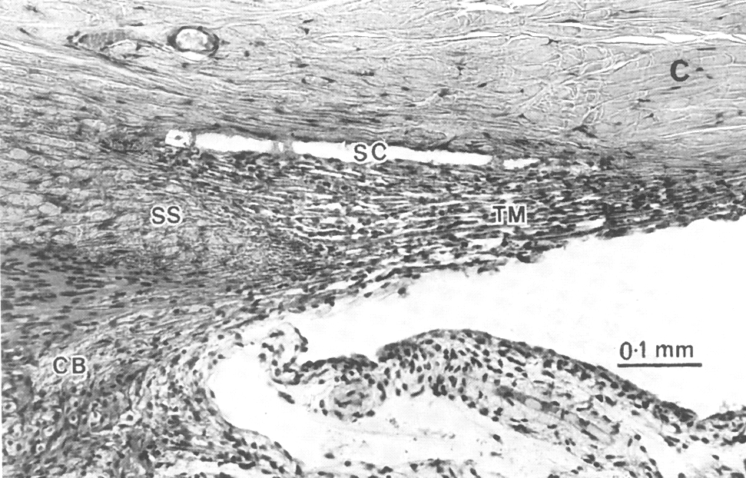
Histological analysis of outflow pathway cells suggesting that the only SC cells are arranged as monolayer.
Light micrograph of outflow pathway
Electron micrograph of outflow pathway

Slide 12
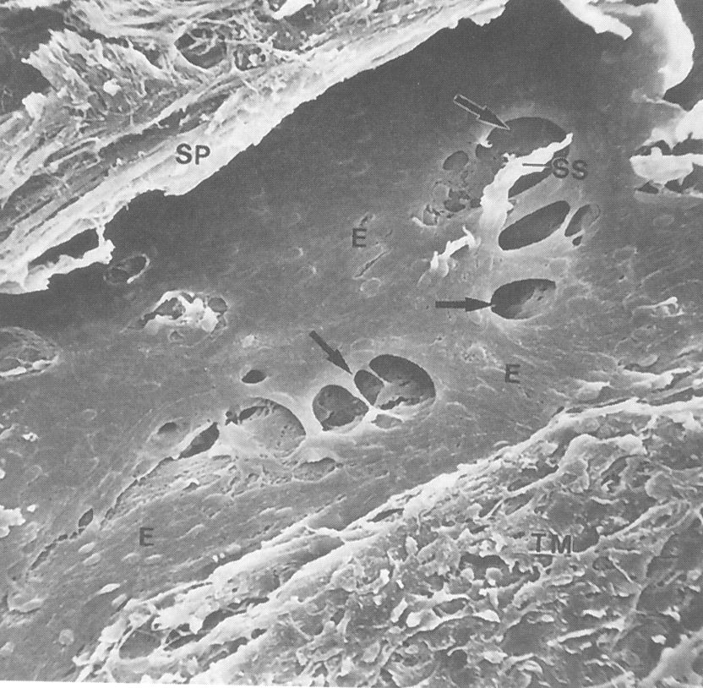
Outer wall of Schlemm’s canal in human eye, showing outer wall endothelium (E), Scleral spur (SP), Septum of SC (SS), pores and trabecular meshwork (TM).

Slide 13
Why to study JCT and/or SC ?
KNOWN FACTS:
Primary open angle glaucoma (POAG): Asymptomatic except increased IOP due to decrease in outflow facility.
*Major population in US has POAG, and common to some part of the world, since the causative factors are unknown and occurs spontaneously, the outflow pathways are almost clean.
*Trabecular meshwork (TM) cells are phagocytic in nature, contains large spaces between tissue lamellae, and contributes a little if any significant resistance to aqueous humor outflow.
*JCT and/or SC appears to be monolayer forming a canal, and hence logical to define molecular mechanism(s) of hydraulic barrier function of SC cells.

Slide 14
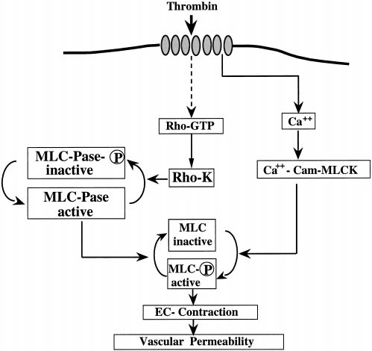
How to reduce IOP in POAG, a major challenge?
The following flow charts depicts the basic model of Dr. Epstein, NIH RO1 grant in 1998 on SC endothelial cells function.
Ref. Essler M et al., 1998. J Biol Chem. 273; 21867-21874 Lampugnani MG, Resnati M, Dejana E, Marchisio PC. 1991. J Cell Biol
112:479–490.

Slide 15
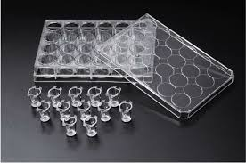
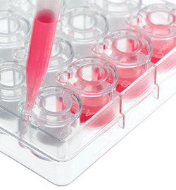
Original concept of Rho-GTPase activation effect
as predicted in NIH RO1 grant of Dr. Epstein.
SC Monolayer Rho-GTPase Activating Agents(e.g. Thrombin)
Permeability
Cellular Contraction
Outflow Facility
IOP
Designed experiments to measure SC monolayer transendothelial hydraulic conductivity assay- in vitro.
3 μm pore
size
Transwells

Slide 16
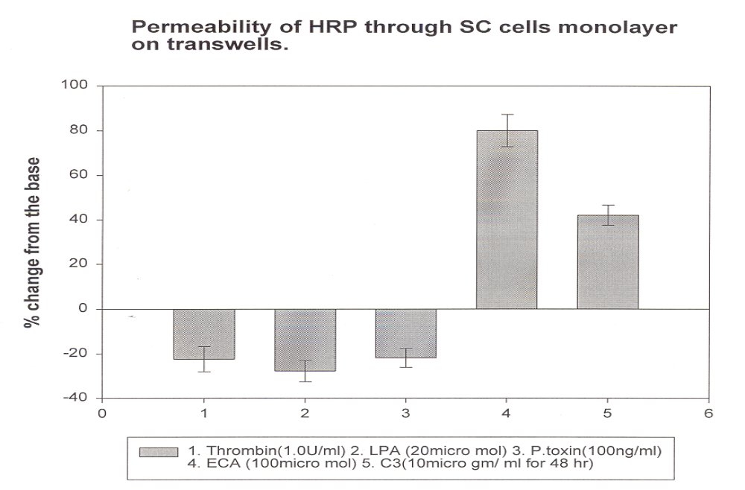
Screening for the effect of Rho-GTPase modulating agents on SC endothelial cells monolayer hydraulic conductivity- in vitro.
Results are here in opposed to RO1 grant of Dr. Epstein-Presented at ARVO 1999.
ECA
Rho-GTPase activation
C3 exoenzyme
Thrombin
LPA
P. toxin
Rho-GTPase inactivation

Slide 17
Inference to the results from the SC cells monolayer
hydraulic conductivity assays-in vitro.
SC Monolayer Rho-GTPase Activation (e.g. Thrombin)
Permeability
Cellular Contraction
Outflow Facility
Results, here predicted the
pathophysiology of glaucoma
by Rho-GTPase activating
agents.
IOP
SC Monolayer Rho-GTPase inctivation with
C-3 exoenzyme
Permeability
Cellular Relaxation
Outflow Facility
Results, here predicted
the possible agents
to glaucoma therapy.
Project led by PV Rao &
presently in clinical trials
IOP

Slide 18
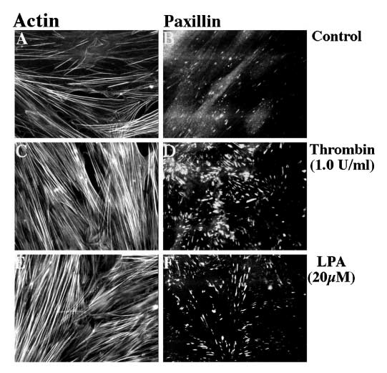
Effect of Rho-GTPase activating agents on actin stress fiber formation & focal adhesion

Slide 19
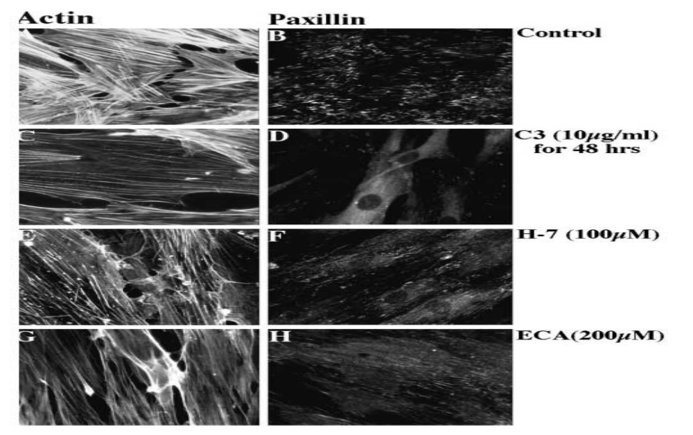
Effect of Rho-GTPase inactivation on actin stress fiber formation & focal adhesion
C3 treatment to the other endothelial systems are well established as Rho-GTPase inhibitor

Slide 20
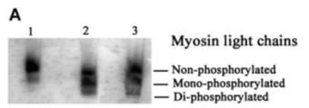
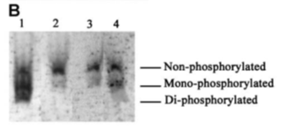
Effect of the agents to the Rho-GTP activation or inactivation on MLC phosphorylation of SC cells.
Di-phosphorylated form of MLC showing inhibition, mainly localized to the periphery of the cells.
Ctrl
Thr
LPA
Experiments performed
under the condition of serum
starvation
Ctrl
C3 + Thr
C3 + LPA
C3
Experiments performed
without serum starvation

Slide 21
Why to detect the effect of Rho-GTPase modulating agents on outflow facility in eyes (ex-vivo)?
For clinical detection of glaucoma, the ratio of steady state pressure to the facility of aqueous outflow is more meaningful than the individual.
Goldmann equation to evaluate IOP:
P(pressure)= F(flow)/C(outflow facility) +Pe
Pe(episcleral venous pressure)

Slide 22
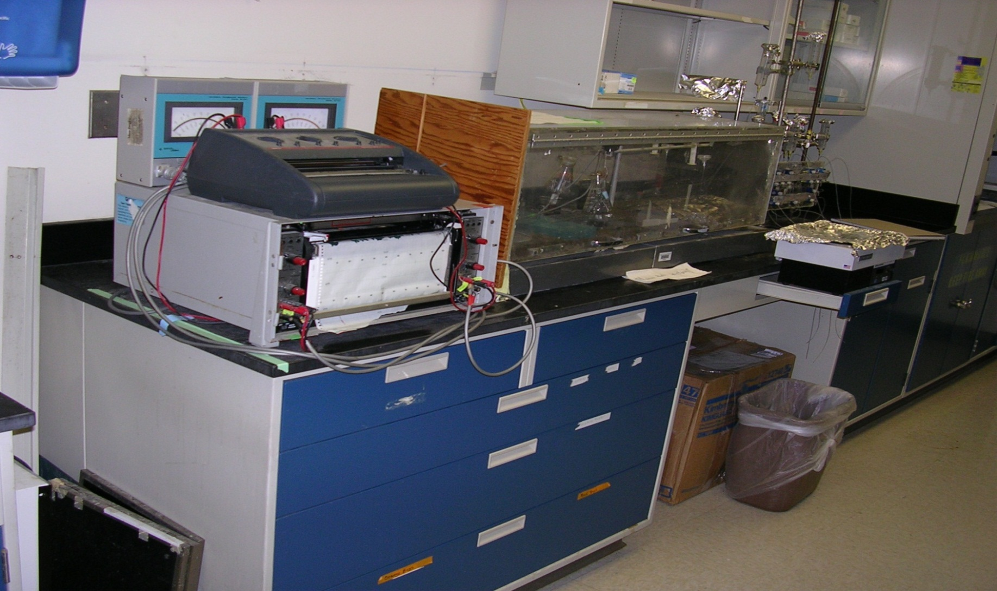
Rho-GTPase modulating agents effect on outflow facility measurements were performed using the following Grant perfusion system developed by W. M. Grant (1955) at MEEI, Harvard Medical School, Boston.

Slide 23
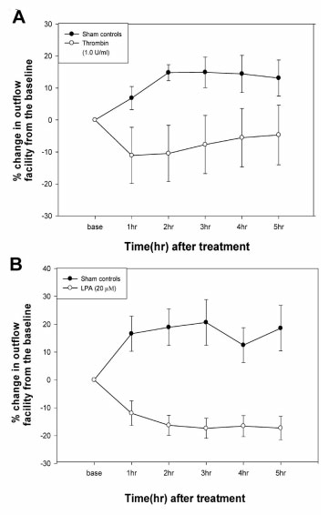
Thrombin and LPA treatments exhibited decreased outflow facility in porcine eyes (ex-vivo) using the Grant perfusion system. This was the first data shown so far in 1999, a decreased outflow facility.
Sham controls
Thrombin treatment (1.0 U/ml)
Sham controls
LPA treatment

Slide 24
Likewise POAG, anterior segment of LPA-perfused porcine eyes showed no sign except appearance of narrowing SC filled with more aqueous plexi.

Slide 25
Conclusions:
*In opposed to the well established concept of thrombin treatment in HUVEC cells that exhibited increased hydraulic conductivity in vitro whereas our results clearly suggested that the treatment of thrombin to human SC cells caused decreased hydraulic conductivity in vitro, and, decreased outflow facility in whole porcine eyes ex-vivo.
*This is the first evidence of thrombin effects on human SC cells in the history of glaucoma research.

Slide 26
Inference
Since clinical diagnosis have shown blood in the angle under certain conditions, such as hyphema from new blood vessels and spontaneous hemorrhage that includes gonioscopy.
But, surprisingly elevation of IOP followed by spontaneous improvement has been observed, too.
Based on thrombin effect on outflow facility, we suggest that aneurysm might be a causative factor for glaucoma that could be assessed by the presence of thrombin in glaucomatous aqueous humor collected from the patients.

Slide 27
Acknowledgement
This lecture is dedicated in the memory of
Dr. David L. Epstein
who supported this project, and even though manuscript
submitted to IOVS in year 2000, but finally published in2011.

Slide 28
Patents: Peptide-based glaucoma therapy
Publication number: 20010053766
Abstract: The present invention relates, in general, to methods of treating disorders of the eye, and, in particular, to methods of preventing or treating elevated eye pressure and glaucoma. The invention further relates to compounds and compositions suitable for use in such methods.
Publication date: December 20, 2001
Inventors: Janardan Kumar, Vasanth Rao, David L. Epstein, Pratap Challa
Publication number: 20030139342
Abstract: The present invention relates, in general, to a method of treating disorders of the eye, and, in particular, to a method of inducing posterior vitreous detachment.
Publication date: July 24, 2003
Inventors: Brooks W. McCuen, Cynthia A. Toth, David Epstein, Leonardo deOliveira, Misako Tatebayashi, Carsten H. Meyer, Janardan Kumar

Slide 29
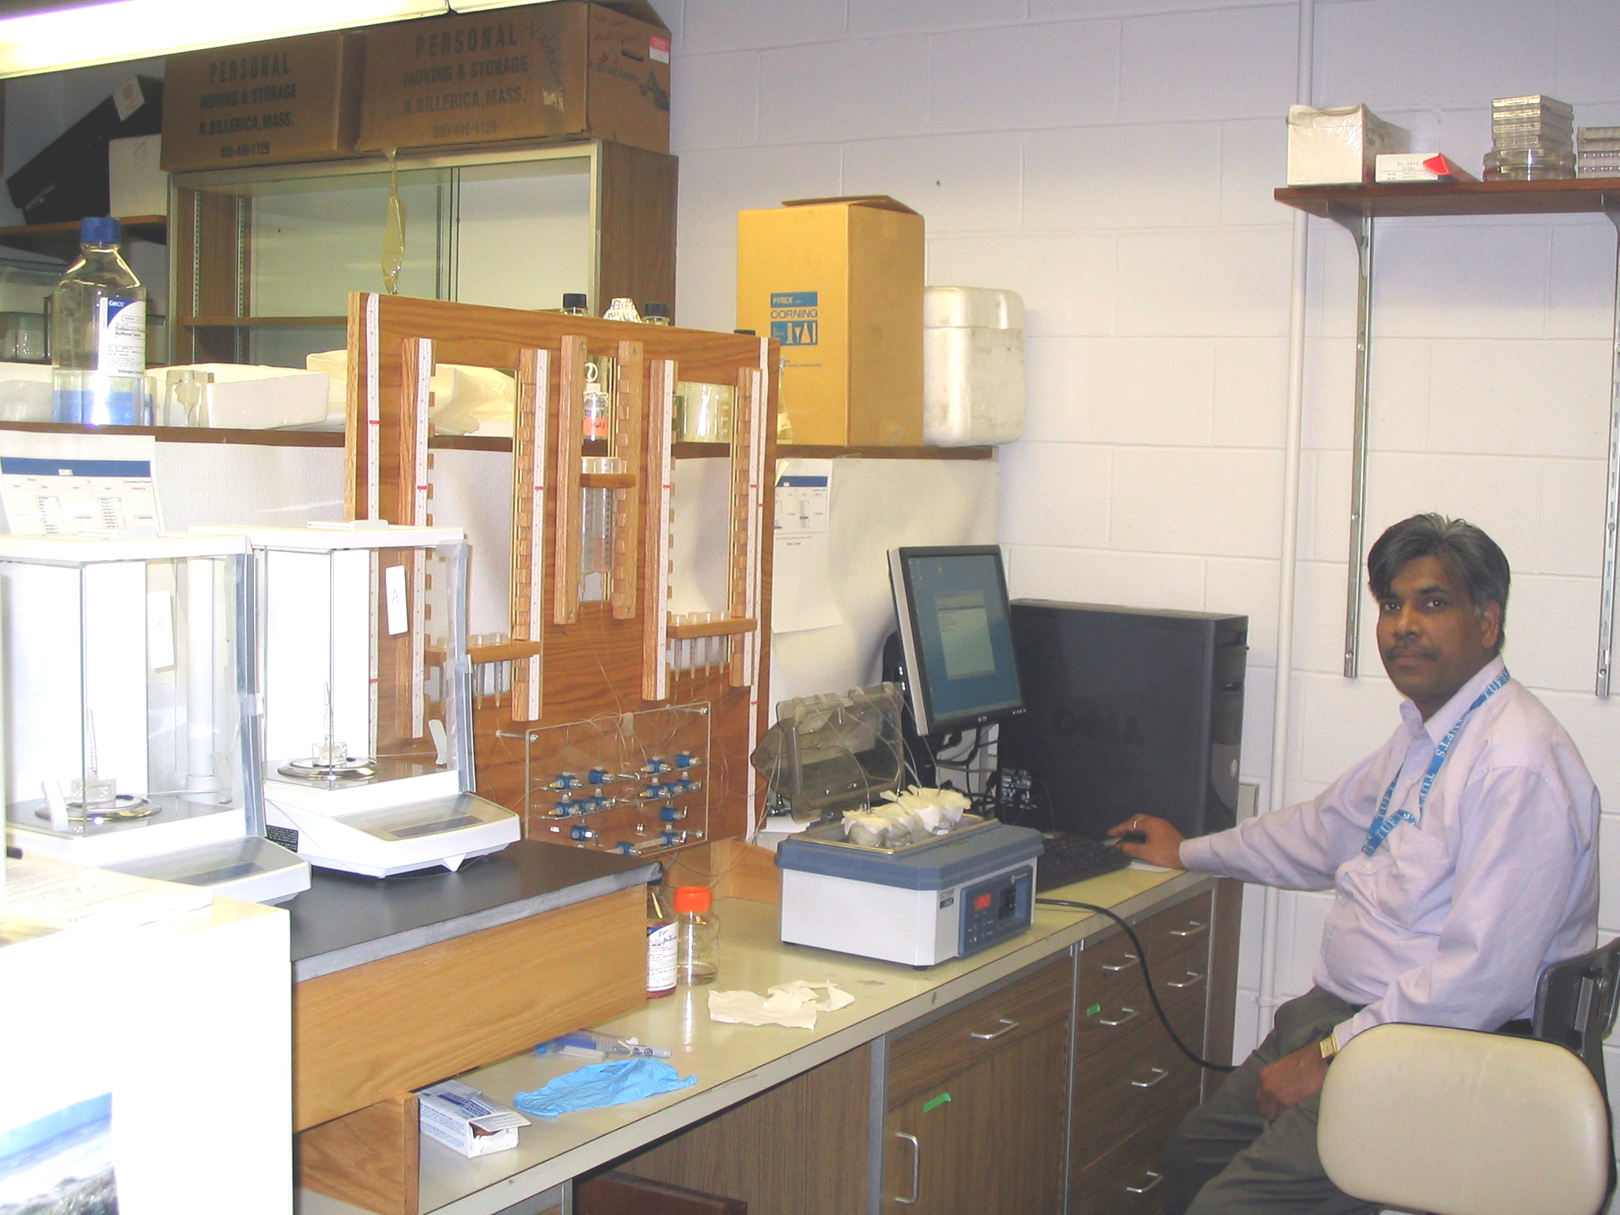
An advanced form of Grant perfusion system developed by Kumar J., at Tufts University in 2006.

