Slide 1
Molybdenum nanoplates incorporated polycaprolactone nanofibers: A potential threat to skin cancer
Janani Indrakumar
Biological Materials Laboratory
CSIR-CLRI, India

Slide 2
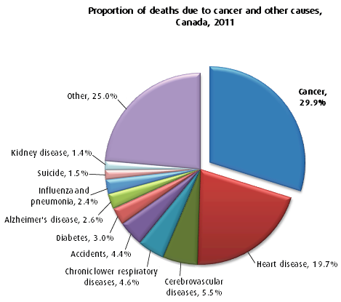
Cancer
Uncontrolled division of abnormal cells
Stages :
Uncontrolled cell division
Hypoxia
Angiogenesis
Invasion
Metastasis

Slide 3
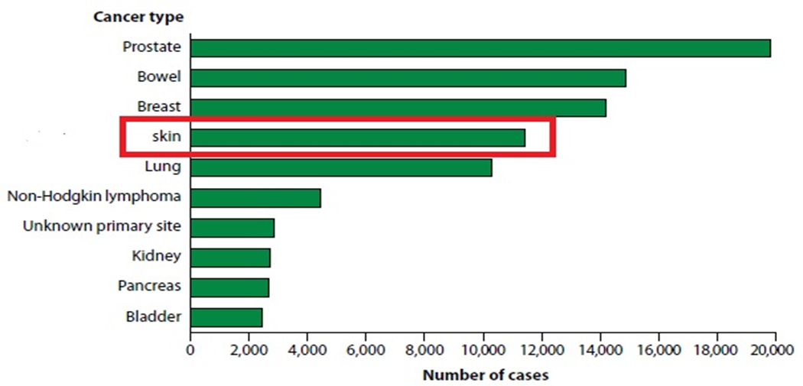
Types of cancer
Basal cell carcinoma
Squamous cell carcinoma
Melanoma
Non-Melanoma

Slide 4
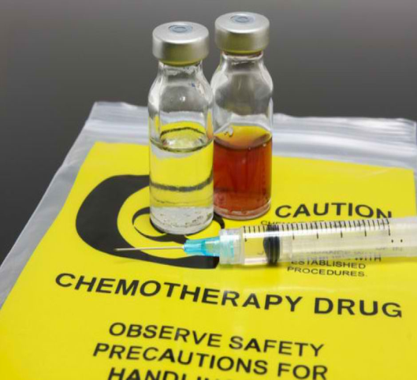
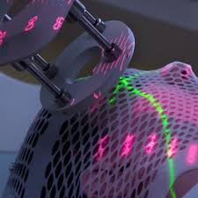
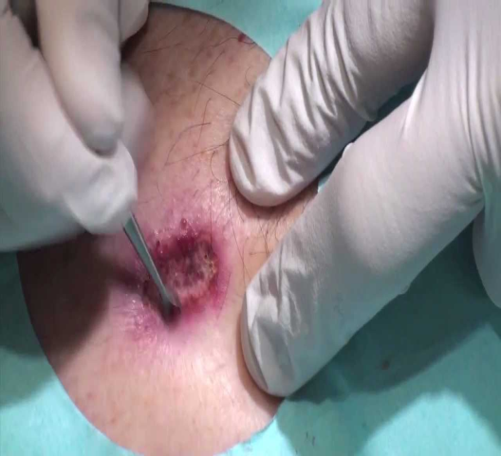
Need for this study
Excision is most practiced method
Chemotherapy and radiation are not targeted
After excision rate of relapse is high
Though mortality is not significant
Once metastasized five year survival rate is very low

Slide 5
Nanoparticles
“Nano” word of the decade
Small size, easy penetration to the plasma membrane
Improves solubility, increases half life
Sustained and targeted delivery into the disease microenvironment
Types of nanoparticles: polymeric nanoparticles, drug nanoparticles, metal nanoparticles etc.,

Slide 6
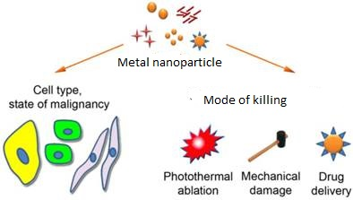
Metal oxide nanoparticles
Effective anticancer agents ( CeO₂ , TiO₂ )
Photo thermal therapy ( Au)
Imaging therapy ( Au , Fe )
Drug carriers

Slide 7
Molybdenum
Essential trace element
Permissible level of molybdenum in circulation is
about 2 mg/day
Cofactor for various enzymes
Aldehyde oxidase , sulphide oxidase,
Nitrate reductase, xanthine dehydrogenase
Complexes have shown anti-diabetic activity

Slide 8
Cheap alternate
Safe metal oxide
MoO₃
Surface Plasmon resonance
Antibacterial activity

Slide 9
Objectives
To synthesize and characterize metal oxide nanoparticles
To explore their potential targeted anticancer activity
To develop a carrier system for the nanoparticles targeting skin cancer cells

Slide 10

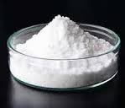

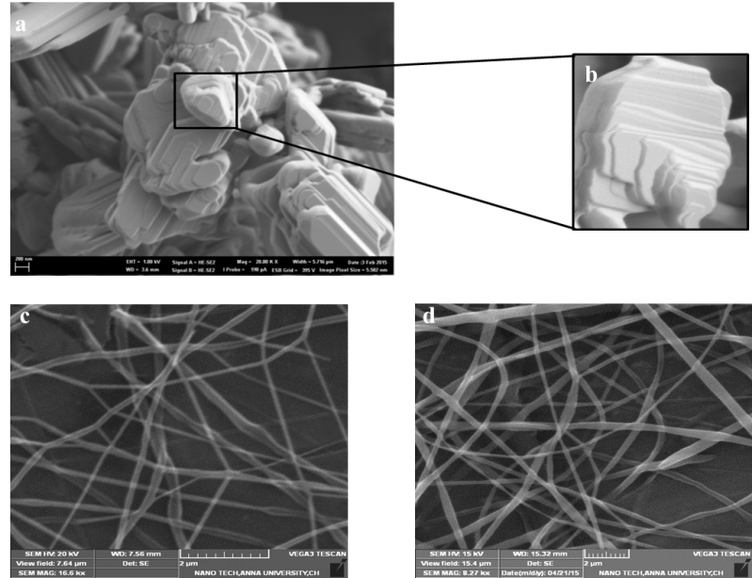
Preparation of metal oxide nanoparticles
H₂0
500°C
2 h
Metallic acid Precursor
Metal oxide NPs
Calcination
MoO₃.2H₂O MoO₃
200ug

Slide 11
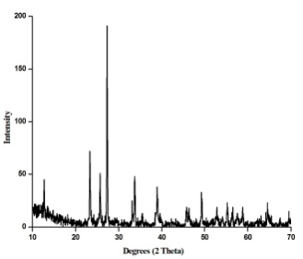
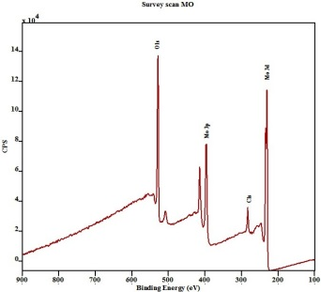
Characterization
X-ray Diffraction
X-Ray Photoelectron Spectroscopy
Orthorhombic plates
Elemental signature

Slide 12
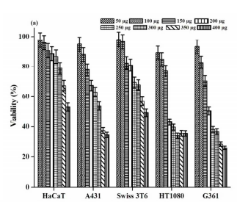
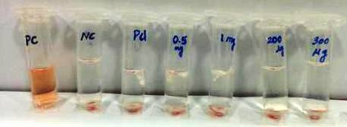
Compatibility Studies
Anti cancer activity
Hemolytic activity

Slide 13
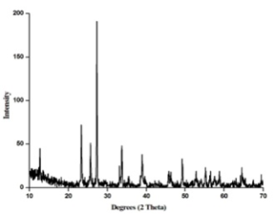
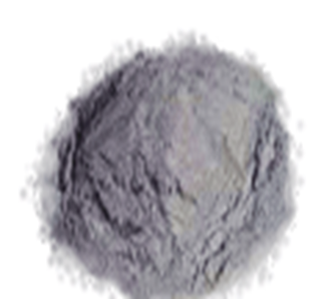
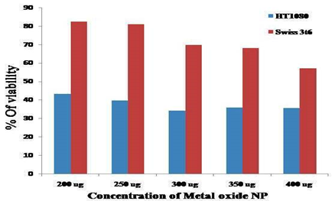

Characterization ✓
Synthesis ✓
Anticancer activity ✓

Slide 14

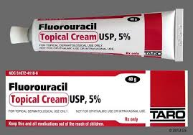
Current treatment methods
Surgical excision
Chemotherapy
Radiation
Topical treatment

Slide 15
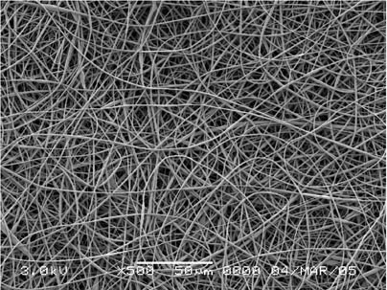
Nanofibers
Greater loading
Easy transport
Minimal wastage
Sustained delivery
Targeted Release
Methods of preparing nanofibers : Self assembly, centrifugal spinning , Electrospinning
Polymers used : natural ( protein , carbohydrate ) , synthetic ( hydrophilic and hydrophobic )

Slide 16
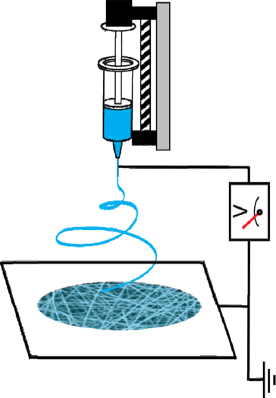
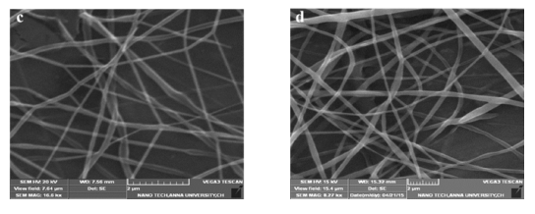

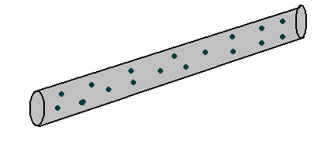
Preparation of Nanofibrous Scaffolds
Sample PCL Nanofibers
Metal oxide NPs
+
0.4ml/ hr
9 kV/ 16 kV
15% PCL
PCL Control Nanofibers
Polymer

Slide 17
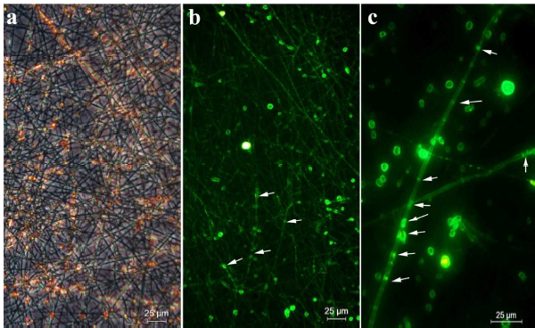
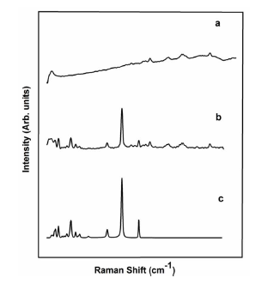
Encapsulation of Nanoplates in the nanofibrous scaffolds
FITC-MoO₃ encapsulated PCL nanofibers
Raman spectroscopy
PCL , b. MoO₃-PCL,
c. MoO₃ Nanoplates

Slide 18
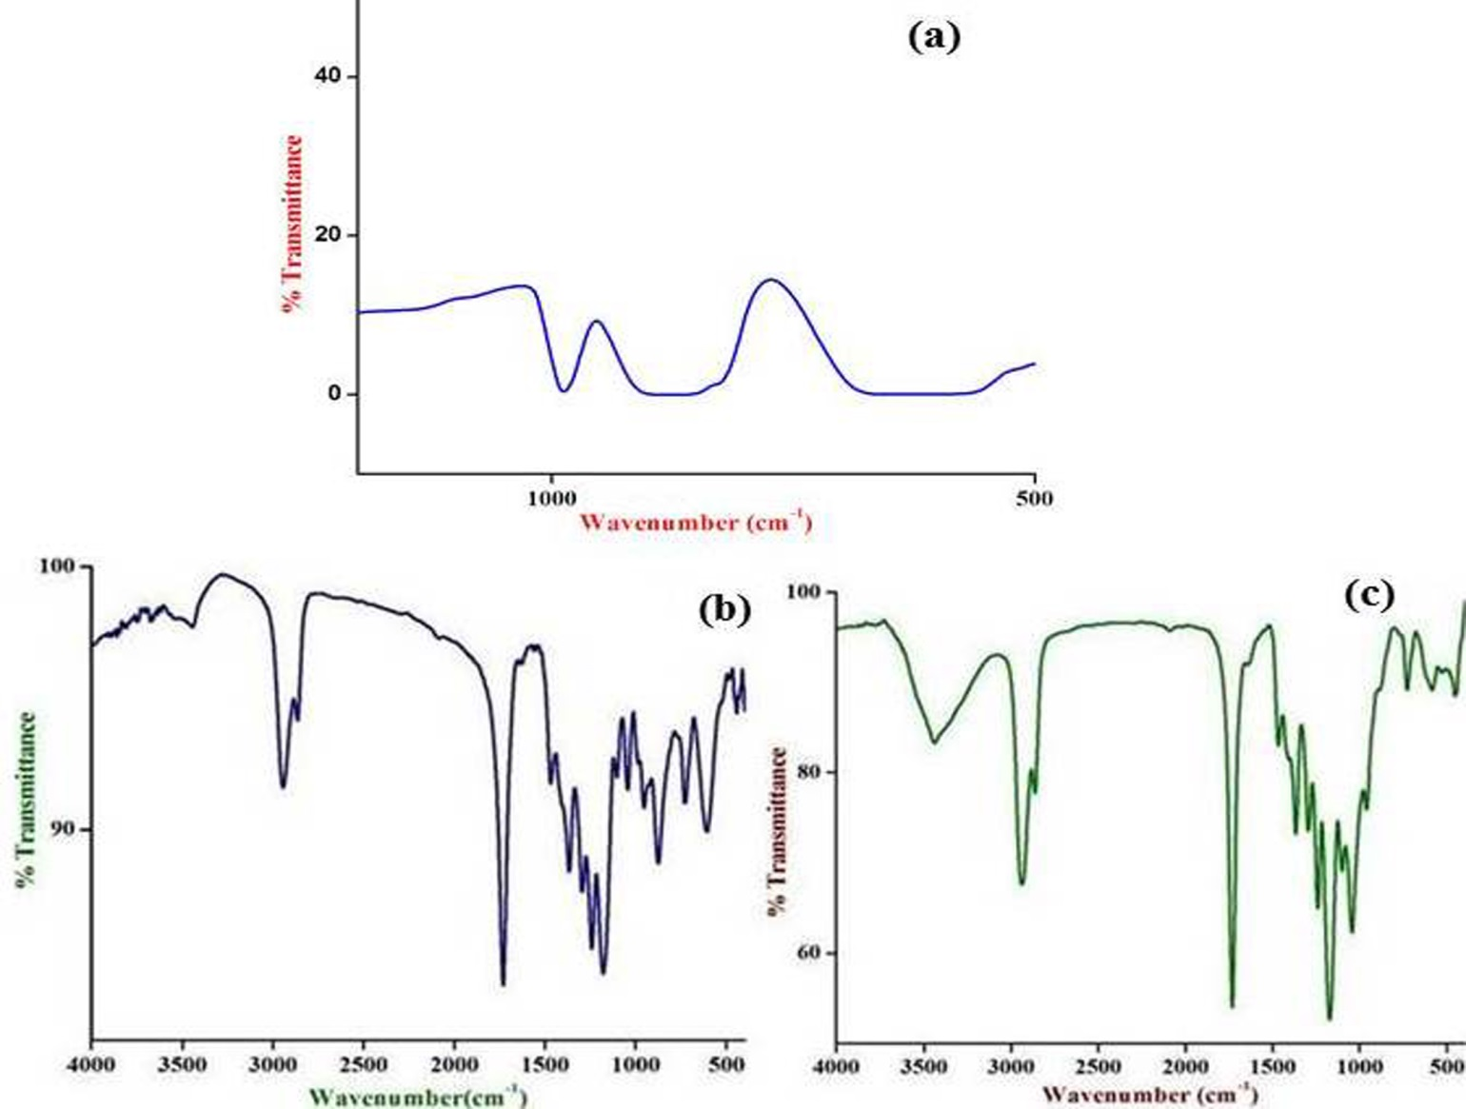
Fourier Transform Infra Red
Spectroscopy
(FTIR )

Slide 19
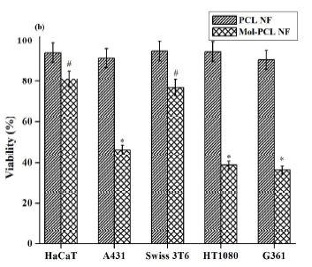
Compatibility studies
Anti cancer activity

Slide 20
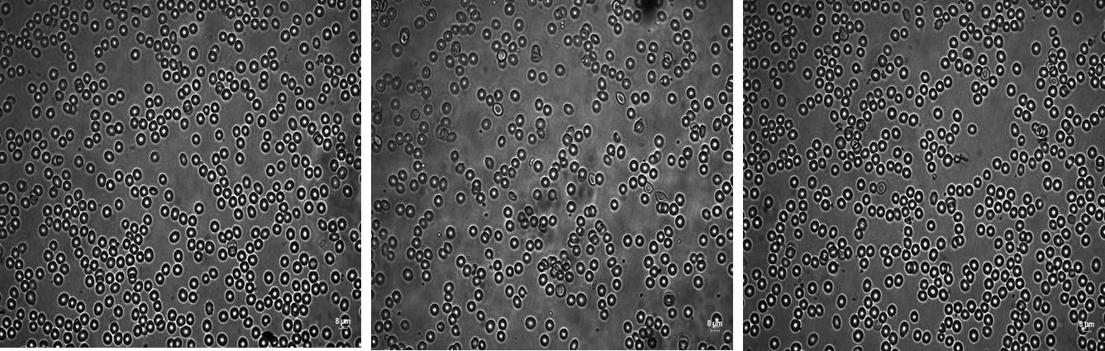
Hemolytic Activity
Control
PCL
MoO₃-PCL
Samples | % Hemolysis
PCL NF | 1.19
MoO₃-PCL NF | 1.48

Slide 21
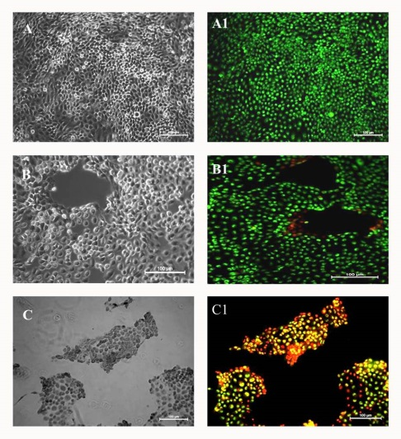
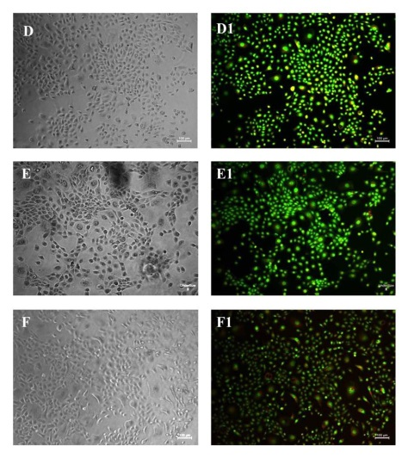
AO/PI Staining
A431
HaCaT
TCP
PCL
MoO₃-PCL

Slide 22
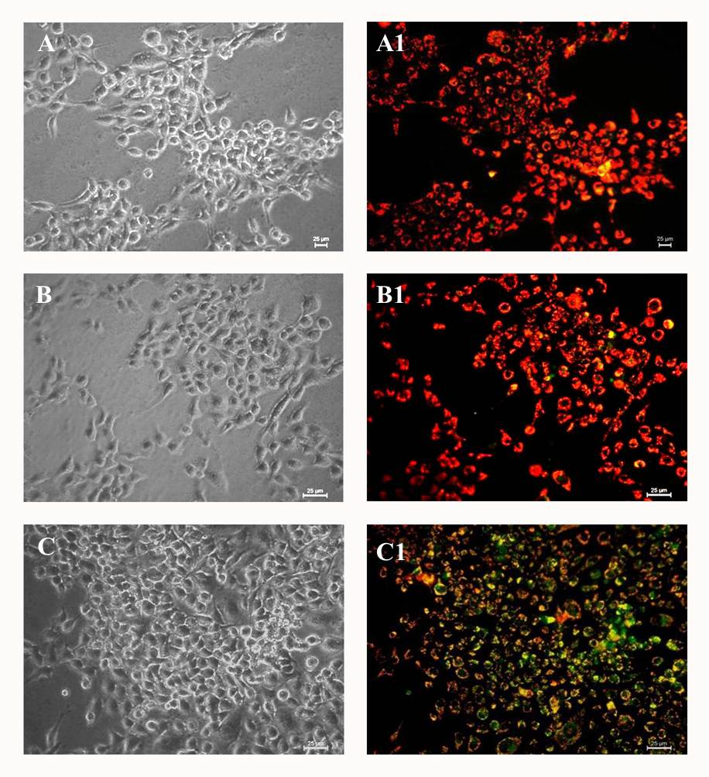
JC1 Staining
TCP
PCL
MoO₃-PCL
The mitochondrial membrane of the treated cells were damaged indicating the start of mitochondrial membrane mediated apoptosis

Slide 23
Conclusion
The nanoparticles were successfully prepared and characterized
The thus prepared nanoparticles were tested for their targeted anticancer activity against skin cancer cells
A nanofibrous scaffold system was successful in carrying the nanoparticle and delivering them in the area of interest

Slide 24
Thank You

