Slide 1

Novel mechanisms of the glucocorticoid receptor in inflammatory bone disease and bone loss
Jan Tuckermann, Jena, Ulm, Germany
e-mail: jan.tuckermann@uni-ulm.de
Notes:
Dear Organizers thank you for giving me the opportunity to start this session

Slide 2

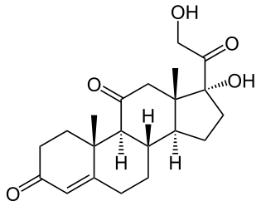
Cortisone
Notes:
Kortison hat heute den Nimbus einer Ambivalenten Substanz. Sehr viele Personen haben es schon einmal bei der einen oder anderen Gelegenheit verschrieben bekommen bei Entzündlichen Erkrankungen. Of ist diese Substanz auch verteufelt und wird manchmal gar nicht verschrieben. Das hängt häufig von der Indikation ab, die Sie haben; Es gibt Erkrankungen, da haben Sie gar keine Andere Wahl; und es gibt Ärzte, die es ohne Bedenken verschreiben und Sie werden Ärzte finden, die es so gut, wie nie verschreiben.
Sie werden von mir heute keine Tips bekommen, in welchem speziellen Fall Kortison nun verschrieben werden sollte und wann nicht. Das kann ich gar nicht, denn ich bin kein Arzt. Sondern Ich werde Sie mit der Forschung vertraut machen, die wir und andere Labors auf der Welt betreiben, um Ersatz-Substanzen zu entwickeln, die die unglaubliche Therapeutische Funktion des Kortisons erhalten, aber die Nebenwirkungen abschwächen sollen.

Slide 3

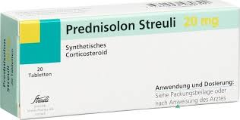
Prescriptions of Synthetic Corticosteroids
World-wide: 1-3% all Adults
20%: Long term Treatments
Current Opinion in Rheumatology 2008, 20:131

Slide 4
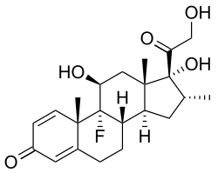
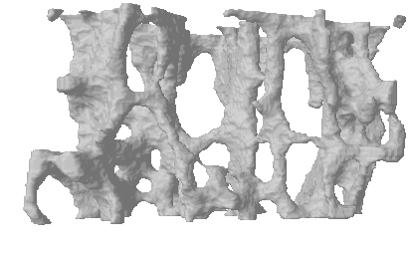
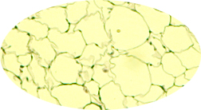
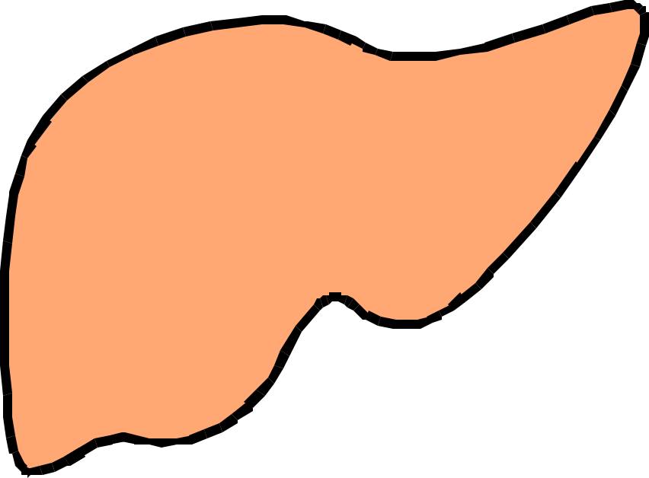
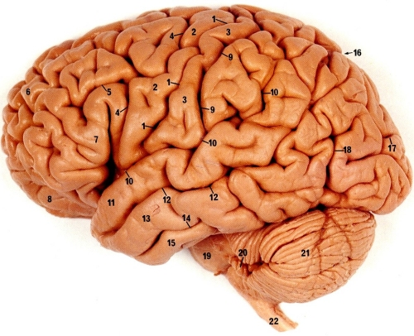
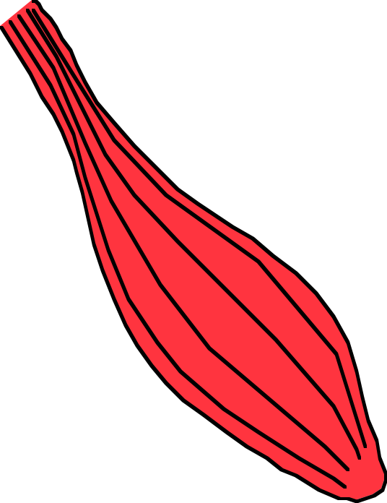
Glucocorticoids as Drugs
FLI
Glucocorticoids
Therapeutic Effects
Side Effects
Myeloid cells
Lymphocytes
Immune Suppression
Osteoporosis
Fat re-
distribution
Type 2 Diabetes
Neurodeg.
Depression
Skin atro-
phy, Muscle weakness
Metabolic Syndrome
Notes:
An these therapeutic effects, where synthetic GCs are still used to treat chronic inflammatory diseases ......
They are strongly hampered by side effects effecting integrity of organs, but also physiological processes shown here.

Slide 5

Baschant and Tuckermann 2010 J. Steroid Biochem Mol Biol
Glucocorticoids
Hsp70
Cyp55
GR
PP5
Hsp90
Hsp23
FKBP52
p38
JNK
p85/PI3K
Importin
GR
GR
GR
p160/SRC
TRIP6
CBP
STAMP
CBP
AP-1
GR
GR
NF-κB
IRF-3
Pol
Pol
“Side effects”
“Therapeutic effects”
Notes:
GCs act via a nuclear receptor , the GR that resides in the absence of hormones in the cytoplasm in an inactive chaperone complex. Upon ligand binding this complex disrupts and the GR can either interact with signalling components in the cytoplasm or as the majority of the molecules does translocate in the nucleus.
In the nucleus the GR can interact direct with DNA upon dimerization and facilitates transcription by recruiting coactivators leading finally to chromatin remodeling. Alternatively the GR can interfere with pro-inflammatory acting transcription factors such AP-1, NF-kB IRF-3 and others, often with the help of co-integrators.
Click- Traditionally, these two different modes have been hypothesized to unerly side effects and therapeutic effects, respectively.
Click - Based on this concept selective GR ligand had been developed, that address only the monomer function. We and others have challenged this concept and I will give you later a brief example that novel criterias for selective ligands that avoid side effects are needed.

Slide 6
Baschant and Tuckermann 2010 J. Steroid Biochem Mol Biol
Glucocorticoids
Hsp70
Cyp55
GR
PP5
Hsp90
Hsp23
FKBP52
p38
JNK
p85/PI3K
Importin
GR
GR
Selective GR Modulators
GR
p160/SRC
TRIP6
CBP
STAMP
CBP
AP-1
GR
GR
NF-κB
IRF-3
Pol
Pol
“Side effects”
“Therapeutic effects”
Notes:
GCs act via a nuclear receptor , the GR that resides in the absence of hormones in the cytoplasm in an inactive chaperone complex. Upon ligand binding this complex disrupts and the GR can either interact with signalling components in the cytoplasm or as the majority of the molecules does translocate in the nucleus.
In the nucleus the GR can interact direct with DNA upon dimerization and facilitates transcription by recruiting coactivators leading finally to chromatin remodeling. Alternatively the GR can interfere with pro-inflammatory acting transcription factors such AP-1, NF-kB IRF-3 and others, often with the help of co-integrators.
Click- Traditionally, these two different modes have been hypothesized to unerly side effects and therapeutic effects, respectively.
Click - Based on this concept selective GR ligand had been developed, that address only the monomer function. We and others have challenged this concept and I will give you later a brief example that novel criterias for selective ligands that avoid side effects are needed.

Slide 7
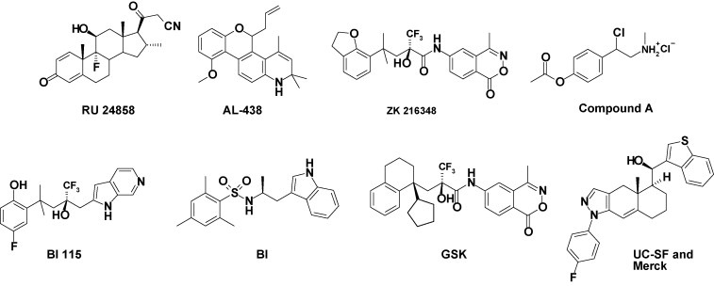
BUT little success to make it to the clinics
Schäcke et al., 2007, MCE 275:109

Slide 8
Contribution of Dimer versus Monomer
GR
?
GR
GR
GR
TRIP6
AP-1
STAMP
NF-κB
IRF-3

Slide 9
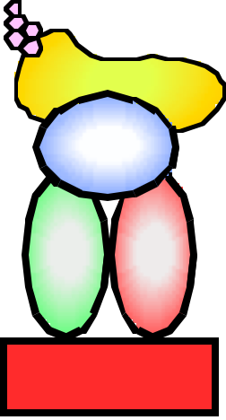
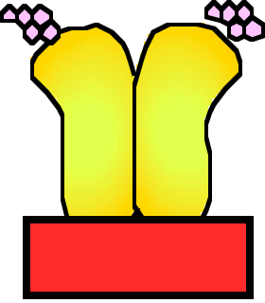
GR^{dim} mice: Impaired GR dimerization interface
GR^{dim}
GR
GR
GR
GR
TRIP6
AP-1
STAMP
NF-κB
IRF-3

Slide 10
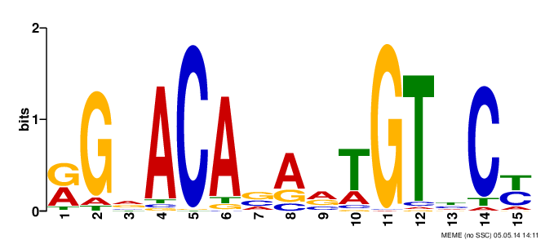
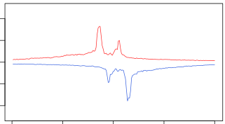
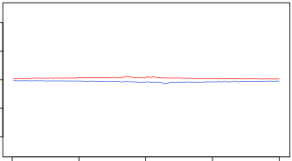
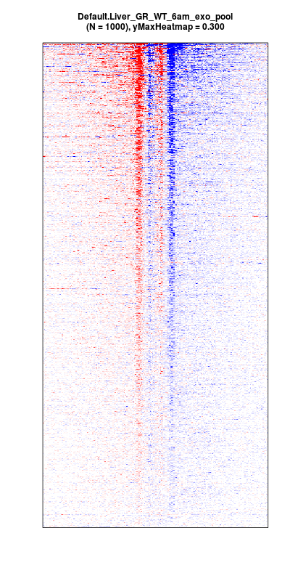
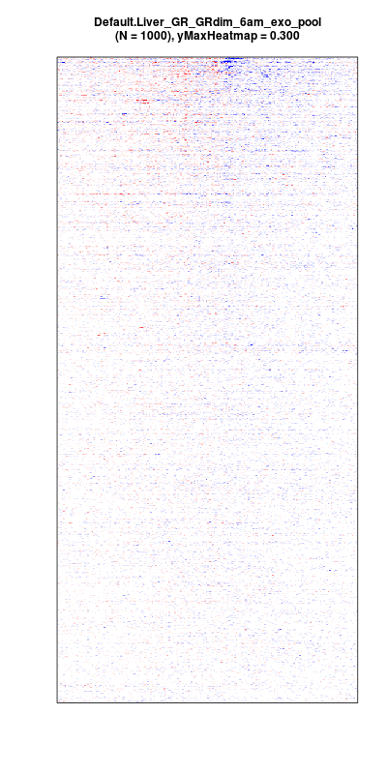
GR^{dim} mice: Impaired GR dimerization interface
GR^{dim}
GR
GR
E = 10⁻¹⁵⁷³
WT
GR^{dim}
GR
0.2
0
-0.2
GR
GR
GR
TRIP6
0.3
AP-1
STAMP
NF-κB
IRF-3
−0.3
motif center +/- 100 bp, N = 1000
David Steger / Mitch Lazar / Henriette Uhlenhaut / Jan Tuckermann

Slide 11
GR^{dim}
Contribution of GR dimerization
Relevant Cell Types
Relevant Target genes
GR^{loxP}
Arthritis
Acute Lung Injury
Glucocorticoid-Induced Osteoporosis

Slide 12
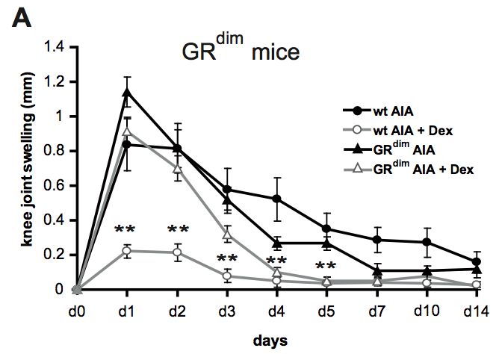
GR dimerization is required for suppression of Arthritis
AIA
Antigen-induced Arthritis
Baschant et al. PNAS 2011, 108: 19317
Notes:
GCs in RA are affecting the bone and the inflammatory response.
We so far have addressed the inflammatory response in a first simple RA model, AIA, which allows to use several compound mutant GR strains to answer which cell type and which mechanism is critical for Immunotherapy. When employ GRLysMCre mice lacking the GR in myeloid cells we see in both wild type and mutant mice a reduction of the inflammatory swelling response. In contrast GRLckCre mice, lacking the GR in T cells have no reduction in the swelling by GCs.
Thus the GR in T cells is critical for anti-inflammatory effects. Similar GR dimerization impaired mice were completely refractory in GC therapy, thus we need for this aspect of RA therapy dimerization of the GR.

Slide 13
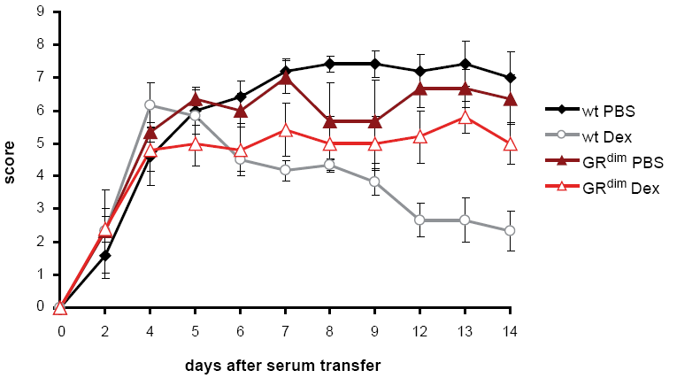
GR dimerization is required for suppression of Arthritis
AIA
Antigen-induced Arthritis
Baschant et al. PNAS 2011, 108: 19317
K/BxN
Serum Transfer-induced Arthritis
Ulrike Baschant, Stephan Culemann, Mascha Koenen
Notes:
GCs in RA are affecting the bone and the inflammatory response.
We so far have addressed the inflammatory response in a first simple RA model, AIA, which allows to use several compound mutant GR strains to answer which cell type and which mechanism is critical for Immunotherapy. When employ GRLysMCre mice lacking the GR in myeloid cells we see in both wild type and mutant mice a reduction of the inflammatory swelling response. In contrast GRLckCre mice, lacking the GR in T cells have no reduction in the swelling by GCs.
Thus the GR in T cells is critical for anti-inflammatory effects. Similar GR dimerization impaired mice were completely refractory in GC therapy, thus we need for this aspect of RA therapy dimerization of the GR.

Slide 14
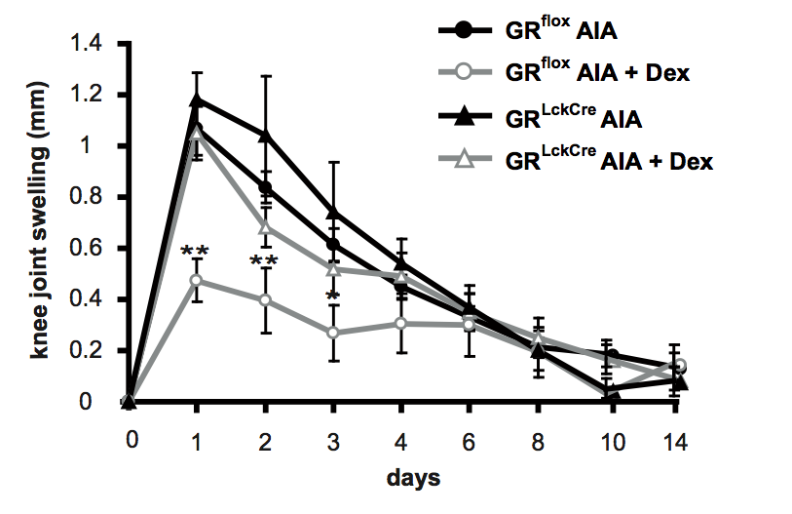
GR in Th17 cells and in chondrocytes is required for suppression of Arthritis
T Cells
AIA
Antigen-induced Arthritis
Baschant et al. PNAS 2011, 108: 19317
Notes:
GCs in RA are affecting the bone and the inflammatory response.
We so far have addressed the inflammatory response in a first simple RA model, AIA, which allows to use several compound mutant GR strains to answer which cell type and which mechanism is critical for Immunotherapy. When employ GRLysMCre mice lacking the GR in myeloid cells we see in both wild type and mutant mice a reduction of the inflammatory swelling response. In contrast GRLckCre mice, lacking the GR in T cells have no reduction in the swelling by GCs.
Thus the GR in T cells is critical for anti-inflammatory effects. Similar GR dimerization impaired mice were completely refractory in GC therapy, thus we need for this aspect of RA therapy dimerization of the GR.

Slide 15
GR in Th17 cells and in chondrocytes is required for suppression of Arthritis
T Cells
AIA
Antigen-induced Arthritis
Baschant et al. PNAS 2011, 108: 19317
Chondr.
K/BxN
Serum Transfer-induced Arthritis
Hong Zhou & Markus Seibel
Notes:
GCs in RA are affecting the bone and the inflammatory response.
We so far have addressed the inflammatory response in a first simple RA model, AIA, which allows to use several compound mutant GR strains to answer which cell type and which mechanism is critical for Immunotherapy. When employ GRLysMCre mice lacking the GR in myeloid cells we see in both wild type and mutant mice a reduction of the inflammatory swelling response. In contrast GRLckCre mice, lacking the GR in T cells have no reduction in the swelling by GCs.
Thus the GR in T cells is critical for anti-inflammatory effects. Similar GR dimerization impaired mice were completely refractory in GC therapy, thus we need for this aspect of RA therapy dimerization of the GR.

Slide 16

Which Are The Effector Genes?
p160/SRC
CBP
?
GR
GR
Pol

Slide 17
Acute Lung Injury (ALI)
ALI: occurs upon infectious insults, severe trauma or sepsis
Mortality rate 40%
Effectively resolved by short term GCs
→ Mechanisms and Target Genes of GR?
Sabine Huebner

Slide 18
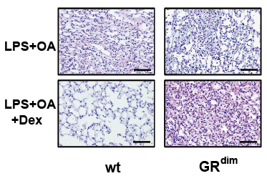
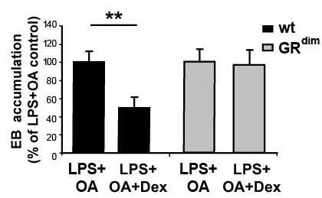
Acute Lung Injury is suppressed by Glucocorticoids by GR with intact Dim.-Interface in Macrophages
Endothelial Leakage
GR^{dim}
Sabine Huebner

Slide 19
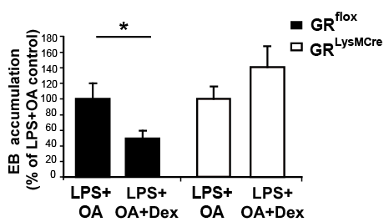
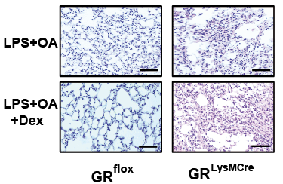
Acute Lung Injury is suppressed by Glucocorticoids by GR with intact Dim.-Interface in Macrophages
Endothelial Leakage
GR^{dim}
Macrophages
PMNs
Sabine Huebner

Slide 20
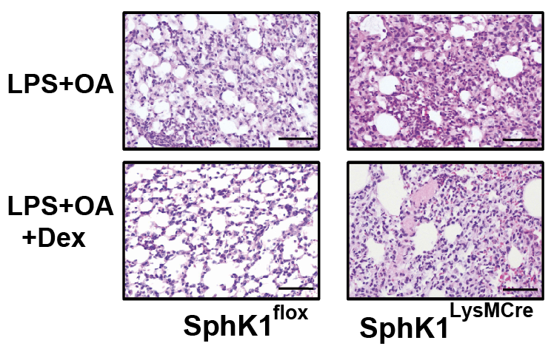
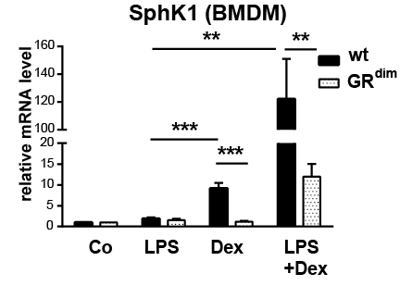
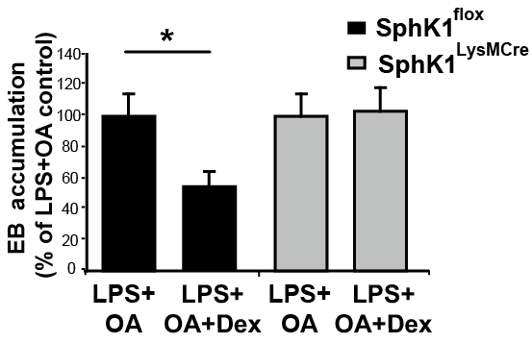
Synergistic Up regulation of anti-inflammatory acting Sphk1 mRNA by Inflammatory Triggers and Glucocorticoids
Macrophages
Endothelial Leakage
Notes:
Mice lacking the GR in Myeloid cells and particular macrophages, so called GRLysMcre mcie for example, have a high regulation of TNF and IL-1b during an acute inflammatory responsed to LPS for example as shown in this study here.

Slide 21
GCs require pro-inflammatory signaling for suppression of Inflammation
Glucocorticoids
LPS
TNF
Others..
LPS
TNF
Others..
GR
GR
GR
p38
MSK1
Cytokines
Sphk1

Slide 22
Glucocorticoids
GR
GR
GR
Osteoblasts
AP-1
Anti-infl.genes
Cytokines/and others
Suppression of Inflammation
Side effects: Osteoporosis
Notes:
Mice lacking the GR in Myeloid cells and particular macrophages, so called GRLysMcre mcie for example, have a high regulation of TNF and IL-1b during an acute inflammatory responsed to LPS for example as shown in this study here.

Slide 23
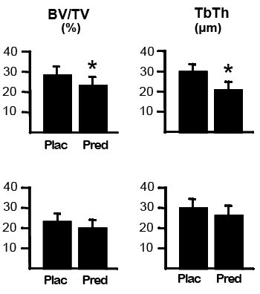
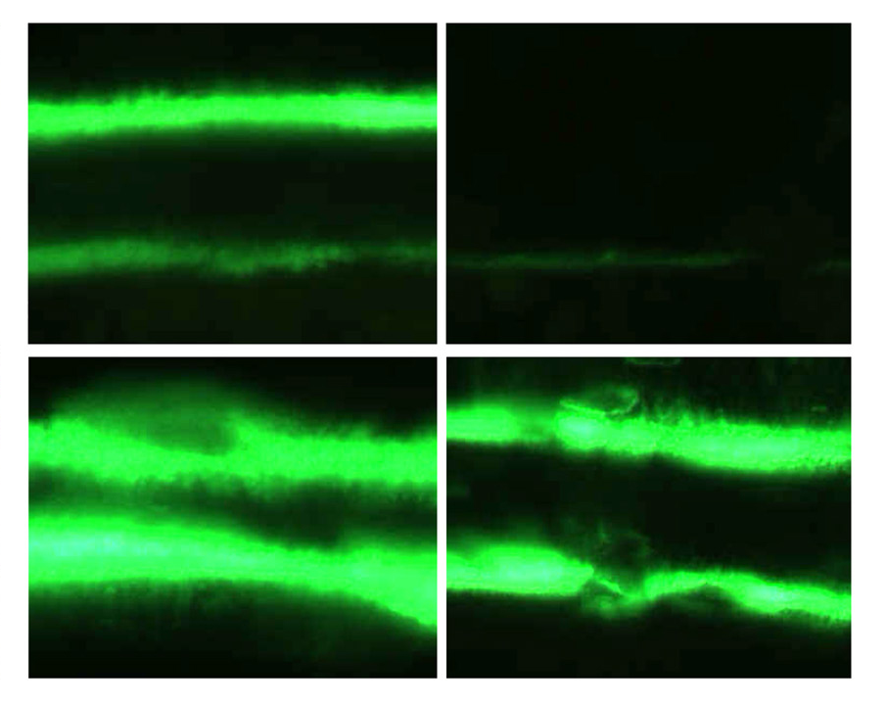
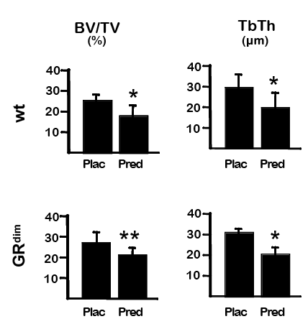
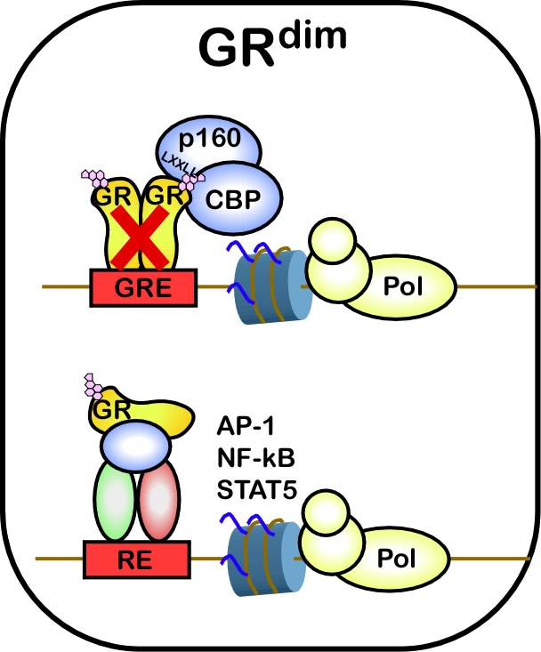
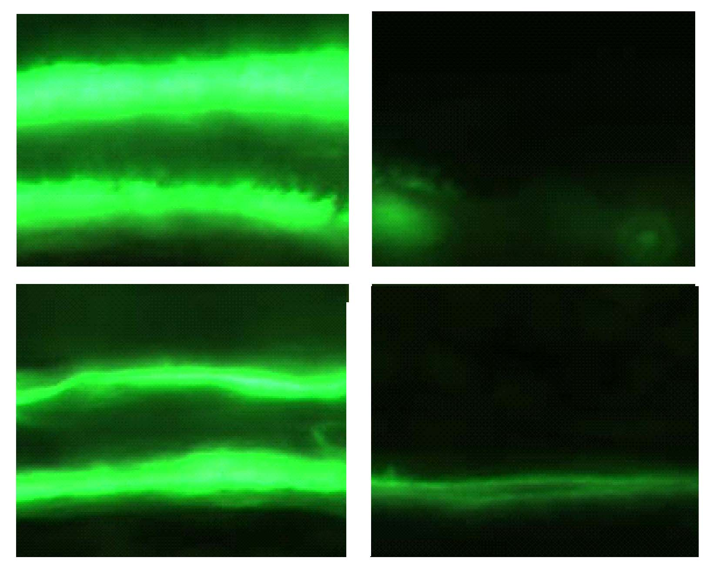
GR Monomer in osteoblasts
Bone Formation
GR^{flox}
Osteoblast
GR^{Runx2Cre}
-Prednisolone
+Prednisolone
Bone Formation
GR^{wt}
GR^{dim}
-Prednisolone
+Prednisolone
Rauch et al. Cell metabolism 2010 11:517

Slide 24
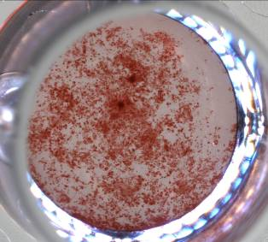
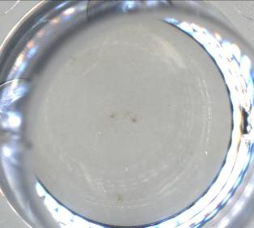
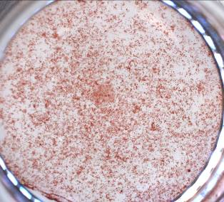
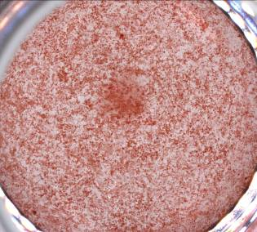
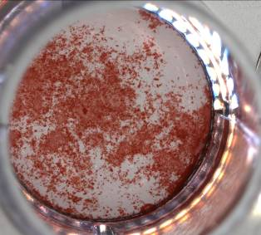
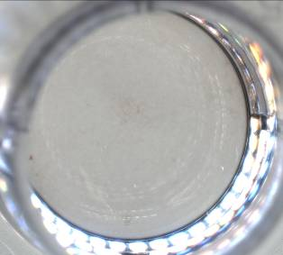
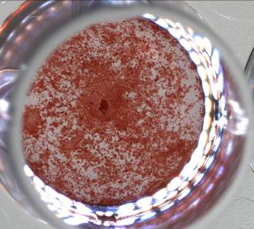
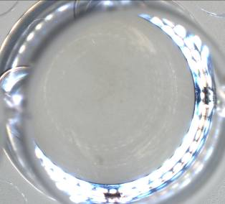
GR Monomer in osteoblasts
In vivo
Ex vivo: Aliz. Red
GR^{flox}
Osteoblast
GR^{wt}
GR^{Runx2Cre}
GR^{null}
+Dex
-Prednisolone
+Prednisolone
GR^{wt}
GR^{wt}
GR^{dim}
GR^{dim}
+Dex
-Prednisolone
+Prednisolone
Rauch et al. Cell metabolism 2010 11:517
Notes:
This we tested now on primary cells.
As you can see, primary cells in terms of differentiation mimick the inhibition of bone formation in these animals;

Slide 25
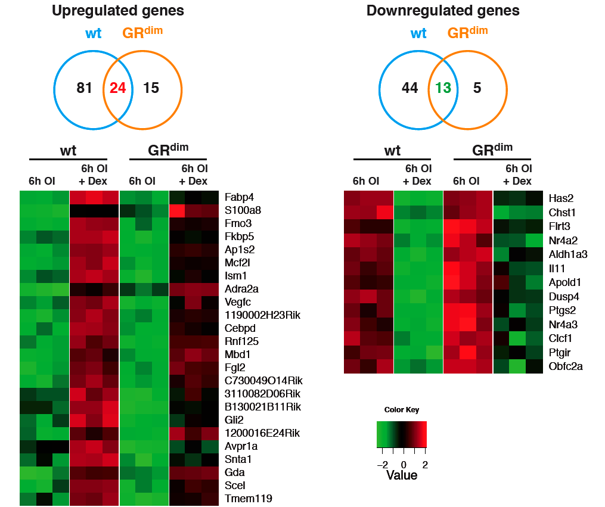
GR dimerization independent target genes
GR^{wt}
GR^{dim}
+Dex
Knoll et al. unpublished

Slide 26
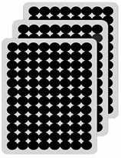
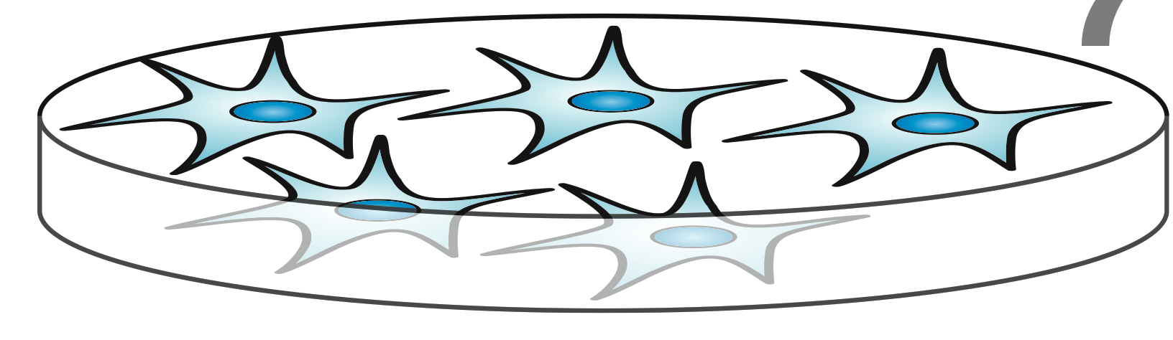
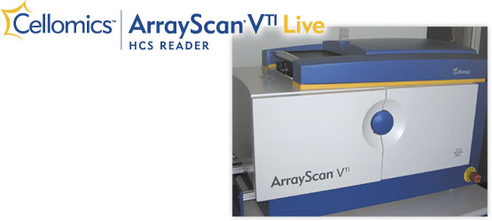
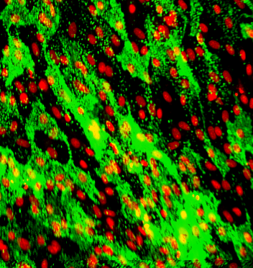
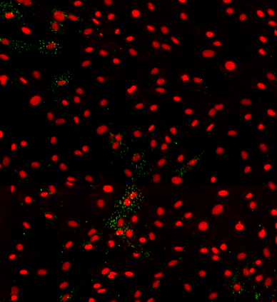
siRNA Screen approach
REVERSE TRANSFECTION
OSTEOGENIC INDUCTION
PHENOTYPIC ANALYSIS
OI-medium
Fixation and staining
OB-Progenitors
0d
2d
8d
siRNA library
SCRAMBLED
ALPL
Mubashir Ahmad, Jeanette Knoll

Slide 27
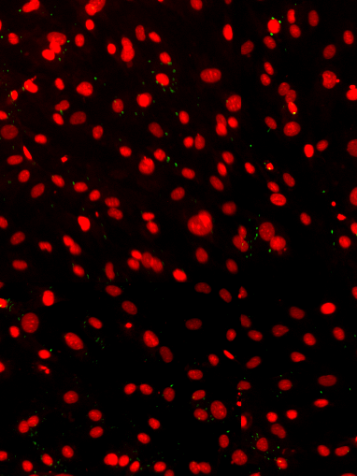
siRNA Screen approach

Slide 28
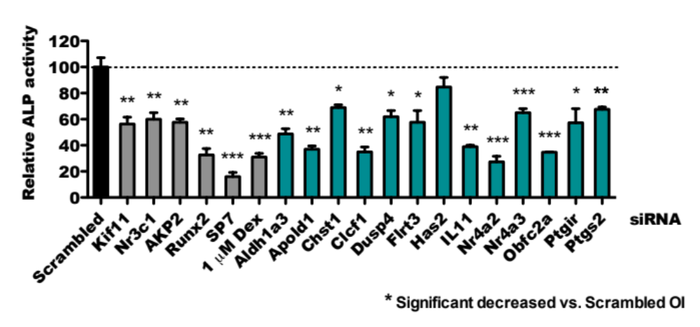
  Functional Test of GR target genes involved in OB Differentiation
Readout: Alkaline phosphatase (ALP) activity
Osteo-
progenitor
siRNA
Mature
osteoblast
Jeanette Knoll

Slide 29
Glucocorticoids
GR
GR
GR
Osteoblasts
AP-1
Anti-infl.genes
Cytokines/and others
Suppression of Inflammation
Side effects: Osteoporosis
Notes:
Mice lacking the GR in Myeloid cells and particular macrophages, so called GRLysMcre mcie for example, have a high regulation of TNF and IL-1b during an acute inflammatory responsed to LPS for example as shown in this study here.

Slide 30

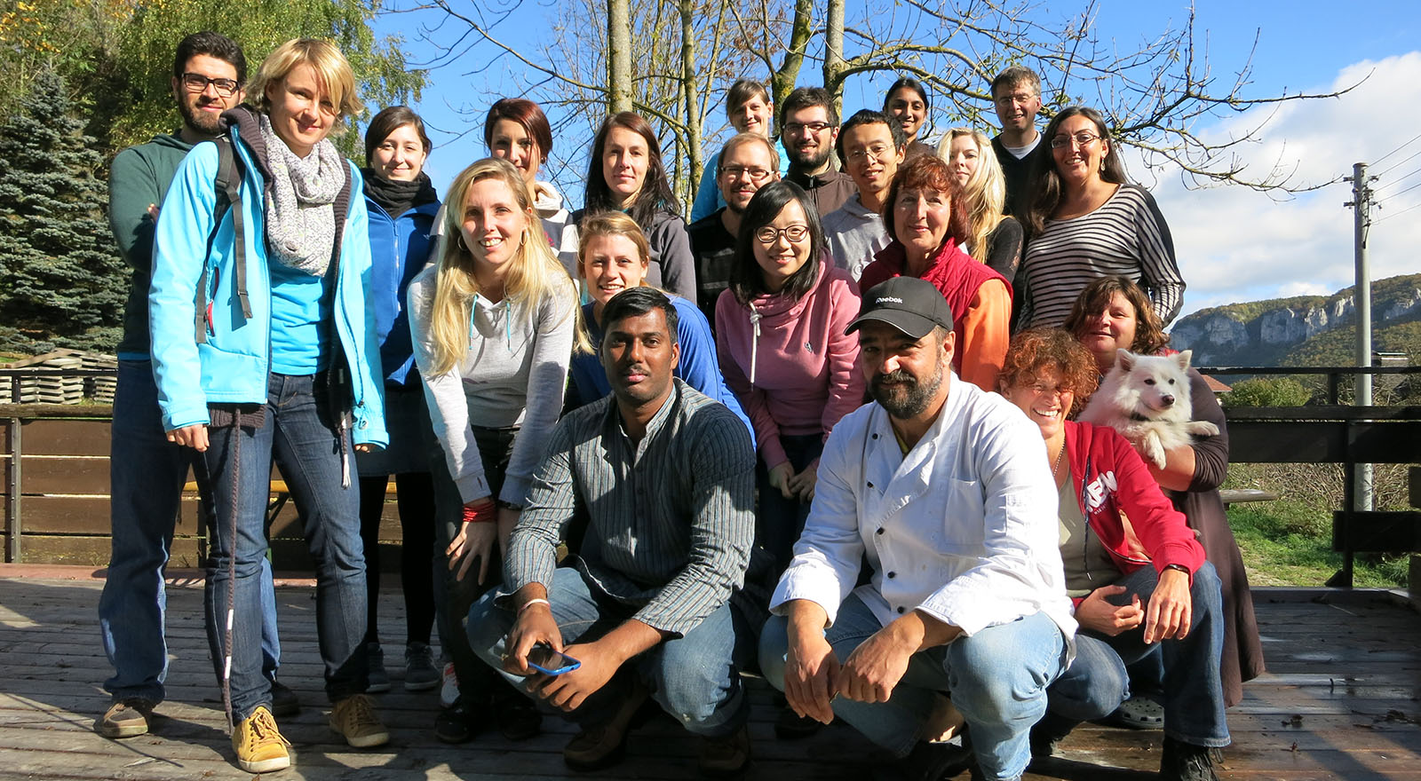
Alexander Rauch
Mubashir Ahmad
Juliane Weiner
Kerstin Bauer
Frederik Bonz
Ulrike Baschant
Mascha Koenen
Sabine Hübner
Jeanette Knoll

Slide 31

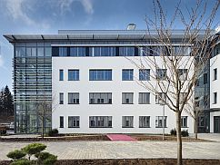



DFG
SPP
FLI
IMMUNO
BONE
1468
Mubashir Ahmad
Markus Gräler, Jena
Sabine Hübner
Holger Reichardt, Göttingen
Jeanette Knoll
Claude Libert, Gent
Mascha Koenen
Martina Rauner, Lorenz Hofbauer, Dresden
Sebastian Schauer
Hong Zhou, Markus Seibel, Sidney
Kerstin Hartmann
Gerhard Krönke, Georg Schett, Erlangen
Aspasia Ploubidou, Jena
Sooyeon Lee
Jean-Pierre David, Hamburg
Peng Liu
Henriette Uhlenhaut, Munich
Alumni
Mitch Lazar, David Steger Philadelphia
Ulrike Baschant
Anna Kleyman
Ilse Beck, Karolien De Bosscher, Gent
Stephan Culemann
Alexander Rauch
Richard Moriggl, Vienna

Slide 33
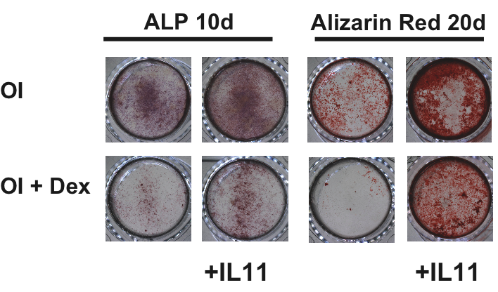

Ectopic IL-11 counteracts Dex mediated inhibition of Osteoblast Differentiation
Rauch et al. Cell metabolism 2010 11:517
Notes:
Most importantly suppression of osteoblast differentiation could be counteracted by the addition of IL-11 on all stages of osteoblast maturation, ALP activitiy and Alizarin Red staining. This was also reflected quantitatively and by the restored expression of the osteoblast key transcription factor Runx2.
Thus reduction of endogenous IL-11 by the monomeric GR is likely to contribute to inhibition of differentiation

Slide 34

GR in Th17 cells and in chondrocytes is required for suppression of Arthritis
T Cells
AIA
Antigen-induced Arthritis
Baschant et al. PNAS 2011, 108: 19317
K/BxN
Serum Transfer-induced Arthritis
Ulrike Baschant, Stephan Culemann, Mascha Koenen
Notes:
GCs in RA are affecting the bone and the inflammatory response.
We so far have addressed the inflammatory response in a first simple RA model, AIA, which allows to use several compound mutant GR strains to answer which cell type and which mechanism is critical for Immunotherapy. When employ GRLysMCre mice lacking the GR in myeloid cells we see in both wild type and mutant mice a reduction of the inflammatory swelling response. In contrast GRLckCre mice, lacking the GR in T cells have no reduction in the swelling by GCs.
Thus the GR in T cells is critical for anti-inflammatory effects. Similar GR dimerization impaired mice were completely refractory in GC therapy, thus we need for this aspect of RA therapy dimerization of the GR.

Slide 35
RNAi Screening Status
Primary Screen
6362
RNAi Screening
1805
Regulators
197
Suppressors
1608
Activators

Slide 36





siRNA Screen approach
UNTREATED
MOCK
SCRAMBLED
KIF11
ALPL
IL11
RUNX2
SP7/Osterix
Jeanette Knoll, Mubashir Ahmad

