Slide 1


RRx-001, a novel ROS-mediated epigenetic modulator: ‘Episensitization’ to previously failed therapies
Jan Scicinski
Mountain View
California, USA

Slide 2





Company Origin and Trajectory
Life science company developing epigenetic- and immunological-based drugs for the treatment of patients with cancer
V-IMMUNETM novel oncolytic immunotherapy platform
Venture capital financing for IND and clinical trials
Completion of successful Phase 1 study for RRx-001 and initiation of multiple phase 2 studies
Lead clinical candidate RRx-001 is identified
Source of aerospace-derived molecules

Slide 3
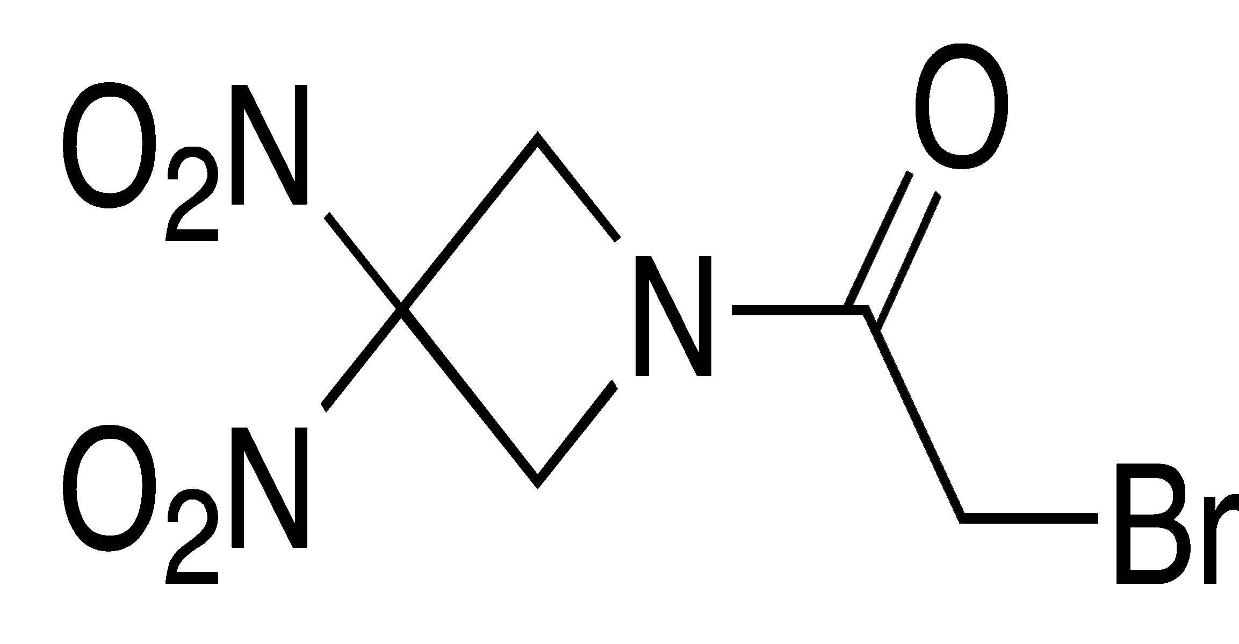
RRx-001: Novel ROS-Mediated Epigenetic Modifying Agent
Novel mechanism of action
Elicits a tumor localized ROS and RNS burst
  Apoptosis
  Necrosis
Induces broad ROS mediated epigenetic effects
Applications
Priming to resensitize patients to refractory chemotherapy
(Epi-Sensitization)
Potent radiosensitizer
Immunological priming
ROS: Reactive Oxygen Species
RNS: Reactive Nitrogen Species

Slide 4
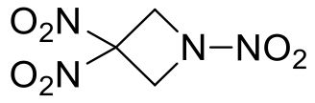
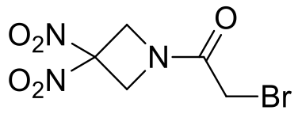
  ROS Mediated agents: Discovery of RRx-001
Screening of energetic materials as radiosensitizers
and single agent cytotoxics
R-O-NO₂
RR’-N-NO₂
Strained heterocycles
TNAZ: Highly energetic material with promising single agent and radiosensitizing activity
TNAZ: (TNT-replacement)
RRx-001: equipotent to CDDP in vitro and in vivo, radiosensitizer
RRx-001 (Phase 2)
6

Slide 5
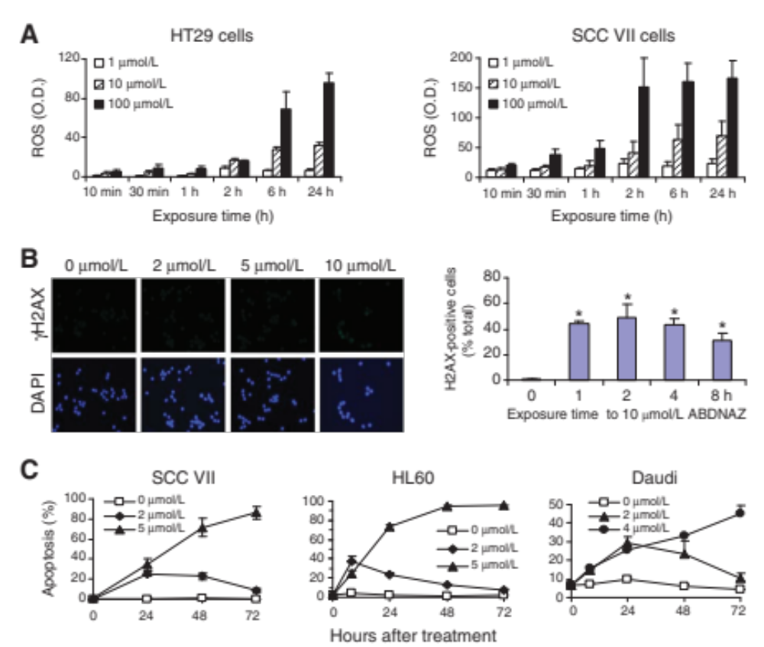
RRx-001 Induces Reactive Oxygen Species (ROS)
Intracellular ROS levels increase in HT29 and SCC VII cells after RRx-001 exposure
DCFH-DA assay
O.D. – optical density
Ning, S. et al. Cancer Res 72, 2600–2608 (2012)

Slide 6
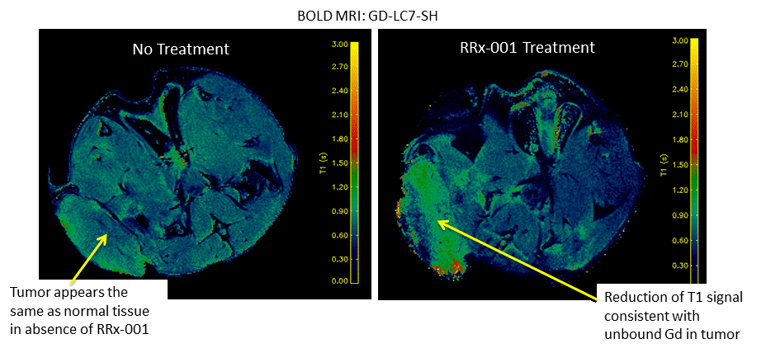
RRx-001 Induces Tumor Oxidation
Target oxidation by RRx-001 can have profound anti-tumor effects – in vivo model
Gd-LC7-SH contrast agent measures oxidation state of tumor
Gd-LC7-SH spontaneously binds to reduced thiols following i.v. administration
RRx-001 treatment results in lower GD-LC7-SH binding; hence increased oxidation state
Raghunand et al, Proceedings of the 105th Annual Meeting of the American Association for Cancer Research; 2014 Apr 5-9; San Diego, CA. Philadelphia (PA): AACR; Cancer Res 2014;74(19 Suppl):Abstract nr 2068. doi:10.1158/1538-7445.AM2014-2068

Slide 7
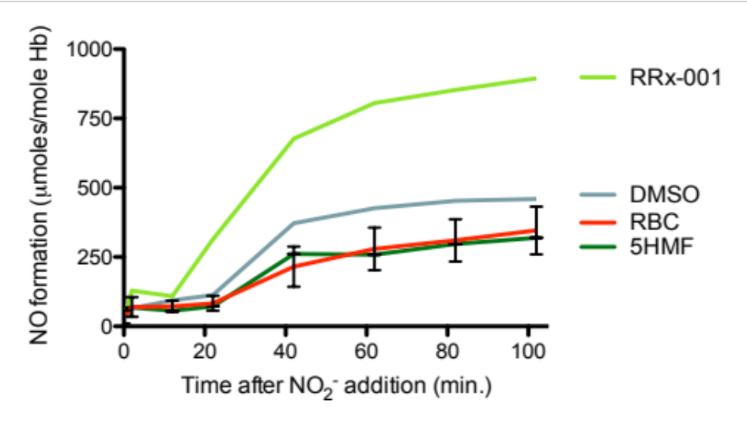

Nitric Oxide Release “On Demand”
RRx-001 increases
deoxy-Hb nitrite reductase activity under hypoxia
High
Low
Tumor
Oxygen
Hb-RRx-001
Nitrosative and
Oxidative stress
O₂⁻
RONS
NO•
Iron catalyzed
oxidation
NO₂⁻
Nitrite
Low
High
Fens, M. ASH 2011

Slide 8
Epigenetic Mechanism of RRx-001
RRx-001 is a pan-epigenetic agent
Methyltransferases
DNMT1, DNMT3a
ROS
RNS
Histone
Deactylase H3, H4
RRx-001
Apoptosis
Secondary
Effects
Vascular normalization
Immune effects
Zhao H, Stanford U, in press,
Chauhan, D, Dana Farber, unpublished data
Thomas D, U Illinois, unpublished data
5

Slide 9
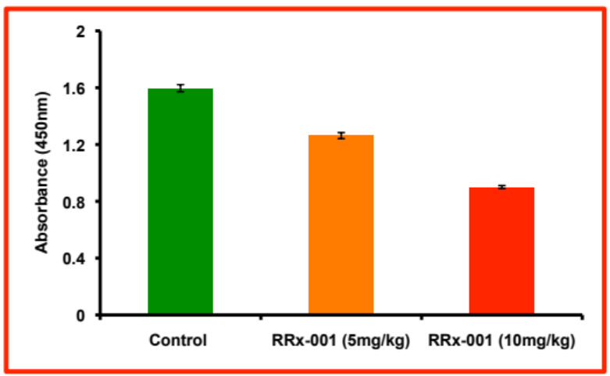
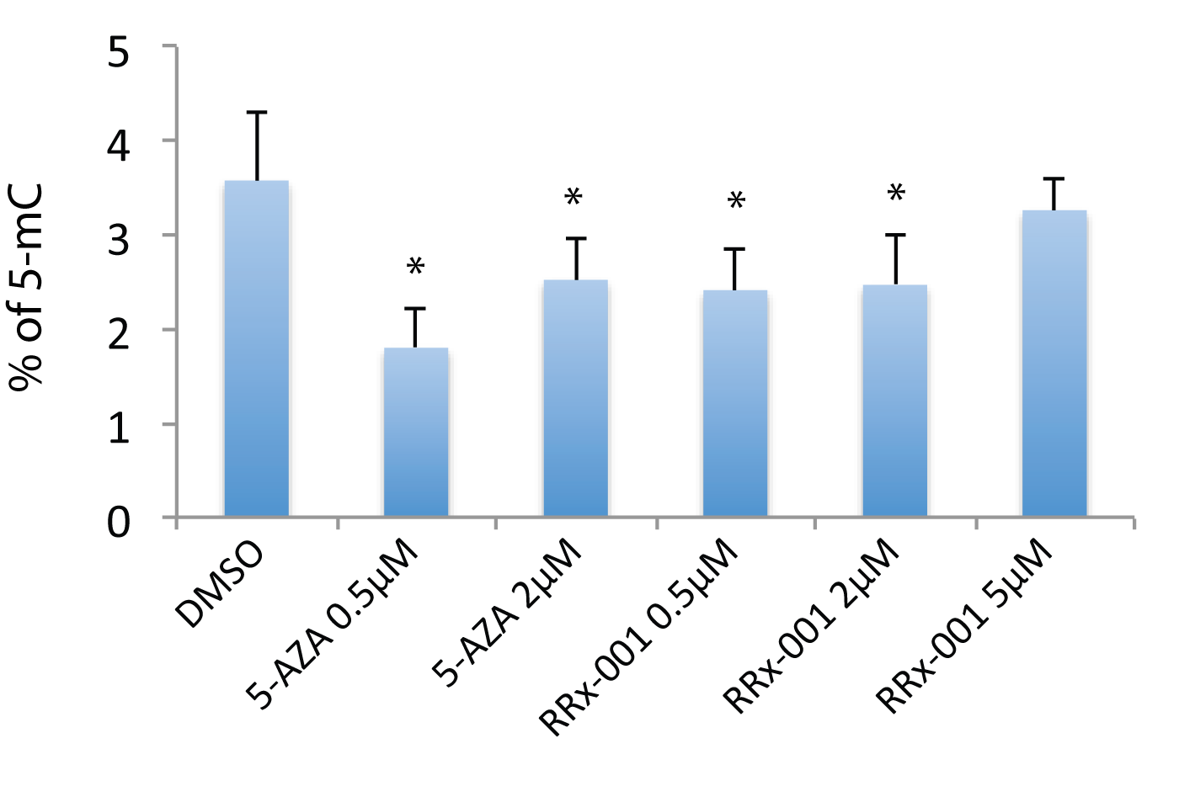
Molecular Mechanism of RRx-001
RRx-001 inhibits DNMT1, affecting global methylation
RRx-001
DNMT1
Global Methylation Control
In vivo DNMT1 activity: Tumors from vehicle or RRx-001-treated mice analyzed for DNMT1 activity using EpiQuik Dnmt1 Assay Kit
RRx-001 reduces global methylation levels
5-methylcytosine levels by ELISA
Zhao H, Stanford U, in press; Chauhan, D, Dana Farber, unpublished data
5

Slide 10
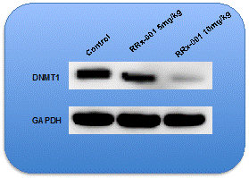
Molecular Mechanism of RRx-001
USP7 activates and stabilizes DNMT1. RRx-001 destabilizes DNMT1/USP7, decreasing DNMT1 levels
SH
SOH
²³³Cys
Oxidation
²³³Cys
USP7
USP7
Interaction
RRx-001
Stabilization
DNMT1
DNMT1
U
U
U
U
HDAC inhibition
Ac
Ac
Ac
K
G
K
G
K
G
K
G
K
G
K
G
Tumors from vehicle or RRx-001-treated mice were subjected to immunoblot analysis using anti-DNMT1 and anti-GAPDH Ab.
Lysine acetylation abrogates
USP7-DNMT1 interaction
Cotto-Rios et al Cell Reports, 2012, 2, 1475
Chauhan, D, Dana Farber, unpublished data
5

Slide 11
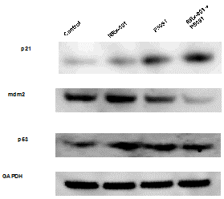
Molecular Mechanism of RRx-001
RRx-001 + USP7 inhibition decreases mdm2 and increases p53/p21 signaling pathways
USP7
RRx-001
+ USP7
inhibition
p53
mdm2
U
U
DNMT1
U
U
U
Normally ubiquitinated by mdm2
U
U
U
Degradation
Degradation
MM.1S cells were treated for 48h with RRx-001 (1.25 uM), P5091 (3 uM), or RRx-001 (1.25 uM)) plus P5091 (3 uM); protein lysates were subjected to immunblotting using antibodies against p21, MDM2, p53, and GAPDH.
Chauhan, D, Dana Farber, unpublished data
5

Slide 12


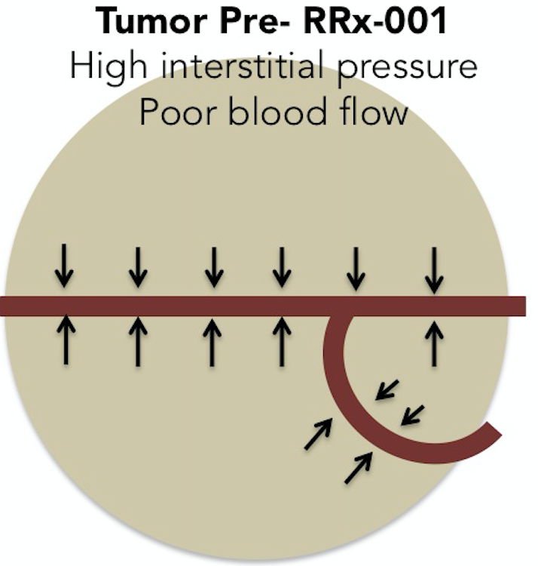
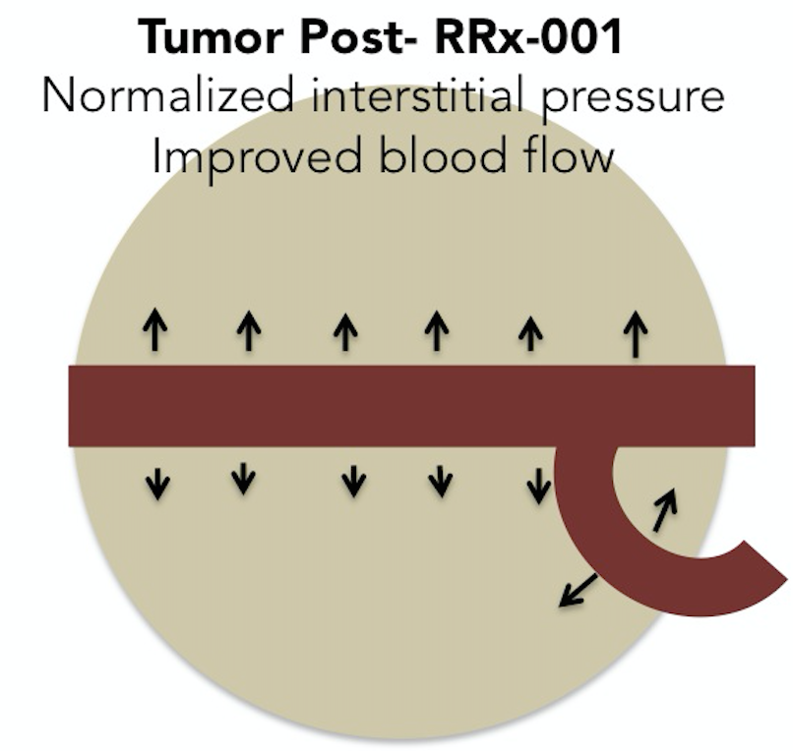
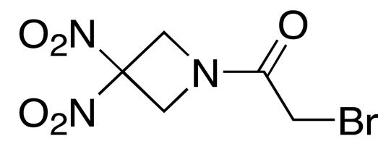
Vascular Normalization by RRx-001
RRx-001 causes vascular normalization and improved blood flow:
- Potential enhanced delivery of nivolumab and “priming” of anti-tumor responses
Abnormal tumor vasculature leads to increased interstitial pressure and poor blood flow.
RRx-001 changes blood flow in functional vessels, and thereby normalizing interstitial pressure, which allows for improved drug delivery within tumor.
RRx-001
High Interstitial Pressure
Normalized Interstitial Pressure

Slide 13
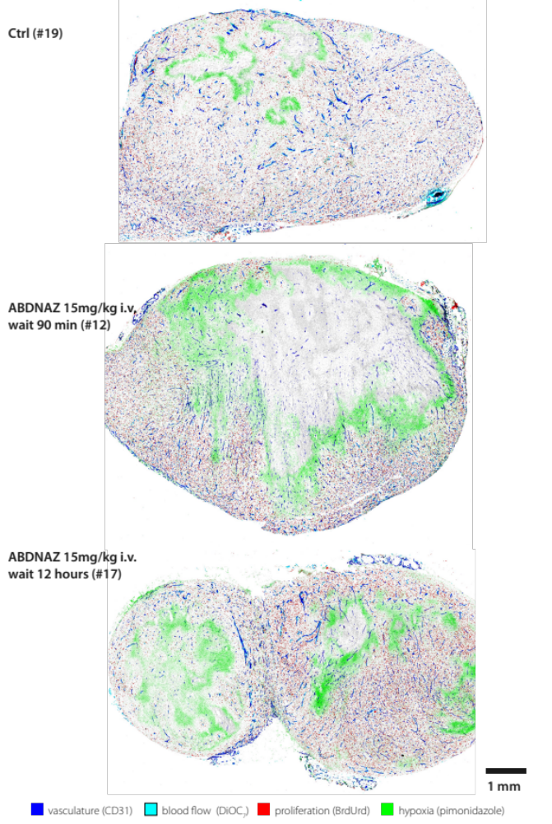
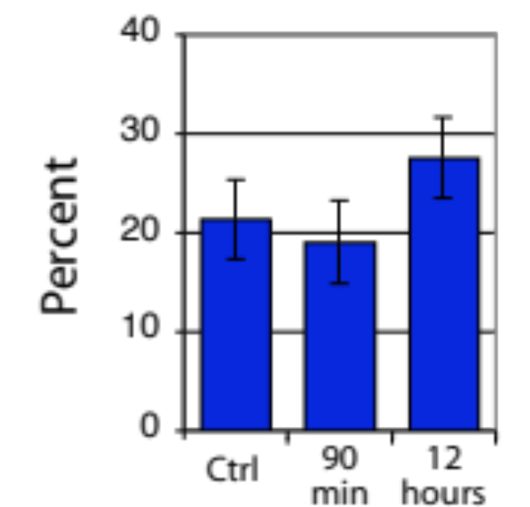
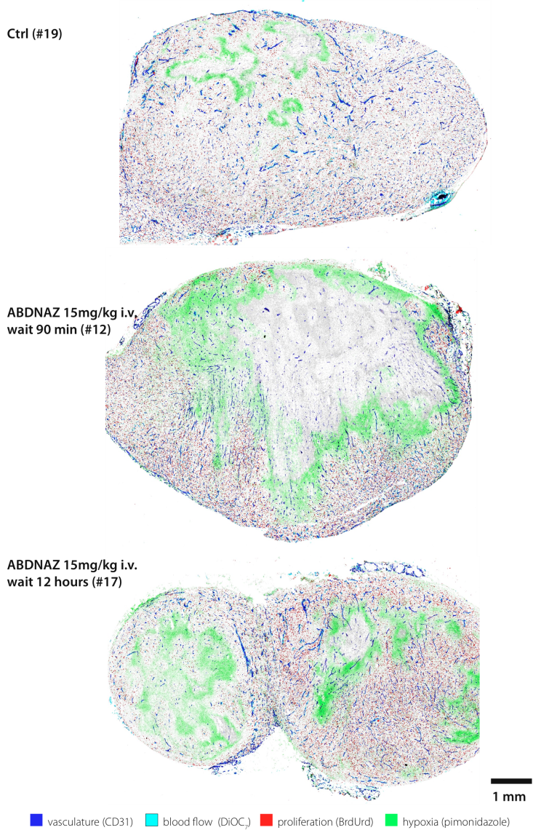
RRx-001 Modifies tumor blood flow
Initial area of
hypoxia
Before dose
Percent of vessels positive for the perfusion marker DiOC₇
Area of
hypoxia
Area of
vascular
shutdown
RRx-001, 15 mg/kg
90 min post dose
Mouse U87 tumor
model
Area of increased
blood flow
12 hours post dose
Scicinski et al. Cancer Res 2012, 72, (8), supl 1, 4371.

Slide 14
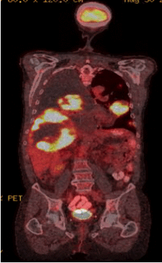
RRx-001 Phase 1 Study
Safe and well tolerated
  Systemically non-toxic & no DLTs
  Maximum feasible dose rather than MTD reached – Infusion pain
5/25 patients still alive at 2-2.5 years
RRx-001 therapy results in dramatic phenotypic changes of the tumor architecture (histological remodeling)
‘Epi-Sensitization’
  4/4 patients resensitized to formerly failed chemotherapy
  1/4 patients retreated with refractory therapy still alive after ~2 years!
Data strongly support further clinical development
Necrotic core with hypermetabolic rim of lung and liver lesions due to treatment with RRx-001
Pathology report:
The majority of the rim is necrotic (>90%)

Slide 15
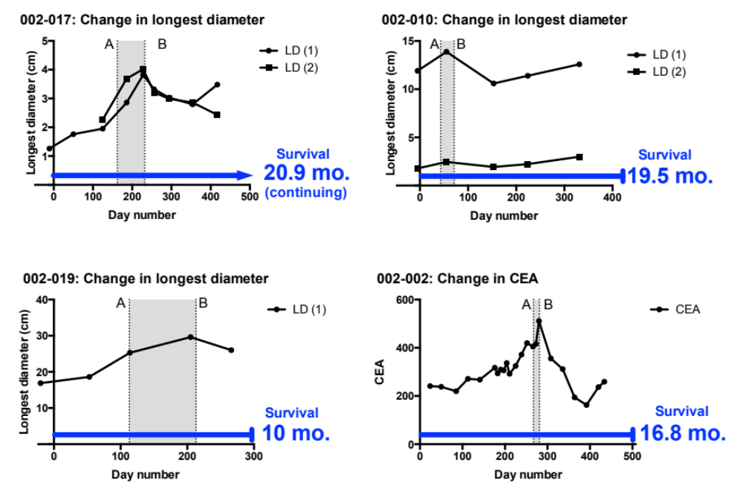
Epigenetic Priming in Action: Epi-Sensitization
Evidence of resensitization to prior refractory chemotherapy in Phase 1
CEA Levels Colorectal Cancer Patient 002-002
Resensitized Colorectal Cancer Patients
Grey area denotes a treatment gap between RRx-001 and subsequent therapy
Time post RRx-001 Months
Survival after RRx-001 Tx Stopped and treatment with therapies thought to be refractory

Slide 16

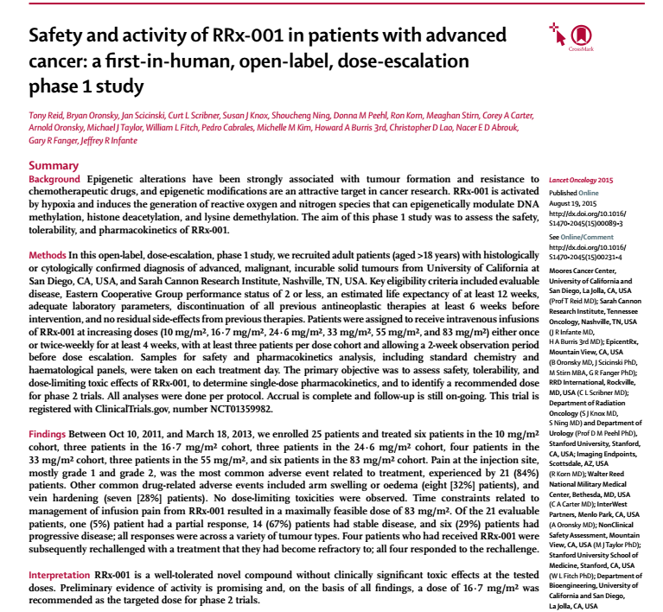
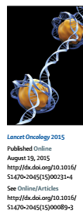
RRx-001 in THE LANCET Oncology
The Lancet Oncology. 2015; 16(9):1133 – 1142.

Slide 17

RRx-001: Redefining Therapeutic Strategies for Cancer
Epi-Sensitization:
Enhancement of therapeutic efficacy by co-dosing or
sequential administration with an epigenetic agent
Resets cellular architecture of the tumor and tumor microenvironment
Sensitization of drugs with combination therapy
Restoration of sensitivity of refractory therapy
Diagnosis Colon Cancer
Treatment Options:
Diagnosis Colon Cancer
Treatment Options:
1st line treatment FOLFOX
1st line treatment FOLFOX
Tumor resistance
Cancer progression
Tumor resistance
Cancer progression
2nd line treatment FOLFIRI
2nd line treatment FOLFIRI
Traditional Cancer Treatment
RRx-001 Cancer Treatment
Turning back the
clock on cancer
Tumor resistance
Cancer progression
Tumor resistance
Cancer progression
3rd line treatment regorafenib
3rd line treatment RRx-001
Tumor resistance
Cancer progression
Tumor resistance
Cancer progression
Hospice/Death

Slide 18
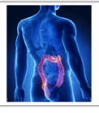
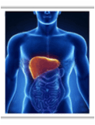
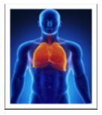
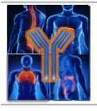
RRx-001: Applications in Chemo-Resensitization
Colorectal Cancer
ROCKET study
RRx-001 vs 3rd line standard
Tony Reid (UCSD)
George Fisher (Stanford)
Paul Thambi (Maryland Onc/Hema)
NCT02096354
Cholangiocarcinoma
EPIC study
Resensitization: gem/cisplatin
Ana De Jesus
(Johns Hopkins University)
Lung Cancer
TRIPLE THREAT study
Resensitize: NSCLC & SCLC
Corey Carter (Walter Reed)
NCT02452970
NCT02489903
Anti-PD-1 Combo
PRIMETIME study
Checkpoint sensitization
Corey Carter (Walter Reed)
NCT02518958

Slide 19
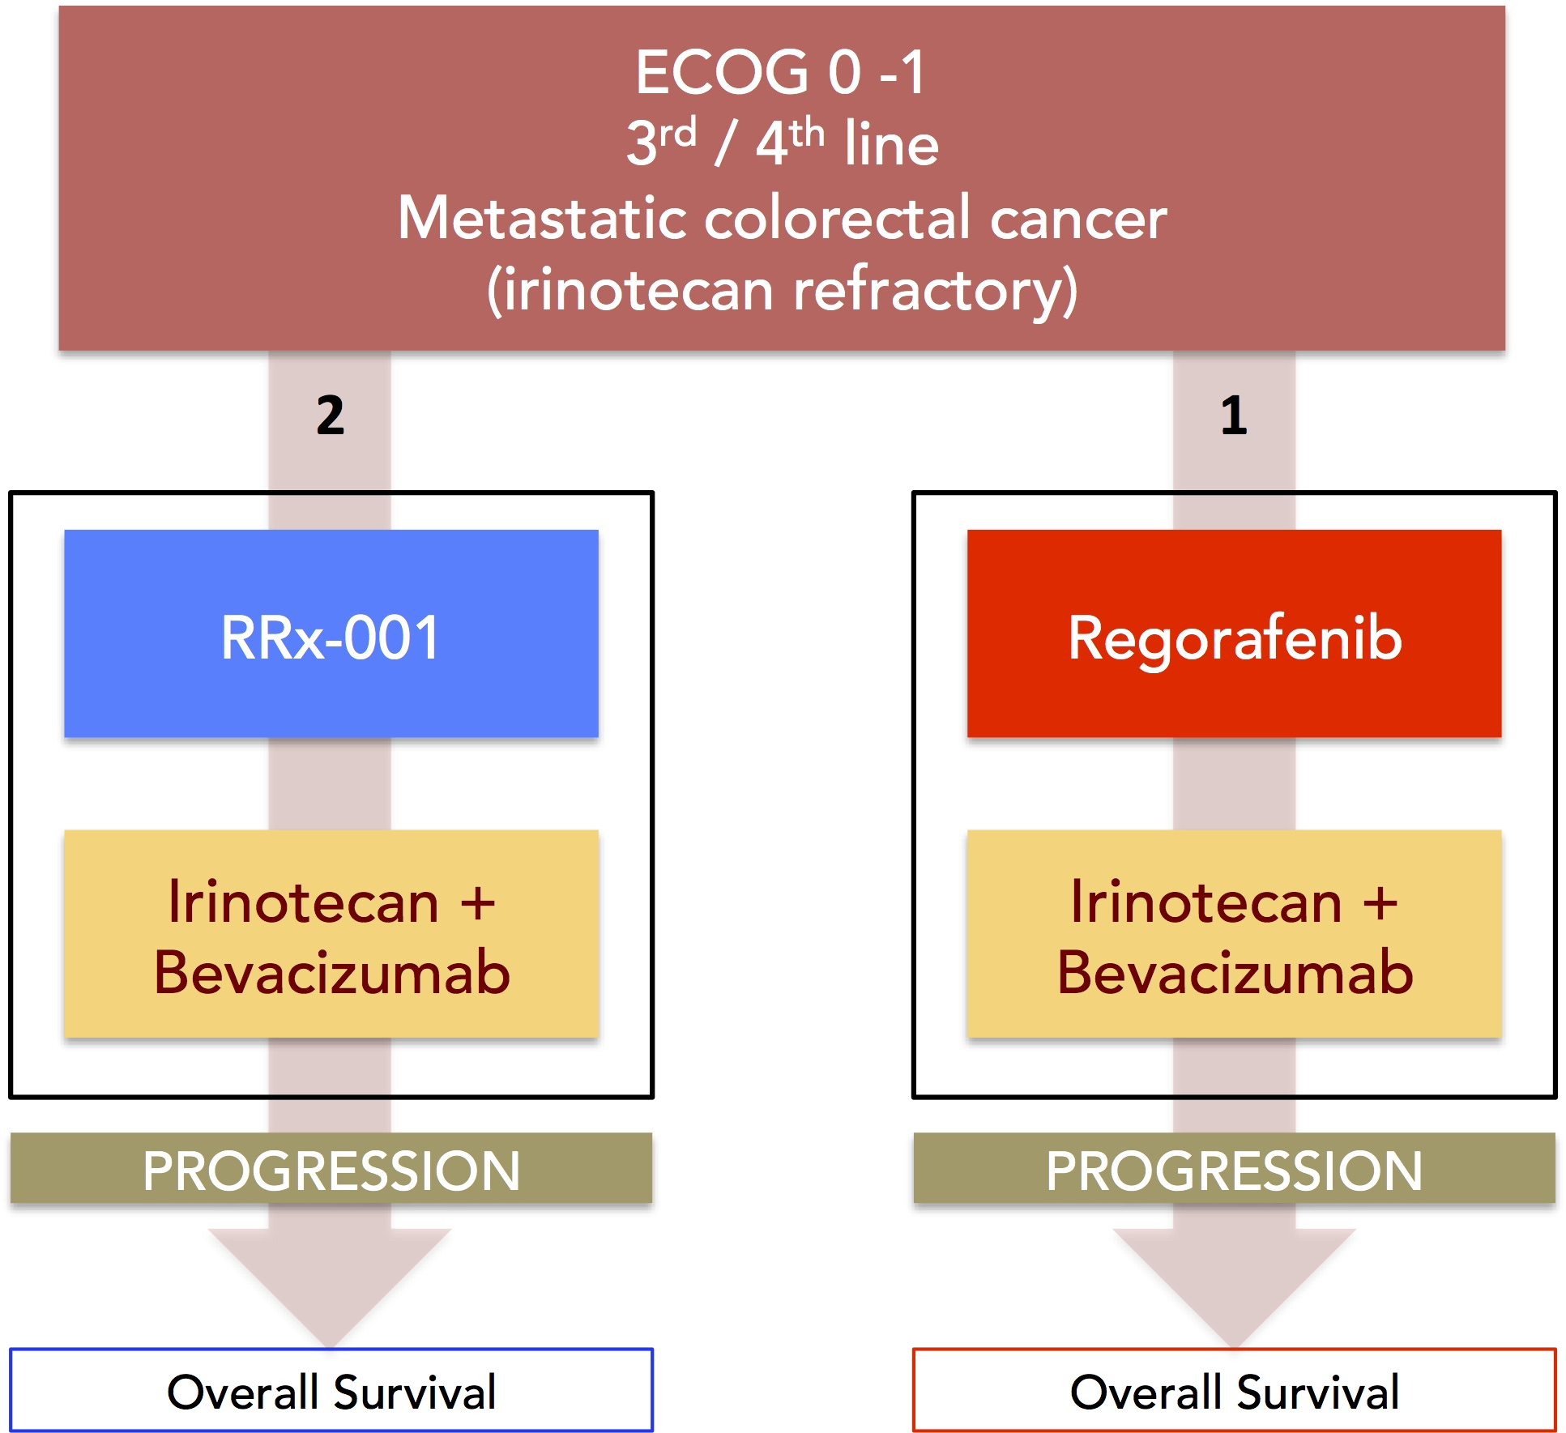
Phase 2 Colorectal Cancer Study Design – RRx-001 vs 3rd/4th Standard of Care
NCT02096354

Slide 20
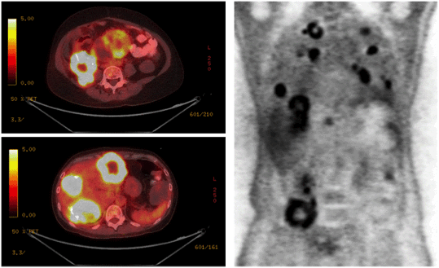
Early Phase 2 RRx-001 Scan Results: Necrotic Centers
Similar to Phase 1, RRx-001 treatment of colorectal cancer patients result in distinct changes in tumor architecture including highly necrotic tumor centers

Slide 21
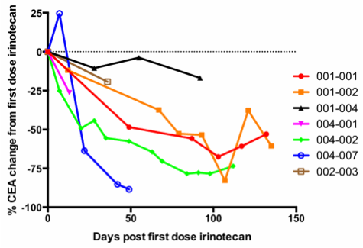
Early Phase 2 RRx-001 Results: CEA Biomarker Reductions
Resensitization to previously failed therapy in majority of RRx-001 patients to date
CEA (carcinoembryonic antigen): Serum marker closely correlates with tumor burden in CRC

Slide 22
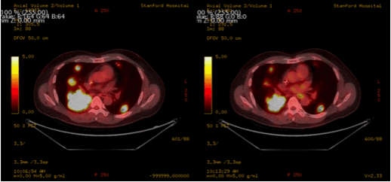
Early Phase 2 RRx-001 Results – PET/CT Partial Responses
Patient 004-002 PET/CT – At completion of RRx-001 vs 8 weeks post irinotecan
Oct 2014
Completion of RRx-001
Dec 2014
8 weeks irinotecan

Slide 23
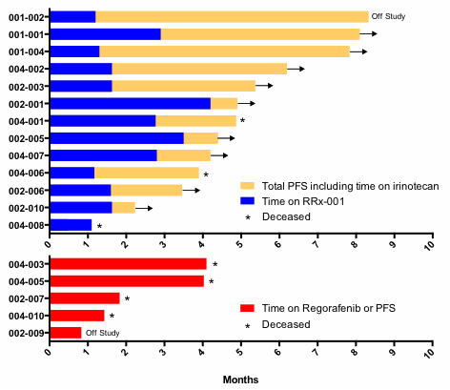
Early Phase 2 RRx-001 Results: Improving Patient Survival
Evidence of resensitization: PFS differences evolving between RRx-001 arm and Regorafenib (standard of care) in the progressing Phase 2 trial
Experimental therapy: RRx-001 + retreatment with previously failed therapy
Standard of care for 3rd/4th line therapy: regorafenib

Slide 24
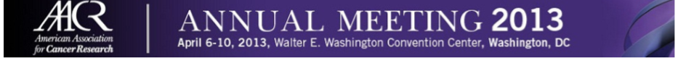
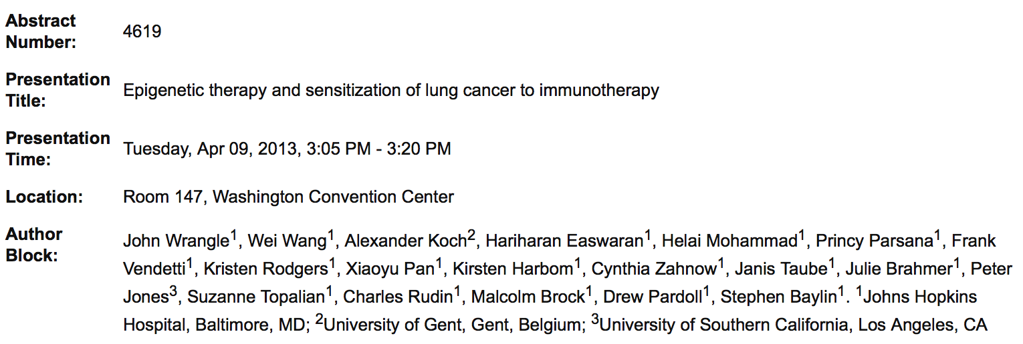
Johns Hopkins – Stand Up for Cancer Funded Study
“Epigenetic alterations driving carcinogenesis and cancer progression can be specifically targeted by the demethylating agent azacitidine (Aza) and the histone deacetylase inhibitor entinostat. While this treatment combination has been effective in a limited number of patients (pts) with treatment-refractory non-small cell lung cancer (NSCLC), we observed clinical benefit in 5 of 5 patients who received immunotherapy with PD-1/PD-L1 pathway blockade immediately following epigenetic therapy.”

Slide 25
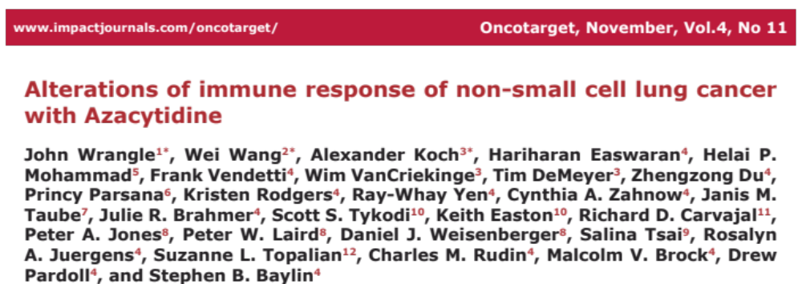
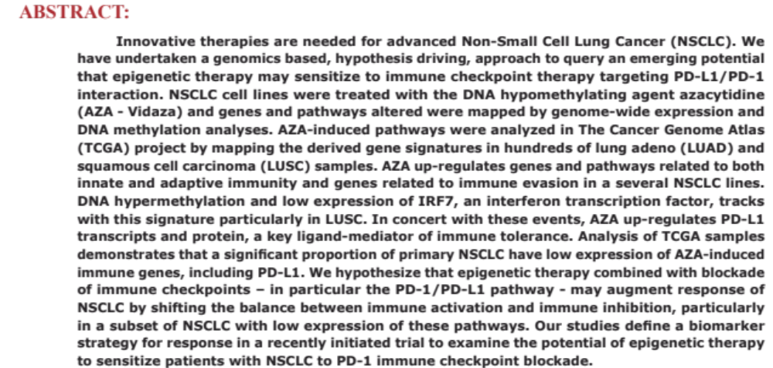
Epigenetic activation of immune therapy

Slide 26
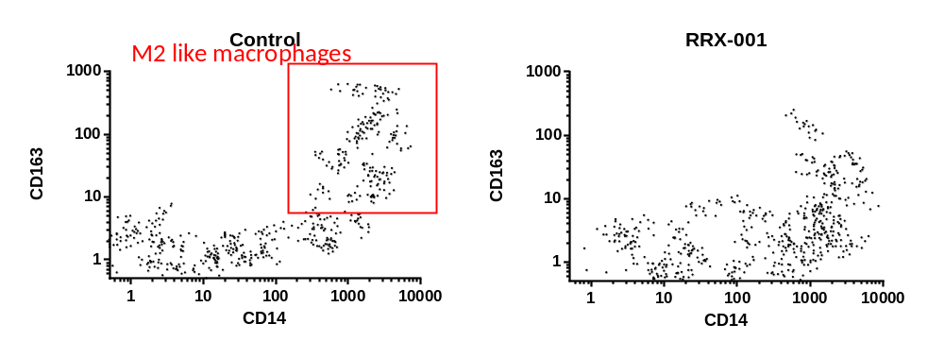
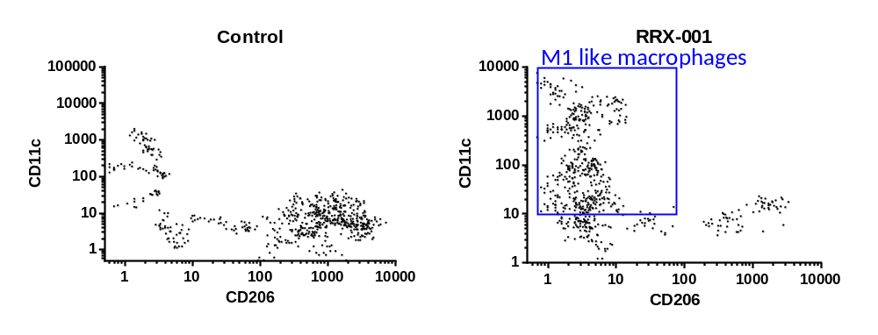
RRx-001 Induces M2 → M1 Conversion
Importance of M1-macrophages for induction of inflammatory anti-tumor response is well established
Administration of RRx-001 results in an increase of M1-like macrophages together with a decrease in M2-like macrophages in TAMs.
P Cabrales, UCSD , unpublished data

Slide 27
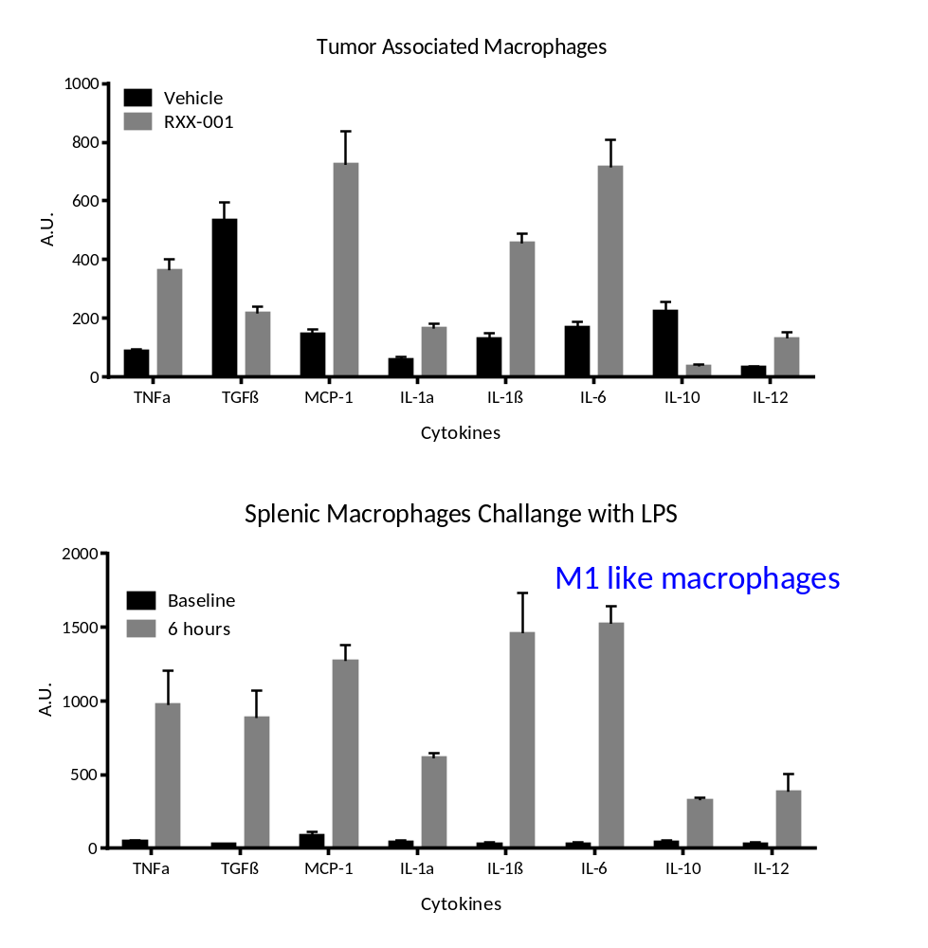
RRx-001 Induces M2 → M1 Conversion
Importance of M1-macrophages for induction of inflammatory anti-tumor response is well established
Administration of RRx-001 results in a predominantly M1 macrophage phenotype in TAMs. Induction of the M1 phenotype by LPS in splenic macrophages is shown below as a comparison.
P Cabrales, UCSD , unpublished data

Slide 28
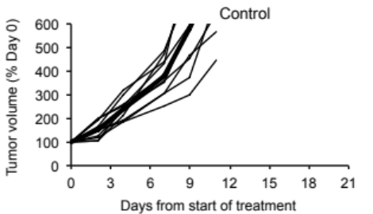
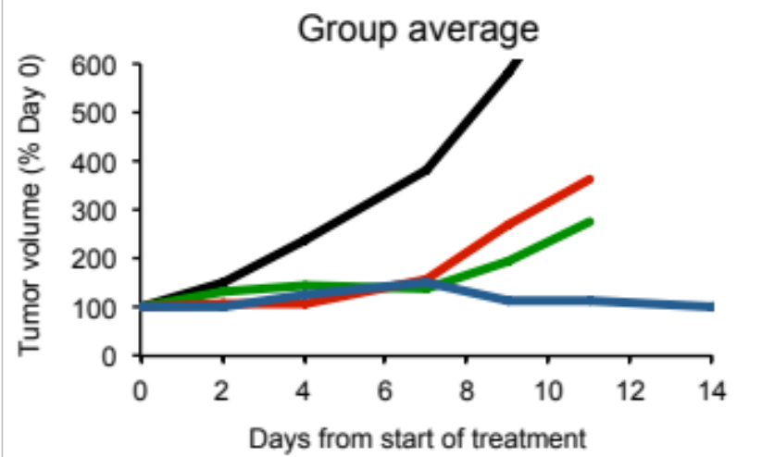
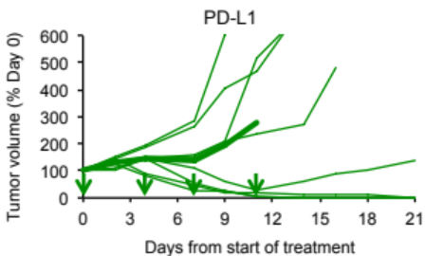
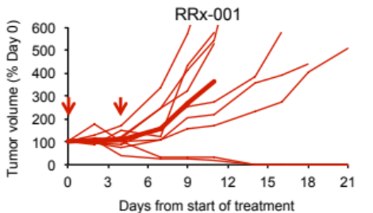
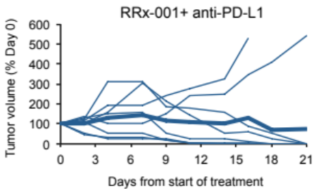
Immune Synergy with PD-1 Checkpoint Therapy – in vivo
Tumor response
Mice
CR
PD
Control
10
10
PD-L1
8
3
5
ABDNAZ
9
2
7
ABDNAZ + PD-L1
8
6
2
* CR: complete regression; PD: progressive disease.
J558L myeloma tumors in BALB/c mice. RRx-001: 10 mg/kg (IP), Day 0 and 4; anti-PD-L1: 10 mg/kg, 2 x week for 2 weeks.
Shoucheng Ning, Stanford University, unpublished data

Slide 29
RRx-001 + Immunotherapy Combination Studies
Anti-PD-1 Combo Study “PRIMETIME”
Population:
Advanced, solid tumor(s) or lymphomas
Refractory, intolerant to, or has refused all standard available life-prolonging therapies.
Dose escalation of
RRx-001 2 to 32 mg/m² 1x wk
+
Nivolumab 3 mg/kg 1x 2 wk
Safety,
Survival,
Response
Biomarkers
NCT02518958

Slide 30
Conclusions
RRx-001 is a well tolerated systemically non-toxic agent
ROS/RNS-mediated mechanism of action
Active against multiple epigenetic targets
Reversal of chemotherapy resistance observed in clinic
Early preclinical data suggests synergy with immune therapy, particularly immune checkpoint inhibitors
Reversal of resistance to immune checkpoint inhibitors being explored in ongoing clinical trials

Slide 31

Acknowledgments
Clinical:
  UCSD: Dr Tony Reid
  SCRI: Dr Jeff Infante
  Walter Reed: Dr Corey Carter
  Stanford: Dr George Fisher
ORBITAL ATK
  Lou Cannizzo
  Bob Wardle
  Nick Straessler
EpicentRx Team
  Bryan Oronsky
  Gary Fanger
  Meaghan Stirn
  Chris Parker
  Scott Caroen
Preclinical Collaborations
  Mark Bednarski
  Susan Knox
  Donna Peehl
  Shoucheng Ning
  Pedro Cabrales (UCSD)
  Dharminder Chauhan (Dana Farber)
  Douglas Thomas (U Illinois)
  Frans Kuypers (CHORI)
Investors
  InterWest Partners
Patients and their families

Slide 32



THANK
YOU!
800 West El Camino Real
Suite 180
Mountain View, CA 94040

Slide 33
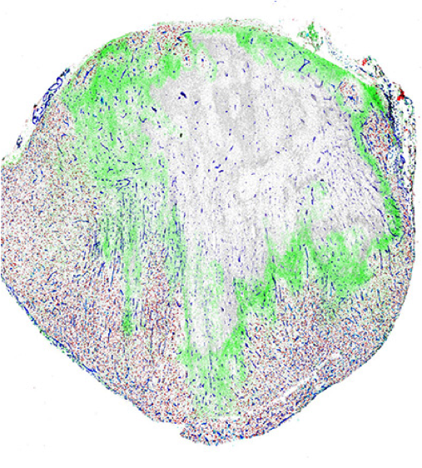
Immature
Dendritic Cell
RRx-001-Mediated Immunogenic Cell Death
Dying Tumor Cell
Immature
Dendritic Cell
DAMPs
Mature
Dendritic Cell
Antigen
engulfment
c
c
c
c
c
c
c
c
Antigen
presentation
c
c
c
IL-1β
Immunogenic Cell Death
c
c
c
c
c
c
Naïve
T-cell
c
RRx-001
c
c
c
c
Necrotic tumor cells
IL-17
c
c
c
c
c
c
c
c
c
c
c
c
c
c
IFN-γ
Cytotoxic
Tumor
Lymphocytes
Tumor cell lysis

