Slide 1
Accretionary complexes: Recorders on Earth and possibly Mars
James Dohm and S. Maruyama
ELSI, Titech, Japan

Slide 2
Contents
1 Debate on Mars; Plate Tectonics (PT) was present or not?
2 How to demonstrate PT on Mars.
ANS: Accretionary complex (ACs) and Pacific-type orogen
3 Presence of ACs on Mars (cf. SW Japan)
4 Presence of olistostrome? (cf. Wales, UK)
5 Next step to demonstrate and conclusions

Slide 3
1. Debate on Mars
Plate Tectonics was present or not?

Slide 4
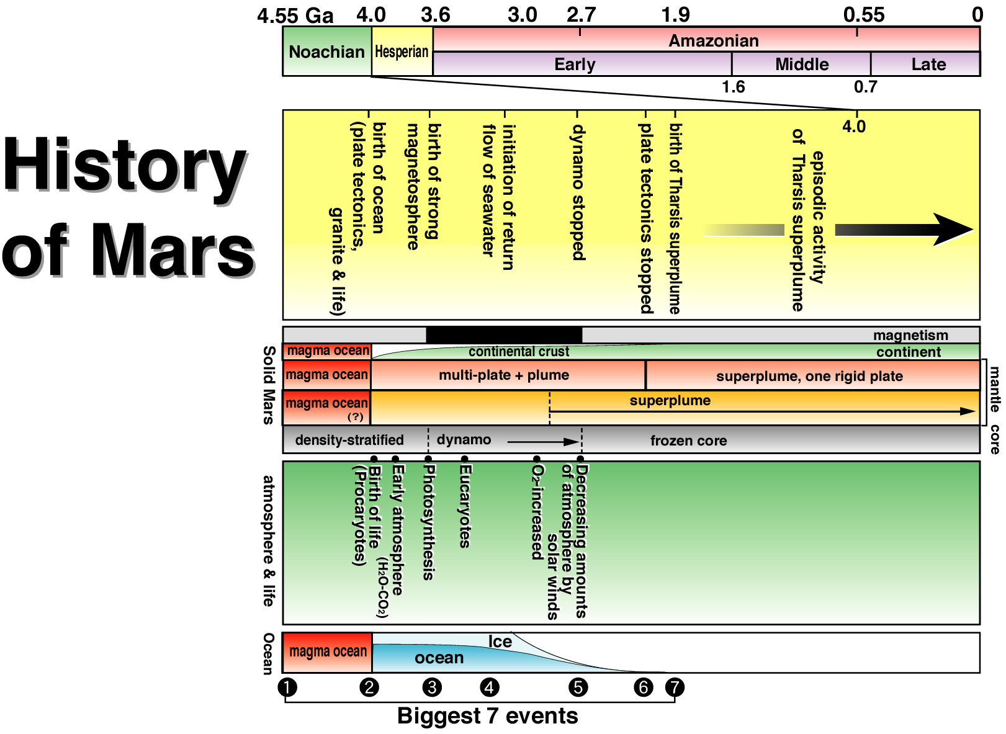
From multi-plates to
one plate planet

Slide 5
2 How to demonstrate PT on Mars?
ANS:
Accretionary complex and
Pacific-type orogen

Slide 6
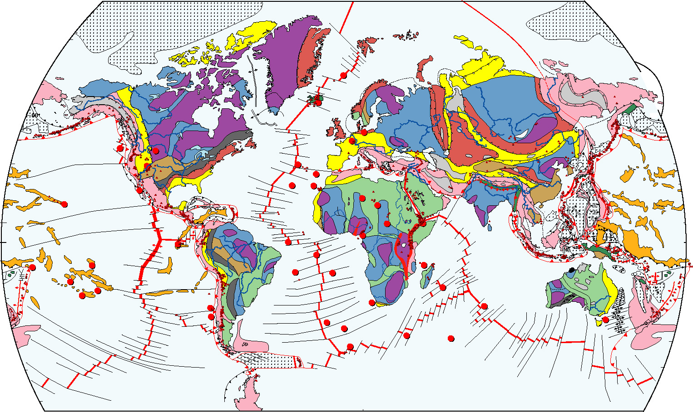
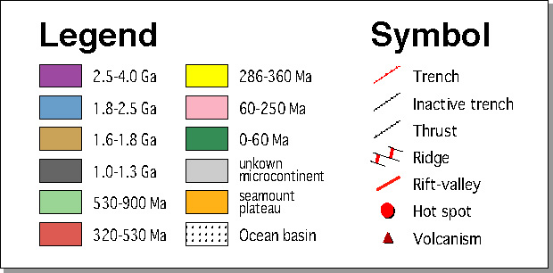
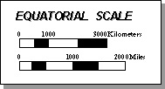
■
How to demonstrate PT on the Earth before 200Ma
Orogenic belts of the world

Slide 7
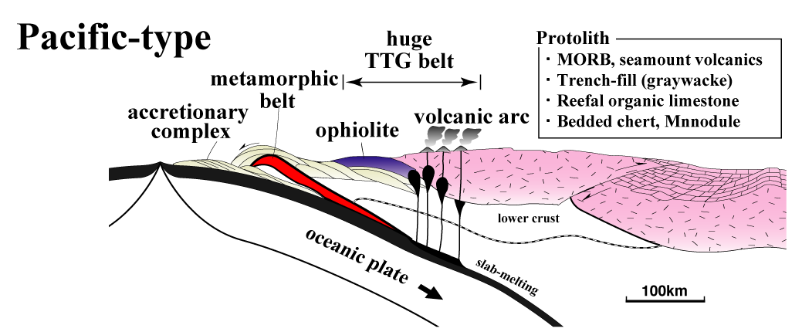
3. Key new evidence of plate tectonism on Mars: “candidate” accretionary complex
(Maruyama et al., 2002)

Slide 8
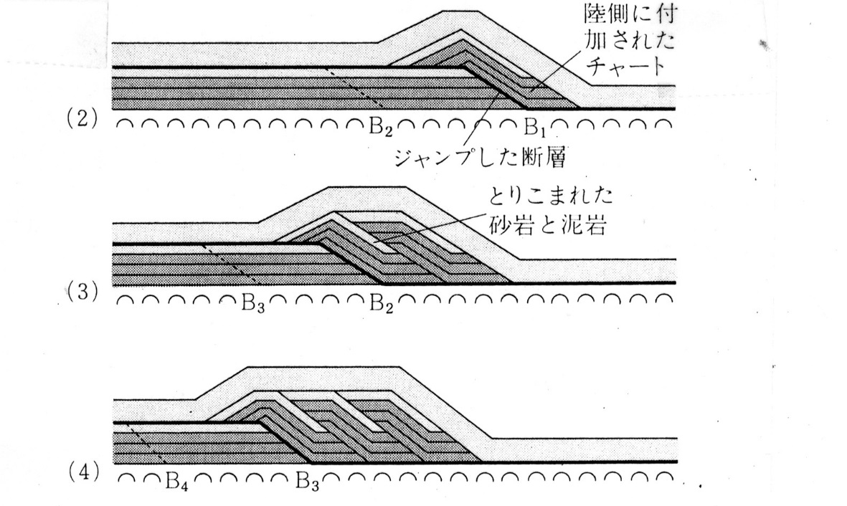
What is accretionary complex?
Trench turbidite
Deep-sea sediments
Accretionary complex
Layer-parallel thrust
Rock assemblages
Ocean-plate stratigraphy
1
Plate boundary
MORB→subduction
2
3
MOR
Major crustal shortening in places on Earth especially highlighted here associated with the development of orogenic belts here in the Japanese Islands, including accretionary complexes

Slide 9
Ocean Plate Stratigraphy
(OPS)

Slide 10
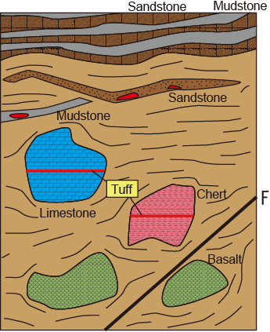
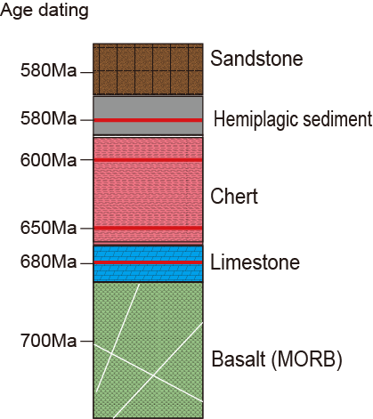
How to reconstruction of OPS
Ocean Plate Stratigraphy, example from Wales, UK
Olistostrome
Melange
OPS
The age of radiolarian
Notes:
This figure shows image of melange. The melange like gwna group also exists in Japan.
Japanese previous worker reveals the age of melange used by microfossils such as radiolarian.
And, they reconstructs geological column on the basis of this age. This colomn was defined ocean plate stratigraphy.
この図は、メランジュを模式的に表したものです。
Gwna Gp.のようなメランジュは、日本にも存在する。日本では、メランジュ中のチャートから放散虫等微化石の研究によってメランジュの年代が求められた。
その年代に基づいてメランジュの復元が行われ、その結果、右の図のような順序の柱状図が明らかとなった。これをＯＰＳと定義した。

Slide 11
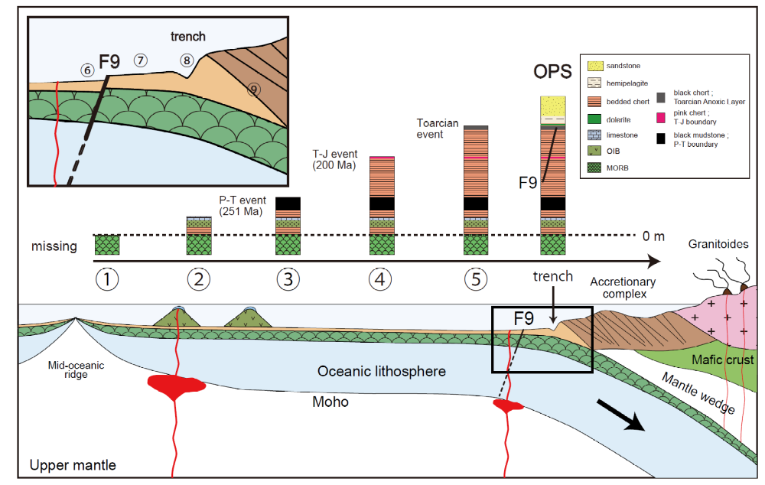
Travel history deduced from OPS, an example from SW Japan
Fujisaki (2013)

Slide 12
Accretionary Complex on Mars

Slide 13
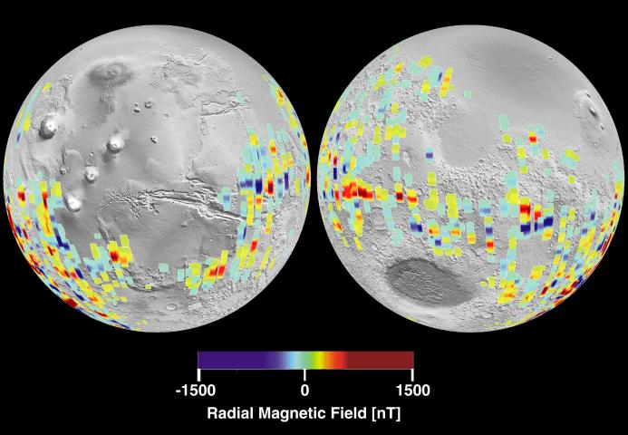
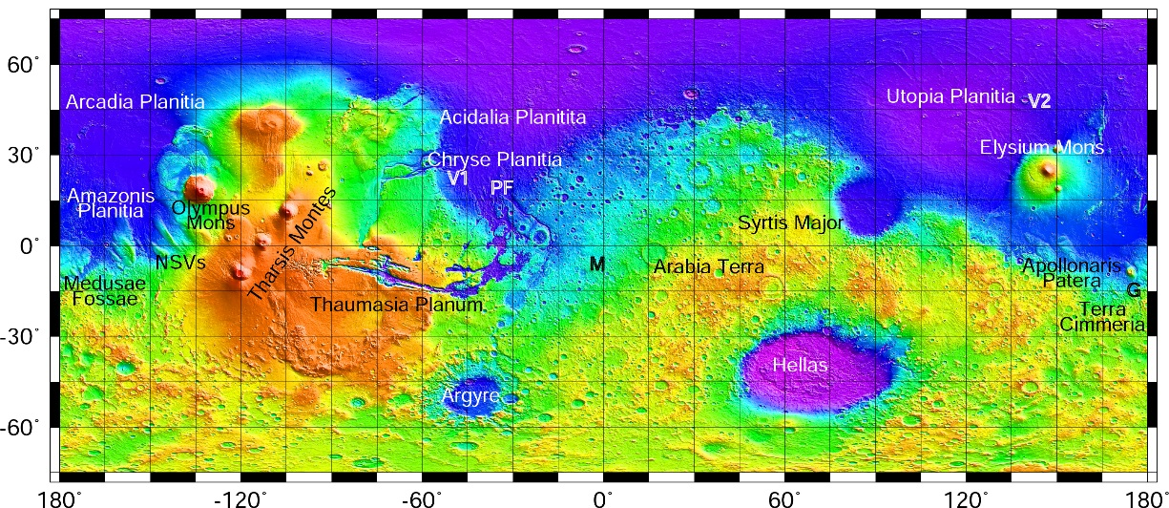
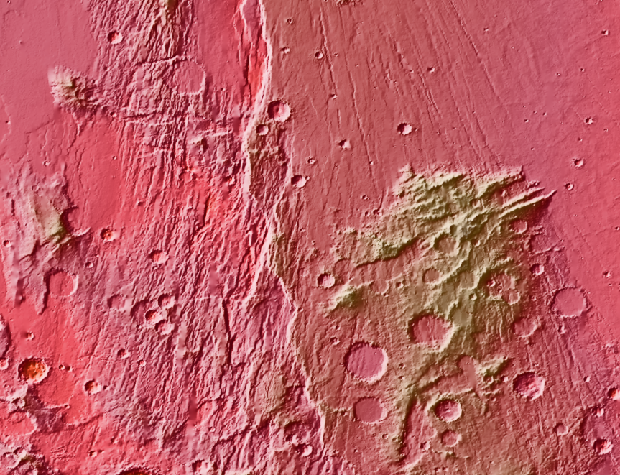
Example candidate 1 (Pacific-type accretionary complex)
50km
N
Target to assess the ancient rock record and plate tectonism, including plate boundaries and accretionary complexes
1
Claritas rise

Slide 14
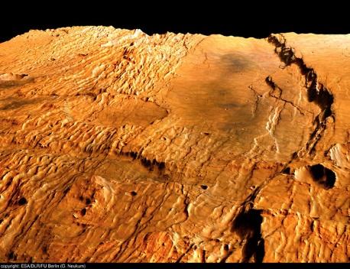
25 km
N
?
?
Possible duplex structures with link, roof, and floor thrusts (evidence of major crustal shortening)

Slide 15
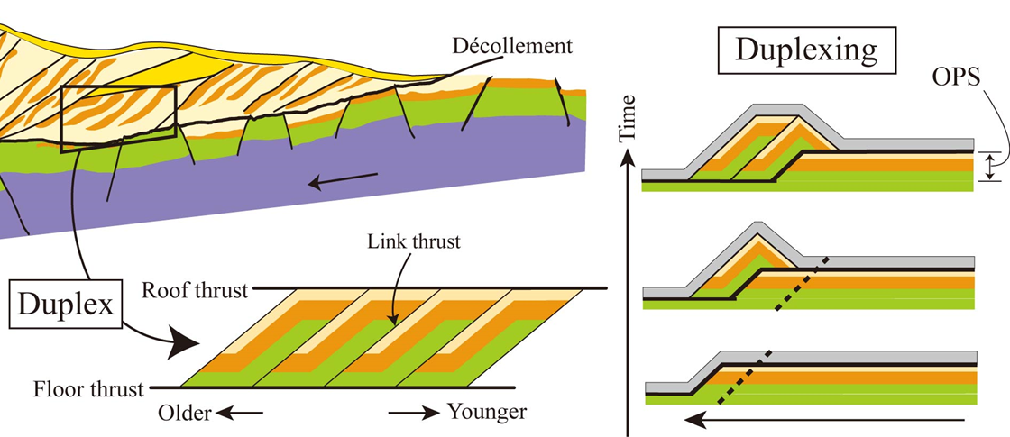
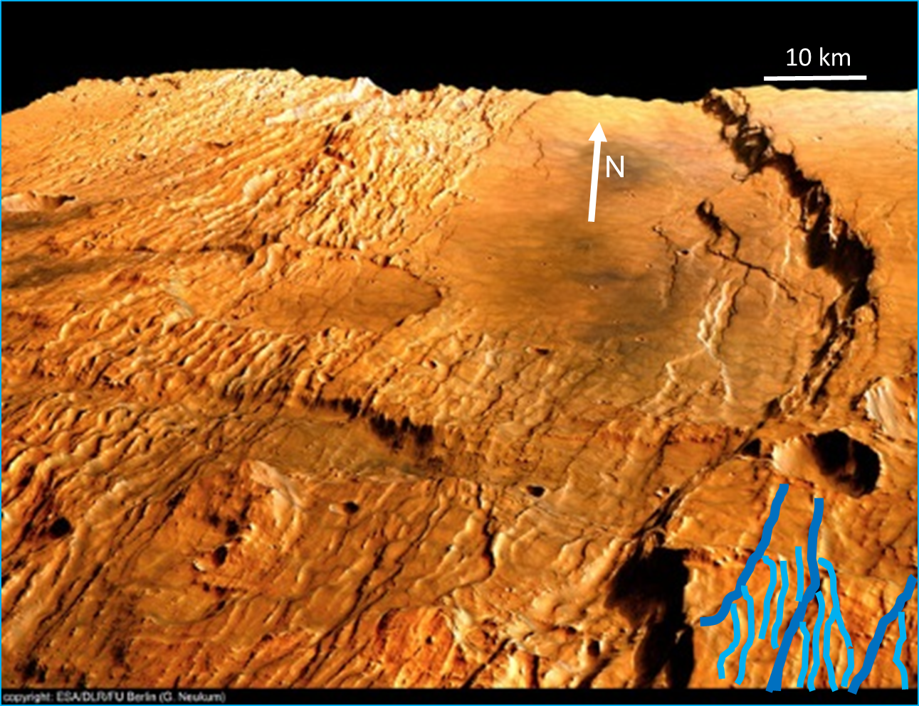
Reconstruction (sense of horizontal shortening, and underlying unit)
2
3
1
a
b
c
1
a
b
c
d
2
25 km
f
e
1
c
d
d
c
a
b
2
b
3
b
a
a
Need chemical mapping to test the hypothesis, which includes attempting to identify MORB and deep-sea sediments with trench turbidite (OPS)

Slide 16
Example candidate 2,
northwest part of a huge mountain range, Thaumasia highlands
Northern
plains
Isidis
Tharsis
superplume
V.M
2
Hellas
Argyre

Slide 17
Example candidate 2
N
Claritas rise – Mountain where serpentine has been identified through the CRISM instrument onboard the Mars Reconnaissance Orbiter (Dohm et al., 2009)
50km
1
2
Claritas rise

Slide 18
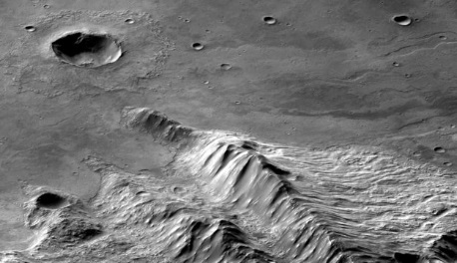
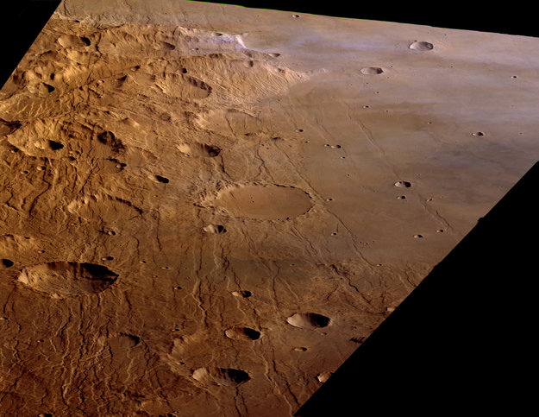
Irregular ridge with steeply dipping beds
N
10 km
10 km
Credit: ESA
N

Slide 19
1 km
~70°
~60°
~70°
Steeply dipping beds which containing blocky masses

Slide 20
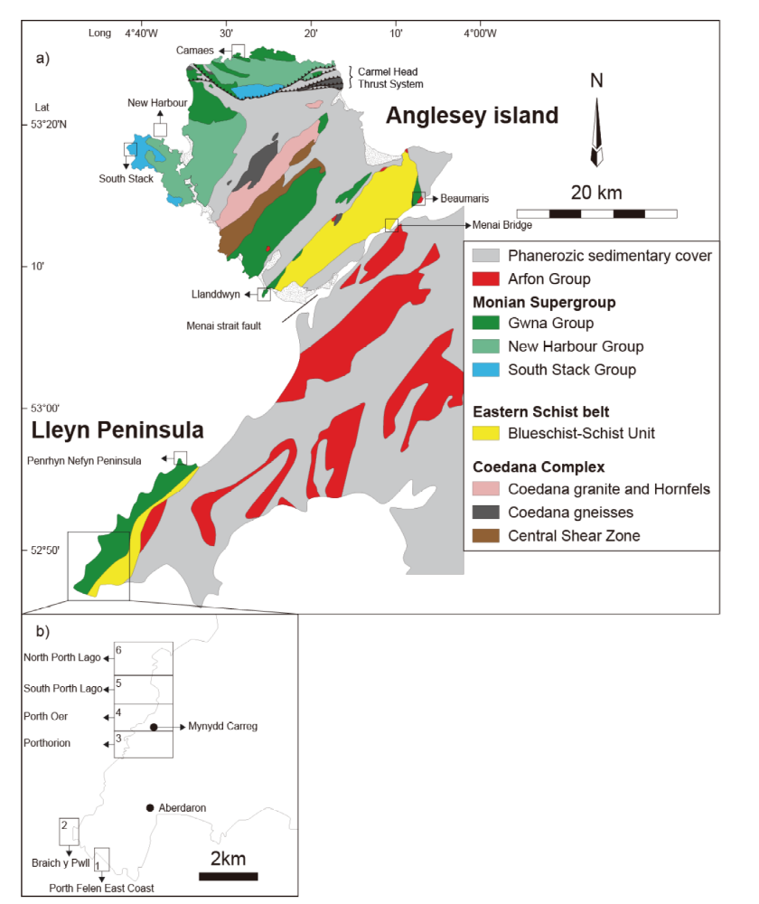
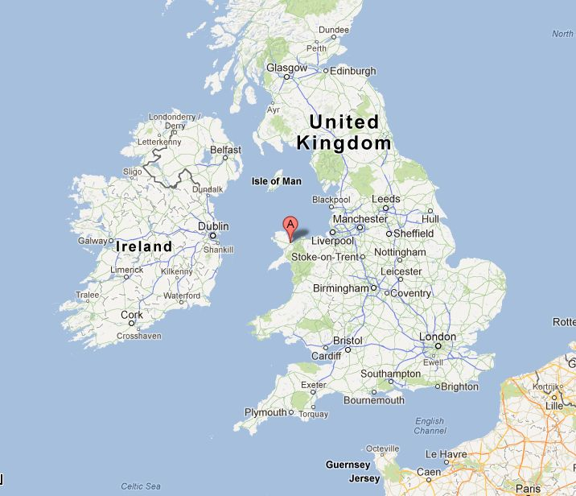

Slide 21
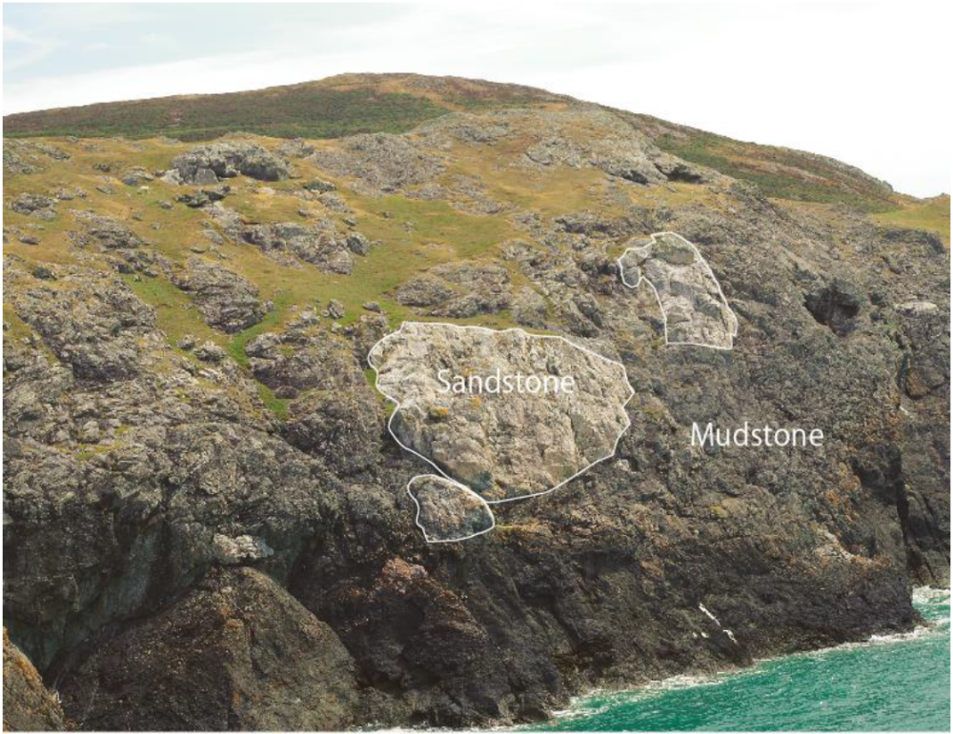
3m

Slide 22
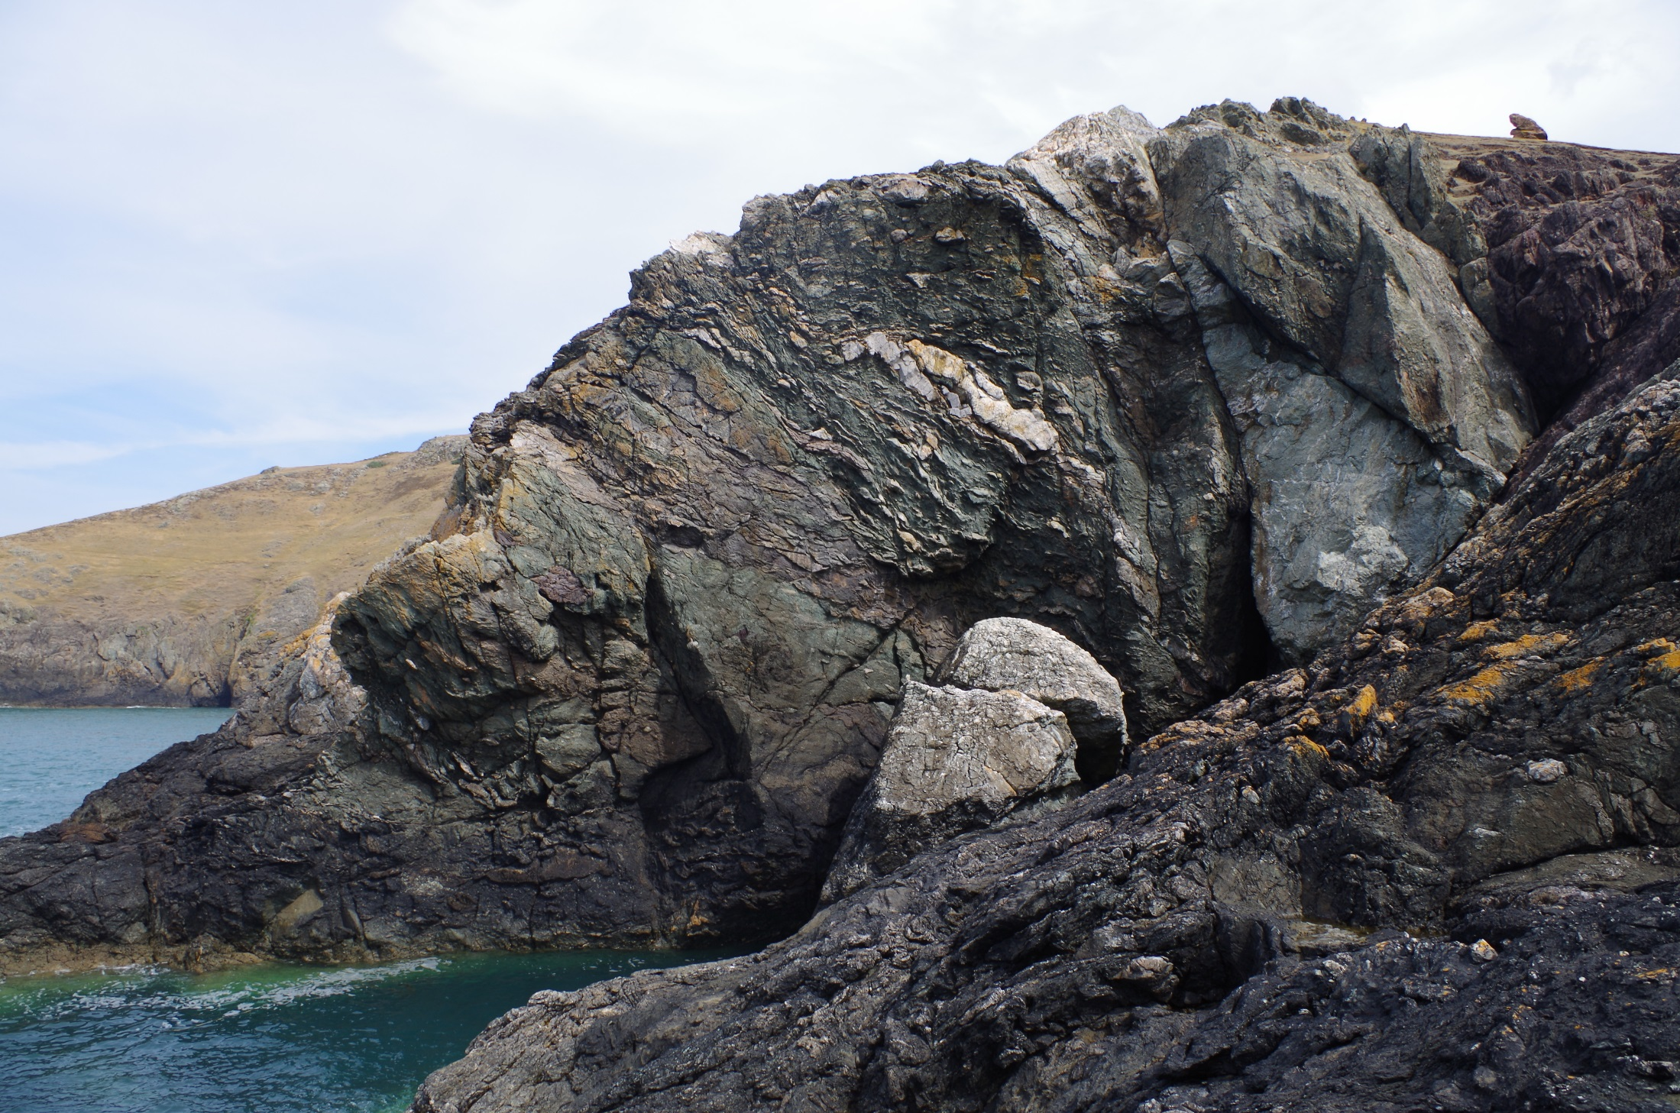

Slide 23
Conclusions
1 Possible candidates of accretionary complex and/or olistostrome were found on Mars.
2 If true, strong lateral shortening must have occurred on Mars presumably by plate tectonics.
3 If geochemical mapping is available, OPS (Ocean Plate Stratigraphy) can be demonstrated in future to demonstrate plate tectonics on Mars.

