Slide 1

Studies of Near Surface Dynamics in Nano-composites
James Hart
Thompson Group

Slide 2
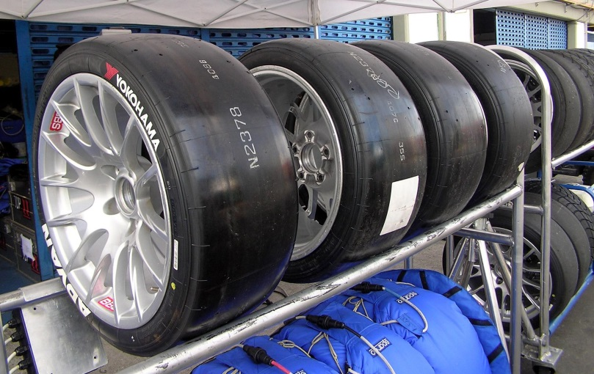
Background
Addition of solid fillers to polymer materials is commonplace
  Improves mechanical properties
  Wear and abrasion resistance
Not fully understood
  Non-linear reinforcement and strain softening observed
Interface interactions thought to be important
  Difficult to measure directly
  Inferred from T_{g}
    Thin films
© Morio / Wikipedia/ CC-BY-SA-3.0/ GFDL
Notes:
I’m going to talk today about near surface dynamics in polymer Nano composites. Now a bit of background, fillers are commonly added to polymers matrices to improve their properties, such mechanical response and the wear and abrasion resistances. An example of this is car tyres, where this has been going on for about 50 years. The issue is that this process is not fully understood, it’s a bit of a black box to use an engineering term. For instance, non linear reinforcement is often seen this where there …

Slide 3
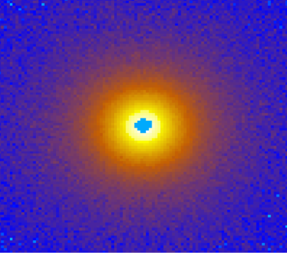
Neutron Scattering
Similar to x ray scattering
Neutrons
  Excellent sample penetration
  Bulk measurements
  Non destructive
  Isotopic substitution identifies components
k_{f}
Q
k_{f}sin⁡(θ/2)
θ
k_{i}sin⁡(θ/2)
k_{i}
2π/Q

Slide 4
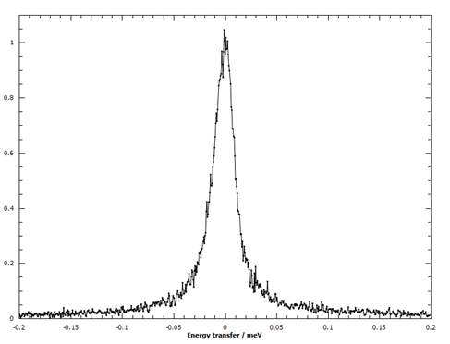
Quasi elastic neutron scattering
Examines the energy transfer of the neutrons
k_{f}sin⁡(θ/2)
k_{f}
k_{f}
Q
Q
θ
k_{i}sin⁡(θ/2)
θ
k_{i}
k_{i}
Normalised Intensity
¹H
²D
Energy transfer / meV

Slide 5
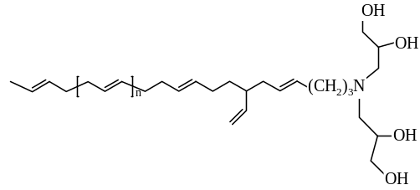
Materials
Matrix - polybutadiene
Filler - Stöber Silica
End functionalised polybutadiene
  Mw:10k, 15k
  H/D neat polymer blend (15k)
  H bulk, H end functional polymer (15k), silica
  D bulk, H end functional polymer (10k, 15k), silica

Slide 6
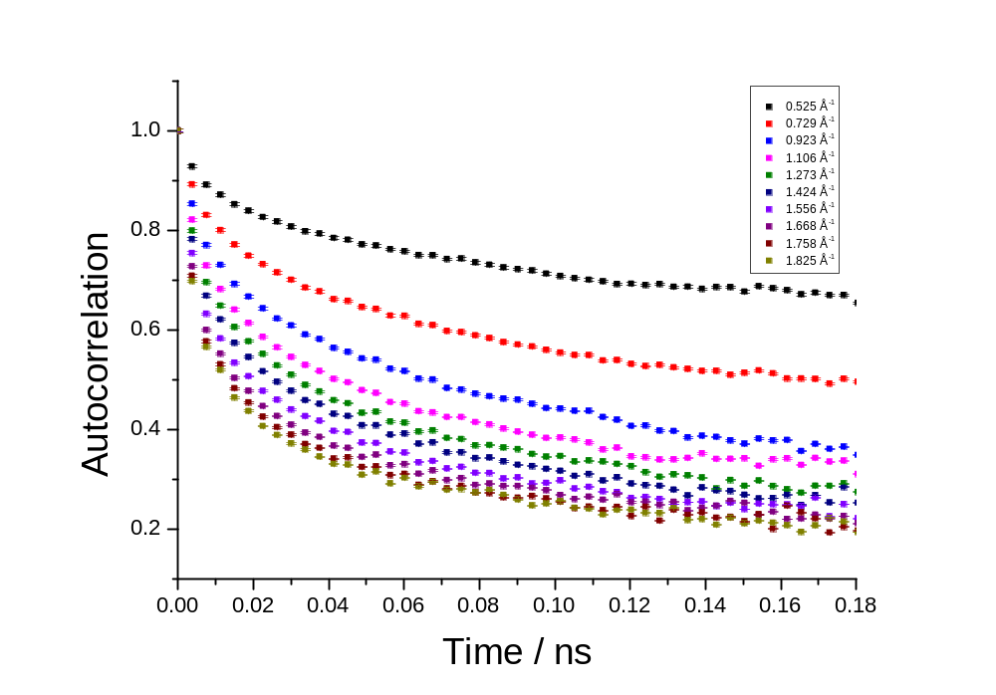

Measurement
FFT
Normalised Intensity
Energy transfer / meV
Fit to a stretched exponential
B- background, what’s not moving
τ- relaxation time
β- measure of the heterogeneity
$$C\left(t\right)=B+(1−B)e^{{−(t/τ)}^{β}}$$

Slide 7
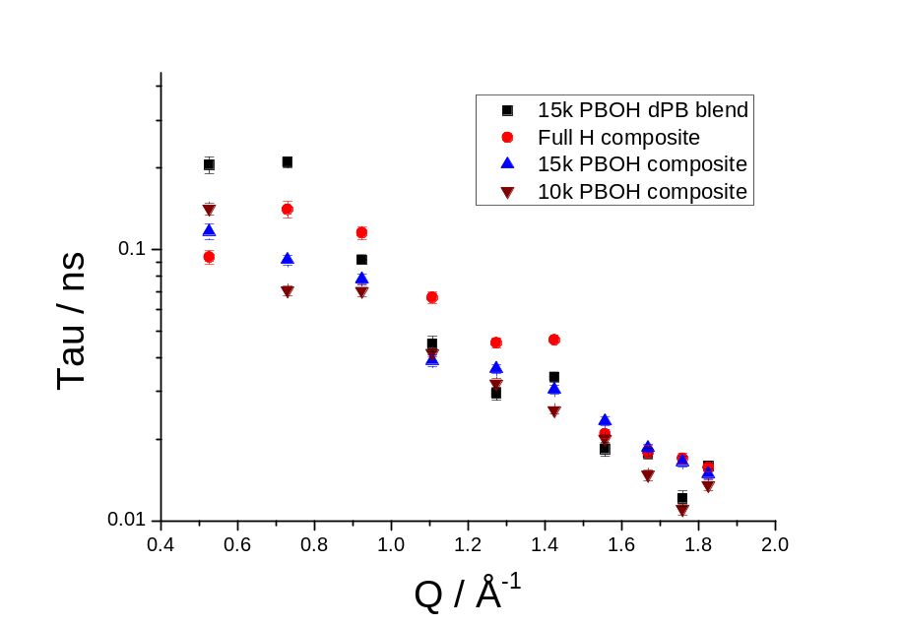
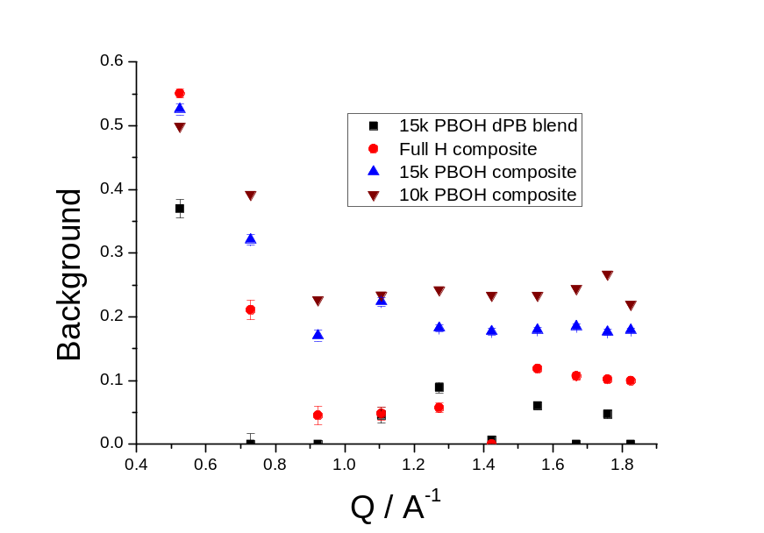
Results
τ is similar between samples
Background increases with silica presence
‘Immobile’ fraction
  Outside experiment window

Slide 8
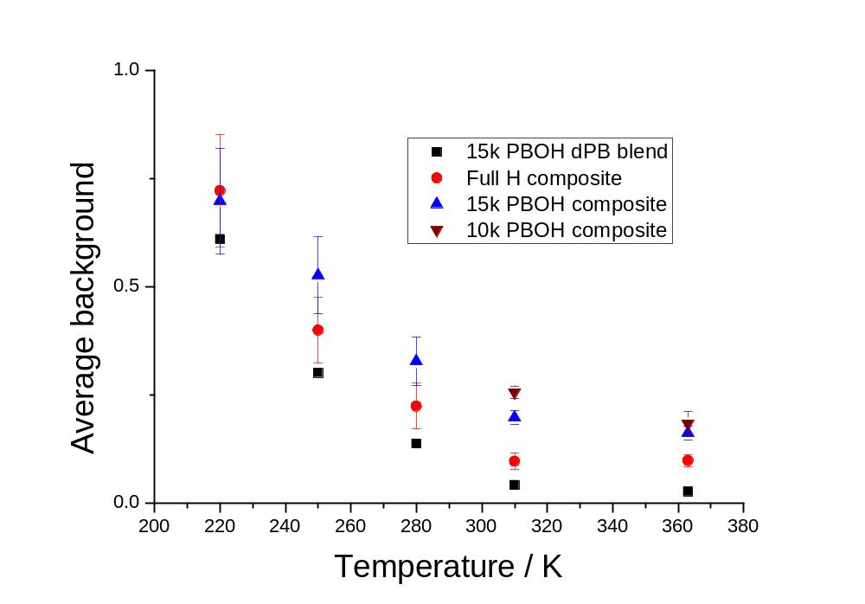
Temperature sweeps
Background decreases with temperature
Composites consistently higher
  Thus slower dynamics in composites

Slide 9


Variation of dynamics with surface distance
Glassy layer
  Treated as a background fraction
  Decays exponentially with characteristic length
rubber
glass
$$I=e^{−x/d}$$

Slide 10
Control of sampled region with isotope screening
Deuterium ‘hidden’ on QENS measurements
10k
15k
H matrix

Slide 11

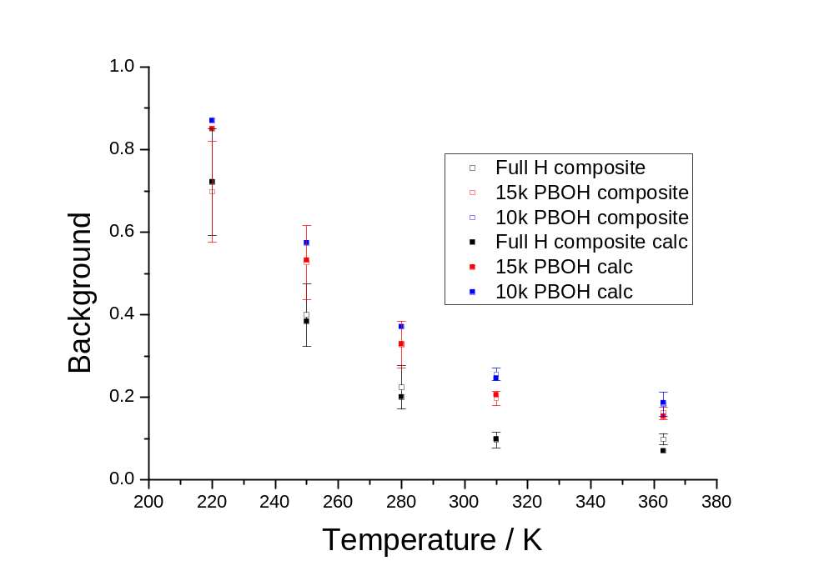
Fitting to the background value
10k
15k
H matrix
Integrate and average to determine background level
Layer function to the measured background by varying d, characteristic length

Slide 12
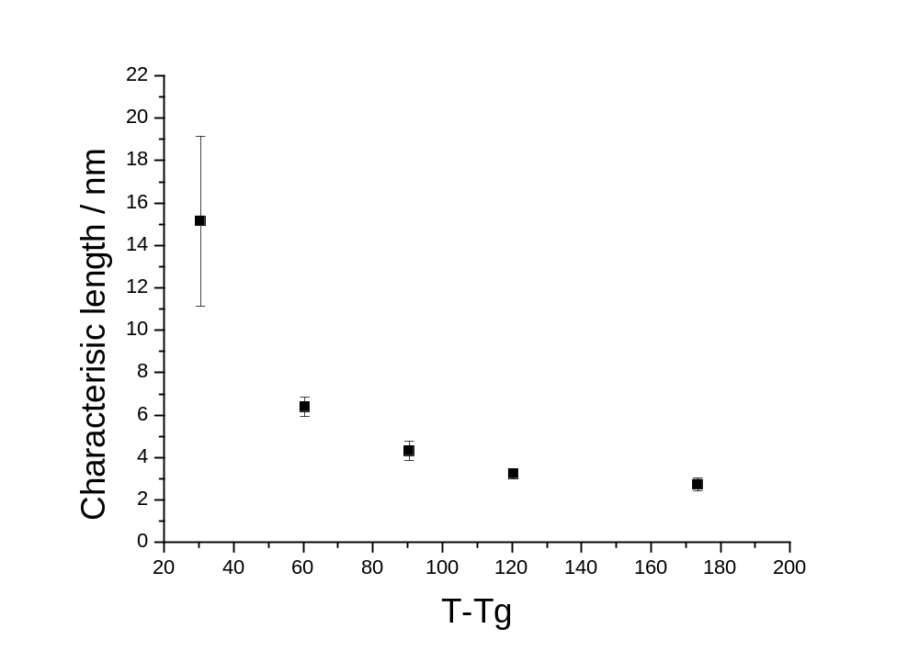
silica
glassy layer
Immobile fractions significantly above T_{g}
  Thought to be limited to ~T_{g}+30K, not the +100K found here
  Can help explain reinforcement at low volume fractions
Similar to other measurements/calculations of layer thickness
  Geometry less important - thin film results can be applied to bulk

Slide 13
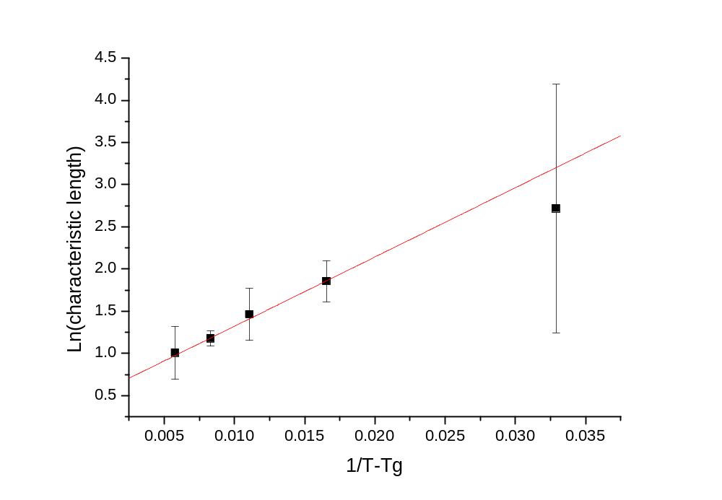
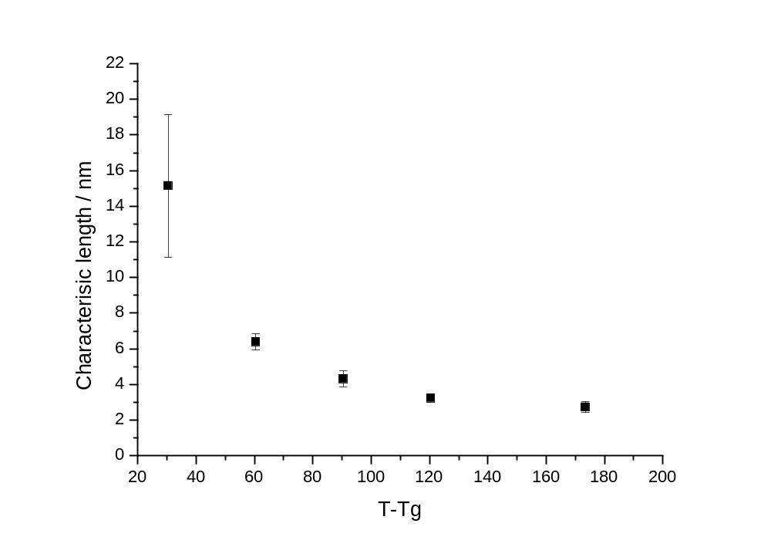
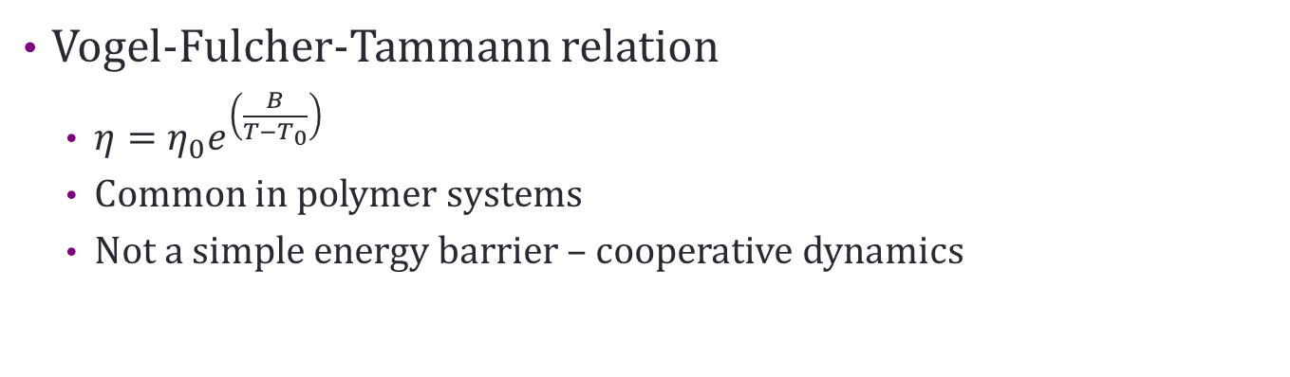
Vogel-Fulcher-Tammann relation
  $η=η_{0}e^{\left(\frac{B}{T−T_{0}}\right)}$
  Common in polymer systems
  Not a simple energy barrier – cooperative dynamics

Slide 14
Conclusions
Direct measurement of localised polymer dynamics
Findings show glassy layer at higher temperatures than previously theorised
    Helps explain reinforcement at low volume fractions
  Layer thickness appears to follow VFT relation
  Few geometry effects, thin film results can be applied to bulk
Notes:
Now then overall. The first important note is the fact that is a comparatively direct method of measurement, we’re not having to infer the values from Tg and it’s a bulk measurement rather than a thin film. Secondly the glassy layer we’ve found occurs at much higher temperatures than is commonly thought, at +100K tg rather than +30K. This could help explain the non linear reinforcement mentioned at the beginning. We’ve also found that the geometry does not appear to affect the dynamics too much, and that means the bulk measurements can be applied, cautiously, to the bulk material properties. Finally the stretching the sample does appear to effect the glassy layer, and this could be behind the strain softening seen in many of these composites.

Slide 15
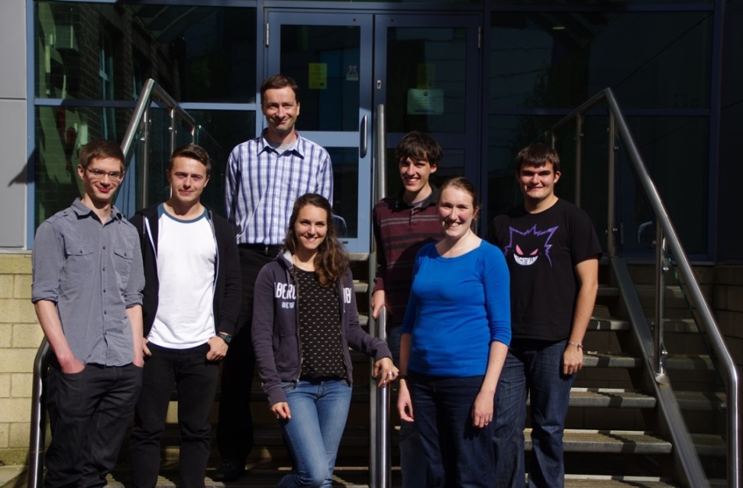

Thanks to
Richard Thompson
And the group
Victoria Garcia-Sakai (IRIS instrument scientist)

Slide 16
Any Questions?

Slide 17
Appendices

Slide 18
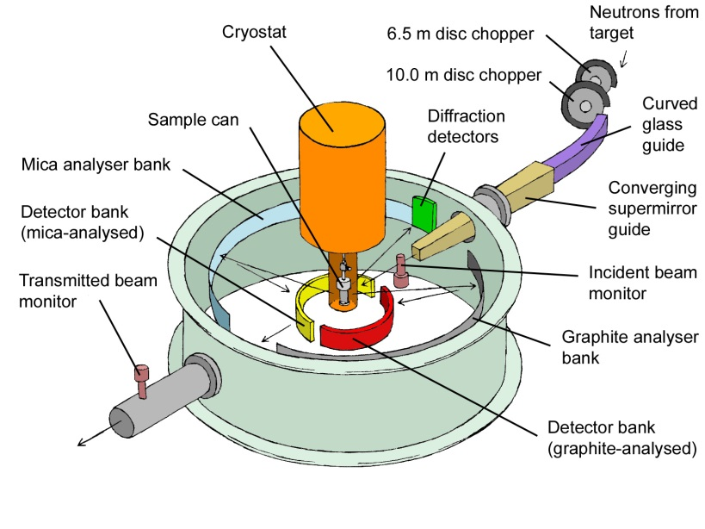
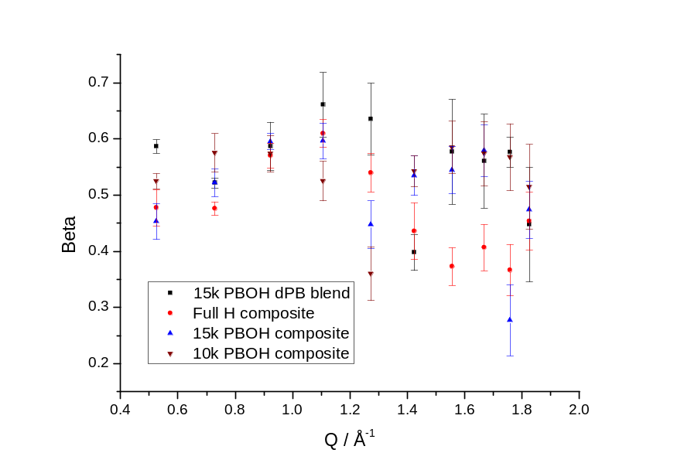
QENS
isotope | Coherent (x 10⁻¹⁵m) | Incoherent (x 10⁻¹⁵m)
¹H | -3.74 | 25.27
²D | 6.67 | 4.04

Slide 19
Screening
Difference in scattering between Hydrogen and Deuterium
  H – mainly incoherent, energy is transferred
  D – mainly coherent, no energy transfer
H
D

Slide 20

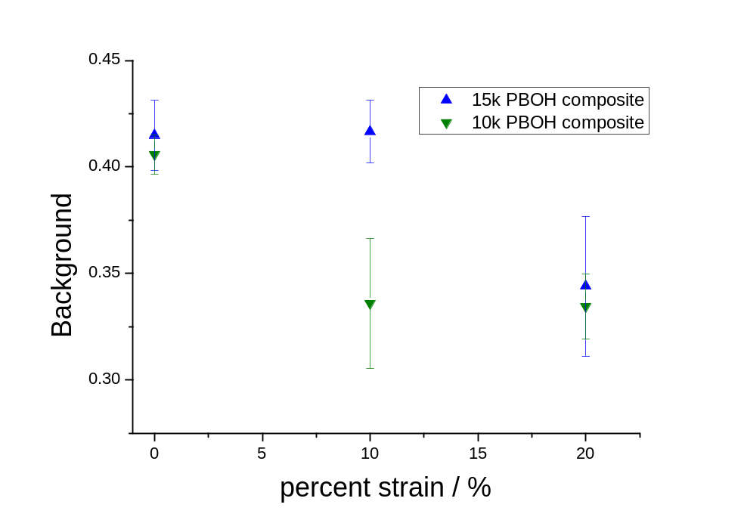
Effect of strain
Does distortion affect the layer?
  Payne effect- strain softening is seen in these composites
Line to guide the eye
Cross-linked samples
Measured stretched samples with QENS

Slide 21
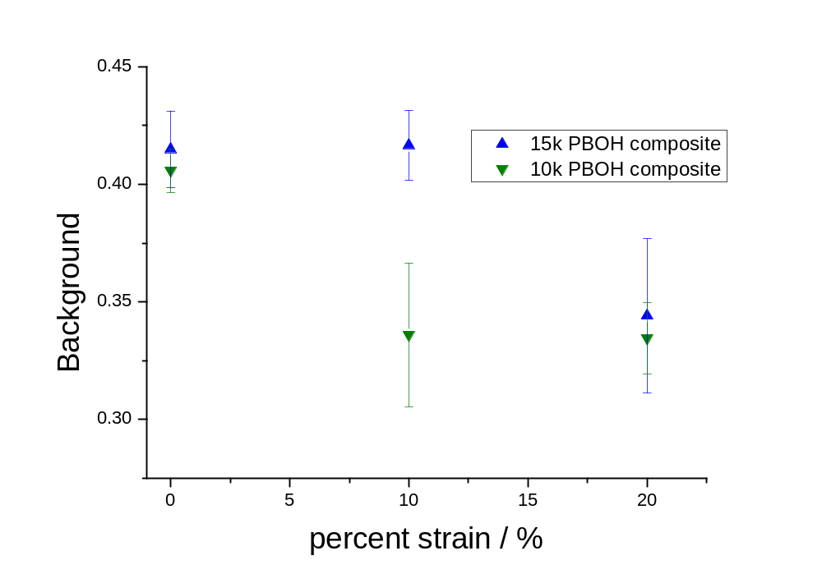
Line to guide the eye
Change in background is related to strain softening

