Slide 1
Blood Cancers Associated with Closed Oil Refinery
James Dahlgren
2016

Slide 2
Refinery
Operated 55 years from 1930 to 1985
Produced
  Gasoline
  Diesel Fuel
  Asphalt
Essentially no controls on
  Air emissions
  Ground water contamination

Slide 3
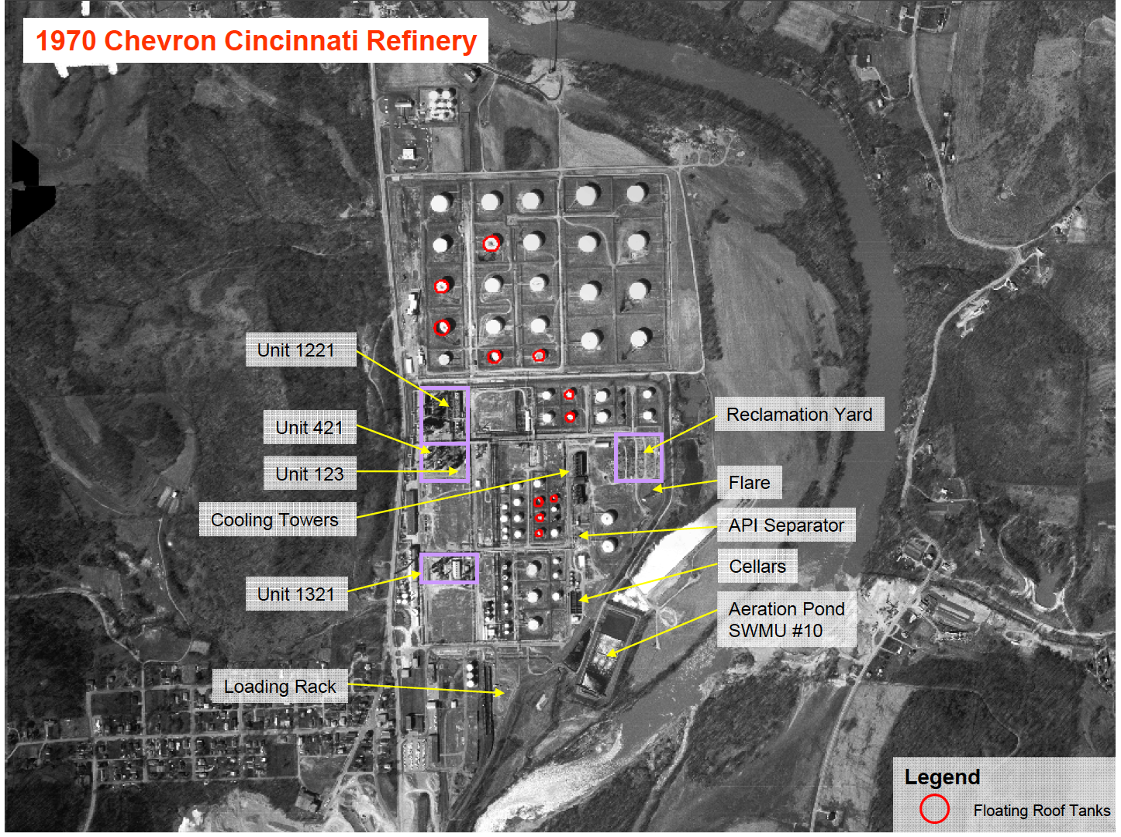
Refinery Site

Slide 4
254 Residents
36 cases of cancer
  14% of population
    Expected 2%
  State Health Department 5 X excess of cancer
  Four cases of blood cancers
    Acute Myelogenous Leukemia (AML)
    Two cases of Hodgkin’s Lymphoma
    Multiple Myeloma

Slide 5
263 Acres of Liquid Petroleum
5 Million gallons
  80% gasoline
  20% diesel
Benzene
PAHs
Dioxin
Heavy Metals
Other Hydrocarbons
Toxic cocktail

Slide 6
Routes of exposure
Inhalation
Ingestion
Air pollution
Vapor intrusion
Particulates
Fires
Accidental releases
Family members working at site -
  Smelled bad
  Dust on clothes
Contaminated private well water
Vegetable gardens
Soil ingestion

Slide 7
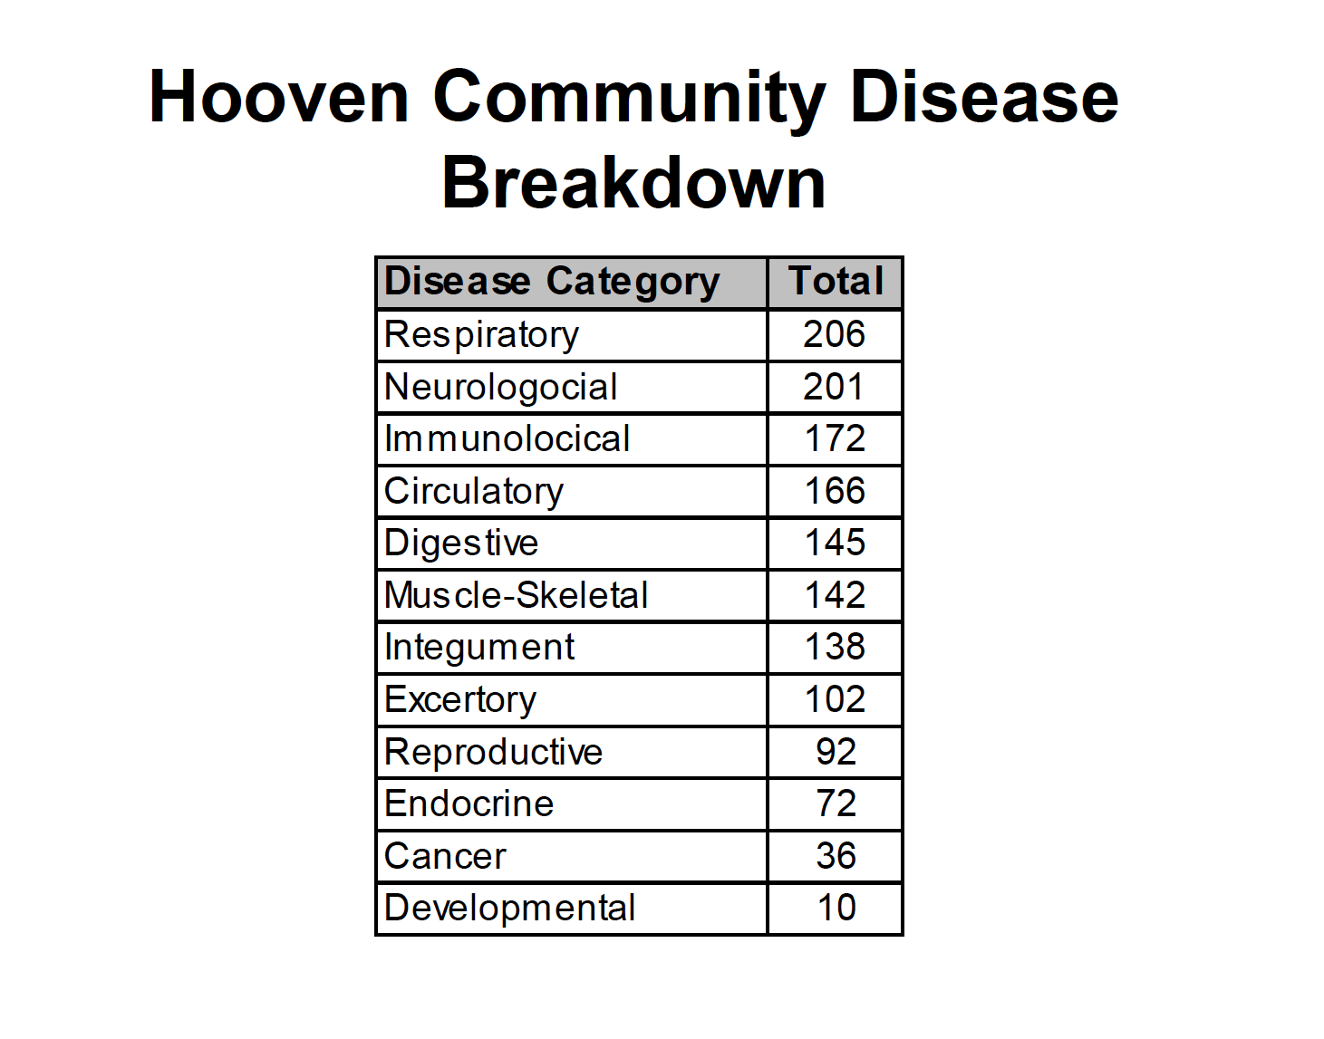
Diseases in Hooven

Slide 8
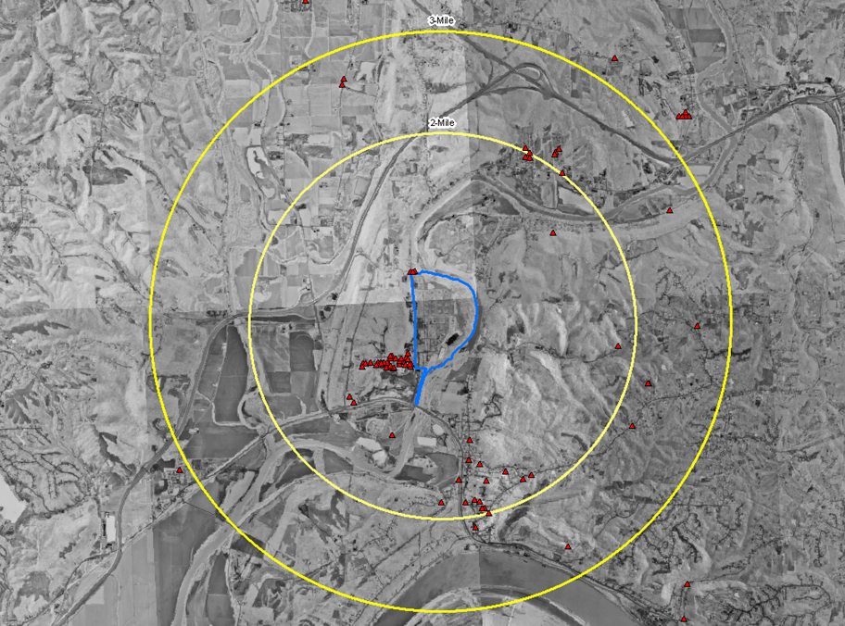
CANCER

Slide 9
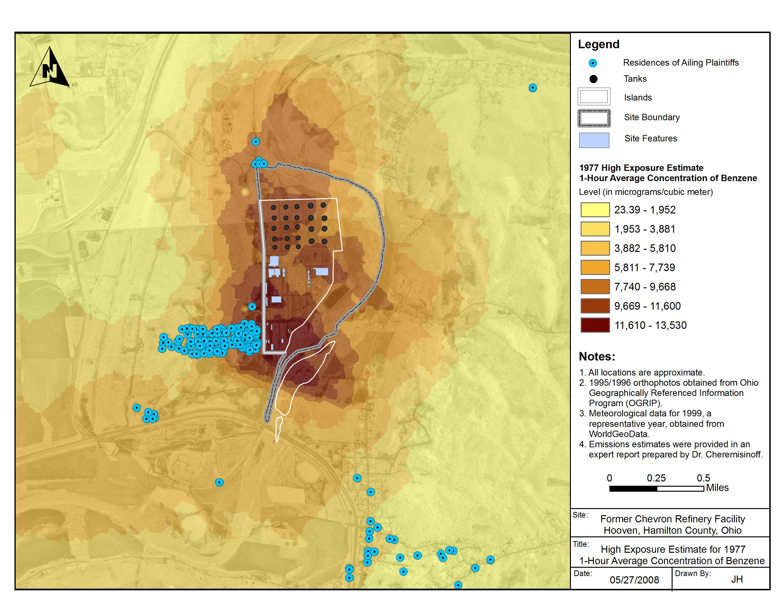
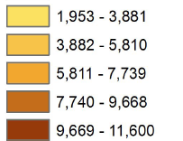
Benzene Levels
Range of Peak Benzene Exposures

Slide 10
Four Cases Lived in Odor Plume
Initials/ Age at Diagnosis | Illness 1 | Illness 2 | Illness 3 | Exposed
1. MG/20 | Hodgkin’s Lymphoma | Bilateral Breast cancers | Repeated Infections | Child
2. CL/54 | Multiple Myeloma | Diabetes | Coronary Heart Disease | Child
3. JR/64 | Hodgkin’s Lymphoma | Anemia Persisting | Repeated Infections | Child
4. MS/38 | Acute Myelogenous Leukemia | Myelodysplastic Syndrome (MDS) before AML | Repeated Infections | Child
All non-smokers

Slide 11
Benzene Dose
Case | Ages/Years of Exposure | Upper bound total dose - ug
1. MG | 2 to 20 | 51,932,694
2. CL | 0 to 26 | 49,698,783
3. JR | 1to 56 | 12,777,006
4. MS | 0 to 19 | 3,218,823

Slide 12
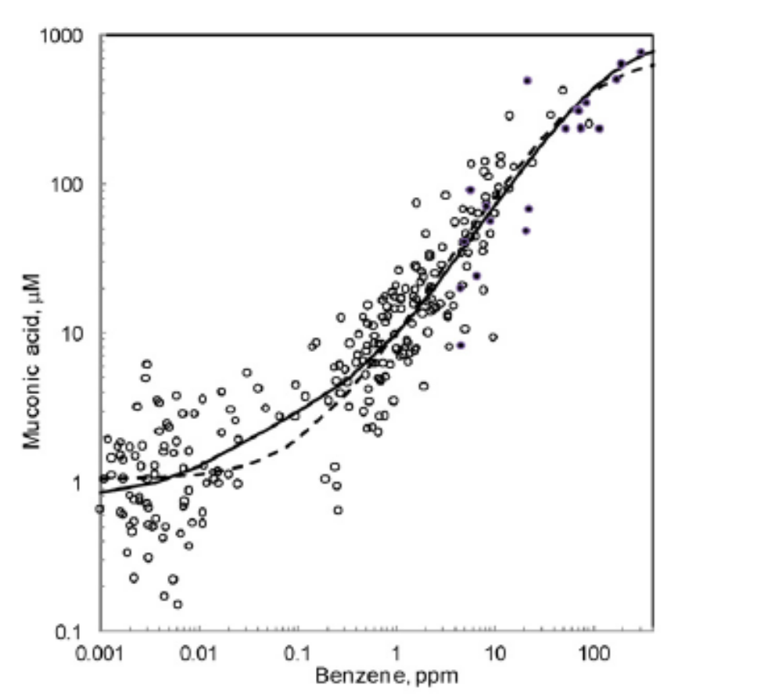
Benzene Exposure Below 1 PPM
More of the metabolites that cause cancer is formed than has been assumed by regulators
Low levels more dangerous, risk of harm is underestimated
Muconic Acid Levels

Slide 13
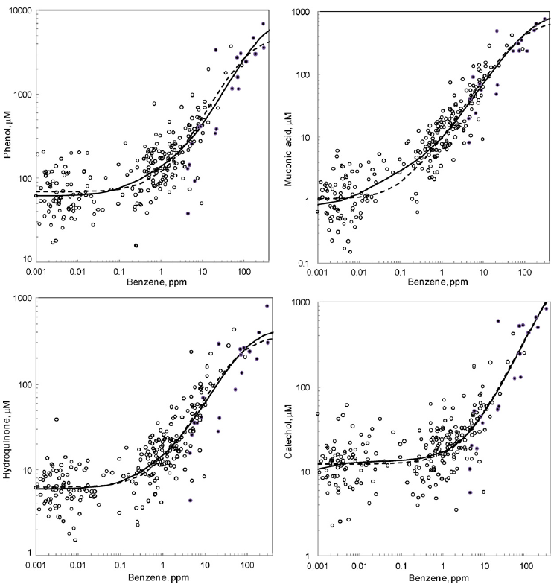
Low Dose Increased Toxic Metabolites
Rappaport 2010

Slide 14
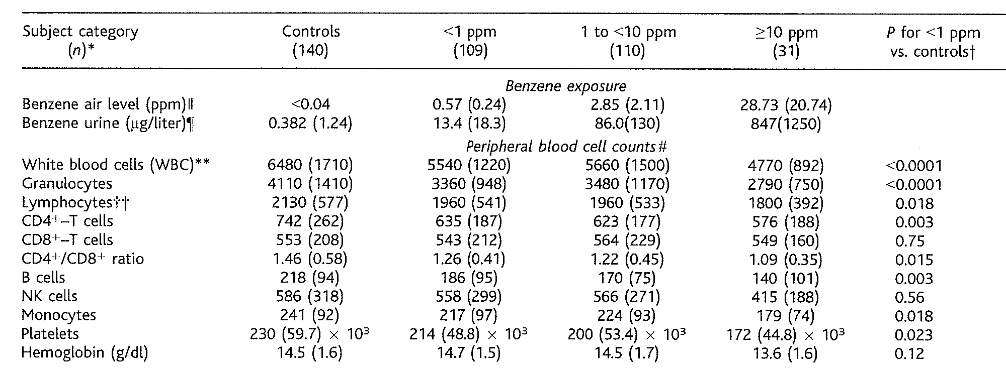
Under 1 PPM
Lan 2004

Slide 15
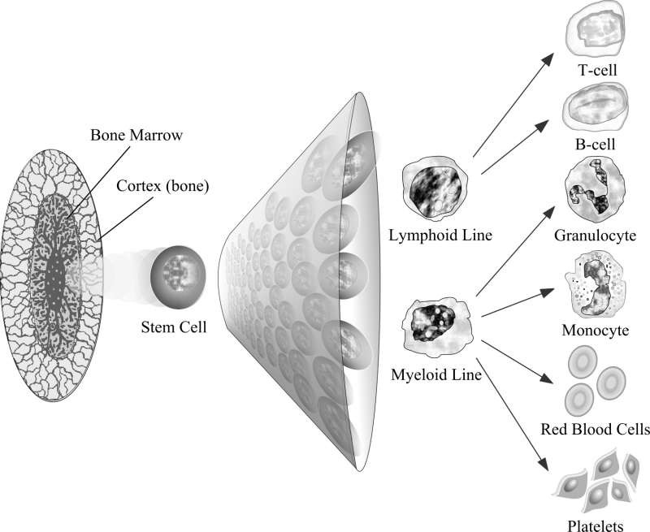
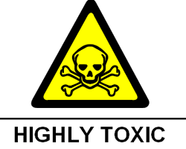
Benzene attacks stem cells
White Blood
Cells
Red Blood Cells
Reduced white & red blood cells & platelets, anemia, blood cancers, decreased immune function
Platelets
Notes:
Picture from Yoon 2001.

Slide 16


American Petroleum Institute (API)
Toxicology Committee
  Industry sponsored committee
In 1948 based on numerous deaths
  Many with short term exposure
    Noted individual susceptibility
Concluded
  No Safe level of exposure to benzene

Slide 17
Low-Level Studies:
Glass et al. 2009
Oil refinery workers study by Australian Industry Group
  6-fold increased cancer (leukemia) risk
    2-4 ppm-years of benzene exposure
  4-fold increase seen in lowest exposure group
    1 ppm-year
  “We found no evidence of a threshold cumulative exposure below which there is no risk”

Slide 18
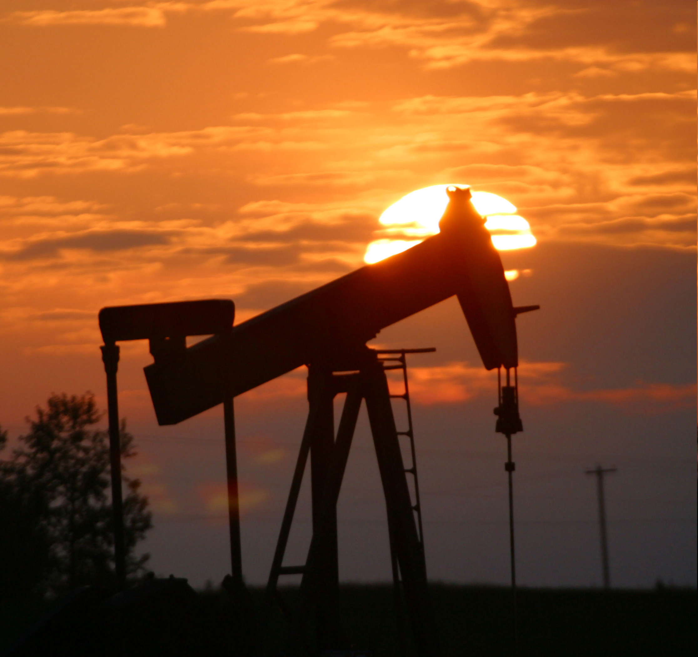
Low-Level Studies:
Barregard 2009 from Sweden
Increased leukemia in people
living near oil refinery
  Measured air benzene never over 5 part per billion
  Cancers found in areas thought to be at highest risk (highest pollution, highest cancer)
  “low-level benzene exposure may pose a higher risk than was previously believed”

Slide 19

Low-Level Studies:
Pennsylvania Health Department
Gasoline Spill in residential area
  Benzene is component of gasoline
  4-fold increased incidence of leukemia
Measured benzene in homes
  Average estimated cumulative exposure:
  30 ppb-years
Follow up study confirms leukemia increase
  Talbott et al. 2011
  This area continues to have more leukemia than expected based on State and County rates

Slide 20
Low-Level Studies:
Kirkeleit 2008 from Norway Industry
Cited by defense experts
Increased risk of multiple cancers at very low levels of exposure, less than 1 PPM
“This increased risk thus implies that the exposure levels have been higher than published for [the oil refinery] industry, or that the increased risk for these neoplasms can be found at lower levels of exposure than previously assumed.”

Slide 21
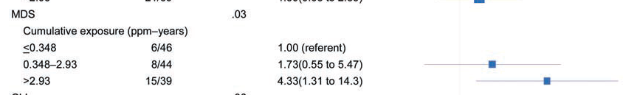
Schattner 2012 - Petroleum Industry Study
Myelodysplastic syndrome (MDS) precursor to Acute Myelogenous Leukemia (AML)
Controls were other workers in the place of business so all exposed to benzene. Shows that there is no threshold.

Slide 22
Low-Level Studies:
Lan et al. 2009
Benzene exposure below 1 ppm
  Mean 0.24 ppm (240 PPB)
  Lowered
    WBCs
      Granulocytes
      Lymphocytes
      B cells
      Platelets
  Even Lower
    Colony formation from myeloid progenitor cells
Some people more susceptible to blood changes
Genetic variation
  Myeloperoxidase (MPO-433GG)
    susceptible
  NAD(P)H:quinone oxireductase (NQO1-465CT)
    Added susceptibility

Slide 23
Bolatti 2007
Study of policemen and gas station attendants
  Controls office workers
Benzene air level 2 PPB to 159 PPB
  0.002 PPM to 0.159 PPM
Significant DNA damage to cancer causing genes
  Correlated with air benzene levels

Slide 24
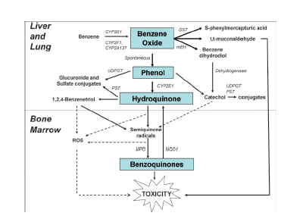
Benzene Metabolites
Major Toxic Metabolites
Hydroquinone
  Semiquinones
    1,2,4 Benzenetriol
    Catechol
Muconaldehyde
Benzoquinones

Slide 25
Some Mechanism for Leukemia from Benzene
BZ metabolites
  Induces oxidative Stress
  Form DNA adducts
    Creates Mutations
    29 genes differentially expressed
    Creates leukemic stem cell clones
  Epigenetic Changes
    Interference with DNA Repair
  Interferes with
    Immune function
    Cell cycling
    Apoptosis
    Stem cell Niche regulation

Slide 26
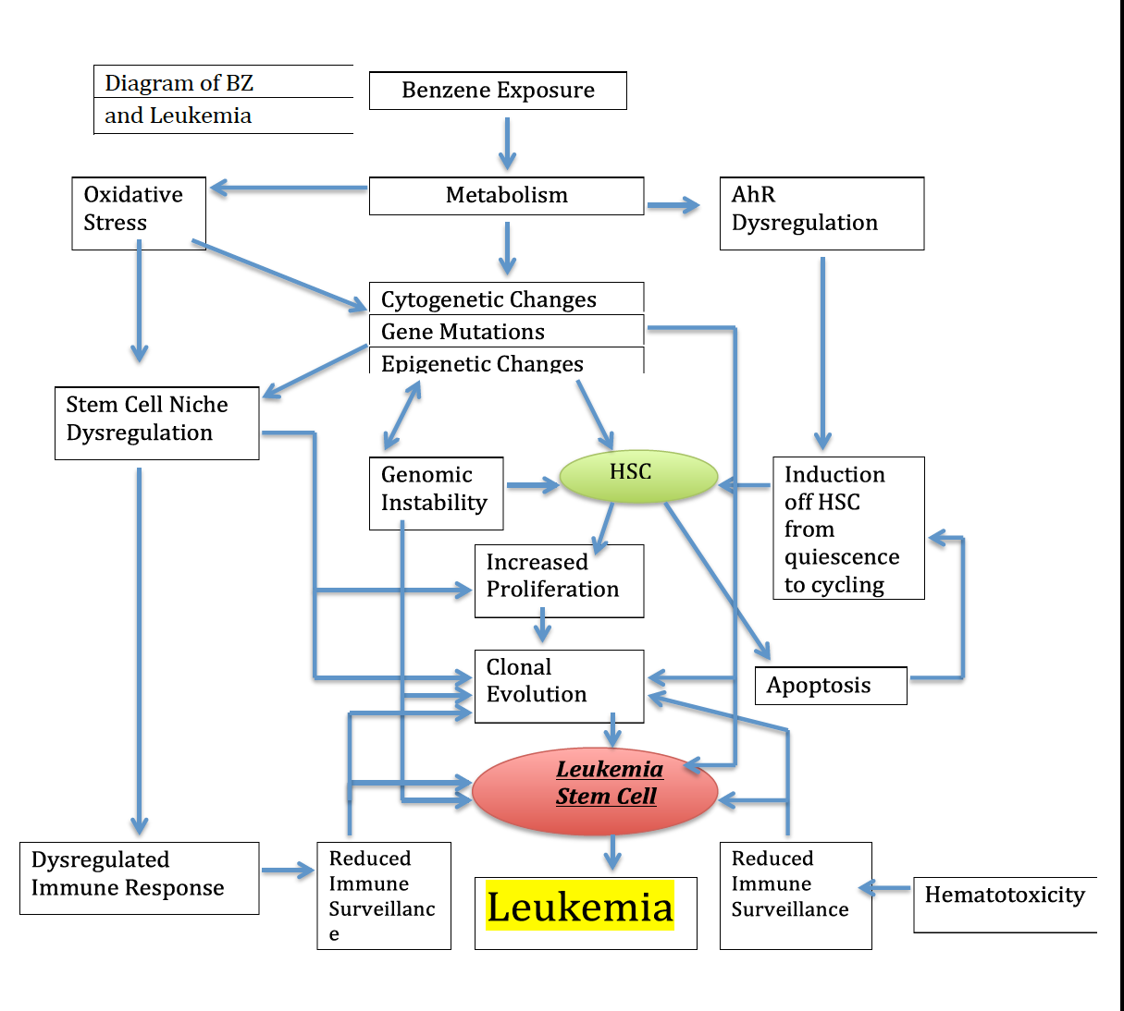

Slide 27
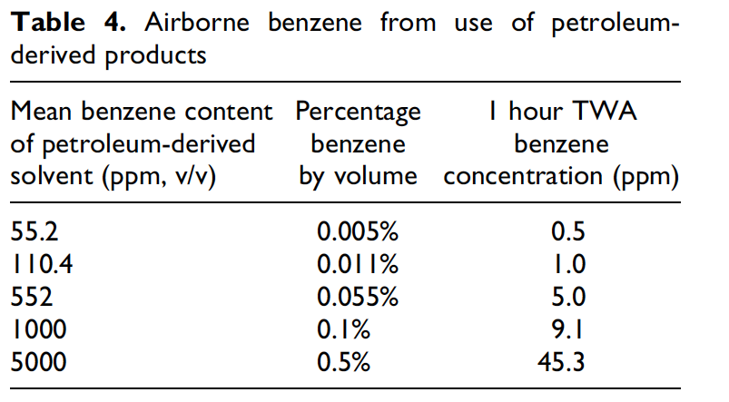
Hidden Benzene Danger in Mixtures

Slide 28
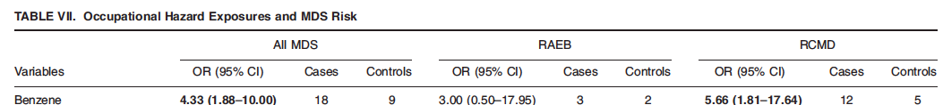
Lv 2011 - Study of 403 cases of MDS

