Slide 1


Ergonomic comparison between pistol-like and standard style paint brush handle types
J Agostinucci, J McLinden
Physical Therapy Department
University of Rhode Island

Slide 2
Introduction
Upper extremity (UE) repetitive strain injuries associated with painting
  are costliest injuries to employers and employees when cost of care, loss of productivity, and length of recovery time were analyzed.^{2, 4}
Standard paint brush handles promote a “screwdriver-like” grip, which has been shown to increase risk of UE repetitive strain injury.
The ergonomic design of the Right Brush® employs a pistol-like grip theoretically increasing ergonomic benefit by using larger muscle groups less prone to injury.^{1, 3, 5}

Slide 3
Objectives
To investigate if a right angle “pistol like” handle style paint brush will promote:
    The use of more proximal musculature than a standard pain brush
    Less muscle activity in distal muscles than a standard paint brush
    Decrease muscle fatigue in all muscles tested compared to a standard paint brush

Slide 4
Methods
Subjects
30 volunteers ≥ 18 years old
  2 left handed
  21 between 18-30
  1 between 30 – 45
  3 between 45 – 65
No history of neuromuscular/musculoskeletal disorders.
All read an informed consent approved by the URI IRB.

Slide 5
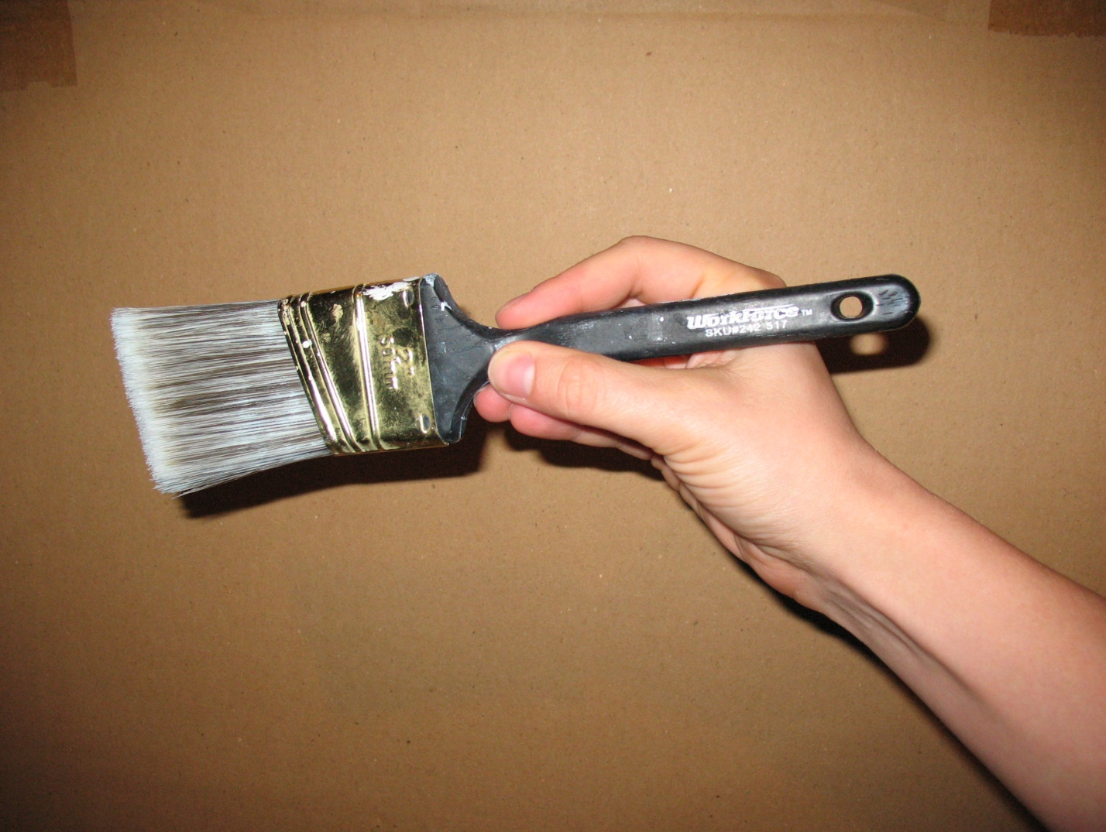
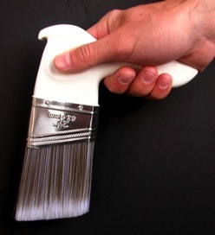
Methods
Materials
Paint Brushes
  ArroWorthy traditional screwdriver type handle
  Right Brush® - pistol like handle style handle

Slide 6
Methods
Materials
7’ 4” (254cm) wooden structure was constructed
  Simulated a commonly painted area of a house with trim, bookshelf and fixtures.
Used 15 times, receiving 30 coats of paint then replaced
Areas of structure were labeled 1-6.
  served as a standardized location for EMG recordings to take place.

Slide 7
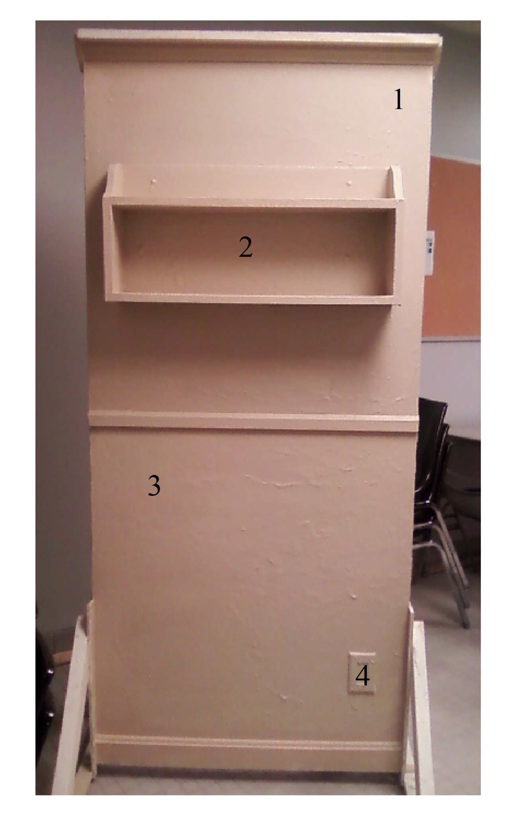
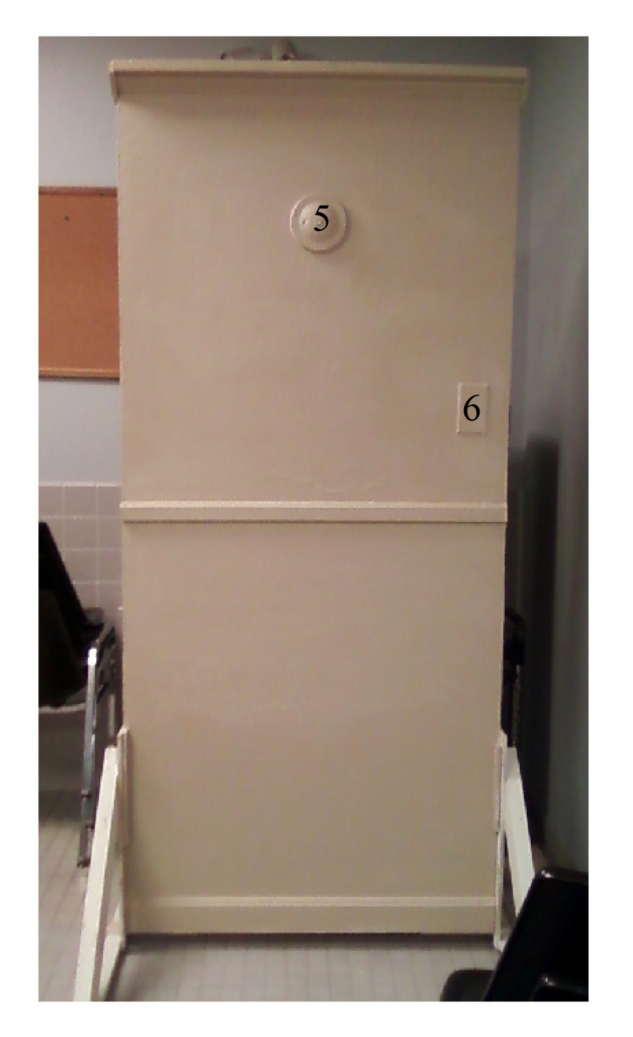
Wooden Structure

Slide 8
Methods
Materials
Paint
  Acrylic based paint was used for safety purposes and easy cleaning.
  Two distinct neutral colors were used to differentiate between trials.

Slide 9
Methods
Research Design
Randomized cross over repeated measure design
Participants served as their own controls.
All participants returned within one week to perform the same painting activity with the other paint brush handle type.

Slide 10
Methods
EMG
Muscle Groups Assessed
  Thenar
  Forearm flexors
  Forearm extensors
  Upper arm flexors
  Upper arm extensors
  Anterior deltoid
  Upper trapezius

Slide 11
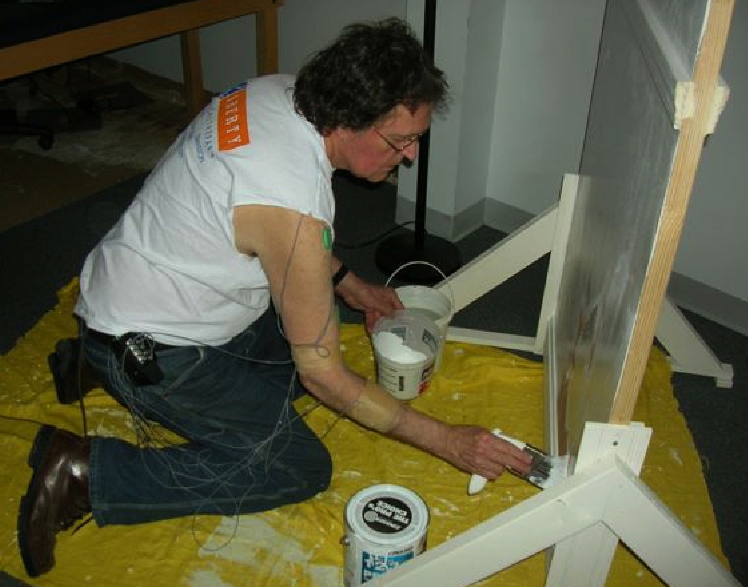
Methods
EMG - Parameters
8 channel Blue tooth Biometrics EMG.
Bipolar Ag-AgCL surface electrodes.
Placed on skin over the motor point on the major muscle group within the functional group.

Slide 12
Methods
EMG - Parameters
EMG recording were taken at the initiation of painting and at 5 min intervals for 30 min (7 recordings total).
Duration 10 sec.
Digitized at 1000 Hz
Bandwidth 20-450 Hz
Amplifier had an input impedance of 1MΩ (4730pf)
Common mode rejection ration of 96dB @ 50 Hz
Signal to noise ration of <1µV r.m.s

Slide 13
Methods
Procedure
Participants were randomly given a paint brush handle type

Slide 14
Methods
Procedure
Participants were asked to begin painting freely on the standard pre-fabricated wooden structure.
During EMG recordings, participants were asked to move and paint one of 6 marked locations.

Slide 15
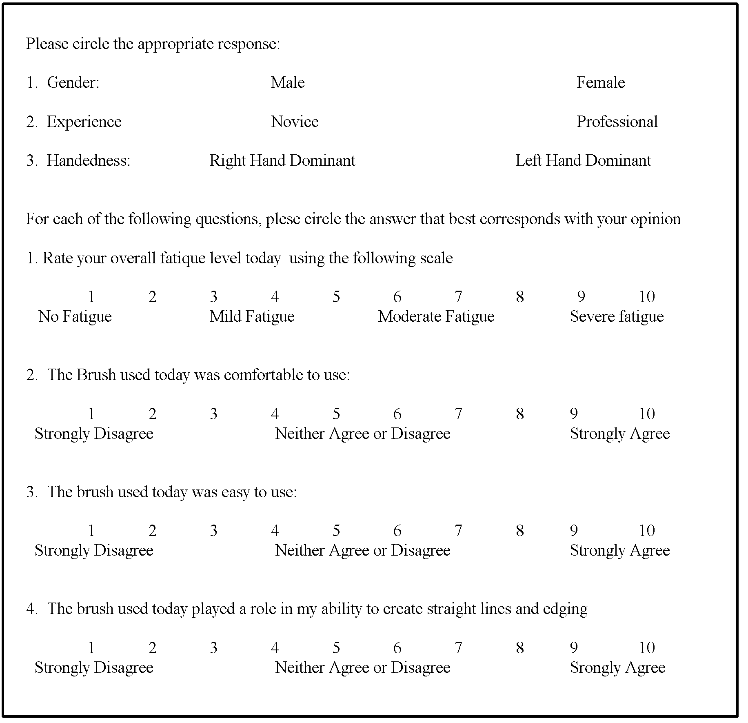
Methods
Procedure
The numbered areas were painted in the same order at the same point in every trial.
Upon completion of the task, participants were asked to:
  return within a week to complete the experiment with the alternate brush and
  complete a questionnaire detailing their experience.

Slide 16
Methods
Analysis
EMG data was downloaded using a Biometrics DataLOG analysis software
Data was normalized by using the 1st EMG recording at the beginning of the experiment and using this data as a reference that all other EMG trials were compared to. (Roman-Liu et al., 2013)
Statistical Analysis used the ratios of the EMGs (trial EMG / reference EMG) and any changes in these ratios determined its significance.
One way ANOVAs with two repeated measures (time/brush type) were used to compare each muscle group myoelectric activity.

Slide 17
Methods
Analysis
EMG Analysis – Two analyses were conducted
  Area under the curve
  Median frequency (MF)

Slide 18
Methods
Analysis
Area under the Curve
  The raw EMG Signal was:
    Full wave rectified
    Filtered at 20 – 500KHz
    Integrated
  For each of the 6, 10 second recordings, for each muscle for both sessions

Slide 19
Methods
Analysis
MF
  Was calculated using the “Biometrics DataLOG Analysis Software” median frequency filter.
  A sliding window technique with a step size of 500 sample and a window size of 10,000 samples was used.

Slide 20
Methods
Analysis
Questionnaire data that was analyzed statistically were:
  Comfort
  Ease of use
  Subjective fatigue level
  Ability to paint straight lines
  Signed rank test was used to determine significance between handle types.

Slide 21
Results
No difference in:
  Area under the curve
  MF
Participants rated the “Right Brush® (p<.05)
  Less fatiguing
  More comfortable
  Easier to use
  And easier to make straight lines and edges

Slide 22
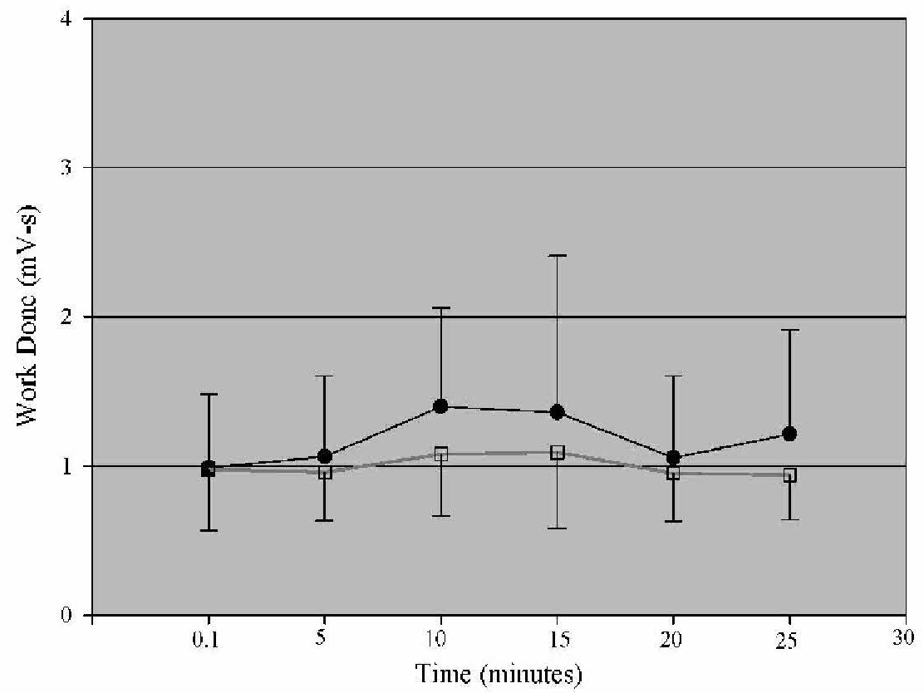
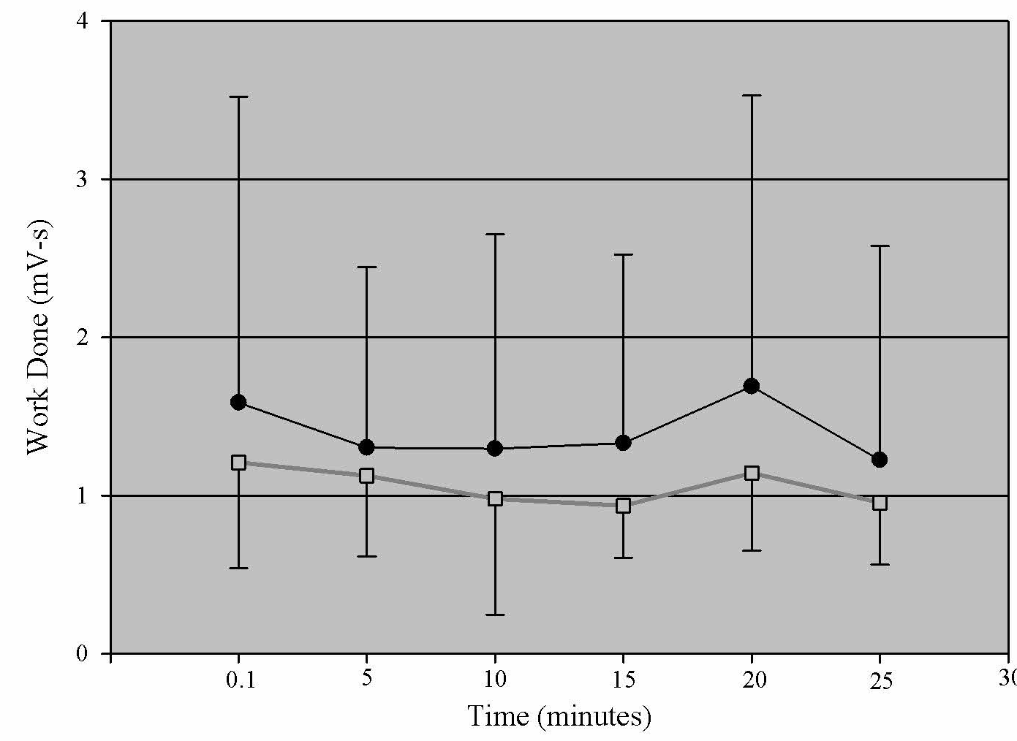
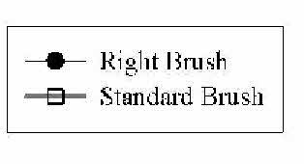
Results - Area
Forearm extensors
Thernar Group
Each point represents the normalized average from all subjects over a 10s period

Slide 23
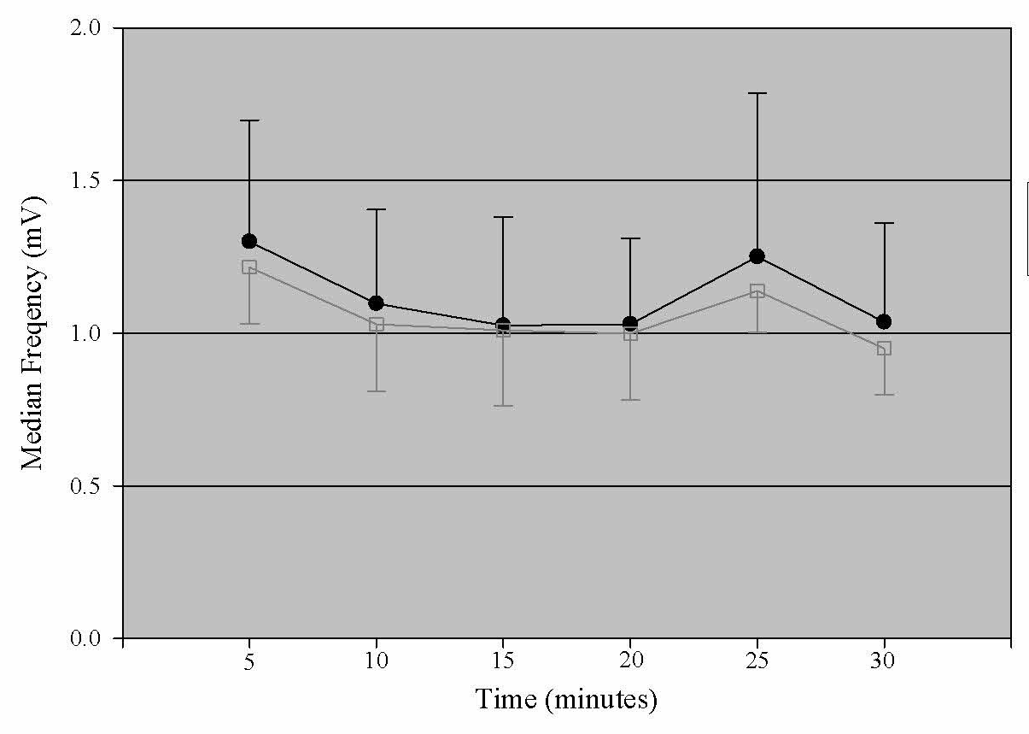
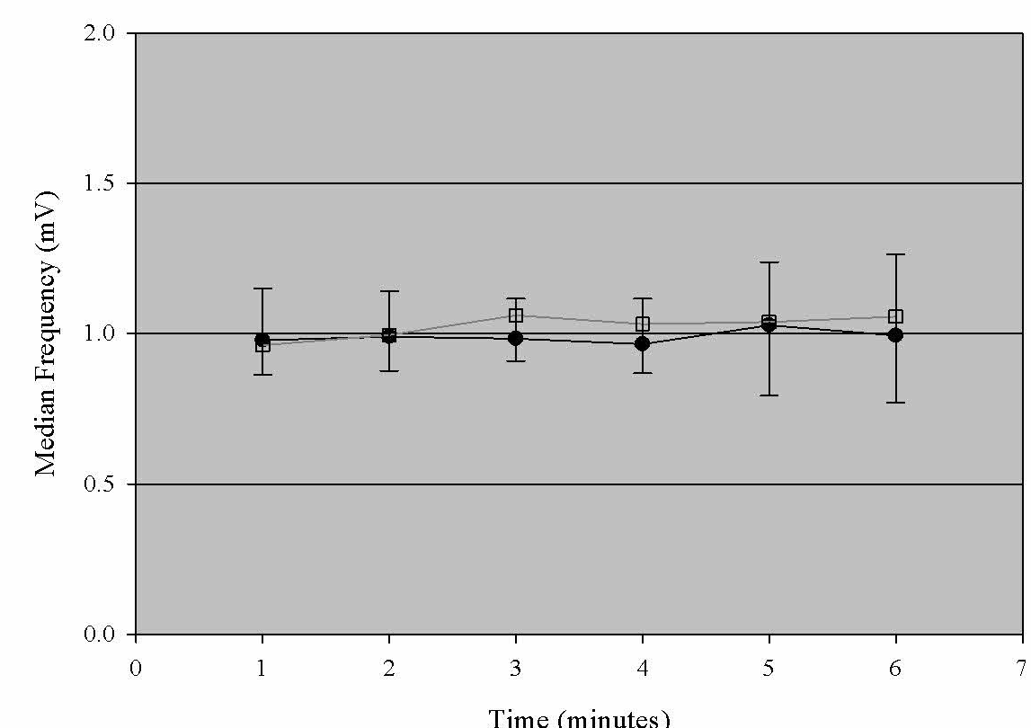
Results - MF
Upper trapezius
Thenar group
Each point represents the normalized average MF from all subjects over a 10 s period

Slide 24
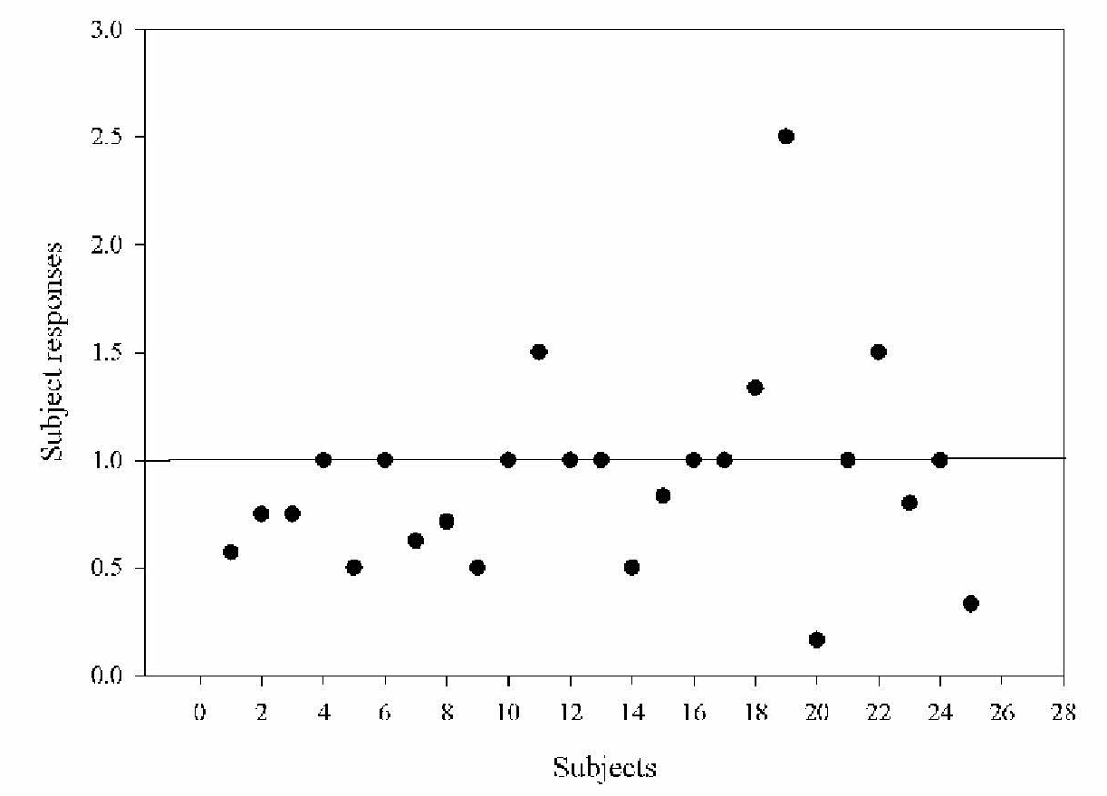
Results Questionnaire
Scatter Plots
Fatigue
Participants subjectively chose numbers from 1-10 on a visual analog scale
Lower values are less fatiguing
p < .05

Slide 25
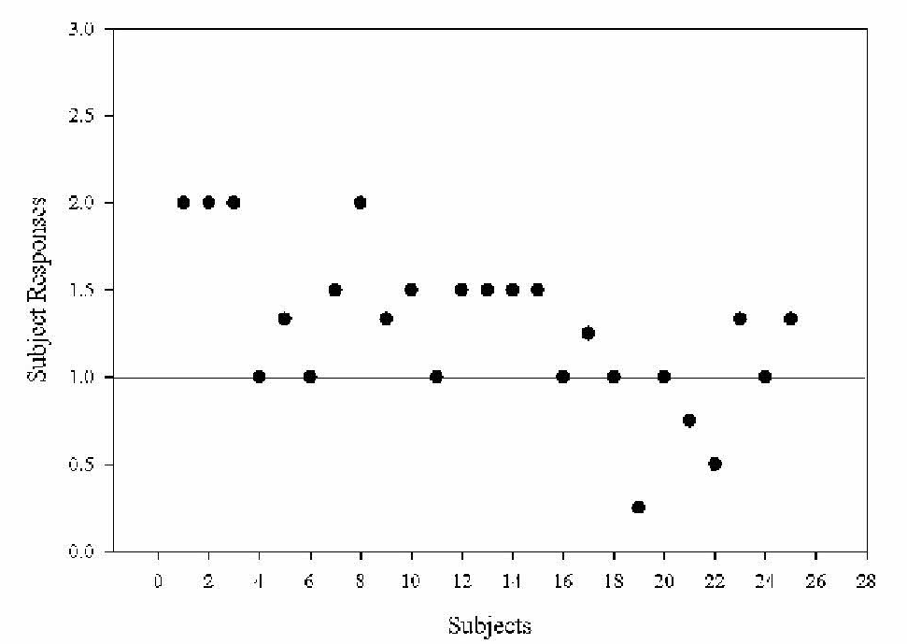
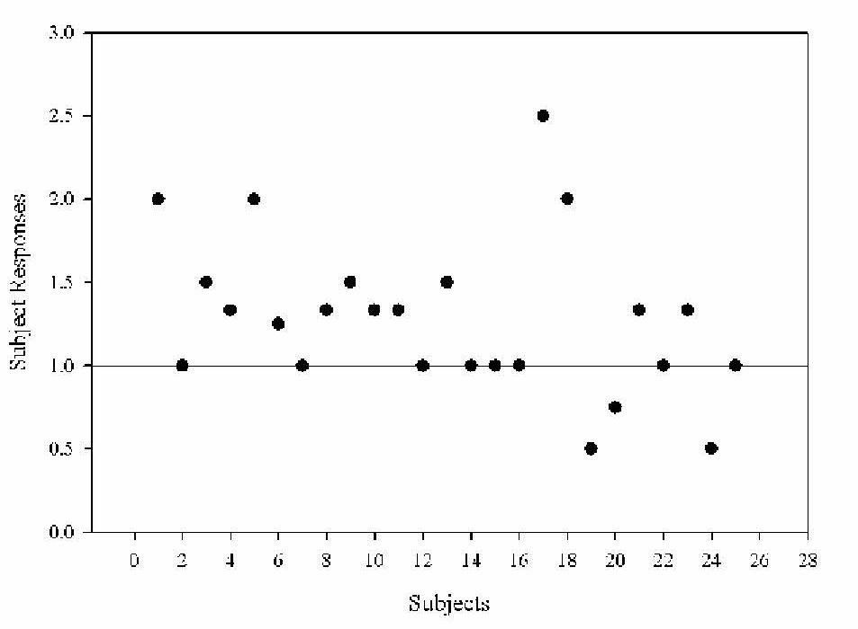
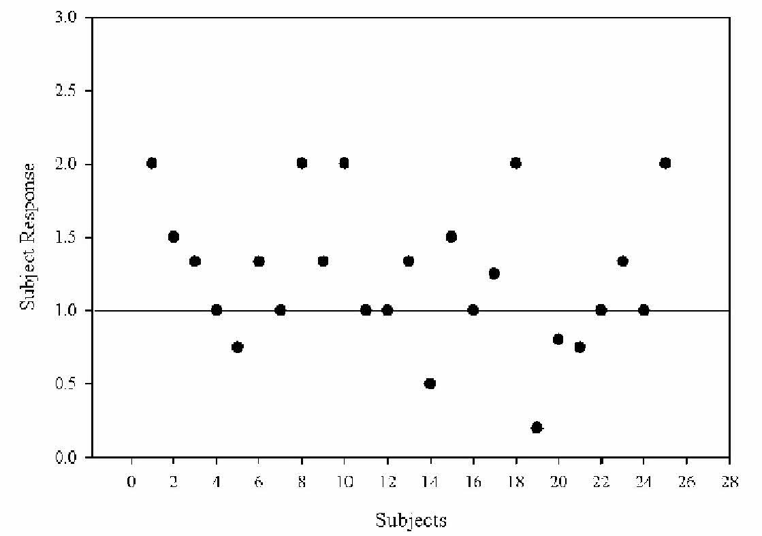
Results Questionnaire
Scatter Plots
Comfort
Ease of Use
Straight Lines
Participants subjectively chose numbers from 1-10 on a visual analog scale
Data points above the line represent values favoring the Right Brush®
p < .05

Slide 26
Conclusion
A pistol like handle had no added ergonomic advantage over the commonly used standard handle paint brush in people without injury.
The Right Brush® was subjectively shown to be comfortable, and easy to use.
Assumptions:
  Pistol style brush handles do not prevent “Occupational Overuse Syndromes” (OOS) from occurring
  individual preference may mean more than ergonomic
  effectiveness between the two brush types for evaluating fatigue levels and ease of use.
  Further research needs to be conducted on a patient population to investigate the effectiveness that brush handle type has on furthering disability from OOS.

Slide 27
References
Barr, A. E., Barbe, M. F., & Clark, B. D. (2004). Work related musculoskeletal disorders of the hand and wrist: epidemiology, pathophysiology, and sensorimotor changes. Journal of Orthopedics and Sports Physical Therapy, 34(10), 610-627.
Bureau of Labor and Statistics. LOST-WORKTIME INJURIES AND ILLNESSES: CHARACTERISTICS AND RESULTING TIME AWAY FROM WORK, 2004. 2005;USDL 05-2312:9-10, 27, 28. Accessed September 2009.
Fung, B. K. K., Chan, K. Y., Lam, L. Y., Cheung, S. Y., Choy, N. K., & Chu, K. W., et al. (2007). Study of wrist posture, loading and repetitive motion as risk factors for developing carpal tunnel syndrome. Hand Surgery, 12(1), 13-18.
National Institute of Occupational Safety & Health. MUSCULOSKELETAL DISORDERS AND WORKPLACE FACTORS: A Critical Review of Epidemiologic Evidence for Work-Related Musculoskeletal Disorders of the Neck, Upper Extremity, and Low Back. . 1997;97-141:243-310. Accessed February 2010.
Thomsen, J. F., Mikkelsen, S., Andersen, J. H., Fallentin, N., Loft, I. P., & Frost, P., et al. (2007). Risk factors for hand-wrist disorders in repetitive work. Journal of Occupational Environmental Medicine, 64, 527-533.

