Slide 1

Retroviruses and the RW Genome –
Active Roles in Evolution of Immunity and Pregnancy
Retroviruses 2015
Chicago, June 8, 2015
James A. Shapiro
University of Chicago
jsha@uchicago.edu
www.shapiro.bsd.uchicago.edu

Slide 2
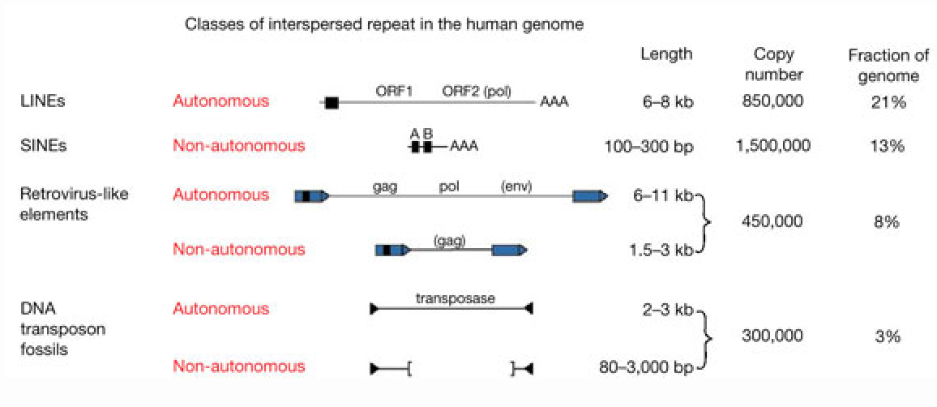
Evolutionary time: Genome writing by natural genetic engineering – dispersed mobile elements

Slide 3
Conventional Wisdom About Mobile DNA
“However, as much as two-thirds or more of the human genome is derived from repetitive sequences. Most of these are retrotransposon sequences that were active in the distant evolutionary past and are now present as fossils that litter our genomes. But this image belies the damage that can be wreaked by evolutionarily recent transposable elements.”
Vera Gorbunova, Jef D. Boeke, Stephen L. Helfand, John M. Sedivy. Human Genomics: Sleeping dogs of the genome. Science 5 December 2014. 346 pp. 1187-1188 DOI: 10.1126/science.aaa3177

Slide 4
Evolutionary time: Genome innovations by mobile elements
Alter genome expression by inserting control signals for transcription and epigenetic modification
Rewire dispersed genome regulatory networks by related insertions at multiple sites
Facilitate rapid protein evolution by mobilizing functional domains to form proteins with new combinations
Generate novel protein-coding information (new domains) by “exonization” of DNA from inserted mobile elements
“Our data revealed >280,000 mobile element exaptations common to mammalian genomes covering ~7 Mb…, a considerable expansion from the ~10,000 previously recognized cases. Of the ~1.1 million constrained elements that arose during the 90 million years between the divergence from marsupials and the eutherian radiation, we can trace >19% to mobile element exaptations.”
Lindblad-Toh, K., M. Garber, et al. (2011). "A high-resolution map of human evolutionary constraint using 29 mammals." Nature 478(7370): 476-482.
The Majority of Primate-Specific Regulatory Sequences Are Derived from Transposable Elements. Pierre-Étienne Jacques, Justin Jeyakani, Guillaume Bourque, 2013. PLOS Genetics DOI: 10.1371/journal.pgen.1003504

Slide 5
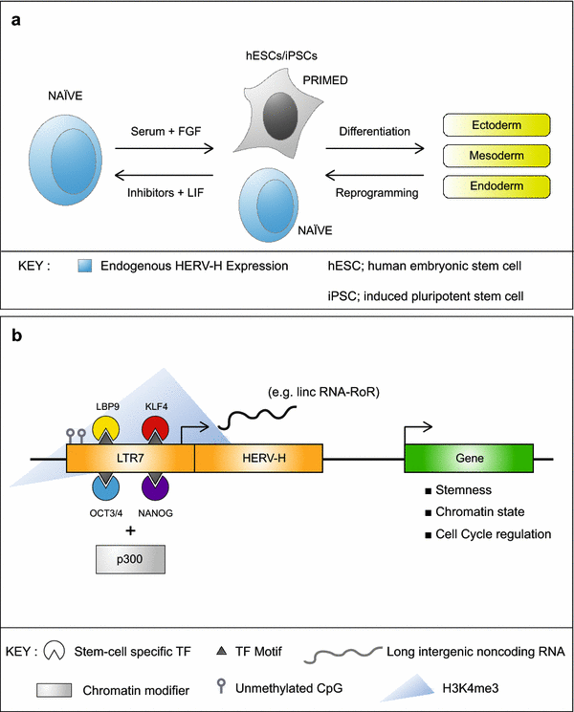
HERV-H activity overlaps with ground state pluripotency. a HERV-H expression is thought to define naïve-like stem cells. b Mechanism of HERV-H regulation of stem cell gene expression.
Robbez-Masson and Rowe. Retrotransposons shape species-specific embryonic stem cell gene expression.
Retrovirology 2015 12:45 doi:10.1186/s12977-015-0173-5
Notes:
HERV-H activity overlaps with ground state pluripotency. a HERV-H expression is thought to define naïve-like stem cells. b Mechanism of HERV-H regulation of stem cell gene expression.
Robbez-Masson and Rowe Retrovirology 2015 12:45 doi:10.1186/s12977-015-0173-5

Slide 6
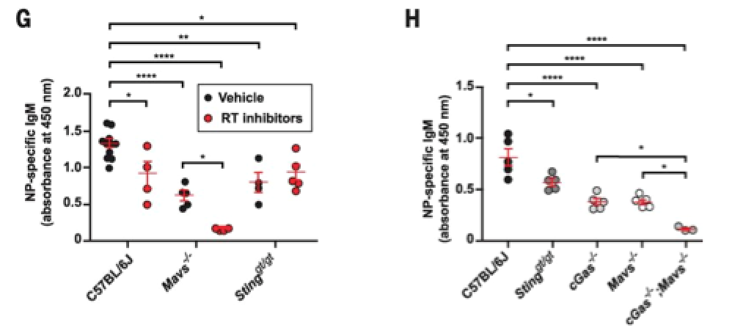
TI-2 antigen immunization
induces expression of ERV mRNA and cDNA that is detected by cytosolic sensors
in antigen-specific B cells.
Ming Zeng et al. MAVS [mitochondrial antiviral signaling protein], cGAS [cGMP-AMP synthase, involved in DS RNA sensing], and endogenous retroviruses in T-independent B cell responses. Science 2014;346:1486-1492
Published by AAAS
Notes:
TI-2 antigen immunization induces expression of ERV mRNA and cDNA that is detected by cytosolic sensors in antigen-specific B cells.Splenic NP-specific or non–NP-specific CD19⁺ B cells were collected from C57BL/6J mice (A, C, and D) or Igh^{B1-8+} transgenic mice (B) 4.5 days after immunization with NP-Ficoll (N = 3 mice per experiment). (A) Transcript levels of the indicated ERVs measured by reverse transcription quantitative PCR (RT-qPCR) of mRNA isolated from NP-specific or non–NP-specific B cells. Data were normalized to glyceraldehyde phosphate dehydrogenase (GAPDH) mRNA levels in the same cells. Because of copy number differences, the magnitude of up-regulation of different ERVs cannot be directly compared in this experiment. (B) Igh^{B1-8+} transgenic mice express a recombined variable region derived from an NP-binding antibody in place of the endogenous 3′ Igh-D element (DQ52) and the Igh-J elements. RT-qPCR of the indicated ERV mRNAs immunoprecipitated with RIG-I from NP-specific or non–NP-specific B cells. Data were normalized to the level of GAPDH mRNA bound to RIG-I in the same samples, which represents a nonspecific interaction equivalent in NP-specific and non–NP-specific cells as shown in fig. S7E. (C) qPCR of ERV DNA in the cytoplasmic fraction of NP-specific or non–NP-specific B cells. Data were normalized to GAPDH intronic DNA levels in the same cells. Endogenous ecotropic murine leukemia virus (eMLV) and mouse mammary tumor virus (MMTV) were amplified with primers targeting spliced cDNAs; these species probably represent a minority of the cytoplasmic eMLV and MMTV cDNAs and thus may not precisely reflect total eMLV and MMTV cDNA levels. (D) RT activity in the indicated B cells from C57BL/6J mice. (E and F) Splenic CD19⁺ B cells from mice of the indicated genotypes were treated with NP-Ficoll plus RT inhibitors (AZT, NVP, and ddI) or NP-Ficoll plus vehicle for 2 days, and CD86 (E) or GL7 expression (F) was measured in NP-specific B cells. N = 3 mice for each genotype. (G) Serum NP-specific IgM on day 4.5 after NP-Ficoll immunization of mice pretreated for 3 days with RT inhibitors (AZT and NVP) or vehicle. RT inhibitor treatment continued after immunization until measurement of serum IgM. (H) Serum NP-specific IgM on day 4.5 after immunization with NP-Ficoll. Data points represent individual mice [(D), (G), and (H)]. P values were determined by Student’s t test [(A) to (C)] or one-way ANOVA and post hoc Tukey test [(D) to (H)]. n.d., not detected. Results are representative of two or three independent experiments.

Slide 7
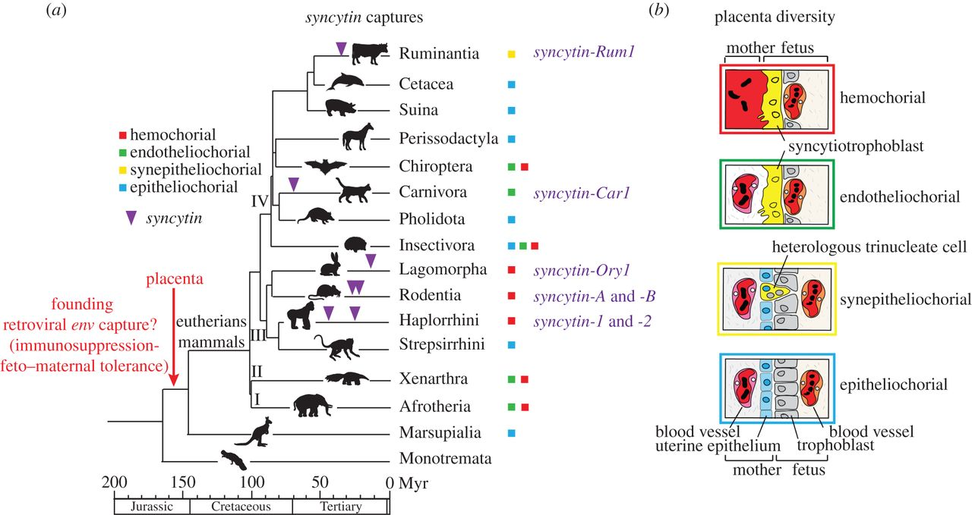

Multiple syncytin gene captures and diversity of placental structures in eutherian mammals.
Lavialle C et al. 2013 Paleovirology of 'syncytins', retroviral env genes exapted for a role in placentation. Phil. Trans. R. Soc. B;368:20120507
©2013 by The Royal Society
Notes:
Multiple syncytin gene captures and diversity of placental structures in eutherian mammals. (a) Phylogenetic tree of mammals, with the four major clades of eutherians: (I) Afrotheria, (II) Xenarthra, (III) Euarchontoglires and (IV) Laurasiatheria (adapted from Meredith et al. [61]). The four basic types of placentation are indicated by coloured squares (the colour code corresponds to that of the boxes that frame the images shown to the right). The time of insertion of the different syncytin genes identified to date is indicated. Branch length is proportional to time (in million years, Myr). (b) Schematic colour-coded representation of the maternal–fetal interface in the four main types of placental structures. Placental types are classified from top to bottom in the order of decreasing extent of syncytialization and invasive properties.

Slide 8
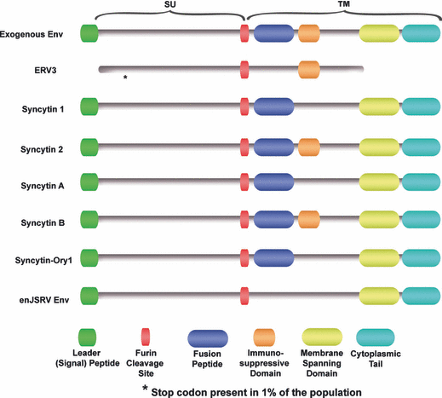
Endogenous Retroviruses in Trophoblast and Placental Development:
Syncytin Evolution from ERV Envelope Protein
Sarah G. Black et al. Endogenous Retroviruses in Trophoblast Differentiation and Placental Development. American Journal of Reproductive Immunology. Vol 64 (4), pages 255-264, 2010 DOI: 10.1111/j.1600-0897.2010.00860. http://onlinelibrary.wiley.com/doi/10.1111/j.1600-0897.2010.00860.x/full#f2
Notes:
Schematic diagram of the functional domains of Env glycoproteins proposed to be involved in placental morphogenesis compared to a typical exogenous betaretroviral Env. ERV3 codes for a truncated Env in humans, with 1% of the population having a stop codon within the amino terminus of the SU region. Syncytin 2 (human) and syncytin‐B (mouse) contain all the hallmarks of intact and functional Env proteins, including the leader peptide, furin cleavage site, fusion peptide, immunosuppressive domain, membrane‐spanning domain, and a cytoplasmic tail.
© IF THIS IMAGE HAS BEEN PROVIDED BY OR IS OWNED BY A THIRD PARTY, AS INDICATED IN THE CAPTION LINE, THEN FURTHER PERMISSION MAY BE NEEDED BEFORE ANY FURTHER USE. PLEASE CONTACT WILEY'S PERMISSIONS DEPARTMENT ON PERMISSIONS@WILEY.COM OR USE THE RIGHTSLINK SERVICE BY CLICKING ON THE 'REQUEST PERMISSION' LINK ACCOMPANYING THIS ARTICLE. WILEY OR AUTHOR OWNED IMAGES MAY BE USED FOR NON-COMMERCIAL PURPOSES, SUBJECT TO PROPER CITATION OF THE ARTICLE, AUTHOR, AND PUBLISHER.

Slide 9
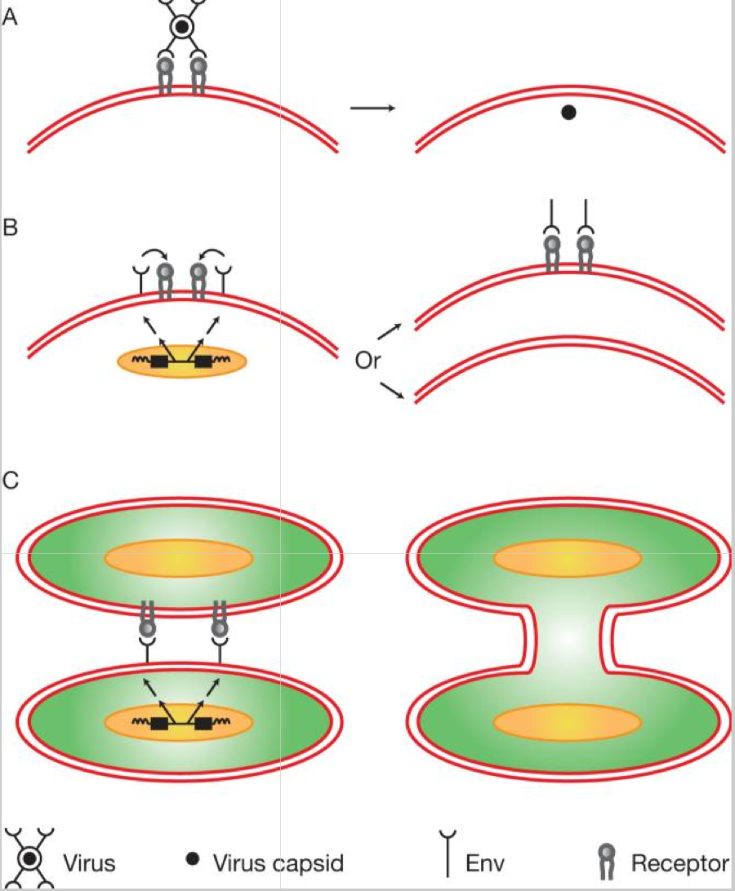
Proviral protein provides placental function
Stoye, J. P. (2009). "Proviral protein provides placental function." Proc Natl Acad Sci U S A 106(29): 11827-11828. http://www.ncbi.nlm.nih.gov/pubmed/19617545.
Notes:
Consequences of Env–receptor interactions. (A) Retrovirus infection. After receptor binding, Env-mediated fusion between virus and cell membranes occurs, resulting in the uptake of viral cores into the cell cytoplasm. Precise details of the triggering of fusion, other factors involved, and the site of membrane fusion vary from virus to virus. (B) Restriction of virus entry. The product of a retrovirus-derived env gene interacts with receptor protein leading to the absence of free receptor on the cell surface thereby preventing infection. Where in the cell the receptor–Env interaction takes place and the mechanism of resistance, e,g. blocking or down-regulation from the cell surface, is likely to vary on a case-by-case basis. (C) Cell fusion. Env-mediated membrane fusion between two cells results in the formation of multinucleate cells.

Slide 10
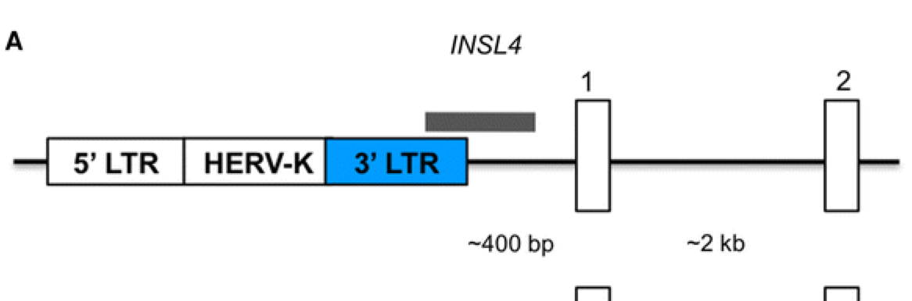
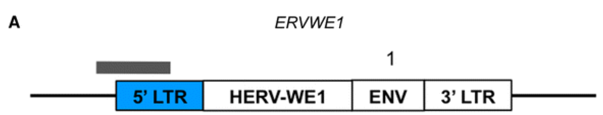
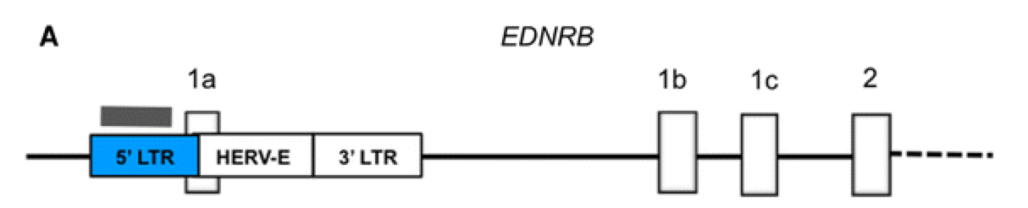
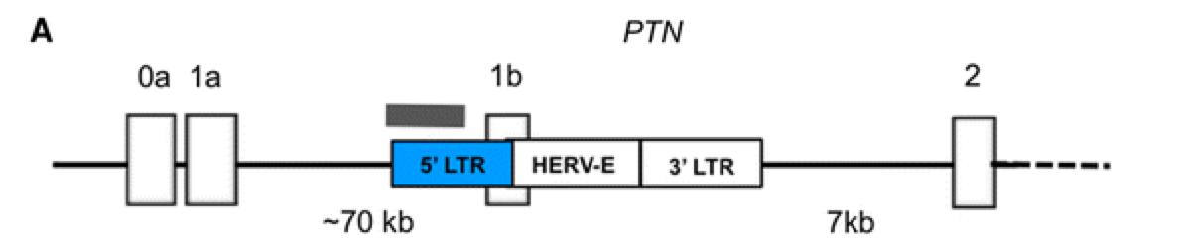
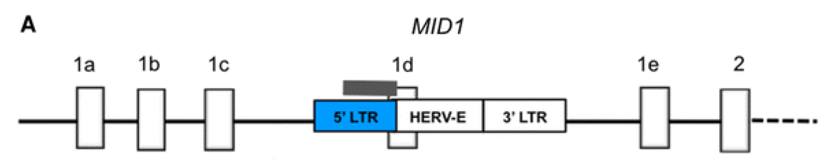
ERVs as Promoters for Human Placental-Specific Transcripts and Sites for Epigenetic Regulation
Macaulay EC, Weeks RJ, Andrews S, Morison IM. Hypomethylation of functional retrotransposon-derived genes in the human placenta.Mamm Genome. 2011 Dec;22(11-12):722-35.
Notes:
ERVWE1 encodes Syncytin-1; INSL4 – insulin-like factor; EDNRB - endothelin B receptor; PTN - growth factor pleiotrophin; MID1 – site of X-linked mutations for Opitz syndrome, a genetic disorder that primarily affects the development of midline structures.

Slide 11
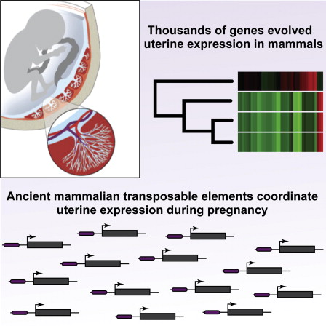
DNA Transposons and Uterine Evolution
Vincent J. Lynch , Mauris C. Nnamani ,, et al. Ancient Transposable Elements Transformed the Uterine Regulatory Landscape and Transcriptome during the Evolution of Mammalian Pregnancy. Cell Reports, Volume 10, Issue 4, 2015, 551 - 561

Slide 12
Take-Home Lesson
Genomes and their host organisms can do more -- and are more likely to persist -- when they have mobile DNA than when they don’t.

