Slide 1
Pancreatic Variant Anatomy: V shaped Pancreas
Dr J A Abdulkarim,
George Eliot Hospital NHS Trust, Nuneaton, Warwickshire, UK

Slide 2
Aims
• Review pancreatic embryology and anatomy, including common variants.
• Describe a ‘V shaped pancreas’, a pancreatic anomaly we have encountered not previously
described in humans.

Slide 3
Overview of pancreatic embryology
• Ventral and dorsal pancreatic buds form in the 5th gestational week as outgrowths of the primitive foregut.
• Fusion of the buds occurs in the 7th gestational week to form the pancreas.
• Ventral bud forms the posterior head and uncinate process.
• Dorsal bud forms the anterior head, body and tail of the pancreas.
• Pancreatic ductal systems anastomose following bud fusion.
• Dorsal pancreatic bud gives rise to the accessory pancreatic duct which drains to the minor papilla,
• Ventral pancreatic bud gives rise to the major pancreatic duct which drains to the major papilla

Slide 4
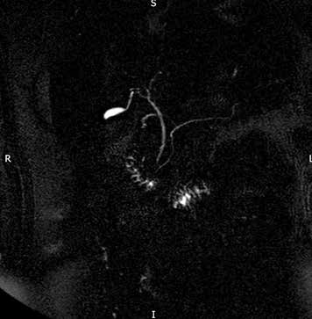
Normal pancreatic duct anatomy
The pancreas is predominately drained through the major pancreatic duct which joins the common bile duct at level of major papilla
Fig 1: MRCP thick slab single shot heavily T2 weighted turbo spin echo
radial sequence depicting conventional pancreatic anatomy.

Slide 5
Anatomic Variants
• Complications arising during pancreatic embryological development can lead to a number of variations of pancreatic duct anatomy.
• Anatomic anomalies may be a cause of recurrent pancreatitis or gastric outlet obstruction in some patients.
• Recognition of these variants is important to guide management of these conditions.

Slide 6
Examples of common variants
1. Pancreas divisum
• Failure of fusion of the ventral and dorsal pancreatic buds.
• Most of the pancreatic secretions drain via accessory pancreatic duct to minor papilla.
• Major pancreatic duct may be absent

Slide 7
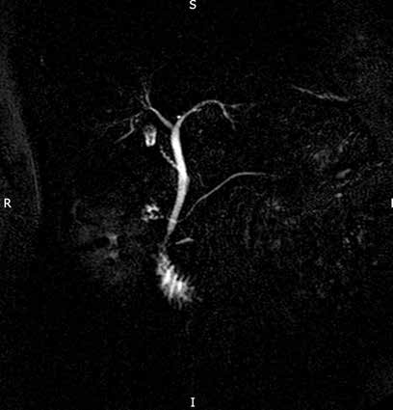
Fig 2: thick slab single shot heavily T2 weighted turbo spin echo radial sequence
depicting pancreatic divisum configuration of the pancreatic duct.

Slide 8
2. Bifid pancreatic duct
Main pancreatic duct is bifurcated along its length.
3. Absent accessory pancreatic duct
4. ‘Ansa pancreatica’
• Side branch arises from the main pancreatic duct and forms a loop to terminate near the minor papilla.
5. Annular pancreas
• Pancreatic tissue completely or incompletely surrounds the 2nd part of duodenum.
• Associated duodenal narrowing and dilatation of proximal duodenum may be seen.
6. Variations in course of the main pancreatic duct
• Descending course is the commonest course (50%)
• Variations include sigmoid, vertical and loop shaped courses.

Slide 9
Rare variant: V shaped pancreas
We have encountered a pancreatic anatomical variant that, to our knowledge, has not been
previously described.
This variant is similar to the V shaped pancreatic anatomy seen in canines.

Slide 10
• Pancreatic tissue is divided into two lobes separated by fat.
• Lobes fuse lateral to the duodenum forming a ‘V shaped’ configuration with the tip pointing to the
duodenum.
• Each pancreatic lobe has its own duct.
• Ducts join to form a single duct in the fused portion of the pancreas.
• The single duct enters the duodenum at the minor papilla.

Slide 11
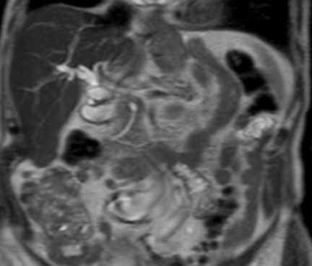
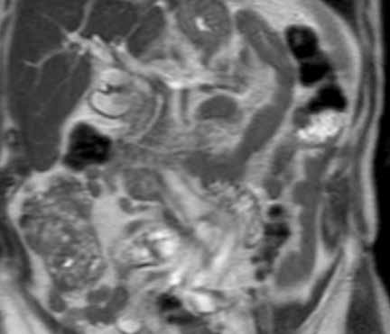
Fig 3&4: T2 weighted turbo spin echo single shot coronal sequence showing
2 separate moieties of pancreatic tissue separated by fat.

Slide 12
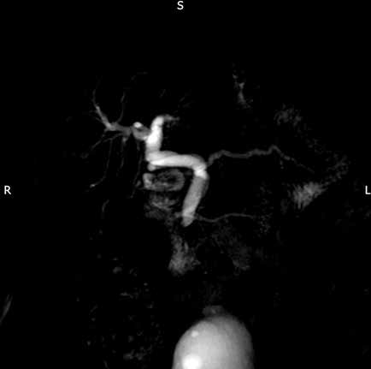
Fig 5: MRCP thick slab single shot heavily T2 weighted turbo spin echo radial sequence showing two separate pancreatic ducts joining before entering the duodenum at the minor duodenal papilla. Incidentally, there is also dilatation of the common bile duct.

Slide 13
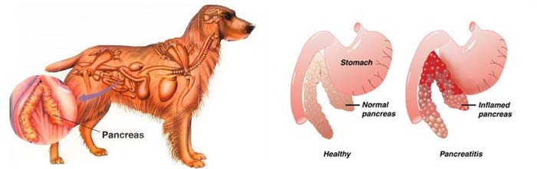

Slide 14
Summary
• We have described a ‘V shaped pancreas’, a pancreatic anatomical variant that is similar to
canine pancreatic anatomy.
• Recognition of pancreatic anomalies on imaging is important as they may be of clinical
relevance.
• An understanding of pancreatic embryology and anatomy is required to detect these anomalies.

Slide 15
References
1) Türkvatan A, Erden A, Türkoğlu MA, Yener Ö. Congenital Variants and Anomalies of the Pancreas and Pancreatic Duct: Imaging by Magnetic Resonance Cholangiopancreaticography and
Multidetector Computed Tomography. Korean Journal of Radiology 2013;14(6):905-913. doi:10.3348/kjr.2013.14.6.905.
2) Koenraad J. Mortelé, Tatiana C. Rocha, Jonathan L. Streeter, and Andrew J. Taylor. Multimodality Imaging of Pancreatic and Biliary Congenital Anomalies
RadioGraphics 2006 26:3 , 715-731
3) Jinxing Yu, Mary Ann Turner, Ann S. Fulcher, and Robert A. Halvorsen
Congenital Anomalies and Normal Variants of the Pancreaticobiliary Tract and the Pancreas in Adults: Part 2, Pancreatic Duct and Pancreas
American Journal of Roentgenology 2006 187:6 , 1544-1553
4) Peyman Borghei, Farnoosh Sokhandon, Ali Shirkhoda, and Desiree E. Morgan Anomalies, Anatomic Variants, and Sources of Diagnostic Pitfalls in Pancreatic Imaging
Radiology 2013 266:1 , 28-36
5) Rizzo RJ, Szucs RA, Turner MA. Congenital abnormalities of the pancreas and biliary tree in adults. RadioGraphics1995;15(1):49–68; quiz 147–148.
6) Douglas H. Slatter, Textbook of Small Animal Surgery, 2003 - Veterinary surgery

