Slide 1
Effects of Natural Pigments on the Poly ( methyl methacrylate )
Biopolymer
Jaleel Kareem Ahmed
University of Babylon / Babylon – Iraq

Slide 2
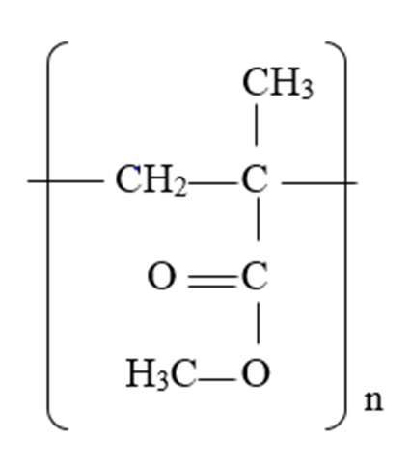
PMMA structure

Slide 3
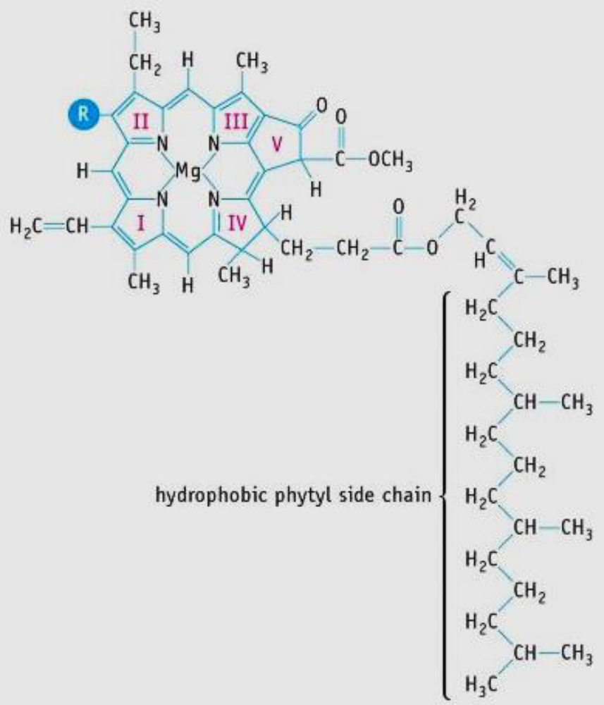
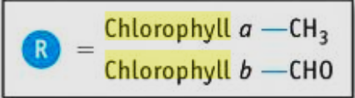
The structures of chlorophyll a and b

Slide 4
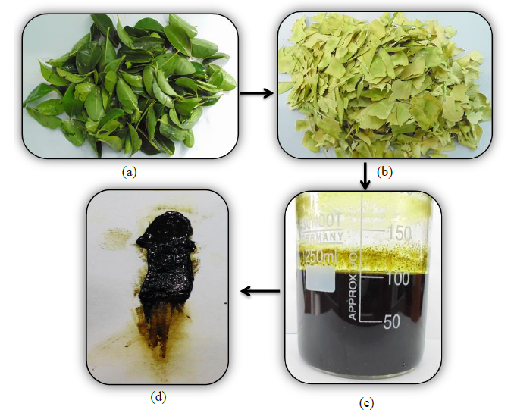
Procedure of chlorophyll extraction (a)citrus aurantium leaves, (b)the remnants of leaves and (c)extracted chlorophyll solution, (d)dense chlorophyll pigment

Slide 5
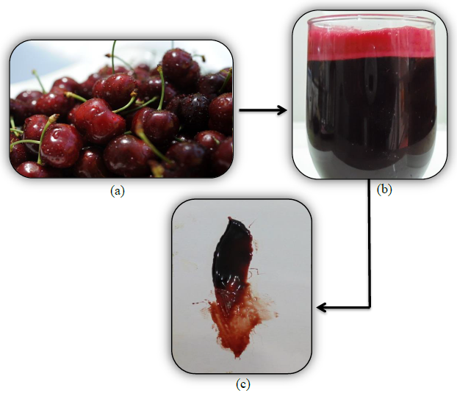
(a) Cherry fruit, (b) extracted anthocyanin solution, (c) dense anthocyanin dye.

Slide 6
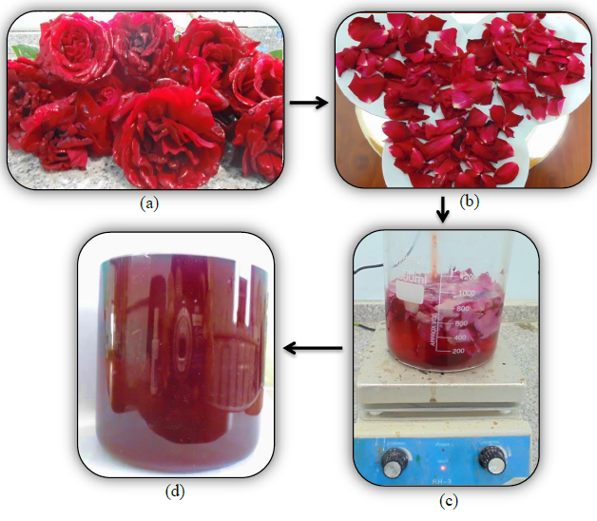
Procedure of anthocyanin extraction (a)red rose, (b)cleaned petals (c)heating mixture on 70°C,and (d)extracted anthocyanin dye.

Slide 7
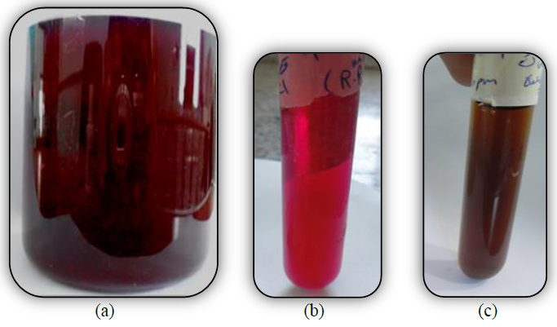
Color change of anthocyanin aqueous solution (a) dark red to, (b) scarlet red in acidic solution, while changing to, (c) reddish green color in the basic solution.

Slide 8
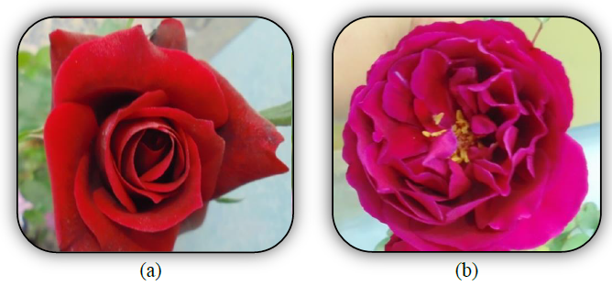
Chang in red rose color of the leaves from (a) deep red to (b) shine red.

Slide 9
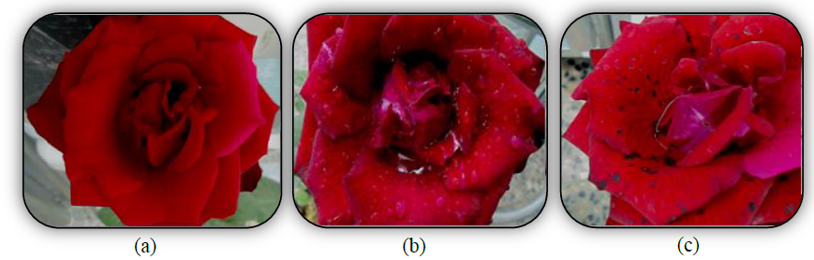
Effect of aqueous copper sulphate solution on red rose. (a) red rose, (b) sparyed red flower with aqueous copper sulphate, (c) appearance of black spot inside the leaves.

Slide 10
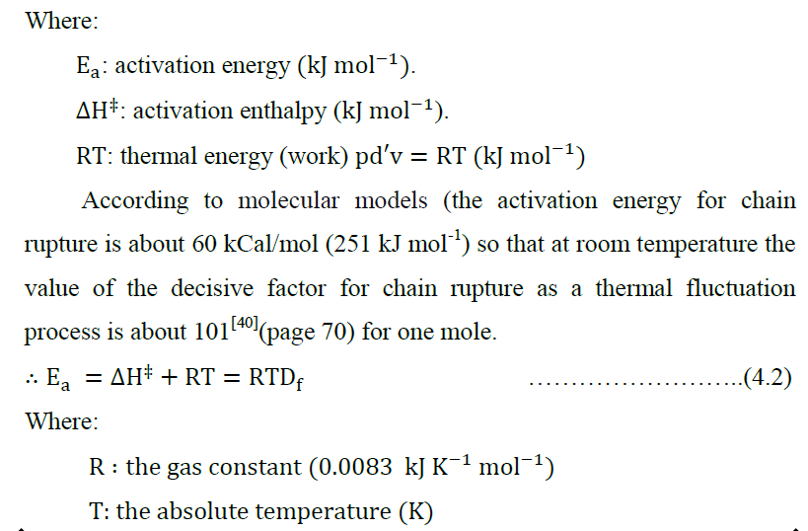

Slide 11
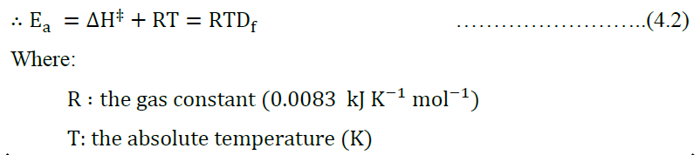
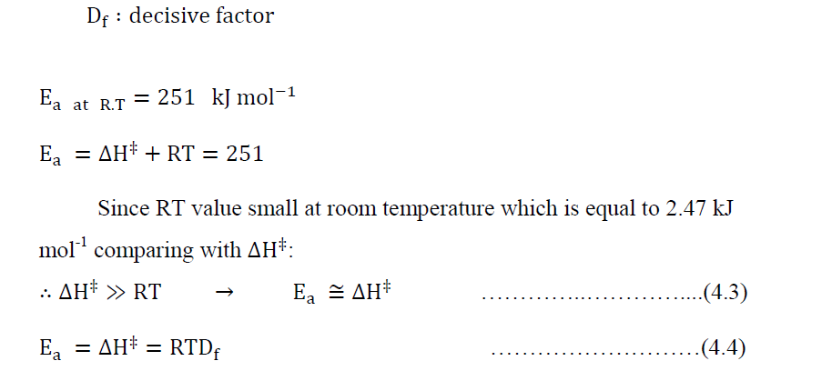

Slide 12
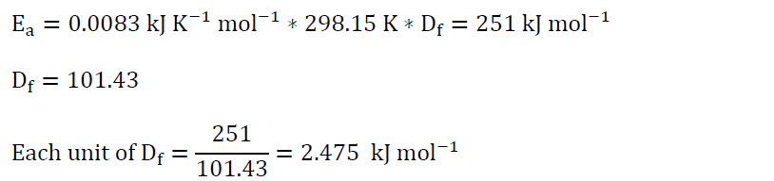
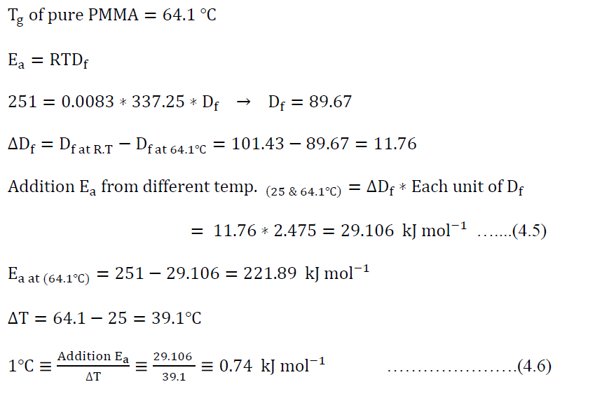
Poly (methyl methacrylate) powder (PMMA):

Slide 13
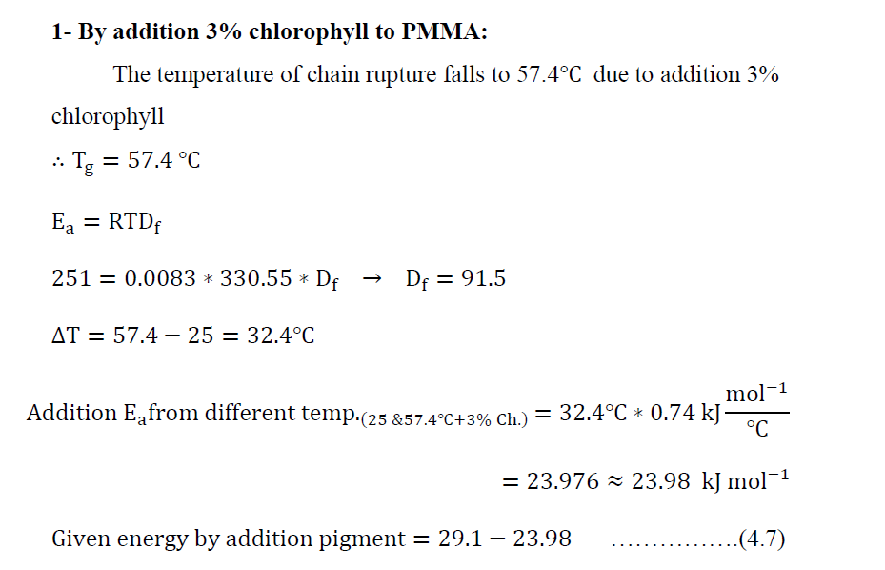

Slide 14
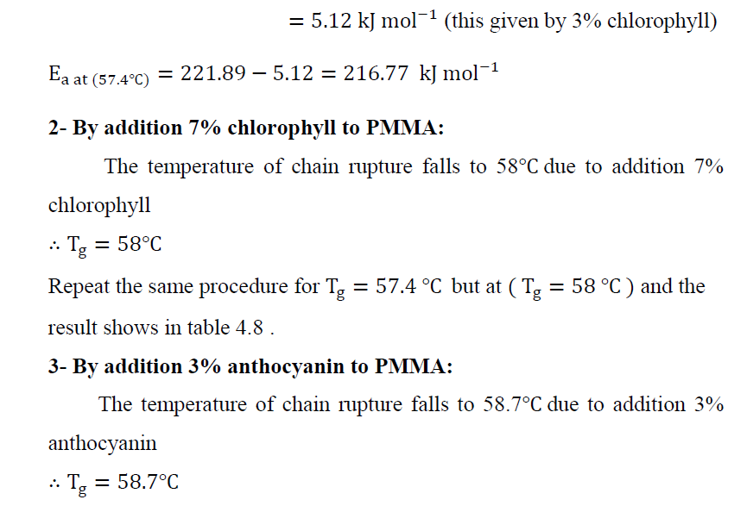

Slide 15
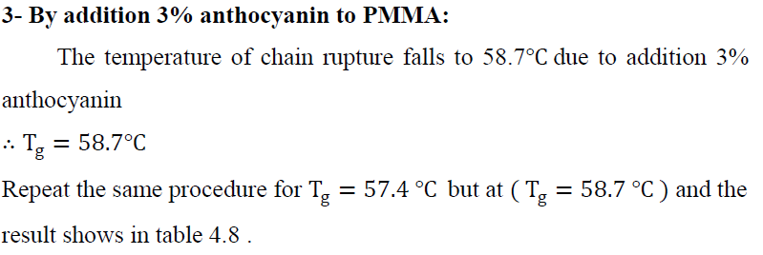
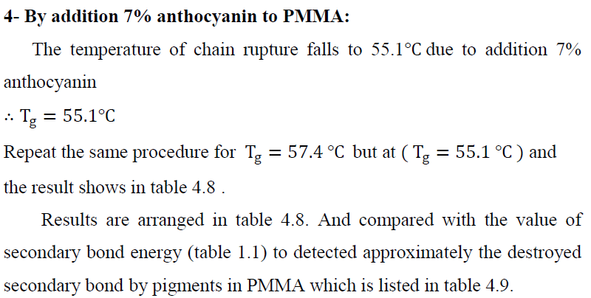

Slide 16
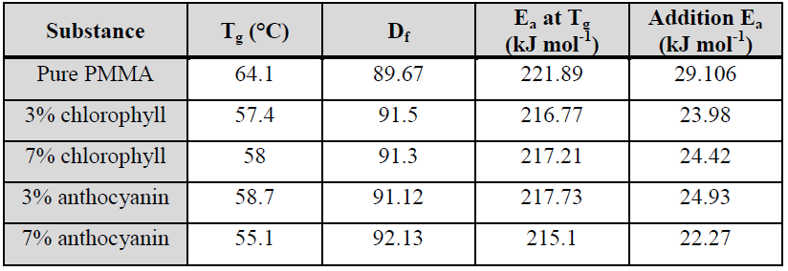

Slide 17
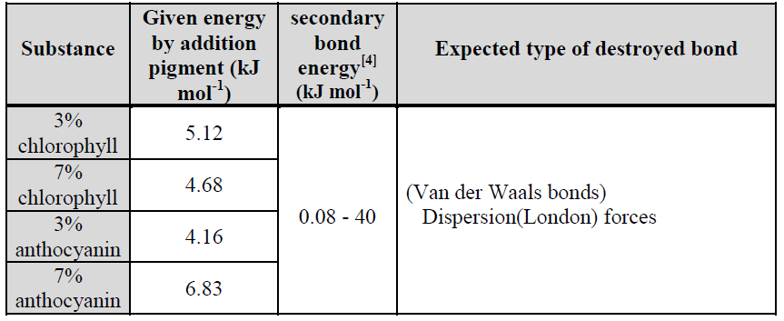
Expected destroyed secondary bond by pigments in PMMA.

Slide 18
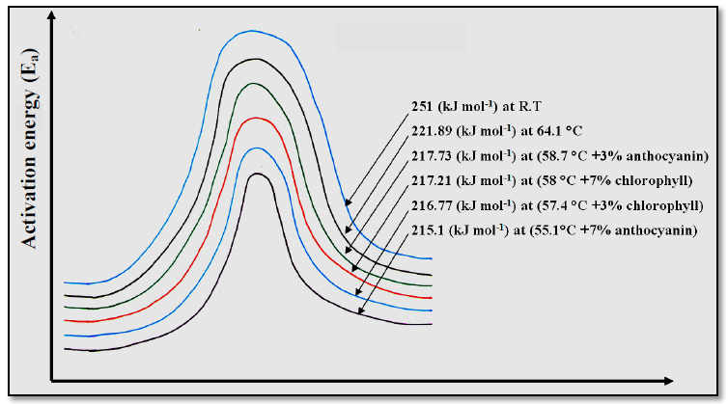
Activation energy for chain rupture in PMMA

Slide 19
This research deals with the effects of natural pigments ( chlorophyll and anthocyanin ) on the secondary ( Engineering ) bonds in the poly (methyl methacrylate )which play an important role on the physical and chemical properties of polymer. Natural pigments extracted from plants by a simple methods and show a good agreement with the standard one which characterized by ultraviolet – visible ( UV – Vis ) spectroscopy and Fourier transform infrared ( FTIR) spectroscopy . The blend of poly (methyl methacrylate , PMMA )with pigments were characterized by FTIR , differential scanning calorimeter ( DSC) , hardness , and density. Hardness of PMMA decreases as concentration of pigment increases while density show decreasing by anthocyanin higher than with chlorophyll , this due to presence of many hydroxyl groups in anthocyanin molecule and it is smaller than chlorophyll molecule , so it diffuses more in the PMMA polymer and creates voids between the polymer chains which is destroyed secondary bonds.

Slide 20
Results show that anthocyanin shows higher depression in glass transition temperature (Tg) of PMMA than do chlorophyll where its maximum effect is 3%. From Tg data calculations depending on polymer molecular model which its content the simplest idealized model of a linear silk-like molecule i.e. chain model without branching, the energies provided by the pigment to destroy the secondary bonds as a function of pigments concentration ( depress in Tg values ) are shown in the following table.

Slide 21
Pigment | Glass transition temperature (ºC) | Given energy by added pigments (kJ mol⁻¹)
Pure PMMA | 64.1 | ----
3% chlorophyll | 57.4 | 5.12
7% chlorophyll | 58.0 | 4.68
3% anthocyanin | 58.7 | 4.16
7% anthocyanin | 55.1 | 6.83
From the above tab. It seems that pigments providing small amounts of energy to depress Tg of the PMMA biopolymer .
All results of addition natural pigments are contributed to theses pigments which act as plasticizers by effecting on secondary bonds of poly (methyl methacrylate ).

Slide 22
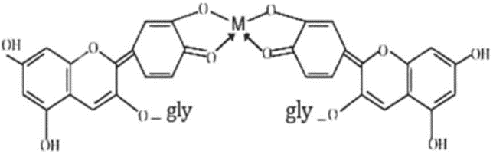
The expected structure of M -Cyanidin-3-glucoside complex in acidic pH (M= Pb, Cd).

Slide 23
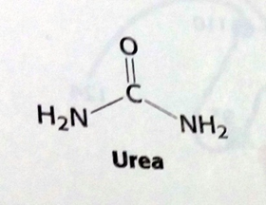
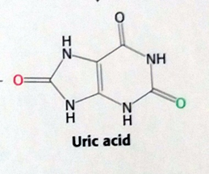
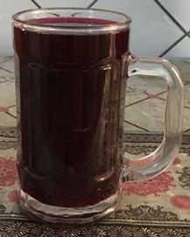
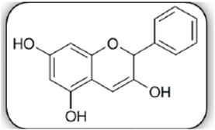
Juice
Anthocyanin

Slide 24
Results show strongly interactions via hydrogen bonding , thus anthocyanin helps in detoxification process from urea and uric acid and help kidney in its function . Lastly we recommend that :-
1.The juice from red beet obtain mechanically not by heating .
2.No addition any material to the juice .
3.storage juice in glass container .
4.Heating the juice up to boiling result in polymerization and loss exchangeable protons which is the horse of the juice .
5.Anthocyanin red dye can be use as colorant for human parts for medical purposes .
6.Enhance people to drink red beet juice two times a week in quantity enough to appear its orange color in urine .
7.We ask researchers to go more deep to investigate the role of the juice in human body . This will discover important results concerning human health.

Slide 25
Conclusions
1- Anthocyanin from red rose acts an as indicator for acid – base reaction as well as scavenger for metal ions and fighting pollution.
2- Extraction procedure of natural pigments which done in suitable way as in literature was confirmed by UV-Visible and FTIR spectrum.
3- FTIR spectrum of polymers with pigment shows lightly effect on the absorption band, which indicates that there is no effect on the primary bond. There is just effect on secondary bond by physical interaction.
4- The amorphous structure of PMMA shows no change with addition 7% chlorophyll, which confirm by XRD test.

Slide 26
5- The DSC result shows that 3% chlorophyll gives maximum effect on polymer.
6- The main attack of pigments is to overcome the dispersion force in polymers.
7- It seems that hydrogen bond in PMMA and PVC are very weak comparing with in that PVA and starch.
8- As anthocyanin concentration increasing leads to increase starch hardness while for other polymers show decreases. And as chlorophyll concentration increase lead to decrease all polymers hardness.
9- Anthocyanin has large effect on density of PMMA and PVC while chlorophyll shows more effect on PVA and starch density.
10- Morphology test shows the homogenous of pigment with polymers.
11- Finally, from all above result we conclude that the anthocyanin and chlorophyll pigment act as natural plasticizers by destroying the secondary bonds in these polymers which facilitate processability.

