Slide 1
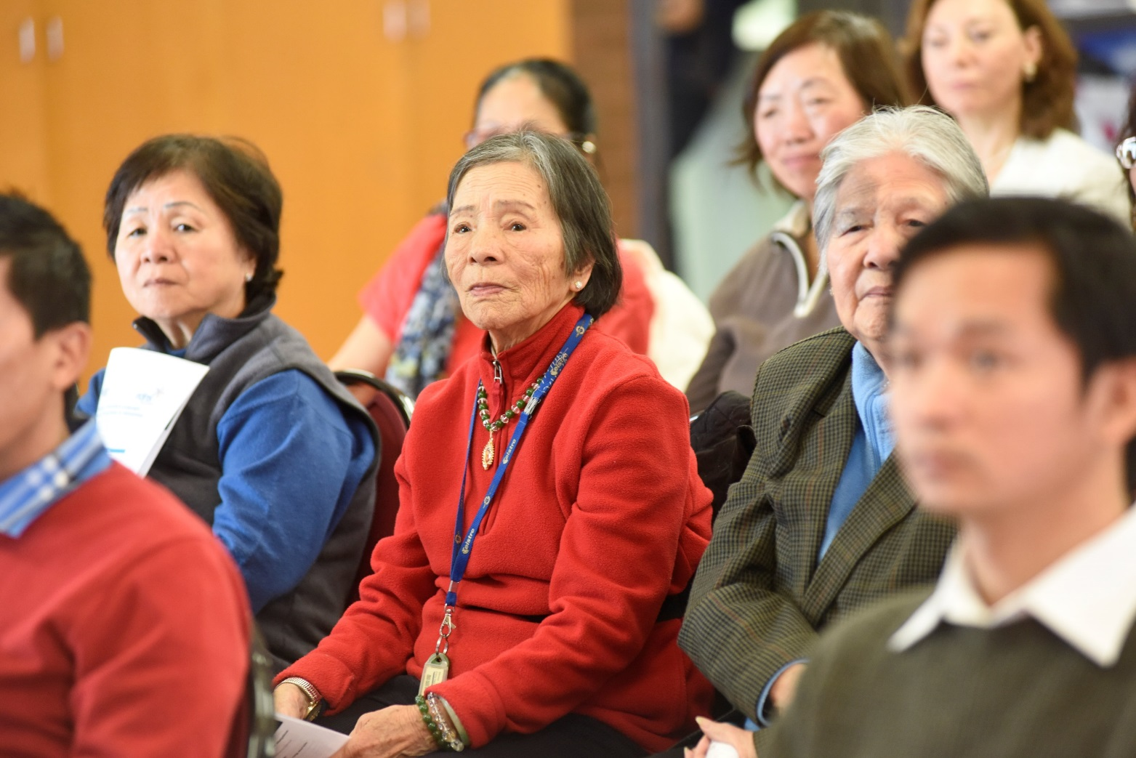
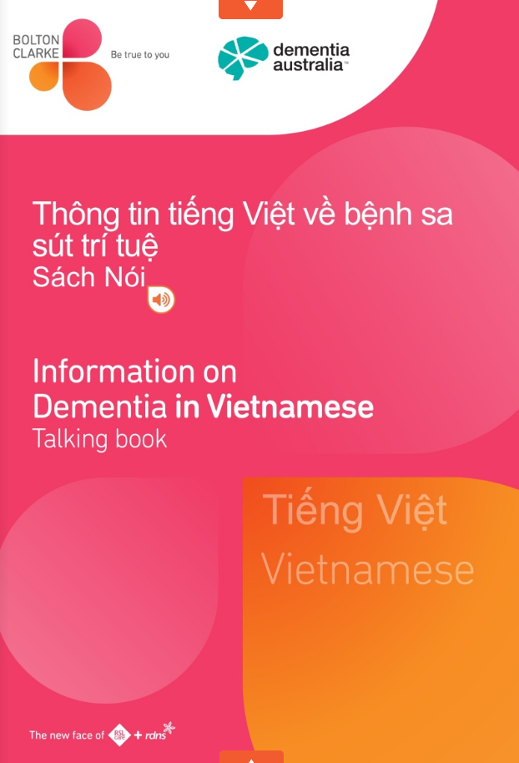
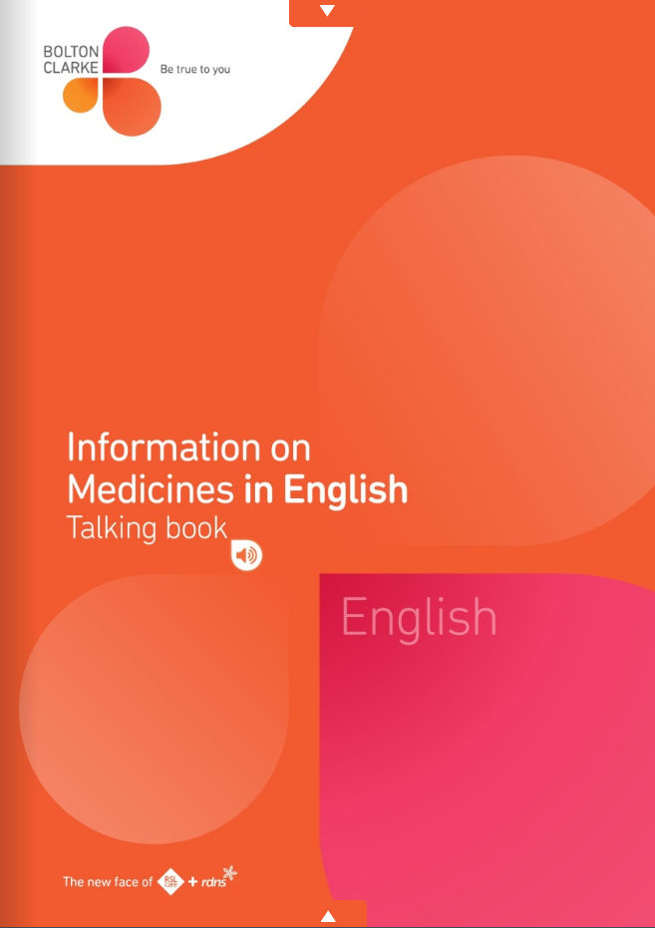
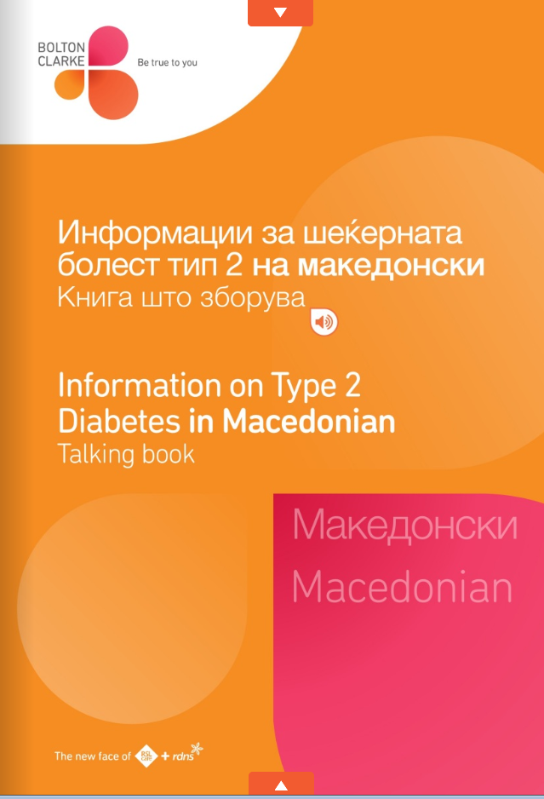
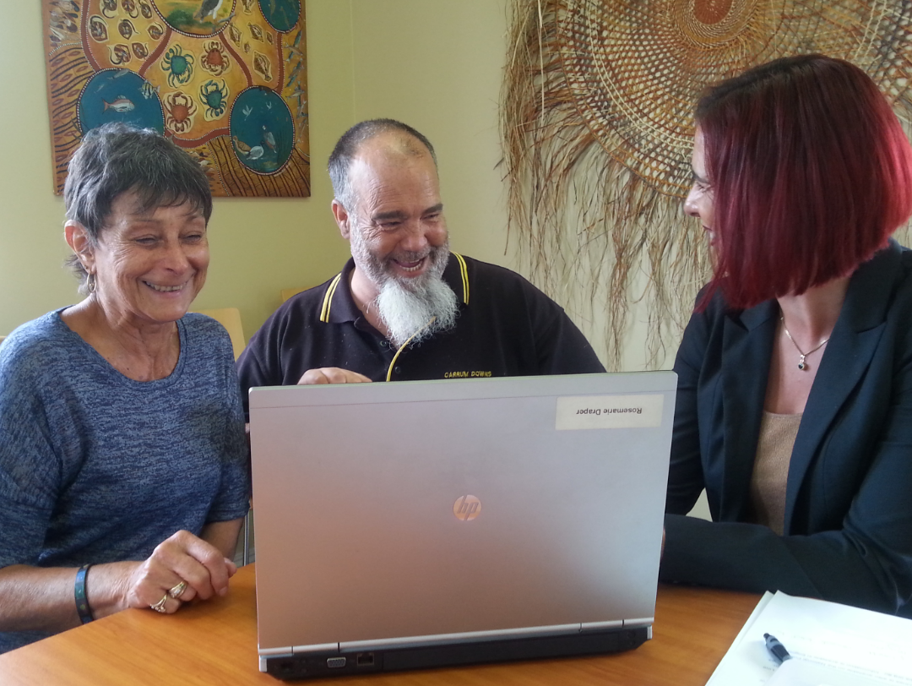
Digital ‘Talking Books’ on medicines, diabetes and dementia: Using the latest technology to meet the information needs of consumers
Jaklina Michael
Diversity Manager
Bolton Clarke, AUSTRALIA
Asia Pacific Global Summit on Health Care
Singapore - March 2018
Notes:
Good morning everybody and a big Hello from Australia!
I’m Jaklina Michael. I am the Diversity Manager for an international not-for-profit aged care service provider Bolton Clarke. I head the Diversity Team that covers the work of the Group. My job is to provide expert advice and high level solutions to the wider organisation and it’s workforce on legislation and Government policy that impacts on diversity across all business areas, in line with the strategic priorities of the business.
Thank you so much for the opportunity to present to you today.
My paper is titled, Digital ‘Talking Books’ on medicines, diabetes and dementia: Using the latest technology to meet the information needs of consumers.

Slide 2
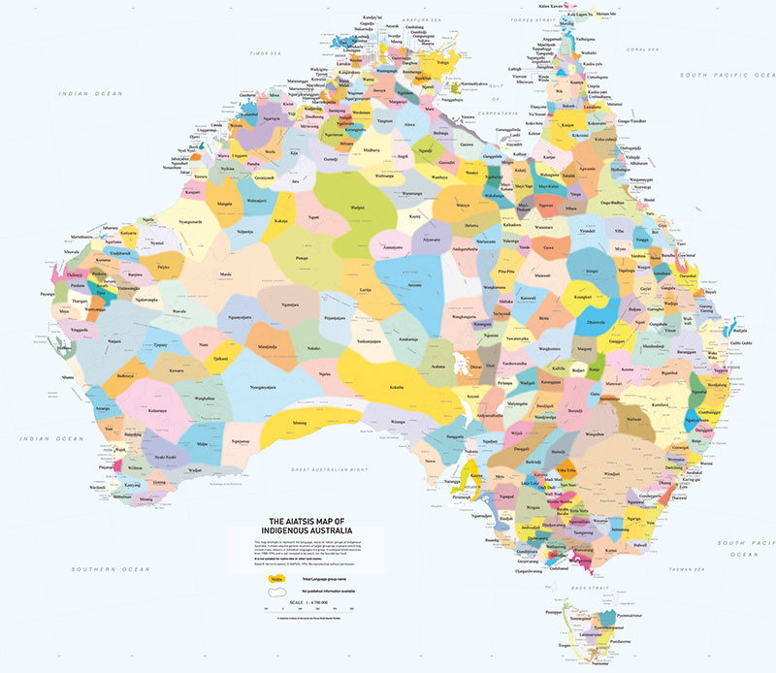
Map of Indigenous Australia
Notes:
In Australia it is common practice and very respectful to acknowledge the traditional owners of the land on which a public event is taking place. My organization has a policy that requires employees who participate in public relations activities, such as presenting at a conference to begin with an ‘Acknowledgment of Country’….something like this. “ I would like to show my respect and acknowledge the Traditional Custodians of this Land, past and present , on which this meeting is taking place’
A bit of background for you….
Australia has two indigenous population groups: Aboriginal and Torres Strait Islanders. The Torres Strait Islands are located midway between the Australian mainland and Papua New Guinea.
Over 250 Indigenous Australian language groups covered the continent at the time of European settlement in 1788. Today only around 120 of those languages are still spoken and many are at risk of being lost as Elders pass away.
Aboriginal and Torres Strait Islander people across Australia are speaking out about the need to protect, preserve and strengthen traditional languages. There is currently a wave of activity, with people in many communities working to learn more about their language, and to ensure they are passed on to the next generation before it is too late.
The Australian Institute of Aboriginal and Torres Strait Islander Studies is a world-renowned research, collections and publishing organisation and Ill now take you to their website to view the interactive map of Indigenous Australia.
The map attempts to represent the language, social or nation groups of indigenous Australia. It shows only the general locations of larger groupings of people which may include clans, dialects or individual languages in a group.
You can move your cursor over any area of the map to reveal the 'magnifying glass' circle. Then, keep your finger on the screen and move the circle around to show the zoomed in map.
I live in the city of Melbourne, in the state of Victoria. The Kulin Nation is the indigenous name for Melbourne The Wurundjerri people, Boonwurrung, Taungurong, Dja Dja Wurrung and the Wathaurung people make up the Kulin Nation. Woiworung is one of the traditional languages of the original people of the land where I live.
So why am I telling you all this…because firstly it’s a bit of an introduction to Australia for you, secondly I am proud of indigenous and multicultural Australia and thirdly I want to provide you with a context and highlight the challenges faced by my organisation to cater for the diversity of Australia’s population. In 2016, in addition to the many indigenous languages there were over 300 separately identified languages spoken in Australian homes.

Slide 3
Topics
About Bolton Clarke
Diversity at Bolton Clarke
Digital Talking Books
Demonstration
Notes:
A little bit about Bolton Clarke….

Slide 4
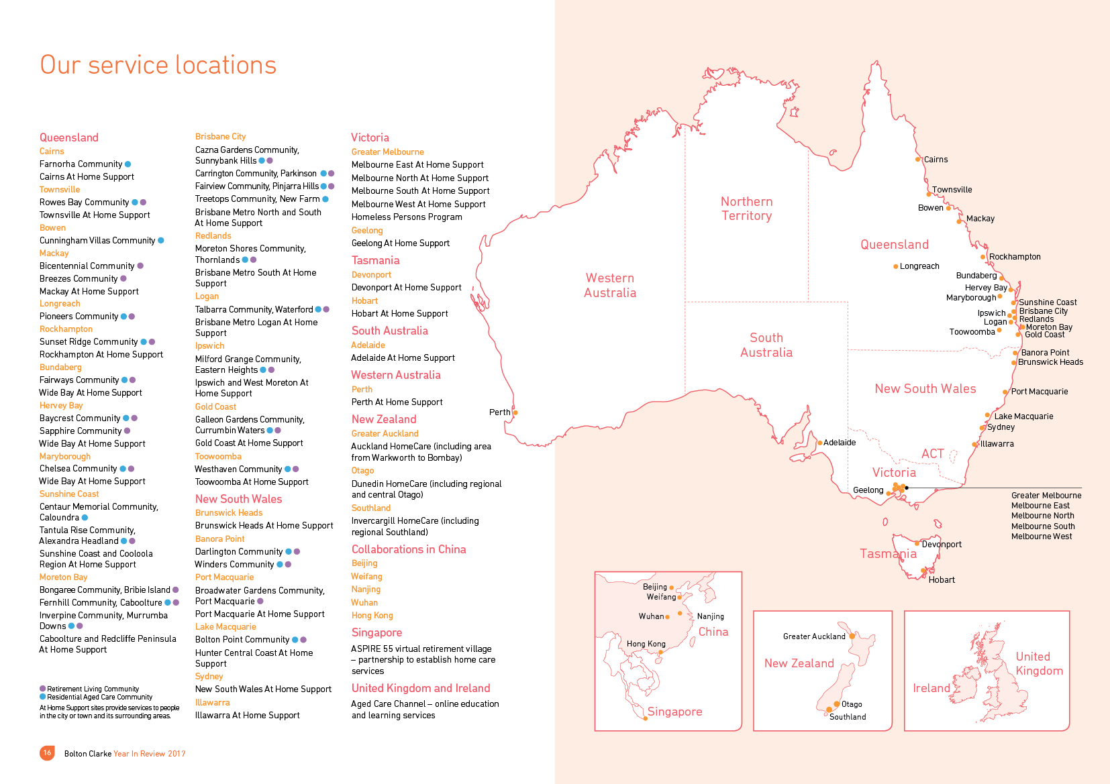
Notes:
Bolton Clarke is the trading name for a group of companies being RSL Care RDNS Limited, Royal District Nursing Service Limited and RDNS HomeCare Limited.
Our 200 years of combined service and common purpose led us to create Bolton Clarke, a unified not-for-profit organisation. We are one of Australia’s largest and most experienced independent providers of At home support, retirement living and residential aged care. Our strategic intent is to improve lives through innovative and responsive health and wellbeing solutions.
Our head office is located in Brisbane. Brisbane is the capital city of the state of Queensland in Australia.
Our footprint extends to New Zealand, China, Singapore, the United Kingdom and Ireland. Our services vary across jurisdictions and catchments.
In China we are called Royal District Nursing Service Limited. The Aged Care Channel provides online education and learning services across Australia, the United Kingdom and Ireland.
There is a longstanding and good relationship between Royal District Nursing Service and Singapore. We have enjoyed a number of exchanges on community nursing, telehealth and customer service. Singaporean health ministers have visited our sites in Melbourne and our Customer Service Centre.
Our Group CEO Stephen Muggleton is a Board member on the Ageing Asia International Advisory Board. Our Research Institute is an advisor to the Aspire 55 virtual retirement village project led by Janice Chia the Managing Director of Aging Asia Pty Ltd.
As you can see we are quite active in this region and looking for growth.

Slide 5
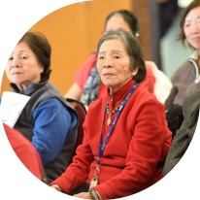
Services we provide:
At Home Support
Retirement Living
Residential Aged Care
Notes:
We work with more than 100,000 community care clients, more than 5,600 residential aged care residents and retirement village residents across Australia.

Slide 6
Topics
About Bolton Clarke
Diversity at Bolton Clarke
Digital Talking Books
Demonstration
Notes:
A little bit about Diversity at Bolton Clarke….

Slide 7
Diversity at Bolton Clarke
7,000 employees
4 million home visits
More than 23,000 clients/residents every day
81% age 56 + & 63% age 70+
High % women & lone-person household
High % disability
High % pension income source
22,000 veterans
5,600 residents-retirement living & residential aged care
168 countries & 133 languages
Notes:
Our 7,000 strong workforce is very diverse and they support more than 23,000 clients and residents everyday with At home support, retirement living and residential aged care services.
Our clients, residents and the workforce come from diverse background and have diverse needs.
Our employees make over 4 million client visits each year. We support more than 22,000 war veterans annually and over 5,600 residents in retirement living and residential aged care communities. Our clients originate from 168 countries and speak 133 different languages.

Slide 8
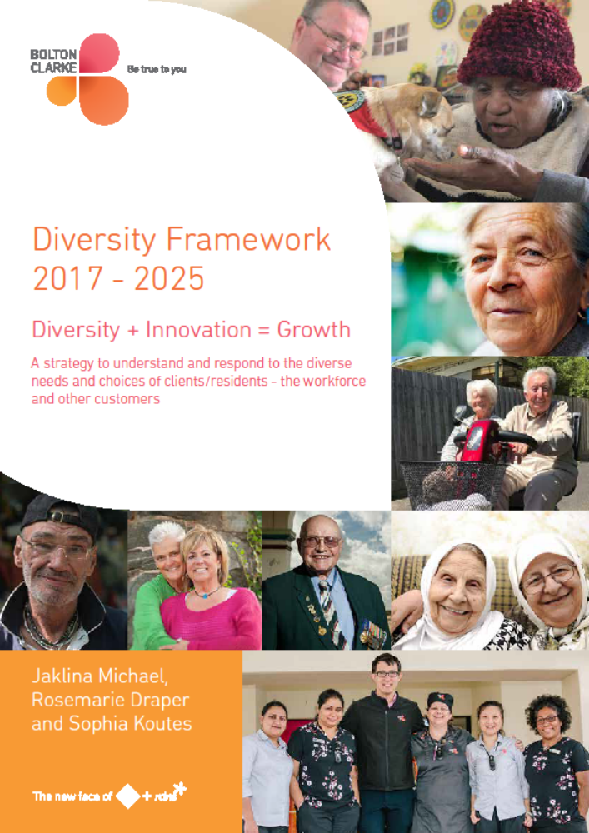
Notes:
The Bolton Clarke Diversity Framework 2017–2025: Diversity + Innovation = Growth is an organisational strategy to meet the needs and choices of clients/residents, their carers and families, the workforce and other customers.
The Bolton Clarke Diversity Framework aligns with the Australian Government Department of Health Aged Care Diversity Framework. It has been designed for implementation across all business areas and service types at Bolton Clarke. Aspects of the Diversity Framework are applied to service jurisdictions outside Australia.

Slide 9
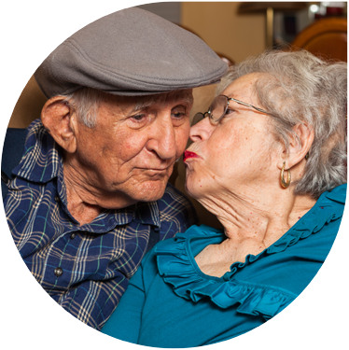
Digital Technology in Australia
92% of Australians use the internet
68% are older Australians and they are using smartphones to access the internet
More consumers and health professionals are using iPads and smartphones to access health information
Notes:
92% of Australians use the internet.
Of these 68% are older Australians and they are increasingly using smartphones to access the internet.
With the rapid increase in digital technology more consumers and health professionals are using iPads and smartphones to access health information.

Slide 10
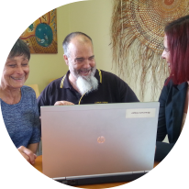
Statement of the problem
60% of adult Australians have low health literacy
We have consumers with diverse needs and from diverse backgrounds
Using digital technology to provide culturally appropriate health information
Notes:
Australian Bureau of Statistics identified that almost 60% of adult Australians have low health literacy. 6 out of 10 people in Australia have difficulty accessing, understanding, using and applying health information.
We have consumers with diverse needs and from diverse backgrounds.
Bolton Clarke is finding new ways of using digital technology to ensure our workforce provides culturally appropriate health information and care.

Slide 11
Topics
About Bolton Clarke
Diversity at Bolton Clarke
Digital Talking Books
Demonstration

Slide 12
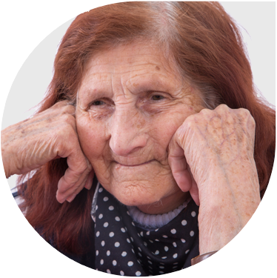
Purpose
To develop Digital Talking Books on a range of health topics and in a range of languages
To use the latest technology with stakeholders to ensure relevance, accuracy, acceptability and accessibility
Notes:
The purpose of the project is
1. To develop Digital Talking Books on a range of health topics and in a range of languages.
2. To use the latest technology, in partnership with and to a wide range of internal and external stakeholders to ensure relevance, accuracy, acceptability and accessibility for the targeted population groups.

Slide 13
Digital Talking Books
Can be read or listened to
Can be accessed from a mobile telephone, tablet or computer
The books have a number of information sheets on a range of topics
Individual information sheets or the whole book can be printed for future reference
Notes:
The Digital Talking Book enables the consumer to view or listen to the health-related message on a computer, tablet or mobile telephone, in their preferred language, to support better management of their care. Listening to the information especially benefits older people with reading and literacy difficulties or who have vision impairment.
The talking-book can be used by an individual and or their carer and families or groups of people in a community setting. This teaching and learning resource supports health professionals to provide health and care management education to consumers.

Slide 14
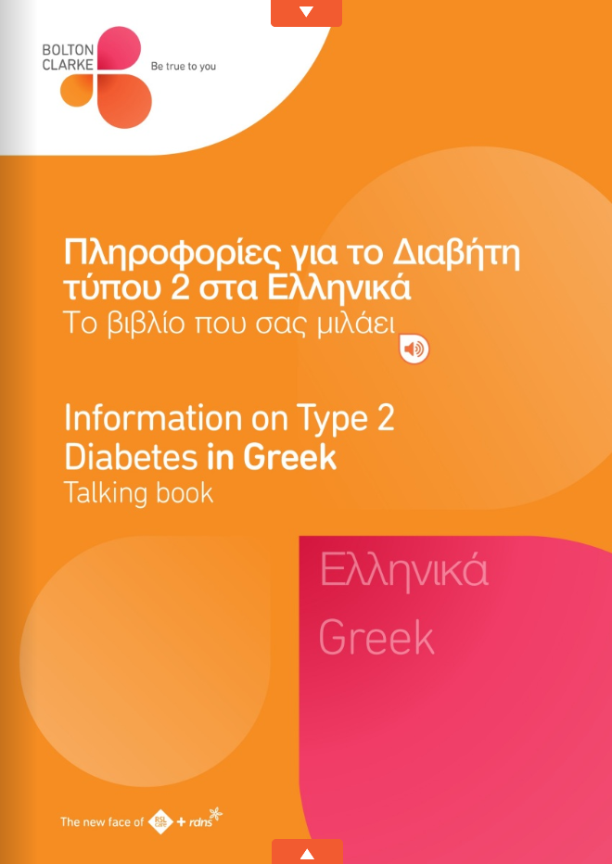
Digital Talking Books
Notes:
We now have a suite of 7 talking books on medicines, diabetes and dementia in English and a range of other languages.

Slide 15

Partnering with Consumers for Diversity Model
    Winner of a 2017 Australian Government Better Practice Award
Notes:
A consumer co-design model titled, Partnering with Consumers for Diversity was used to inform the development of Digital Talking Books to engage with consumers and to better understand and respond to the needs, choices and low health literacy.
The Co-design Model is a recipient of a 2017 Australian Government Better Practice Award which recognizes innovation across aged care services. The Model has been used repeatedly and consistently to inform the development of a suite of Digital Talking Books on diabetes, dementia and medicines in English and a range of other languages.

Slide 16

Selected candidate–Bolton Clarke
Notes:
The Consumer co-design model is a selected candidate for a 2018 SilverEco and Ageing Well International Award. There are 50 selected candidates from across the world and winners will be announced in Paris on the 29 March 2019. We are very excited from the land-down-under Australia to be part of this and we are keeping our fingers very crossed!

Slide 17
Partnering with Consumers for Diversity Model
Business processes for development of all types of aged care policies and products
Designed to accommodate equal participation from all Australian population groups including Aboriginal and Torres Strait Islanders, English speaking and non-English speaking people
The theoretical basis is for aged care organisations to work in collaboration with stakeholders
Notes:
The Co-design Model presents business processes for the development of all types of culturally and linguistically appropriate aged care policies and products. . It was designed to accommodate equal participation from all Australian population groups including Aboriginal and Torres Strait Islanders, English speaking and non-English speaking people.
The theoretical basis of the Co-design Model is for aged care organisations to work in collaboration with stakeholders to develop policy and products to better understand the literacy needs of consumers to meet their health information needs, so that they can participate in their care.

Slide 18
Diversity characteristics of community participants
Project | Representative community organisation | Number of focus groups / Number of community participants | Average age of community participants | Average number of years of schooling in English of community participants | Average number of years of schooling in another language of community participants
Diabetes Talking Book in Macedonian | Macedonian Community Welfare Association | 5/105 | 72 | 1 | 3 years schooling in Macedonian
Diabetes Talking Book in Greek | Australian Greek Welfare Society | 4/69 | 77 | 1 | 6 years schooling in Greek
Diabetes Talking Book in Italian | Co.As.It (Italian Assistance Association) | 3/55 | 83 | 0 | 5 years schooling in Italian
Diabetes Talking Book in Vietnamese | Australian Vietnamese Women’s Association | 4/67 | 73 | 2 | 4 years schooling in Vietnamese
Dementia Talking Book in Vietnamese | Australian Vietnamese Women’s Association | 3/59 | 73 | 2 | 4 years schooling in Vietnamese
Medicines Talking Book in English | Willum Warrain Aboriginal Association Spanish-speaking Planned Activity Group Peninsula Advisory Committee for Elders | 1/8 1/19 1/20 | 52 76 72 | 9 Not available 11 | Not available 7 years schooling in Spanish Not available
Notes:
Participatory action was used over 10 years during 2006 to 2016 to develop the Co-design Model.
It was repeatedly tested and refined with contribution from Australian consumer organisations such as, Diabetes Australia and Dementia Australia; Aboriginal and Torres Strait lslander groups, English-speaking populations and national multicultural organisations to ensure relevance and acceptability.
These peak bodies supported Bolton Clarke to recruit 426 older diverse community members who participated in 22 community focus groups to further test the Co-design Model.
The table lists the Digital Talking Book projects and demographic/ethnicity data from the participants for example….

Slide 19
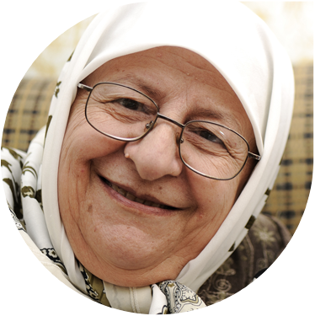
Methodology
3D Floppy Books software to keep the technology up-to-date
‘Key word’ google search
Instructions guide to construct new books & update and maintain existing
Notes:
A range of strategies have been used to develop and promote the digital Talking Books including:
-Using 3D Floppy Books software to keep the technology up-to-date with the latest mobile devices and web browsers;
-‘Key word’ google search approach for easy access; and
- Instructions guide to construct new books and update and maintain existing ones.

Slide 20
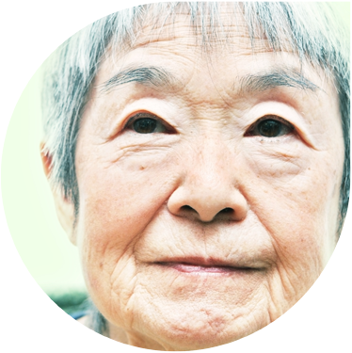
Findings
Qualitative studies reveal that the Digital Talking Books improved health-related literacy amongst older people
Availability of hard copy PDF bi-lingual versions of the content of the Digital Talking Books
Notes:
Preliminary qualitative studies reveal that the digital Talking Books improved health-related literacy amongst older people.
Older people are less likely to use online information and communication technology; however, this barrier can be overcome through the availability of hard copy PDF bi-lingual versions of the content of the Talking Books.

Slide 21
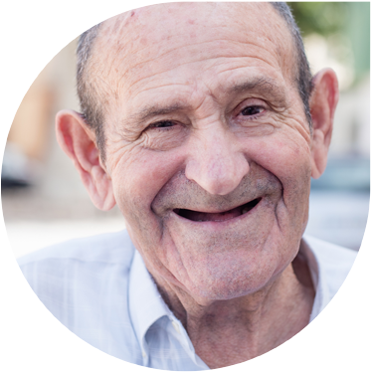
Conclusion
Big increase in visits to the Digital Talking Books
Determine the best way to teach older people how to access the Digital Talking Books
How the Digital Talking Books are contributing to the health outcomes of older people
Notes:
Analytical data reveals that the Talking Books are popular. There has been a big increase in visits to the Talking Books from within Australia and across the world.
There is a need to conduct further studies to determine the best way to teach older people how to access the digital talking books. Further studies are also required on how the Talking Books and their PDF versions are contributing to the health outcomes of older people.
For the future, using the Consumer Co-design Model, Bolton Clarke plans to complete its suite of 28 talking books in English and six other languages (Arabic, Cantonese, Greek, Italian, Macedonian, Mandarin and Vietnamese) on diabetes, dementia, medicines and incontinence (including catheter care and stoma care).

Slide 22
Demonstration
Vietnamese Diabetes Talking Book
Notes:
The Digital Talking Books are available, free of charge on the Bolton Clarke website.
Id like to demonstrate to you the workings and functionality of a Talking Book.
I will demonstrate the Vietnamese Dementia Talking Book

Slide 23
References
Australian Commission on Safety and Quality in Health Care. Health Literacy: Taking action to improve safety and quality. 2014:34
Goeman D, Michael J, King J, et al (2016) Partnering with consumers to develop and evaluate a Vietnamese Dementia Talking-Book to support low health literacy: a qualitative study incorporating co-design and participatory action research. BMJ Open 6: e011451. doi:10.1136/ bmjopen-2016-011451
Michael J (2016) Diversity Conceptual Model for aged care: Person-centred and difference-oriented and connective with a focus on benefit, disadvantage and equity. Australasian Journal on Ageing. 35: 210–215. doi:10.1111/ajag.12313
Michael J, McDonald V, Ogrin, Fraser J, Roysmith, T, Harvey K. (2016) Education delivered to community aged care workers based on a Diversity Conceptual Model: An evaluation using qualitative methods. Diversity and Equality in Health and Aged Care Journal. Insight Medical Publishing Group: 14(1): 9-15
Michael J, Aylen T, Petralia W. (2015) Italian Diabetes Information: The perceptions and suggestions of older Italians living in Melbourne. Australian Diabetes Educator: 18
Michael J, Aylen T, Ogrin R. (2013) Development of a Translation Standard to support the improvement of health literacy and provide consistent high-quality information. Australian Health Review. 37(4):547–551

Slide 24
Digital ‘Talking Books’ on medicines, diabetes and dementia: Using the latest technology to meet the information needs of consumers
Jaklina Michael
Bolton Clarke, AUSTRALIA
jmichael@boltonclarke.com.au
+61 0410 561 068

