Slide 1
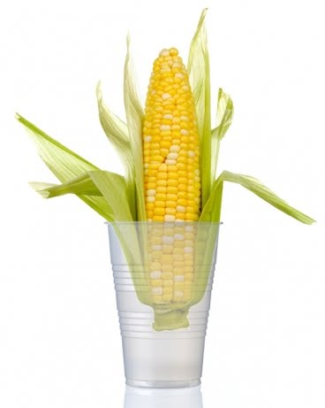
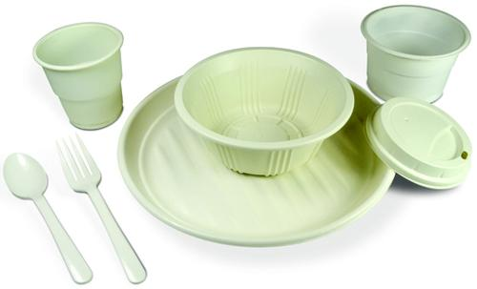
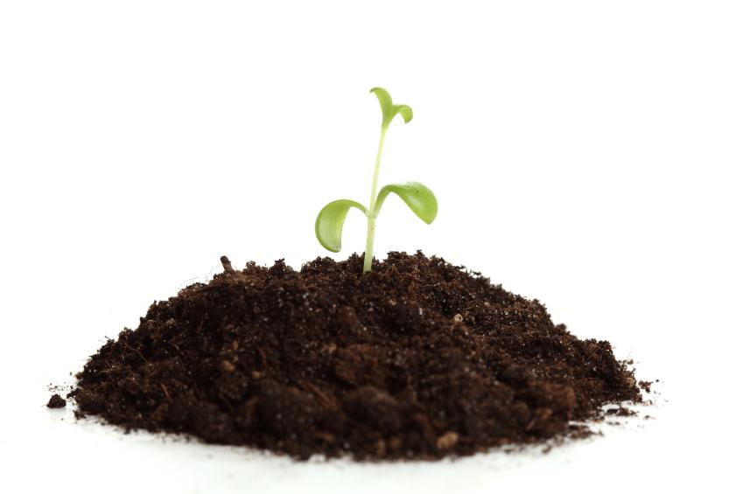
PHA Copolymers from CH₄
Biopolymers & Bioplastics 2015 (Aug 10, 2015)
Jaewook Myung

Slide 2
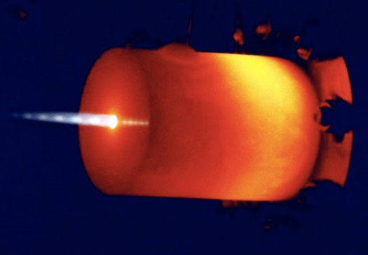
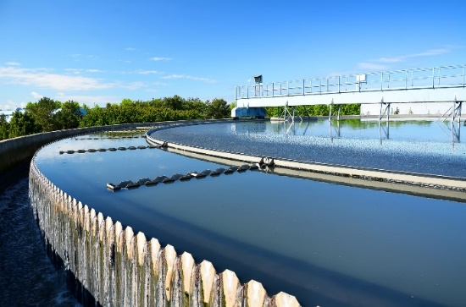
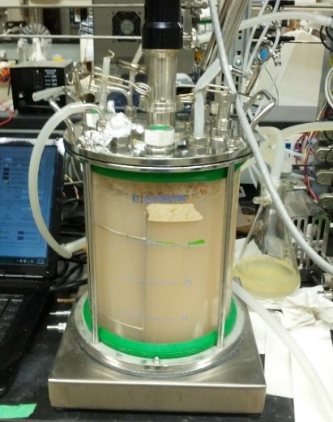
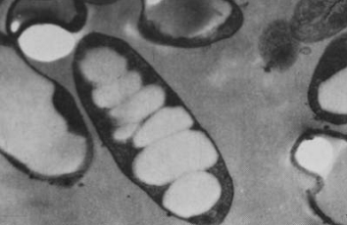
Research backgrounds
Wastewater treatment
  Energy-efficient nitrogen removal
  Biological phosphorus removal
Polyhydroxyalkanoate (PHA)
  PHA recycling
  PHA production from biogas or natural gas

Slide 3
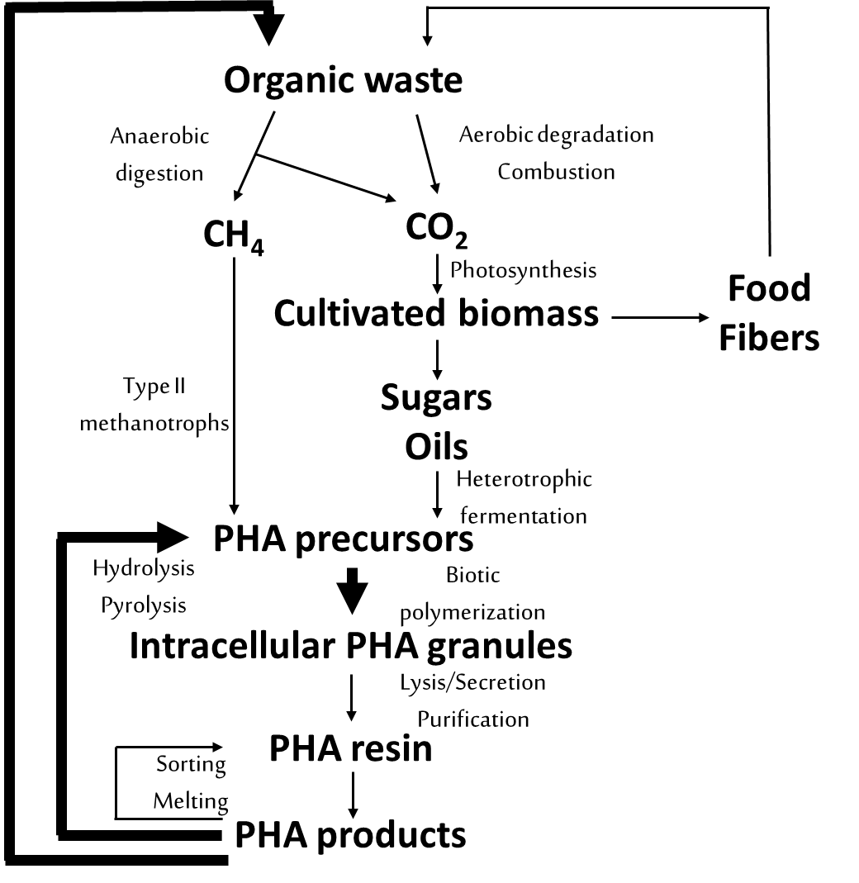
Life Cycle of PHA Products
① Abiotic-biotic cycle
② Methane-PHA cycle
②
①

Slide 4
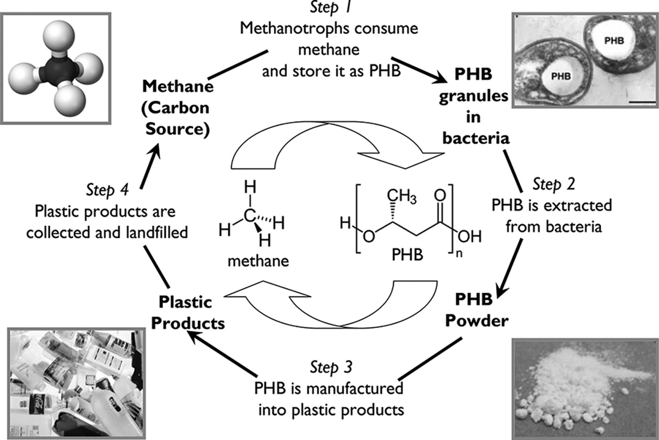
Methane-PHA Cycle
K. H. Rostkowski, C. S. Criddle, M. D. Lepech, Cradle-to-gate life cycle assessment for a cradle-to-cradle cycle: biogas-to-bioplastic (and back). Env. Sci Technol. 46, 9822–9829 (2012).

Slide 5
PHA Drawback: High Production Cost
Bioplastics
Product | Manufacturer | Price ($/lb)
PLA | Natureworks (USA) | 0.85 – 3.00
P3HB | Metabolix (USA) | 2.00 – 2.75
PHBV | Tianan (China) | 2.40 – 2.75
Bio-PE | Braskem (Brazil) | 0.80 – 1.00
Petroleum-based plastics
Product | Price ($/lb)
Polypropylene (PP) | ~ 0.60 (depending on oil price)

Slide 6
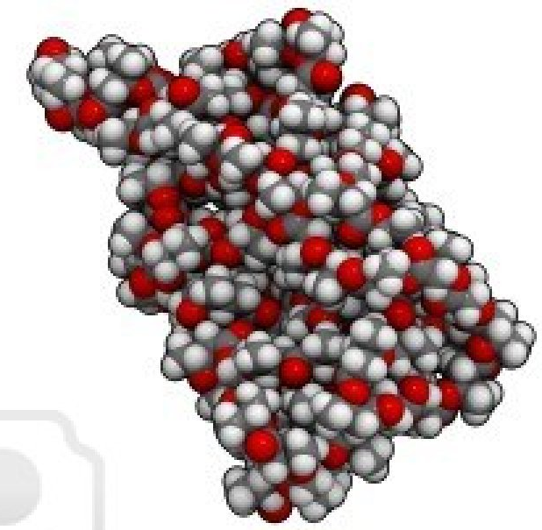
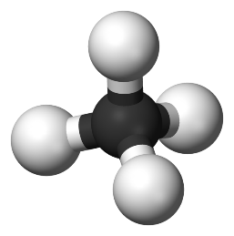
One Solution
Use of Inexpensive Substrate: Methane (CH₄)
Type II methanotrophs
Methane
P3HB
Available as biogas and natural gas
Waste-driven feedstock
Low substrate cost
Carbon sequestration (CO₂ to polymer)

Slide 7
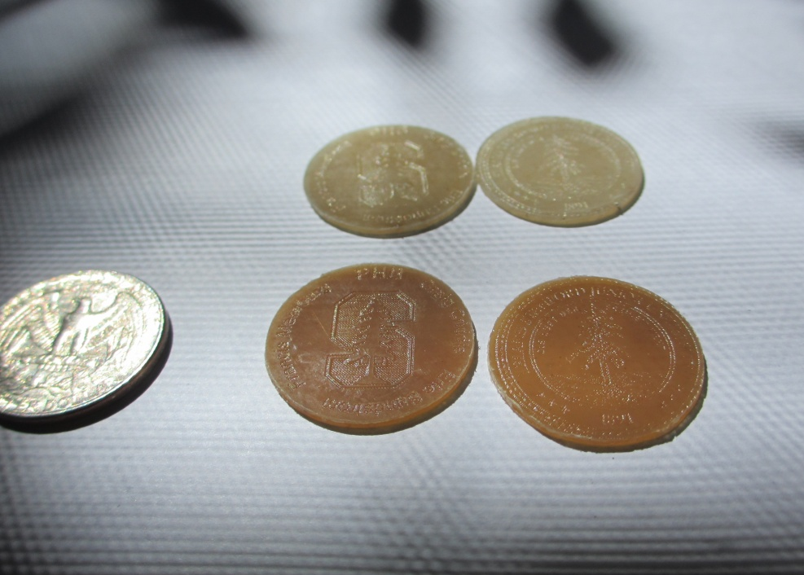
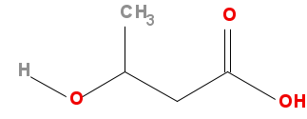
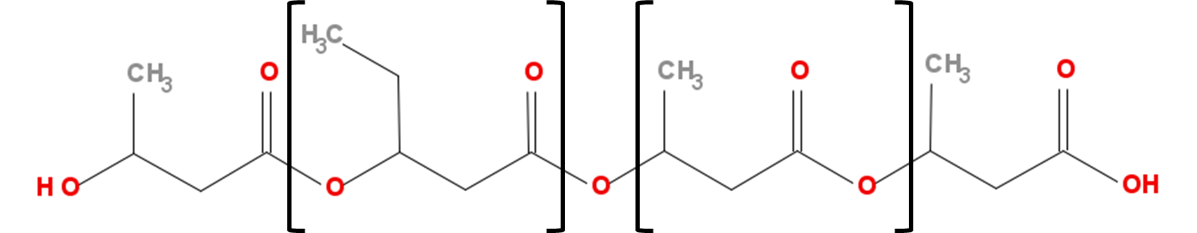
Limitations of P3HB
P3HB
Low thermal stability
Slow crystallization
Lack of flexibility
Narrow melt processing window
PHBV copolymer overcomes these limitations

Slide 8
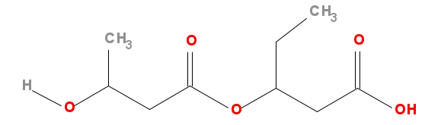
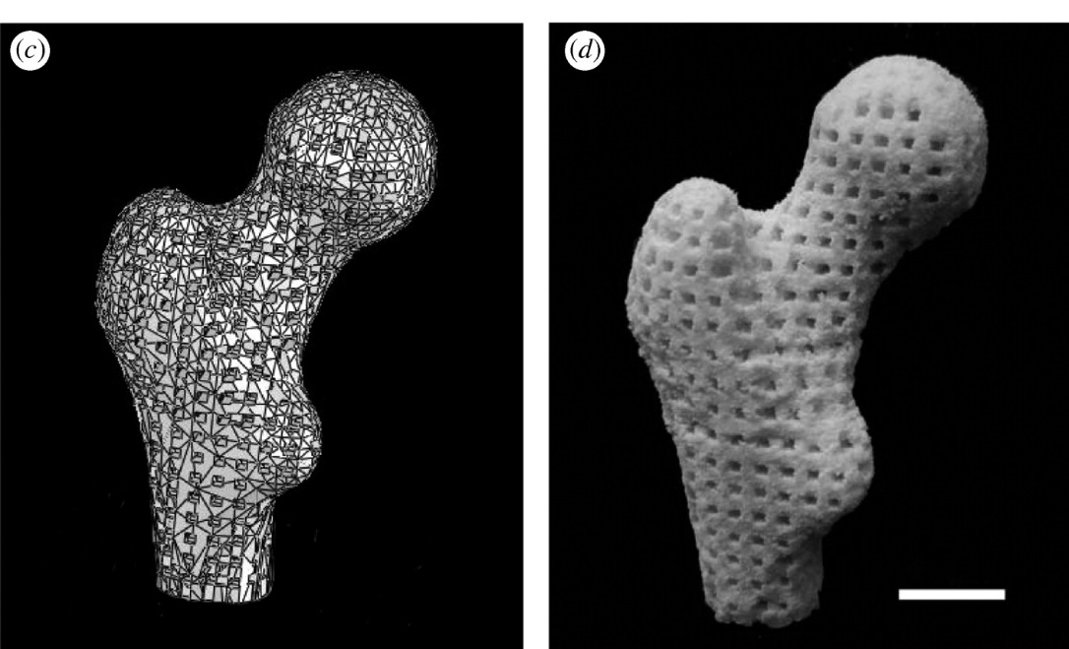
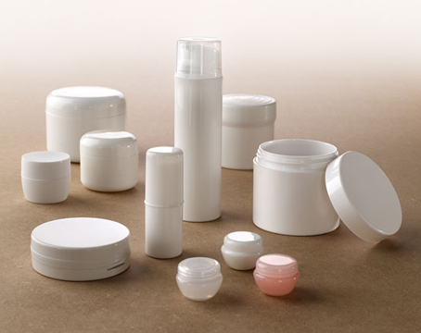
PHBV
Poly(3-hydroxybutyrate-co-3-hydroxyvalerate)
n
m
Duan, Wang. (2010) J. R. Soc. Interface, 7(5)
http://www.bioplasticpieces.com/products.html

Slide 9
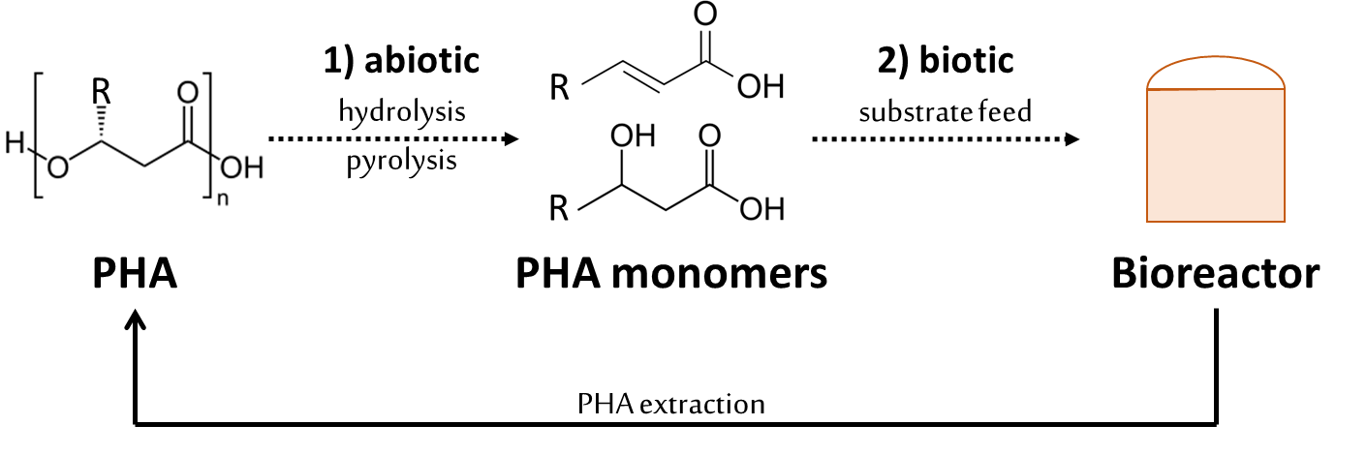
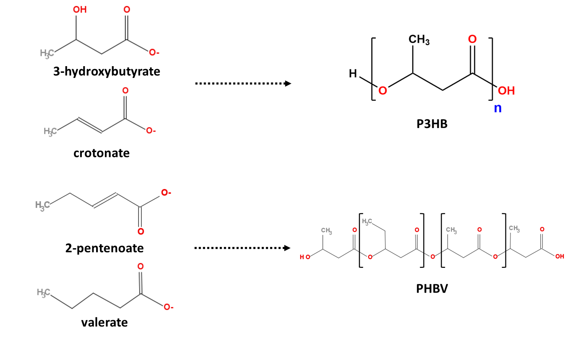
Recall: how to produce PHBV?
Abiotic-biotic
PHA recycling
PHBV copolymer was produced upon addition of odd-numbered VFAs

Slide 10
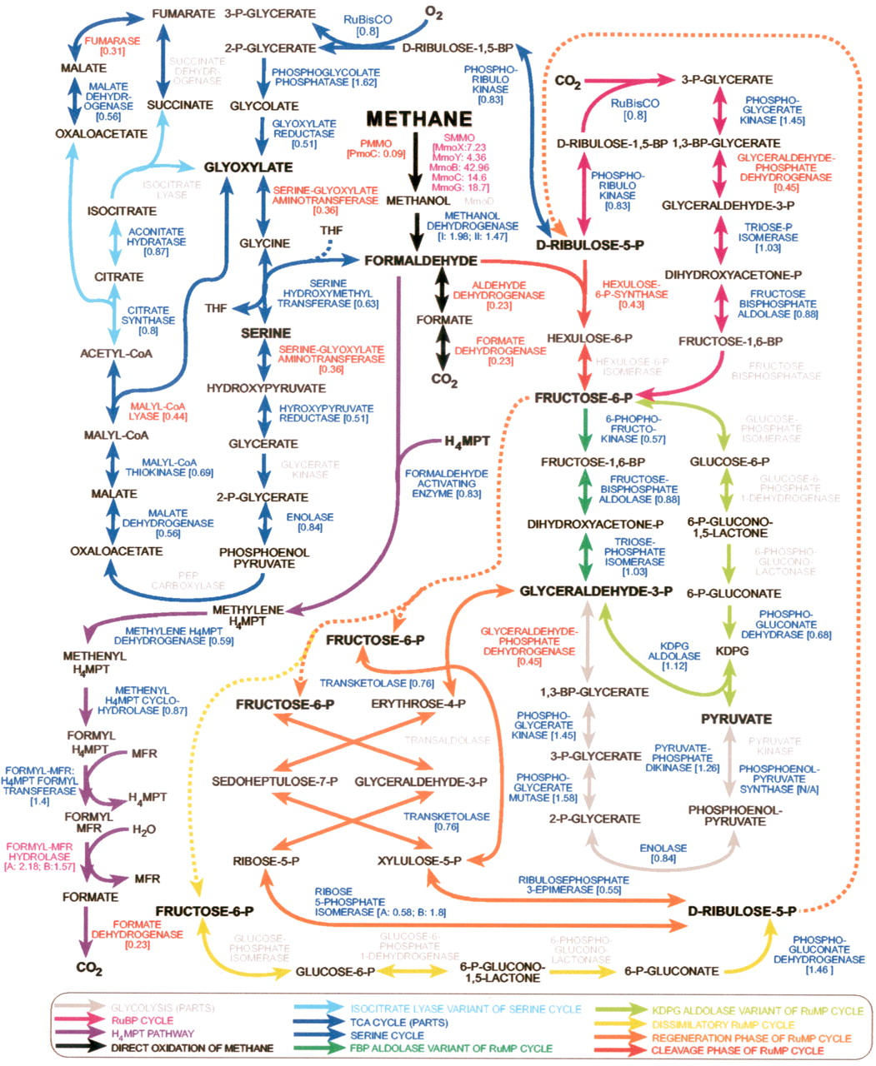
Problem: C1 Metabolism
W.-C. Kao et al., Quantitative proteomic analysis of metabolic regulation by copper ions in Methylococcus capsulatus (Bath). J. Biol. Chem. 279, 51554–51560 (2004).
Many researchers clearly state that…
obligate methanotrophs are limited to growing on C1 compounds.
Confirmed:
No obligate methanotrophs were able to grow with VFAs

Slide 11

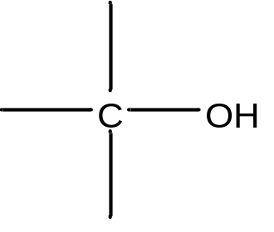
P3HB Production by methanotrophs
or
methane
methanol
Type II methanotrophs
P3HB

Slide 12
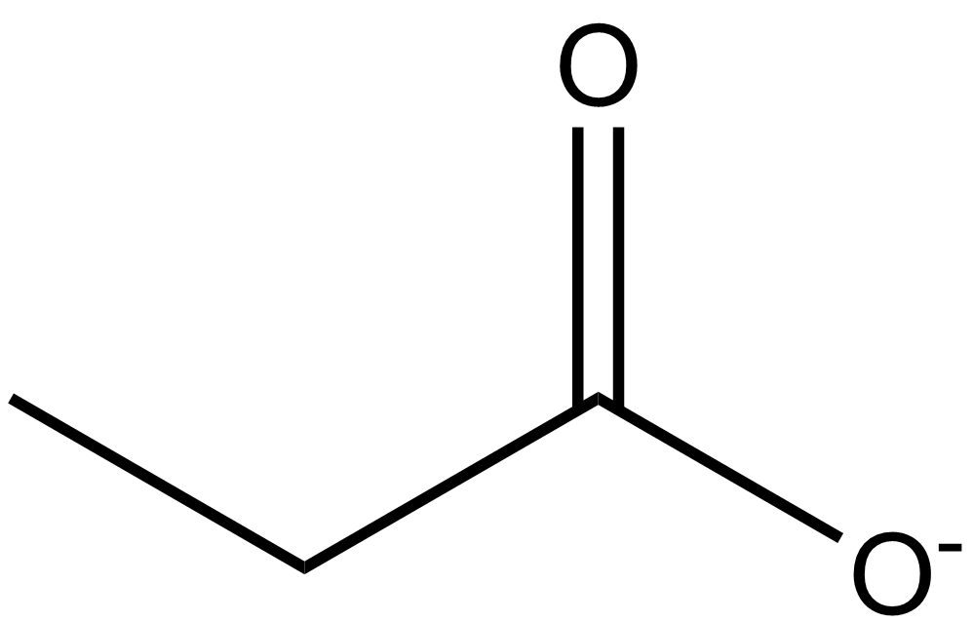
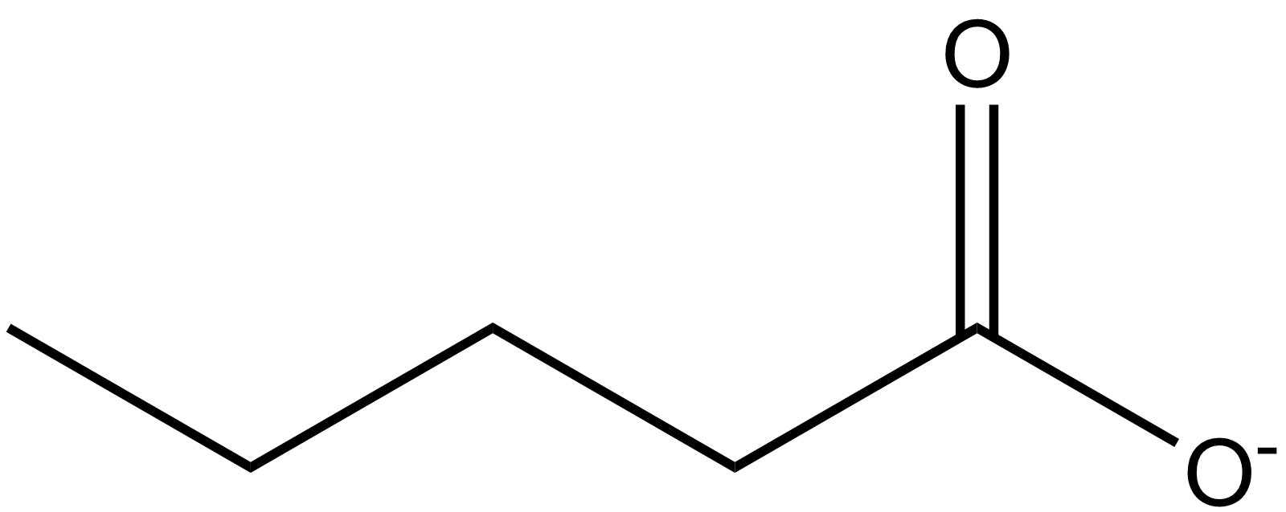
PHBV Production by methanotrophs
cosubstrates
methane
methanol
propionate
valerate
Type II methanotrophs
PHBV

Slide 13

Pure culture & enrichment strategy
Methanotrophic pure culture
or
Methylocystis parvus OBBP
Methylosinus trichosporium OB3b
Methanotrophic enrichment
Inoculum from activated sludge

Slide 14
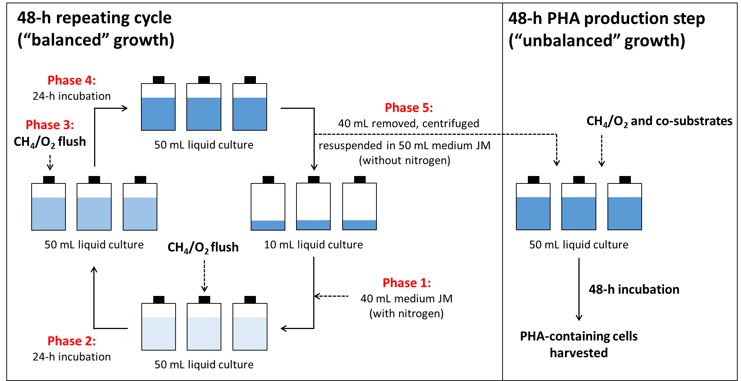
CH₄-Fed Microbial Enrichment

Slide 15

Two Phases
Repeating
Cycle
(N > 300)
PHA production
(75% of the cells for PHA harvest)
1) Repeating cycle (balanced growth) – cell replication for 48 hours
2) PHA production step (nutrient-limiting condition) – PHA accumulation for 48 hours

Slide 16
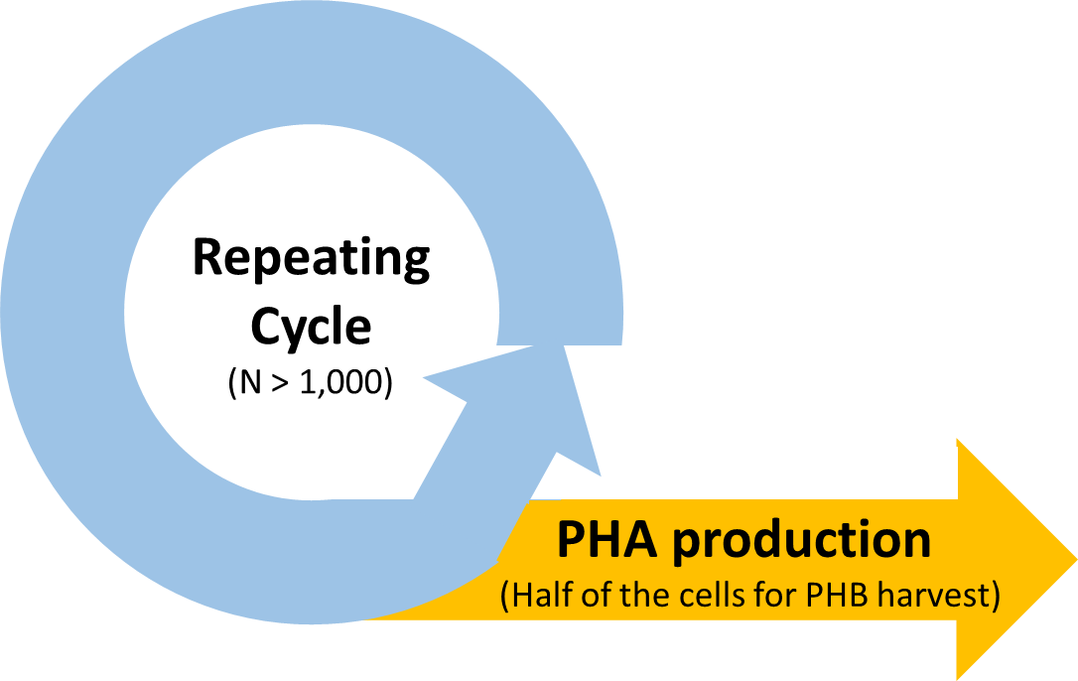
PHA Accumulation
A
B
A
Before PHA production (t = 0h)
B
After PHA production (t = 24h)

Slide 17
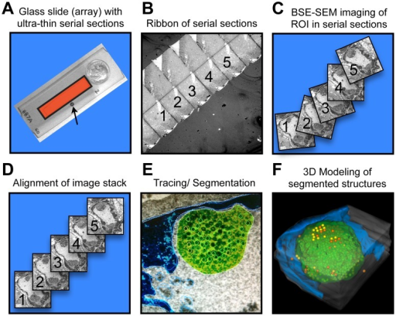
SSA-SEM
Serial Section Array-Scanning Electron Microscopy
Reichelt et al., (2012) PloS Pathog.

Slide 18







SSA-SEM
Serial Section Array-Scanning Electron Microscopy
100 nm
section
reconstruction

Slide 19
SSA-SEM

Slide 20
SSA-SEM

Slide 21
SSA-SEM
stack

Slide 22
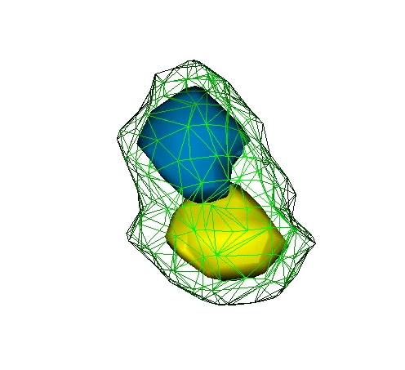
3-D Reconstruction of PHA Granules
Volume fractions
PHA 1
: 18.2%
PHA 2
: 16.0%

Slide 23
How do we know we got PHBV?
Gas chromatography (GC)
  - Monomer composition: 3HB and 3HV
Gel permeation chromatography (GPC)
  - Molecular weight distribution
  - Single peak: not a blend of P3HB and P3HV
Differential scanning calorimetry (DSC)
  - Peak melting temperature: typical range for PHBV
  - Single peak: not a blend of P3HB and P3HV

Slide 24

microbiologists
Questions remain…
1. Is the produced polymer really a copolymer?
  - Need structural verification
2. Do methanotrophs really consume volatile fatty acids?
  - No transporters found in methanotrophs
  - Restricted to C1 metabolism
Solution:
NMR &
isotopic enrichment

Slide 25
Hypothesis
Isotopic Enrichment + ¹³C NMR
Type II methanotrophs
methane
valerate
PHBV
(*) = ¹³C
(*)
Type II methanotrophs
(*)
methane
¹³C-valerate
¹³C-PHBV

Slide 26
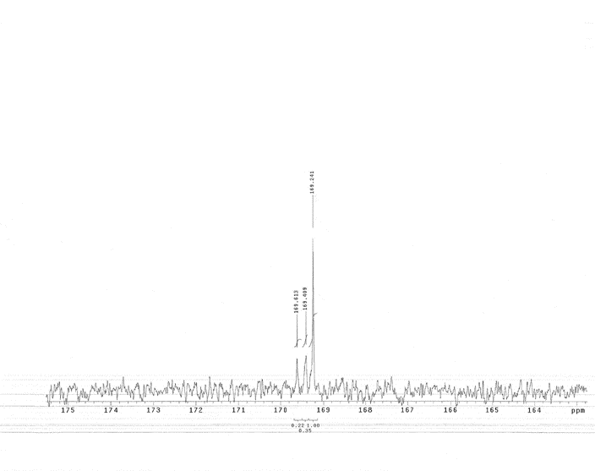
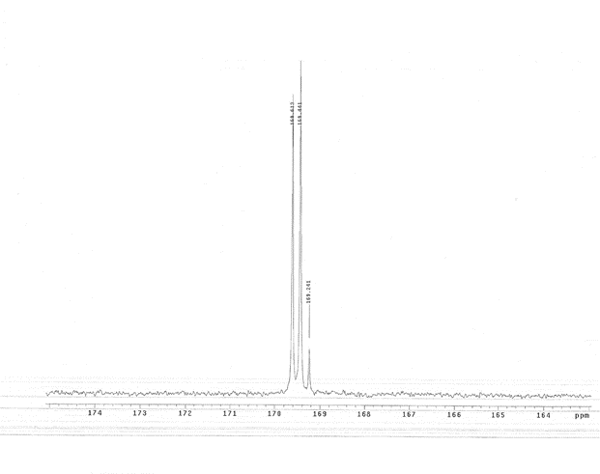
Result
¹³C NMR
(9)
(4)
(8)
(1) 3HB-3HB
(5) 3HV-3HV
(5)* 3HV-3HB
(3)
(1)
(7)
(5)
(2)
(6)
(5)*
(1)
(5)
20-fold increase in (5) and (5)*
(5)*
¹³C-enriched PHBV!
(5)
(1)
PHBV from ¹²C-valerate
PHBV from ¹³C-valerate

Slide 27
NMR conclusion
(5)*
Structural verification
  - PHBV copolymer
Methanotrophic incorporation of volatile fatty acids
  - Valerate is taken up by methanotrophs
(5)
(1)
Isotropic enrichment + ¹³C NMR

Slide 28
Methanotrophic PHBV Production
Type II methanotrophs
methane
P3HB
Type II methanotrophs
No polymer
valerate
Type II methanotrophs
methane
(main substrate)
valerate
(co-substrate)
PHBV

Slide 29
Pure culture & enrichment strategy
Methanotrophic pure culture
or
Methylocystis parvus OBBP
Methylosinus trichosporium OB3b
Methanotrophic enrichment

Slide 30
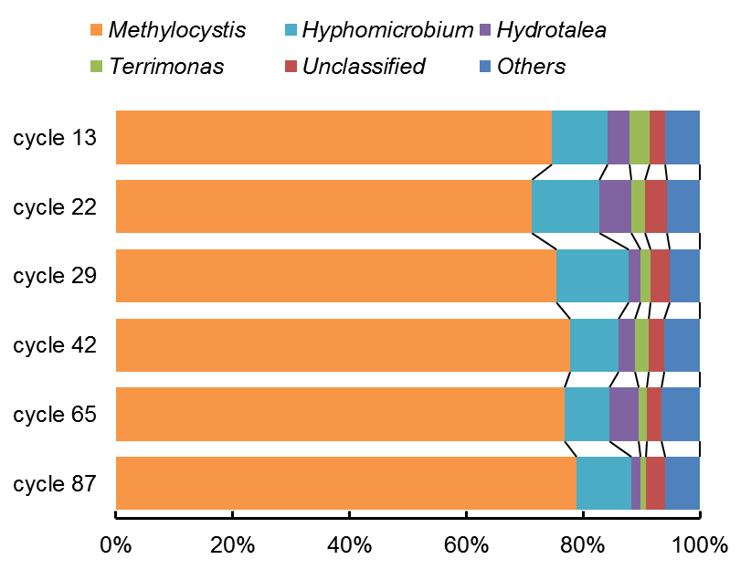
Stable microbial community
Methylocystis-dominated methanotrophic enrichment was stable in a long-term operation (> 300 days).

Slide 31
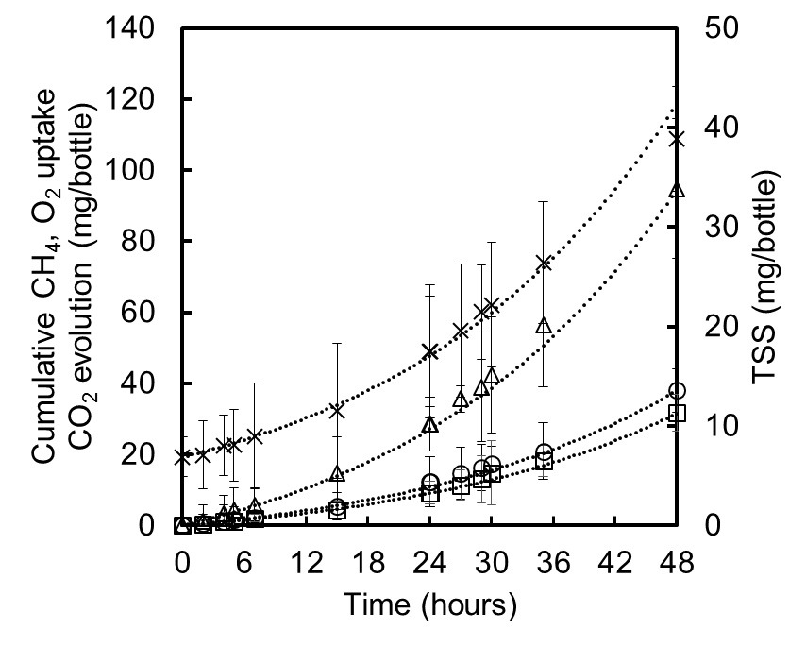
Stable functional performance
Exponentially growing methanotrophic cells
Stable PHA
production capacity

Slide 32
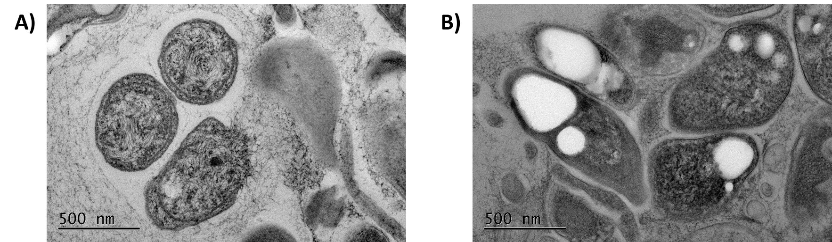
PHA Production Phase
Growth Phase
PHA Production Phase

Slide 33
“Customizable” PHBV Copolymer
3HB
3HV
Consistency of produced PHA polymer
Ability to tweak the polymer properties
Very critical requirements in polymer industry

Slide 34
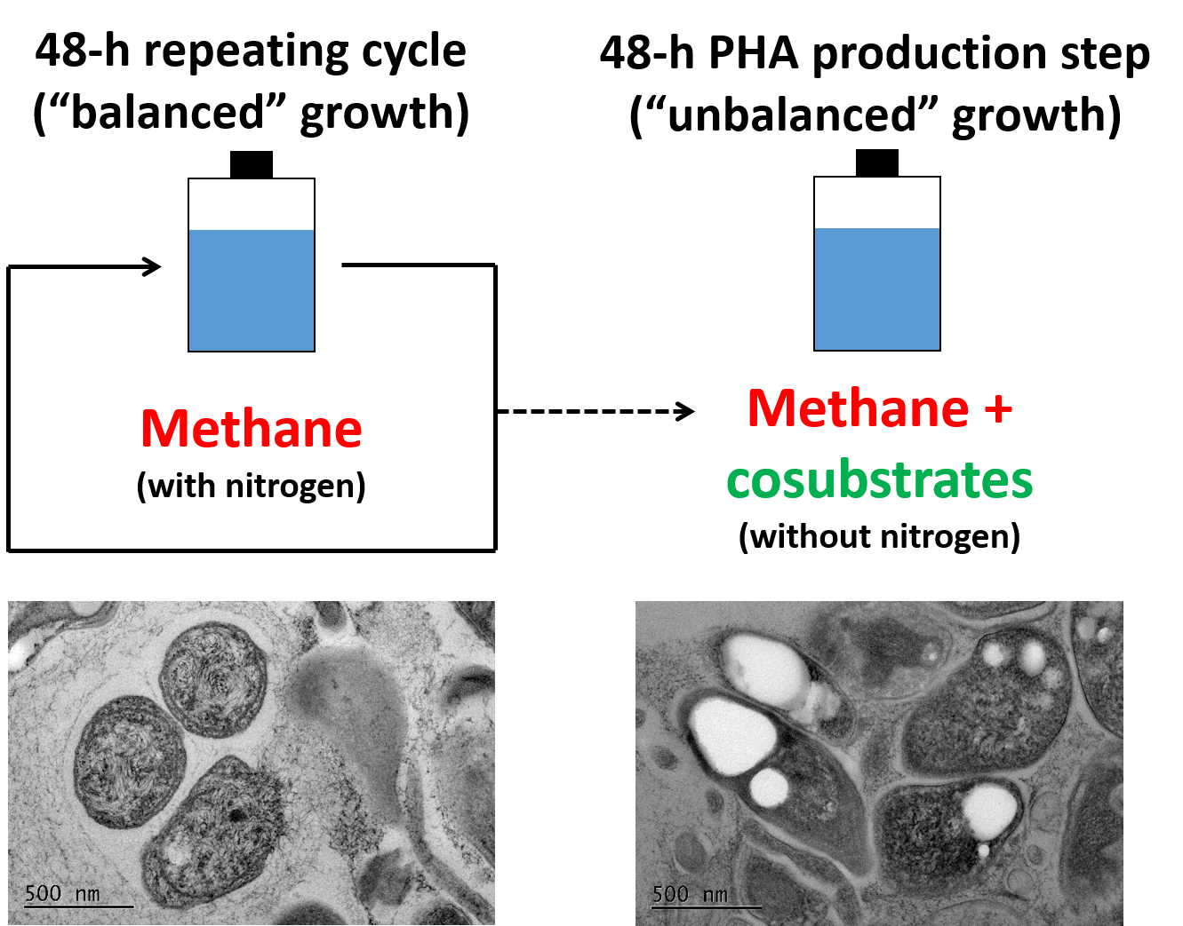
Summary
PHBV
copolymer

Slide 35
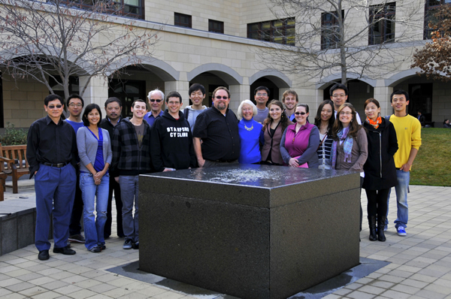
Thank you!
Acknowledgements
  Craig Criddle
    Wakuna Galega
    Nathan Strong
    Sung-Geun Woo
  Robert Waymouth
    James Flanagan
  Jizhong Zhou
    Joy Van Nostrand
    Tong Yuan
  Curtis Frank
  Sarah Billington
    Cecily Ryan
  Green Team
  Funding
    Samsung Scholarship
    Chevron

