Slide 1
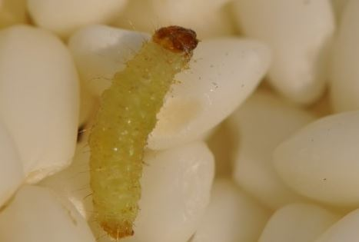
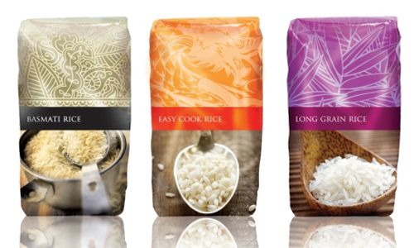
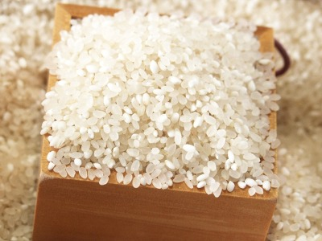
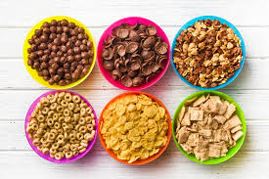


Development of anti-insect food packaging materials containing encapsulated essential oils
at a pilot plant scale
Jaejoon Han
Food Process Engineering Laboratory
Department of Food Bioscience and Technology
Korea University

Slide 2
CONTENTS
01
INTRODUCTION
- Insect-proof packaging
02
LAB SCALE
- For insect-proof packaging
03
PILOT PLANT SCALE
04
HAN LAB
- lab introduction

Slide 3
CONTENTS
01
INTRODUCTION
- Insect-proof packaging
02
LAB SCALE
- For insect-proof packaging
03
PILOT PLANT SCALE
04
HAN LAB
- lab introduction

Slide 4
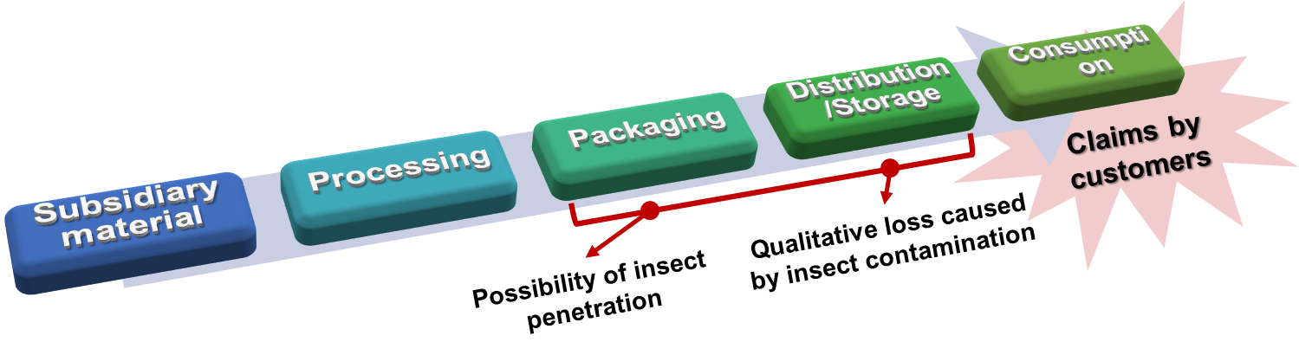

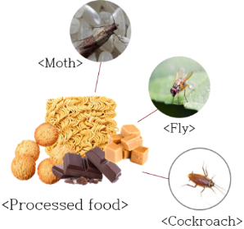
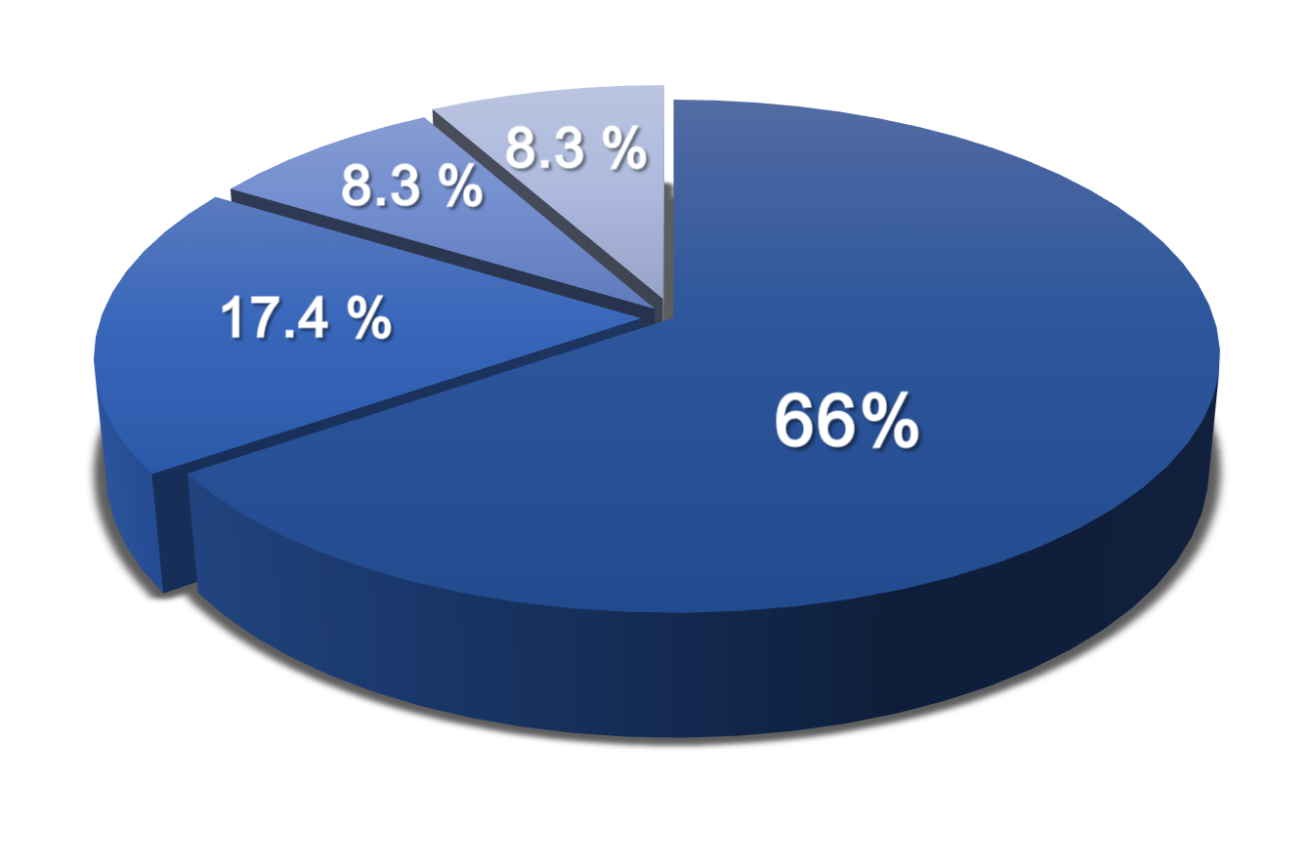
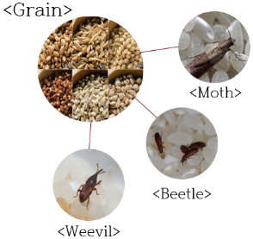
Introduction
▪ Increase of insect penetration risk into stored food products
Cockroach
Moth
Fly
Foreign Materials reported in Foods
Indian meal moth larvae
Plodia interpunctella larvae accounted for the majority of insect contamination
< Analysis of foreign materials reported in food in 2015, Ministry of Food and Drug Safety, Korea (2016) >
- 4 -

Slide 5
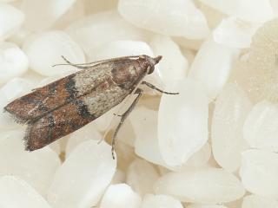
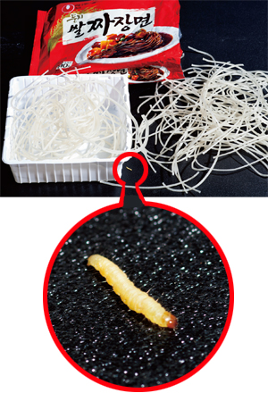
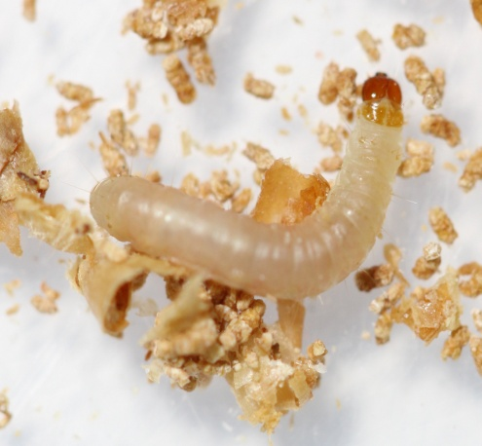
Introduction
▪ Indian meal moth (Plodia interpunctella)
One of the most troublesome pests in food industry in Korea during the last 10 years
“Penetrators”
- Penetrate and tear plastic films using sharp mandibles
Quantitative and qualitative losses in processed foods
- Repulsion of the products by consumers
Cockroach
Moth
Fly
Foreign Materials reported in Foods
Indian meal moth larvae
Plodia interpunctella larvae accounted for the majority of insect contamination
< Analysis of foreign materials reported in food in 2015, Ministry of Food and Drug Safety, Korea (2016) >
- 4 -

Slide 6
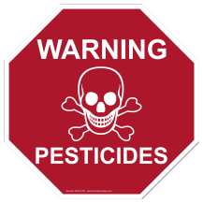

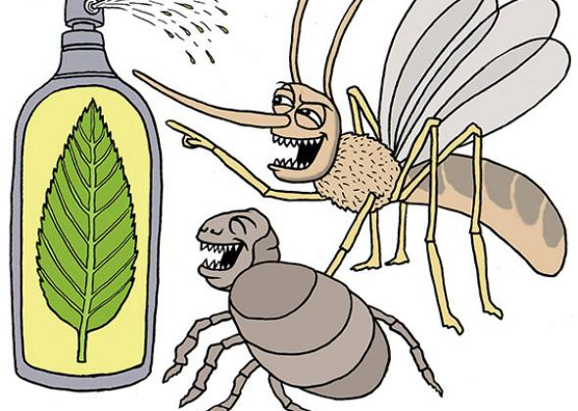
Introduction
▪ Increasing needs of insect-proof food packaging system
PESTICIDE
INSECT-PROOF PACKAGING
BENEFIT
• Effective for preventing insects, but toxic to human
• Helps assure consumers of insect-free food and protects manufacturers against loss of goodwill arising from insect-infested packaging
• Use of essential oil extracted from plants
• Non toxic to human and resistance to insect-invasion to food
▪ Various essential oils from plants can be applied
Citronella, Clove, Lemongrass, Lemon eucalyptus, Cedarwood, Rosemary, Tea tree, Eucalyptus, Cedar, Catnip, Lavender, Peppermint, Basil, Rose Geranium, Cinnamon, Thyme, Lemon, Orange, Pine, etc.
- 5 -

Slide 7
Research objectives
1) To find the most effective anti-insect essential oil extracted from natural ingredients against insect penetration into food products
2) To micro-encapsulate the essential oils using various wall materials to demonstrate the controlled release mechanism
3) To verify the use of a pilot plant scale system on manufacture of insect-proof package and its applicability as a food packaging material
- 6 -

Slide 8
CONTENTS
01
INTRODUCTION
- Insect-proof packaging
02
LAB SCALE
- For insect-proof packaging
03
PILOT PLANT SCALE
04
HAN LAB
- lab introduction

Slide 9
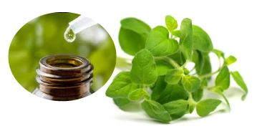
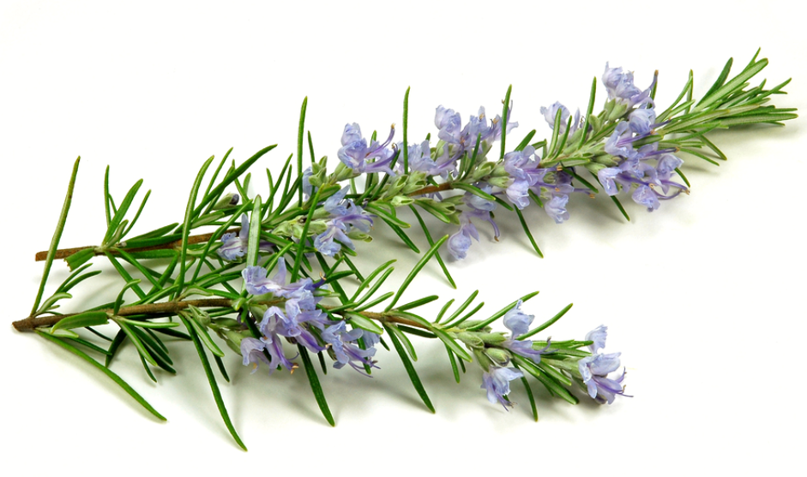
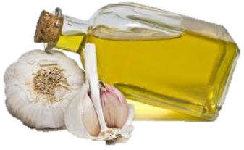
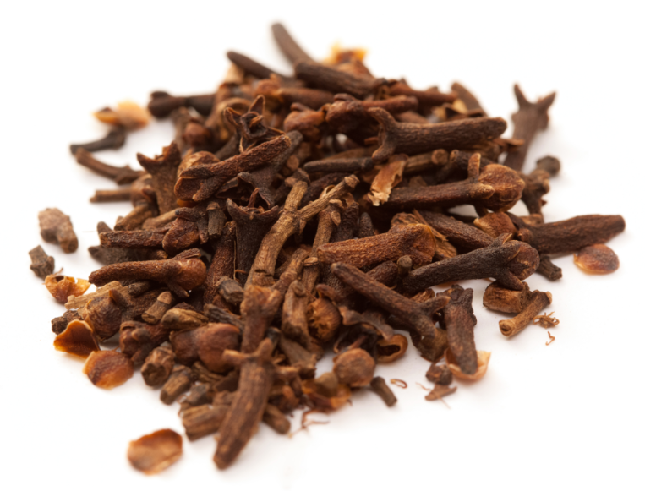
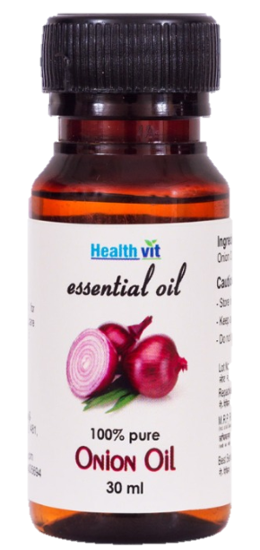
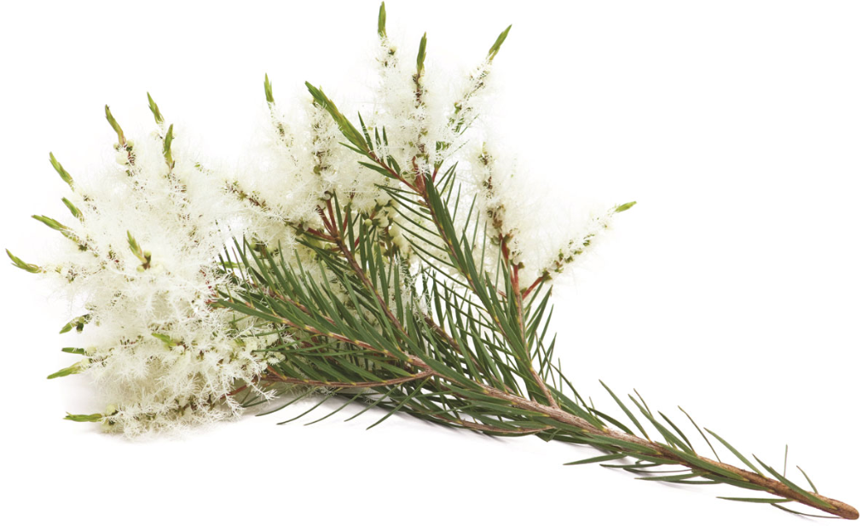
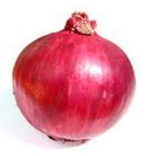
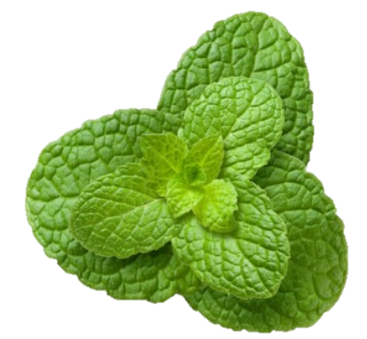
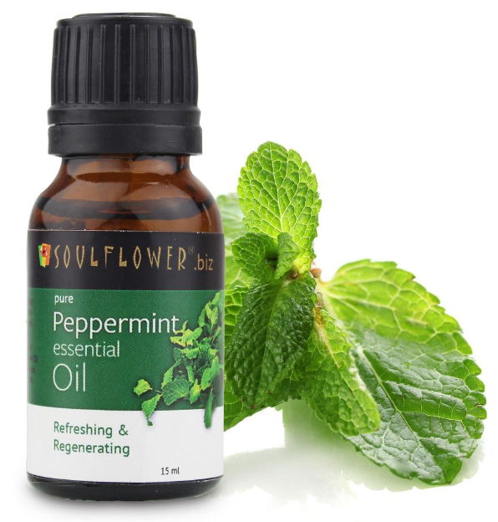
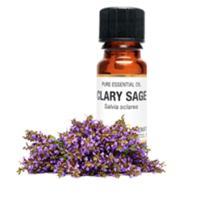

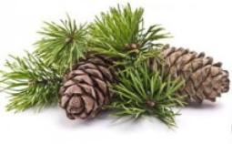
Screening of the natural anti-insect agents – Essential Oils
▪ Essential oils extracted from plants
Plant essential oils have been widely used for their antimicrobial, antioxidant and insecticidal effects
Natural active agents
Easily evaporate and spread into space (volatile)
Table 1. List of the essential oils from plants – more than 30 different essential oils
Common name | Scientific name | Common name | Scientific name
Garlic | Allium sativum | Pine | Pinus rigida
Onion | Allium cepa | Mint | Mentha spp.
Oregano | Origanum vulgare | Tea tree | Melalueca alternifolia
Sage | Salvia officinalis | Clove | Syzygium aromaticum
Orange | Citrus sinensis | Rosemary | Rosematinus officinalis
Essential oil
- 8 -

Slide 10
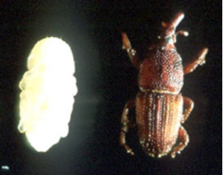
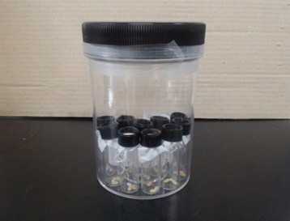
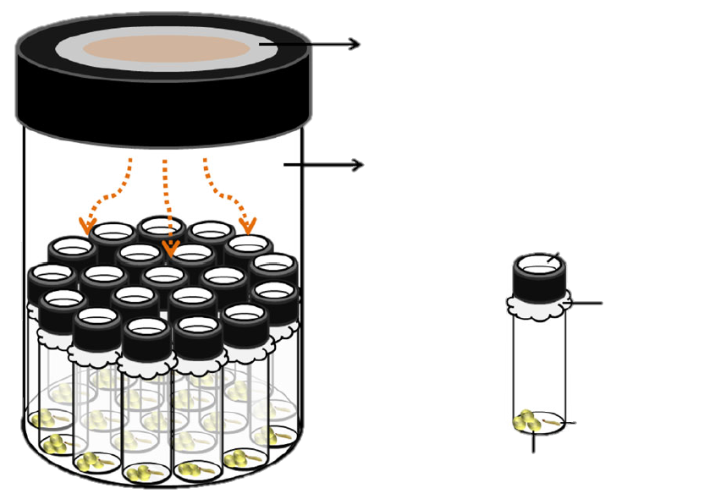
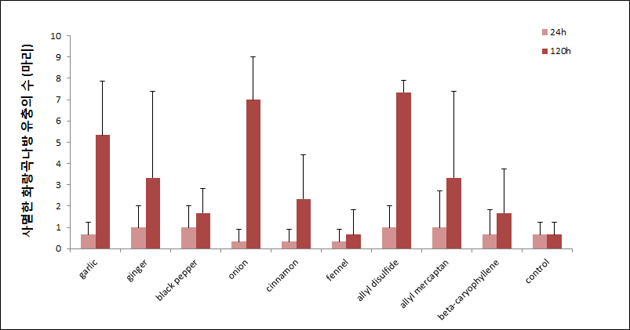
Screening of the natural anti-insect agents – Essential Oils
▪ Screening of the Essential Oils (EOs) for anti-insect activity against Plodia interpunctella and Sitophilus oryzae was done by measuring the fumigant activity and repellent activity
▪ Fumigant motality assay
Filterpaper with EO inside of the cap
Indian meal moth
Plodia interpunctella
Rice weevil
Sitophilus oryzae
Fumigant toxicity assay system
0.5L Polyethylene jar
* Fumigant mortality $(\%)$ $= \frac{the number of dead larvae}{the starting number of larvae} ×100 (\%)$
Screening of Essential Oils
Ventilation
Calico cloth
20 glass vials
The number of dead larvae
3rd instar larva
3 grains of brown rice
< Schematic diagram of the fumigant motality assay system >
- 9 -

Slide 11
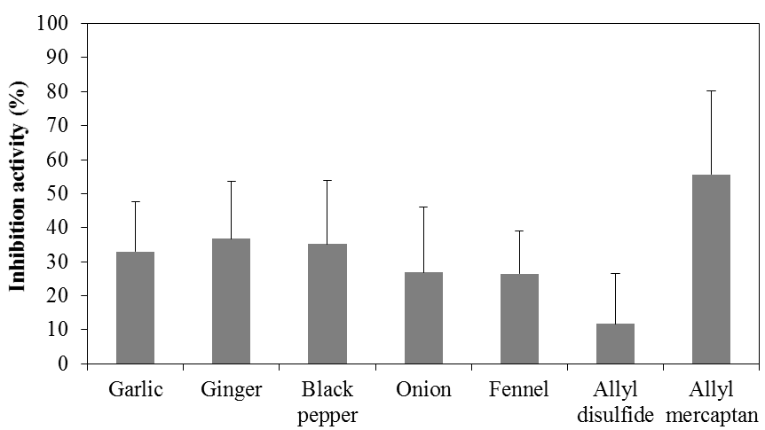
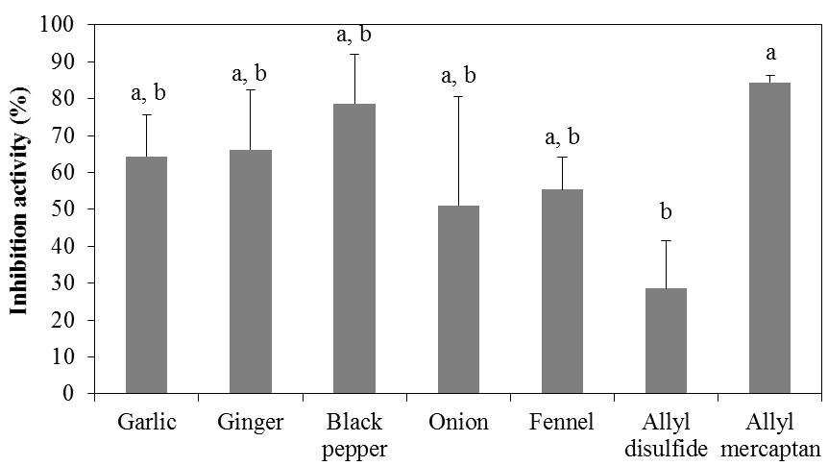
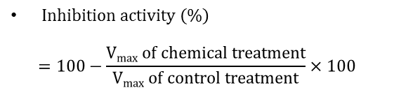
Screening of the natural anti-insect agents – Essential Oils
▪ Acetylcholinesterase (AChE) inhibition assay:
Neurotransmitter inhibition activity of essential oils was measured by the modified colorimetric method using acetylcholinesterase as a substrate.
1 ml phosphate buffer
homogenize
Supernatant: enzyme source
Thirty of
dead insects
centrifuge
Enzyme source : 79 ㎕
+
Anti-insect agents 1 ㎕
Indian meal moth
Plodia interpunctella
+
10 mM Acetylthiocholine iodide (ATChI) : 10 ㎕
+
4 mM 5,5′-dithio-bis(2-nitrobenzoic) acid (DTNB) : 10 ㎕
$Inhibition activity \left(\%\right)$
$$=100−\frac{Vmax of chemical treatment}{Vmax of control treatment}×100$$
Rice weevil
Sitophilus oryzae
Calculate the maximum velocity to measure O.D every 30 sec for 20 min in 405 nm with microplate spectrophotometer
- 9 -

Slide 12
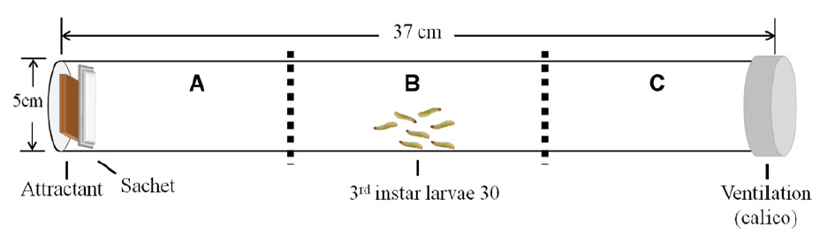
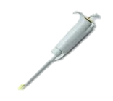
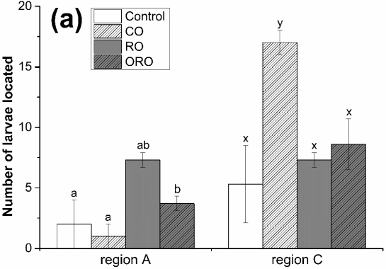
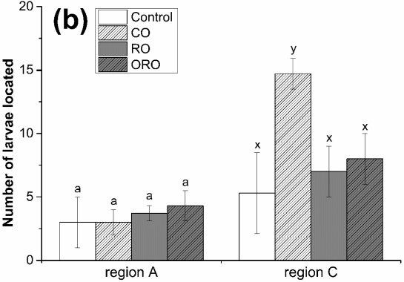
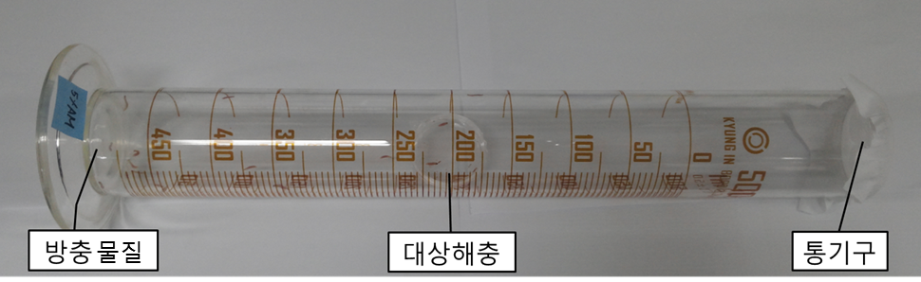
Screening of the natural anti-insect agents – Essential Oils
▪ Repellent assay
< Schematic diagram of the repellent assay system >
Screening of repellent activity of EOs
Screening of repellent activity of EOs – Results
CO : Clove bud oil
RO : Rosemary oil
ORO : Orange oil
24 h
48 h
2% (v/v) EOs
Filter paper
A
B
C
Repellent
Larvae
Ventilation
Figure 3. Repellent activity of clove bud oil, rosemary oil, and orange oil after (a) 24 h and (b) 48 h against
Plodia interpunctella larvae. Values that do not share a common letter are significantly different (p ≤ 0.05)
- 11 -

Slide 13
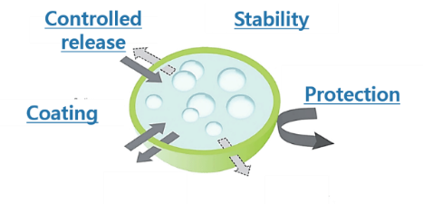
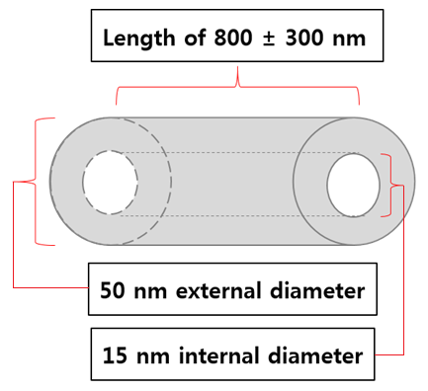
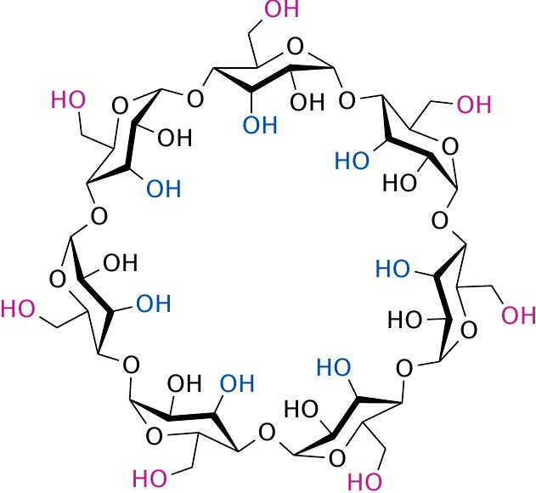
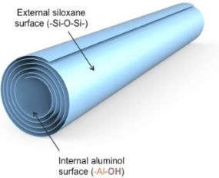
Microencapsulation for controlled release of anti-insect agents
▪ Encapsulation techniques for controlled release
(1) Essential oils
(2) Wall materials
(3) Encapsulation
GRAS (generally recognized as safe)
Displaying repellent activity
Highly volatile substance
Acting as a carrier
Protecting essential oils from burst release
(controlled release)
Improved stability of essential oil
Controlled release (sustained repellent activity)
Reduced intense odor
[ Examples of Wall materials ]
< β-Cyclodextrin >
< Halloysite nanotube >
- 12 -

Slide 14
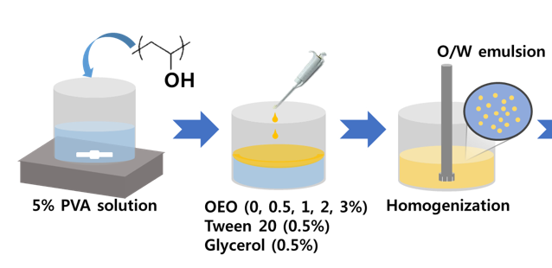
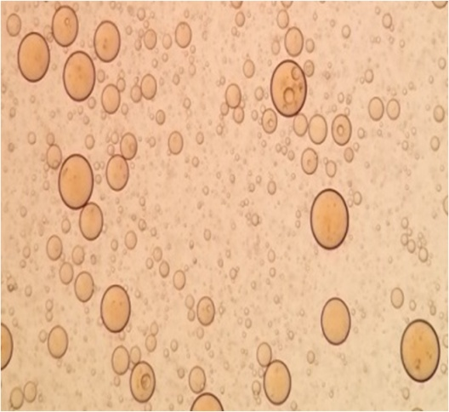
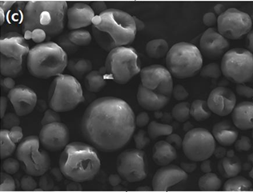
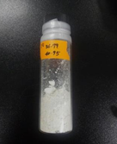
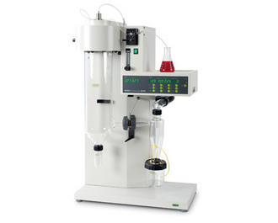
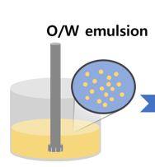
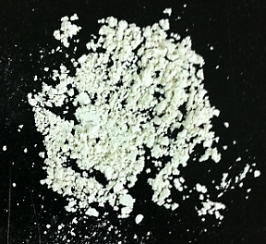
Microencapsulation for controlled release of anti-insect agents
▪ Microcapsule containing anti-insect agents
1) Microcapsule emulsion containing anti-insect agents
Wall materials : Gum arabic, maltodextrin, whey protein isolate, β-cyclodextrin, starch, polyvinyl alcohol (PVA)
< Micrographs of emulsion form >
2) Microcapsule powder containing anti-insect agents
< Micrographs of powder form >
Spray dryer
- 13 -
Notes:
impregnated

Slide 15

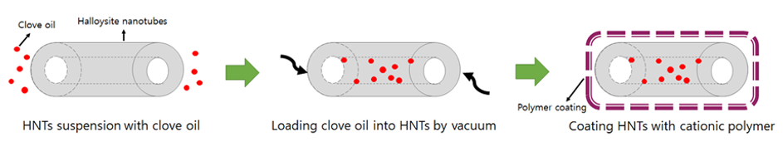
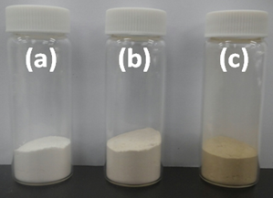
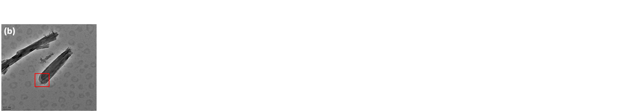

Microencapsulation for controlled release of anti-insect agents
▪ Microencapsulation of anti-insect agents using halloysite nanotube
1) Development of insect repellent-loaded halloysite nanotubes
2) Encapsulated anti-insect agent into HNTs
Halloysite suspension
Spray dryer
< Microcapsule powder >
< Micrographs of nanotube form >
- 14 -
Notes:
impregnated / SiO2 silica

Slide 16




Anti-insect packaging system
▪ Development of anti-insect multi-layered film
▪ Anti-insect packaging system – Film
▪ Development of anti-insect sachet
▪ Anti-insect packaging system – Sachet
(1)
(2)
Sachet
β – Cyclodextrin
+ EOs
β - Cyclodextrin inclusion complex
- 15 -

Slide 17
CONTENTS
01
INTRODUCTION
- Insect-proof packaging
02
LAB SCALE
- For insect-proof packaging
03
PILOT PLANT SCALE
04
HAN LAB
- lab introduction

Slide 18







1) Twin screw extruder
3. Application of a pilot-plant scale system
Application of a pilot-plant scale system
▪ Twin screw extruder
: SiO2 impregnated with cinnamon oil and LDPE were used to produce master batch
by using a twin screw extruder
[ Hot melt extrusion process ]
LDPE
SiO₂ impregnated with cinnamon oil
4. Cooling
1. Melting
2. Mixing
3. Homogeneous discharge
5. Pelletizing
< Master batch of cinnamon oil >
- 17 -

Slide 19


Application of a pilot-plant scale system
▪ Manufacture of master batch
(1) Preparation of master batch manufacture
(2) Input of resin
(3) Mixture of natural insect-proof materials
(4) Extrusion process
Cooling
(5) Freezing
(7) Master batch
(cinnamon oil added)
(6) Cutting, drying, and packaging process

Slide 20









Application of a pilot-plant scale system
▪ Application of master batch to manufacture food sheet and containers
[ Mixture of cinnamon oil and citric acid master batch ]
Cinnamon oil
master batch 15 %
Cinnamon oil
master batch 30 %
Citric acid
master batch 15 %
[ Extrusion process (cup) – temp 220 $℃$ ]
(1) Input of blending material, hopper
(2) Purge and extrusion process
Cup

Slide 21









Application of a pilot-plant scale system
[ Extrusion process (sheet) – temp 225 $℃$ ]
(1) Input of blending material, hopper
(2) After pressing, sheet molding process
Sheet
[ Extrusion process (tray) – temp 225 $℃$ ]
(1) Input of sheet
(2) Molding process under high temperature and high pressure
(3) Cutting
Tray

Slide 22






Application of a pilot-plant scale system
▪ Gravure printing method
: (1) Cinnamon oil encapsulated with PVA
(2) Allyl disulfide and allyl mercaptan homogenized with rice flour
(3) Clove bud oil loaded into halloysite
were coated on PP and LDPE, respectively, and then dried to make insect-proof films
[ Gravure printing process ]
PP or
LDPE film
< Process of gravure printed film >
Essential oil such as Cinnamon oil, allyl disulfide, ally mercaptan, and clove bud oil
< Developed insect-proof film and paper >
- 18 -

Slide 23


Application of a pilot-plant scale system
▪ Dry laminating & Extrusion lamination machine
: Insect-proof multilayer films, which composed of PP film coated with anti-insect material and LDPE, were produced by dry lamination and extrusion lamination machine
[ Process of insect-proof multilayer film manufacture ]
< Insect-proof multilayer film >
- 19 -

Slide 24


Application of a pilot-plant scale system
▪ Penetration test of developed insect-proof films
[ Device for measuring the penetration activity of vermin ]
< Penetration test trap >
- 20 -

Slide 25


Application of a pilot-plant scale system
▪ Penetration test of developed insect-proof films
[ Result of penetration test of insect-proof multilayer film, 30µm thick]
Accumulated penetration rate (%)
50% reduction of insect-penetration was shown in multi-layer film but not in control film.
Insect-proof film containing 5 % allyl disulfide showed a high insect-proof ability and it has a potential use as an anti-insect material
1 2 3 4 5 6 7 8 9 10 11 12 13 14 15 16 17 18 19 20 21 22 23 24 25 26 27 28 29 30
Time (d)
Control : untreated film
AD 5%l : insect-proof film treated with allyl disulfide 5%
- 21 -

Slide 26

Application of a pilot-plant scale system
▪ Penetration test of developed insect-proof films
[ Result of penetration test of insect-proof multilayer film, 30µm thick]
100%
In penetration tests, HNTs/CO/LBL film showed the anti-insect effect as compared to control.
The encapsulated essential oil was gradually and slowly released by the encapsulation process, causing delayed penetration by insects.
48.8%
* Printed LDPE : Gravure-printed low-density polyethylene film
HNTs/CO film : Gravure printed film containing clove bud oil-loaded halloysite nanotubes
HNTs/CO/LBL film : Gravure-printed film containing clove bud oil-loaded halloysite nanotubes with polyethylenimine coating
- 21 -

Slide 27







Application to real food packaging
▪ Encapsulated cinnamon oil for insect-proof adhesive
[ Application of encapsulated cinnamon oil to corrugated paper box manufacture ]
Encapsulated cinnamon oil
Anti-insect starch-based adhesive including cinnamon oil encapsulated with β–cyclodextrin
against Plodia interpunctella and Trogoderma granarium
(Khapra beetle)
- 22 -

Slide 28








Application to real food packaging
▪ Master batch
▪ Gravure printed insect-proof films
▶ Anti-insect films coated by gravure printing machine
▶ Master batch including anti-insect material
[ Application of master batch ]
[ Application of printed insect-proof films ]
Tray
Cup
Chocolate
Cookie
Caramel
Brown rice
- 23 -

Slide 29





Sensory evaluation
▪ Sensory evaluation and Acceptance test
Samples
[ 9-point-hedonic scale ]
9. Like Extremely
8. Like Very Much
7. Like Moderately
6. Like Slightly
5. Neither Like nor Dislike
4. Dislike Slightly
3. Dislike Moderately
2. Dislike Very Much
1. Dislike Extremely
Chocolate
Cookies
50 Panelists
Caramel
List
Color, flavor,
taste, texture
9-point-
hedonic scale
(most widely used scale for measuring food acceptability)
- 24 -

Slide 30



Sensory evaluation
▪ Sensory evaluation and Acceptance test
Chocolate
Odor of film
(Score)
Odor
Color
Texture
Taste
Overall preference
(Score)
Cookie
Odor of film
(Score)
Odor
Color
Texture
Taste
Overall preference
(Score)
Number of people
Score
Number of people
Score
Number of people
Score
Number of people
Score
Number of people
Score
Number of people
Score
Number of people
Score
Number of people
Score
Cinnamon oil (CO) 0 % (control)
3.89
5
6.20
2
5
6
6
3
5.67
6
Cinnamon oil (CO) 0 % (control)
2.08
7
7.57
6
5.33
3
5.67
1
7
6.31
Cinnamon oil (CO) 2 %
5.67
6
4.33
2
5
3
6.33
4
6
5.89
Cinnamon oil (CO) 2 %
7.54
7
3.86
2
6
2
5
2
4
5.92
Micro-encapsulated CO emulsion 1 %
4.56
4
4.5
0
-
3
6.33
0
6.15
6.15
Micro-encapsulated CO emulsion 1 %
3.23
5
2.4
5
5
4
6.5
5
4.2
5.31
Micro-encapsulated CO emulsion 2 %
5
5
4.6
4
5.5
5
6.6
5
5
6.08
Micro-encapsulated CO emulsion 2 %
3.31
9
2.78
7
5.86
9
3.89
8
3
4.58
< Table1. Sensory evaluation of chocolates with anti-insect films >
< Table 2. Sensory evaluation of cookies with anti-insect films >
Caramel
Odor of film
(Score)
Odor
Color
Texture
Taste
Overall preference
(Score)
Sensory evaluation of Milk chocolate, cookies, and caramels
Number of people
Score
Number of people
Score
Number of people
Score
Number of people
Score
In chocolate and cookie, the flavor of films with cinnamon oil 5% was the strongest one in 4 experimental groups.
There was no big difference with a control group although the microencapsulated form of cinnamon oil was applied.
The application of insect-proof films to package real foods has no potential effect on organoleptic property
Cinnamon oil (CO) 0 % (control)
4.5
4
3.5
3
5
3
3
1
5
4.78
Cinnamon oil (CO) 2 %
2.79
12
4.67
7
4.71
8
5.13
3
5.67
6
Micro-encapsulated CO emulsion 1 %
1.96
2
3
0
-
1
5
6
5
5.17
Micro-encapsulated CO emulsion 2 %
3
6
4
2
5
5
6.2
3
6.33
5.21
< Table 3. Sensory evaluation of caramel candies with anti-insect films >
- 25 -

Slide 31





Anti-insect Food Packaging Research
▪ Publications on SCI
Development of anti-insect food packaging film containing a polyvinyl
alcohol and cinnamon oil emulsion at a pilot plant scale
< Journal of Food Science, 2013 >
< Journal of Food Science, 2013 >
< Journal of Stored Products Research, 2015 >
< Journal of Food Science, 2014 >
< Journal of Food Science, 2016 >

Slide 32
CONTENTS
01
INTRODUCTION
- Insect-proof packaging
02
LAB SCALE
- For insect-proof packaging
03
PILOT PLANT SCALE
04
HAN LAB
- lab introduction

Slide 33














In Our Lab
▪ Emerging new technologies in food packaging
1. Noble packaging materials
2. New packaging system & technology
3. Safety of packaging materials
Biodegradable plastics
Edible coating
Eco-friendly film coating
Active packaging
Anti-microbial packaging
Anti-oxidant packaging
Anti-insect packaging
Oxygen scavenger
Smart packaging
Packaging study – Migration
Regulations on packaging safety
Packaging materials
Non-metallic
oxygen scavenger
Foods
Apple peel by-products
Mass transfer by concentration gradient
Antioxidant activity
Film-forming ability
Colorimetric pH indicator using natural pigments
Turmeric
Gelatin
Turmeric-gelatin biodegradable film
- 27 -

Slide 34


Grazie mille
http://hanlab.korea.ac.kr/
Food Process Engineering Lab at Korea university

