Slide 1
2016 World Conference on Climate Change
Projection of drought characteristics according to future climate
and hydrological change in the Korean Peninsula
October, 25, 2016
Jae-Min So*, Kyung-Hwan Son, Deg-Hyo Bae
Dept. of Civil & Environmental Engineering, Sejong Univ., Seoul, Korea
Notes:
(의장이 소개할 경우) Thanks chairman for introducing me.
(의장이 소속이나 이름을 다 소개하지 않을 경우 My name is Jae-Min So. I’m a doctoral course’s student in Sejong university, South Korea.
Today, I’d like to talk about the “Projection of drought characteristics according to future climate
and hydrological change in the Korean Peninsula”
Today, I’d like to talk about my topic, These are my topic.

Slide 2
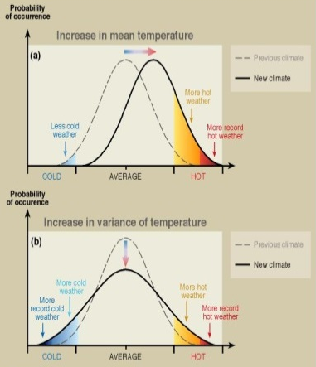
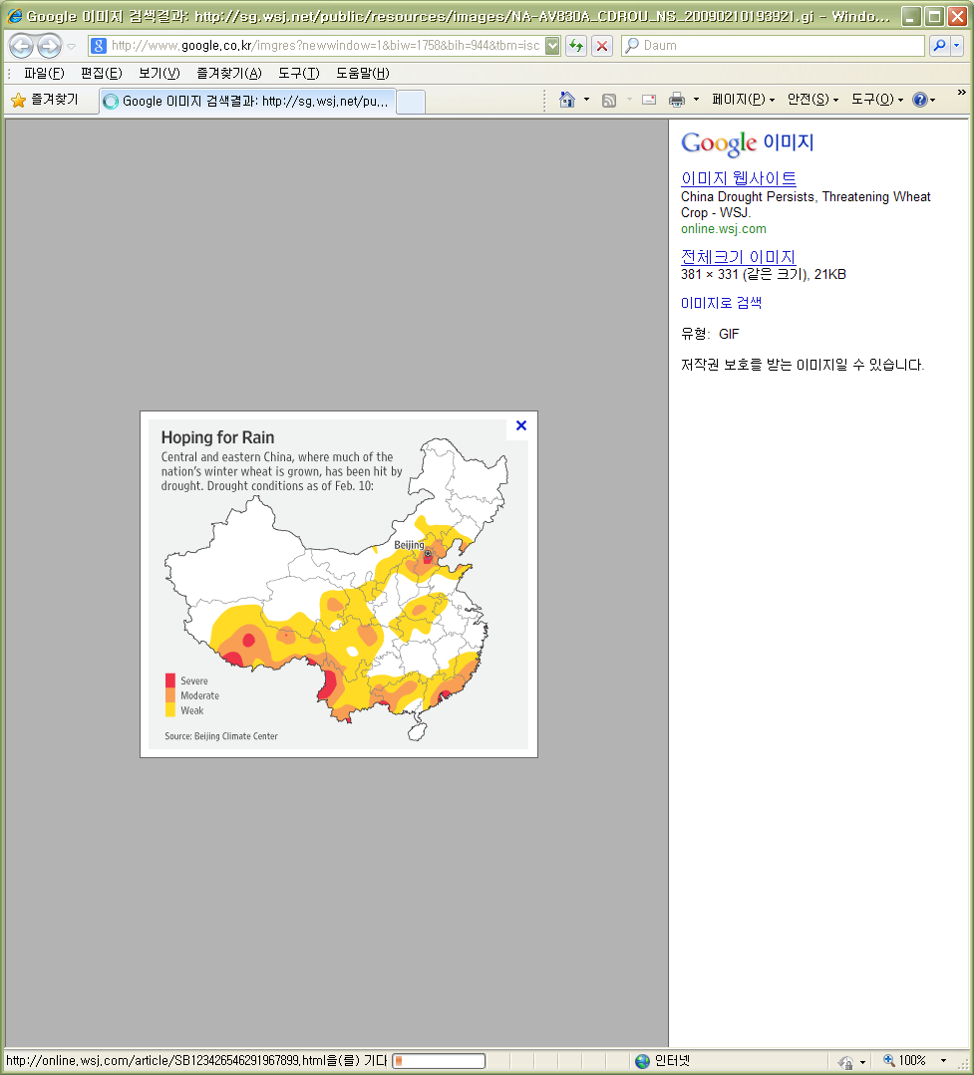
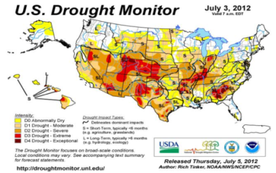
Introduction
Necessities of this study
  Drought is one of the serious natural disasters along with the floods, and that of South Korea with 2-3 year cycle is no exception
  Understanding of drought characteristics in North Korea is very limited due to the lack of meteorological and hydrological information
  Drought is projected to be more severe due to climate change impact
  It is useful to project future drought conditions in Korea and to compare their characteristics
  in South and North Korea
Objectives of this study
  To project drought conditions using future global-scale climate & hydrological information in Korea
Drought
China (2009)
  To analyze the changes of drought trend and frequency in the region
Drought
USA (2012)
Notes:
Drought is one of the serious natural disasters along with the floods, and that of South Korea with 2-3 year cycle is no exception
However, understanding of drought characteristics in North Korea is very limited due to the lack of meteorological and hydrological information
Moreover, drought is projected to be more severe due to climate change impact
Therefore, it is useful to project future drought conditions in Korea and to compare their characteristics in South and North Korea
So the objectives of this study is to project drought conditions using future global scale~ and to analyze the change of drought trend and frequency in the region

Slide 3
Methodology
Procedure of this study
Study area & Data collection
Study domain : Korean Peninsula
NCDC (prec., temp., wind.), ASOS (prec., temp., wind.)VIC model data set (prec., max/min temp., wind), RCM
NCDC & ASOS data
(1976~2005)
RCM selection
(HadGEM3-RA)
Future scenario
(RCP8.5 scenario, RCM, Delta method)
Hydrology analysis
(VIC model)
Historical analysis
Future analysis
Drought indices
SPI, SRI, SSI
Notes:
The procedure of this study / are divided 2 part.
The first part is the historical data analysis to compute the drought indices by using hydro-meteorological data and hydrology model
And second part is the future projections by using the RCM with a downscaling scheme
For the historical analysis, the past climatology data was collected from NCDC (National Climate Data Center) and Korea meteorological Administration respectively.
And then for analysis of historical data, we used the hydrological model.
The future scenarios of RCM were used daily time scale, and applied delta method.
Finally, the hydrology model was run using scenario data to compute the future hydrology information
And then Drought indices was calculated for historical and future periods based on precipitation, Runoff, soil moisture.

Slide 4
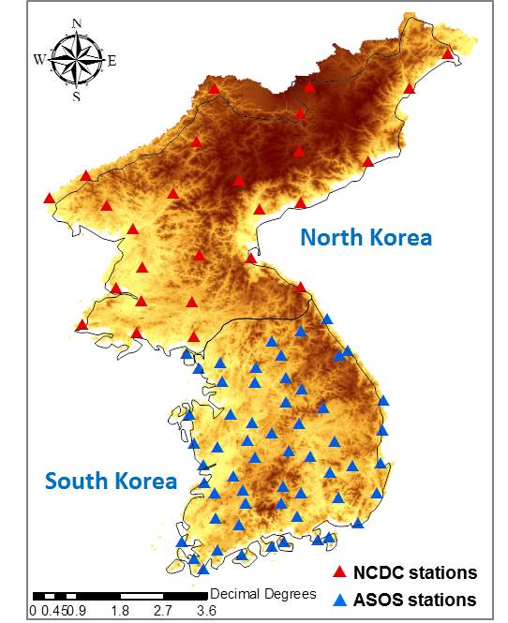
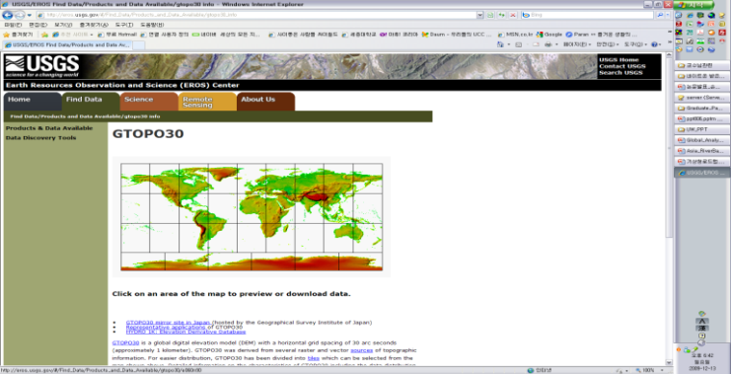
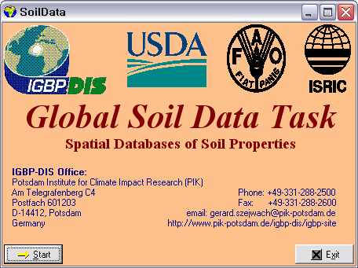
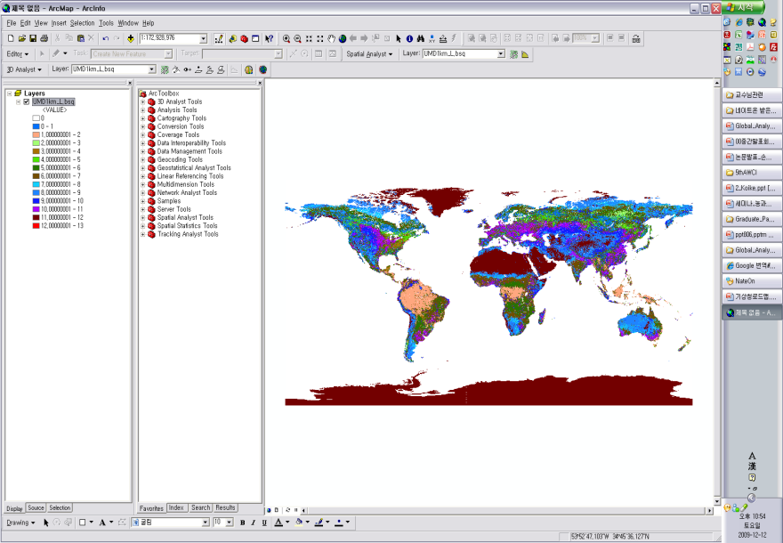
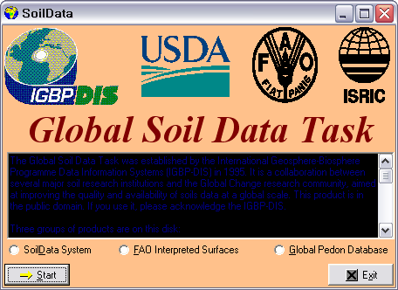

Study Area & Data Collection
Study area
Meteorological & topographical data
  Korean Peninsula with South and North Korea
  Meteorological data
    S. Korea : 59 ASOS of KMA (Korea Meteorological Administration)
    South Korea area : 120,500km²
    North Korea area : 99,720km²
    N. Korea : 24 NCDC (National Climate Data Center) data
  Topographical data
    DEM
    United States Geological Survey (USGS)
    Resolution : 30″×30″
    Land use
    University of Maryland (UMD)
    Resolution : 1km×1km
    Soil properties
    Food Agriculture Organization (FAO)
    Resolution : 5′×5′
Notes:
This is / our study area and data collections
Out study area is the Korean Peninsula for both south and north Korea
You can see the area in here.
For the me~ and Top~ data collections
We used a 59 ~ from KMA, and 24 NCDC data
For to~ data, we used USGS ~ , univer landuse, Fao Soil properties data
`
with south and north Korea, those of area is like this.
For detail, The study area is the Korean Peninsula with south and north Korea, those of area like this.
South and North Korea meteorological data was collected from KMA and NCDC. We used 59 ASOS data of KMA and 24 NCDC data for south and north Korea.
For this topographical data to apply the hydrologic model, we used USGS DEM, UMD land use data, and FAO soil properties data.

Slide 5
Climate change scenario & Climate variables
  Emission scenario : RCP8.5 (Radiative force, 8.5 W/m², 2099yr)
  GCM &RCM : HadGEM3-A0 & HadGEM3-RA
  Statistical post processing : Delta method
    Reference period (S0) : 1977-2006yr.
    Projection periods (S1, S2, S3) : 2020s(2010~2039yr.), 2050s(2040~2069yr.), 2080s(2070~2099yr.)
    Meteorological variables : Precipitation, Max. & Min. temperature, Wind speed
Emission
Scenario
GCM
RCM
Statistical post processing
Data
extraction
Climate change factor
Scenario run
Historical run
Observation
Bias
Notes:
We used RCP 8.5 emission scenario,
Had a0 GCM from IPCC, Had ra for the regional model~ from KMA
The RCM used in this study were driven by RCP 8.5 scenarios based on AR5, (which have an important role for climate projection and water resource management in the future.)
The GCM and RCM data was collected from IPCC Data Distribution Center and KMA, respectivily
For the downscaling from RCM outputs to regional scale results
We do the post processing by using the delta method for bias correction

Slide 6
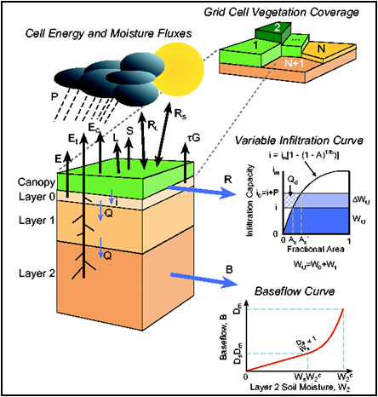
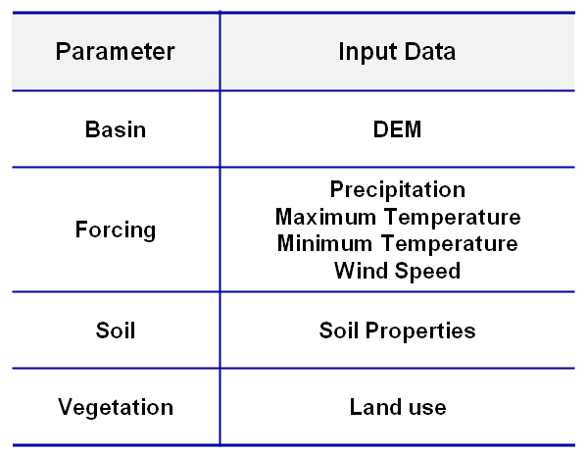
Hydrological model
  VIC (Variable Infiltration Capacity) model : a soil-vegetation-atmospheric transfer scheme that considers both energy and water balances
  A grid-based macro-scale model : usually implemented at various spatial scales from 1/8 °to 2°
  Widely used for analyzing the variations of water resources on climate change
Notes:
For the future projection of hydrologic information like runoff, soil moisture, else on, we selected VIC model.
The VIC model is a soil-vegetation-atmospheric transfer scheme that consider both energy and water balances, so it widely used for analyzing the variations of water resources on climate change

Slide 7
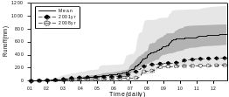
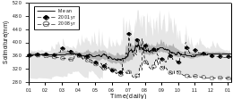

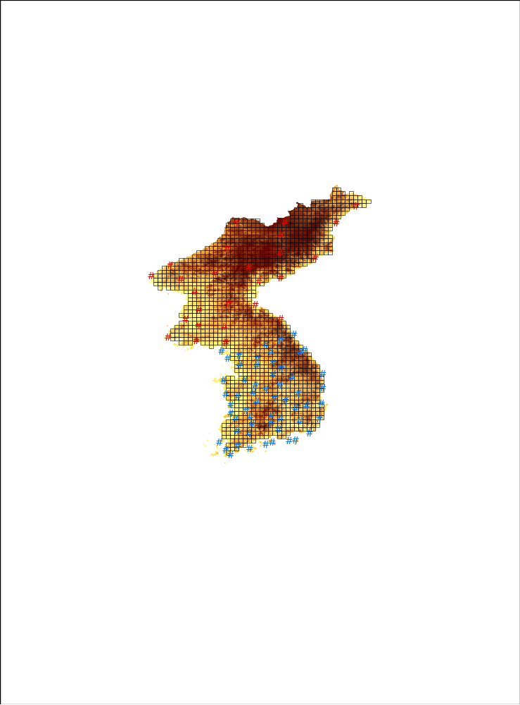
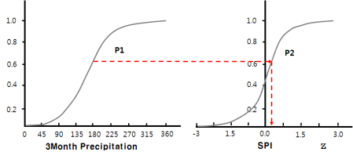


Drought index calculation
  Use 3-month cumulative precipitation, runoff and soil moisture at each grid
  Select the appropriate distribution for the variables
  Compute the drought indices (SPI, SRI, SSI) by using normalization process
VIC Model
(Physical based)
Drought Indices
(Statistical based)
Precipitation, Runoff, Soil moisture
Estimation of the Cumulative Time Series
Selection of Optimal Distribution
Estimation of the Cumulative Probability
Standardization
SPI(Standardized
Precipitation Index)
SRI(Standardized
Runoff Index)
SSI(Standardized
Soil moiture Index)
    Number of Grid
    - N. Korea : 929
    NCDC stations
    - S. Korea : 572
    ASOS stations
< Study Area>
Notes:
We used the drought indices like SPI, SRI and SSI classified as meteorological, hydrological and agricultural drought (to apply on South and North Korea)
This figure show the drought index calculation
we need the technique to estimate drought indices from hydro-climate variables.
Firstly, we estimate time series for 3-month cumulative prec, runoff, soil moisture.
And than select the optimal distribution and estimate distribution parameter
Finally, through the normalization process, we estimate the drought index

Slide 8
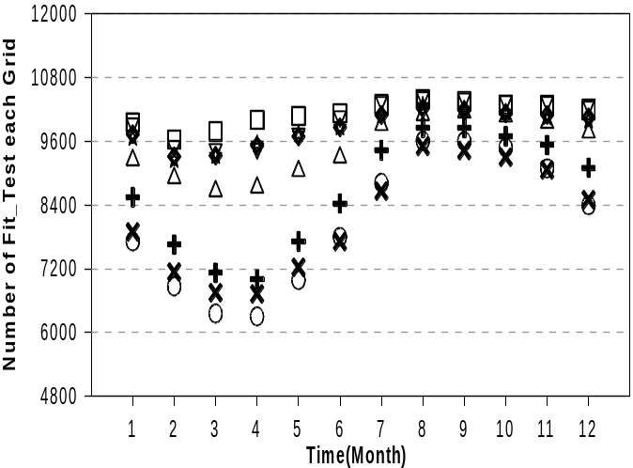
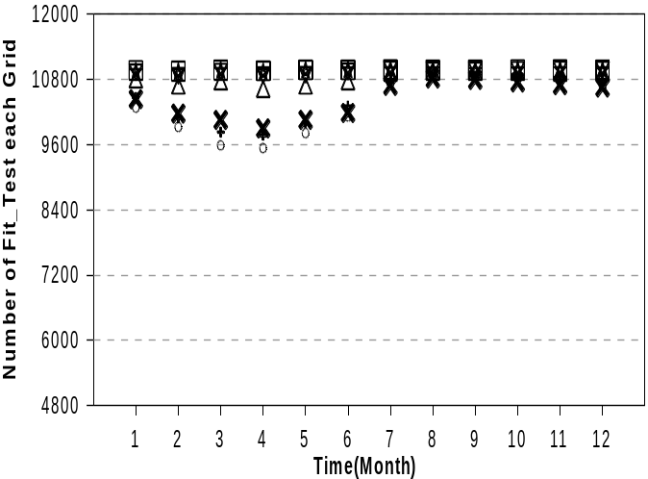
  Estimation of optimal distribution for hydro-climate variables
    Application of pdf and their parameter estimation
    Probability distributions : Lognormal(2p), Gamma(2p), Log-pearson type-3, Gumbel, GEV, Wakeby(5p)
    Parameter estimation methods : L-moment method (Hosking and Wallis, 1993)
    Selection of suitable distribution
    Precipitation : Gamma, Runoff : Log-pearson type-3, Soil moisture : Wakeby (5 parameters)
Notes:
For estimating the optimal distribution for hydro-climate variables. We used the several distribution like that.
This figure show the fit-test result for several distributions.
Based on this result, we selected the Gamma, Log-pearson, and Wakeby distribution for prec. Runoff, soil moisture and calculated drought index using each distribution

Slide 9
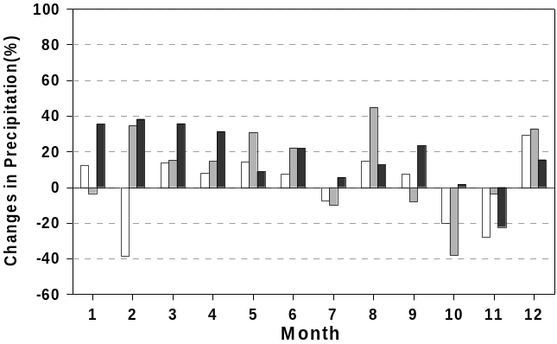
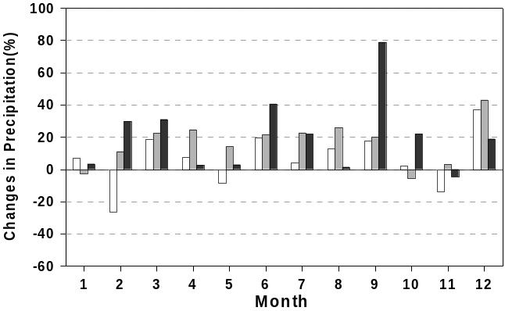
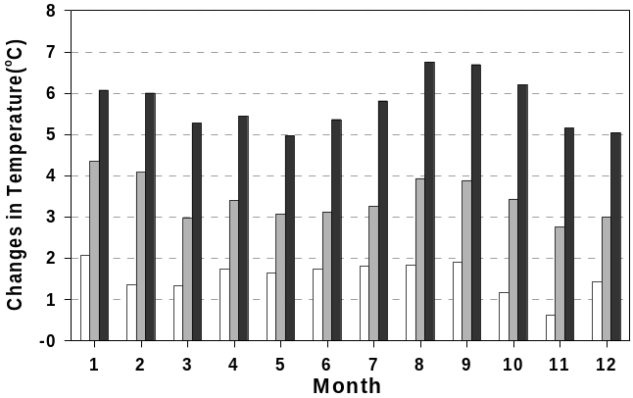
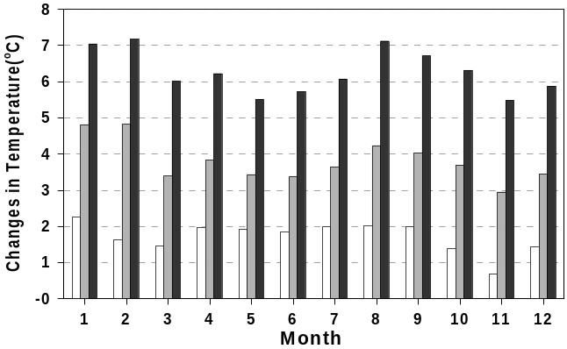
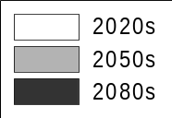
Results & Analysis
Future climate and hydrology projections
  Monthly average precipitation (P), temperature (T) in the region
    P increases in Mar. ~ Jun., and T rises in all the month in South Korea,
    In North Korea, P increases in Jun. ~ Sep., and T rises with similar pattern of South Korea
Precipitation
Precipitation
Temperature
Temperature
[South Korea]
[North Korea]
Notes:
This slide show the future precipitation and temperature projections in South and North Korea.
As you can see this figures,
Precipitation increases in spring season, and temperature rise in all the month in South Korea.
In North Korea, P increases in summer season, and tem. rise with similar pattern of South Korea.

Slide 10
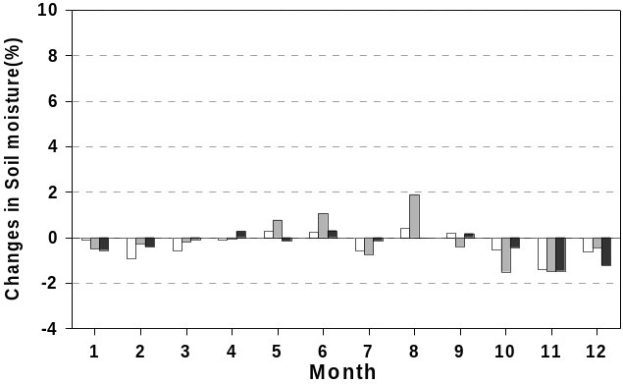
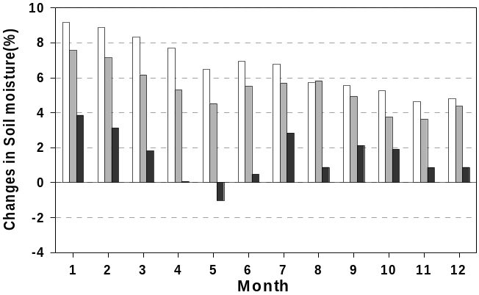
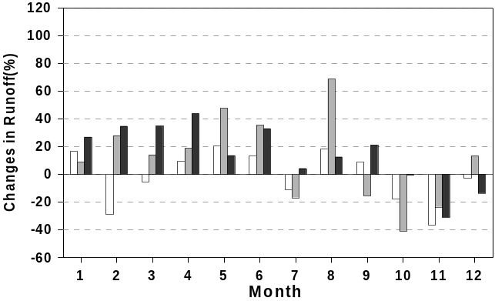
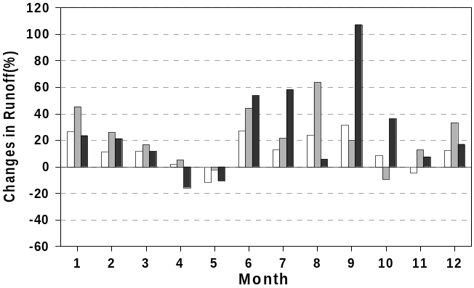
  Monthly average soil moisture (SM), runoff (Q) in the region
    SM increases in May, Jun., Aug., and Q increases in Apr. ~ Jun. in South Korea
    SM increases in almost all the month, and Q increases in jun. ~ Sep. in North Korea
Soil moisture
Soil moisture
```
Runoff
Runoff
[South Korea]
[North Korea]
    The increase of Q are directly related to the increase of P
Notes:
This slide show the future soil moisture and runoff projections in South and North Korea.
Soil moisture increase in may, jun., aug., and runoff increases in Apr, may, jun in South Korea
And in North Korea, Soil moisture increases in almost all the months, and runoff increases jun, jul, aug
Therefore, We can say The increase of runoff are directly related to the increase of Precipitation due to the similar temperature change

Slide 11
Future drought trend analysis by Mann-Kendall test
  SPI3 : Meteorological drought
    Increasing trend, but not statistically significant on all the months of South and North Korea for S1, S2, S3
    Spring drought increase is significant compared to the other seasons in South Korea
    Summer drought increases, but not statistically significant in North Korea
- | South Korea |  |  |  | North Korea
 | ▲(95%↑) | △(95%↓) | ▽(95%↓) | ▼(95%↑) | ▲(95%↑) | △(95%↓) | ▽(95%↓) | ▼(95%↑)
Jan. | 1.9 | 79.9 | 18.2 | 0.0 | 0.1 | 83.1 | 16.8 | 0.0
Feb. | 17.7 | 79.0 | 3.3 | 0.0 | 19.1 | 60.1 | 20.9 | 0.0
Mar. | 60.7 | 39.3 | 0.0 | 0.0 | 6.4 | 75.6 | 18.1 | 0.0
Apr. | 46.2 | 53.3 | 0.5 | 0.0 | 0.2 | 78.5 | 21.3 | 0.0
May | 5.2 | 91.1 | 3.7 | 0.0 | 1.4 | 82.7 | 15.9 | 0.0
Jun. | 12.4 | 86.9 | 0.7 | 0.0 | 13.1 | 80.6 | 6.2 | 0.0
Jul. | 9.6 | 85.8 | 4.5 | 0.0 | 33.5 | 63.1 | 3.4 | 0.0
Aug. | 10.1 | 88.5 | 1.4 | 0.0 | 10.0 | 80.8 | 9.1 | 0.0
Sep. | 7.2 | 92.8 | 0.0 | 0.0 | 16.7 | 78.1 | 5.2 | 0.0
Oct. | 10.0 | 90.0 | 0.0 | 0.0 | 4.8 | 89.2 | 5.9 | 0.0
Nov. | 6.5 | 92.8 | 0.7 | 0.0 | 30.0 | 68.9 | 1.1 | 0.0
Dec. | 0.0 | 75.9 | 24.1 | 0.0 | 0.0 | 86.3 | 13.7 | 0.0
Spr. | 60.8 | 38.1 | 1.0 | 0.0 | 4.0 | 77.8 | 18.2 | 0.0
Sum. | 26.2 | 72.9 | 0.9 | 0.0 | 26.2 | 67.1 | 6.8 | 0.0
Aut. | 13.1 | 86.9 | 0.0 | 0.0 | 19.9 | 77.7 | 2.4 | 0.0
Win. | 1.2 | 43.5 | 51.2 | 4.0 | 18.7 | 71.4 | 9.1 | 0.8
Notes:
This slide show result of the future drought trend in the region
As you can see the table,
Spring drought increases, and statistically significant compared to the other seasons in South Korea
But, in North Korea, Summer drought increases

Slide 12
  SRI3 : Hydrological drought
    Increasing trend, but not statistically significant on all the months of South and North Korea for S1, S2, S3
    Autumn drought increases, but not statistically significant In South Korea
    Summer drought increases, and relatively statistical significance compared to other seasons in North Korea
- | South Korea |  |  |  | North Korea
 | ▲(95%↑) | △(95%↓) | ▽(95%↓) | ▼(95%↑) | ▲(95%↑) | △(95%↓) | ▽(95%↓) | ▼(95%↑)
Jan. | 0.0 | 57.5 | 42.5 | 0.0 | 6.5 | 78.6 | 15.0 | 0.0
Feb. | 1.0 | 71.5 | 27.4 | 0.0 | 14.3 | 72.2 | 12.7 | 0.8
Mar. | 11.7 | 80.8 | 7.5 | 0.0 | 5.6 | 69.8 | 23.6 | 1.1
Apr. | 5.8 | 81.8 | 12.4 | 0.0 | 0.2 | 68.4 | 26.6 | 4.8
May | 1.9 | 83.4 | 14.7 | 0.0 | 1.3 | 65.2 | 30.7 | 2.8
Jun. | 4.2 | 86.0 | 9.8 | 0.0 | 11.0 | 66.7 | 22.3 | 0.0
Jul. | 3.5 | 88.5 | 8.0 | 0.0 | 23.1 | 65.4 | 11.4 | 0.0
Aug. | 7.3 | 83.0 | 9.6 | 0.0 | 5.3 | 79.4 | 15.3 | 0.0
Sep. | 2.3 | 89.2 | 8.6 | 0.0 | 7.5 | 78.1 | 14.3 | 0.0
Oct. | 4.5 | 90.0 | 5.4 | 0.0 | 5.1 | 82.8 | 12.2 | 0.0
Nov. | 0.2 | 92.3 | 7.5 | 0.0 | 7.2 | 86.3 | 6.5 | 0.0
Dec. | 0.0 | 68.0 | 32.0 | 0.0 | 8.7 | 77.8 | 13.5 | 0.0
Spr. | 8.6 | 82.2 | 9.3 | 0.0 | 3.0 | 70.5 | 24.2 | 2.3
Sum. | 11.0 | 83.7 | 5.2 | 0.0 | 22.4 | 63.2 | 14.3 | 0.1
Aut. | 2.6 | 94.6 | 2.8 | 0.0 | 10.5 | 78.5 | 11.0 | 0.0
Win. | 0.7 | 25.0 | 72.4 | 1.9 | 1.5 | 90.2 | 5.8 | 2.5
Notes:
This is SRI results.
In South Korea, autumn drought increases, but North Korea, Summer drought Increases

Slide 13
  SSI3 : Agricultural drought
    Not statistically significant increasing trend on all the months of the region, but decreasing trend in spring season
    of South Korea
    Autumn drought increases, but not statistically significant in South Korea
    Winter drought increases, but not statistically significant in North Korea
- | South Korea |  |  |  | North Korea
 | ▲(95%↑) | △(95%↓) | ▽(95%↓) | ▼(95%↑) | ▲(95%↑) | △(95%↓) | ▽(95%↓) | ▼(95%↑)
Jan. | 0.0 | 29.9 | 69.8 | 0.3 | 2.9 | 57.5 | 36.7 | 2.9
Feb. | 0.0 | 45.1 | 54.4 | 0.5 | 2.7 | 51.9 | 42.0 | 3.4
Mar. | 2.4 | 60.5 | 36.5 | 0.5 | 2.6 | 60.4 | 34.3 | 2.7
Apr. | 1.9 | 60.1 | 37.8 | 0.2 | 1.1 | 60.8 | 33.4 | 4.7
May | 0.5 | 59.1 | 40.4 | 0.0 | 1.6 | 57.6 | 35.0 | 5.8
Jun. | 0.0 | 58.0 | 42.0 | 0.0 | 2.7 | 57.2 | 34.1 | 6.0
Jul. | 0.0 | 59.3 | 40.7 | 0.0 | 4.8 | 57.3 | 34.6 | 3.3
Aug. | 0.2 | 64.7 | 35.0 | 0.2 | 7.1 | 57.6 | 34.1 | 1.2
Sep. | 0.2 | 73.4 | 26.4 | 0.0 | 7.3 | 52.3 | 39.2 | 1.2
Oct. | 0.3 | 89.0 | 10.7 | 0.0 | 6.9 | 62.0 | 30.5 | 0.6
Nov. | 0.2 | 60.8 | 39.0 | 0.0 | 7.4 | 60.5 | 31.0 | 1.1
Dec. | 0.5 | 44.4 | 55.1 | 0.0 | 7.2 | 56.8 | 34.1 | 1.8
Spr. | 1.4 | 42.8 | 59.8 | 0.2 | 3.7 | 57.7 | 34.4 | 4.2
Sum. | 0.0 | 63.6 | 36.4 | 0.0 | 9.5 | 53.9 | 32.3 | 4.3
Aut. | 0.2 | 79.7 | 20.1 | 0.0 | 8.9 | 59.1 | 30.8 | 1.2
Win. | 1.0 | 70.1 | 28.7 | 0.2 | 10.2 | 82.7 | 6.9 | 0.2
    The critical increasing seasons of drought are different for each SPI3, SRI3 and SSI3 and each region
Notes:
For SSI result is here.
In south Korea, Autumn drought increases, but North Korea, Winter drought increases
Therefore, We can say the critical increasing seasons of drought are different for each meteorological, hydrological, agricultural drought in south and north korea

Slide 14
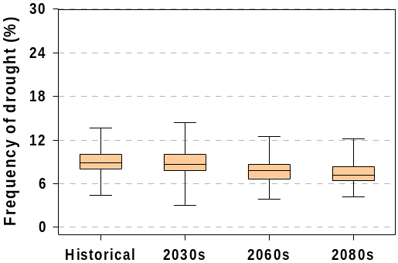
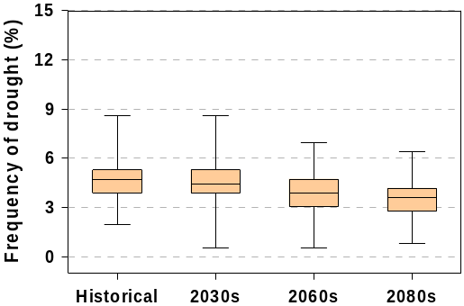
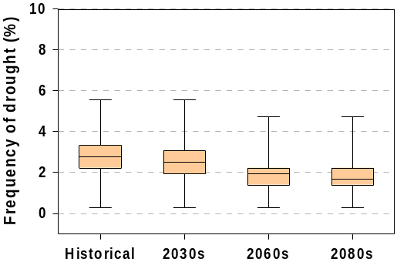
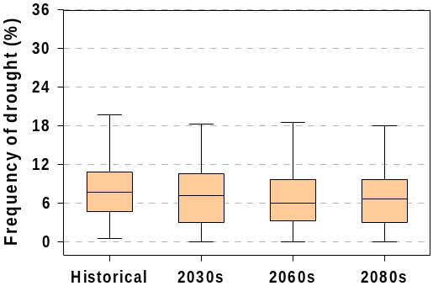
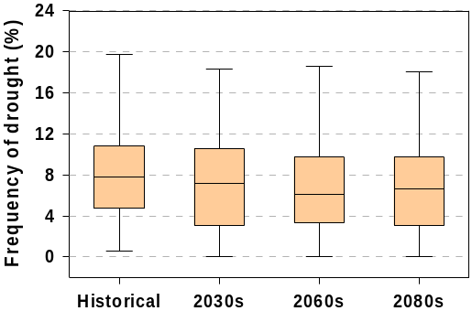
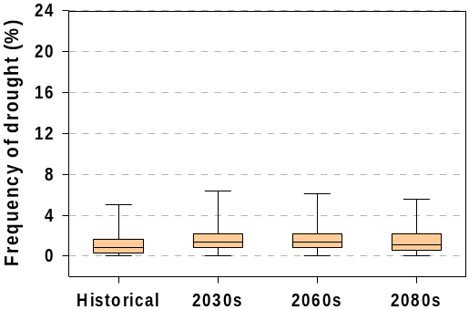
Future drought frequency according to severity
  SPI3
    Future drought frequencies for S1, S2, S3 decreases on all the cases in South Korea
    The frequency on Moderate drought decreases, but increases for the rest of two cases in North Korea
Moderate Drought
Severe Drought
Extreme Drought
SPI
SPI
SPI
4.7%
4.6%
3.9%
3.5%
2.7%
2.4%
1.9%
1.8%
South
Korea
9.0%
8.8%
7.7%
7.5%
SPI
SPI
SPI
7.8%
6.9%
6.6%
6.8%
8.9%
9.3%
9.0%
9.1%
North
Korea
1.1%
1.5%
1.5%
1.4%
Notes:
This slide show the future drought frequency for SPI according to severity.
As you can see the figures.
In South Korea, future drought frequency decreased on all the cases for three future periods
North Korea, frequency on moderate drought decrease, but increases for the rest of two cases

Slide 15
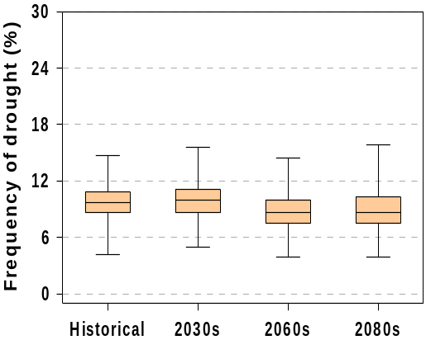
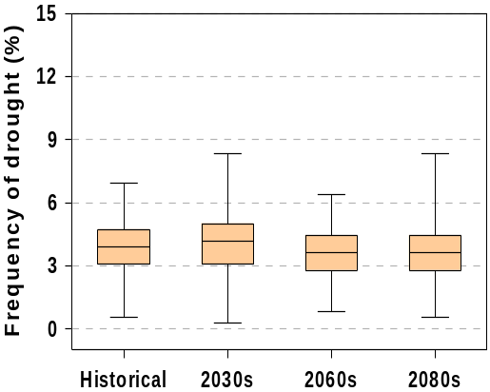
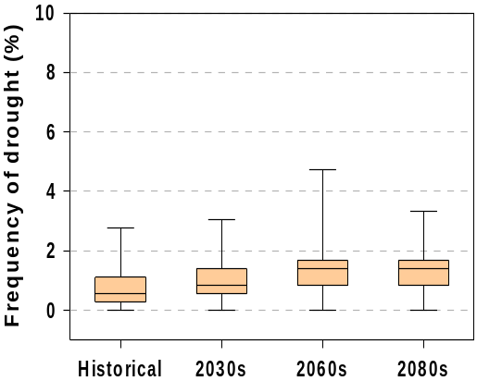
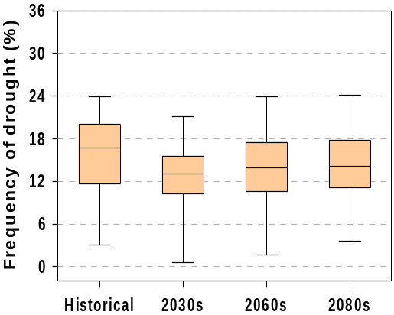
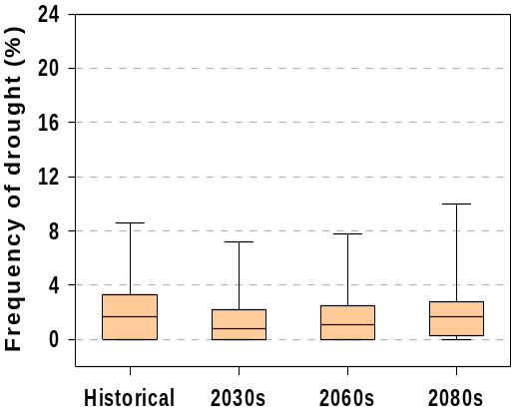
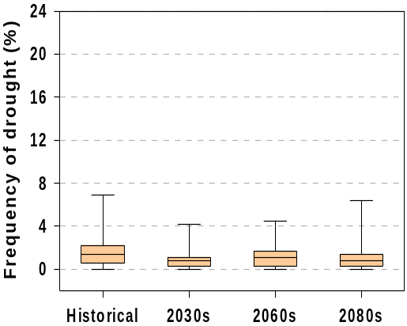
  SRI3
    Future drought frequency on extreme drought increases in South Korea, but decreases in North Korea
Moderate Drought
Severe Drought
Extreme Drought
SRI
SRI
SRI
9.7%
10.0%
8.8%
8.9%
3.9%
4.1%
3.6%
3.7%
0.7%
1.0%
1.4%
1.3%
South
Korea
15.4%
13.6%
SRI
SRI
SRI
12.8%
13.9%
North
Korea
1.9%
1.2%
1.5%
1.9%
1.5%
0.8%
1.0%
1.1%
Notes:
This slide show the SRI results like bellow figures.
Future drought frequency on extreme drought increases in South Korea, but decreases in North Korea

Slide 16
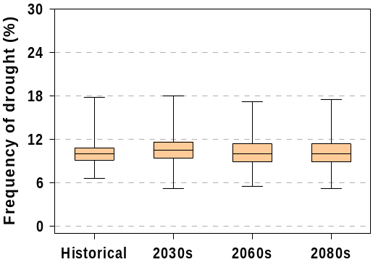
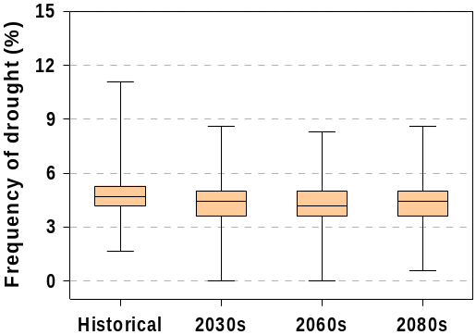
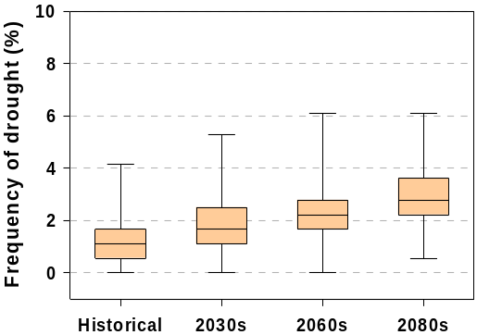
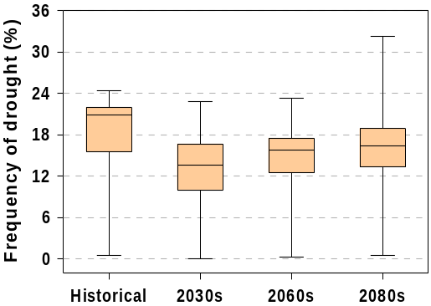
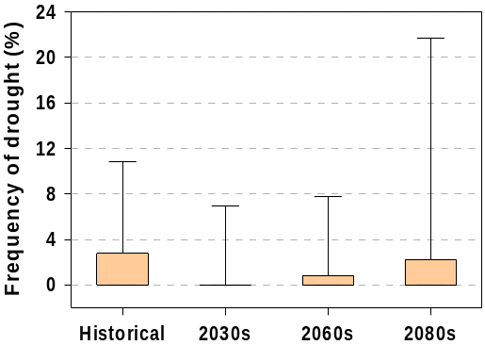
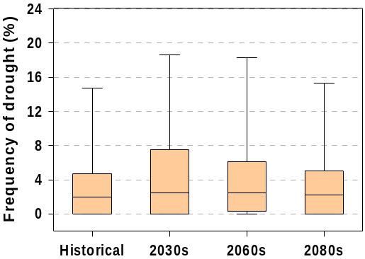
  SSI3
    Future drought frequency on extreme drought increases in South and North Korea
    Those on moderate and severe drought decreases in South and North Korea
Moderate Drought
Severe Drought
Extreme Drought
SSI
SSI
SSI
10.1%
10.7%
10.1%
10.4%
4.7%
4.2%
3.9%
4.1%
1.3%
1.9%
2.3%
2.8%
South
Korea
SSI
SSI
SSI
17.8%
13.7%
14.9%
16.0%
North
Korea
1.4%
0.5%
0.9%
1.7%
2.9%
4.1%
3.6%
3.2%
    The extreme drought frequencies between North & South Korea are different for SPI3, SRI3 and SSI3
Notes:
For SSI results
Future drought frequency on Extreme drought increases in South and North Korea
But Those on Moderate and severe drought decreases in the region
Therefore, We can say The extreme drought frequency between North and South Korea are different for meteorological, hydrological and agricultural drought.

Slide 17
Conclusions and Recommendations
Analysis of future climate and hydrology projections
  The increase of Q are directly related to the increase of P
Future drought trend analysis
  The critical increasing seasons of drought are different for each SPI3, SRI3 and SSI3 and each region
  The future trend of SPI3, SRI3, and SSI3 may be related to the trend of their input variables
  Further researches will be necessary to figure out the cause and effect
Future drought frequency analysis
  The extreme drought frequencies between North & South Korea are different for SPI3, SRI3 and SSI3
  Those are related to the extreme variables of P, SM and Q, but further research for finding
  the cause and effect is required in the near future
Notes:
The analysis of future climate and hydrology projections is the increases of runoff are directly related to the increases of precipitation
In term of the future drought trend analysis, the critical ~ for each meteorological, hydrological and agricultural drought in south and north korea
However, the future trend of spi3, sri3, and ssi3 ~ and further researches will be necessary to ~
In term of the future drought frequency analysis, The extreme drought ~ for meteorological, hydrological, and agricultural drought
Therefore, those are related to the extreme variables of precipitation, soil moisture, runoff, but further research for finding the cause and effect is required in the near future

Slide 18
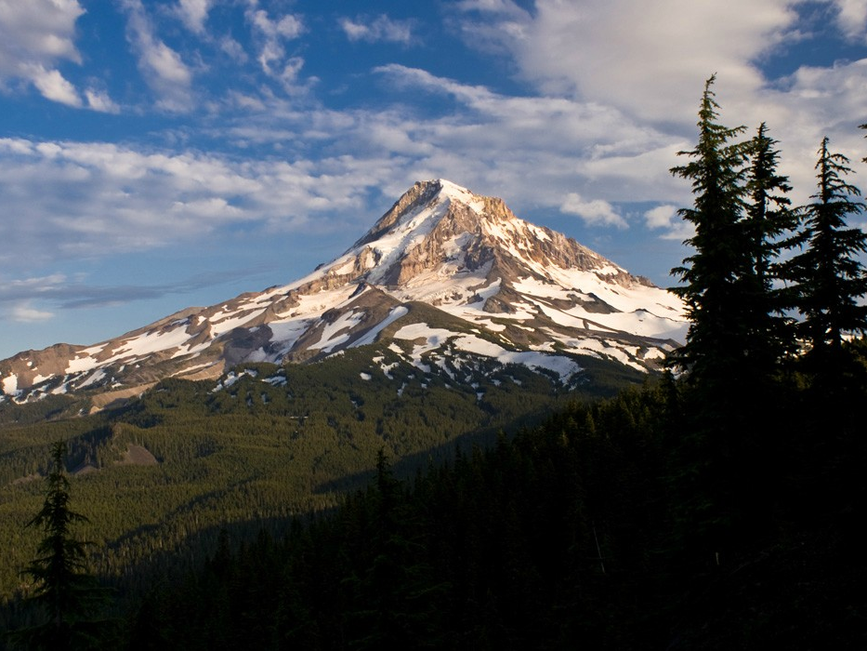
Thank you for your attention!

