Slide 1



August 12, 2015
4th International Conference and Exhibition on
Food Processing & Technology
London, UK
Occurrence, Impact and Biocontrol of
Biogenic Amines in Fermented Soybean Foods
Professor Jae-Hyung Mah
Department of Food and Biotechnology
Korea University

Slide 2

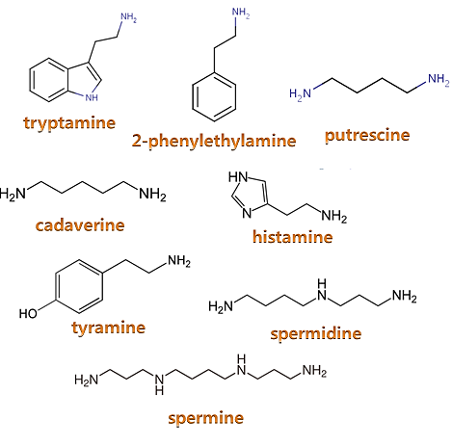
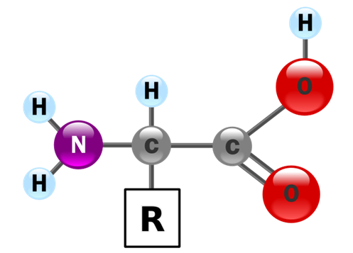
Biogenic amines
Biogenic amines are mainly produced by the growth of decarboxylase-positive microorganisms
Microbial decarboxylation

Slide 3
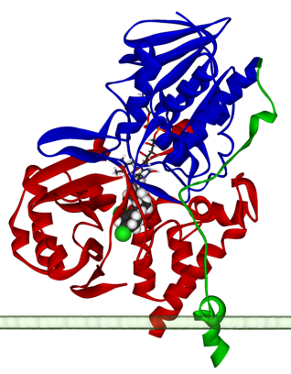
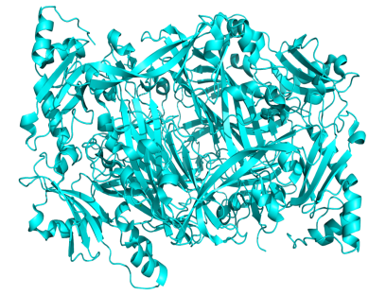

High dose
of amines
Detoxication system
Specific
inhibitors
Guidelines
Tyramine : 100-800 mg/kg
Histamine : 100 mg/kg
ß-phenylethylamine : 30 mg/kg
Pargyline,
Phenelzine,
Brofaromine,
Isocarboxazide,
Tranylcypromine
Monoamine oxidase
Diamine oxidase
Polyamine oxidase

Slide 4
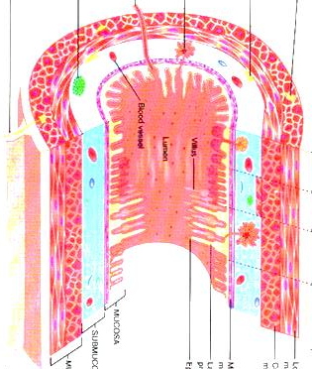
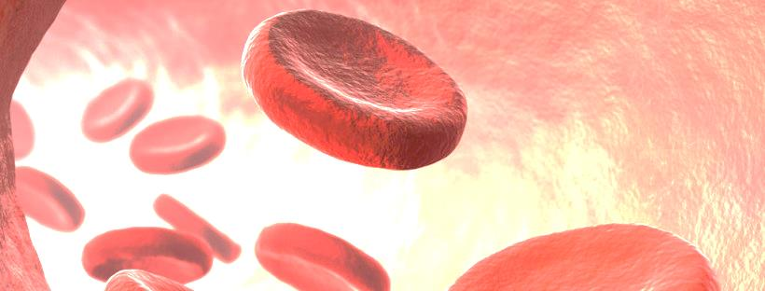
Digest Tract
Intestinal Wall
Blood Stream
(a) Normal conditions
Tyramine
in food
MAO
Oxidation
Products
(b) With antidepressant
monoamine oxidase
(MAO) inhibitors
Tyramine
in food
Releases
noradrenaline
Raised blood
pressure
Headache
Hypertensive
crisis
Haemorrhage
Heart failure
The mechanism of detoxication and inhibition of monoamine oxidase against the tyramine in food

Slide 5
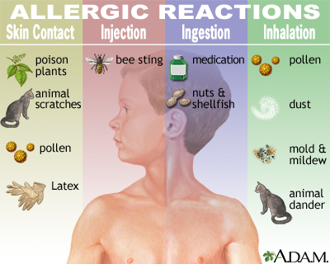
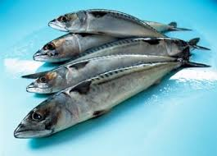
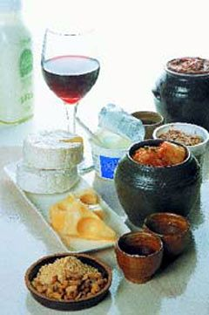
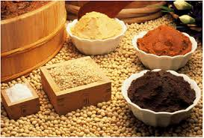
Allergic reaction
IgE
+
mastcell
mastcell
degranulation
release mediators
(e. g. histamine)
indirect
direct
vegetative
nervous
system
lungs
skin
intestine
Non allergic reaction
Food intolerance
Biogenic amines
e. g. histamine

Slide 6
Biogenic amines in foods and their physiological and toxicological effects
Biogenic amines | Precursor | Physiological effects | Toxicological effects
Histamine | Histidine | Neurotransmitter, local hormone, gastric acid secretion, cell growth and differentiation, regulation of circadian rhythm, body temperature, food intake, learning and memory, immune response, allergic reactions | Headaches, sweating, burning nasal secretion, facial flushing, right red rashes, dizziness, itching rashes, oedema (eyelids), urticaria, difficulty in swallowing, diarrhea, respiratory distress, bronchospasm, increased cardiac output, tachycardia, extrasystoles, blood pressure disorders
Tyramine | Tyrosine | Neurotransmitter, peripheral vasoconstriction, increase cardiac output, increase respiration, elevate blood glucose, release of norepinephrine | Headaches, migraine, neurological disorders, nausea, vomiting, respiratory disorders, hypertension
Putrescine and Cadaverine | Ornithine and lysine | Regulation of gene expression, maturation of intestine, cell growth and differentiation | Increased cardiac output, tachycardia, hypotension, carcinogenic effects
Alvarez et al., 2014. The problem of biogenic amines in fermented foods and the use of potential biogenic amine-degrading microorganisms as a solution. Food science and technology. 39, 146-155.
(Ladero, Calles-Enriquez et al., 2010; Ladero, Fernandez et al., 2010; Ladero, Martienz et al., 2010)

Slide 7
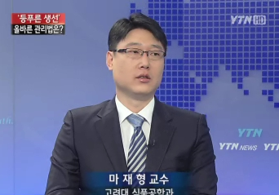
Tolerance levels of histamine in foods
▷ The regulation for canned albacore, skipjack, yellowfin tuna, mahimahi (FDA, 1982)
  • 20 mg% : “decomposed” as an indication of prior mishandling
  • 50 mg% : “danger to health” as an indication of a potential health hazard
▷ The guideline for histamine content of fish (Shalaby, 1996)
  • < 5 mg% : safe for consumption
  • 5~20 mg% : possibly toxic
  • 20~100 mg% : probably toxic
  • > 100 mg% : toxic and unsafe for consumption
▷ The regulation for maximum allowable levels (EU, 1991)
  • fresh fish (n=9; c=2; m=100 ppm; M=200 ppm)
  • enzymatically ripened fish products (n=9; c=2; m=200 ppm; M=400 ppm)
▷ The permissible limit of wine : 10 mg/L (Switzerland)

Slide 8
Studies on the tolerance levels of biogenic amines in foods
Food | Maximum amounts (mg/kg) |  |  |  |  |  | Ref
 | His | Cad | Put | Tyr | β-Phe | Total
General | - | - | - | - | - | 40ª | Ayres et al., 1980
 | 100 | - | - | 100-800 | 30 | - | Brink et al., 1990
 | - | - | - | - | 3 | - | Sandler et al., 1974
 | - | - | - | 6 | - | - | Blackwell, 1965
Fish | - | - | - | - | - | 300^{b} | Spanjer and Van Roode, 1991
Canned tuna | - | 0.5 | - | - | - | - | Sims et al., 1992
Cheese | - | - | - | - | - | 900^{c} | Spanjer and Van Roode, 1991
Sauerkraut | 10 | 25 | 50 | 20 | 5 | - | Kuensh et al., 1989
ª As total BA per meal
^{b} Sum of his + cad + put
^{c} Sum of his + cad + put + tyr

Slide 9
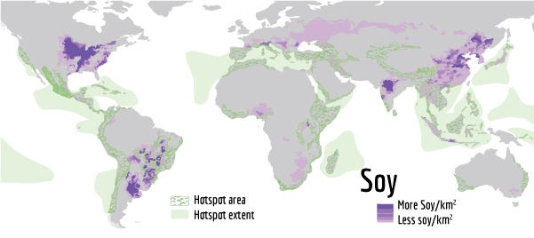
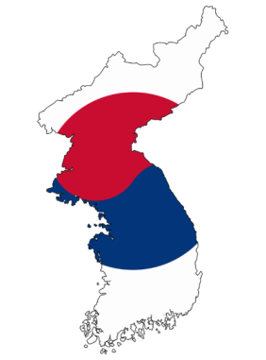
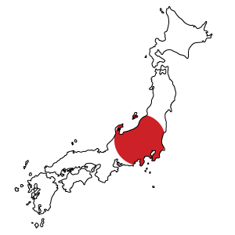
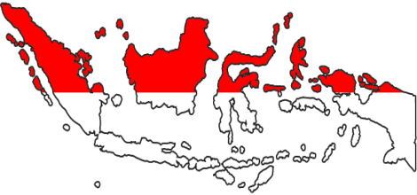

Soy production Area
Fermented soybeans?

Slide 10
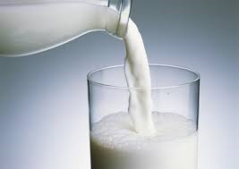
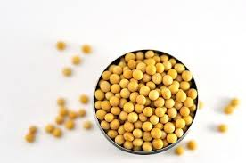
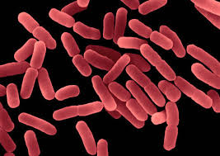
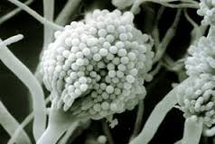
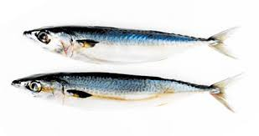
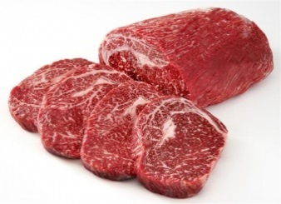
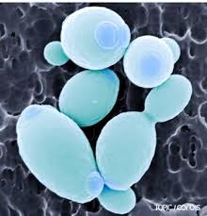
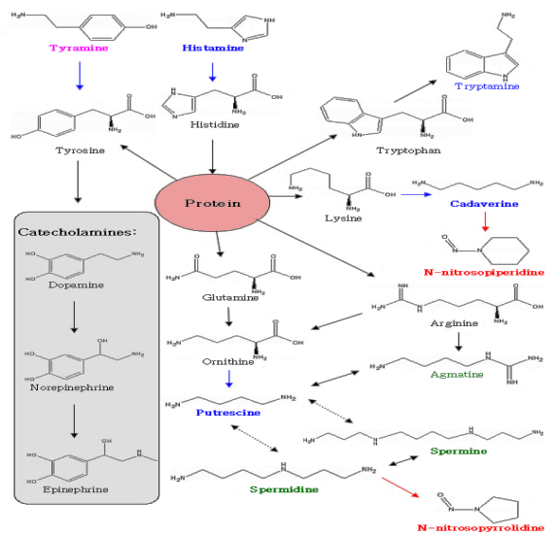


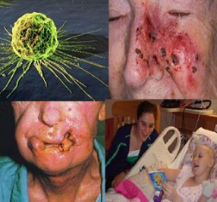
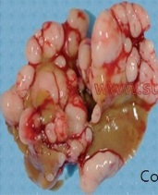
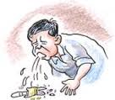

High protein foods
Fermented foods
Biogenic amines
Microorganisms
Toxicological
effects
Carcinogen precursors

Slide 11
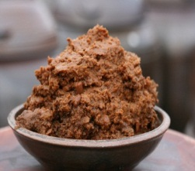
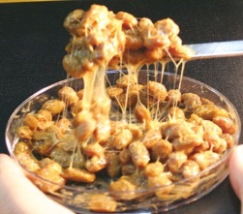
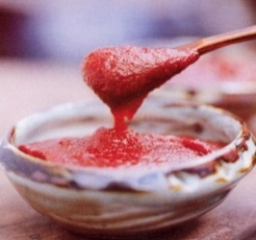
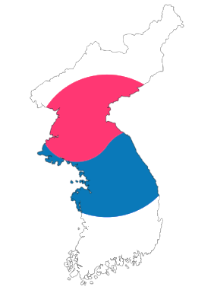
Doenjang, Cheonggukjang, Gochujang
Korean traditional fermented soybean pastes
Doenjang is a traditional soybean paste, produced from meju through the fermentation of soybeans by naturally occurring bacteria and fungi and has been consumed for centuries as a rich protein source and flavoring ingredient in Korea
Cheonggukjang is made through fermentation of boiled soybeans by adding Bacillus subtilis, which is usually in the air or in jip (dried rice plants), at 40°C–42°C for 1–3 days without adding salt
Gochujang is produced by mixing meju powder with glutinous rice powder and red pepper powder, and then the mixture is fermented by using mainly Aspergillus oryzae and Bacillus subtilis

Slide 12
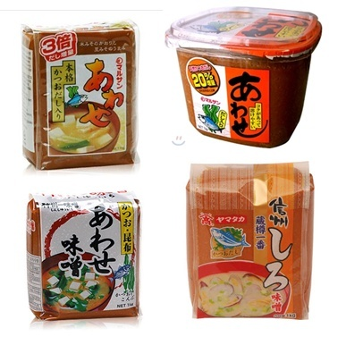
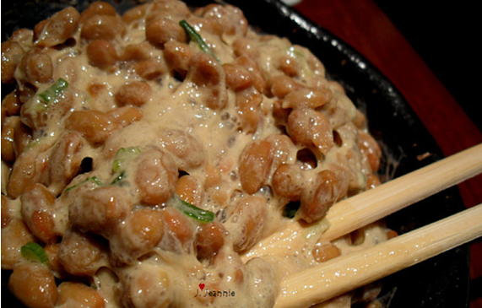
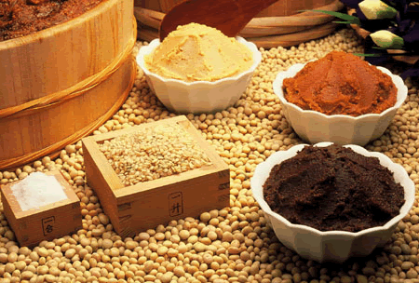
Natto
Miso
Japanese fermented soybean product made from boiled soybeans fermented for 15–24 h with B. subtilis var. natto (previously called B. natto) that produces a strong flavor and sticky texture (Ohta, 1986)
The product is generally served as it is with mustard and/or soy sauce and often used as a topping for cooked rice
Japanese fermented soybean paste made from soybeans and salt (and sometimes cereal grains) through a two-step fermentation with molds, yeasts and bacteria (Fukushima, 1981; Wang & Hesseltine, 1979)

Slide 13
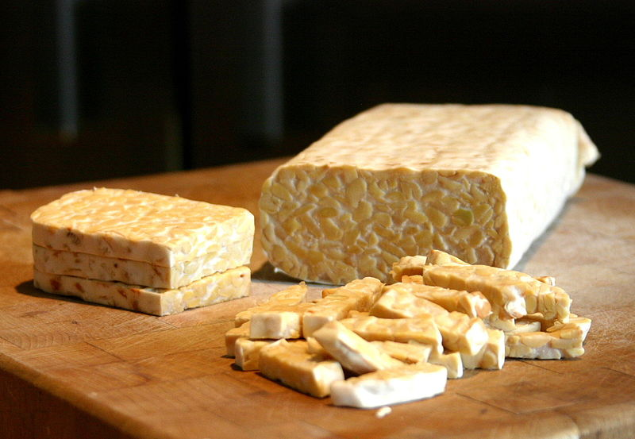
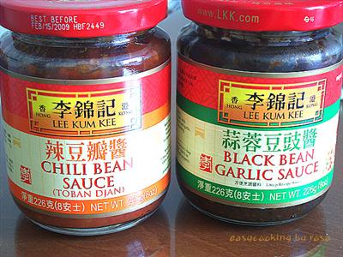
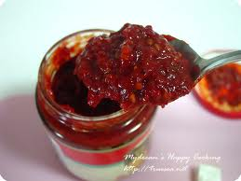

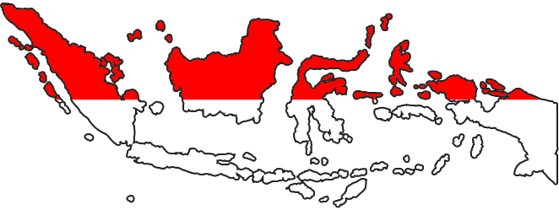
Doubanjiang
Tempeh
Chinese traditional fermented soybean product produced through the fermentation of soybeans, broad beans, chili peppers, salt and spices by naturally occurring bacteria (Yamaura, 2004, Whitaker, 1978)
Indonesian traditional soybean product made by a natural culturing and controlled fermented process that binds soybeans into a cake from, similar to a very firm vegetarian burger patty

Slide 14
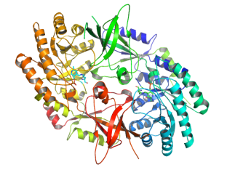
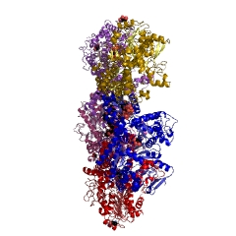
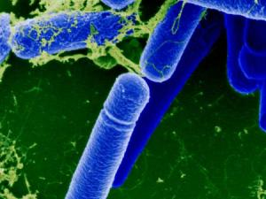
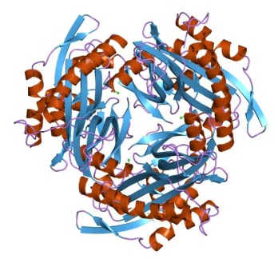
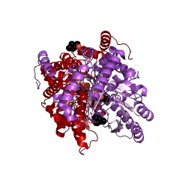
Putrescine
Ornithine decarboxylase
Cadaverine
Lysine decarboxylase
Bacillus subtilis
Histamine
Histidine decarboxylase
Tyramine
Tyrosine decarboxylase

Slide 15


Contents
1.
Levels of biogenic amines in fermented soybean foods
2.
Biocontrol technology for reduction of biogenic amines in foods
3
Molecular studies on biogenic amine producers in fermented soybean foods

Slide 16
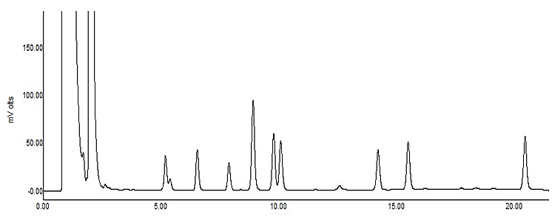
Levels of biogenic amines in fermented soybean foods

Slide 17
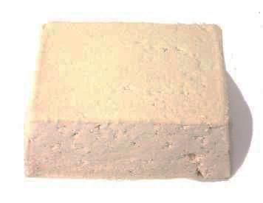
Table 1. The contents of biogenic amines in Tofu samples.
Tofu | Biogenic amines (mg/kg)
 | Trp¹⁾ | Phe | Put | Cad | His | Tyr | Spd | Spm
1 | 2.96±0.46³⁾ | 1.55±2.19 | 3.68±0.36 | 0.52±0.73 | 4.91±0.46 | ND | 28.37±0.88 | 9.90±0.05
2 | 1.06±1.49 | ND²⁾ | 1.90±0.53 | 1.71±0.31 | 4.06±0.86 | ND | 23.49±1.49 | 7.87±0.56
3 | 1.88±0.12 | ND | 4.73±1.05 | 1.07±0.31 | 4.80±0.37 | ND | 28.09±0.47 | 7.19±0.38
4 | 6.10±0.43 | ND | 1.27±1.80 | 0.93±1.32 | 3.98±1.32 | ND | 19.43±0.66 | 4.75±0.42
5 | 5.48±2.23 | 1.89±2.67 | 1.14±1.61 | 1.25±1.77 | 4.38±0.69 | ND | 18.69±1.01 | 5.94±0.73
6 | 3.31±0.30 | 3.60±0.12 | 2.20±0.48 | 1.62±0.49 | 4.76±0.12 | ND | 19.94±0.78 | 4.67±0.15
7 | 8.10±1.03 | 2.91±0.10 | 0.99±1.40 | ND | 4.01±0.05 | ND | 18.89±0.71 | 4.08±0.40
8 | 9.46±2.93 | 5.36±0.25 | 1.64±0.44 | 0.80±1.13 | 4.15±0.32 | ND | 17.41±0.53 | 4.05±0.77
9 | 4.37±0.76 | 3.61±0.22 | 1.35±0.94 | 1.38±0.55 | 4.11±0.06 | ND | 19.70±0.07 | 4.78±0.14
10 | 7.35±0.12 | 4.65±0.56 | 1.69±0.70 | 2.12±0.08 | 4.59±0.19 | ND | 21.08±0.73 | 6.36±0.27
11 | 3.53±0.89 | 0.71±1.00 | 3.08±0.73 | 1.12±1.58 | 3.52±0.05 | ND | 29.11±1.12 | 5.95±0.88
12 | 4.45±1.18 | 1.75±2.48 | 4.03±0.32 | 2.21±0.28 | 4.41±0.67 | ND | 26.08±0.83 | 5.29±0.59
13 | 8.95±3.78 | 4.58±0.46 | 2.53±0.96 | 2.45±0.34 | 4.89±0.57 | ND | 27.58±1.31 | 9.09±0.10
14 | 6.22±1.99 | 4.49±1.21 | 4.65±0.01 | 3.35±0.03 | 4.81±0.22 | ND | 32.96±1.16 | 8.37±0.49
15 | 6.19±2.87 | 4.06±1.47 | 5.01±0.75 | 2.82±0.08 | 4.55±0.01 | ND | 22.37±1.42 | 17.04±0.94
16 | 7.51±1.24 | 4.76±0.01 | 2.80±0.44 | 2.19±0.21 | 4.67±0.09 | ND | 18.06±0.26 | 5.82±0.11
17 | 2.59±1.42 | 1.53±2.17 | 3.71±0.07 | 2.62±0.25 | 5.76±0.32 | ND | 35.30±3.64 | 19.15±3.44
18 | 3.80±0.72 | ND | 2.28±0.17 | 0.52±0.73 | 4.80±1.55 | ND | 26.34±0.38 | 8.48±0.01
19 | 2.76±0.47 | ND | 0.00 | 0.75±1.06 | 5.15±0.35 | ND | 14.97±1.20 | 4.83±0.75
Average | 5.06±2.46 | 2.39±1.95 | 2.56±1.43 | 1.55±0.90 | 4.54±0.51 | 0.00 | 23.57±5.63 | 7.56±4.11
¹⁾ Trp: Tryptamine, Phe: β-phenylethylamine, Put: Putrescine, Cad: Cadaverine, His: Histamine, Tyr: Tyramine, Spd: Spermidine, Spm: Spermine.
²⁾ ND: Not detected (amine level is less than 0.1 mg/kg).
³⁾ Mean ± standard deviation.

Slide 18
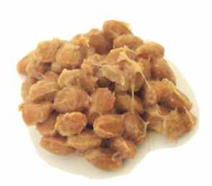
Table 2. The contents of biogenic amines in Natto samples.
Source | Natto | Biogenic amines (mg/kg)
 |  | Typ¹⁾ | Phe | Put | Cad | His | Tyr | Spd | Spm
Japanese | 1 | 14.20 ± 20.10³⁾ | 21.40 ±30.30 | ND | ND | ND | ND | 297.70 ± 34.90 | 20.50 ± 29.00
 | 2 | 36.70 ± 1.50 | ND | 18.10 ± 1.70 | 33.50 ± 0.70 | ND | ND | 398.50 ± 29.10 | 52.20 ± 4.50
 | 3 | 30.00 ± 1.40 | ND | 12.20 ± 0.50 | 19.50 ± 9.90 | ND | ND | 344.50 ± 4.30 | 31.90 ± 8.20
 | 4 | 33.50 ± 1.00 | 13.60 ± 19.30 | ND | 9.50 ± 13.40 | ND | ND | 313.40 ± 20.20 | 55.40 ± 12.20
 | 5 | 38.20 ± 5.80 | 48.10 ± 13.40 | ND | 1.10 ± 1.50 | ND | ND | 411.30 ± 104.20 | 54.80 ± 12.50
 | 6 | 30.30 ± 18.00 | 36.70 ± 0.70 | ND | 18.50 ± 1.70 | ND | ND | 309.30 ± 4.20 | 33.70 ± 2.10
 | 7 | 12.70 ± 7.20 | 13.20 ± 18.60 | ND | 10.90 ± 15.40 | ND | ND | 321.00 ± 32.50 | 18.80 ± 26.50
 | 8 | 5.10 ± 7.20 | ND | 15.00 ± 6.00 | 28.40 ± 14.00 | ND | ND | 410.20 ± 144.20 | 49.90 ± 0.30
 | 9 | ND²⁾ | ND | 43.10 ± 0.40 | 12.80 ± 0.10 | ND | ND | 473.40 ± 7.50 | 61.40 ± 5.90
 | 10 | 11.60 ± 16.40 | 11.10 ± 15.80 | 27.70 ± 1.40 | ND | ND | ND | 333.40 ± 21.50 | 63.20 ± 7.00
 | 11 | 24.70 ± 6.90 | 40.80 ± 3.70 | 12.60 ± 6.00 | 36.80 ± 19.70 | ND | 300.20 ± 8.80 | 478.10 ± 194.20 | 61.20 ± 16.90
 | 12 | ND | 38.00 ± 5.60 | ND | 5.10 ± 7.20 | ND | ND | 270.00 ± 22.10 | 43.60 ± 9.40
 | 13 | 37.30 ± 0.50 | 18.40 ± 26.10 | ND | 19.00 ± 8340 | ND | ND | 370.90 ± 0.60 | 50.00 ± 6.20
 | 14 | ND | 29.10 ± 6.20 | 17.80 ± 1.60 | ND | ND | ND | 292.00 ± 12.10 | 35.90 ± 4.50
 | 15 | 31.30 ± 5.00 | 44.60 ± 13.50 | 14.70 ± 3.40 | 20.80 ± 6.50 | 6.10 ± 1.40 | 155.20 ± 219.40 | 410.30 ± 97.60 | 66.50 ± 11.70
 | 16 | 40.70 ± 0.80 | 42.10 ± 5.60 | ND | ND | ND | ND | 321.90 ± 2.90 | 28.90 ± 12.90
 | 17 | 11.10 ± 15.70 | 50.30 ± 1.50 | ND | ND | ND | ND | 305.60 ± 11.30 | 34.50 ± 7.70
Korean | 18 | 45.80 ± 5.00 | 20.80 ± 29.40 | ND | ND | 12.30 ± 17.40 | ND | 246.50 ± 15.50 | 27.10 ± 6.40
 | 19 | ND | ND | ND | ND | ND | 290.50 ± 6.20 | 281.30 ± 27.50 | 39.10 ± 4.50
 | 20 | ND | 51.50 ± 1.10 | ND | ND | 34.40 ± 0.40 | 243.00 ± 82.40 | 265.00 ± 5.20 | 80.10 ± 6.50
 | 21 | ND | ND | 6.40 ± 9.10 | ND | 1.80 ± 2.50 | ND | 279.50 ±10.30 | 46.40 ± 5.10
Average |  | 19.20 ± 16.41 | 22.84 ± 19.12 | 7.98 ± 11.66 | 10.28 ± 12.21 | 2.60 ± 7.85 | 47.09 ± 102.73 | 339.70 ± 67.17 | 45.48 ± 16.21
¹⁾ Trp: tryptamine, Phe: β-phenylethylamine, Put: putrescine, Cad: cadaverine, His: histamine, Tyr: tyramine, Spd: spermidine, Spm: spermine.
²⁾ ND: Not detected (amine level is less than 0.1 mg/kg).
³⁾ Mean ± standard deviation.

Slide 19
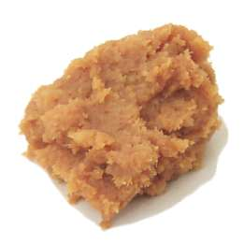
Table 3. The contents of biogenic amines in Miso samples.
Miso samples | Biogenic amines (mg/kg)
 | Trp¹⁾ | Phe | Put | Cad | His | Tyr | Spd | Spm
1 | 5.99 ± 0.84³⁾ | 5.89 ± 1.03 | 5.31 ± 0.35 | 0.14 ± 0.20 | ND | ND | ND | ND
2 | 1.87 ± 2.64 | 4.83 ± 6.83 | 4.35 ± 1.00 | ND | 24.42 ± 2.84 | 66.66 ± 4.88 | ND | 1.26 ± 0.15
3 | 3.59 ± 0.90 | 7.43 ± 0.73 | 4.55 ± 0.38 | ND | 3.07 ± 0.57 | 4.91 ± 0.44 | ND | 1.21 ± 0.10
4 | 2.84 ± 4.02 | 2.38 ± 3.37 | 2.69 ± 0.80 | ND | 3.18 ± 0.67 | 4.37 ± 0.12 | ND | 1.31 ± 0.03
5 | 3.56 ± 0.28 | 9.13 ± 1.93 | 8.74 ± 1.12 | 0.12 ± 0.17 | ND | ND | 11.98 ± 0.02 | 0.77 ± 1.08
6 | 1.73 ± 2.44 | 8.00 ± 0.23 | 6.96 ± 0.12 | 0.90 ± 0.04 | ND | ND | 9.88 ± 0.59 | ND
7 | 9.71 ± 0.15 | 4.78 ± 0.95 | 5.72 ± 0.04 | ND | ND | ND | 9.12 ± 0.38 | ND
8 | ND²⁾ | 5.86 ± 1.70 | 6.97 ± 0.12 | 1.31 ± 0.00 | ND | ND | 4.48 ± 2.41 | 0.65 ± 0.92
9 | 1.92 ± 2.71 | 4.64 ± 6.56 | 9.89 ± 1.58 | 0.69 ± 0.67 | 0.69 ± 0.98 | ND | ND | 1.84 ± 0.36
10 | ND | 4.46 ± 6.31 | 4.74 ± 5.88 | 0.48 ± 0.67 | 0.77 ± 1.08 | ND | 11.66 ± 3.07 | 0.18 ± 0.25
11 | 6.41 ± 0.09 | 7.34 ± 0.14 | 8.29 ± 0.43 | 0.85 ± 0.14 | 0.81 ± 1.15 | ND | 1.49 ± 2.10 | 1.07 ± 0.64
12 | 2.91 ± 4.12 | 4.06 ± 5.75 | 3.61 ± 4.23 | 0.34 ± 0.49 | ND | ND | 13.19 ± 4.34 | 2.79 ± 0.32
13 | 2.69 ± 0.23 | 5.94 ± 0.82 | 10.34 ± 0.71 | 0.20 ± 0.02 | ND | ND | 28.31 ± 3.08 | 2.85 ± 0.22
14 | 1.96 ± 0.26 | 4.76 ± 0.33 | 10.50 ± 0.34 | 0.20 ± 0.01 | ND | ND | 27.84 ± 2.08 | 0.80 ± 0.19
15 | 2.03 ± 0.00 | 5.85 ± 0.00 | 2.83 ± 0.00 | ND | ND | ND | ND | 1.05 ± 0.00
16 | 2.66 ± 0.94 | 5.09 ± 0.71 | 14.09 ± 3.79 | 0.17 ± 0.23 | ND | ND | ND | 1.84 ± 0.44
17 | 5.61 ± 1.39 | 8.92 ± 0.55 | 12.82 ± 1.71 | ND | 12.63 ± 2.01 | 20.53 ± 3.97 | ND | 1.35 ± 0.21
18 | 5.00 ± 0.59 | 5.94 ± 0.43 | 6.76 ± 3.00 | ND | 1.82 ± 0.24 | 5.79 ± 0.80 | 6.47 ± 1.37 | ND
19 | 4.79 ± 3.54 | 5.13 ± 0.55 | 11.89 ± 0.50 | ND | 0.68 ± 0.08 | ND | ND | 0.71 ± 0.02
20 | 3.19 ± 0.05 | 3.91 ± 1.97 | 4.85 ± 0.08 | ND | 0.26 ± 0.11 | ND | ND | 1.11 ± 0.52
21 | 2.90 ± 0.02 | 6.35 ± 0.17 | 4.39 ± 0.37 | ND | 0.85 ± 0.09 | ND | 2.59 ± 3.67 | 1.86 ± 0.01
22 | 3.52 ± 0.02 | 11.76 ± 0.09 | 11.52 ± 0.27 | ND | 9.67 ± 0.24 | 14.89 ± 0.29 | 15.81 ± 0.29 | 1.86 ± 0.01
Average | 3.40 ± 2.20 | 6.02 ± 2.08 | 7.36 ± 3.41 | 0.25 ± 0.37 | 2.67 ± 5.85 | 5.33 ± 14.70 | 6.49 ± 8.74 | 1.11 ± 0.83
¹⁾ Trp: Tryptamine, Phe: β-phenylethylamine, Put: Putrescine, Cad: Cadaverine, His: Histamine, Tyr: Tyramine, Spd: Spermidine, Spm: Spermine.
²⁾ ND: Not detected (amine level is less than 0.1 mg/kg).
³⁾ Mean ± standard deviation.

Slide 20
Table 4. The contents of biogenic amines in Doenjang and Gochujang samples.
Samples |  | Biogenic amines (mg/kg)
 |  | Trp¹⁾ | Phe | Put | Cad | His | Tyr | Spd | Spm | Ref
Doenjang | 1 | 16.6±4.2 | 30.8±9.9 | 54.4±2.2 | 10.9±1.3 | 82.2±3.6 | 90.8±11.1 | 15.6±1.3 | NT | Kim et al., 2011
 | 2 | 13.5±1.9 | 23.7±2.2 | 69.3±7.1 | 12.9±1.8 | 133.5±11.3 | 46.4±8.2 | 23.6±3.9 | NT
 | 3 | 45.9±5.1 | 65.0±6.9 | 168.2±11.0 | 10.9±1.0 | 382.4±8.0 | 1,190.7±12.4 | ND | NT
 | 4 | 21.2±1.1 | 18.5±2.4 | 47.0±3.1 | ND | 149.8±4.6 | 102.9±8.3 | 21.1±3.2 | NT
 | 5 | 19.2±0.6 | 8.6±0.5 | 150.3±3.5 | ND | 201.1±1.3 | 120.9±5.7 | 20.6±1.5 | NT
 | 6 | 15.6±0.9 | 3.3±0.4 | 46.7±1.5 | 5.4±0.7 | 241.8±7.9 | 82.9±3.9 | 24.7±2.3 | NT
 | 7 | 17.2±1.8 | 4.0±0.1 | 54.4±2.8 | 5.2±3.0 | 71.1±0.8 | 192.3±2.6 | 22.0±1.5 | NT
Gochujang | 1 | 8.1±2.0 | 9.3±2.2 | 36.4±1.0 | 14.1±2.1 | 59.0±4.0 | 116.5±4.2 | ND | NT
 | 2 | ND | 9.8±2.9 | 23.5±1.2 | 18.1±4.0 | 17.8±1.5 | 23.4±1.9 | ND | NT
 | 3 | ND | 4.5±0.6 | 20.5±2.1 | ND | 13.8±1.6 | 13.4±3.1 | 14.5±2.9 | NT
 | 4 | ND | 24.8±0.2 | 13.5±2.1 | 5.5±1.3 | 2.2±0.7 | 2.9±1.0 | 1.5±0.4 | NT
 | 5 | ND | 1.5±0.3 | 10.4±2.8 | 2.1±0.3 | 3.3±0.3 | 60.2±8.8 | 11.7±1.2 | NT
 | 6 | ND | 3.8±0.1 | 15.0±0.6 | 0.5±0.1 | 5.4±0.2 | 126.8±14.3 | 3.3±0.2 | NT
 | 7 | ND | 1.8±0.2 | 16.8±0.1 | 2.8±0.0 | 5.4±0.3 | 3.8±0.4 | 6.9±0.9 | NT
¹⁾ Trp: Tryptamine, Phe: β-phenylethylamine, Put: Putrescine, Cad: Cadaverine, His: Histamine, Tyr: Tyramine, Spd: Spermidine, Spm: Spermine

Slide 21
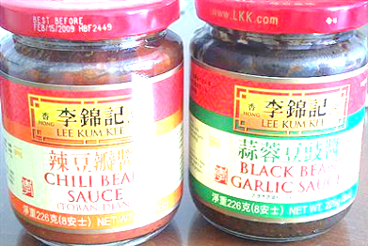
Table 5. The contents of biogenic amines in Doubanjiang samples.
Doubanjiang | Biogenic amines (mg/kg)
 | Trp¹⁾ | Phe | Put | Cad | His | Tyr | Spd | Spm
A | 1.71±0.33³⁾ | 4.62±0.73 | 2.08±0.67 | 0.17±0.24 | ND | 1.17±0.27 | ND | 1.69±0.06
B | 3.39±0.65 | 4.05±0.37 | 4.95±0.44 | 0.12±0.17 | ND | 25.75±2.53 | ND | 0.43±0.18
C | 3.06±0.23 | 12.39±8.00 | 81.34±0.88 | ND | ND | 2.61±0.07 | ND | 1.53±0.30
D | 2.28±0.18 | 1.43±0.27 | 1.15±0.19 | ND | ND | 7.83±1.10 | ND | ND
E | 62.43±9.81 | 185.61±0.70 | 129.17±18.70 | ND | ND | 2.14±0.22 | 0.18±0.26 | 0.42±0.03
F | 3.01±0.49 | 4.13±1.82 | 1.87±0.35 | ND | ND | 5.61±0.93 | ND | 0.67±0.25
G | ND²⁾ | 6.65±0.22 | 1.42±0.01 | ND | ND | ND | 0.09±0.13 | 0.47±0.51
Average | 10.84±22.78 | 31.27±68.14 | 31.71±52.12 | 0.04±0.07 | ND | 6.44±8.92 | 0.04±0.07 | 0.74±0.63
¹⁾ Trp: tryptamine, Phe: β-phenylethylamine, Put: putrescine, Cad: cadaverine, His: histamine, Tyr: tyramine, Spd: spermidine, Spm: spermine.
²⁾ ND: Not detected (amine level is less than 0.1 mg/kg).
³⁾ Mean ± standard deviation.
6 times higher than toxic dose of this amine (30 mg/kg)

Slide 22
Fig. 1. The contents of biogenic amines in Tempeh samples.
Trp: tryptamine, Phe: β-phenylethylamine, Put: putrescine, Cad: cadaverine, His: histamine, Tyr: tyramine, Spd: spermidine, Spm: spermine.

Slide 23
Fig. 2. Guideline suggested versus experimental data of biogenic amine contents in different fermented soybean foods.
Red line indicates Brink’s guideline (1994) of each biogenic amine. Upper and lower lines of each bar indicate minimum and maximum content of each biogenic amine in the food indicated, respectively.

Slide 24
Table 6. Detection frequency of fermented soybean products containing excess amounts of biogenic amines from retail markets in Korea.
Samples | His > 100 mg/kg | Tyr > 100 mg/kg | Phe > 30 mg/kg | Ref
Tofu | 0¹⁾/19²⁾ | 0/19 | 0/19 | Byun et al., 2013
Doenjang | 5/7 | 4/7 | 2/7 | Kim et al., 2011
Gochujang | 0/7 | 2/7 | 0/7 | Kim et al., 2011
Natto | 0/21 | 4/21 | 7/21 | Kim et al., 2012
Miso | 0/22 | 0/22 | 0/22 | Byun et al., 2012
Doubanjiang | 0/7 | 0/7 | 1/7 | Byun et al., 2013
¹⁾ Number of products containing hazardous levels of biogenic amines.
²⁾ Total number of fermented soy bean products analyzed.

Slide 25
Table 7. The contents of biogenic amines in fermentation foods of Asia.
Raw material | Samples | N¹⁾ | Biogenic amine content (mg/kg) |  |  |  |  |  |  |  | ref.
 |  |  | Trp²⁾ | Phe | Put | Cad | His | Tyr | Spd | Spm
Fermented soybean foods | Gochujang | 5 | 17.9-36.6 | 0.7-9.1 | 2.5-3.2 | ND-1.1 | 0.6-1.3 | 2.1-4.9 | 1.6-3.4 | 1.4-1.8 | Cho et al., 2006
 |  | 7 | ND-8.1 | 1.5-24.8 | 10.4-36.4 | ND-18.1 | 2.2-59.0 | 2.9-126.8 | ND-14.5 | NT | Kim et al., 2011
 | Doenjang | 7 | 13.5-45.9 | 3.3-65.0 | 47.0-168.8 | ND-12.9 | 71.1-382.4 | 46.4-1190.7 | ND-24.7 | NT | Kim et al., 2011
 |  | 14 | 6.1-234.1 | ND-529.2 | 9.9-1453.7 | 0.3-65.4 | 1.5-952.0 | 3.4-1430.7 | 4.2-23.4 | ND-10.2 | Cho et al., 2006
 |  | 10 | ND-449.8 | ND-544.0 | 28.8-1076.6 | 2.7-144.1 | 1.4-329.2 | 12.5-967.6 | ND-30.3 | ND-9.8 | Lee et al., 2009
 |  | 23 | ND-2808.1 | ND-8704.6 | ND-4292.3 | ND-3235.5 | ND-2794.8 | ND-6616.1 | ND-8804.0 | ND-9729.5 | Fd Chem Tx, 2010
 | Chungkukjang | 102 | NT | NT | NT | NT | ND-755.40 | ND-1913.51 | NT | NT | Ko et al., 2012
 |  | 10 | 6.7-76.9 | ND-32.6 | 4.7-148.5 | 4.6-70.6 | 0.2-70.3 | 4.2-483.1 | 39.6-67.7 | 7.2-23.1 | Han et al., 2007
 |  | 7 | 6.7-236.4 | ND-40.8 | 4.7-121.3 | 2.1-20.2 | 1.3-54.3 | 0.7-483.1 | 39.6-59.2 | 7.1-14.7 | Cho et al., 2006
 | Natto | 39 | ND-301.0 | ND | ND-27.0 | ND-42.0 | ND-457.0 | ND-45.0 | ND-124.0 | ND-71.0 | Tsai et al., 2007
 |  | 21 | ND-45.80 | ND-51.50 | ND-43.10 | ND-36.80 | ND-34.40 | ND-300.20 | 246.50-478.10 | 18.80-80.10 | Kim et al., 2012
 | Miso | 40 | ND-762 | ND | ND-12 | ND-201 | ND-221 | ND-49 | ND | ND-216 | Kung et al., 2007
 |  | 8 | ND-1.3 | ND-42.0 | ND-12.9 | ND-8.7 | ND | ND-41.9 | ND-35.7 | ND | Shukla et al., 2011
 |  | 22 | ND-9.71 | 2.38-11.76 | 2.69-14.09 | ND-1.31 | ND-24.42 | ND-66.66 | ND-28.31 | ND-2.85 | Byun et al., 2012
 |  | 5 | 21.6-23.7 | 0.7-8.1 | 16.4-23.2 | 2.8-3.2 | 0.8-1.1 | 2.0-95.3 | 9.5-21.9 | 1.3-3.1 | Cho et al., 2006
 | Chunjang | 4 | 19.57-28.67 | ND-6.79 | 3.26-28.59 | ND-2.04 | 1.85-272.55 | 19.78-131.27 | 0.24-11.63 | ND-1.49 | Bai et al., 2013
 |  | 4 | 13.3-19.9 | 2.2-11.8 | 9.2-11.7 | 1.7-6.6 | 11.6-22.4 | 29.7-54.6 | 1.4-12.8 | ND-2.9 | Cho et al., 2006
 | Sufu | 22 | ND-81 | ND | ND-45 | ND-371 | ND-158 | ND-65 | ND | ND-82 | Kung et al., 2007
 |  | 38 | ND-104.1 | ND-36.3 | 0.5-316.9 | 0.6-85.8 | ND-196.9 | ND-446.6 | ND-4.0 | ND-6.9 | Guan et al., 2013
 | Soy sauce | 23 | NT | ND-190 | ND-775 | ND-170 | 0.2-126 | ND-5250 | NT | NT | Stute et al., 2002
 |  | 40 | NT | NT | NT | ND-550 | ND-592 | ND-673 | ND-486 | ND-145 | Yongmei et al., 2009
 | Douchi | 26 | ND-440 | ND-239 | ND-596 | ND-191 | ND-808 | ND-529 | ND-719 | ND-242 | Tsai et al., 2007
 | Doubanjiang | 7 | ND-62.4 | 1.43-185.61 | 1.15-129.17 | ND-0.17 | ND | ND-25.75 | ND-0.18 | ND-1.69 | Byun et al., 2013
 | Tofu | 19 | 1.06-9.46 | ND-5.36 | ND-4.73 | ND-3.35 | 3.52-5.76 | ND | 14.97-35.30 | 4.05-19.15 | Byun et al., 2013
 | Tempeh | 2 | ND-<5 | NT | 475-3200 | <5-225 | <5-100 | 500-575 | NT | NT | Nout et al., 1993
¹⁾ Number of samples examined. ²⁾ Trp, tryptamine; Phe, β-phenylethylamine; Put, Putrescine; Cad, cadaverine; His, histamine; Tyr, tyramine; Spd, spermidine; Spm, spermine. ³⁾ The range from minimun-maximum. ⁴⁾ ND: Not detected (amine level is less than 0.1 mg/kg, NT: Not tested.

Slide 26
Problematic BAs |  | Phe, Tyr, Polyamines | His, Tyr | Phe
Factors | Physicochemical contribution | X | X | O (salt conc)
 | Microbial contribution (TPC) | X | X | △
 | Ratio of ingredient in raw materials | - | O | -
 | Bacterial activity | O | O | O (period)
Natto
Miso
Doubanjiang

Slide 27
Biocontrol technology for reduction of
biogenic amines in foods

Slide 28
Table 8. Microorganisms producing biogenic amines in fermented soybean food.
Biogenic amines | Bacteria | Reference
Decarboxylase activity (common foods) | Bacillus, Citrobacter, Clostridium, Klebsiella, Escherichia, Proteus, Pseudomonas, Salmonella, Shigella, Photobacterium, Lactobacillus, Pediococcus and Streptococcus | Rice et al., 1976; Brink et al., 1990; Huis in’t Veld et al., 1990
Amine-producing LAB | Lactobacillus brevis, Lactobacillus buchneri, Lactobacillus bulgaricus, Lactobacillus curuatus, Lactobacillus carnis, Lactobacillus dicergens and Lactobacillus hilgardii | Maijala et al., 1993
Tyrosine decarboxylase (from Miso) | Enterococcus faecium, Lactobacillus bulgaricus | Ibe et al., 1992
Histidine decarboxylase (from Miso) | Lactobacillus species and Lactobacillus sanfrancisco | Ibe et al., 1992
Histamine producers (from Natto) | Lactobacillus species | Tsai et al., 2007
Histamine and tyramine producing bacteria from traditional soybean pastes | Clostridium and Pseudomonas strains | Moon et al., 2010

Slide 29
Table 9. Environmental factors influencing biogenic amine production in fermented foods.
Factors | Range | Reduction in the formation of biogenic amines | Reference
pH | 3.0-6.0 | Optimal for bacteria to produce decarboxylase | Santos, 1996
 | 4.0-5.5 | Amino acid decarboxylase activity | Teodorovi, 1994
 | 3.0-6.0 | Increasing the decarboxylase activity | Kim et al., 2003
Salt content | 0-6% | Reduction of amine production by L. bulgaricus | Chander et al., 1989
 | 0.5-10% | Inhibition of histamine formation by Staphylococcus capitis and S. epidermidis | Hernandez-Herrero et al., 1999
 | 3.5% | Partial inhibition of L. bucheri forming histamine | Maijala et al., 1995
 | 3.5-5.5% | Inhibition of histamine production | Chin and Koehler, 1986
 | 20% | Inhibition of histamine formation and its producer | Hernandez-Herrero et al., 1999
 | 20% | 14% of Cad, 5.84% of His, 49.33% of Tyr, 28.81% of Spd¹⁾ | Mah and Hwang, 2009
Temperature | 4°C | Lowering BA amounts | Bover-Cid et al., 2000
 | 25°C | Carnobacterium divergens produced more tyramine | Masson et al., 1999
 | Higher temperature | Increased amine concentration | Bover-Cid et al., 2000
¹⁾Cad; cadaverine, His; histamine, Tyr; tyramine, Spd, spermidine.

Slide 30
Table 10. Studies on the effect of amine-negative starter cultures on biogenic amine reduction during the manufacture of fermented sausages.
Products | Starter culture | % of reduction | Reference
Fuet | commercial M. carnosus + L. plantarum (Texel, France) | 25% of TI, 61% of CA, 25% of PU¹⁾ | Hernández-Jover et al., 1997
 | commercial M. carnosus + P. pentosaceus (Texel, France) | 34% of TI, 50% of CA, 56% of PU
Fuet | Staphylococcus carnosus LTH2102 | 25% of TY, 23% of CA, 17% of PU | Bover-Cid et al., 1999
 | S. xylosus CTC3037 | 69% of TY, 66% of CA, no effect on PU
 | S. xylosus CTC3050 | 69% of TY, 17% of CA, 28% of PU
Fuet | L. sakei CTC494 + S. carnosus LTH2102 | 90% of TY, 87% of CA, 37% of PU | Bover-Cid et al., 2000
 | L. sakei CTC494 + S. xylosus CTC3037 | 87% of TY, 87% of CA, 37% of PU
 | L. sakei CTC494 + S. xylosus CTC3050 | 90% of TY, 87% of CA, 37% of PU
Fuet | L. sakei CTC494 (high quality raw material) | 87% of TY, 38% of HI, 41% of CA, 67% of PU | Bover-Cid et al., 2001
Fuet | L. sakei CTC6626 + S. xylosus CTC6013 | 19% of TY, 46% of PU | Latorre-Moratalla et al., 2010
 | L. sakei CTC494 + S. xylosus CTC6013 | 45% of TY, 50% of PU
Salchichón | P. acidilactici MS200 + S. vitulus RS34* | 38% of TY, 74% of HI, 77% of CA, no effect on PU | Casquete et al., 2011
 |  | 70% of TY, 82% of HI, 64% of CA, 89% of PU
 | P. acidilactici MS198 + S. vitulus RS34* | 65% of CA, no effect on HI, TY, PU
 |  | 58% of HI, 71% of CA, 72% of PU, no effect on TY
Chorizo | L. sakei K29 | 98% of TY, 100% of CA, 98% of PU | González-Fernández et al., 2003
 | Pediococcus sp. P22 | 92% of TY, 67% of CA, 93% of PU
 | Pediococcus sp. P208 (Rhodia Food, France) | 81% of TY, 100% of CA, 89% of PU
Chorizo | L. sakei CTC6469 + L. sakei CTC6626 + S. xylosus CTC6013 + S. xylosus CTC6169 | 76% of TY, 97% of CA, 90% of PU | Garriga et al., 2005
* Starter was tested in different technological conditions., which appeared the different% of reduction for each technological condition.
¹⁾ TI; tyramine, CA; cadaverine, PU; putrescine, HI; histamine, TY, tryptamine

Slide 31
Products | Starter culture | % of reduction | Reference
Xouriço | L. sakei | 17% of TY, 75% of CA. No effect on PU | Latorre-Moratalla et al., 2010
 | S. equorum | 45% of CA. No effect on TY and PU
 | L. sakei + S. equorum | 15% of TY, 89% of CA. No effect on PU
French fermented | L. sakei + S. succinus + S. equorum | 87% of TY, 35% of CA, 38% of PU | Talon et al., 2008
Greek fermented sausage | L. sakei (+ 0.5% of satureja tymbra extract oil) | 62% of TY, 71% of HI, 100% of PU | Latorre-Moratalla et al., 2010
Greek fermented sausage | L. sakei 4413 | 13% of TY, 72% of PU. No effects on CA | Bakaetal. 2011
 | L. sakei 8426 | 25% of CA. No effect on TY and PU
 | L. plantarum 7423 | 26% of CA. No effect on TY and PU
 | L. curvatus 8427 | 9% of TY, 29% on PU. No effect on CA
Finnish fermented sausage | commercial P. pentosaceus + S. carnosus (Rudolf Müller and Co, Germany)* | 41% of TY, 28% of HI, 86% of CA. No effect on PU | Maijala et al., 1995
 |  | 79% of TY, 62% of HI, 70% of CA. No effect on PU
 |  | 67% of TY, 77% of HI. No effect on PU and CA
Turkish Soudjoucks | commercial L. sakei + P. pentosaceous + S. carnosus + S. xylosus (Bioback-K, Germany) | 100% of PU. No effect on TY | Ayhan et al., 1999
Turkish Sucuk | commercial L. sakei + S. carnosus (CHR-HANSEN, Germany) | 88% of TY, 54% of CA, 63% of PU. No effecton HI | Gençcelep et al., 2007
 | commercial P. acidilactici + L. curvatus + S. xylosus (CHR-HANSEN, Germany) | 86% of TY, 27% of HI, 62% of CA, 60% of PU
Turkish fermented sausage | commercial L. sakei + S. xylosus (CHR-HANSEN, Germany) | 54% of TY, 62% of PU | Gücükoglu and Küplülü. 2010
 | commercial L. plantarum + S. carnosus (CHR-HANSEN, Germany) | 52% of TY, 61% of PU
 | L. curvatus + S. carnosus + S. xylosus (CHR-HANSEN, Germany) | 55% of TY, 63% of PU
Chinese fermented sausage | P. pentosaceus + S. xylosus | 66% of TY, 49% of CA, 30% of PU. No effect on HI | Lu et al., 2010
 | L. farciminis + S. saprophyticus | 83% of TY, 99% of HI, 99% of CA, 66% of PU
Thai fermented sausage | L. plantarum BCC9546 (BIOTEC, Thailand) | 94% of TY, 75% of CA, 97% of PU | Tosukhowong et al., 2011
 | L. plantarum BCC9546 + L. brevis BCC26756 (BIOTEC, Thailand) | 37% of TY, 75% of CA, 99% of PU
Latorre-Moratalla et al., 2012. Control of biogenic amines in fermented sausages: role of starter cultures. Frontiers in Microbiology. 3, 169-178.

Slide 32
Table 11. Studies on biogenic amine degradation by food microorganisms.
Matrix | Bacteria | Reduction in the formation of biogenic amines | Reference
Fermented anchovy | B. coagulans, St. xylosus and Kocuria rhizophila | 3.27-34.31% of His, 0.75-4.36% of Tyr¹⁾ | Mah and Hwang, 2009
In vitro | L. plantarum, L. sakei, L. pentosus, Pediococcus acidilactici, Rhodococcus sp., Arthrobacter sp., Micrococcus sp., Brevibacterium linens, Geotrichum candidum | 0.00-87.12% of His, 0.00-5.20% of Tyr | Leuschner et al., 1998
Munster cheese | B. linens | 55-70% of His and Tyr | Leuschner and Hammes, 1998
Ensiled fish slurry | L. sakei | 98.00-100.00% of His | Dapkevicius et al., 2000
In vitro | B. amyloliquefaciens, St. carnosus | 29.10% and 59.90% of His | Zaman et al., 2010
In vitro | B. subtilis, St. intermedius | 30.40% of Put, 28.90% of Cad | Zaman et al., 2010
Fish sauce fermentation | B. amyloliquefaciens, St. carnosus | 27.70% and 15.40% of His | Zaman et al., 2011
In vitro | St. xylosus | 53.00-100.00% of His | Martuscelli et al., 2000
In vitro | L. casei, L. plantarum | 60.00-98.00% of Tyr | Fadda et al., 2001
Cabrales cheese model | L. casei | 14.92-56.52% of His, 12.76-47.90% of Tyr | Herrero-Fresno et al., 2012
Culture media | L. casei, L. hilgardii, P. parvulus, Oenococcus oeni, L. plantarum, P. pentosaceus | 10.00-54.00% of His, 12.00-55.00% of Tyr, 16.00-69.00% of Put | Garcıa-Ruiz et al., 2011
Wine | L. casei | 54.00% of His, 55.00% of Tyr, 65.00% of Put | Garcıa-Ruiz et al., 2011
In vitro | L. plantarum | 0.00-22.12% of Tyr, 3.47-31.09% of Put, 2.21-8.63% of His, 0.00-6.68% of Cad | Capozzi et al., 2012
In vitro/ Commercial wines | Penicillium citrinum, Alternaria sp., Phoma sp., Ulocladium chartarum, Epicoccum nigrum | 0.00-100.00% of His, 20.08-100.00% of Tyr, 22.80-100.00% of Put | Cueva et al., 2012
¹⁾Put; putrescine, Cad; cadaverine, His; histamine, Tyr; tyramine.
Alvarez et al., 2014. The problem of biogenic amines in fermented foods and the use of potential biogenic amine-degrading microorganisms as a solution. Food science and technology. 39, 146-155.

Slide 33
Molecular studies on biogenic amine producers in fermented soybean foods

Slide 34
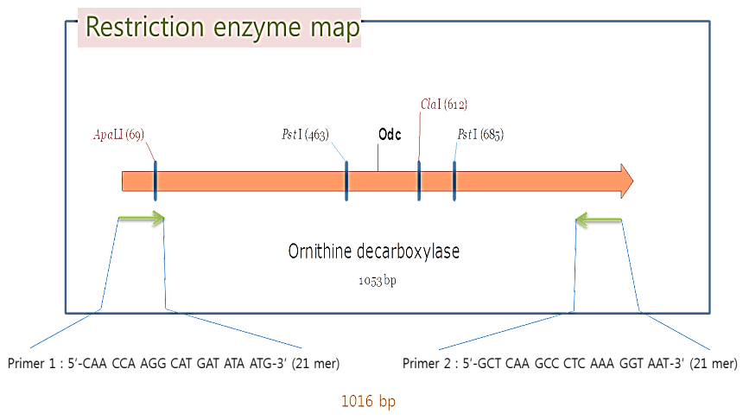
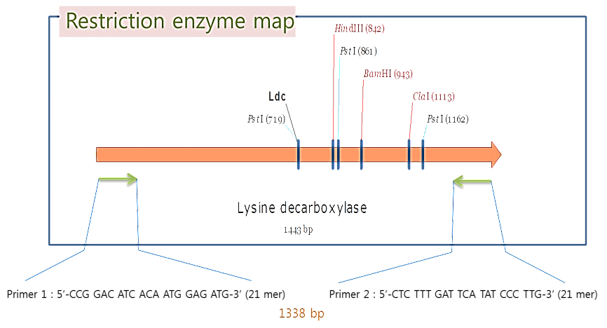
Table 12. List of the decarboxylase genes in Bacillus subtilis available on the NCBI BLAST.
Name | Bacteria name | No. of amino acids | Locus | GenBank | Size
Ornithine decarboxylase | 37.0% identity over 119 aa to the E. coli ornithine decarboxylase antizyme; putative [Bacillus subtilis subsp. subtilis str. 168] | 331 | AAA96638 | AAA96638.1 | 1052 bp
Lysine decarboxylase | Bacillus subtilis | 490 | AAC24937 | AAC24937.1 | 1442 bp
Fig. 3. Gene maps of odc and ldc in Bacillus subtilis.
Assignment !
Hdc & Tdc ?

Slide 35
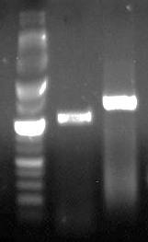
M 1 2
6 kb
3
2
ldc
1,000 bp
odc
600
500
300
200
Fig. 4. PCR amplification of the 2 amino acid decarboxylase genes in Bacillus subtilis KCTC 1021 by using primers 4Od-det-fw and 4Od-det-rv giving an amplicon of 1016 bp (1), primers 4Ld-det-fw and 4Ld-det-rv giving an amplicon of 1338 bp (2).

Slide 36




Strains from a culture collection
1 2 3 4 5 6
odc
1016 bp
ldc
1338 bp
Fig. 5. PCR based detection of odc and ldc genes in different B. subtilis strains.
1, Bacillus subtilis subsp. subtilis (type strain, KCTC 3135); 2, B. subtilis (from kimchi, KCTC 13112) 3, B. subtilis (from tea leaves, KCTC 13021); 4, B. subtilis (from soil or fermented soy bean, KCTC 3014); 5, B. subtilis (from tea leaves, KCTC 13022); 6, B. subtilis subsp. subtilis (from fermented soy bean, Maejoo, Sunchang, Korea, KCTC 13241).
Spontaneously mutated?
N1119 N1503 N1516 N2005 M701 M1501 M2201 M2205 D101 D102
odc
1016 bp
ldc
1338 bp
Fig. 6. PCR based detection of odc and ldc genes in B. subtilis strains isolated from fermented soybean products.

Slide 37
Fig. 7. Quantitative analysis of expression levels of odc and ldc genes in B. subtilis strains isolated from fermented soybean products.
Fig. 8. Screening of starter culture candidates through HPLC and RT-PCR analyses.

Slide 38

Genetically designed cultures needs to be considered to ensure the healthy functions as well as safety of fermented foods in the future !

Slide 39

K
C
O
KNO UT
Strategy
Application of odc and ldc gene knockout mutants for reducing biogenic amine formation

Slide 40

Fig. 9. Scheme of double-crossover homologous recombination.

Slide 41

Fig. 10. PCR amplification of odc and ldc genes in WT and K/O strains of B. subtilis.

Slide 42

Fig. 11. Comparison of biogenic amine contents in the cultures of WT and K/O strains of B. subtilis.
Trp: tryptamine, Phe: ß-phenylethylamine, Put: putrescine, Cad: cadaverine, His: histamine, Tyr: tyramine, Spd: spermidine, Spm: spermine.

Slide 43
Summary I
The amounts of biogenic amines in most samples of fermented soybean products are within the safe levels for human consumption.
  Some samples had β-phenylethylamine or tyramine contents greater than toxic dose of each amine although no samples showed total amounts of biogenic amines higher than harmful level.
The variability of biogenic amine levels in the fermented soybean products are attributable to:
  The ratio of ingredients used in raw material,
  Microbial and/or physicochemical contribution, and
  Conditions and periods of the entire food supply chain.

Slide 44
Summary II
Understanding of biogenic amine occurrence in fermented foods would probably provide direction and framework for developing strategies to reduce biogenic amine formation chemically, biologically and physically.
Biocontrol strategies have been vigorously developed for reducing biogenic amine formation in common fermented foods, mainly focusing on microbial intervention
  The use of starter culture would be a successful way to reduce biogenic amine formation in fermented soybean foods.
  It causes less adverse organoleptic and unhealthy alterations than that of additives.

Slide 45
Summary III
The abundance and diversity of biogenic amines in fermented soybean foods are closely related to the expression levels of decarboxylase genes in B. subtilis.
  Bacillus strains belonging to the same species have different levels of expression of odc and ldc genes and production of putrescine and cadaverine depending on the types of fermented soybean products from which they were isolated.
The formation of overall biogenic amines as well as putrescine and cadaverine can be successfully reduced by using the Δodc and Δldc mutants.
  The use of genetically modified starter and protective cultures needs to be considered to ensure the safety of fermented foods in the near future.

Slide 46
Mah, J. -H. *. 2015. Fermented soybean foods: Significance of biogenic amines. Austin Journal of Nutrition & Food Sciences. 3(1), 1058.
Bai, X., B. Y. Byun and J. -H. Mah*. 2013. Formation and destruction of biogenic amines in Chunjang (a black soybean paste) and Jajang (a black soybean sauce). Food Chemistry, 141(2), 1026-1031.
Byun, B. Y., X. Bai and J. -H. Mah*. 2013. Occurrence of biogenic amines in Doubanjiang and Tofu. Food Science and Biotechnology, 22(1), 55-62.
Byun, B. Y. and J. -H. Mah*. 2012. Occurrence of biogenic amines in Miso, Japanese traditional fermented soybean paste. Journal of Food Science, 77(12), T216-T223.
Oh, S. -J., J. -H. Mah, J. -H. Kim, Y. -W. Kim and H. -J. Hwang. 2012. Reduction of tyramine by addition of Schizandra chinensis Baillon in Cheonggukjang. Journal of Medicinal Food, 15(12), 1109-1115.
Kim, B., B. Y. Byun and J. -H. Mah*. 2012. Biogenic amine formation and bacterial contribution in Natto products. Food Chemistry, 135(3), 2005-2011.
Kim, T. -K., J. -I. Lee, J. -H. Kim, J. -H. Mah, H. -J. Hwang and Y. -W. Kim. 2011. Comparison of ELISA and HPLC methods for the determination of biogenic amines in commercial Doenjang and Gochujang. Food Science and Biotechnology, 20(6), 1747-1750.
Key Publications
on Biogenic Amines in fermented soybean foods

Slide 47

Acknowledgements
Lab members
Bo Young Byun, PhD student
Jwahaeng Park, PhD student
Young Kyoung Park, PhD student
Hyeock Youn, MS student
Ah-Ran Jeon, MS student
Huiling Xu, MS student
Martti Tapani Sinnelä, MS student
Fundings
National Research Foundation of Korea (NRF)
Korea Foundation for the Advancement of Science & Creativity (KOFAC)
Ministry of Korea Food & Drug Safety (MFDS)
Ministry of Trade, Industry & Energy (MOTIE)
Ministry of Agriculture, Food & Rural Affairs (MAFRA)
Ottogi Foundation

Slide 48





Thank you
Jae-Hyung Mah, PhD., Associate Professor
Department of Food and Biotechnology, Korea University
[Web] http://kfbt.korea.ac.kr
[E-mail] nextbio@korea.ac.kr

