Slide 1

Using Low-Fidelity, Role-Play Simulation in Nursing to Improve Undergraduate Nursing Students’ Attitudes toward Older Adults:
A Pilot Study
Dr. Jacqulin C. Myles, DNP, RN-BC, CNE
Keiser University, Ft. Lauderdale, Florida
Notes:
Good Afternoon Everyone. I would like to thank the Conference team for giving me the opportunity to present here today.
I will now share with you my project that is current and relevant to the scope and mission of this conference and the mission of other organizations that seek to improve the health of older adults.

Slide 2
Disclosure
I have nothing to disclose.

Slide 3

Introduction
Population is aging
Rise in life expectancy
Ageism
Gerontology career
Demand for gerontology nursing skills
Negative attitudes among nursing students
Impact of negative attitudes of nurses
Educational strategy
Notes:
Introduction
Ladies and gentlemen, please give me your undivided attention as I ask for you to try to envision yourself, a friend or a loved one in this possible situation in the later years of life.
“Imagine you are an older adult admitted to a health care facility. Unfortunately, you are stricken with a chronic illness and now unable to bathe, feed, or clothe yourself. Take a moment to envision, just one situation where you are sitting in the hallway in the same position for hours as workers pass and watch you drool and dribble. Imagine how you would feel if you ask for help and be shouted at or ignored? Can you envision yourself, a friend or any of your older loved ones in such a situation where assistance is required with personal care but is treated as if you or your loved one is invisible or unworthy of someone’s time? Are you excited or are you scared about this situation?”
My research focused on the use of Low-Fidelity, Role-Play Simulation in Nursing Education, to Improve Undergraduate Nursing Students' Attitudes toward Older Adults
So here are some information you may or may not know.
The population of older adults is growing worldwide (Sheena & Kulig, 2017).
A projection is the 65 years and-older population is projected will reach 83.7 million by 2050 because of the aging Baby Boomers (Ortman, Velkoff, and Hogan, 2014)
In the United States about one in every seven, or 14.1% of the population is an older American (Administration on Aging, 2014).
Ageism among healthcare workers is demeaning and dangerous, as the impact results in either over or under-treatment of older people (Ouchida and Lachs, 2015).
Studies show that students’ beliefs, past experiences, and knowledge about aging influence their decisions to pursue a career in gerontology nursing (Haron, et al., 2013).
Studies also show that negative attitudes towards older adults persist among nursing students and the attitudes (Liu, Norman, and While, 2013).
7. Nursing students’ choices of other career specialties can be linked to the limited positive outlook that is represented by the media
about aging and the elderly (Mariet, 2016; Sheena and Kulig, 2017).
8. The shortage of nurses specializing in gerontological nursing will become more acute (Lin, Chen, and Lin, 2016).
So why am I and others are concerned about these statistics?
The negative attitudes towards older adults persist among nursing students and the attitudes demonstrated while giving care, have a direct and indirect impact on positive patient outcomes.
2. The rise in the number of older adults will require an increasing demand for more nursing skills in assessing older persons' health and
acute care needs in hospitals, and in primary care.
3. The negative attitudes may result in poor delivery of care to gerontology patients.
4. The possibility of understaffed geriatric facilities due to students not choosing gerontology as their first choice of career path.
5. Few graduates of nursing will choose gerontology nursing as their first choice of career path (Lin,Chen, Hsieh, and Lin (2016).
6. Despite evidence that negative attitude towards older individuals exists, not many practical, hands-on, and experiential learning
interventions have been done to address the affective domain aspect of the theory-practice gap in geriatric nursing.

Slide 4

Research Question
Does role play simulation make a significant difference in mean group attitude scores of first-year associate degree in nursing, semester-one, generic nursing students’ toward older patients’ on the Kogan’s Attitude towards Old People inventory?
Notes:
Research Question
The research question this project was designed to answer is: Does role play simulation make a significant difference in mean group attitude scores of first-year associate degree in nursing, semester-one, generic nursing students’ toward older patients’ on the Kogan’s Attitude towards Old People inventory?

Slide 5
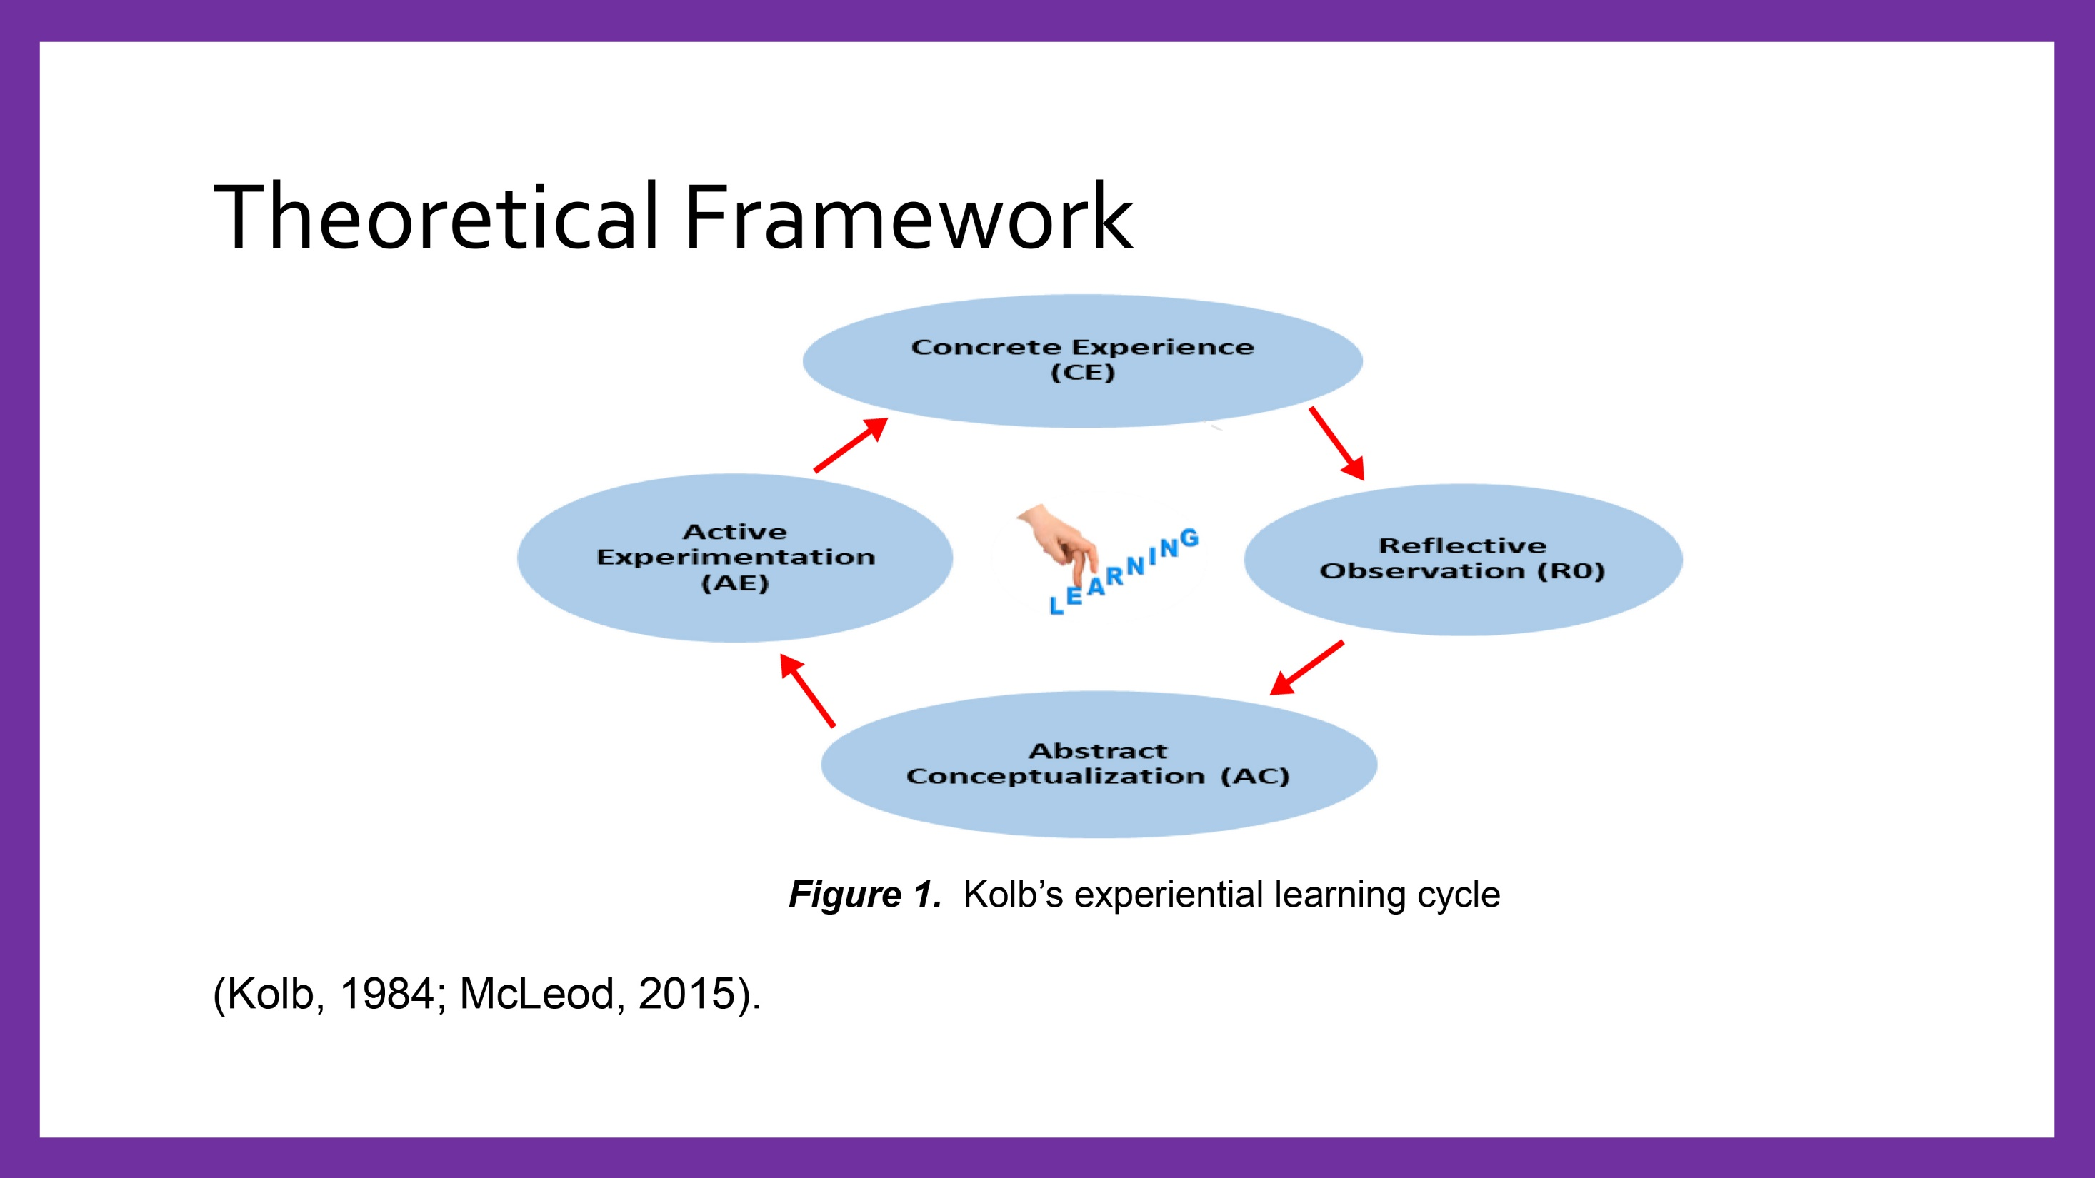
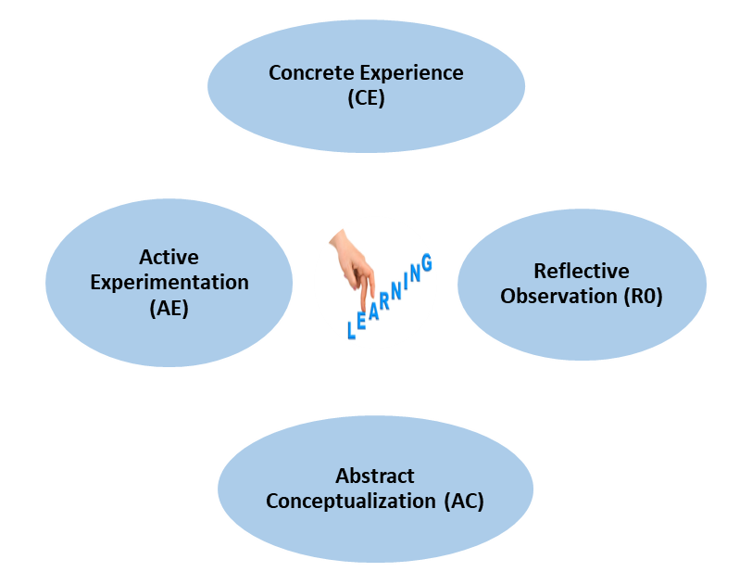
Theoretical Framework
Figure 1. Kolb’s experiential learning cycle
(Kolb, 1984; McLeod, 2015).
Notes:
Theoretical Framework
As an educator, I can teach geriatric nursing easily through lectures. However, the enhancement of attitudes and assumptions about older adults requires more than lecture alone.
It is for this reason that I incorporated Kolb’s experiential learning theoretical framework into this project as it is congruent with the process of a role-play simulation experience as both allow participants to connect previous experiences with new ideas.
At the concrete experience stage, the student learner began by having an active experience, the role-play simulation.
After the role-play simulation, the student took the time to reflect on the experience in the debriefing session. Also, lots of questions were asked and feedback given at this the reflective observation stage.
Next, at the abstract conceptualization stage, the student drew conclusions and related them to what they had experienced during the simulation and the concepts learned during the debriefing session. At this stage, the students examined what they already knew, and the new knowledge they gained from the simulation and debriefing sessions.
The examination of previous and new knowledge will lead to the active experimentation phase. Students at this stage, plan how they will put into action in the clinical setting, what they have learned from the role-play simulation experience

Slide 6

Methodology
Design
Sample
Inclusion-Exclusion
Role-play Simulation
Demographic survey
Instrument
Notes:
Methodology/Study Design/Sample
So, for this project, I decided to utilize a quantitative, quasi-experimental, one-group, non-random, pretest-posttest research design with twenty-three first-year, semester-one, generic, associate degree in nursing students attending a private college in South Florida. LPN students were excluded from participating in this project as they were not enrolled in the Fundamentals of Nursing course.
The project was conducted during a Fundamental of Nursing laboratory session. The students were assigned to long-term care facilities starting the third week of the Fundamentals of Nursing course.
The theme of the role-play simulation was: Treat others how you would want to be treated. Participants completed a brief demographic survey that included questions about age, prior course on aging, intent to work with older adults, and previous experience with older adults (65 years and older). The instrument used for this project was the Kogan Attitude toward Old People questionnaire, a 6-point Likert-type scale, utilized before and one week after a role-play simulation.
To summarize the demographic characteristics of the sample, descriptive statistics were used.

Slide 7
Demographics Items
Age Group
Table 1
Distribution of Age Group of Participants
Age Group | Frequency | Percent
Less than 25 years | 3 | 13.0%
25 years or older | 20 | 87.0%
Total | 23 | 100.0%
Notes:
Based on the results presented in Table 1, the majority (87.0%) of students in this group were 25 years old or older.

Slide 8
Demographics Items
Distribution of Prior Course on Aging
Table 2
Distribution of Prior Course on Aging
Taken a Prior Course on Aging | Frequency | Percent
No | 19 | 82.6%
Yes | 4 | 17.4%
Total | 23 | 100.0%
Notes:
Table 2 results show that the majority of students (82.6%) did not have prior course on aging.

Slide 9
Demographics Items
Intent to Work with Older Adults
Table 3
Intent to Work with Older Adults
Intent to Work with Older Adults | Frequency | Percent
Yes, definitely | 6 | 26.1%
Yes, probably | 3 | 13.0%
I don’t know yet | 1 | 4.3%
No | 3 | 13.0%
Probably not | 5 | 21.7%
Definitely not | 5 | 21.7%
Total | 23 | 100.0%
Notes:
Based on Table 3 results, the participants are somewhat polarized. They seem to be fairly sure they want to work with older adults with 39.1% answering “Yes definitely” or “Yes, probably” or fairly sure they do not as 43.4% answering “Probably not” or “Definitely not”.

Slide 10
Demographics Items
Distribution of Experience Working with Older Adults
Table 4
Distribution of Experience with Older Adults
Experience | Number Yes | Number No | Percent Yes
Nursing Home | 4 | 19 | 17.4%
Hospital | 1 | 22 | 4.3%
Home Care | 3 | 20 | 13.0%
Care of Elderly Relative | 8 | 15 | 34.8%
Relationship with Elderly Relative | 13 | 10 | 56.5%
No Experience | 5 | 18 | 21.7%
Notes:
Distribution of Experience Working with Older Adults
Table 4 results show that most of the participants have had some experience with elderly individuals; only 21.7% responded that they had “No Experience. The most common experiences are through a relationship with an elderly relative (56.5%) or care for an elderly relative (34.8%). The percentages of participants who have worked with a non-relative through a nursing home, a hospital, or a home care agency are much lower (17.4%, 4.3%, and 13.0%, respectively).
Overall the data indicates that the respondents were more likely to have personal, rather than professional experiences with the elderly.
I will now present the results of the pretest and posttest survey results starting with the preliminary analysis.

Slide 11
Presentation of Pretest and Posttest Survey Results
Table 5
Summary Statistics for Pretest and Posttest
 | #Respondents | Mean | Median | Std. Deviation | Minimum | Maximum
Pretest Total | 23 | 114.9 | 118.0 | 27.7 | 75.0 | 153.0
Posttest Total | 23 | 126.2 | 122.0 | 24.0 | 87.0 | 169.0
Notes:
Preliminary Analysis
The scoring provided in Table 5 is based on the sums of the correctly scored responses for each respondent. Theoretically, a score may be between 34, most negative attitude possible, and 204, most positive attitude possible. From Table 5, the mean score did indeed increase for these participants from the pretest to the posttest (pretest mean was 114.9 and posttest mean 126.2). The median score also increased with pretest of 118.0 and posttest 122.0. The minimum and maximum scores for all respondents were higher in the posttest. Table 5 indicates that these respondents’ scores did indeed increase after the intervention.
I will now provide statistical tests to determine whether this effect would occur in a larger population of undergraduate nursing students or whether there is no evidence that it extends beyond this sample.

Slide 12
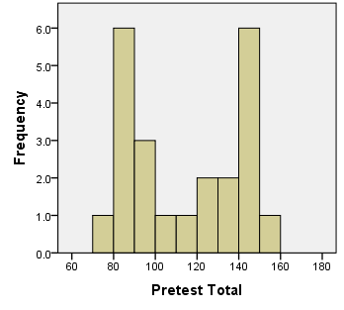
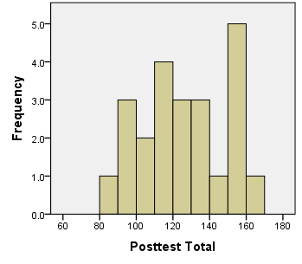
Pretest and Posttest Scores
Figure 3. Histogram of Posttest Total Scores
Figure 2. Histogram of Pretest Total Scores
(Pallant, 2010)
Notes:
Preliminary Analysis (Cont’d)
Figures 2 and 3, provide histograms of the students’ scores how they answered the items on the survey instrument. Figure 1 shows two groups of individuals at pretest; those with relatively negative attitudes, and those with relatively positive attitudes. This interpretation is evident because there are two “modes” or peaks in the graph, one that occurs around a score of 80, and one that occurs around a score of 140.
This outcome does not appear in Figure 3, which indicates there is much less of a tendency on the posttest for individuals to be explicitly negative or positive about their attitudes toward older individuals.
Although other tests could be used to test this phenomenon, two tests that were appropriate for the paired data were considered. One is the matched pairs t-test, a parametric test, that is used when data is collected using a pretest-posttest design with one group of participants. A matched pairs t-test relies on the assumption that the population from which the sample was taken reveal a normal distribution of data. To determine if the assumption of normality holds for the data analysis, the differences between the pretest and posttest for each participant were calculated and then plotted on a histogram to look for a symmetric distribution. Also, to test for normality the Shapiro-Wilk test was also used. A p-value of < .05 was used to determine statistical significance for this project. A histogram of the differences is provided in Figure 4 on the next slide.

Slide 13
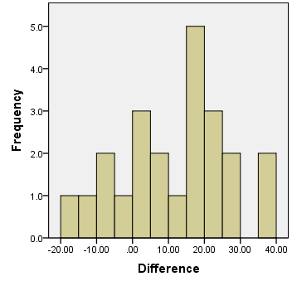
Histogram of Pretest and Posttest Differences
Figure 4. Histogram of pretest and posttest differences
Notes:
Histogram of Pretest and Posttest Differences
The histogram, in Figure 4, certainly is not discouraging with respect to the assumption of normality, but a Shapiro-Wilk test was performed to control adequately for Type 1 error that the normality assumption holds. The result led to a W statistic of .967 with 23 degrees of freedom and a p-value of .628. This result, therefore, is not significant at a .05 level of significance, so it is reasonable to assume that these data are from a normally distributed populace.

Slide 14
Pretest-Posttest Analysis of Survey Data
Table 6
Matched-Pairs t-test Results for Score Change
95% Confidence Interval of the Difference
Mean | SD | SE | Lower | Upper | t | df | p-value
11.304 | 15.275 | 3.185 | 4.699 | 17.910 | 3.549 | 22 | 0.002
Note. SD=Standard Deviation; SE=Standard Error; Significant at the p<0.05 level
(Pallant, 2010)
Notes:
Pretest-Posttest Analysis of Survey Data
Table 6 demonstrates that the average change in the score from pretest to posttest was an increase of 11.3 points, and the standard deviation of this change was 15.3 points. The standard error of the mean was 3.2 points, which means that with some degree of confidence the actual average change that can be inferred to a larger target population of undergraduate nursing students at this institution would be within 3.2 points of 11.3. A 95% confidence interval for the score improvement of the larger undergraduate population places it between 4.7 and 17.9 points, indicating that the intervention has a positive impact on the attitudes of the students toward older individuals. The results of the matched-pairs t-test are t (22) = 3.549, p = .002. The p-value of .002 indicates that the probability this particular sample of students would have increased their scores by an average of at least 11.3 points due to chance is 0.2%. Based on a predetermined alpha confidence level of .05, the null hypothesis of no difference is rejected indicating there is a statistically significant difference from pretest to posttest scores at the .05 level.

Slide 15
Recommendations
Role Play Simulation
Fundamentals of Nursing Curricula
Hands-on Experience
Nurse Educators role
Notes:
Recommendations
From a pedagogical point of view, what can be done to make gerontological nursing more attractive for nurses in the United States of America as well as in other parts of the world?
Here are some recommendations:
Include role-playing simulation experiences in the Fundamentals of Nursing curricula to enhance the gerontology component of the course. Exposing students early with simulated experience to care for older people, may increase students’ knowledge about aging, enhance awareness of the aging process, and foster positive interactions. Role-play simulation is in no way suggested as an intervention to replace geriatric clinical hours but should be regarded as a strategy to meet a variety of teaching needs necessary to prepare students to care efficiently for older people.
2. Given the increasing need for gerontological nurses to provide care to the increased older population, it is vital that nursing graduates are adequately equipped to demonstrate interest, willingness, and excitement about choosing the Gerontology Nursing career path.
Nursing schools can be environments for fostering positive attitudes of students toward older people. Regardless of the type of undergraduate program, nurse educators have a critical role in helping to promote gerontological nursing to interest nursing students.
3. The findings of this project are unswervingly aligned with Kolb’s Experiential Learning Theory indicating that students learn by doing and not simply by watching or reading the information. The gerontology educational module of the Fundamentals of Nursing course for this project relates more to the abstract portion of the methodology, while the role-play simulation is more of the concrete and reflective aspect of the method of the course. Well-designed, hands-on experience, such as role-play simulation have the potential to affect positively students' attitudes and knowledge levels about older adults and may indeed have an impact on the student’s choosing gerontology nursing as a career.
4. Nurse educators can defy the negative attitudes and stereotypes held toward older adults; however, nurse educators should first acknowledge their prejudices before imparting their knowledge.

Slide 16
Future Research
Large Sample
Study Replication
Future Research Proposal
Role Modeling career
Notes:
Future Research
1. The use a larger sample to determine better the values of the data and avoid possible errors with small sample size.
2. Replication of this study with different undergraduate populations and clinical facilities may serve to increase the external validity of the project findings.
3. Future research proposals should consider a mixed-method study to interpret the subtle subjective aspect of nursing students’ perspectives on their attitudes toward older individuals.
4. It would be beneficial to conduct a longitudinal study to determine if students who have exposure to a role-play simulation experience in the first semester of the nursing program transfer their knowledge and attitude change throughout the nursing program and into the clinical setting.
5. Nursing faculty play a vital role in stimulating nursing students’ interest in gerontology nursing but often lack adequate knowledge of the aging process. Nursing education and the health care industry could benefit from future studies that utilize role-play simulation to improve nursing faculty attitudes and knowledge towards older adults.

Slide 17
Summary
Rapid growth of aging population
Choice of career path
Theory to Practice
Statistical Significance
Implication of this study
Impact of Role-play Simulation on attitudes
Notes:
Summary
In summary, the problem is that the population is aging, and negative attitudes of nursing students toward caring for older patients can result in poor delivery of care to gerontology patients.
There is also the possibility of understaffed geriatric facilities due to students not choosing gerontology as their first choice of career path.
A lack of literature exists on the use of role-play simulation to improve nursing students’ attitudes toward older adults. This is despite the strong literature base that suggests, (1) Negative attitudes of nursing students exist toward older adults, (2) The high cost of high-fidelity simulation equipment and resources, (3) Lack of clinical sites, and (4) The critical need to better prepare nursing students to care for the aging population.
While the literature emphasized the problem that negative attitudes exist among nursing students, few studies addressed practical strategies to address the problem early in the nursing program.
The project findings demonstrate that simulation experiences, such as a low-fidelity, role-play simulation, is a useful strategy that allows students to gain insight into the unspoken characteristics of the affective domain of attitudes, thoughts, and feelings of others. A significant improvement in attitudes scores was a 13 points increase on the posttest following the role-play simulation with p<0.05 and a CI of 95% .
The goal for this project is for nursing students to be prepared adequately, which can be achieved by utilizing the Kolb Experiential learning framework, as it promotes active learning, reflection and transformation of ideas from the learning experience.
This researcher hopes that faculty and program leaders will be inspired as they consider restructuring their curricula to include role-play simulation experiences in the Fundamentals of Nursing course at their colleges.
As I bring this presentation to a close, I once again thank everyone for listening, and I hope that this presentation was informational and given you a much clearer insight about the need to strengthen gerontology nursing education to meet some of the demands of the aging population.
Thank you.

Slide 18
Selected References
Administration on Aging. (2014). Profile of Older Americans . Retrieved from http://www.aoa.acl.gov/Aging_Statistics/Profile/2014/docs/2014-Profile.pdf
Centraal Bureau voor Statistiek. (2016). Bevolking kerncijfers[Population: Key figures]. Retrieved from
http://statline.cbs.nl/Statweb/publication/?DM=SLNL&PA=37296ned&D1=8,1213,19-21&D2=0,10,20,30,40,50,60,64-65&HDR=G1&STB=T&VW=T
Hanson, R. M. (2014). Is Elderly Care Affected By Nurse Attitudes? A Systematic Review. British Journal of Nursing 23(4), 225-229
Haron, Y., Levy, S., Albagli, M., Rotstein, R., & Riba, S. (2013). Why do nursing students not want to work in geriatric care? A national questionnaire survey. International Journal of
Nursing Studies, 50, 1558 - 1565.
Kolb, D. A. (1984). Experiential Learning. Experience as the source of learning and development. New Jersey: Prentice Hall PTR.
Lin, H., Chen, S., Hsieh, C., & Lin, P. (2016). Music therapy training for undergraduate nursing students: A modality to foster interest in gerontological nursing. Journal of Gerontological
Nursing, 42(6), 25-31
Liu, Y., While, A.E., Norman, I. J., & Ye, W. (2012).. Journal of Interprofessional Care, 26(5), 397-409.
Mariet, 2016, J. Mariet, Professional socialization models in nursing, International Journal of Nursing Education, 8 (3), 2016, 143-148.
McLeod, S. A. (2015). Kolb - Learning Styles. Retrieved from http://www.simplypsychology.org/learning-kolb.html
Ortman J.M. Velkoff V.A. Hogan H. (2014). An aging nation: The older population in the United States. Retrieved from https://www.census.gov/prod/2014pubs/p25-1140.pdf.
Ouchida, K. M., & Lachs, M. S. (2015). Not for doctors only: Ageism in healthcare. Generations, 39(3), 46-57.
Pallant, J. (2010). SPSS survival manual. (4th ed.). New York, NY: McGraw-Hill Education.
Penney, W., Poulter, N., Cole, C., & Wellard, S. (2015). Nursing assessment of older people who are in hospital: Exploring registered nurses' understanding of their assessment skills.
Contemporary Nurse. 1-13. doi:10.1080/10376178.2015.1111152
Population Reference Bureau. 2015 World Population Data Sheet. [cited 2016 June 2]. Available from URL: https://assets.prb.org/pdf15/2015-world-population-data-sheet_eng.pdf.
Samalot-Rivera, A. (2014). Role playing in physical education to teach in the affective domain. Journal of Physical Education,
Recreation & Dance, 85(2), 41-43
Sheena, S. G., & Kulig, J. C. (2017). “We definitely are role models”: Exploring how clinical instructors' influence nursing students' attitudes towards older adults. Nurse Education in
Practice, 26, 74-81. doi:http://dx.doi.org.contentproxy.phoenix.edu/10.1016/j.nepr.2017.07.006
World Health Organization. (2015). 10 facts on ageing and the life course . Retrieved from http://www.who.int/features/factfiles/ageing/en/

