Slide 1
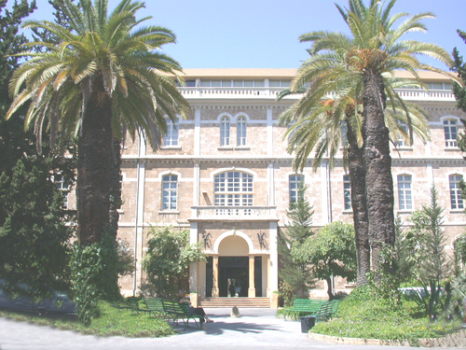

The vaccination of hepatitis B in healthy adults: effect of age and sex, 2 protocols of revaccination for non-responders
Jacques Choucair MD
Infectious diseases specialist at hotel Dieu de France, lecturer at the Saint Joseph University,Beirut

Slide 2
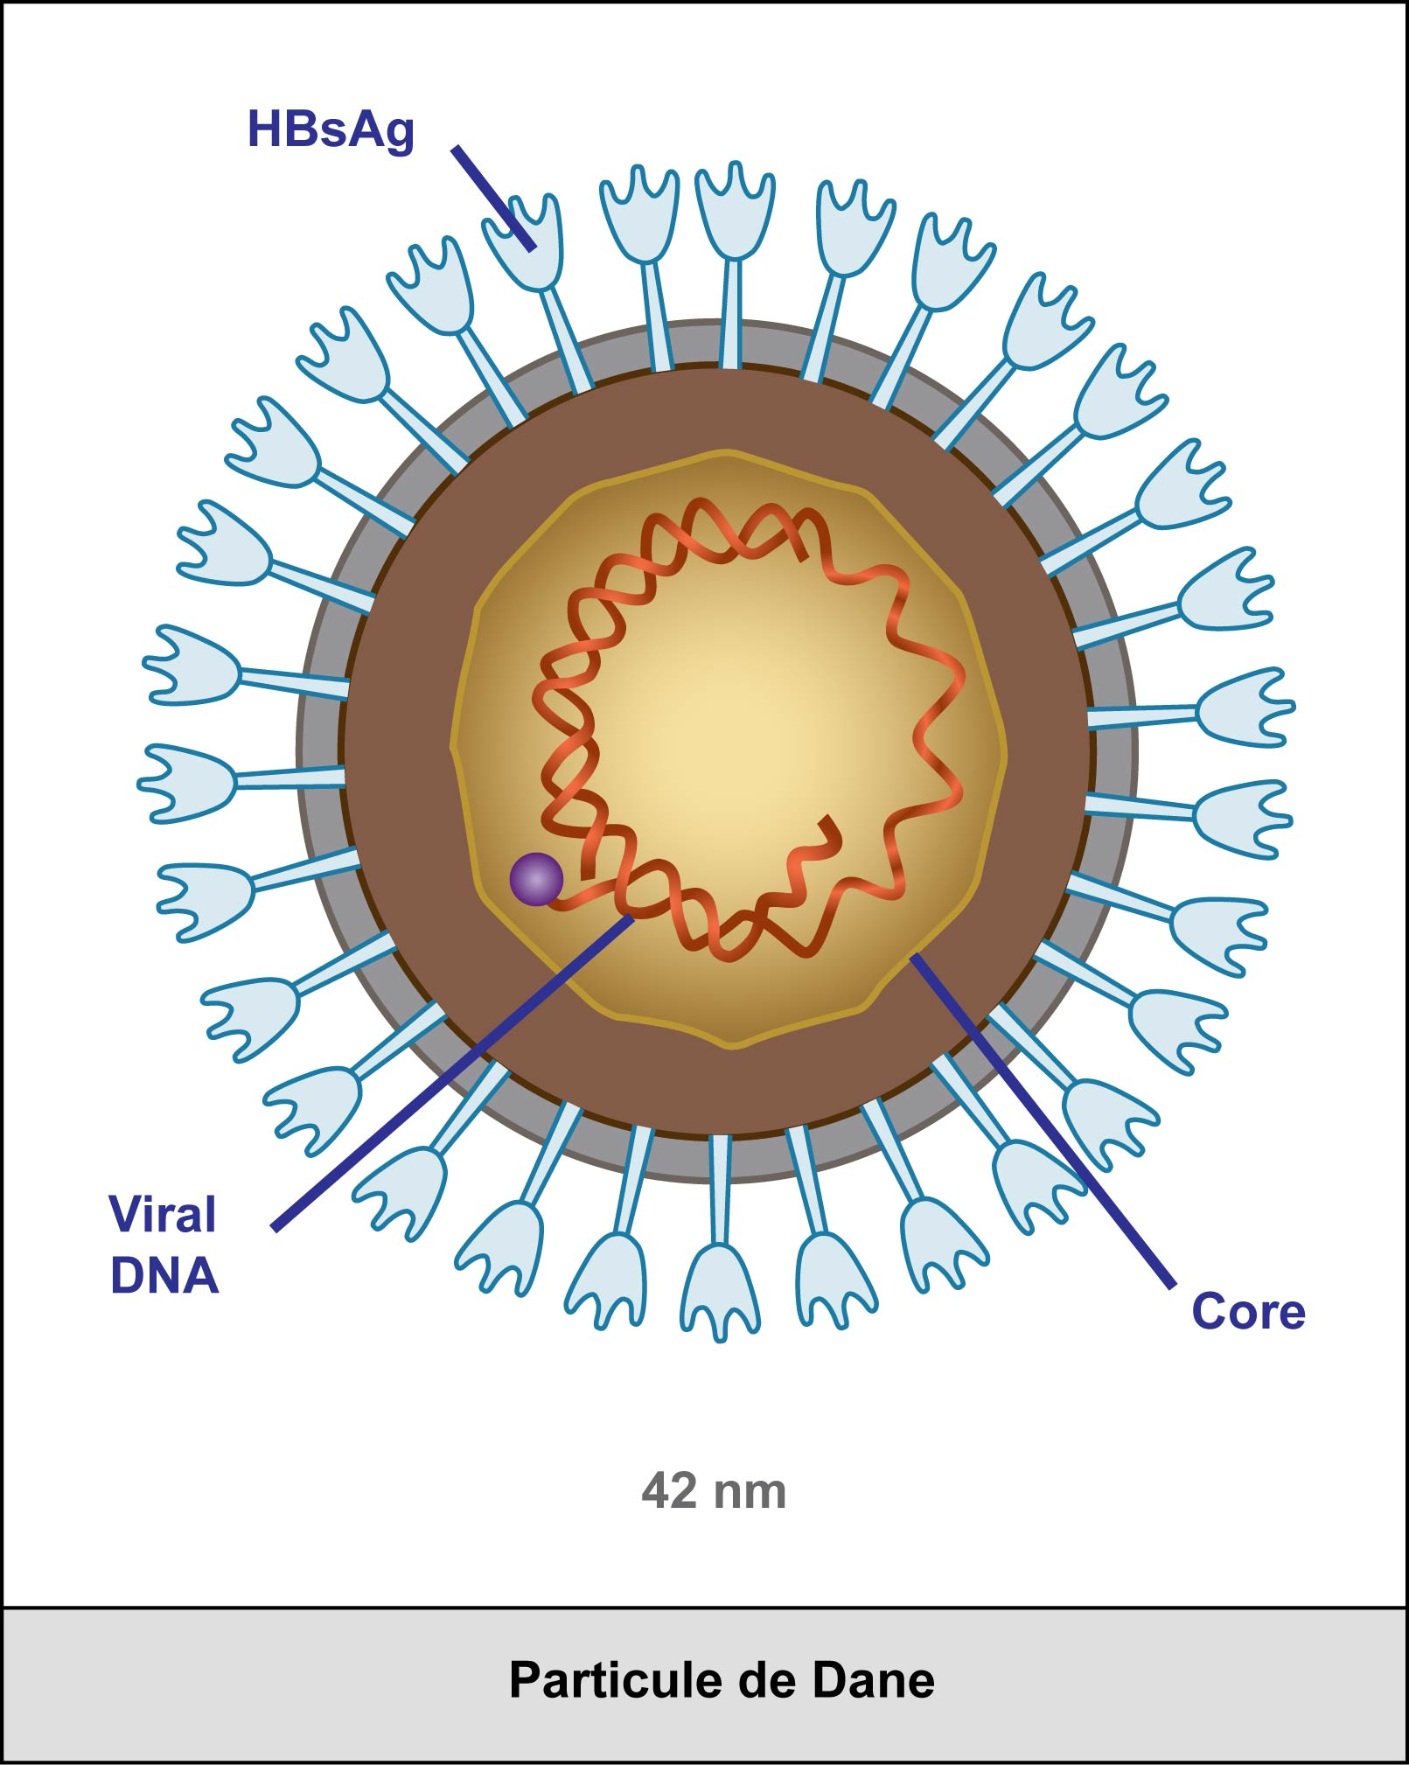

Slide 3
Introduction
Hepatitis B virus infection is a major health problem.
Although non-response is known to increase with age, hepatitis B vaccinations are considered to have only minor non-response rates (anti-HBs<10IU/L) in healthy subjects.
Vermeiren AP¹et al. J Clin Virol. 2013 Sep;58(1):262-4.

Slide 4
Introduction
Vaccination is the main prophylactic measure to reduce the mortality caused by HBV since the immune response to HBV recombinant vaccination occurs in over 90% of general population.
Individuals who develop an anti-HBs titer less than 10 mIU/mL after primary vaccination cycle are defined "no responders".
Filipelli M et al. World J Gastroenterol. 2014 Aug 14;20(30):10383-94

Slide 5
Non response risk factors
Many factors could cause a non response to the HBV vaccination, such as
  administration of the vaccine in buttocks,
  impaired vaccine storage conditions,
  drug abuse,
  smoking,
  infections and
  obesity.
Filipelli M et al. World J Gastroenterol. 2014 Aug 14;20(30):10383-94

Slide 6
Moreover
Some diseases are characterized by a poorer response to HBV vaccination:
  chronic kidney disease,
  HIV infection,
  chronic liver disease,
  celiac disease,
  thalassaemia,
  type I diabetes mellitus,
  down's syndrome and other forms of mental retardation
Filipelli M et al. World J Gastroenterol. 2014 Aug 14;20(30):10383-94

Slide 7
Is the response predictable?
Despite HBV immunization, a percentage of healthy individuals display an Ab titre below the threshold for clinical protection (10 IU/L).
To predict the existence of this inducible immunological response, the precise anti-HBs titre required to achieve protection in immunized patients with waned HBs antibodies was determined
Chiara F et al. Vaccine. 2013 Dec 17;32(1):62-8.

Slide 8
Is it predictable?
4486 vaccinated students attending the University of Padova Medical, Science, and Veterinary School were recruited between 2004 and early 2012.
The baseline concentration of anti-HBs was measured at enrolment.
anti-HBs titre < 10 IU/L at mean 10.8 years were given a booster vaccination and retested 20-30 days later
Chiara F et al. Vaccine. 2013 Dec 17;32(1):62-8.

Slide 9
Is it predictable?
At enrolment, 87.6% of the 4486 vaccinated showed anti-HBs > 10 IU/L.
Of the 279 booster-vaccinated subjects, 94.6% achieved the cut-off titre.
Booster-induced immunological response was correlated to the pre-booster titre level
≥ 2 IU/L ensuring a robust positive response
< 2 IU/L being associated with the probability of developing insufficient levels of antibodies
Chiara F et al. Vaccine. 2013 Dec 17;32(1):62-8.

Slide 10
Factors of non responsiveness to HBV vaccine in healthy adults
The response to the SP of 20-μg HbsAg vaccine, among 11,439 healthy employees using a retrospective cohort design. Predictors of responsiveness included sex, age and time between the last vaccination and Ab titre.
From the age of 29 on in men and 43 on in women, more than 5% of subjects did not respond.
Compared with women, men had a higher risk of non-response and exhibited a steeper decline in antibody titres produced with increasing age.
Vermeiren AP ^{et} al. J Clin Virol. 2013 Sep;58(1):262-4.

Slide 11
The persistence of anti-HBs antibody and anamnestic response 20 years after primary vaccination
At 20 y post-vaccination 37.0% had protective levels of antibody with geometric mean titer (GMT) of 55.44 mIU/mL.
After booster vaccination, 97.1% of vaccinees developed protective levels of antibody and the GMT rose from 2.35±6.49 mIU/mL to 176.28±161.78 mIU/mL.
90.6% of re-vaccinated subjects also showed an anamnestic response to booster vaccination.
Bagheri-Jamebozorgi M ^{et} al. Hum Vaccin Immunother.2014;10(12):3731-6.

Slide 12
Which vaccine dose: 10 μg or 20 μg?
317 adults(20-46 y) : HBsAg(-), anti-HBs(-), anti-HBc(-)
group I
3 doses of 10 μg HBV vaccine at 0, 1 and 3 months
group II
3 doses of 20 μg HBV vaccine at 0, 1 and 3 months
Anti-HBs levels at one month after the third vaccination
 | Group I | Group II | P value
Anti-HBs ≥ 10 mIU/mL | 88,05 % | 94,06 % | >0,05
Seroconversion (20-35 y) v/s (36-46 y) |  |  | < 0,05
GMT | 91,69 | 290,23 | < 0,05
the 20 μg dose can be used in adults aged 20-46 y
and
the 10 μg dose can be used in subjects aged 20-35 y
Li J et al. Hum Vaccin Immunother. 2015;11(5):1108-13

Slide 13
Is early vaccination better?
anti HBs Ab ≥ 10 mIU/ml was 94.5% in 2,620 persons
98.6% in adults vaccinated at age 20-24 years
64.8% in those vaccinated at age ≥ 65 y
A model on seroprotection rates showed
  a statistically significant decrease with age,
  and predicted that the anti-HBs seroprotection rate
    remains ≥ 90% up to 49 y of age and
    ≥ 80% up to 60 y of age.
Individuals at risk of HBV infection should be vaccinated as early in life as possible to improve the likelihood of achieving seroprotection.
Van Der Meeren O ^{et} al. Hum Vaccin Immunother. 2015;11(7):1726-9.

Slide 14
Can we do better?
Recent studies seem to indicate that the administration of HBV recombinant vaccine by the intradermal route is very effective and could represent a more useful strategy than intramuscular route.
→ The use of anti hepatitis B vaccine by intradermal route as alternative to conventional intramuscular vaccine in all non responder patients.
Filipelli M et al. World J Gastroenterol. 2014 Aug 14;20(30):10383-94

Slide 15
Role of Td vaccination on promoting HBV vaccine response
This was a randomized controlled clinical trial in Isfahan Province (Iran) in 2013,
of 140 healthy individuals, whose HBsAb t< 10 IU/L.
Control group 40 μg of recombinant HBV vaccines IM at 0, 1, and 6 months
Intervention group simultaneously vaccinated by Td with the first dose of HBV vaccine
HBV antibody levels (titer) were measured before the vaccination and 6 months after the last vaccination.
Salehi M et al. J Res Med Sci. 2015 Oct;20(10):958-62

Slide 16
Role of Td vaccination on promoting HBV vaccine response
 | Ab titers before | Ab titers after | P value
Intervention group | 5.07 ± 2.9 IU/L | 744.45 ± 353.07 IU/L | P < 0.001
Control group | 4.45 ± 3.4 IU/L | 589.94 ± 353 IU/L | P < 0.001
P value | P < 0.001 | P < 0.001
Td vaccination can be applied as a feasible approach to promote efficient and persistent immunity in healthy individuals with insufficient HBsAb titers.
Salehi M et al. J Res Med Sci. 2015 Oct;20(10):958-62

Slide 17
Osteopontin promotes dendritic cell maturation and function in response to HBV antigens.
Dendritic cells (DCs) play critical roles in promoting innate and adaptive immunity in microbial infection. Functional impairment of DCs may mediate the suppression of viral-specific T-cell immune response in chronic hepatitis B (CHB) patients. Osteopontin (OPN) is involved in several liver diseases and infectious diseases. However, whether OPN affects DC function in hepatitis B virus (HBV) infection is unknown.
METHODS:
Twenty CHB patients and 20 healthy volunteers were recruited. OPN secreted by DCs was compared. Peripheral blood mononuclear cells cultured with OPN antibody were examined to study the costimulatory molecular expression and interleukin (IL)-12 production of DCs after HBV antigenic stimulation. OPN-deficient mice were used to investigate the influence of OPN on DC maturation and function after HBV antigenic stimulation in vitro and in vivo. Exogenous OPN was administrated to further verify the functioning of DCs from CHB patients upon HBV antigenic stimulation.
RESULTS:
We found that OPN production of DCs from CHB patients was significantly lower than those from healthy volunteers. The absence of OPN impaired IL-12 production and costimulatory molecular expression of DCs upon stimulation with HBV antigens. Defective DC function led to reduced activation of Th1 response to HBV antigens. In addition, OPN deficiency in DCs reduced the HBV antigen-induced inflammatory response in the liver of mice. Importantly, OPN administration significantly promoted the maturation of DCs from CHB patients in vitro.
CONCLUSION:
These findings suggested that OPN could improve the maturation and functioning of DCs in the immune response to HBV antigens, which might be useful to further improve the effect of DC vaccine.
Cui G et al. Drug Des Devel Ther. 2015 Jun 12;9:3003-16

Slide 18
OBJECTIVES
To assess, in non vaccinated healthy adults,
  the response to the standard protocol SP (0, 1, 6 months), and
  the response to two protocols using additional boosters in nonresponders.

Slide 19
MATERIELS AND METHODS:
192 employees of the Psychiatric Hospital of the Cross with
  a mean age of 44.3 ± 12.35 years,
  non vaccinated ( HBs Ag, Anti HBs and anti HBc neg) and
  not having other illness ( hepatic failure, chronic renal failure, HIV infection, cancer and active hepatitis C) ,
received the standard three-dose vaccination regimen (SP), of 20-μg HbsAg vaccine.

Slide 20
MATERIELS AND METHODS:
The non responders to this protocol (anti-Hbs antibodies <10UI/l) are divided into two groups.
The first group (P1) receives a single booster (R1) 4 months after the SP, and those who remained nonresponders receive a double booster (R1b) 2 years after the SP.
The second group (P2) receives a unique double booster (R2), 2 years after the SP.

Slide 21
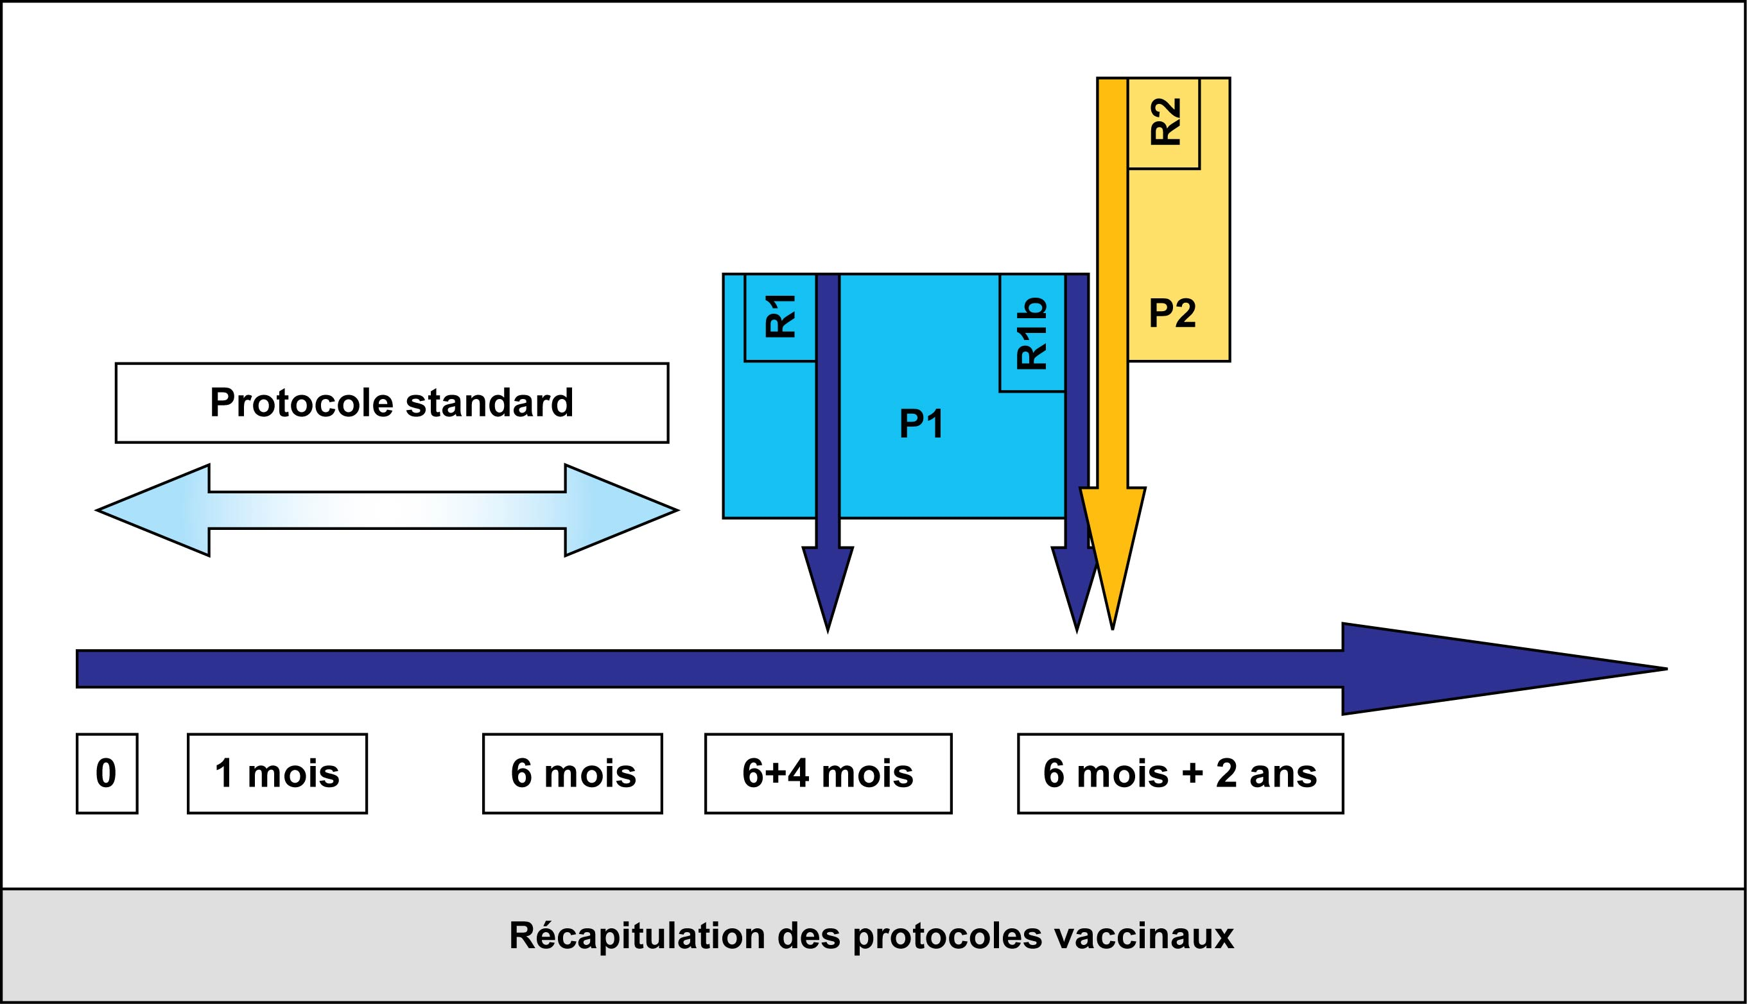
Our study protocol
Standard protocol
1 month
6 months
6+4 months
6 months + 2 years

Slide 22
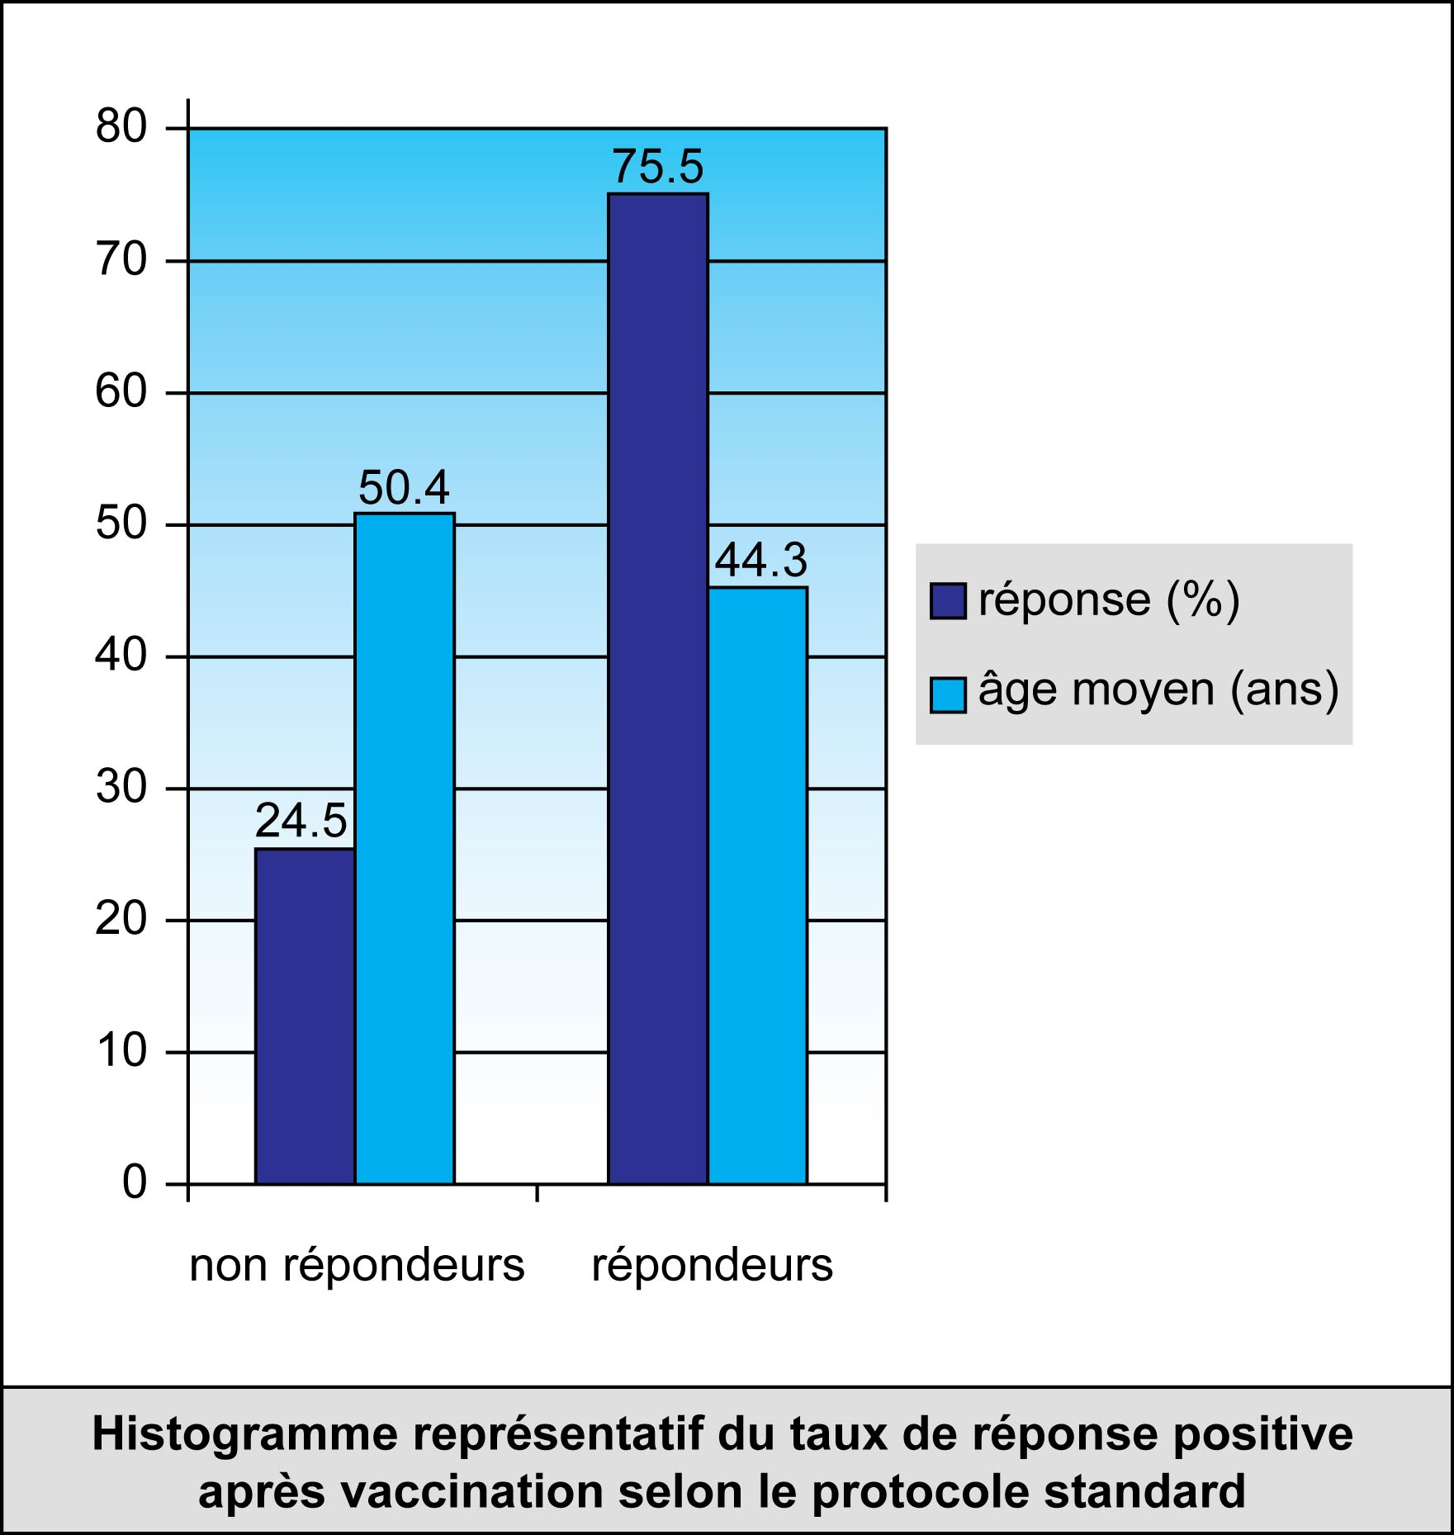
Response (%)
Mean age (years)
nonresponders
responders
To SP

Slide 23
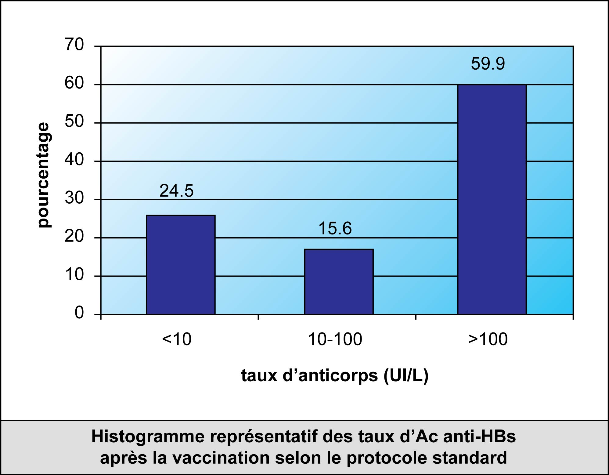
RESULTS:
the rate of response after the vaccination by the SP is 75.5 %( 145/192).
Anti HBs Ab titers

Slide 24
RESULTS
192 healthy workers
145 protective responses after SP
47 nonresponders to SP
12 protective responses
28 received a booster at 4 months
19 received one double dose at 2 years
7 non-responders
9 protective responses
19 nonresponders receive a double dose booster after 2 years
7 protective responses
12 non-
responders
19/192 non responders

Slide 25
RESULTS:
28 nonresponders (P1) receive a booster R1 after 4 months, their rate of response is 32.14 %( 9/28). The 19 nonresponders to R1 receive a double booster (R1b) after 2 years. Their rate of response is 36.84 %( 7/19).
The rate of response among the group P1 is 57.14 %( 16/28).
19 nonresponders (P2) receive a unique double booster after 2 years. Their rate of response is 63.16 %( 12/19).

Slide 26
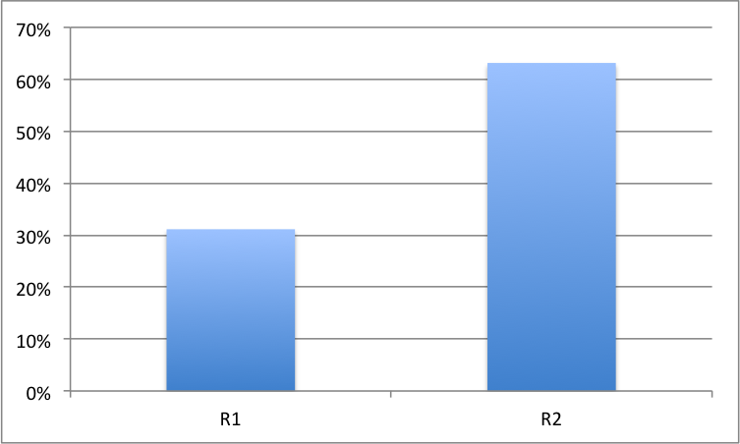

Slide 27
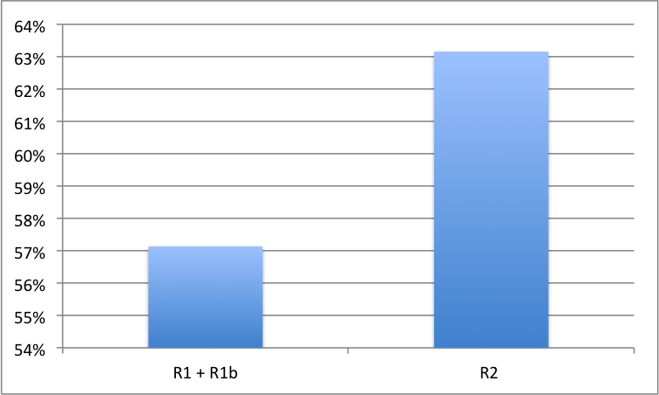

Slide 28
RESULTS:
9.9 %( 19/192) of individuals don't respond to any of the boosters. The rate of response decreases with the age. This decrease is 5% every year and 41% every 10 years.
For the same age, men are 2 fold more responders then women.
But after receiving all boosters, there is no difference between genders.

Slide 29
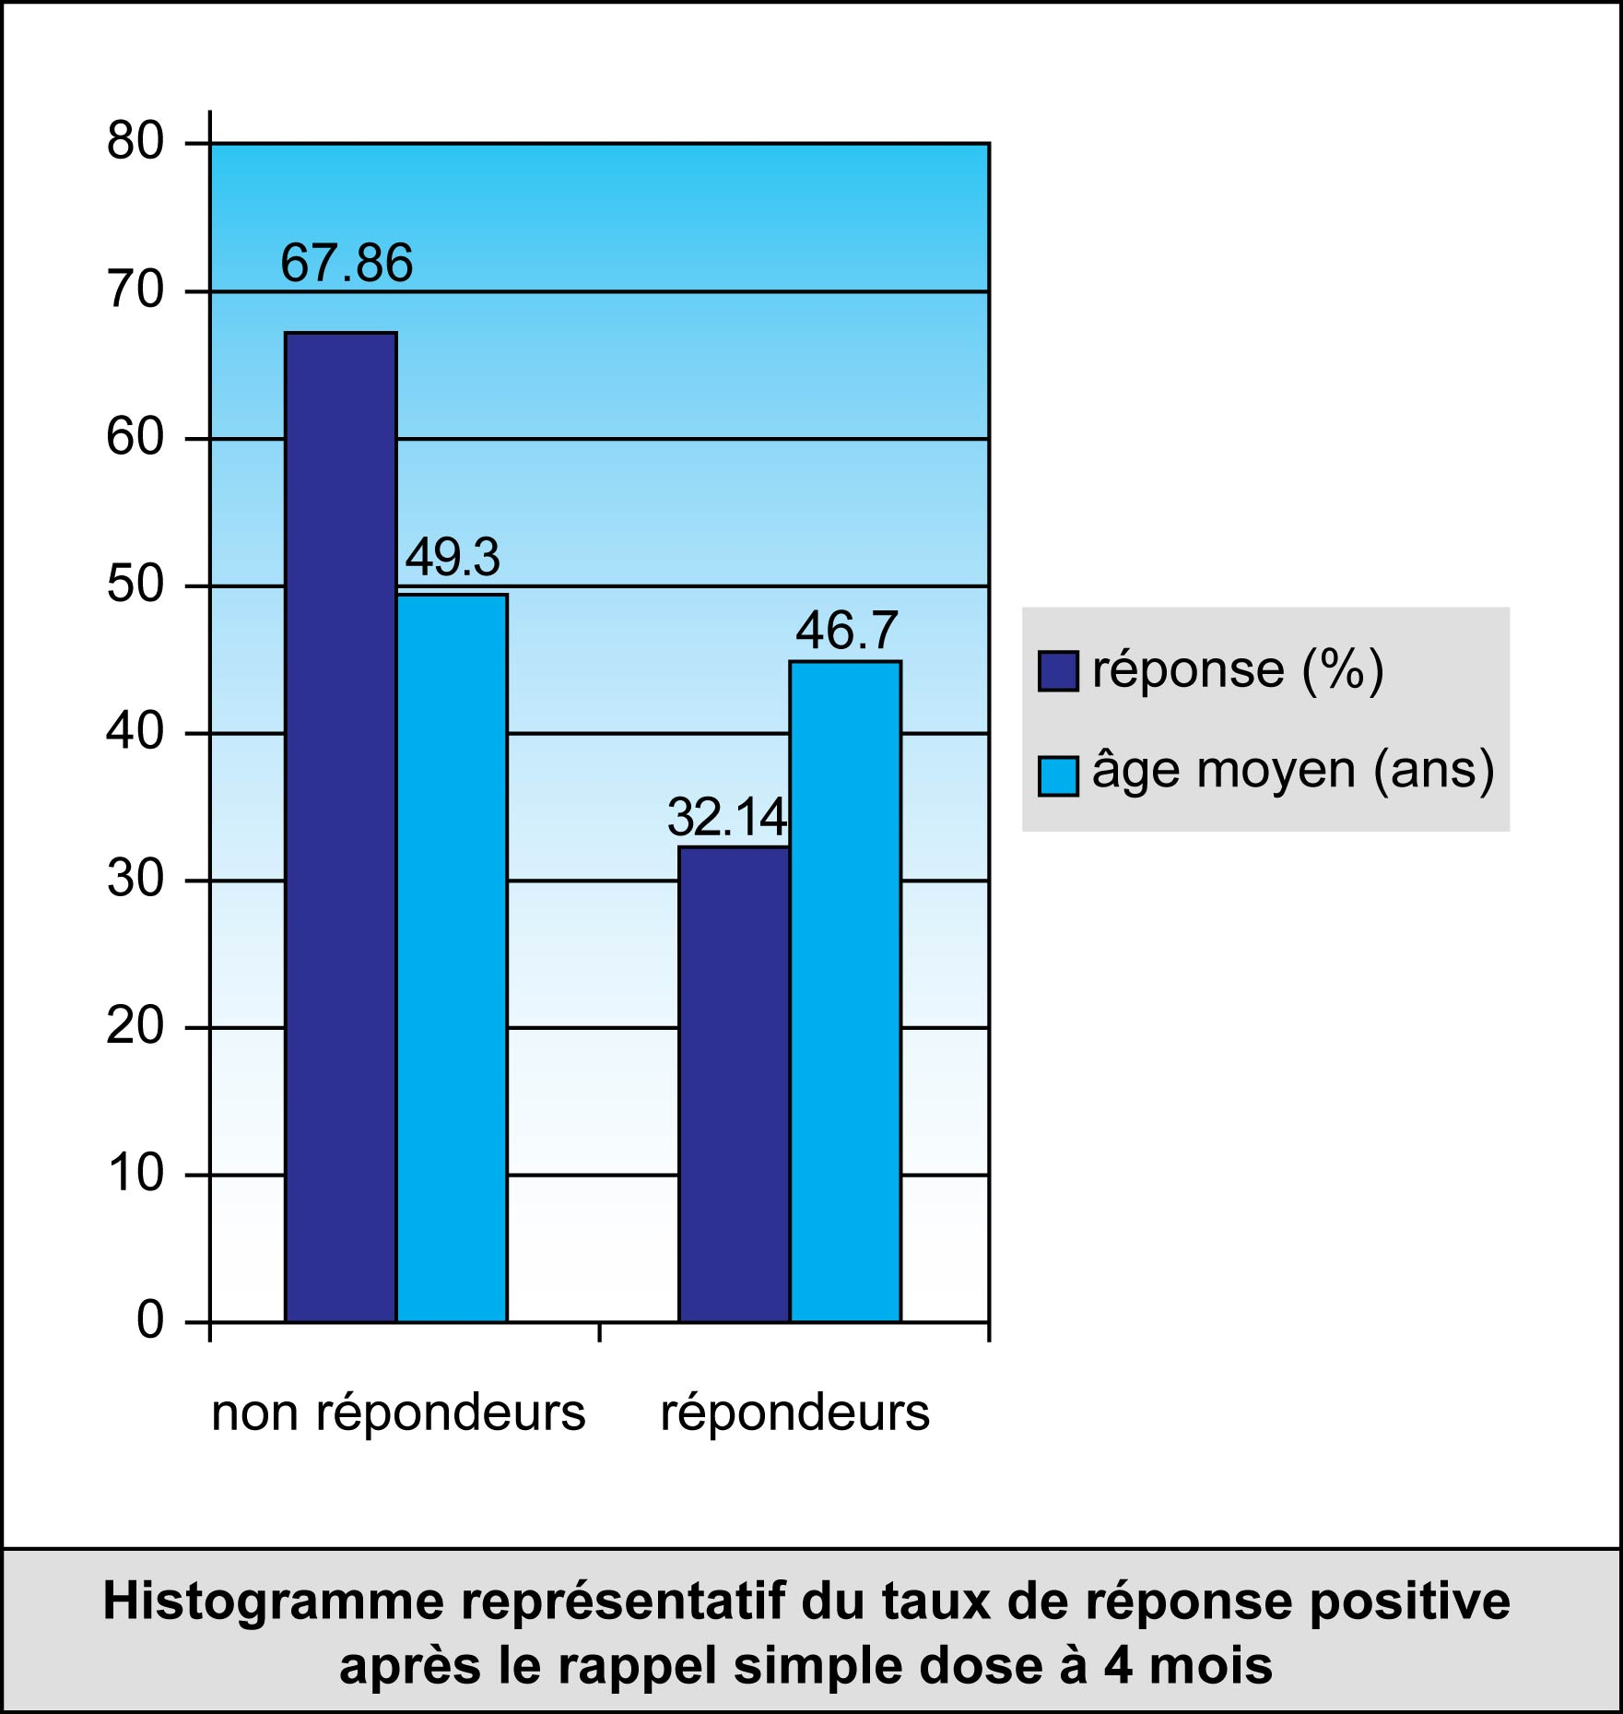
Response (%)
Mean age (years)
nonresponders
responders
1 dose boost at 4 M

Slide 30
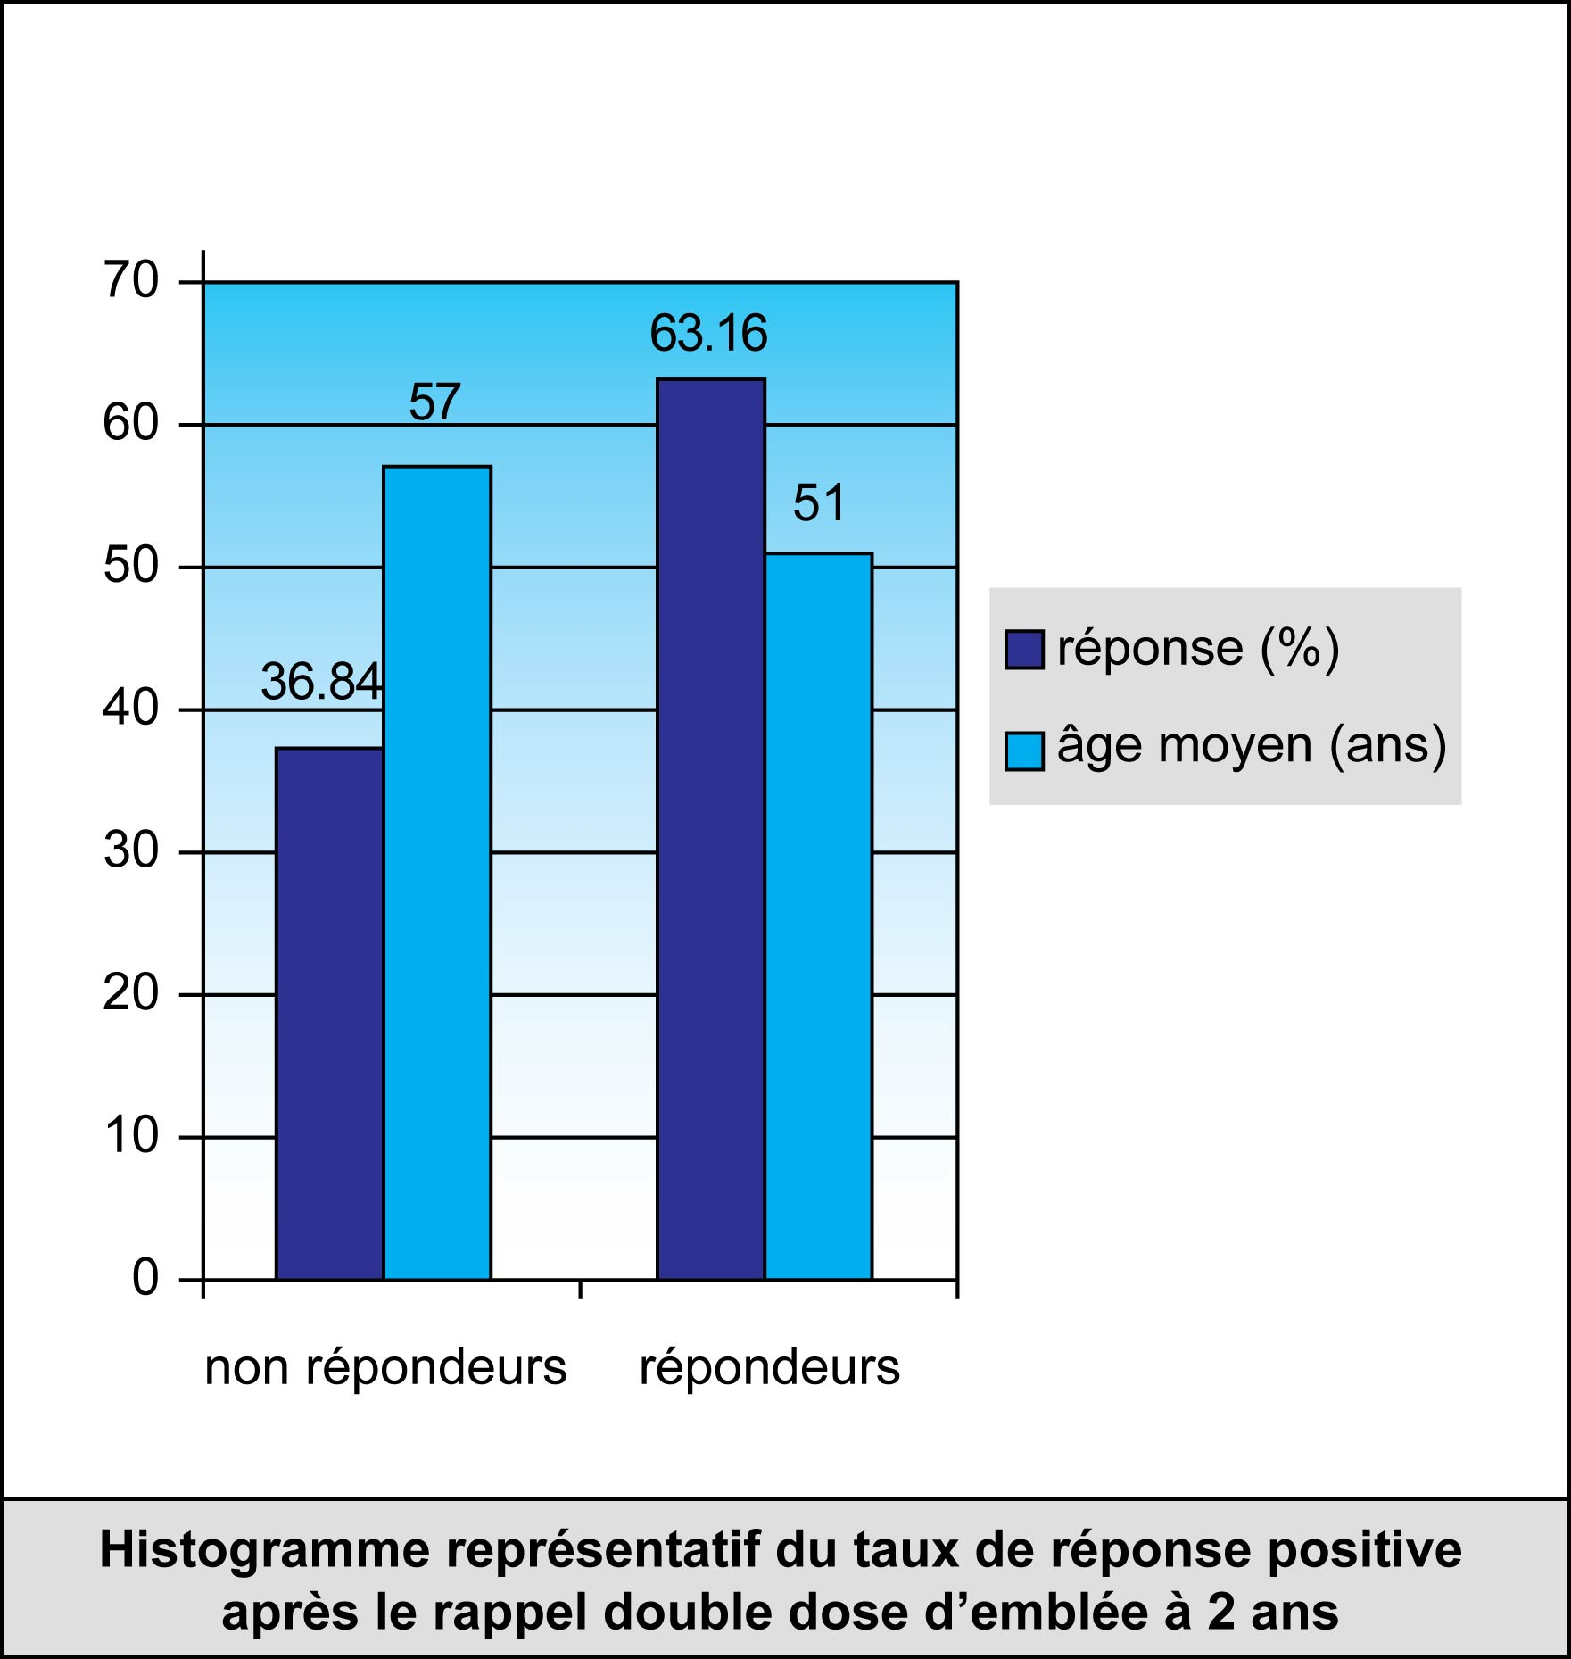
Response (%)
Mean age (years)
nonresponders
responders
1 dose boost at 2 Y

Slide 31
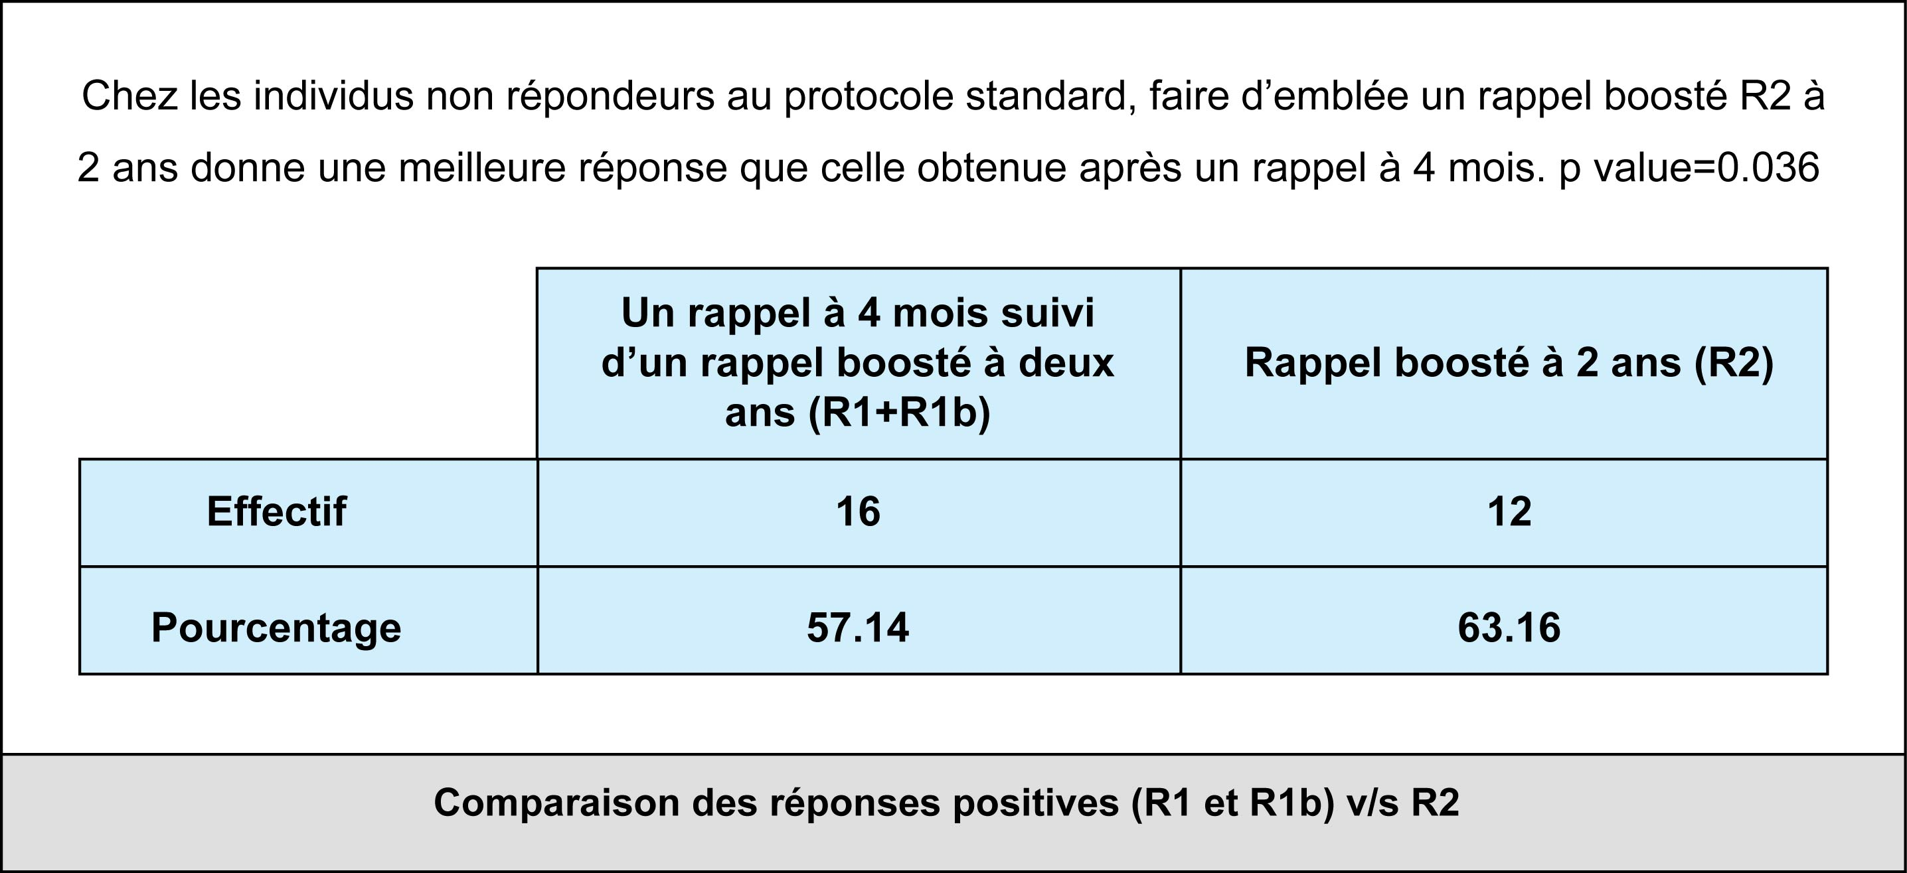
P1=(+4 M + 2 Y) v/s P2=(+2 Y)
P=0,036
Comparaison of positive response rates of P1 v/s P2

Slide 32
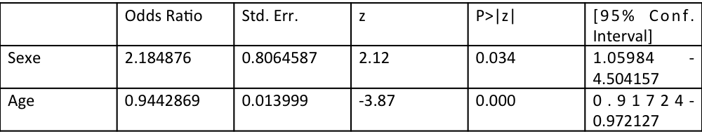

Slide 33
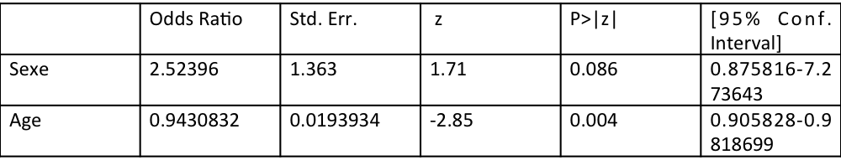

Slide 34
CONCLUSION :
For nonresponders
gives a better response than
a single booster done after 4 M
a unique double booster done after 2 Y of SP
a single booster done after 4 M followed by a double booster done after 2 Y.
a similar response to
The female gender and the age are 2 factors that decrease the response to the vaccination.

Slide 35
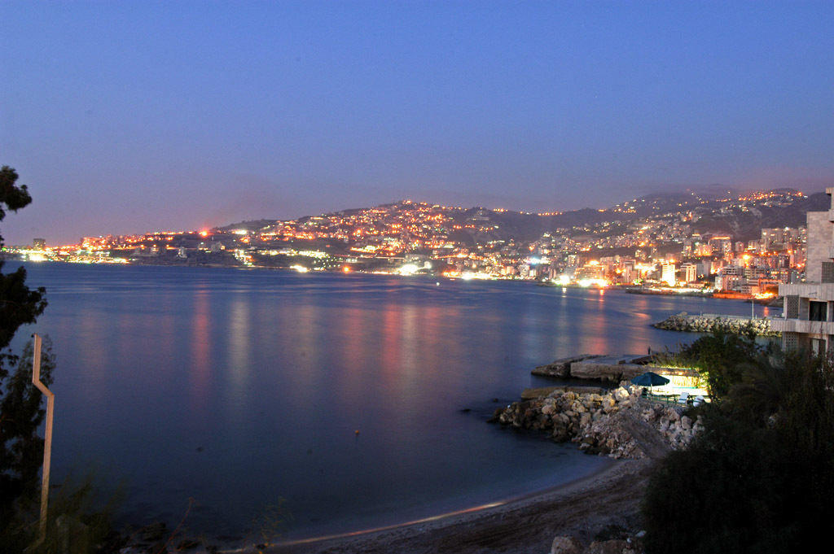
Thank you for your attention

