Slide 1

SIMULATION, MODELLING AND DIAGNOSTICS
From the «health» of satellite to the health of astronauts
26th-27th September 2016, London (UK)
3rd International Conference on Big Data Analysis and Data Mining
Ing. Jacopo Biancat SATE S.r.l. - R&D - Diagnostics
jacopo.biancat@sate-italy.com

Slide 2

Summary
COMPANY INTRODUCTION
PROBLEM AND APPROACH
APPLICATION EXAMPLES IN THE SPACE SECTOR
APPLICATION EXAMPLES IN THE MEDICAL SECTOR

Slide 3
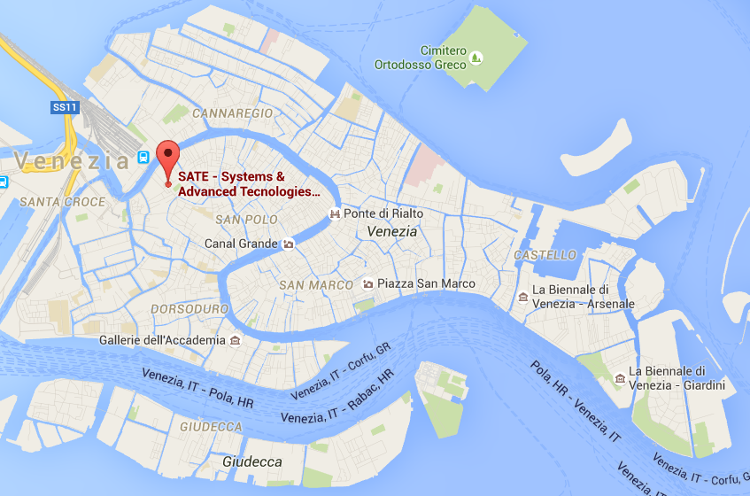


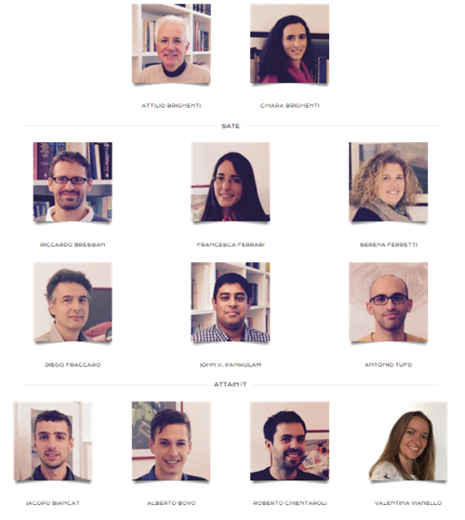
SATE

Slide 4







SATE - Areas of activity
Systems engineering
Software engineering
Simulation and modelling
Knowledge extraction and diagnostics

Slide 5




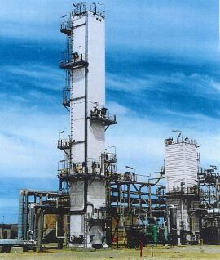

SATE - Domains of application
Oil&gas industry
Upstream & downstream
Automotive: cars, transport vehicles & motorcycles
Space industry
Marine industry
Medical industry
Chemical and power generation industry

Slide 6
Summary
COMPANY INTRODUCTION
PROBLEM AND APPROACH
APPLICATION EXAMPLES IN THE SPACE SECTOR
APPLICATION EXAMPLES IN THE MEDICAL SECTOR

Slide 7

A common problem
Selection of relevant information in the “sea” of data in which we navigate everyday.

Slide 8

Knowledge extraction & diagnostics
Need for automatic methods and/or systems that selects relevant information possibly identifying inconsistencies of a system with respect to expectations or the past behaviour.
HOW DO WE BUILD OUR EXPECTATIONS?

Slide 9

Nominal behavior
This nominal behaviour may be used as reference to automatically identify normal observations and any “new” phenomena
NOVELTY DETECTION OR BROADLY SPEAKING DIAGNOSTICS

Slide 10


Model based approach
Needs knowledge extrapolation and representation by field experts requiring time and resources often not available or not compatible with the constraints

Slide 11

Model based approach
If possible model based approach allows implementing custom solutions tailored to the specific requirements of the customer.

Slide 12

Data-based approach
Historical process data allows generating references of normal conditions without the need of a priori knowledge
SAVING TIME AND RESOURCES

Slide 13
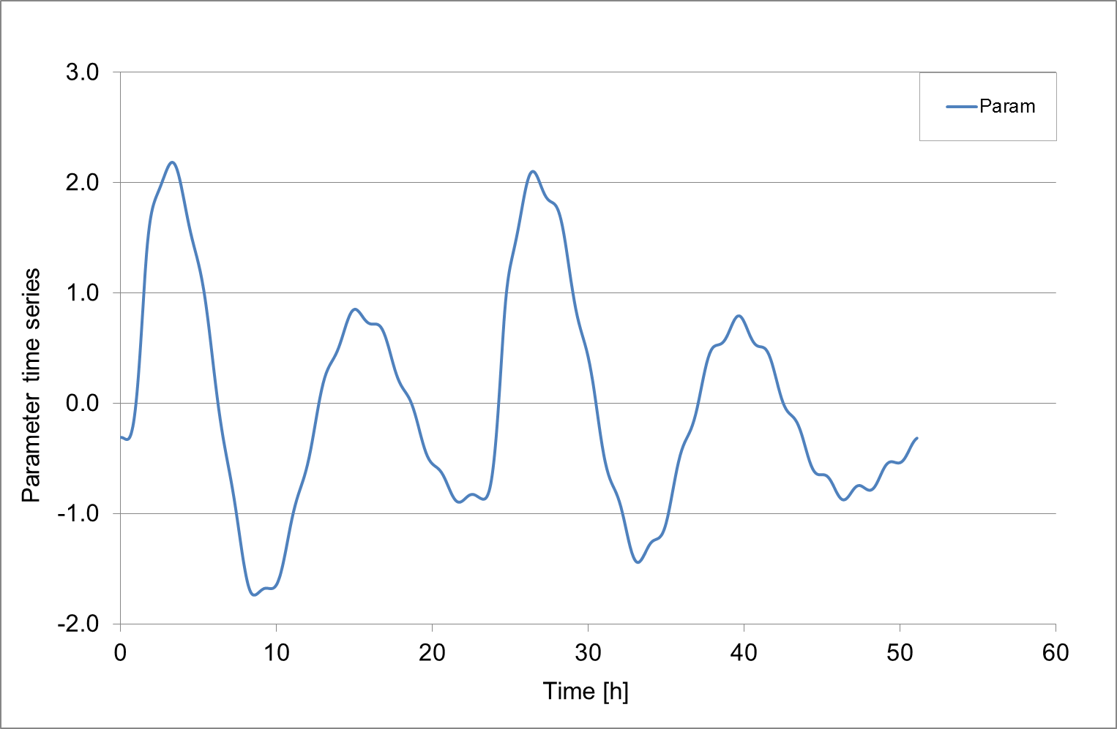
Features
Features are characteristics of a set of data or of a signal or parameter, which can be measured or calculated over a given time window.
‘Parameter time series’ is the time evolution of the raw parameter

Slide 14
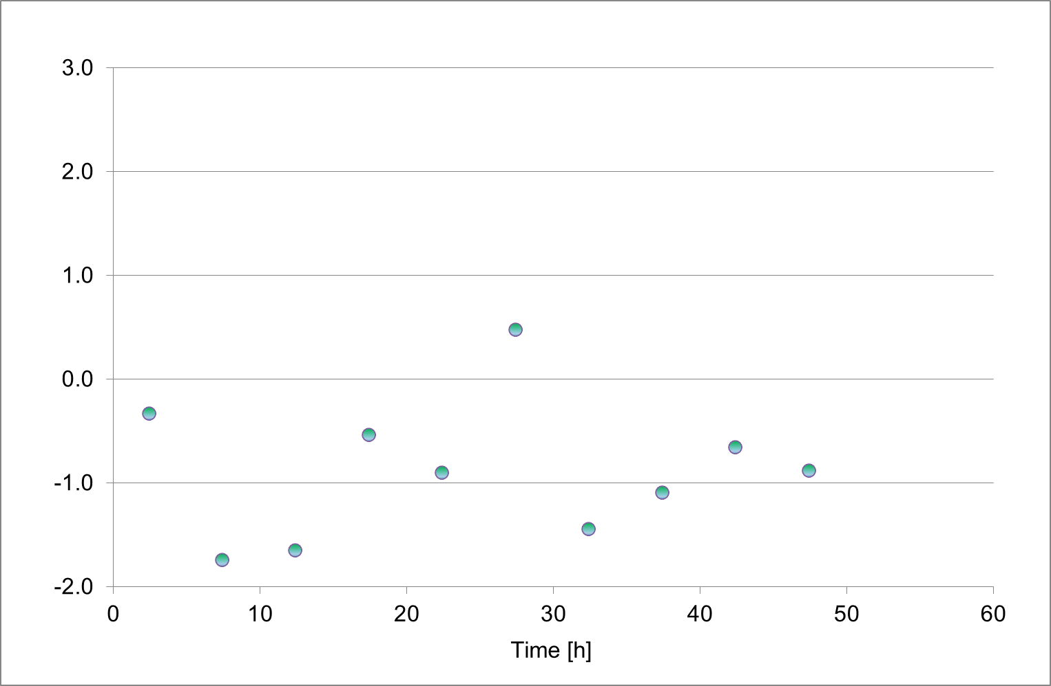
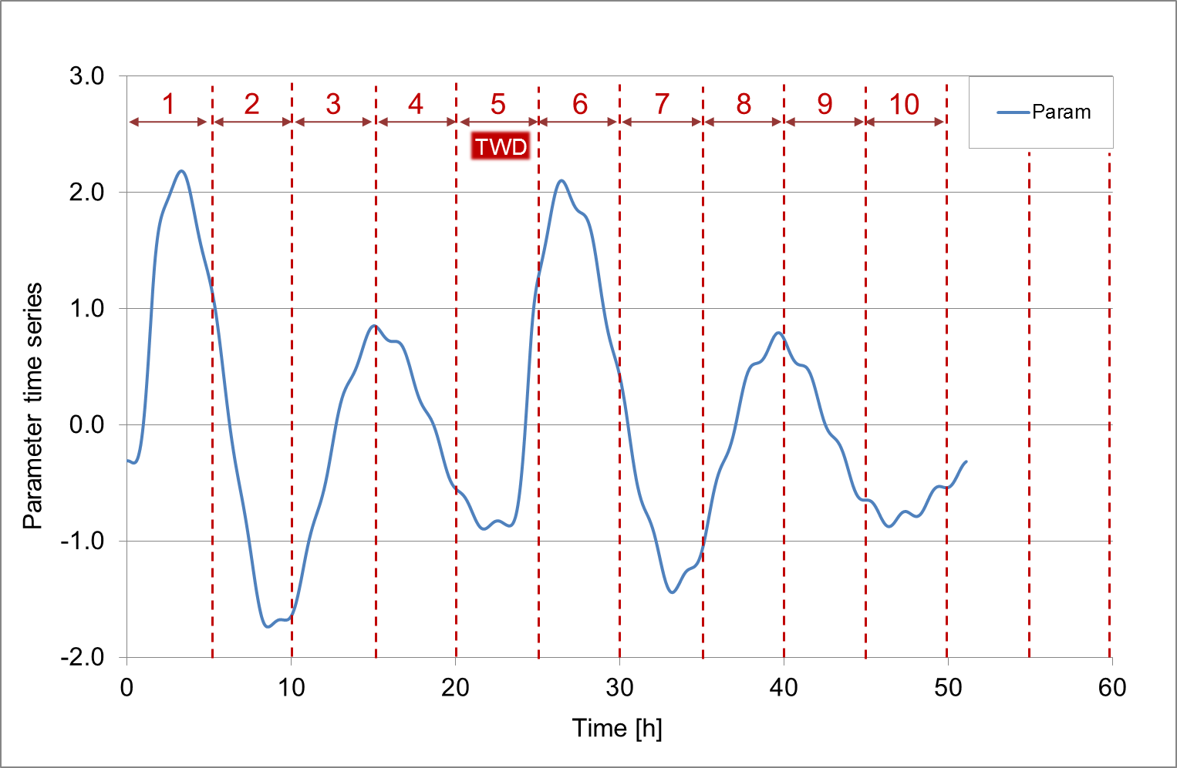
Features
Features are characteristics of a set of data or of a signal or parameter, which can be measured or calculated over a given time window.
‘Time window duration’ (TWD) is the time interval over which features are computed
‘Parameter time series’ is the time evolution of the raw parameter
‘Feature time series’ is the time evolution of the feature

Slide 15
Time window duration
1
2
3
4
5
1
2
3

Slide 16


Possible characterization
Features may be used to characterize the nominal behaviour of a parameter through the characterization either of:
  Single features, thus considering the single feature-time series independently
  Combination of different features computed over the same time window building the so-called feature-based patterns.

Slide 17

Example in the space sector

Slide 18

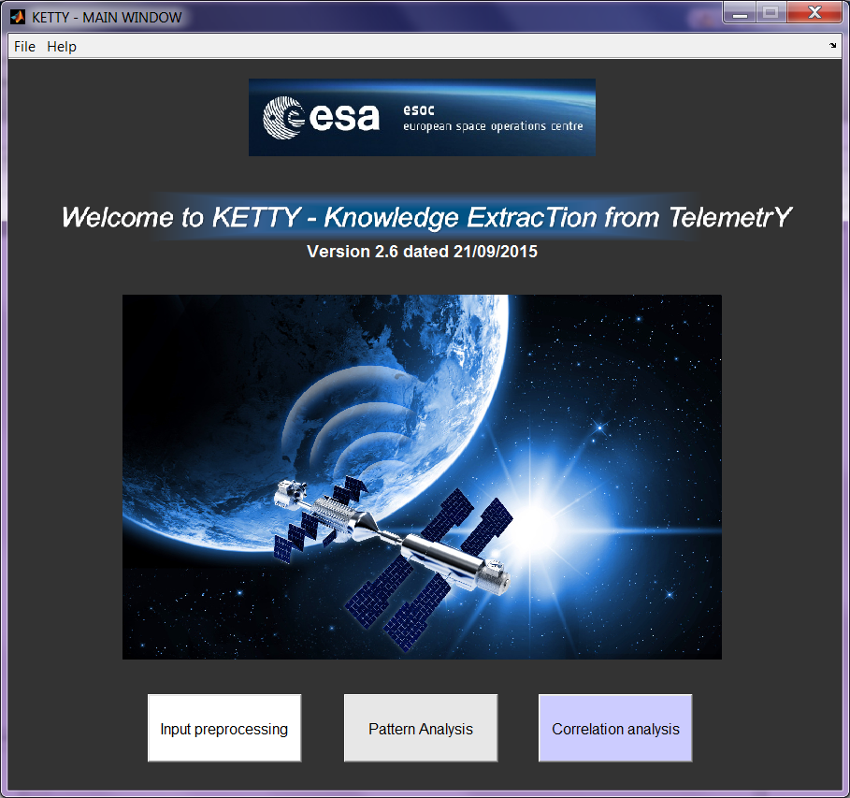
KETTY
Knowledge ExtracTion from TelemetrY
INTEGRATED WITH COMPLEMENTARY SW BY THIRD PARTIES

Slide 19



Knowledge extraction
2013
Knowledge extraction is based on the comparison between data acquired in two different time periods, in order to detect novelties in the behaviour of the parameters.
2014
Reference dataset
2015
2016
Comparison dataset

Slide 20
Priority scores
All the methods implemented for the behaviour evaluation allow generating a priority list, in which parameters are ordered by degree of novelty detected by the specific method.
Exceedance
Normal behaviour
Check range
Observation
Exceedance
Novel behaviour
Check range
Observation
Exceedance
Check range
Symptomatic variable =
(degree of novelty)

Slide 21
Example 1 - Long-term novelty detection
Reference dataset
Comparison dataset
3 months
3 months
Novelty detection

Slide 22
Example 2 - Short-term novelty detection
Reference dataset
Period N° | Period starting date and time | Period ending date and time | Sympt. variable
9 | 2009-05-01,00:00:00 | 2009-05-02,23:59:48 | 0.329
8 | 2009-04-29,00:00:00 | 2009-04-30,23:59:48 | 0.271
10 | 2009-05-03,00:00:00 | 2009-05-04,23:59:48 | 0.255
7 | 2009-04-27,00:00:00 | 2009-04-28,23:59:48 | 0.252
11 | 2009-05-05,00:00:00 | 2009-05-06,23:59:48 | 0.232
12 | 2009-05-07,00:00:00 | 2009-05-08,23:59:48 | 0.232
26 | 2009-06-04,00:00:00 | 2009-06-05,23:59:48 | 0.206
36 | 2009-06-24,00:00:00 | 2009-06-25,23:59:48 | 0
37 | 2009-06-26,00:00:00 | 2009-06-27,23:59:48 | 0
38 | 2009-06-28,00:00:00 | 2009-06-29,23:59:48 | 0
40 | 2009-07-02,00:00:00 | 2009-07-03,23:59:48 | 0
29 | 2009-06-10,00:00:00 | 2009-06-11,23:59:48 | 0
3 months
Comparison dataset
From 1st to 28th period
From 29th to 40th
3 months
Novelty detection

Slide 23
Problem complexity reduction
S/C telemetry data
(monitored by FCE)
The FCE has to focus only on the priority parameters among the ~ 10 new novelties per day
(a part for those days in which major mission changes occur).
Novelties
(sorted by priority)
New novelties
(sorted by priority)
~10.000 params / day
< 1.000 params / day
(upon relevant events)
~ 10 params / day
(when no special events occur)

Slide 24
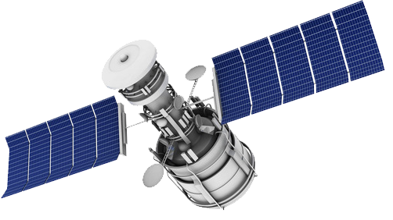
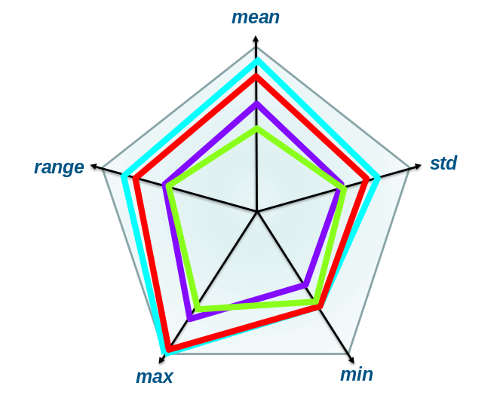
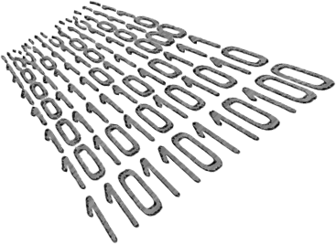
FETCH (FEaTure Checkability) &
Inter period analysis
Extraction of synthetic characteristics (featues) of the monitored data;
Definition of checks to be applied to features;
Definition of checks for features with multiple normal reference behaviours;
Evaluation of usefulness and reliability of checks;
without the need of a priori knowledge about the system.

Slide 25
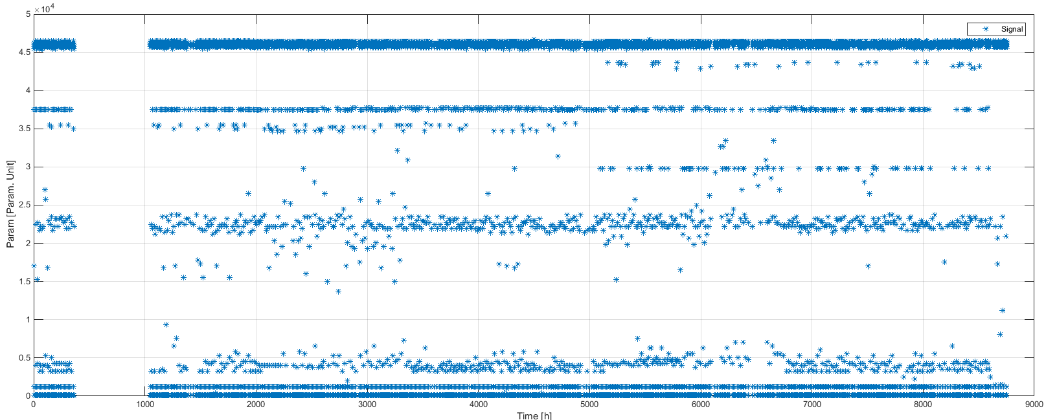
Example: Parameter time series
Example of different checks applied to the parameter using different TWD

Slide 26
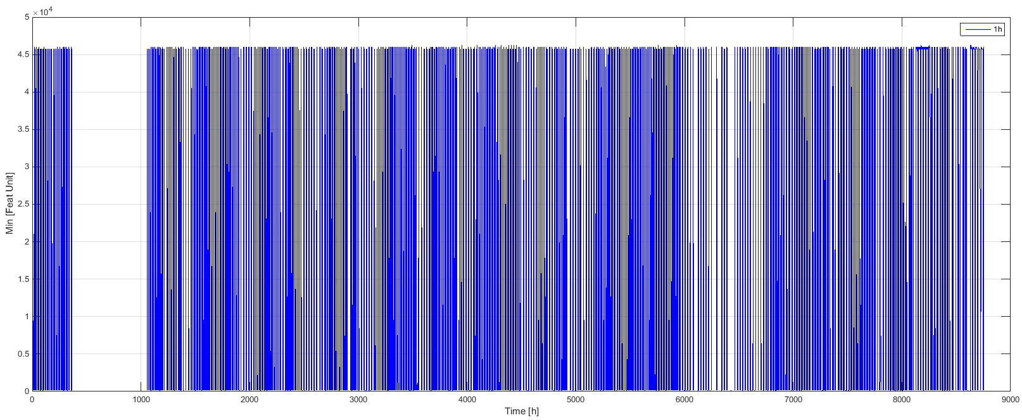
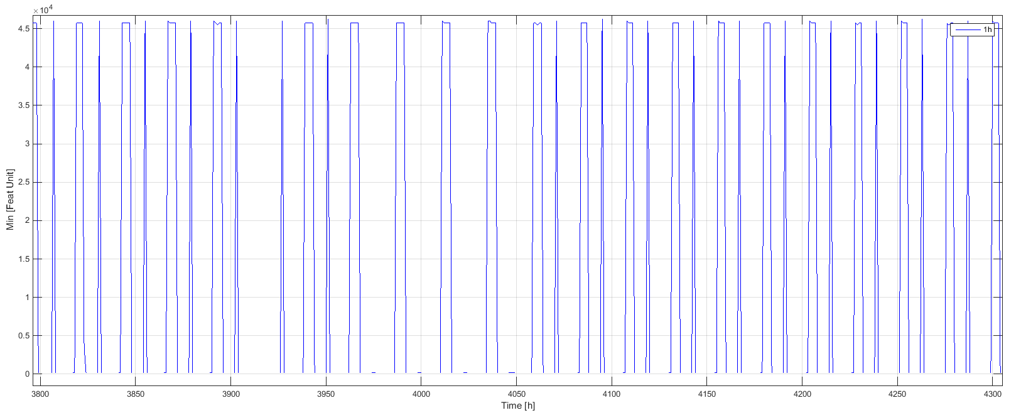
Example: TWD = 1h
Feature time series “Minimum” with TWD = 1h
Feature time series has a recognizable periodicity
FREQUENCY CHECK

Slide 27
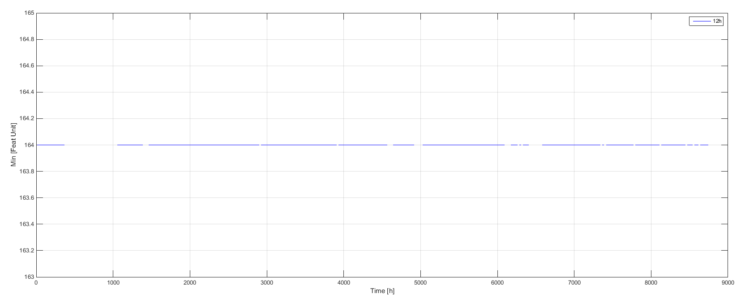
Example: TWD = 36h
Feature time series “Minimum” with TWD = 36 h
Feature time series is constant
DOMAIN CHECK (VALUES CHECK)
Conclusion:
Different TWD
DIFFERENT TYPES OF CHECK

Slide 28

Example in the medical sector

Slide 29
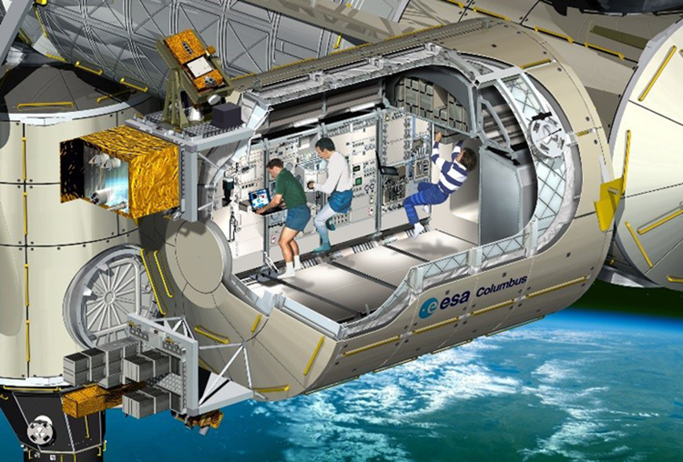

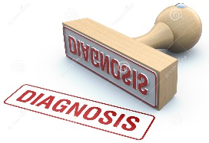

Knowledge extraction for medicine
ECG DATA
60.000 ECG records of 41.000 patients
LABORATORY DATA
87.000.000 laboratory test data of more than 650.000 patients

Slide 30

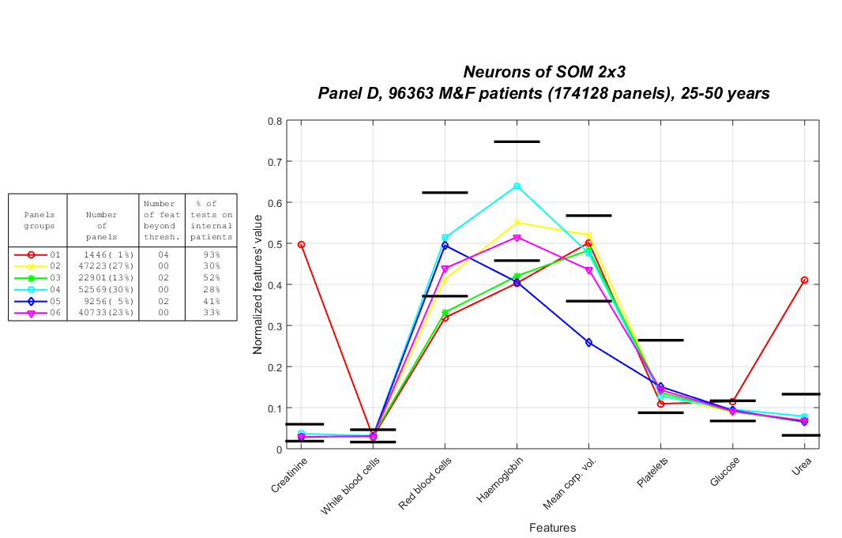
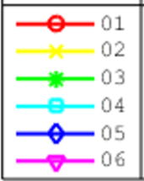
Lab data - Clustering results
Patterns
Clustering with 6 groups
Standard medical thresholds.
Used only
to interpret the results.

Slide 31
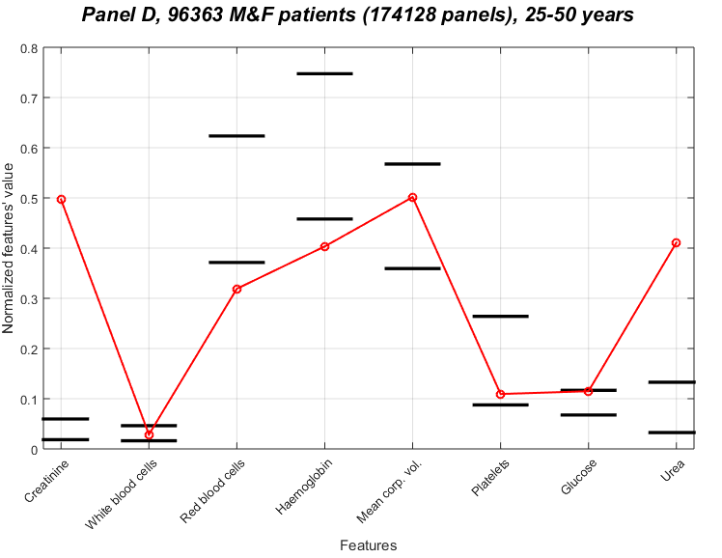
Clustering results - Patterns
Renal failure (very high values of creatinine and urea) often characterized also by anaemia (low values of red blood cells and haemoglobin).
Pattern 1

Slide 32
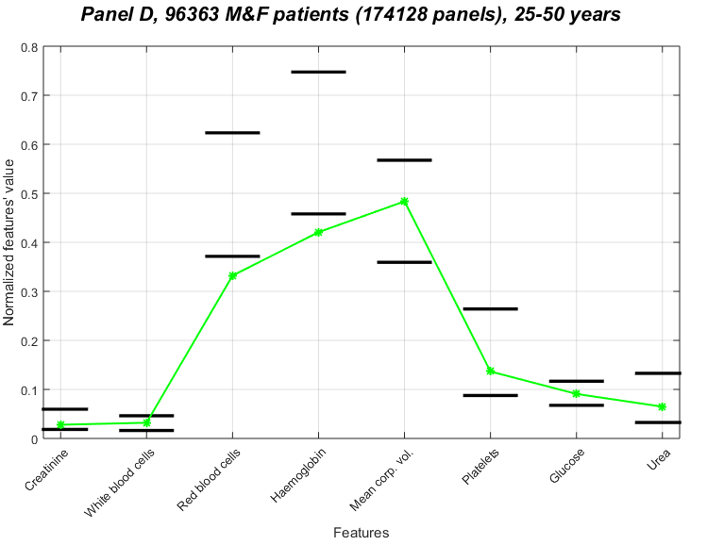
Clustering results - Patterns
Anaemia due to lack of the vitamin B12, which is characterized by large red blood cells.
Pattern 3

Slide 33
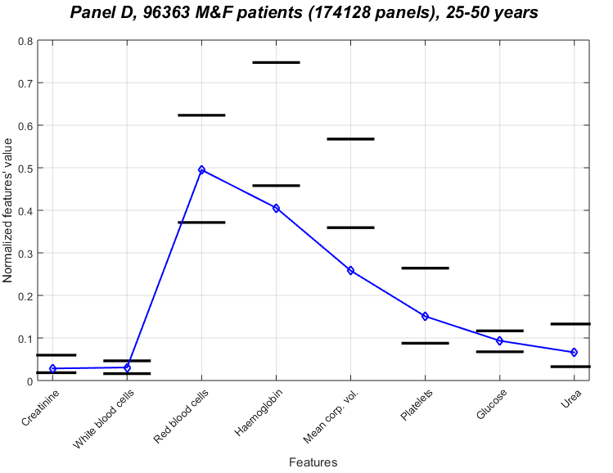
Clustering results - Patterns
Anaemia due to lack of the iron
(small red blood cells ➔ reduction of haemoglobin and mean corpuscular vol.).
Pattern 5

Slide 34
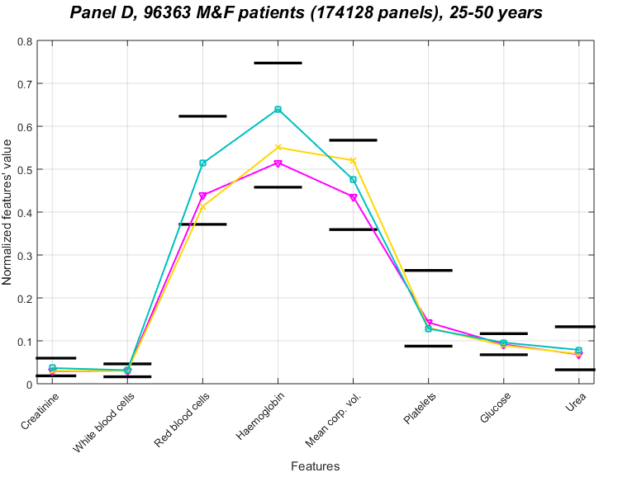
Clustering results - Patterns
All work orders within the reference medical thresholds ➔
➔ NO pathologies are associated to these patterns ➔ healthy patients.
89% Men
70% Women
83% Women
Pattern 2
Pattern 4
Pattern 6

Slide 35
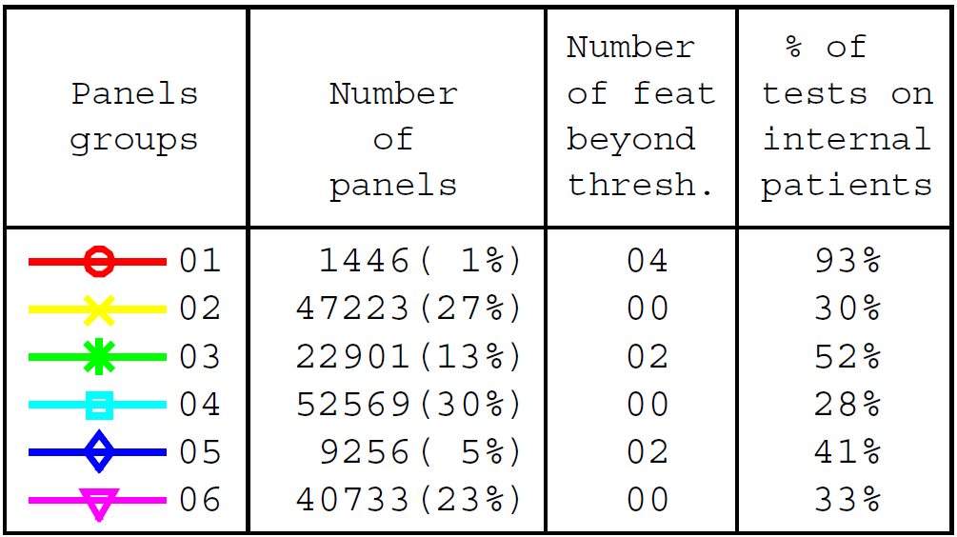
Clustering results - Patterns
Each broken line represent a group of patients with similar medical conditions, automatically detected by the clustering method.
Group 1 Group 4
Group 2 Group 5
Group 3 Group 6
Healthy
Anaemia (iron)
Renal failure
Standard medical thresholds
Anaemia (vitamin B12)
Patterns associated to diseases are characterized by higher percentage of tests carried out by internal patients, usually sick persons.
Work Orders

Slide 36
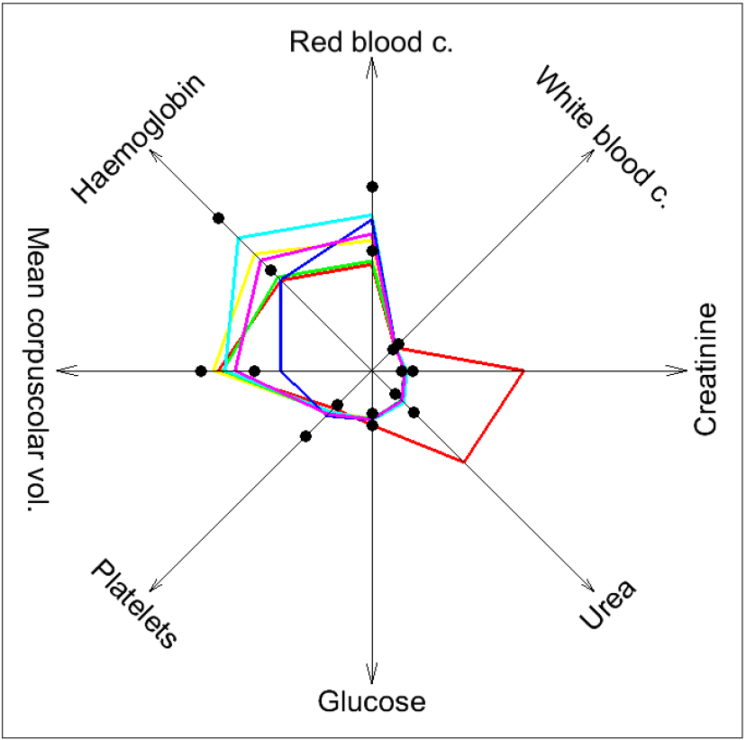
Clustering results - Radar chart
Groups
Work orders (Features)
Standard medical thresholds
●

Slide 37
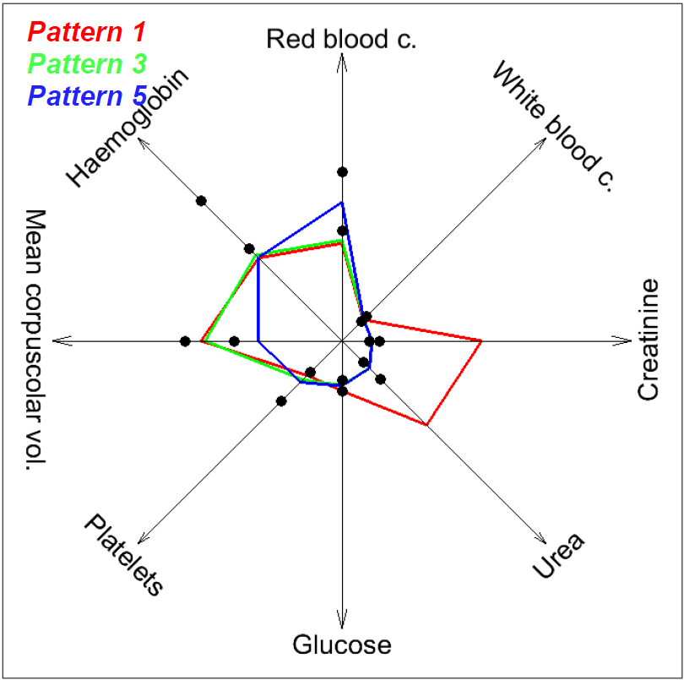
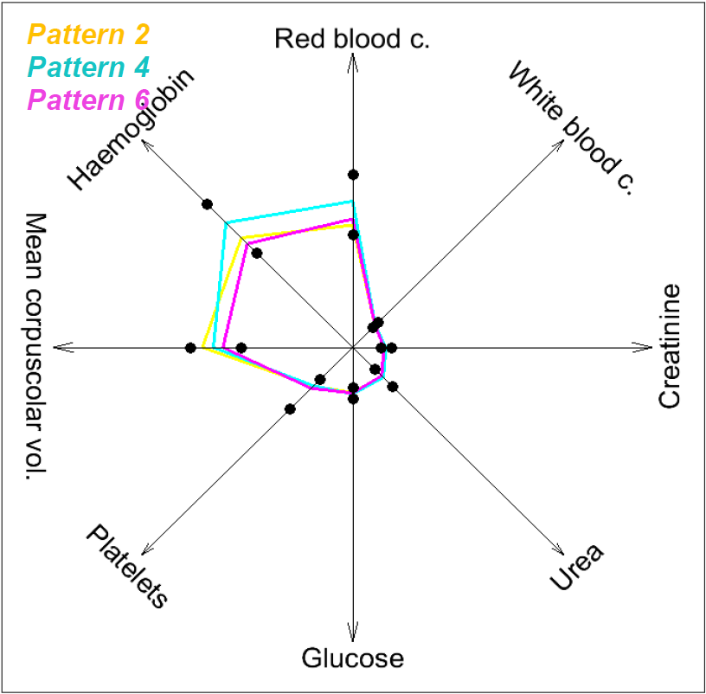
Clustering results - Radar chart
PATHOLOGICAL PATTERNS
HEALTHY PATTERNS

Slide 38
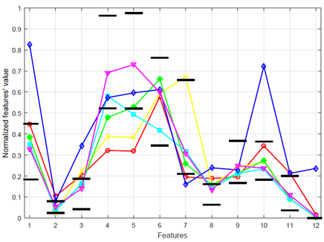
Unknown correlation identified
The method may be used for additional medical investigations like unknown correlations, i.e. specific clinical markers can be used to detect patterns related to specific pathologies and analyse the work orders correlations.
Unknown correlation to heart attack
Pattern associated to patients affected by heart attacks
High value:
features
1, 3, 8, 10
Troponin.
Clinical marker related to heart attacks.
Low value:
feature 7

Slide 39


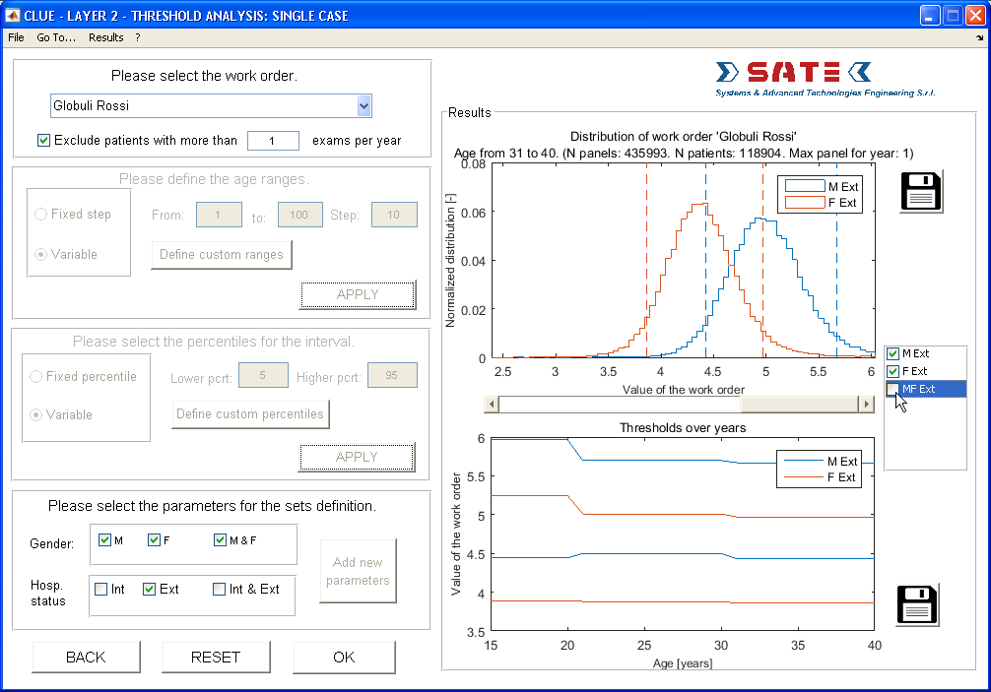
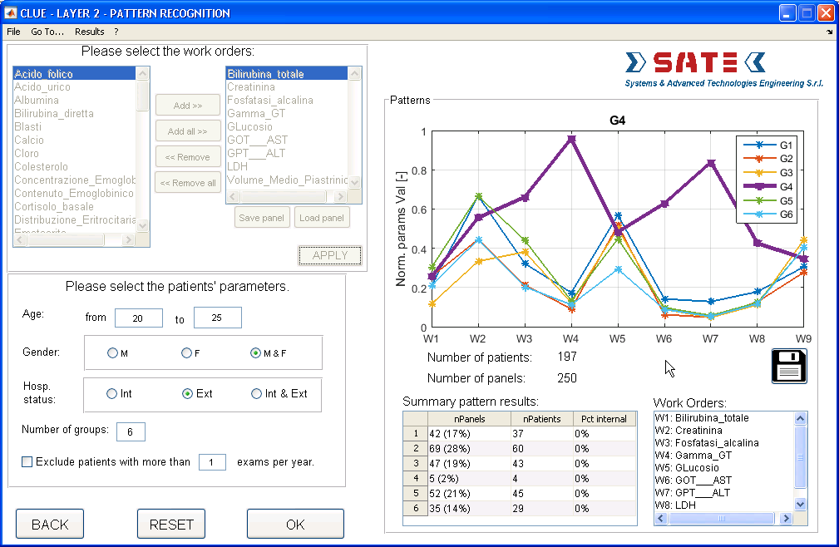
CLUE - TOOL FOR CLINICAL LABORATORY DATA UNDERSTANDING AND KNOWLEDGE EXTRACTION
Automatizing (i.e. improve the efficiency of) the interpretation of laboratory data generating suggested diagnoses based on the medical knowledge extracted.
Enhancing laboratory data interpretation and pathology characterization by physicians, allowing also sharing the extracted medical knowledge among them.
STATISTICAL ANALYSIS
PATTERN RECOGNITION

Slide 40
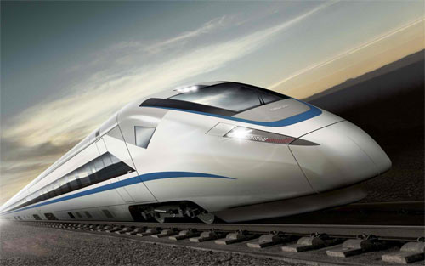

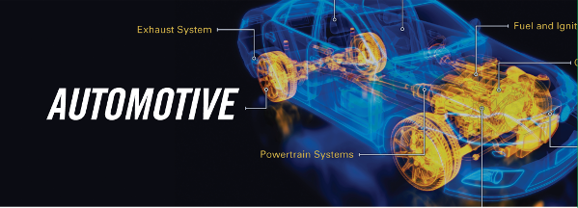



Technology transfer

Slide 41

THANK YOU!
QUESTIONS?

