Slide 1
Measurement of Regional Metabolic Liver Function by Non-invasive Dynamic ¹⁸F-FDGal PET/CT
Jacob Horsager
Department of Nuclear Medicine & Pet-Centre
Department of Hepatology & Gastroenterology
Aarhus University Hospital, Denmark

Slide 2
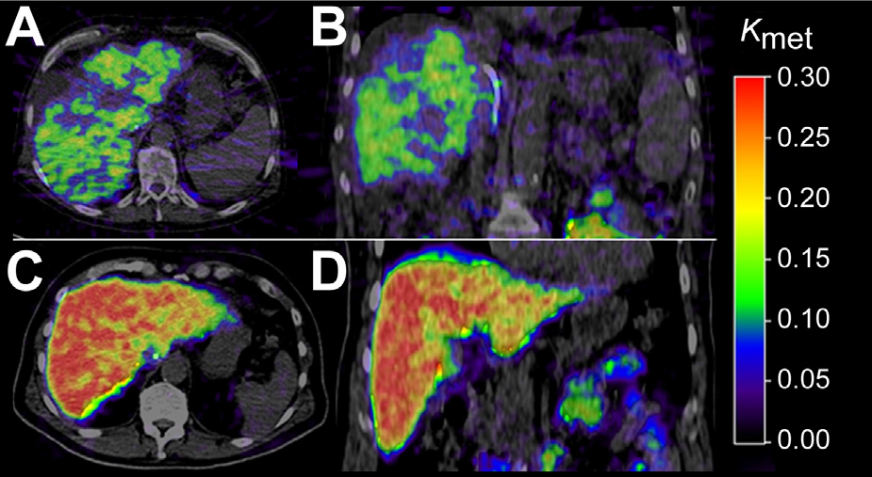
PRIMARY MESSAGE
3D images of regional hepatic metabolic function can be generated from 20 min dynamic PET/CT

Slide 3
Agenda
Description of the method
  PET-procedure
Non-invasive
Perspectives

Slide 4
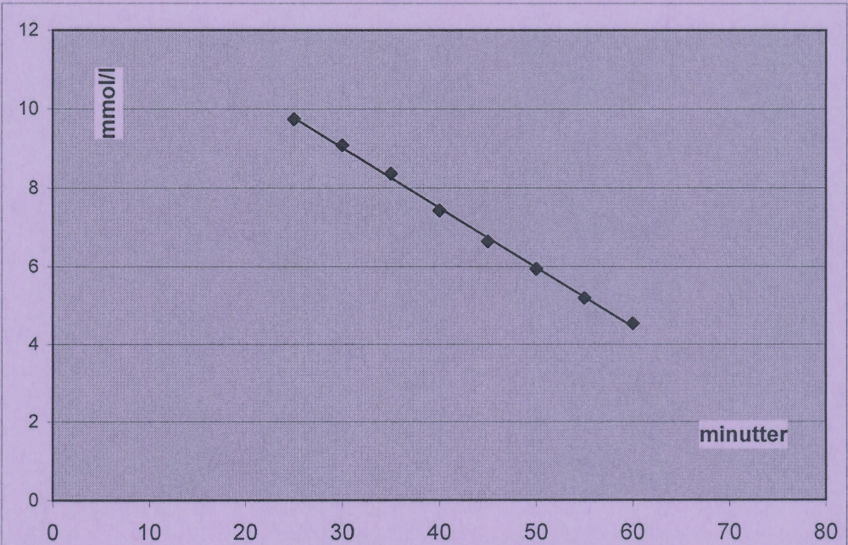
Measurement of global liver function
Galactose elimination capacity test (GEC)
Galactose injection
Max. Removal Rate (V_{max})
Healthy vs sick

Slide 5
Measurement of regional liver function
Liver specific tracer: ¹⁸F-FDGal
Dynamic PET/CT
Kinetic analysis

Slide 6
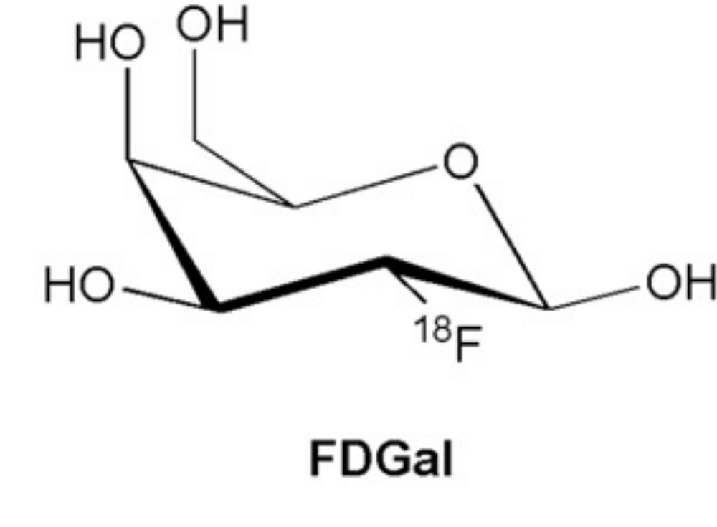
PET-tracer
¹⁸F-FDGal – liver specific
Commercially available products
Same setup as ¹⁸F-FDG-synthesis
Frisch, K et al., Nuclear Medicine and Biology, 2007

Slide 7
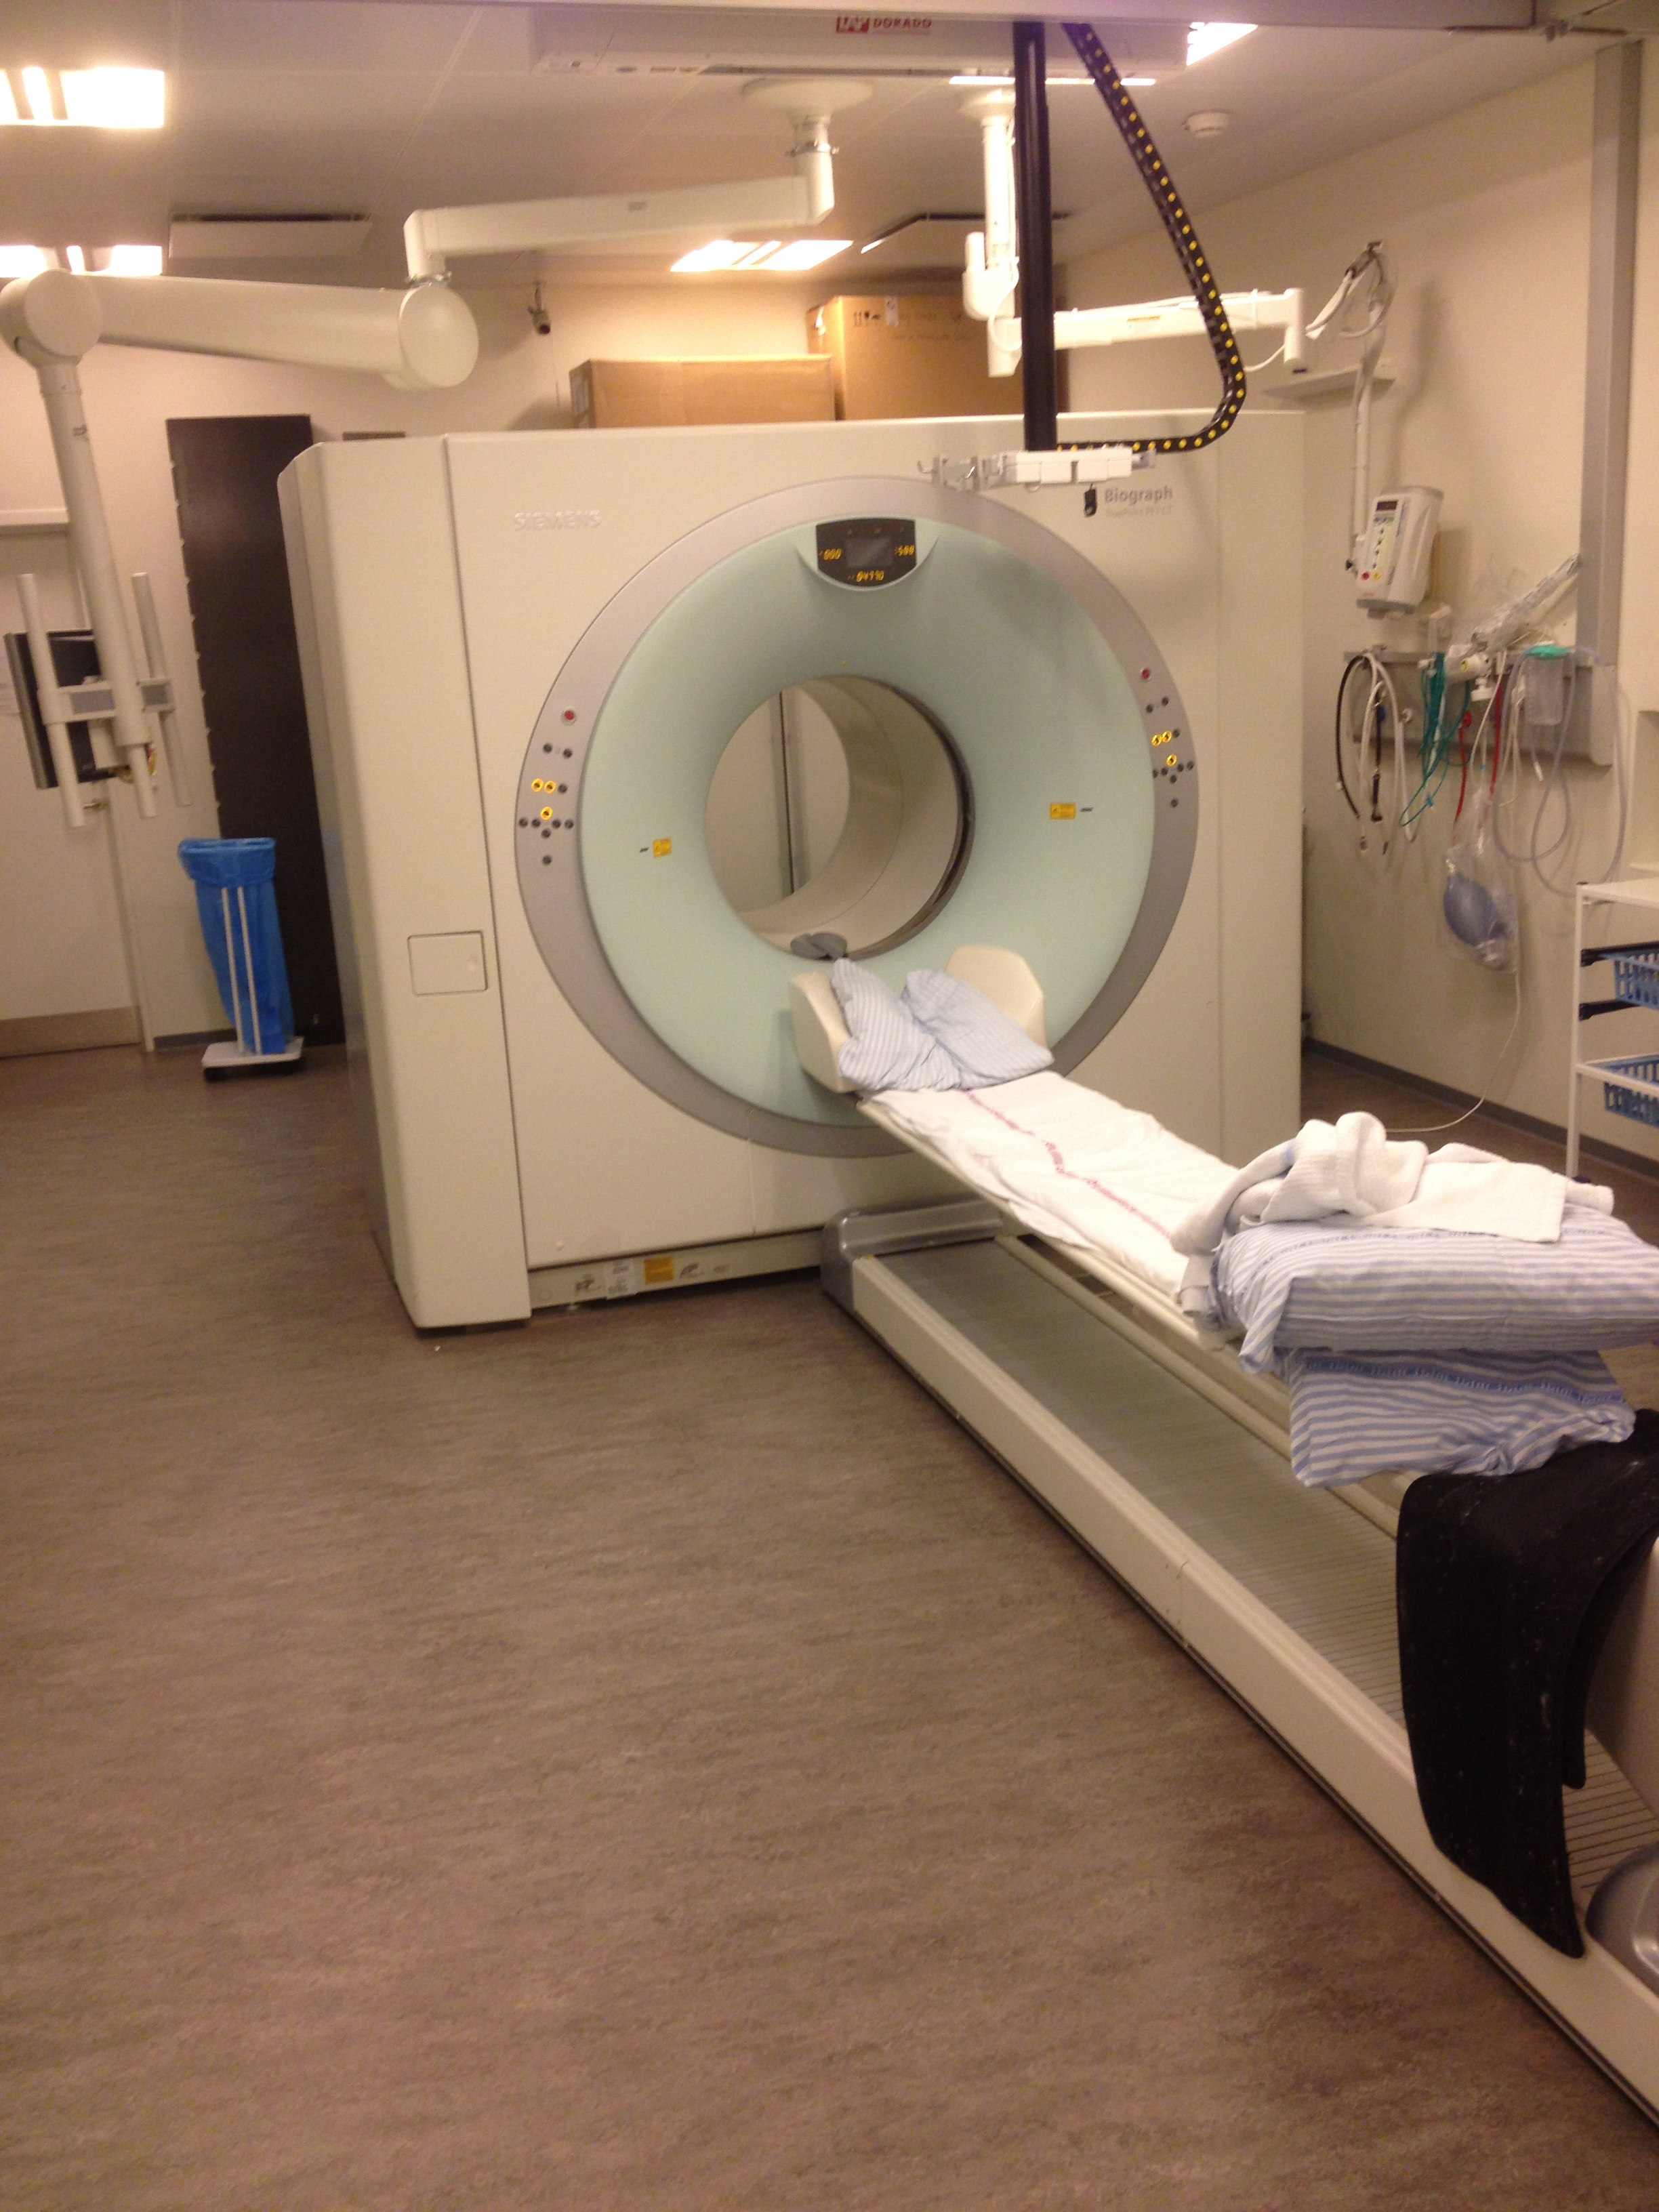
PET-procedure
Supine position
CT
Injection of 100MBq ¹⁸F-FDGal
20min dynamic PET in list mode

Slide 8
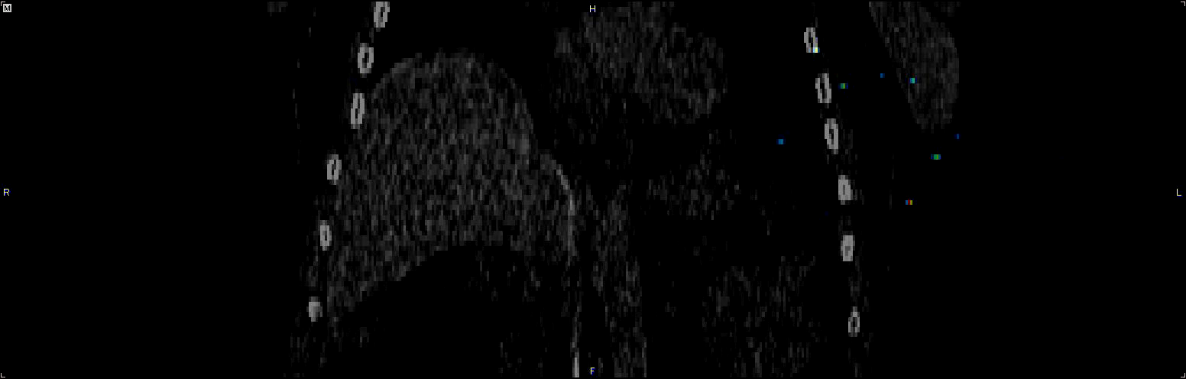
Dynamic ¹⁸F-FDGal PET/CT

Slide 9
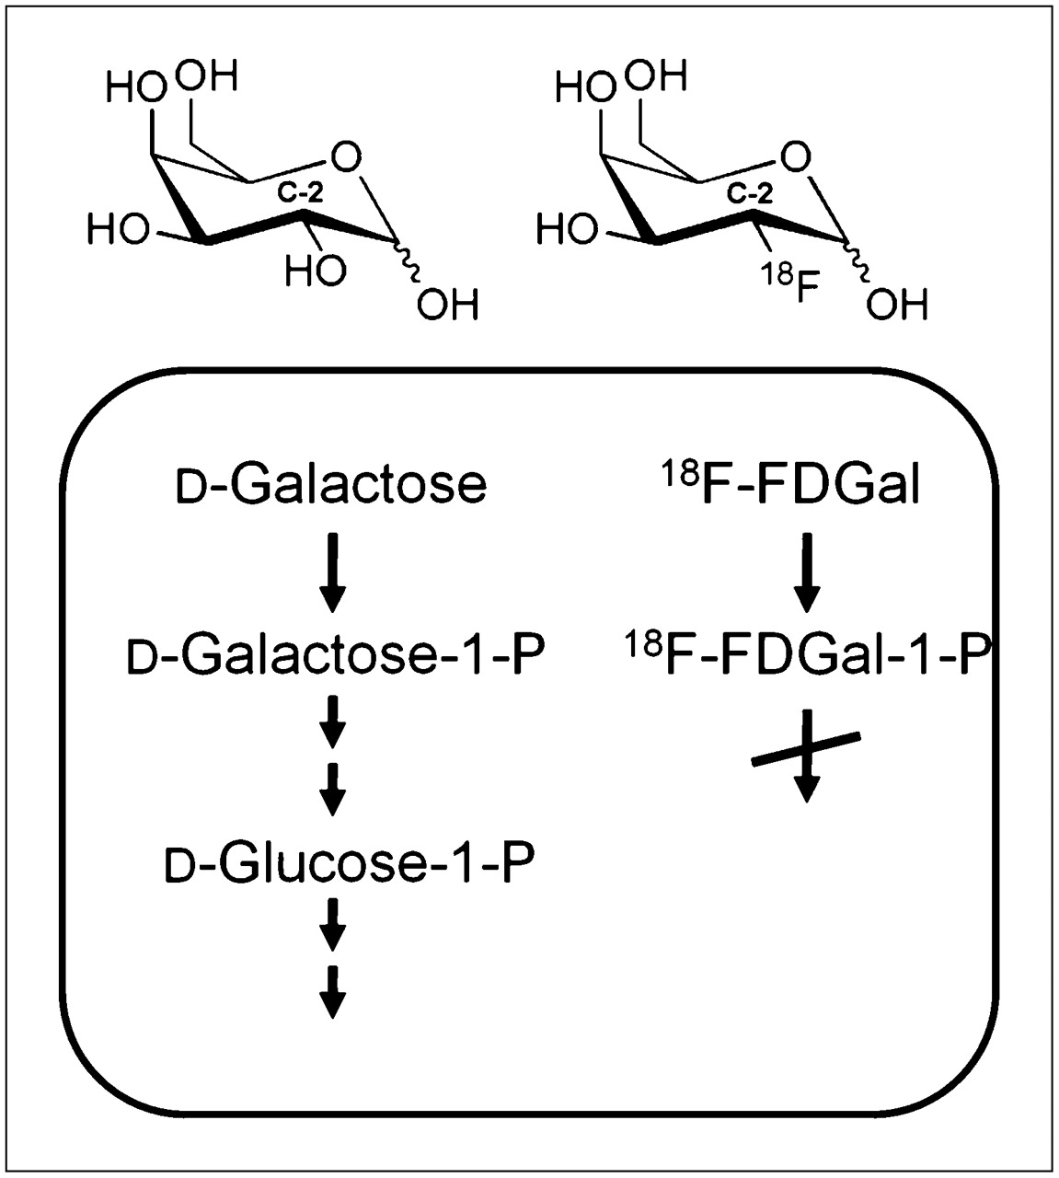
Metabolism
Galactokinase
Sorensen, M et al. J. Nucl. Medicine, 2011

Slide 10
Kinetics
Clearance depends on the amount of galactokinase
Enzyme determined clearance
Amount of galactokinase reflects the metabolic condition of the liver
Clearance can be measured by dynamic PET
Sorensen M et al. J Nuclear Medicine 2011;52(10):1566-1572.
Sorensen M et al. J Hepatol. Jun 2013;58(6):1119-1124.

Slide 11
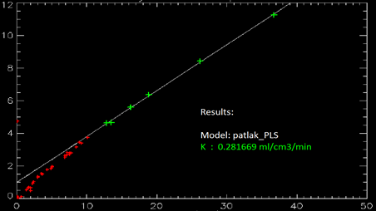
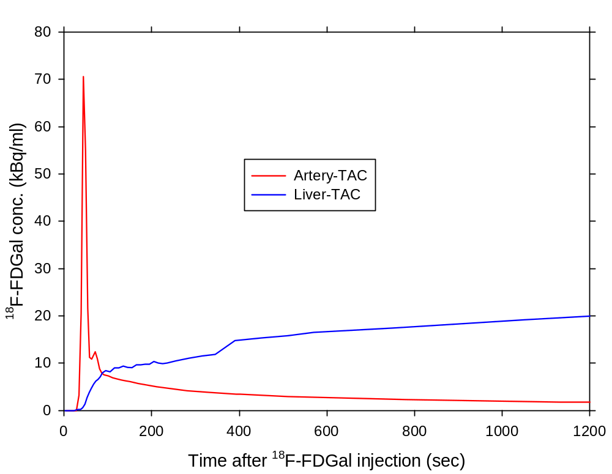
Calculations
1) Input: TAC from arterial blood
2) Output: TAC from liver on dynamic PET
Gjedde-Patlak kinetic analysis
Clearance /
Hepatic metabolic function

Slide 12
The Parametric Image
[ml_{blood} /ml_{liver tissue} /min]
Sørensen M, et al.
J Hepatol 2013;58:1119-1124.
Healthy subjects (n=8): K_{met} 0.27 mL blood/mL liver tissue/min. CoV: 14%.
Patients with liver disease (n=9): K_{met} 0.16 mL blood/mL liver tissue/min. CoV: 24%.

Slide 13
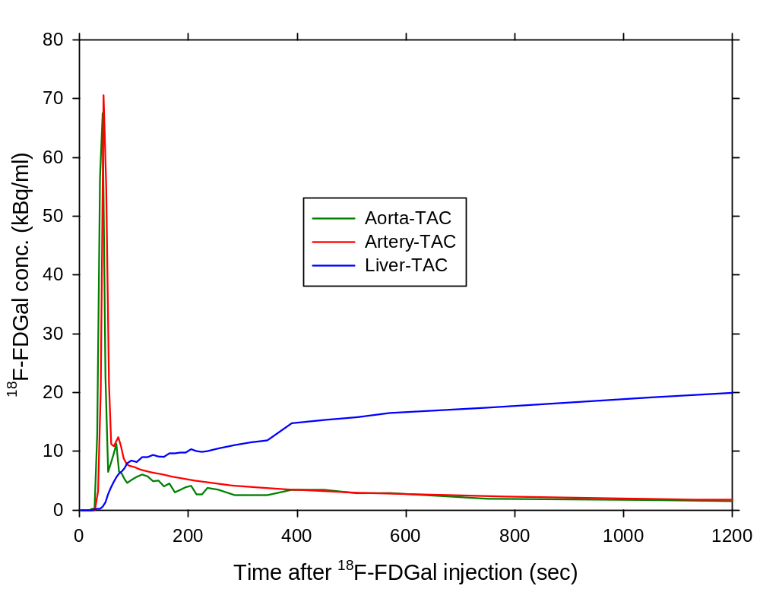
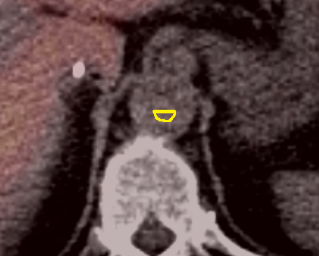
Non-invasive
Horsager et al. EJNMMI Research (2015) 5:32

Slide 14
Non-invasive
1) Input: TAC from arterial blood
2) Output: TAC from liver on dynamic PET
Input: TAC from Aorta-VOI (PET)
Gjedde-Patlak kinetic analysis
Horsager et al. EJNMMI Research (2015) 5:32
Clearance /
Hepatic metabolic function

Slide 15
To sum up
Clearance of ¹⁸F-FDGal can be quantified in vivo, with a 20 min dynamic PET/CT
Clearance of ¹⁸F-FDGal reflects the hepatic metabolic function
We can investigate the regional metabolic differences from parametric images
The method is non-invasive except from iv tracer administration

Slide 16
Perspectives
Stereotactic radiotherapy
Partial liver resection
Sørensen M, et al. J Hepatol 2013;58:1119-1124.

Slide 17
TAKE HOME MESSAGE
3D images of regional hepatic metabolic function can be generated from 20 min dynamic PET/CT

Slide 18



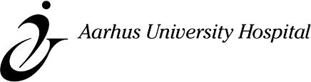
Acknowledgements
Danish Cancer Society
Aase and Ejnar Danielsens Foundation
Oticon Foundation
Collaborators:
  Michael Sørensen
  Susanne Keiding
  Ole Lajord Munk
  Gerda Villadsen
  Kim Frisch
  Lars Larsen

Slide 19
?

