Slide 1


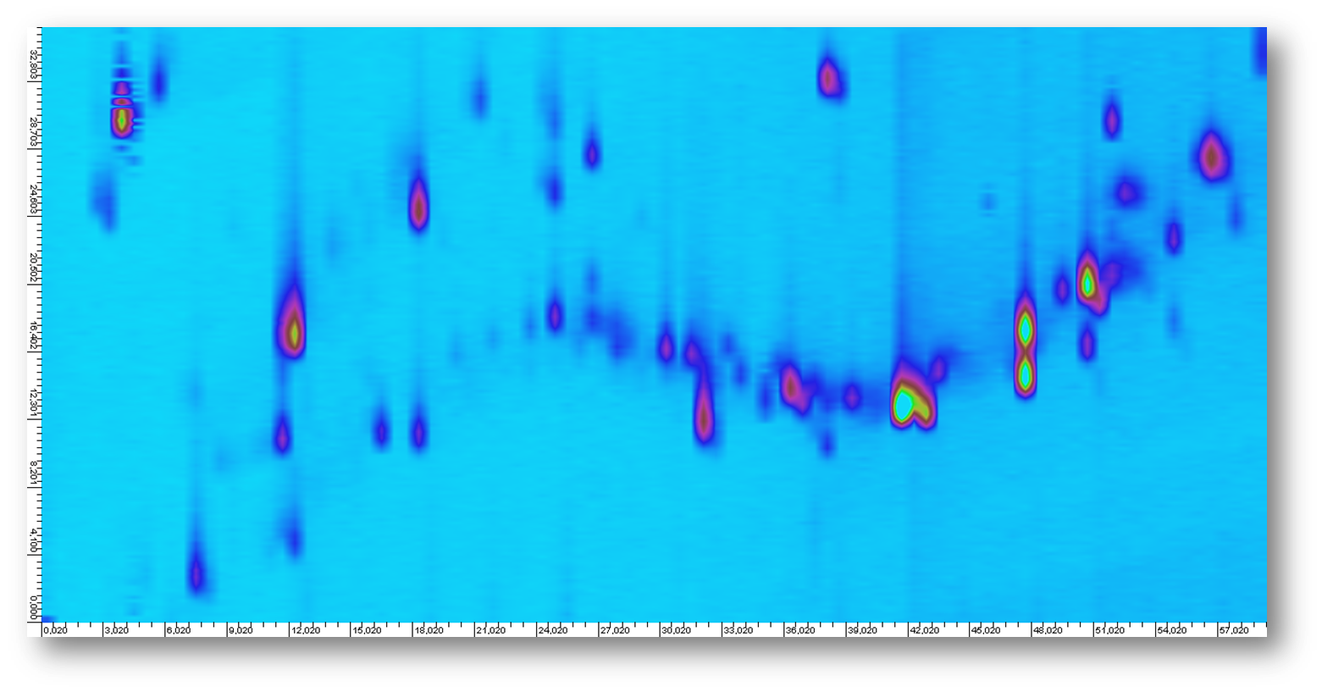

Comprehensive Two-Dimensional Liquid Chromatography for Effect-Directed Analysis in Effluents and Surface Water
Xiyu Ouyang, Jacob de Boer

Slide 2
Objective
Develop an LCxLC system linked to a fraction collector and
high resolution mass spectrometer to support the identification
and monitoring of emerging toxicants in effect-directed
analysis

Slide 3
Instrumentation: LCxLC-ToF MS/UV-FC
loop 1
loop 1
waste
waste
1D column
auto-sampler
1D column
pump 1 (HPLC)
auto-sampler
pump 1 (HPLC)
20%
20%
ESI-TOF-MS
ESI-TOF-MS
2D column
2D column
80%
80%
UV detector
UV detector
fraction collector
fraction collector
pump 2 (UPLC)
pump 2 (UPLC)
loop 2
loop 2
2DLC interface
2DLC interface

Slide 4
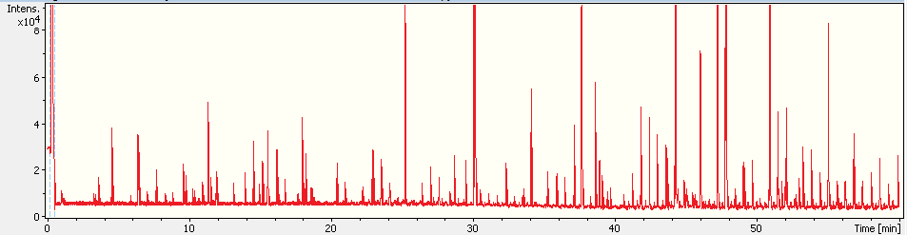
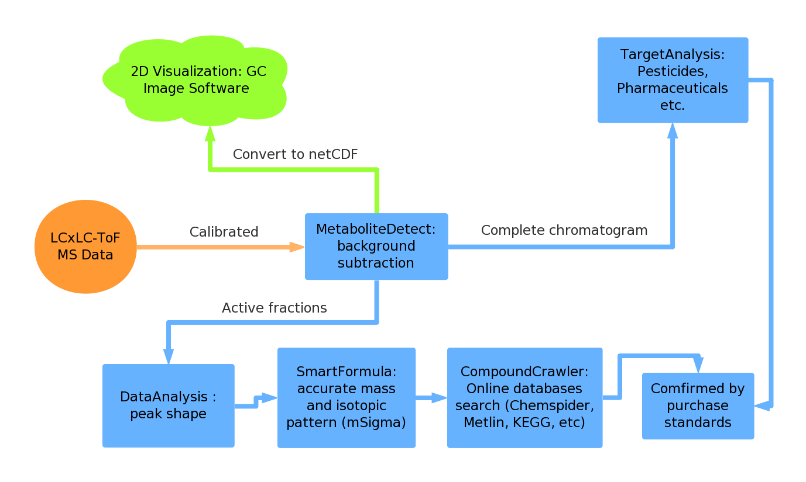
LC×LC-TOF MS Analysis
Dissect: S/N>15
More than 700 compound spectra
Manual “subtraction” necessary
Peak intensity < 10000 counts
Peak intensity > 80000 counts

Slide 5
Stationary phases selection
Mode | IEC× RP | SEC×RP | NP× RP | RP× RP | HILIC× RP | HILIC× HILIC | SEC×NP | SEC×IEC
Orthogonality | ++ | ++ | ++ | + | + | - | + | +
Peak capacity | + | + | + | ++ | + | + | - | --
Peak Capacity/Time | - | -- | + | ++ | + | + | -- | --
Solvent compatibility | + | + | -- | ++ | + | ++ | + | +
Applicability | + | + | - | ++ | + | - | - | -
Score | 4 | 3 | 1 | 9 | 5 | 2 | -2 | -3
Xiaoping Li et al. Journal of Chromatography A, 1218 (2011) 2214–2221

Slide 6
Stationary phases comparison
Three different stationary phases in the 2nd dimension (1st dimension C18) for comparison:
A: Coreshell PH 2.7µm 50x4.6 mm
B: Phenomenex Kinetex PFP 2.6µm 50x4.6 mm
C: HILIC 1.8µm 50x3.0 mm
1D C18 0.1ml/min 60min; 2D 2ml/min 30s H₂O/ACN, UV at 290nm
Orthogonality estimation:
Surface coverage
(vector cross product)
A: 0.643
B: 0.671
C: 0.687
Conclusion: C18×PFP

Slide 7
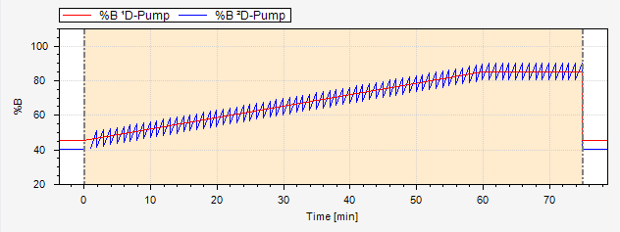
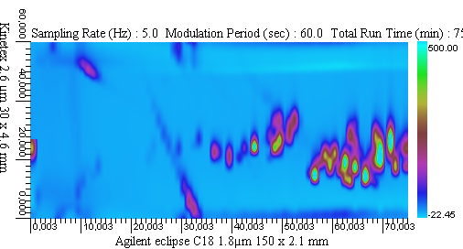
EPA 8270c Mixture (38 compounds)
Semi-volatile compounds from solid waste, soil, air, and water
Acenaphthene | 2,4-Dimethylphenol
Acenaphthylene | Fluoranthene
Acetophenone | Fluorene
Aniline | Hydroquinone
Anthracene | Indeno[1,2,3-cd]pyrene
Benzoic acid | Isophorone
Benz[a]anthracene | 3-Methylcholanthrene
Benzo[b]fluoranthene | 2-Methylnaphthalene
Benzo[k]fluoranthene | 2-Methylphenol
Benzo[ghi]perylene | 3-Methylphenol
Benzo[a]pyrene | 4-Methylphenol
p-Benzoquinone | Naphthalene
Benzyl alcohol | Perylene
Chrysene | Phenanthrene
Dibenz[a]acridine | Phenol
Dibenz[a,h]anthracene | 2-Picoline
Dibenzofuran | Pyrene
Dibenzo[a,e]pyrene | Pyridine
7,12-Dimethylbenz[a]anthracene | Resorcinol
ACN/water system, 30ºC, UV detection at 290nm

Slide 8
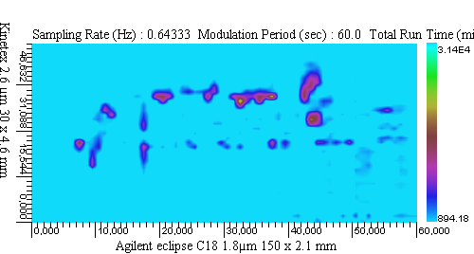
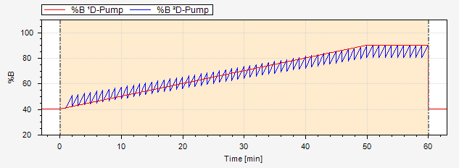
Triazine and Urea Pesticide Mixture (29 compounds)
Atrazine | Isoproturon
Atrazine-desethyl | Metabromuron
Atrazine-desisopropyl | Metazachlor
Metamitron | Propazine
Chloridazon | Dimefuron
Metoxuron | Terbuthylazin
Carbetamid | Linuron
Bromacil | Chloroxuron
Simazine | Prometryn
Cyanazin | Chlorpropham
Terbutylazine-desethyl | Terbutryn
Methabenzthiazuron | Metolachlor
Chlorotoluron | Ethofumesate
Monolinuron | Ethidimuron
Diuron
ACN/water system
Ambient temperature
ESI-TOF detection, 27/29 detectable

Slide 9
Reproducibility (2D retention time stability)
(A) methomyl
(B) 3-hydroxycarbofuran
(C) propoxur
(D) carbofuran
(E) carbaryl
(F) methiocarb

Slide 10
LC/MS Conditions
ToF-MS resolution 10,000
ESI: 4500 V with end plate offset -500 V
Flow rate 2nd dimension: 400 µl/min
Agilent 1260 fraction collector, delay volume: 55 µl
Splitter 1:4
m/z 50-1,000
Nebulizer gas N₂, 4.0 bar
Drying gas: 8 L/min, 200 ˚C
Capillary exit was set at 100 V, skimmer voltage 33.3 V
Hexapole RF: 90 Vpp and lens 1 pre-pulse storage: 1 µs
Bruker OtofControl 3.0 (Bruker Daltonics), 5 Hz scan

Slide 11
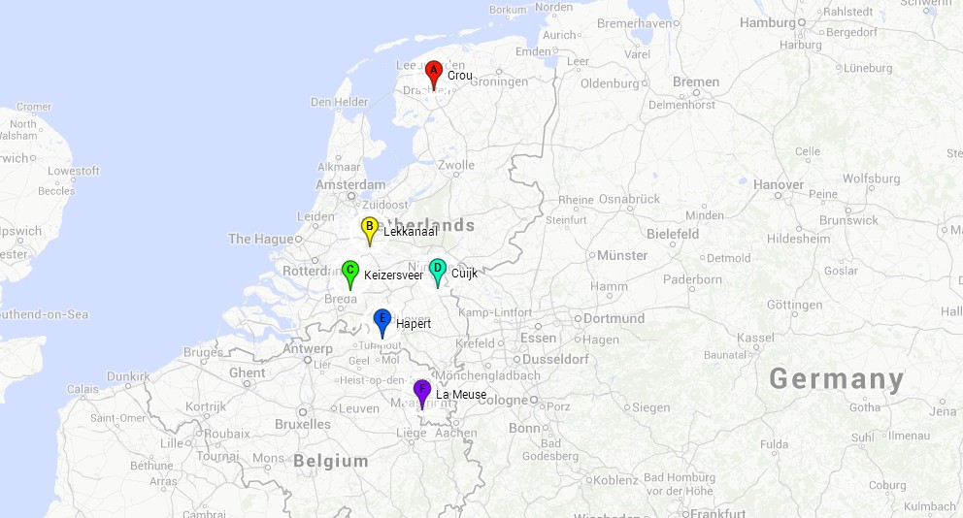
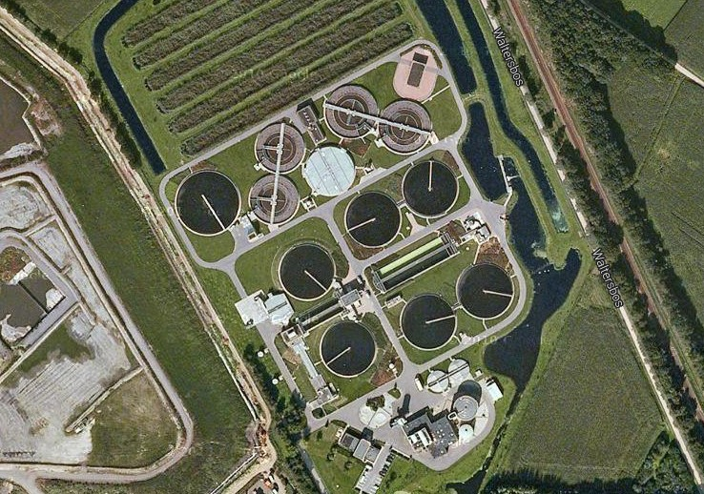
Example: effluent sample from WWTP Cuijk
6 sampling location in NL (surface water, effluent)
silicon rubber passive sampler
large volume solid phase extraction
Courtesy BE-Basic project

Slide 12
Silicon rubber treatment
Silicon rubber blades were cut into small pieces and
collected in pre-cleaned thimbles in the Tecator® Soxtec Avanti
The extraction with 80 ml of a methanol: acetonitrile (1:2 v/v)

Slide 13
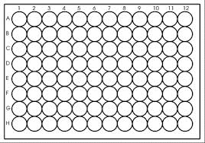
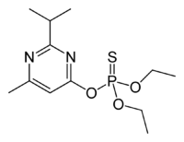
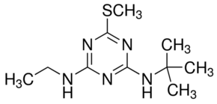
LC×LC of Cuijk WWTP sample
Diazinon
2
4
Terbutryn
1
3

Slide 14
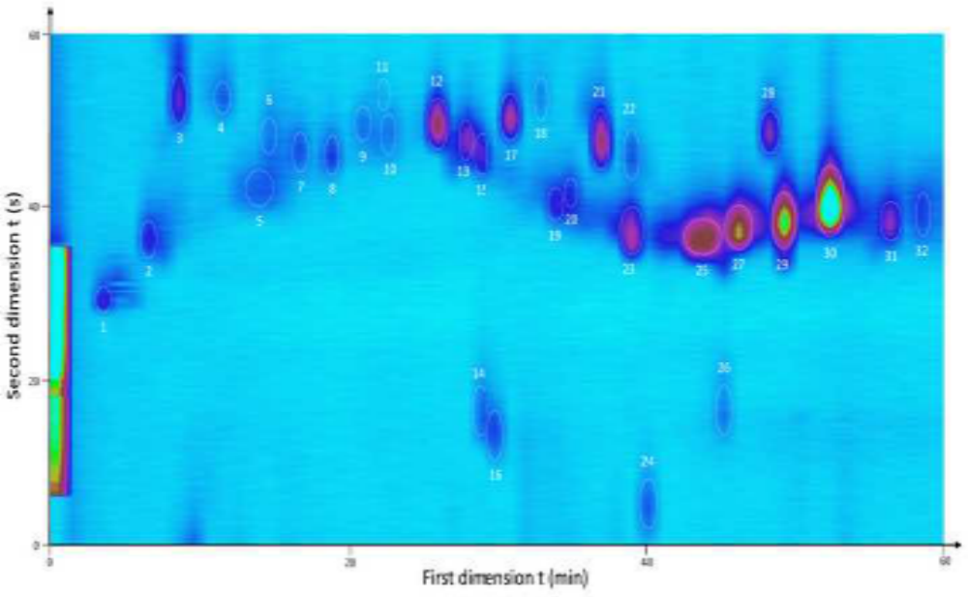
Contour plot

Slide 15
Tentative identification
No. | m/z measured | Intensity | Suggested molecular formula [M+H]⁺ or [M+Na]⁺ | m/z calculated | error (ppm) | mSigma | Tentative candidates |  | Application/Source
4 | 202.1225 | 9828 | C₁₃H₁₆NO | 202.1226 | 0.51 | 7.3 | (E)-1-Cinnamoylpyrrolidine | food and beverage additive
5 | 156.0815 | 6944 | C₁₁H₁₀N | 156.0809 | -0.69 | -4.5 | 4-Phenylpyridine | beverage additive
6 | 278.1900 | 6779 | C₂₀H₂₄N | 278.1903 | 1.30 | 10.1 | Amitriptyline or EDDP | antidepressant/ drug metabolite
7 | 207.1493 | 9287 | C₁₂H₁₉N₂O | 207.1492 | 0.24 | 8.3 | Isoproturon | herbicide
12 | 212.2010 | 8166 | C₁₃H₂₆NO | 212.2009 | -0.08 | 9.1 | Ethyl menthane carboxamide | food and beverage additive
14 | 293.1055 | 10882 | C₁₃H₁₉ClN₂NaO₂ | 293.1027 | -9.40 | 12.6 | Chloroprocaine | local anesthetic
15 | 182.0095 | 7237 | C₈H₈NS₂ | 182.0093 | -1.35 | 14.1 | 2-Methylthiobenzothiazole | degradation product of biocides
17 | 232.1334 | 33911 | C₁₄H₁₈NO₂ | 232.1332 | 0.92 | 0.7 | Indeloxazine | drug for cerebrovascular disease
18 | 242.1427 | 4947 | C₁₀H₂₀N₅S | 242.1434 | -1.76 | 6.7 | Terbutryn | herbicide
20 | 225.0914 | 8743 | C₁₅H₁₃O₂ | 225.0910 | 1.57 | 3.3 | Flavanone | natural product
22 | 226.1337 | 11064 | C₁₄H₁₆N₃ | 226.1339 | 1.00 | 11.6 | Cyprodinil | pesticide
23 | 219.1945 | 16676 | C₁₂H₂₇O₃ | 219.1955 | -4.55 | 8.3 | 8,8-Dimethoxy-2,6-dimethyl-2-octanol | food additive
 | 241.1773 | 10252 | C₁₂H₂₆NaO₃ | 241.1774 | -0.70 | 3.2 | Na adduct | /
26 | 312.2317 | 7057 | C₂₁H₃₀NO | 312.2322 | -1.66 | 9.5 | Biperiden | drug (Parkinson’s disease)
27 | 305.1094 | 34662 | C₁₂H₂₂N₂O₃PS | 305.1088 | -2.29 | 5.9 | Diazinon | pesticide
28 | 322.0665 | 29395 | C₁₆H₁₇ClNO₂S | 322.0663 | -0.64 | 2.8 | Clopidogrel | drug for cerebrovascular disease
29 | 399.2510 | 159335 | C₁₈H₄₀O₇P | 399.2506 | 0.96 | 4.0 | Tris(2-butoxyethyl) phosphate | organic flame retardant
 | 421.2326 | 24812 | C₁₈H₃₉NaO₇P | 421.2326 | 0.02 | 2.4 | Na adduct | /

Slide 16
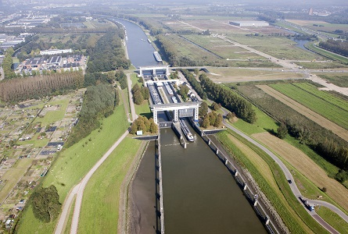
Surface water sample from Lekkanaal
Samples from BE-Basic project, courtesy to all relevant

Slide 17
LCxLC Chromatogram of water sample Lekkanaal

Slide 18
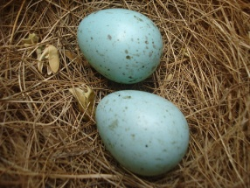
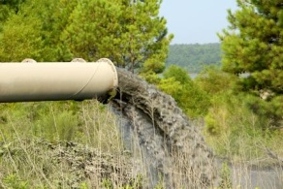



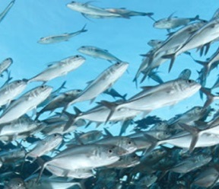
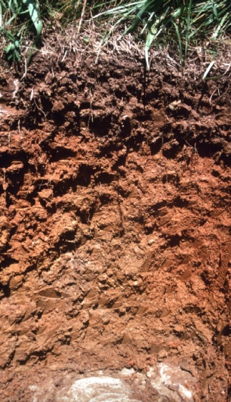

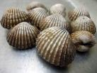
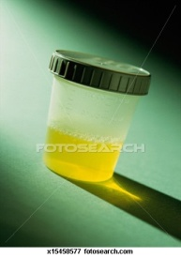
Effect-directed Analysis (EDA)
List of
toxicants
List of
suspects
Extract
Confirmation
Biological
analysis
Fractionation
Identification
Chemical
analysis
  Demand of developing/applying a technique that offers greater separation power: LC×LC!

Slide 19
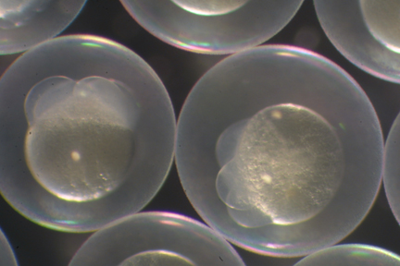
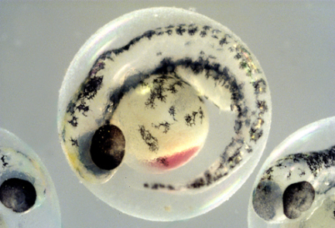
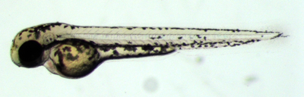
Zebrafish embryo toxicity test (zFET)
Freshwater fish, native to Southeastern Himalaya region
Egg-diameter is around 1 mm, survives in 96 well plates till day 6
Clear chorion allows to monitor the early development
Till the end of the larva stage (day 7) they are not “animals” (replace animal tests)
Complex organism - > Multiple Endpoints
1 hour
Embryo (2 days)
Larva (3 days)

Slide 20
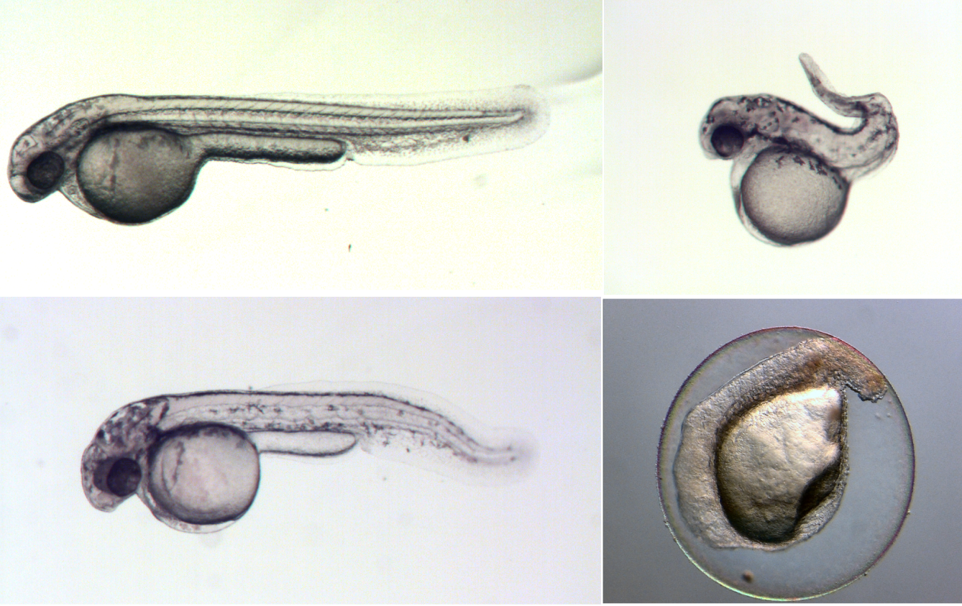
Examples of embryotoxicity
control
thiram
bAPN
RA

Slide 21
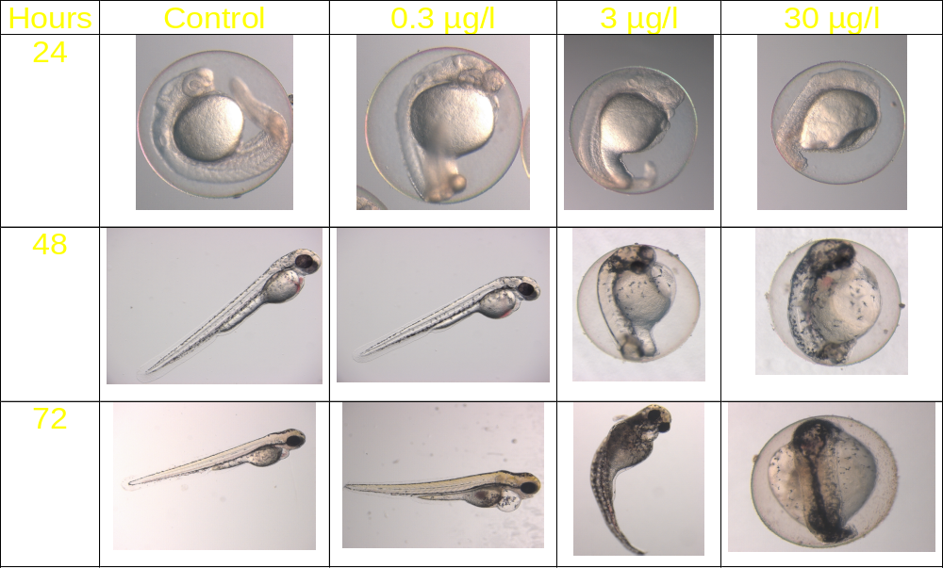
Zebra Fish: Model Organism for Teratogenicity Studies

Slide 22


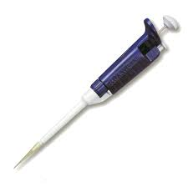
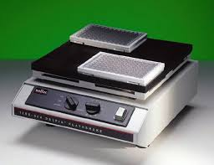
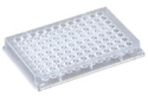
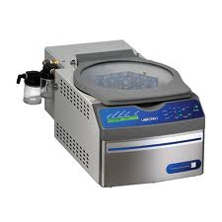
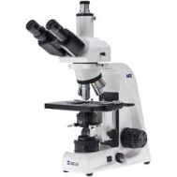
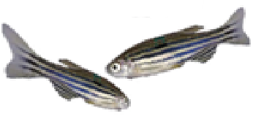

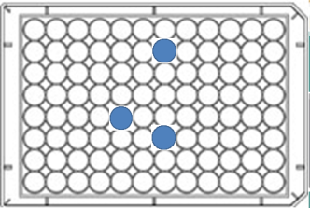
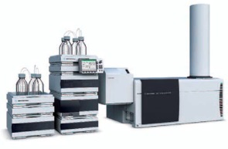
EDA Study: LC×LC-ZFET
Chemical-Mix
Add Fish-medium
Centrivap 6h
Environmental Samples
LC x LC
Fractionation
12h on shaker
Phenotype screen
Add Zebrafish eggs
Chemical Identification
LC/MS

Slide 23
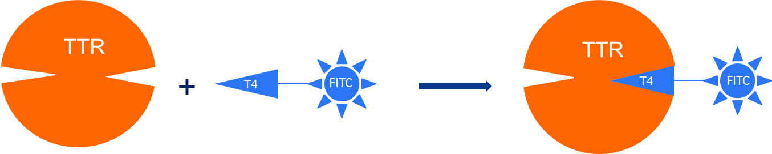
Summary
LC×LC (ToF-MS) is a very promising tool in analyzing complex environmental samples due to greater peak capacity and multi-(tunable) selectivity.
Direct post-column high resolution fractionation of LC×LC combined with high throughput bioassay makes EDA easier and better.
Future plan:
Application of LC×LC facilitated EDA in combination of a high-throughput fluorescent TTR assay to screen for Thyroid hormone disruptor of indoor environment, where:
  Novel sample preparation method will be developed
  More stationary combinations will be tested
  Different ionization sources (APCI, APPI, etc.) will be applied
FI Enhancement

Slide 24





Acknowledgement
Dr. Jessica Legradi
Dr. Ron van der Oost
Prof. Dr. Juliette Legler
Dr. Marja Lamoree
EU project (FP7, Marie Curie ITN) EDA EMERGE
X. Ouyang et al. (2015), J. Chromatogr. A 1380, 139-145

