Slide 1
About OMICS Group
OMICS Group International is an amalgamation of Open Access publications and worldwide international science conferences and events. Established in the year 2007 with the sole aim of making the information on Sciences and technology ‘Open Access’, OMICS Group publishes 400 online open access scholarly journals in all aspects of Science, Engineering, Management and Technology journals. OMICS Group has been instrumental in taking the knowledge on Science & technology to the doorsteps of ordinary men and women. Research Scholars, Students, Libraries, Educational Institutions, Research centers and the industry are main stakeholders that benefitted greatly from this knowledge dissemination. OMICS Group also organizes 300 International conferences annually across the globe, where knowledge transfer takes place through debates, round table discussions, poster presentations, workshops, symposia and exhibitions.

Slide 2
About OMICS Group Conferences
OMICS Group International is a pioneer and leading science event organizer, which publishes around 400 open access journals and conducts over 300 Medical, Clinical, Engineering, Life Sciences, Phrama scientific conferences all over the globe annually with the support of more than 1000 scientific associations and 30,000 editorial board members and 3.5 million followers to its credit.
OMICS Group has organized 500 conferences, workshops and national symposiums across the major cities including San Francisco, Las Vegas, San Antonio, Omaha, Orlando, Raleigh, Santa Clara, Chicago, Philadelphia, Baltimore, United Kingdom, Valencia, Dubai, Beijing, Hyderabad, Bengaluru and Mumbai.

Slide 3
Progenic Hair Regrowth Treatment
The Use of Platelet-Released Growth Factors for Treating Androgenetic Alopecia (AGA) by Activating Hair Follicle Stem Cells
Jack Sung,¹ Jiang, Meili,²
Wang, Zunyan³
President, Asiamedic Biotechnology; Director, Jiang’s Anesthetic Clinic;
President, Taiwan Society of Trichological and Anti-aging Medicine

Slide 4
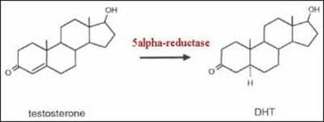
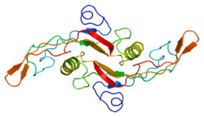
Major challenges in AGA
DHT converted by 5-α Reductase suppresses hair follicle growth, miniaturing follicle tissue and life span
TGF-ß1 secreted by DPCs induces catagen, leading to prematured hair loss
Hair follicle microinflammation & fibrosis block follicle regeneration to next anagen and diminish hair density

Slide 5
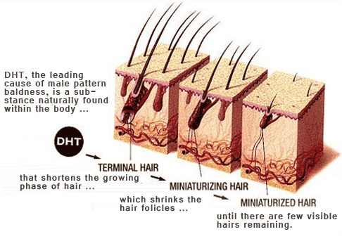
DHT miniatures hair follicles in AGA affected zone
Androgenetic Alopecia (AGA) is a common disease affecting over 50% male population over 50 years old in the United Stats.

Slide 6
The main molecular pathway has been accepted that 5-alpha reductase in the fast growing cells outside dermal papilla of hair follicle converting testosterone into dihydrotestosterone (DHT). DHT then binds androgen receptor and the complex of which next binds DNA in cell nucleus, resulting in growth arrest of follicle cell and gradual decrease of protein synthesis. Such molecular pathway prevents vellus hair growing into terminal hair in the next shortened anagen phase

Slide 7
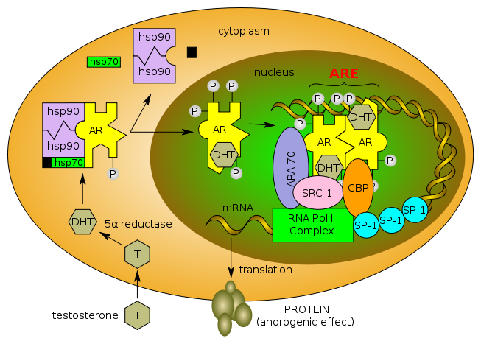
DHT pathway in AGA
Normal function of the androgen receptor. Testosterone (T) enters the cell and, if 5-alpha-reductase is present, is converted into dihydrotestone (DHT). Upon steroid binding, the androgen receptor (AR) undergoes a conformational change and releases heat shock proteins (hsps). Phosphorylation (P) occurs before and / or after steroid binding. The AR translocates to the nucleus where dimerization, DNA binding, and the recruitment of coactivators occur. Target genes are transcribed (mRNA) and translated into proteins. Original work, adapted from the following sources:
Meehan KL, Sadar MD. Androgens and androgen receptor in prostate and ovarian malignancies. Front Biosci. 2003;8780-800.
Gottlieb B, Lombroso R, Beitel LK, Trifiro MA. Molecular pathology of the androgen receptor in male (in)fertility. Reprod biomed online. 2005;10:42:48.
Choong CS, Wilson EM. Trinucleotide repeats in the human androgen receptor: a molecular basis for the disease. J Mol Endocrinol. 1998;21:235 - 257.
Quigley CA, De Bellis A, Marschke KB, El-Awady MK, Wilson EM, French FS. Androgen receptor defects: historical, clinical, and molecular perspectives. Endocr Rev. 1995;16:271 - 321.

Slide 8
TGF-ß1
Transforming Growth Factor-Beta 1
The major follicle killer

Slide 9
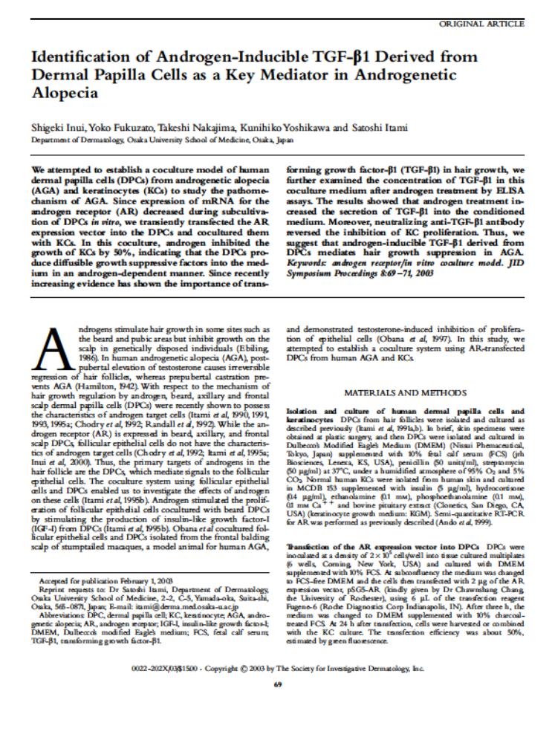

Slide 10
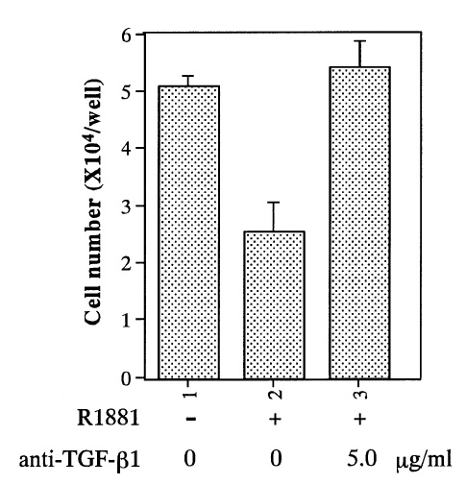
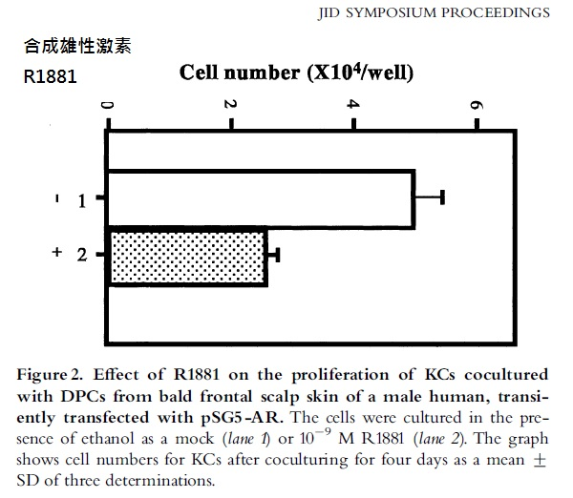

Slide 11
TGF-ß1 Induces follicle catagen
Androgen inhibited the growth of KCs by 50%, indicating that the DPCs produce dffusible growth suppressive factors into the medium in an androgen-dependent manner.”
“The results showed that androgen treatment increased the secretion of TGF-b1 into the conditioned medium. Moreover, neutralizing anti-TGF-b1 antibody reversed the inhibition of KC proliferation. Thus, we suggest that androgen-inducible TGF-b1 derived from DPCs mediates hair growth suppression in AGA.”.

Slide 12
Microinflammation & Fibrosis

Slide 13
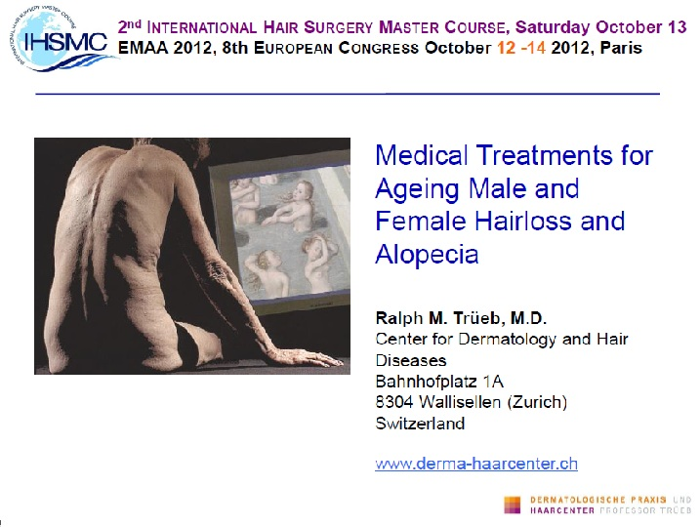

Slide 14
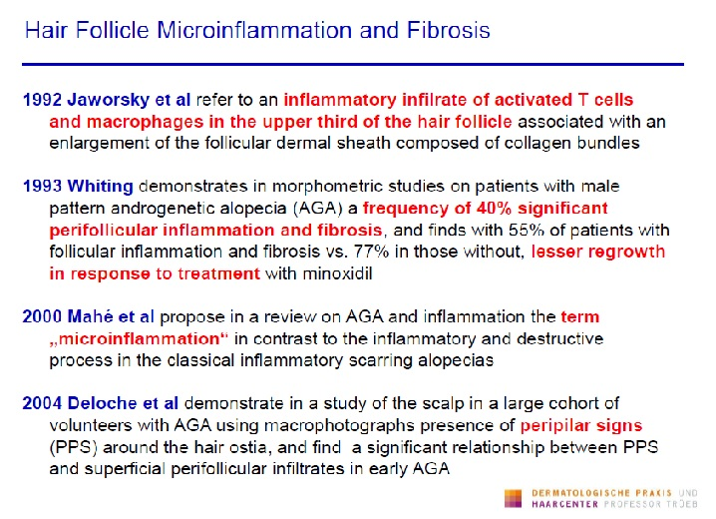

Slide 15
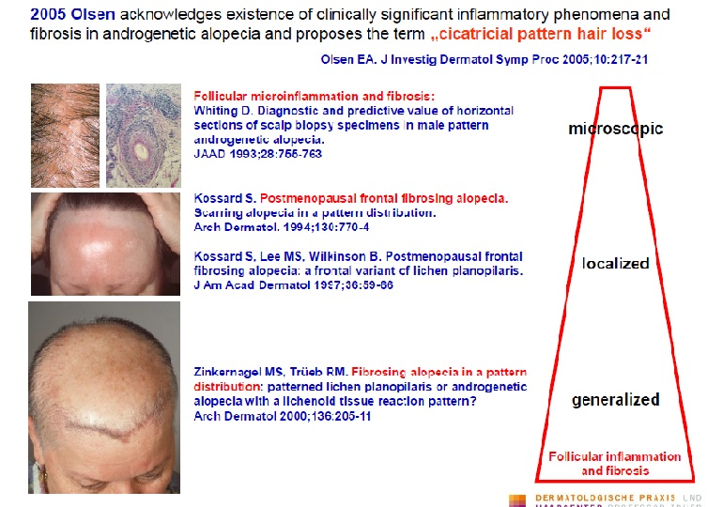

Slide 16
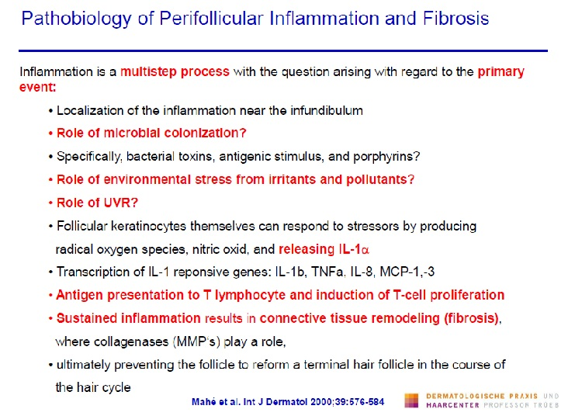

Slide 17
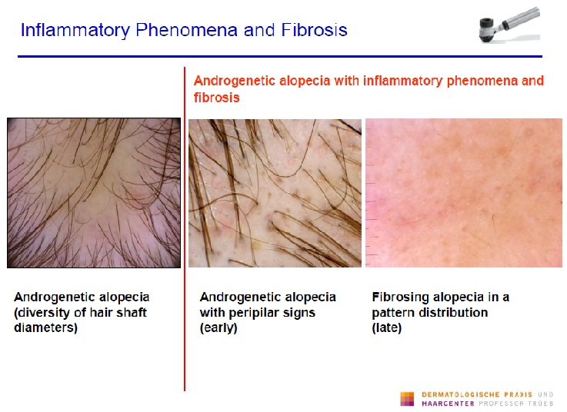

Slide 18
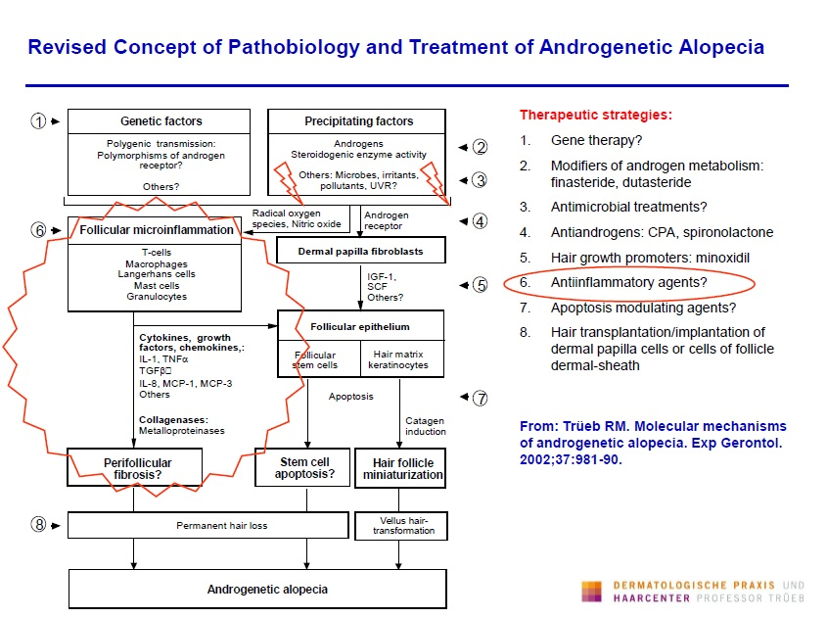

Slide 19
Hair Follicle Stem Cells
The Prosmises to hair loss tomorrow

Slide 20
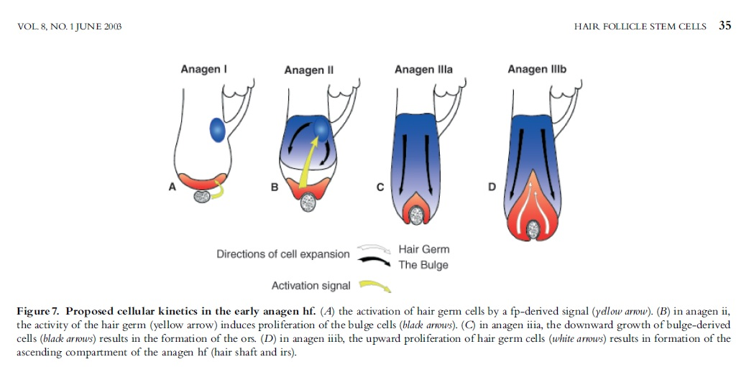
Hair Follicle Stem Cells

Slide 21
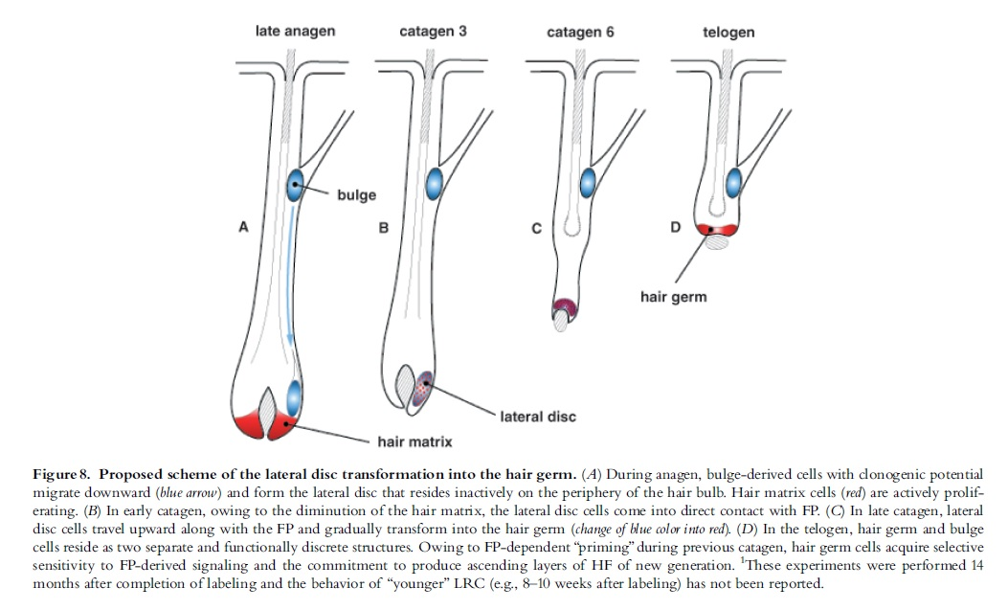
Hair Follicle Stem Cells

Slide 22
PDGF isoforms induce and maintain anagen phase of murine hair follicles
Y. Tomita, M. Akiyama and H. Shimizu
Department of Dermatology,
Hokkaido University Graduate School of Medicine,
Sapporo, Japan
J. Dermatological Science 2006

Slide 23
PDGF isoforms induce and maintain anagen phase of murine hair follicles
Methods
Recombinant human PDGF-AA and PDGF-BB were dissolved in sterile and toxin-free phosphate-buffered saline containing 0.1% bovine serum albumin (0.1% BSA-PBS). 1μg PDGF-AA or PDGF-BB dissolved in 100μl of 0.1% BSA-PBS and 0.1%BSA-PBS for controls were intradermally injected into the dorsal skin of 47-day-old male C3H mice (second telogen) once daily for 5 consecutive days (total 5μg of PDGF isoforms) (PDGF-AA, n=5;5 PDGF-BB, n=5; control, n=5). All mice were sacrificed 10 days after the injections
anti-PDGF-AA antibody or anti-PDGF-BB antibody was injected just after each injection of PDGF-AA or PDGF-BB (anti-PDGF-AA antibody following PDGF-AA, n=5; anti-PDGF-BB antibody following PDGF-BB, n=5).

Slide 24
PDGF isoforms induce and maintain anagen phase of murine hair follicles
Results
The area in close proximity to the injection sites in 3 out of 5 mice became darkened in color, indicating that HFs were in the anagen hair cycle phase (Figs.1a, 1d), whereas the injection sites using just the vehicle solution alone (0.1% BSA-PBS) all five mice retained their normal white color, suggesting that they remained in telogen phase.
Expression of Shh, Wnt5a and Lef-1 was upregulated in the skin samples in which anagen had been induced by PDGF local injections

Slide 25
PDGF isoforms induce and maintain anagen phase of murine hair follicles
Conclusions
“These results indicate that both PDGF-AA and -BB are involved in the induction and maintenance of the anagen phase in the mouse hair cycle. Local application of PDGF-AA and -BB might therefore prove to be an effective treatment option for alopecia associated with early catagen induction and elongated telogen phase.”

Slide 26
Adipocyte Lineage Cells Contribute to the Skin Stem Cell Niche to Drive Hair Cycling
Eric Festa, Jackie Fretz, Ryan Berry, Barbara Schmidt, Matthew Rodeheffer, Mark Horowitz, and Valerie Horsley,
Departments of Molecular, Cell, and Developmental Biology
Yale Stem Cell Center

Slide 27
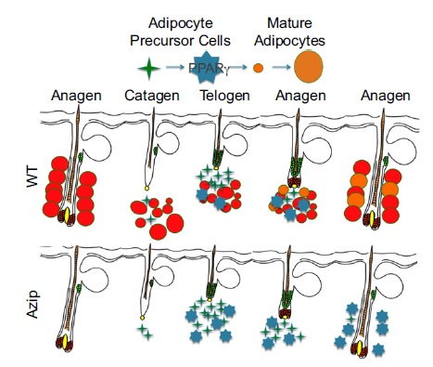
Adipocyte Lineage Cells Contribute to the Skin Stem Cell Niche to Drive Hair Cycling

Slide 28
Adipocyte Lineage Cells Contribute to the Skin Stem Cell Niche to Drive Hair Cycling
We injected PDGFA-coated beads intradermally into Ebf1 null mice at P21. Three days after bead implantation, a majority of follicles adjacent to PDGFA-coated beads displayed morphologies characteristic of anagen follicles. This growth induction increased with elevated concentrations of PDGFA with 100ng/ml activating 86% of adjacent follicles, demonstrating a dose dependency of activation of Ebf1 null hair follicles.

Slide 29
Adipocyte Lineage Cells Contribute to the Skin Stem Cell Niche to Drive Hair Cycling
Expression of PDGFA in adipocyte precursor cells was elevated almost 100 fold over the expression in SVF cells. Mice lacking PDGFA display phenotypic similarities with Ebf1 null mice, including a delay of follicle stem cell activation that blocks anagen induction (Karlsson et al., 1999; Tomita et al., 2006).

Slide 30
Adipocyte Lineage Cells Contribute to the Skin Stem Cell Niche to Drive Hair Cycling
Adipocyte lineage cells are not the only cell type in the skin that expresses PDGF ligands, multiple cells in the follicular epithelium, the matrix and the hair germ, have been shown to express PDGF (Karlsson et al.,1999). Additional signals expressed by intradermal adipocytes may also be involved in signaling to the DP or epithelium (Park et al., 2010).

Slide 31
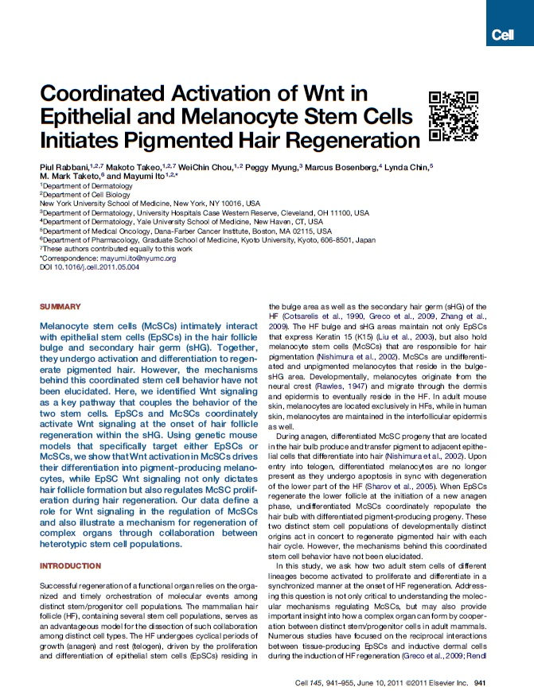

Slide 32
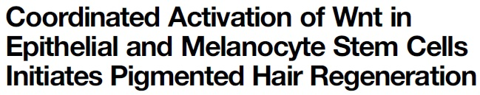
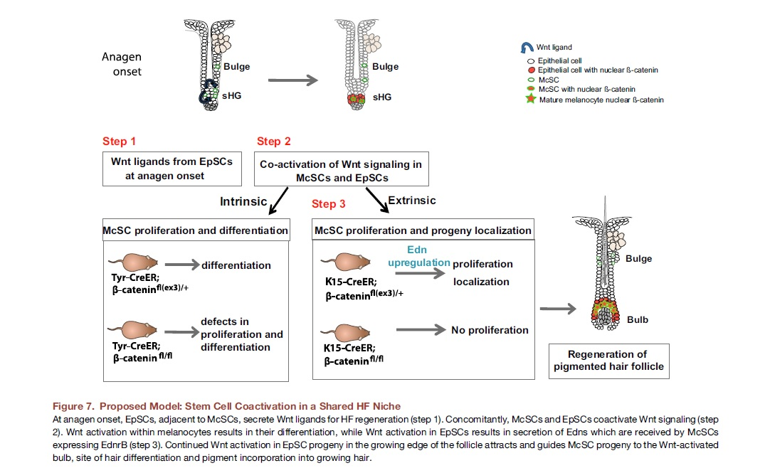
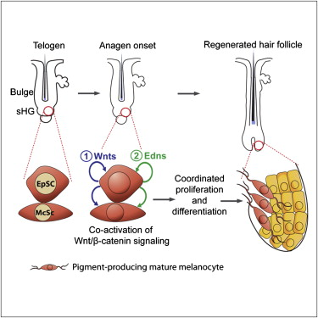

Slide 33
Progenic Hair Treatment
Activation
Hair follicle stem cells should be activated to gain new hairs
Blockage
5-α Redutase and TGF-ß1 pathways should be blockaged
Control
Hair follicle microinflammation & fibrosis should be addressed

Slide 34
Platelet Derived Growth Factor from PRP
Material
PRP (Platelet-Rich-Plasma) is collected
Process
PRP Proceeded (lyophilization, radiation)
Isolation
PDGF/VEGF Isolation from Platelet

Slide 35
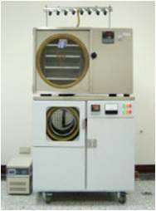
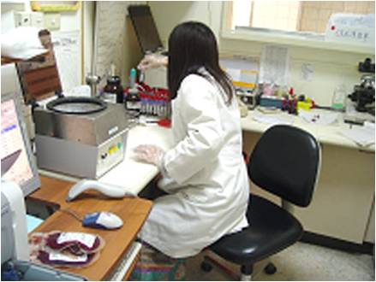
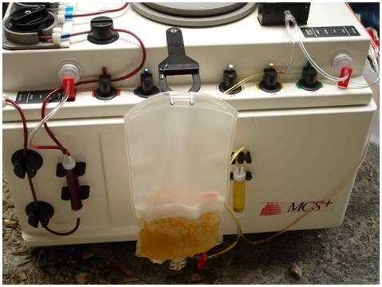
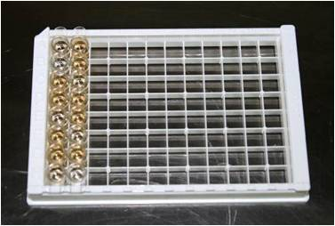
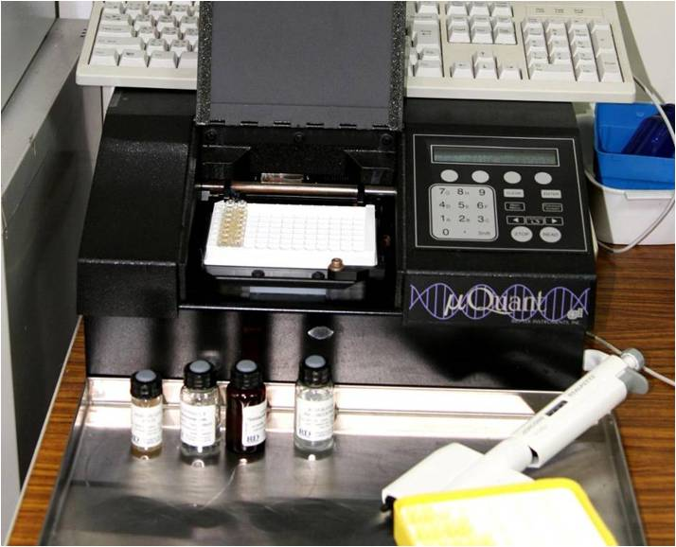
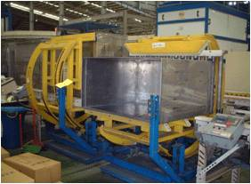
PRP Isolation Processing for retrieving PDGF/VEGF

Slide 36
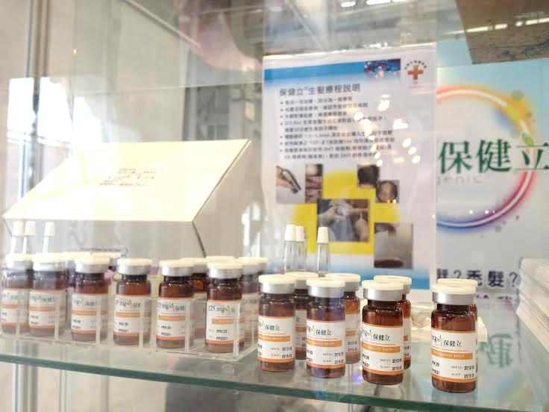
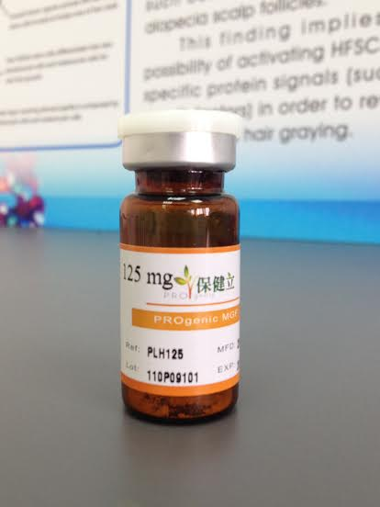
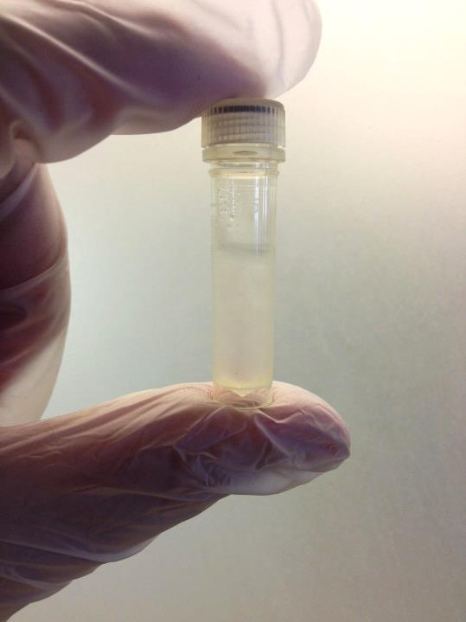
PRP lyophilized powder and PDGF solution
PRP powder in 60/125mg
PDGF solution in 300/600ng vial

Slide 37
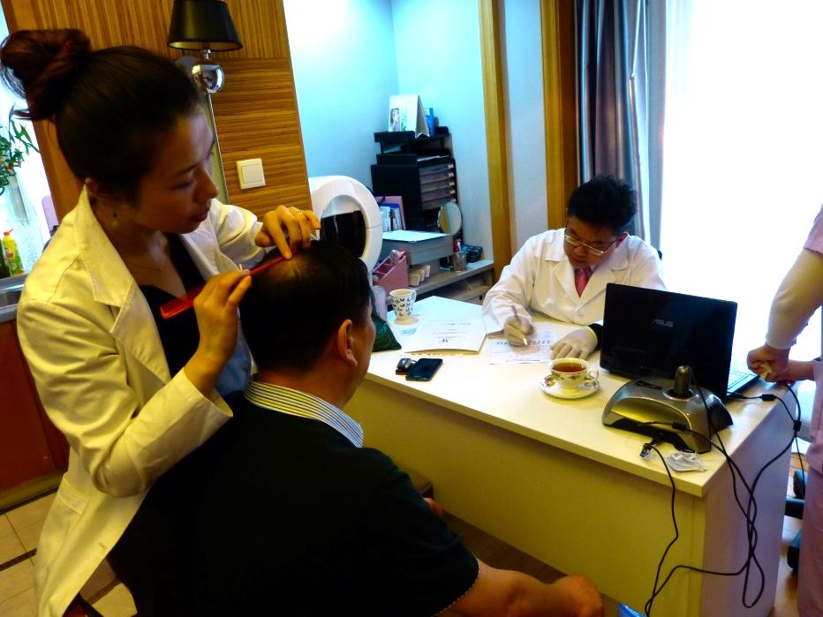
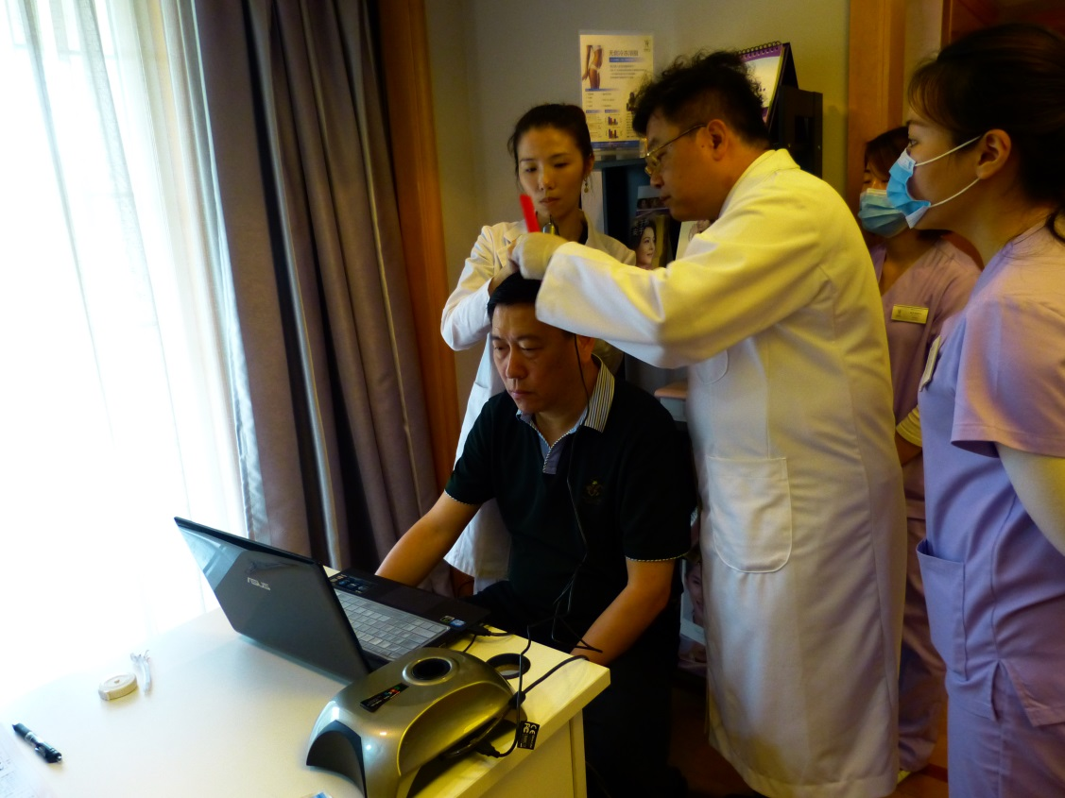
Tricoscopy at occipital/ crown/vertex/temporal
(Courtesy by Shanghai WA Antiaging Clinic)

Slide 38
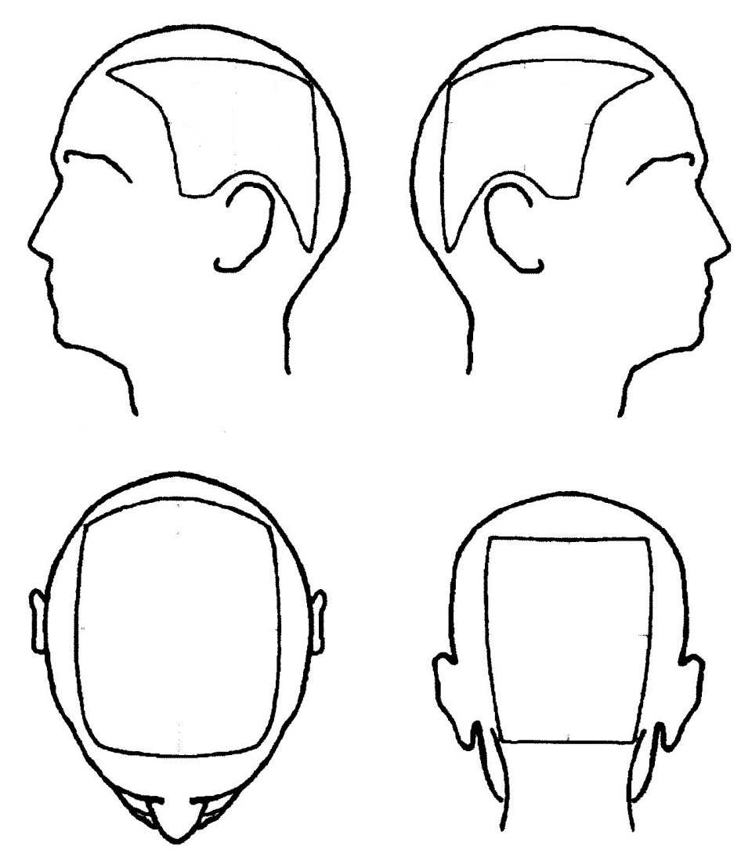
Hair density and terminal/vellus hairs ratio documented
④
⑤
Treatment goal:
Hair density at 120 hairs /cm2
Terminal hair/vellus hair ratio improved
②
③
①

Slide 39
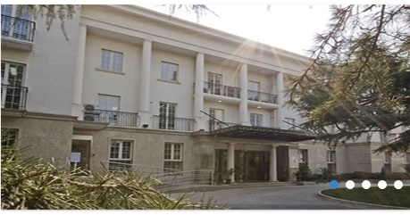
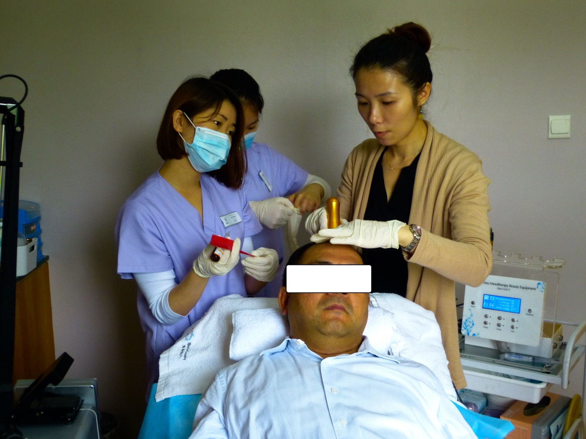
PDGF solution delivered by electroporation system non-invasively
(Courtesy by Shanghai WA Antiaging Clinic)

Slide 40
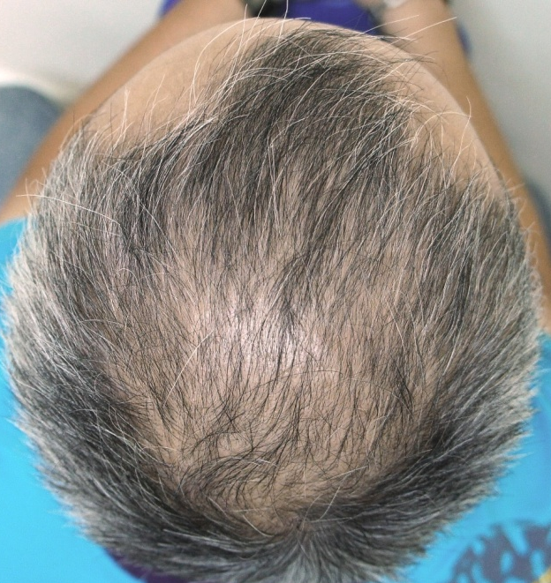
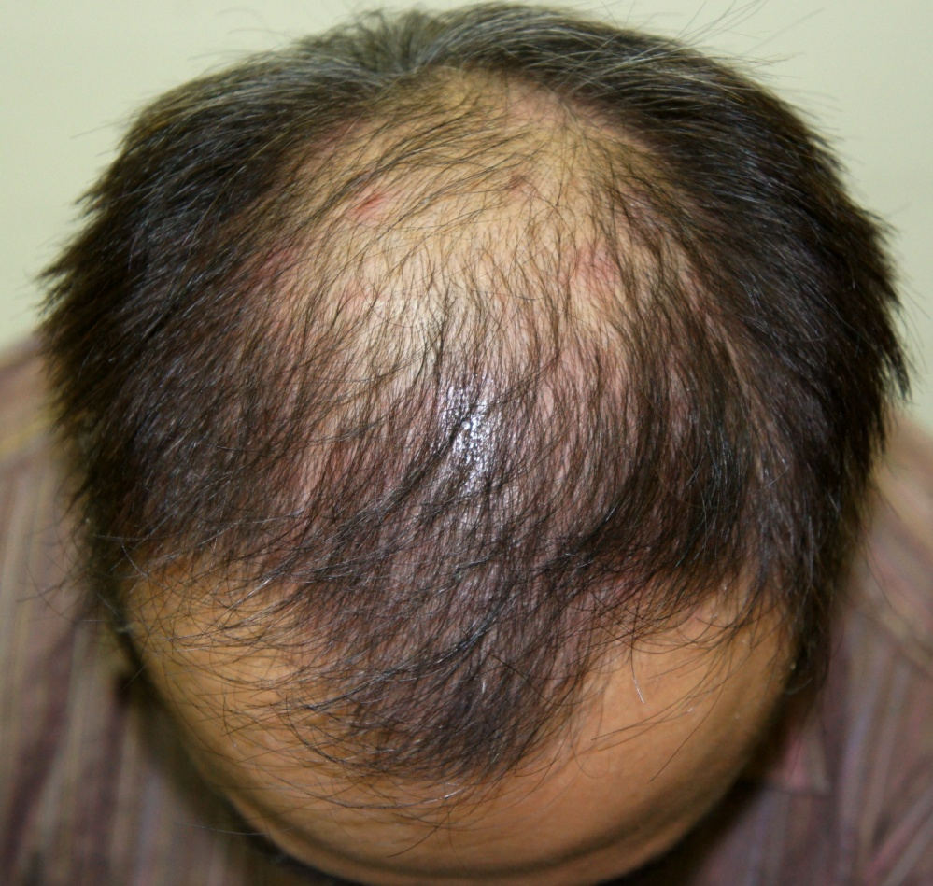
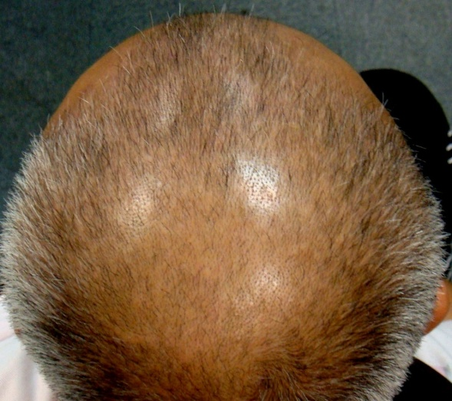
Our first case AGA
Great hair regrowth in all regions except for crown early hair fall out caused by TGF-ß1
Before 2010.07.08
4 treatments 2010.09.08
F/U 2010.12.10

Slide 41
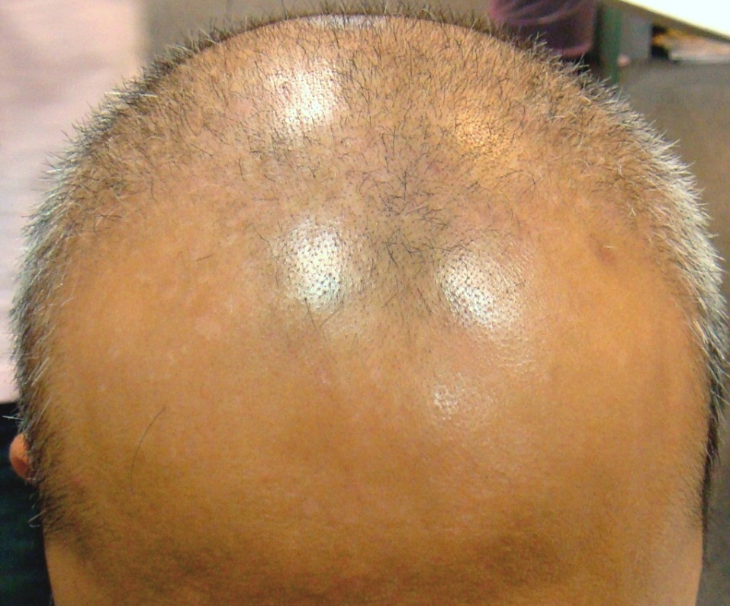
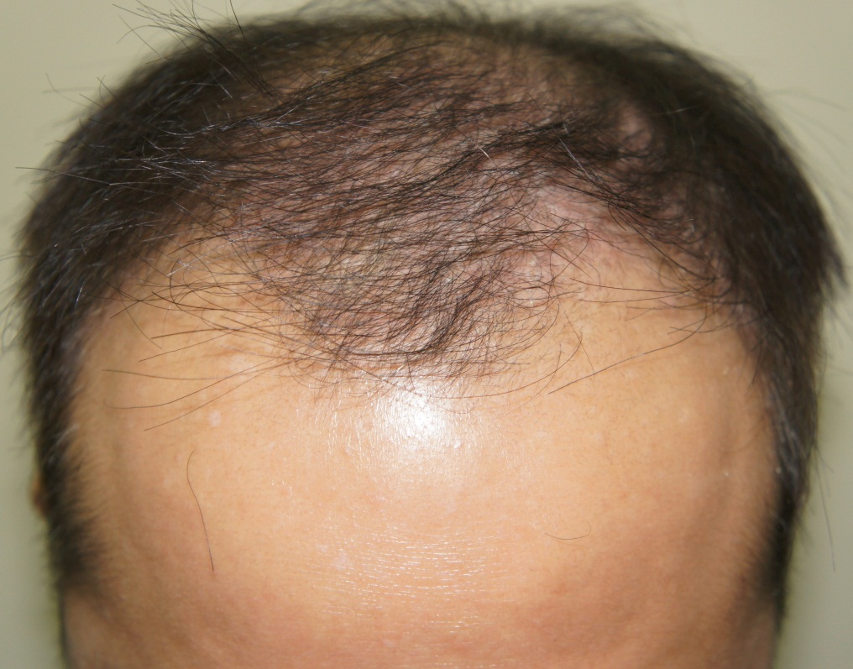
Before 2010.07.08
After 23 weeks 2010.12.08

Slide 42
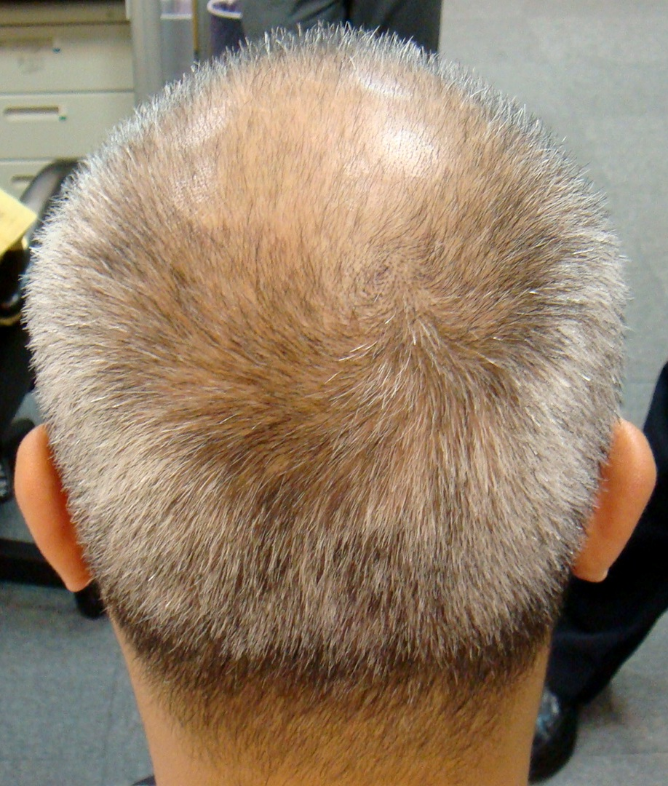
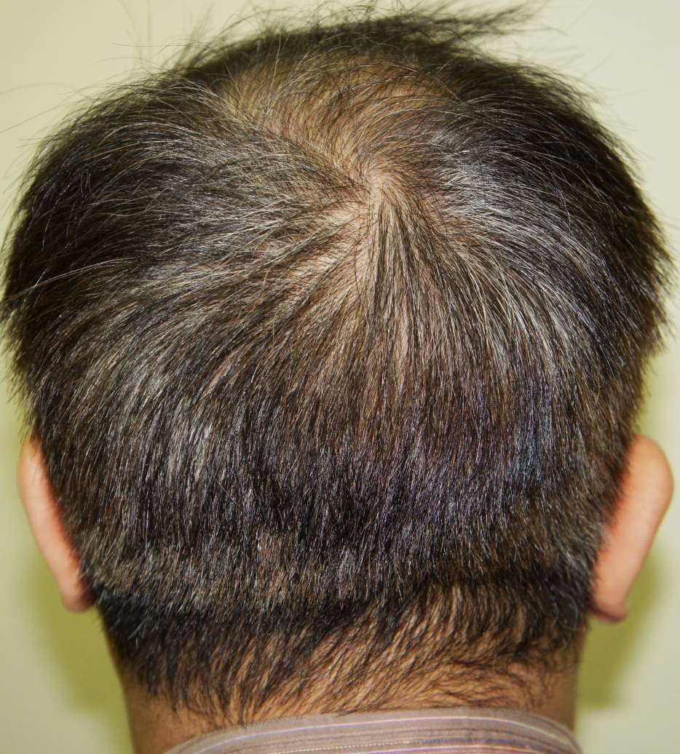
Great hair regrowth in occipital zone!
2010.07.08 使用前
2010.12.08 使用23週

Slide 43
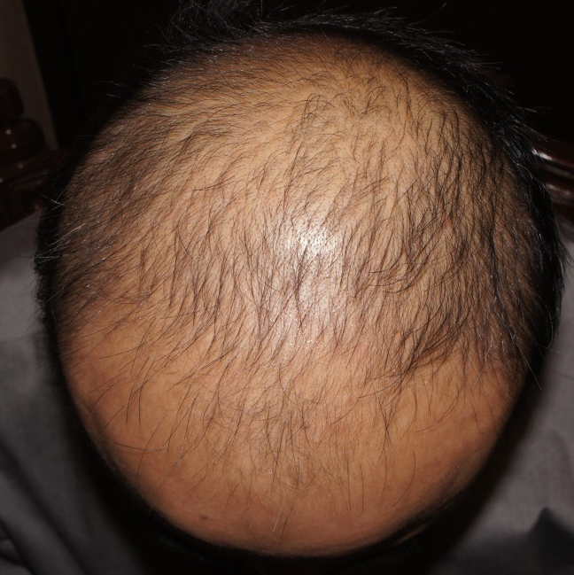
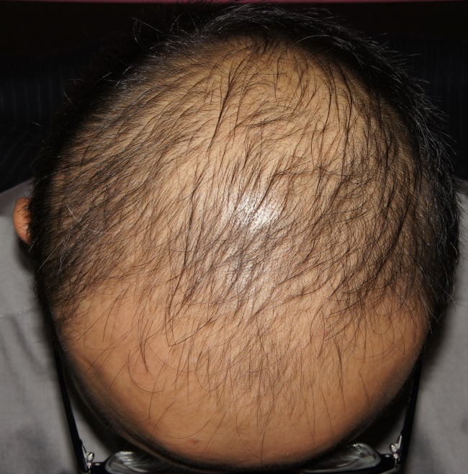
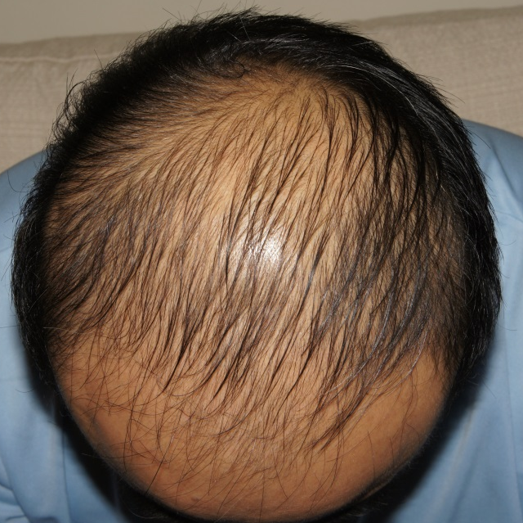
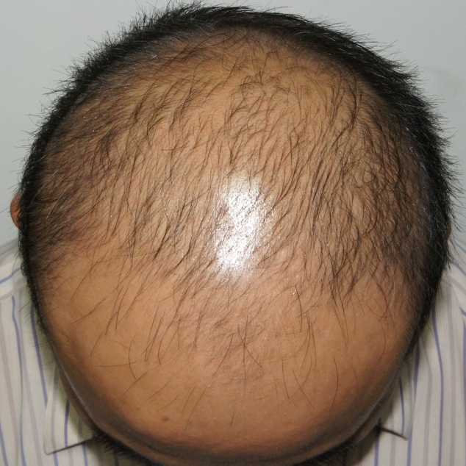
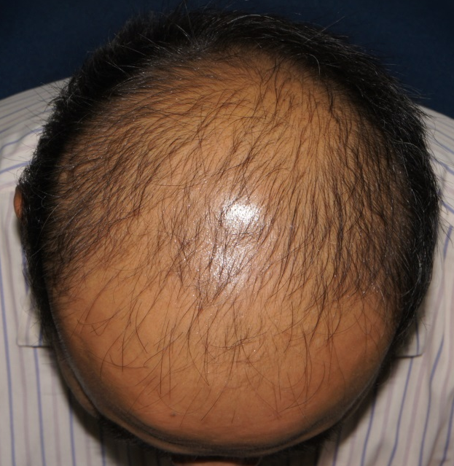
Prematured Hair Loss caused by TGF-ß1
2011.01.06 2011.02.24 2011.04.05
2011.06.30
2011.07.28

Slide 44
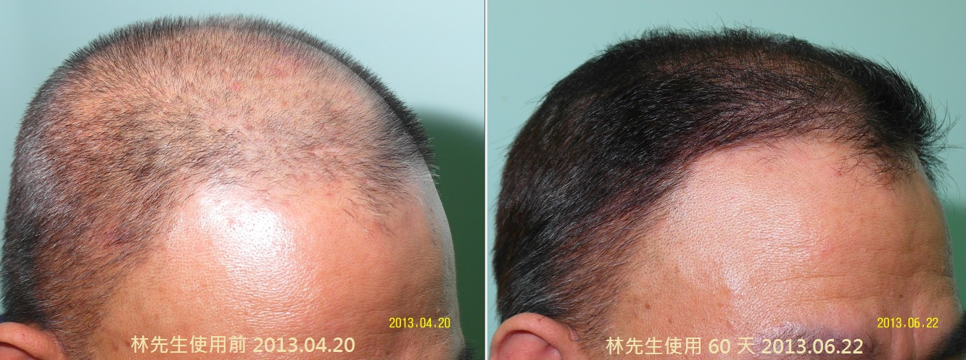
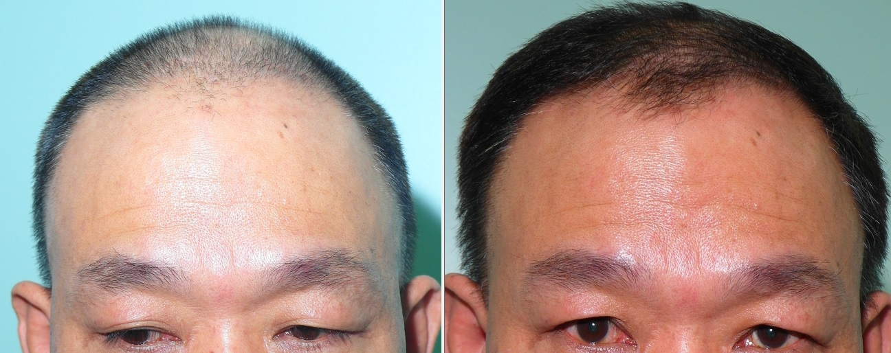
Mr. Hwang(Shanghai)

Slide 45
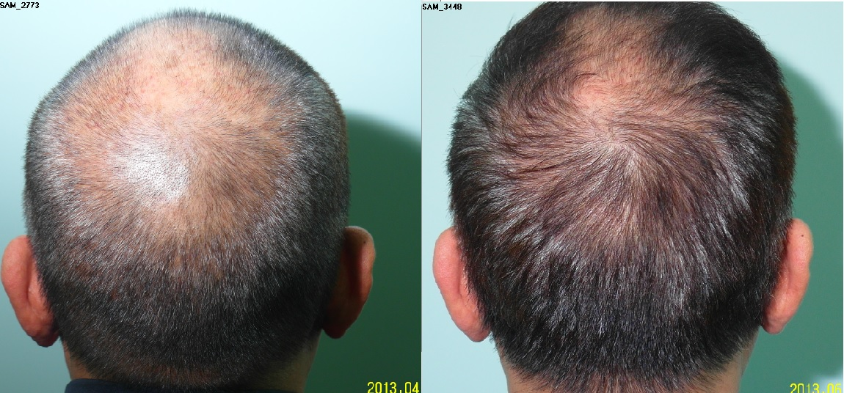
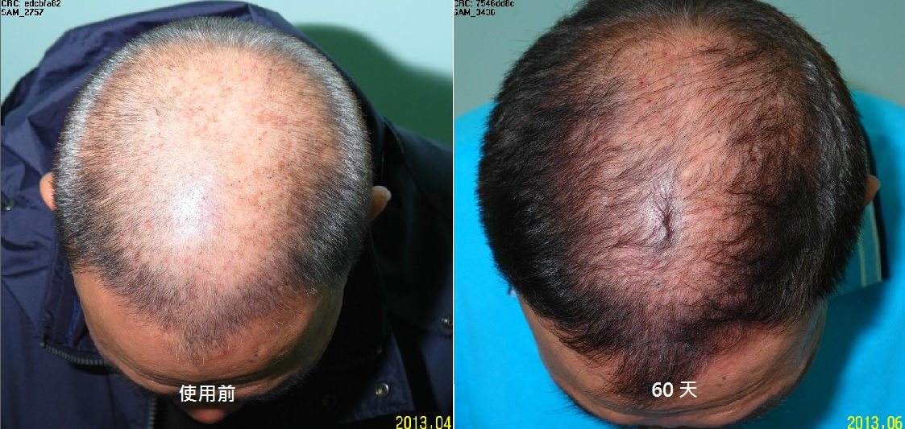

Slide 46


Hair density: 68→128/ cm² @ crown
Before @ 2013.04.20 2013.06.22

Slide 47


Hair density: 88→129/ cm² @ vertex
New hair gain = 40 hairs x 300cm² = 12,000 hairs
Before @ 2013.04.20 2013.06.22

Slide 48

PDGF + Antiinflammatory treatment: Great success at
75 days!

Slide 49


Slide 50

Great recovery in occipital zone!

Slide 51

Satisfactory outcome in crown region at 75 days

Slide 52

Hair density: 139→155/ cm² @ crown
Before @ 2013.07.21 2013.10.06

Slide 53


Hair density: 128→168/ cm² @ vertex
New hair gain = 30 hairs x 240cm² = 7,200 hairs
Before @ 2013.07.21 2013.10.06

Slide 54

R’t temporal regrowth

Slide 55


Significant regrowth in L’t temporal region

Slide 56

Hair line advances by 2cm
Not possible with minoxidil or finasteride!

Slide 57


Mr. Hsieh (Shanghai)
Before @ 2013.11.14 2014.05.06

Slide 58

Hair density improved at vertex!!
Before @ 2013.11.14 2014.05.06

Slide 59

Thicker and denser hairs at crown region!
Before @ 2013.11.14 2014.05.06

Slide 60

Great hair regrowth at
R’t temporal region !!!
Before @ 2013.11.14 2014.05.06

Slide 61


Hair density: 155→180/ cm² @ crown !!!
Before @ 2013.11.14 2014.05.06

Slide 62


Hair density: 142→159/ cm² @ vertex
New hair gain = 17 hairs x 200cm² = 3,400 hairs
Before @ 2013.11.14 2014.05.06

Slide 63


Slide 64


Slide 65


Slide 66

Vertex hair density increase from 129 hairs to 154 hairs/cm²
New hair gain = 25 hairs x 200cm² = 5,000 hairs

Slide 67
Conclusions
PDGF is effective in activating hair follicle stem cells to initiate hair follicle regeneration
Dose dependant
Monthly treatment
TGF-ß1 causes prematured hair loss as early as 4 months by inducing follicles into catagen
Anti-inflammatary agent provides satisfactory bitemporal regrowth at 60 days when used with PDGF
Hair care tonic containing azelaic acid, saw plametto extract, green tea extract, provides satisfactory outcome in terms of inhibition of microinflammation, TGF-ß1 and 5-αreductase.

Slide 68
Conclusions
Hair regrowth treatment with PDGF delivery and supporting therapies proves effective
May replace most hair transplant procedures in AGA cases.

Slide 69
Lets Meet again at Cosmetology-2015
4th International Conference and Expo
On
Cosmetology & Trichology
June 22-24, 2015 Philadelphia, USA
Theme: Cosmetology and Trichology: Tracking and Tackling its Consequences
Website: http://cosmetology-trichology.conferenceseries.com/

