Slide 1
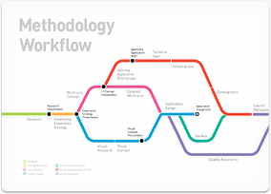
רפואה מותאמת אישית מול רפואה של אוכלוסיות
פרופסור יצחק חביב
בר אילן

Slide 2
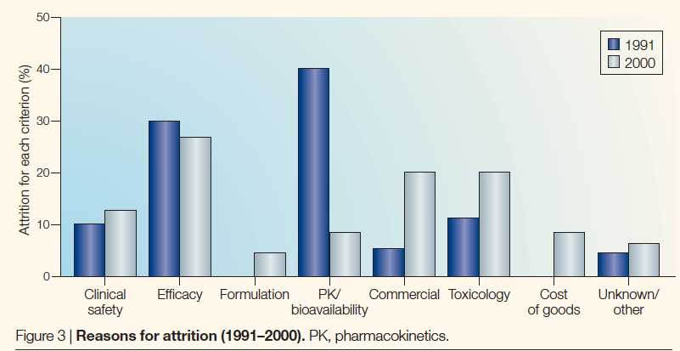
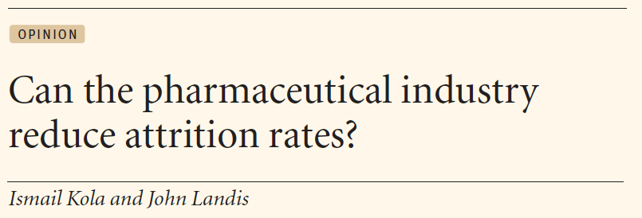
Where do we fail

Slide 3
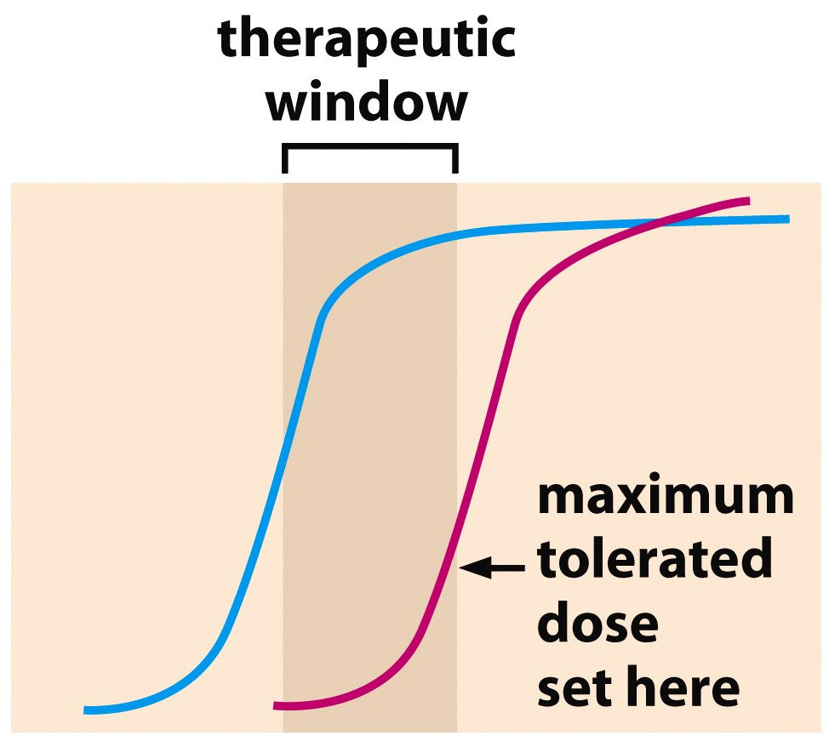
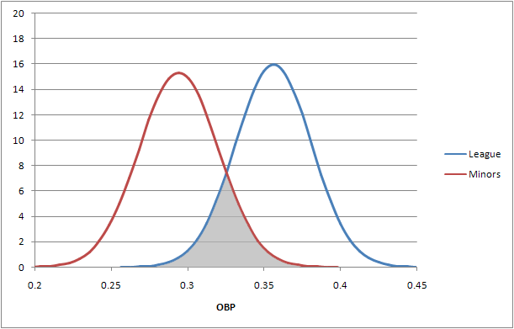
יעילות
רעילות
ריכוז תרופה

Slide 4
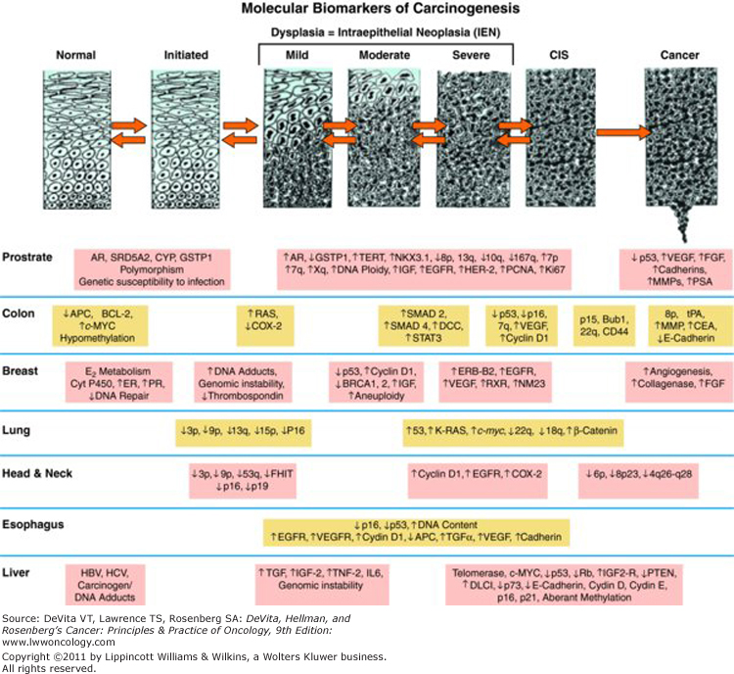

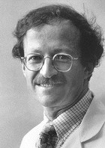
Genomic correlates of histological premalignant conditions
1972 Bishop n Varmus

Slide 5
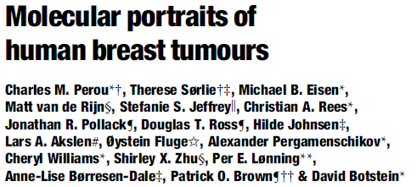
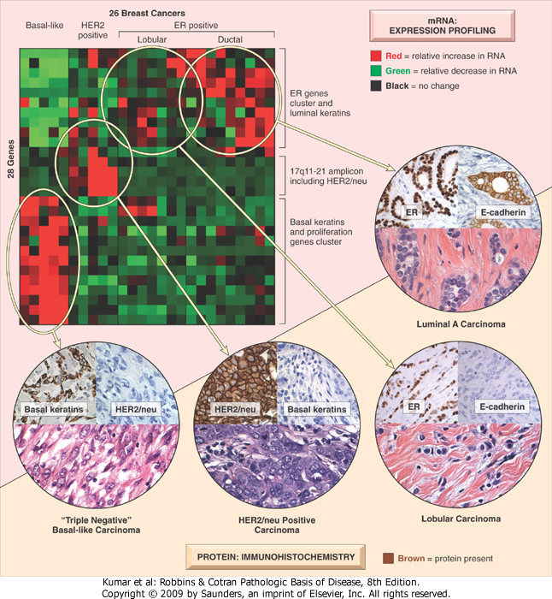
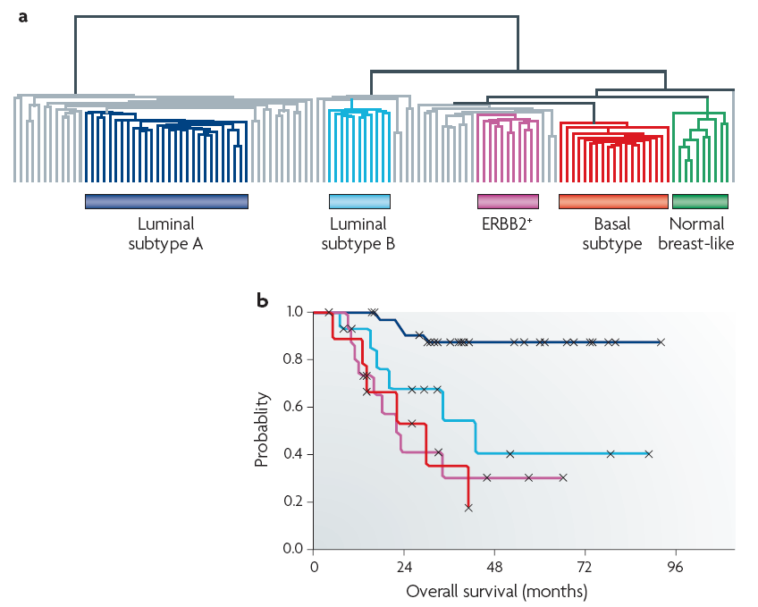
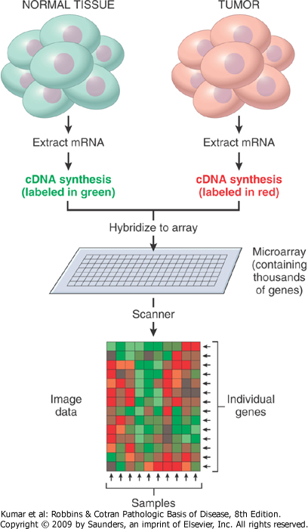
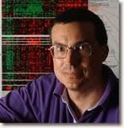
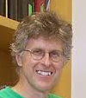

Patient sample stratification
אימונוהיסטוכימיה
חלבונים
Notes:
----- Meeting Notes (12/23/12 10:56) -----
two models for molecular classifications

Slide 6
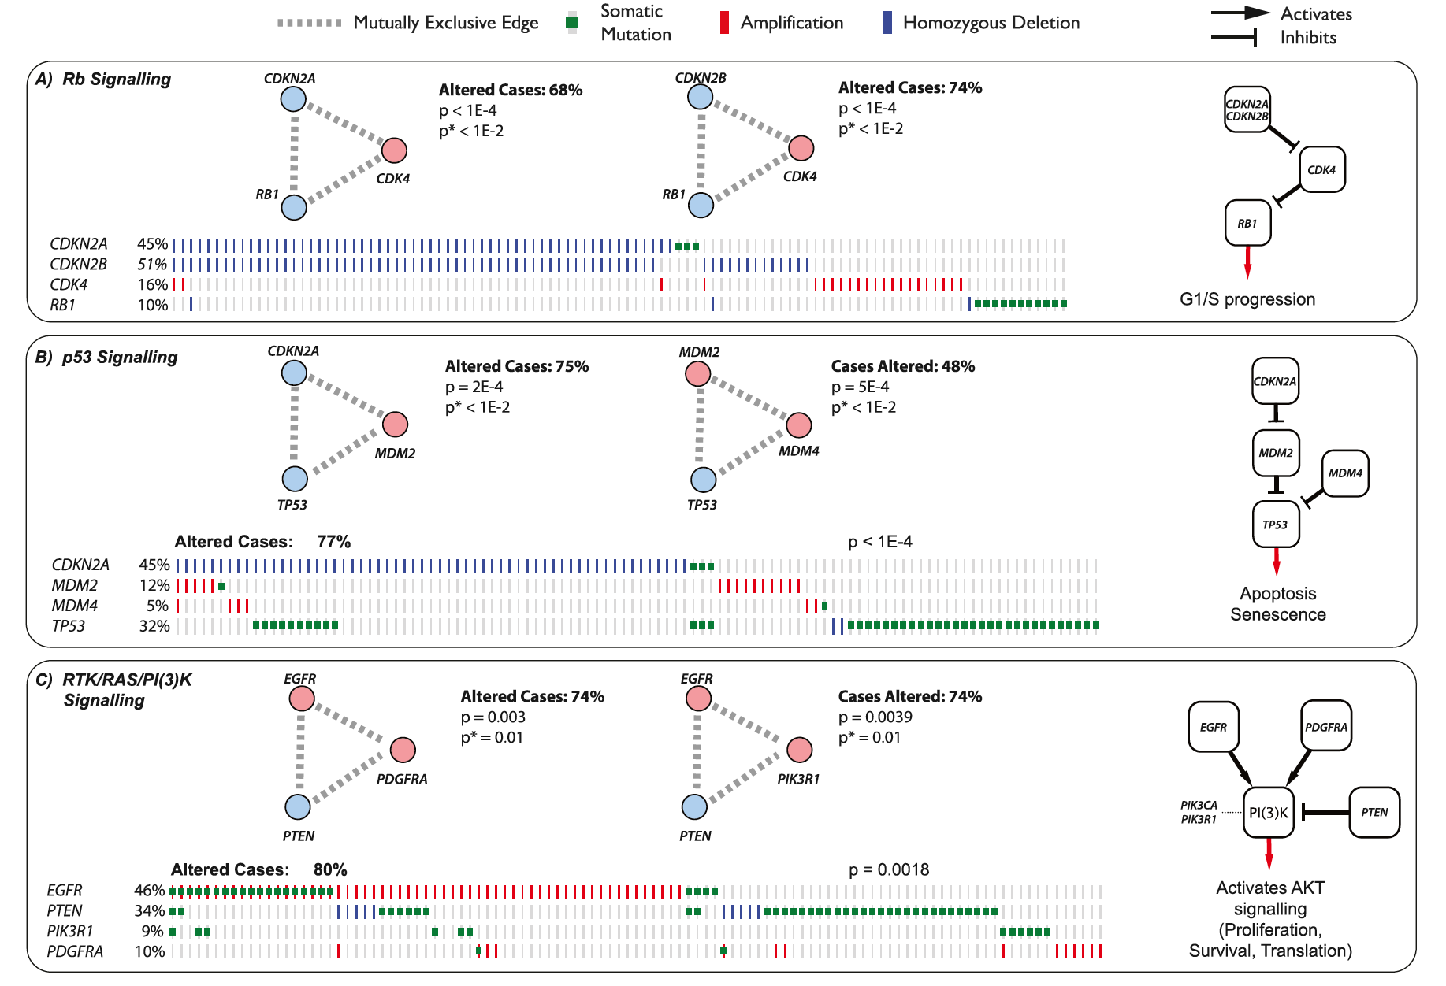

Multiple Pathways analysis

Slide 7
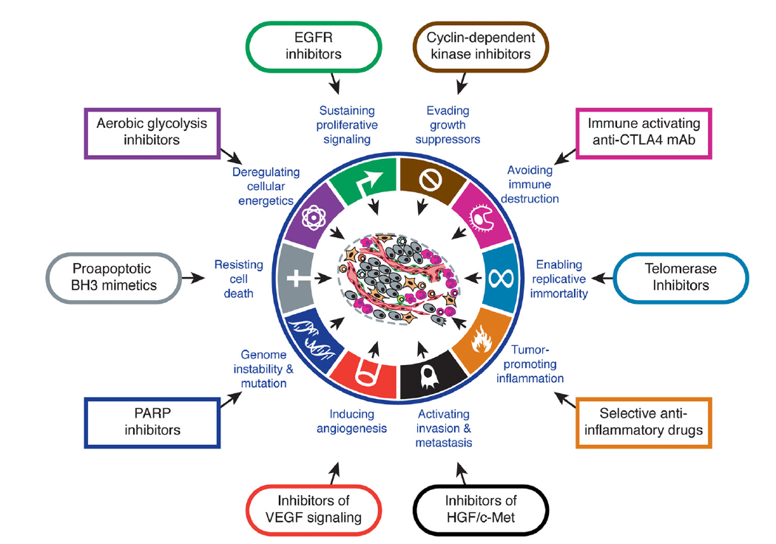
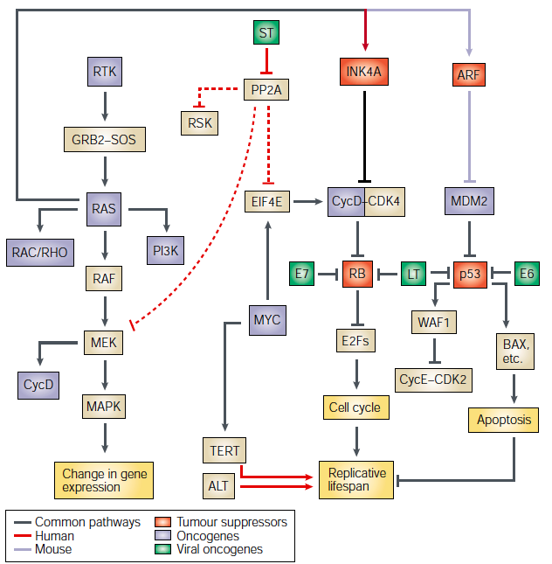
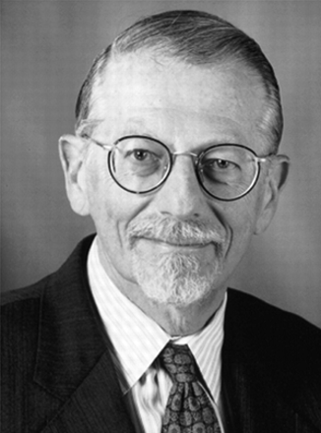
Every event causing cancer becomes drug sensitivity
2006 Weinstein
Notes:
The paradigm for biomarkers of response to anti-cancer drugs is termed “Oncogene-addiction” by Weinstein. According to this view, every genetic change means a new achiles heel of this particular cancer.

Slide 8
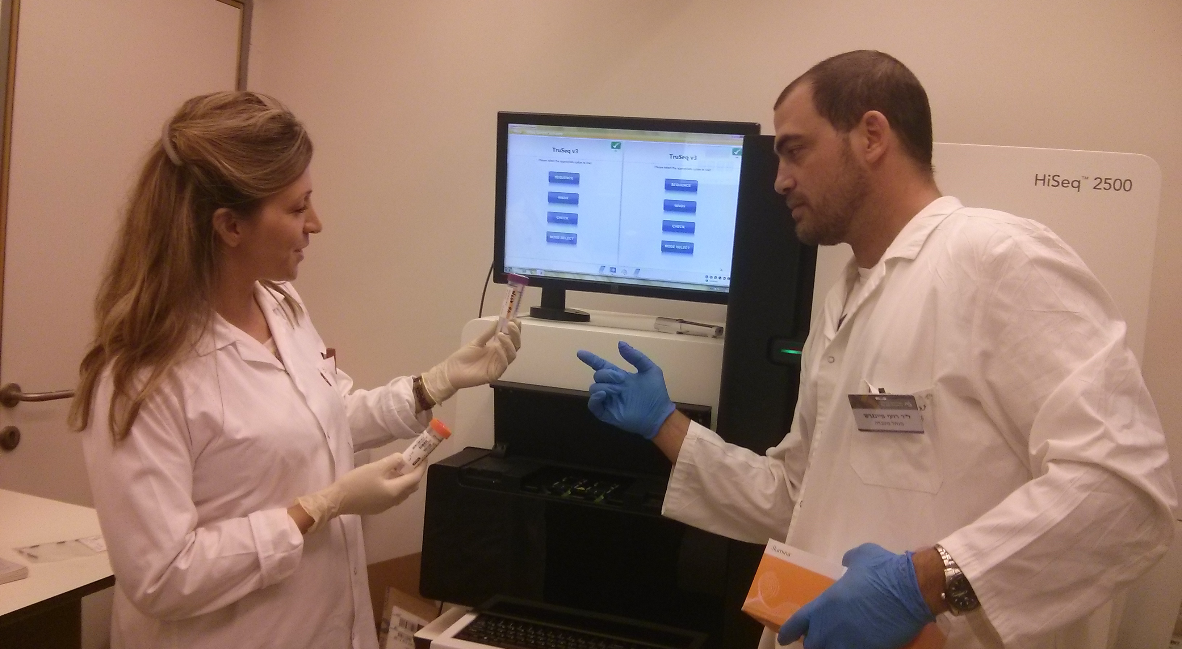
Genomic scale sequencing from lab to hospitals

Slide 9
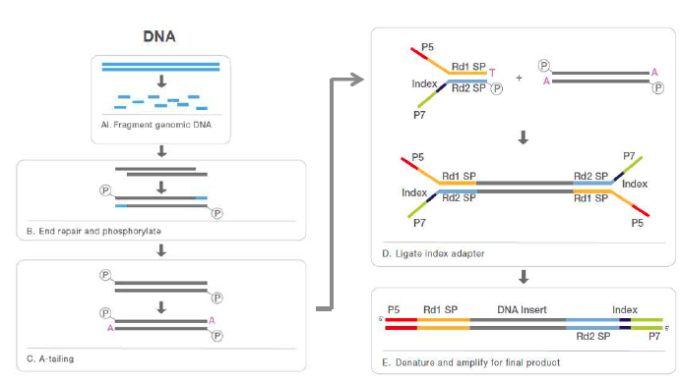
Basic Methodology

Slide 10
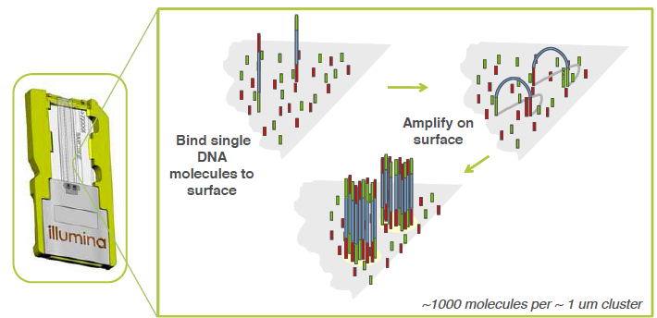
Cluster generation

Slide 11
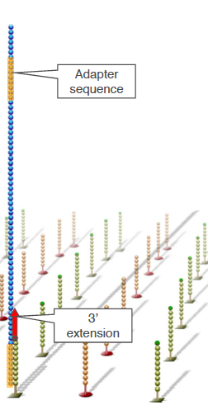
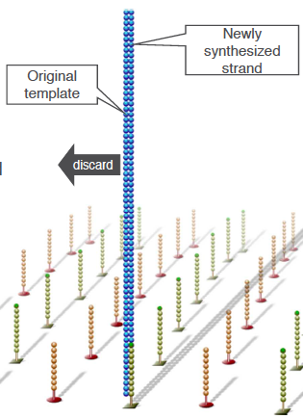
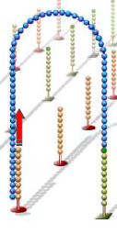

Slide 12
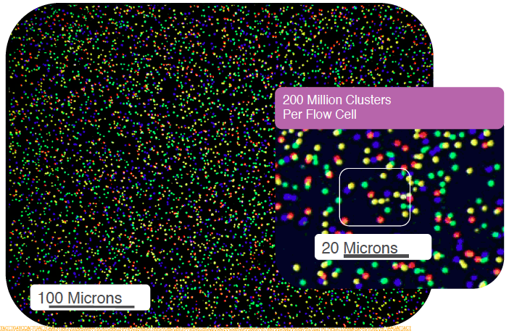
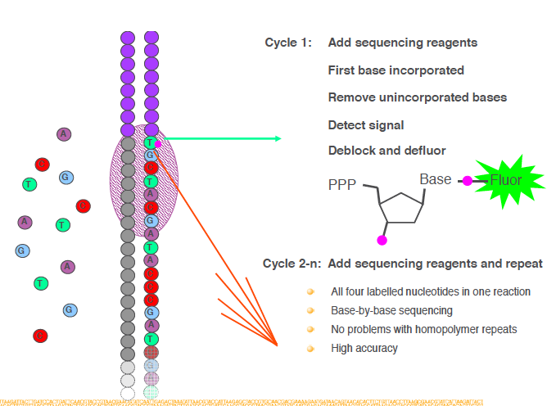
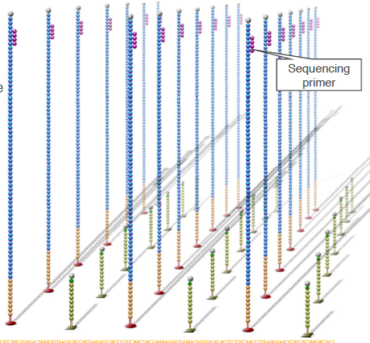
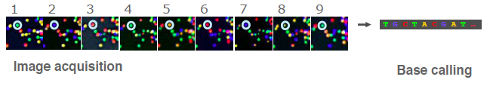
Sequencing

Slide 13
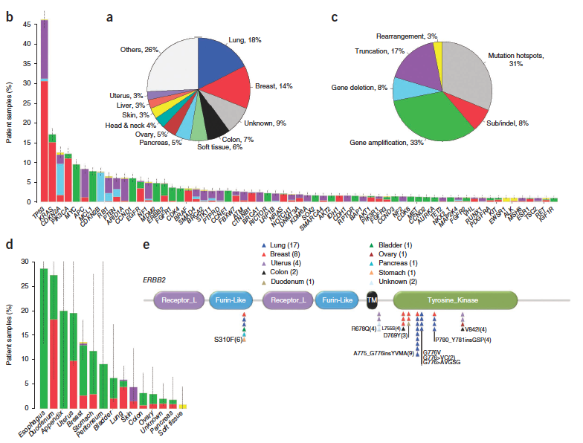

Solid tumour panel (315 genes)
Frampton et al. Nature Biotech 2013;31:1023-31

Slide 14
Solid tumour panel (315 genes)
Frampton et al. Nature Biotech 2013;31:1023-31

Slide 15

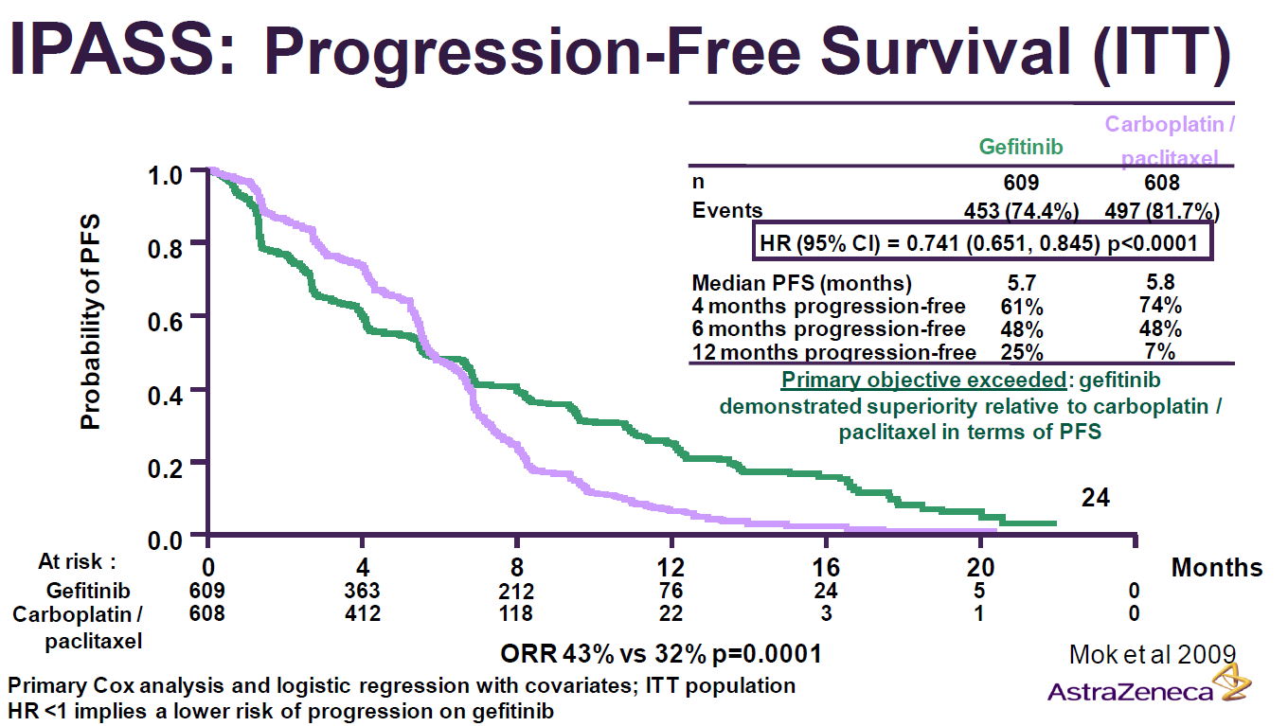
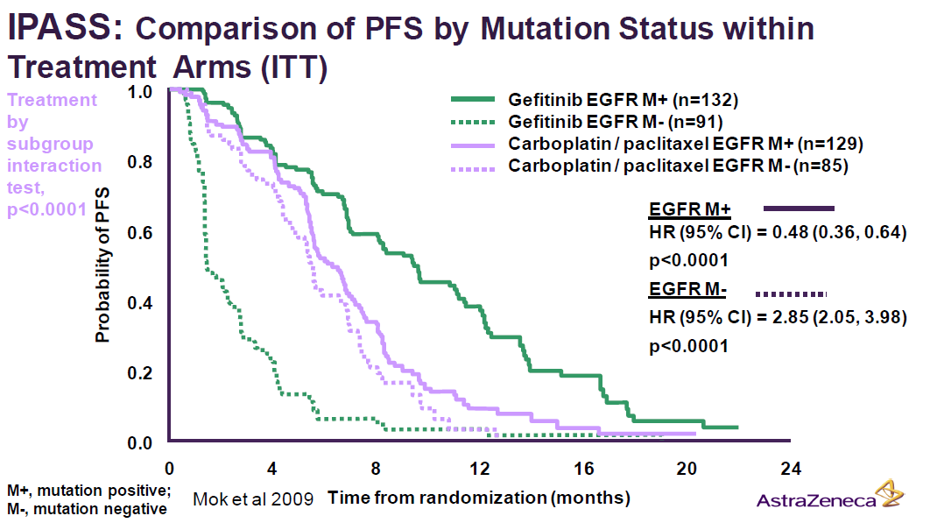
Iressa Pan-Asia Study [IPASS]
Mok, T.S., et al. New England Journal of Medicine, 2009. 361(10): p. 947-957.

Slide 16
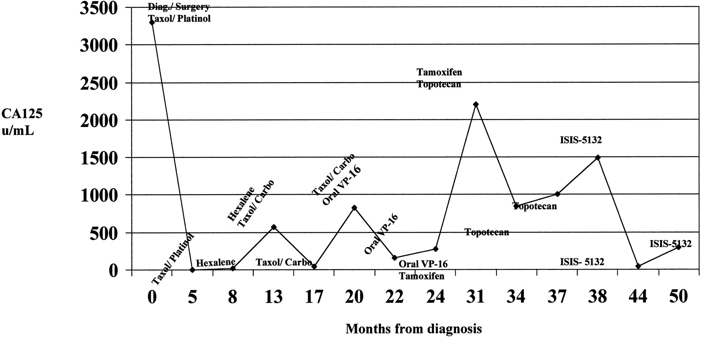
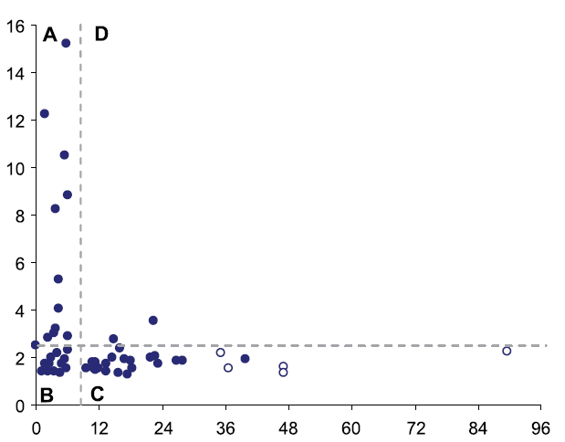
The Therapeutic Window
Chemotherapy efficacy doesn’t last forever
Marker quantity
Time after diagnosis
Often not in the outset
Biomarker
Platform for improved drug indications and combinations as management of Refractory cases
Infrastructure and platform to support pharmaceutical start up projects at the late pre-clinical phase, providing more detailed IND, based on molecular response markers and combinations that would avoid resistance.
Personalized immunotherapy
Overall Survival
Notes:
Graph of CA-125 levels over time for patient 219, with the timing of the various therapies as indicated.

Slide 17
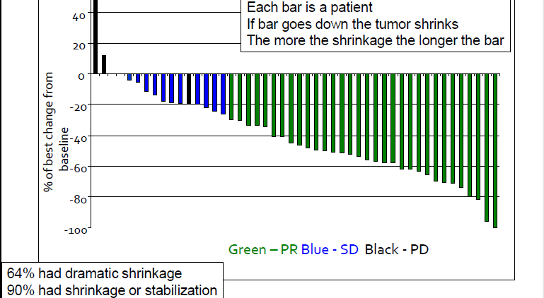

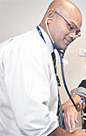
Identifying the 2% of NSCLC carrying the oncogene (ALK) achieves 70% response to Crizotinib
2011
Macarthur n Solomon

Slide 18
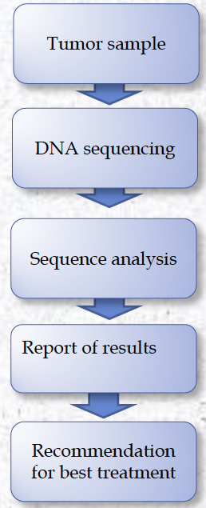
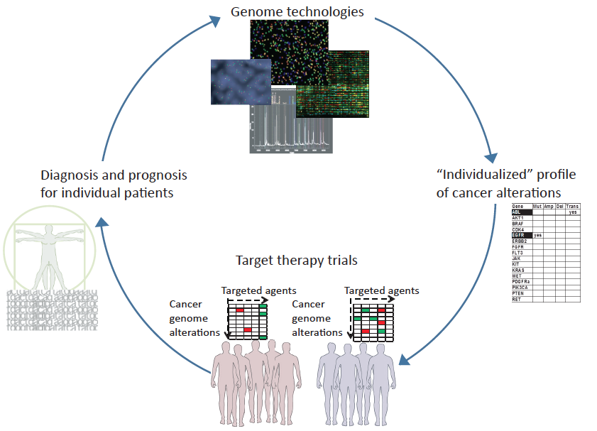
Oncologist as Matchmaker

Slide 19
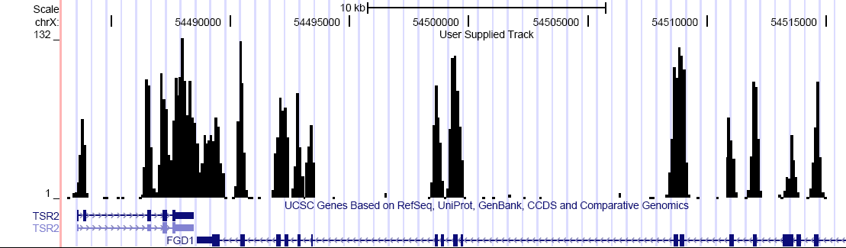
The Alembics of genome sequencing – the wider you go, the lower you get
Depth of Read
Exom
Target region enrichment (3MB) using Agilent SureSelect™
Sequence on MiSeq=14M clustersX300bp
Mutation detection (X2000 read depth)
Include CNV, SNV, translocations, In/Dels, etc.
Predict the drug sensitivity from the mutational combination
WGS
TruSeq
Oncopanel1
Notes:
Our strategy is to capture the oncogenic region of the genome for deep sequencing. Less interval of the genome means more times the same base is read, which for cancer sample in FFPE is clinically vital.

Slide 20
Panel selection
5 databases provide information, some of them are public but do not expose all the information, just part of the raw data (not processed). All the data and the processing, analysis etc. is shared among the participants and the contributors
•TCGA- The cancer genome atlas, full sequencing of many cancer types
•VCFG- Victorian center for functional genomics, measures the essentiality of genes to the cancer development.
•Cosmic- catalog of somatic mutation in cancer
•ICGC -International Cancer Genome Consortium
•Broad Institute, MIT, tools for sequence analysis. All together, we have access to about 8000 patients
Gene selection:
Frequency of the mutation/aberration in the population> 0.1-1%
Frequency of the mutation/aberration in the tumor> 15%
Irrelevant genes filtered out.
Genes with no treatment impact filtered out.
Segments selection:
Mutation- sensitive segments
Capture:
7 capture technologies were tested and the optimal one was selected

Slide 21
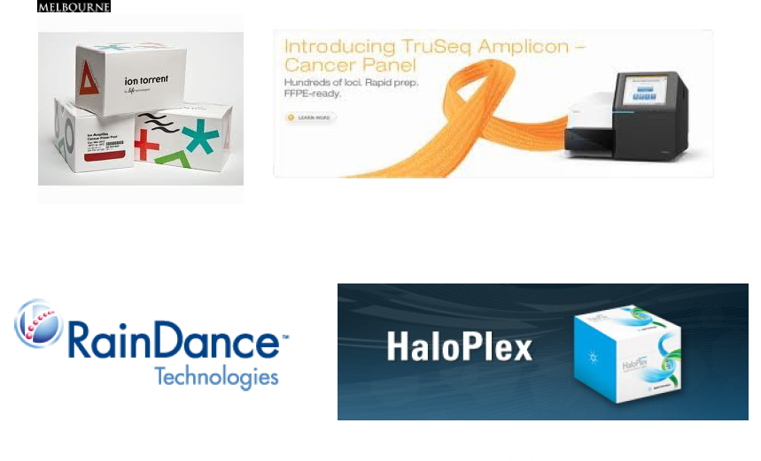
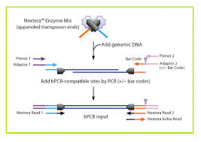
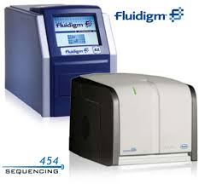


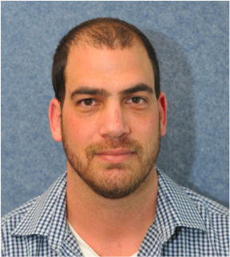
Seven methods were compared
Notes:
We extensively compared technological alternatives for target sequencing.

Slide 22

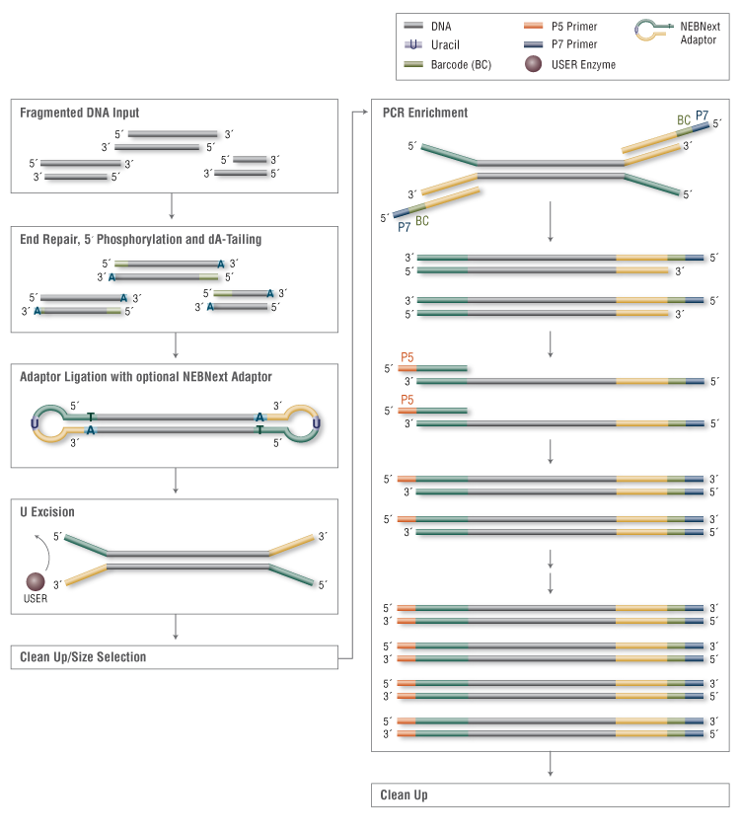
Genome fragmentation and adaptor ligation (library construction)
SureSelect – Sonication
Nextera – Tagmentation
HaloPlex – restriction enzymes

Slide 23
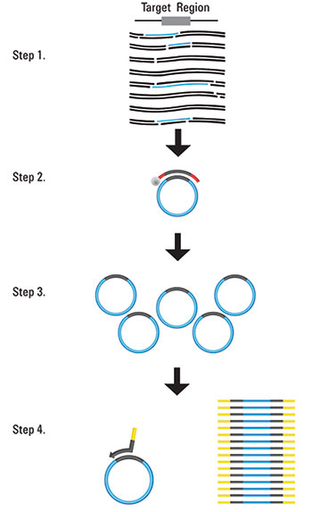
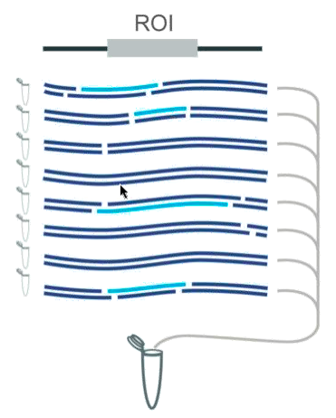
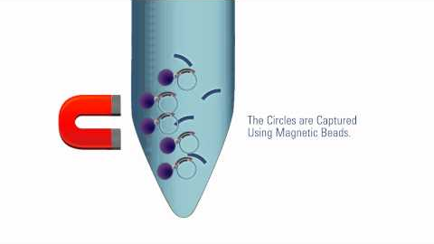
HaloPlex – how does it work

Slide 24
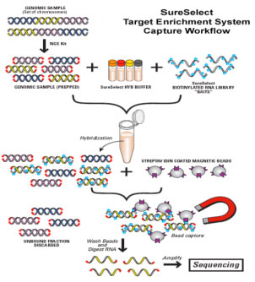
Target capture
HaloPlex - biotinylated short oligoDNA to the restriction sticky end (capture by the edge)
TruSeq custom amplicon – PCR (capture by the edge)
SureSelect – biotinylated RNA
Nextera – biotinylated DNA
IDT - biotinylated DNA

Slide 25
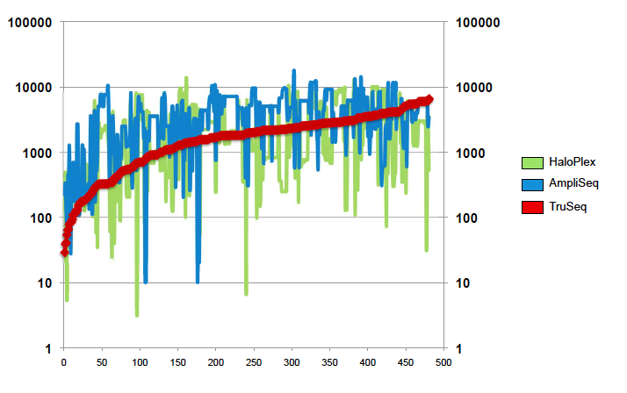
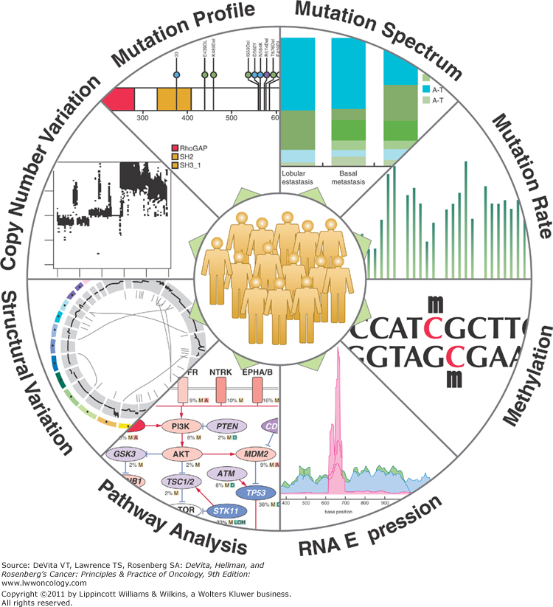
TRUSEQ is best in coverage, but can not track CNV nor translocations
Therefore we focus on target sequencing via Agilent SureSelect™
Notes:
All platforms miss a few hotspots that the others don’t. We are working with Agilent to improve the lost hotspots with changes in the protocol.

Slide 26
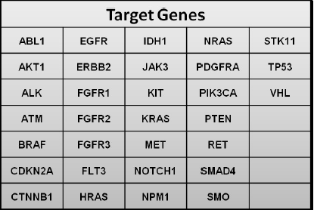
רשימה חלקית של הגנים

Slide 27
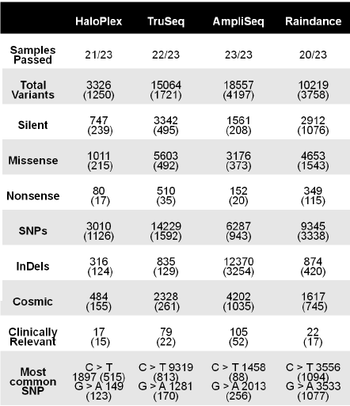


Parameter for comparison

Slide 28



Parameters for comparison (continued)
99.9% Reproducibility

Slide 29

Case summaries

Slide 30
Case
Case
A patient with triple negative metastatic breast cancer - unresponsive to Herceptin.
Persomics DNA multi-testing revealed mutations in c-KIT, EGFR, cMET, SMO, FGFR2, P53 and STK11.
The suggestion was to treat her with the c-KIT inhibitor, Gleevec, although this mutation is typically found in gastrointestinal stromal tumors (GIST).
Six months later, there was a 75% reduction in the tumor size. Notably, there are six more drugs that could be effective, as suggested by the existence of the other mutations
A newly diagnosed patient with colon carcinoma
Persomics DNA multi-testing revealed some of the typical mutations of colon cancer with additional mutations in ATM and ATR, suggesting a high sensitivity to radiation. In addition, the tumor was positive to PIK3CA , a mutation typical to high grade breast cancer, and to MLL that is common in Leukemia, CNS, ovary and breast cancers.
The patient was treated with a higher dose of radiation and a lower dose of chemotherapy. He was treated with Everolimus, an mTOR inhibitor, downstream to PIK3CA and with AR42, a histone deacetylase inhibitor, typical to AML treatment.
A year later he is tumor free, without the side effects characteristic of the standard of care.

Slide 31



Empirical measurement of Patient-Specific Drug Response
New alleles for sensitivity to PARPi
New alleles for immunological checkpoint inhibitors
New alleles for kinase inhibitors

Slide 32
Progress of the cancer sample cohort so far
Developed six disease specific target capture panels, based on ICGC, TCGA, COSMIC datasets.
Over 500 cases sequenced on disease specific panels.
Over 150 cases transplanted into PDX.
Over twenty cases tested in treatment groups.
Over ten novel potential indications found.
Over three drugs completed and seven more in pipeline for IND development, biomarker discovery and combination therapy design.

