Slide 1
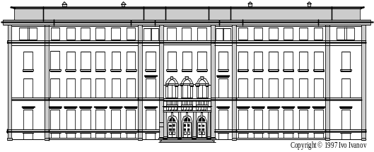
OPTIMISATION SOLUTIONS FOR VALIDATION PROCEDURES IN THE QUALITY CONTROL OF ENANTIOMERS. CHIRALITY TESTS FOR ANTIDEPRESSANTS CITALOPRAM AND VENLAFAXINE
Ivanka Pencheva, Lily Peikova, Guenka Petrova
Medical University – Sofia, Faculty of Pharmacy,
Department of Pharmaceutical chemistry,
Department of Social Pharmacy

Slide 2
Chirality
Chirality exists everywhere in nature and plays a significant role in a number of aspects of our life. The consideration of the aspect of chirality is very important for the environment, as well as for some industries, more concretely for the pharmaceutical industry. More than half of the medicines used are chiral. On the other hand it’s known that for most of them the pharmacological effects are due to one of the enantiomers only. The need of enantiomerically pure medicines is of great importance. In spite of that, only about 25 % of them are introduced as pure enantiomers. There is a difference in the quantity and quality of enantiomers activity. The enantiomers of a chiral drug may differ significantly in their bioavailability, rate of metabolism, metabolites, excretion, potency and selectivity for receptors, transporters and/or enzymes, and toxicity. The use of single-enantiomer drugs can potentially lead to simpler and more selective pharmacologic profiles, improved therapeutic indices, simpler pharmacokinetics due to different rates of metabolism of the different enantiomers, and decreased drug interactions.

Slide 3
Evergreening
Evergreening is a concept of patent law including a variety of legal and business strategies. It is best understood as a social ideas used to refer to the myriad ways in which pharmaceutical patent owners use the law and related regulatory processes to extend high rentearning intellectual property rights of active molecules.
The increasing availability of single-enantiomer drugs promises to provide clinicians with safer, better-tolerated, and more efficacious medications for treating patients.
In particular, each enantiomer of a given chiral drug may have its own particular pharmacologic profile, and a single-enantiomer formulation of a drug may possess different properties than the racemic formulation of the same drug.
When both a single-enantiomer and a racemic formulation of a drug are available, the information from clinical trials and clinical experience should be used to decide which formulation is most appropriate.

Slide 4
Analytical techniques for chiral separation
The guidelines for the development of new drugs issued by regulating authorities require efficient methods for enantiomeric purity control. For enantiomer separation on analytical scale a great variety of methods based on chromatographic techniques such as HPLC, GC, SFC, TLC have been developed during the past three decades. More recently, CE and CEC have also been shown to be useful techniques for this purpose.
HPLC can be used to separate enantiomers either indirectly with chiral derivatization reagents or directly with chiral stationary phases or chiral mobile phase additives.

Slide 5
Advantages and disadvantages of techniques for chiral separation
Each of analytical techniques used for chiral separation has advantages and disadvantages:
Indirect separation is based on the use of chiral derivatization reagents to form diastereomeric derivatives which differ in their chemical and physical behavior and therefore can be separated on achiral stationary phases. This approach circumvents the need for expensive columns with chiral stationary phases and is more flexible; however, derivatization represents an additional step which can involve undesirable side reactions, formation of decomposition products and racemization. Furthermore, the chiral derivatization reagent has to be of high enantiomeric purity and the presence of derivatizable groups in the analyte is a prerequisite.
The direct approach using columns with chiral stationary phases is more convenient and also applicable for separations on preparative scale, but requires a collection of expensive columns to solve a variety of problems, is required.
The chiral mobile phase approach represents a simple and flexible alternative, which is, however, not always applicable. Since the mobile phase containing the chiral selector cannot be reused, this technique cannot be applied with expensive reagents.

Slide 6
Chirality Tests for Pharmaceuticals
Identification tests – pharmacopoeia methods and chiral methods for drug substances and drug formulations, references, Validation procedure*;
Purity tests – chiral methods - HPLC, CG, TLC, CE, references, metabolites, chemical stability study, Validation procedure**;
Quantitation – pharmacopoeia methods; chiral methods (HPLC where the ratio of enantiomers is defined), Validation procedure;
* aspects of single enantiomer drug substance or racemic formulation;
** characters and physico-chemical properties; impurities, levels of chiral impurities, metabolites.

Slide 7
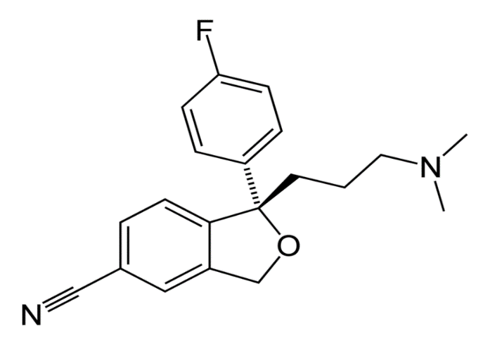

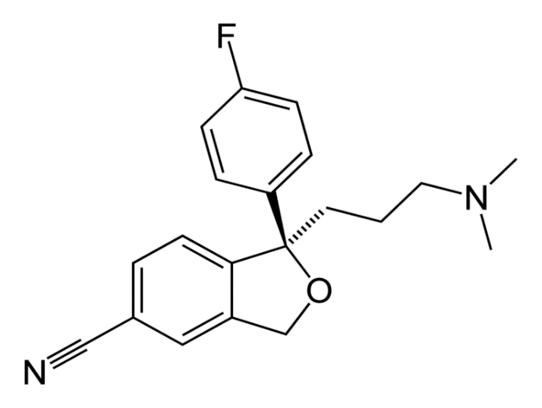
Selective serotonin reuptake inhibitor (SSRI)
S-(+)- citalopram
R-(-)-citalopram

Slide 8


Citalopram has one stereo center, to which a 4-fluorophenyl group and an N,N-dimethyl-3-aminopropyl group bind. Due to this chirality, the molecule exists in two enantiomeric forms - S-(+)-citalopram and R-(–)-citalopram. Citalopram is fixed on the pharmaceutical market as a racemic mixture, consisting of 50% (R)-(−)-citalopram and 50% (S)-(+)-citalopram and pure enantiomer. But only the (S)-(+) enantiomer has the antidepressant effect and high selectivity of serotonin reuptake inhibition.
The (S)-(+) enantiomer, which generic name is escitalopram is approved in antidepressant therapy for the treatment of adults with major depressive disorders, generalized anxiety disorders, social anxiety disorders or panic disorder. Whereas citalopram is supplied as a hydrobromide, escitalopram is supplied as an oxalate salt (hydrooxalate). Escitlopram can be considered an example of "evergreening" (also called "lifecycle management") pharmaceutical strategy in order to extend the lifetime of a drug, in this case of the citalopram franchise. Escitalopram as enantiopure compound of the racemic mixture citalopram requires less investment and less time to develop used for the same indications.

Slide 9
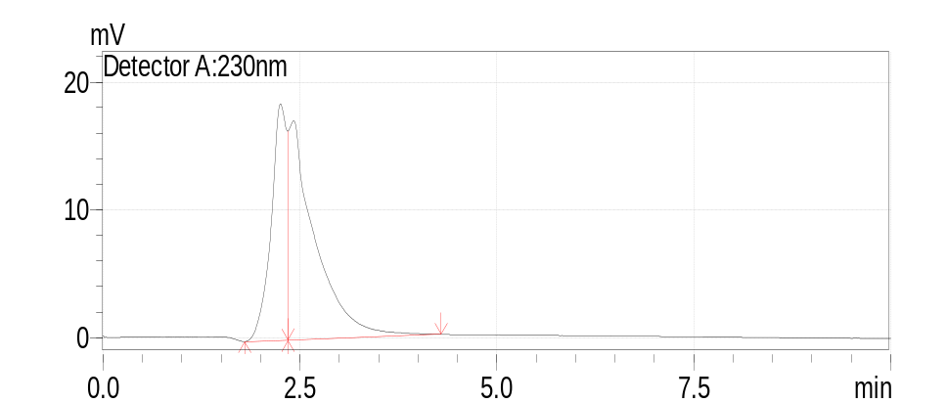
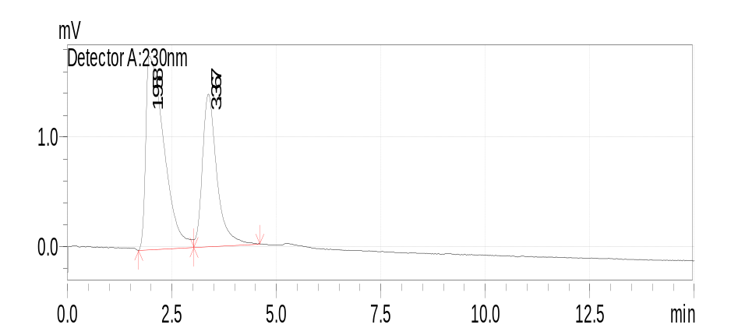
ODS (octadecylsilan)
Citalopram
HPLC chirality test
ODS (octadecylsilan) (S)-valine and
(R)-1-(α-naphthyl)ethylamine urea

Slide 10
Chemical stability profile of Citalopram:
Developed chromatographic procedure includes identification test against reference substances citalopram and escitalopram, purity test and assay. The chemical stability of analytes in different media – solvent mixtures and buffer solutions with appropriate biological pH values - 2, 7.4 and 9 was studied and the ratio of two enantiomers was determinate in dependence on kind of solvents and time. The identification is based on comparison of Rt of analyte with those of reference substance. The retention time and the areas of the citalopram peaks corresponded to that observed in the chromatogram of the reference solution.

Slide 11
Chemical stability profile of Citalopram:
Solvent mixture | Time (min) | % R-(–)-citalopram | % S-(+)-citalopram
Mobile phase | 0 – 50 | 52 | 48
Buffer solution with рН = 2 | 0 - 120 | - | 94.11 – 102.27
Buffer solution with рН = 9 | 0 | - | 95
 | 30 | 50 | 33
 | 60 | 50 | 27
 | 90 | 50 | 27
 | 120 | 44 | 27
 | 180 | 48 | 22
 | 210 | 63 | -
 | 240 | 52 | -
 | 270 | 62 | -
 | 300 | 55 | -
 | 330 | 65 | -
Buffer solution with рН = 7.4 | 0 - 180 | - | 94 – 100 %

Slide 12
Validation procedure
Specificity
Specificity in respect of reagents – “Placebo” solution containing all reagents without active substances was prepared. There are no peaks in the chromatogram obtained from this solution with Rt of R-(–) and S-(+) citalopram.
2. Precision
Six (6) equal solutions from homogenous samples containing (RS) citalopram were analyzed by HPLC method. Standard deviation (SD) in AU (absorption units) from area and relative SD (RSD) in % were found.
3. Accuracy
Three model reference mixtures containing active substances citalopram or escitalopram (concentration ratio 75 – 125 % of theoretical calculated quantity) were prepared and analyzed three times each. The results were estimated on the base of RSD.
4. Limit of detection (LOD)
5. Limit of quantitation (LOQ)

Slide 13
Validation procedure
6. Linearity
The analytical parameter linearity was studied in concentration ratio 9 mg – 2 mg. The accordance between the Area of peaks, measured in absorption units (AU) and concentrations in g/ml is proportional in the intervals. The correlation coefficients was found to be about 0.98853 for (RS) citalopram.
7. System suitability test
For system suitability test determination some chromatographic parameters such as retention time, resolution, LOD and LOQ were appointed for optimization of conditions at different mobile phases. At mobile phase Methanol/Acetonitrile (55 : 45 v/v) and flow rate about 1ml/min the resolution of enantiomers in (RS) citalopram is better than at the mobile phase Methanol/Acetonitrile (70 : 30 v/v) but the change of flow rate effects higher column efficiency – from 2840 to 6200 theoretical plates which is more suitable in assay and purity tests.
8. Range

Slide 14
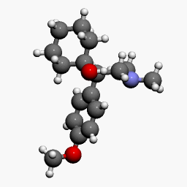
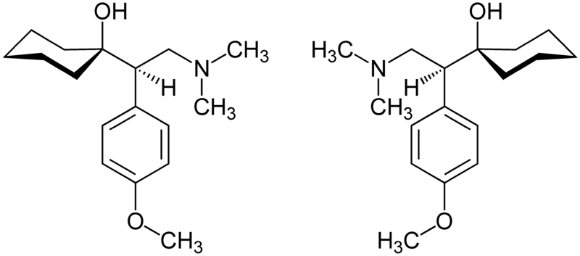
SNRI
Venlafaxine

Slide 15
Venlafaxine
More than 17 million prescriptions per year;
Venlafaxine is metabolised in the body into another antidepressant drug called desvenlafaxine (O-desmethylvenlafaxine) which is also sold as an antidepressant;
Huge number of generic formulations;
The US Food and Drug Administration body (FDA) requires all antidepressants, including venlafaxine, to carry a black box warning with a generic warning about a possible suicide risk.

Slide 16

System suitability test
For system suitability test determination some chromatographic parameters such as limits, retention time, resolution and column efficiency as number of theoretical plates and capacity factors were appointed for optimization of conditions in respect of time.
The resolution is suitable for pharmacokinetic investigations, assay and purity tests. The quantity of compound after 40 min is in the method tolerance – under +/- 2 % in respect of Area under peaks in AU.
The chromatographic profile of venlafaxine HCl is not changed. Venlafaxine at pH = 2 and 9 has been hydrolyzed very slowly and at the end of investigated period the remainder is about 74 % and 43 % resp. At pH = 7.4 the concentration was increasing depending on time and the stability profile of Venlafaxine is found to be second order reaction.

Slide 17
Venlafaxine stability

Slide 18
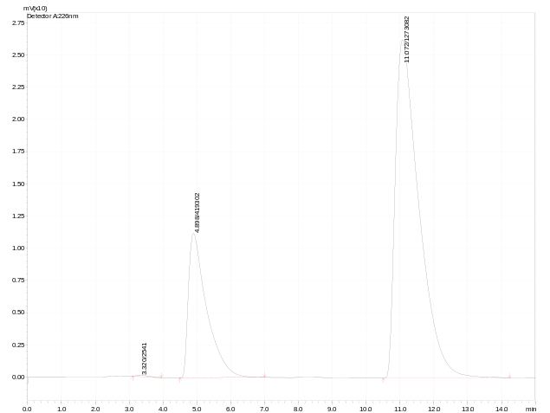
Applications
Quality control of patent, generic and illegal formulations;
Pharmacokinetic studies;
Creating of complete drug profile;
Determination in drug combinations.
Venlafaxine
Metoprolol

Slide 19
Conclusions
Developing of analytical programs with varying elements;
Creating complete and with on-line free access drugs profiles;
Creating chiral HPLC procedure for quality control of antidepressants venlafaxine HCl and citalopram at different chromatographic condition. The methods is validated in respect of purposes of pharmaceutical and toxicological practices for venlafaxine HCl and citalopram and their binary mixtures.

Slide 20


