Slide 1
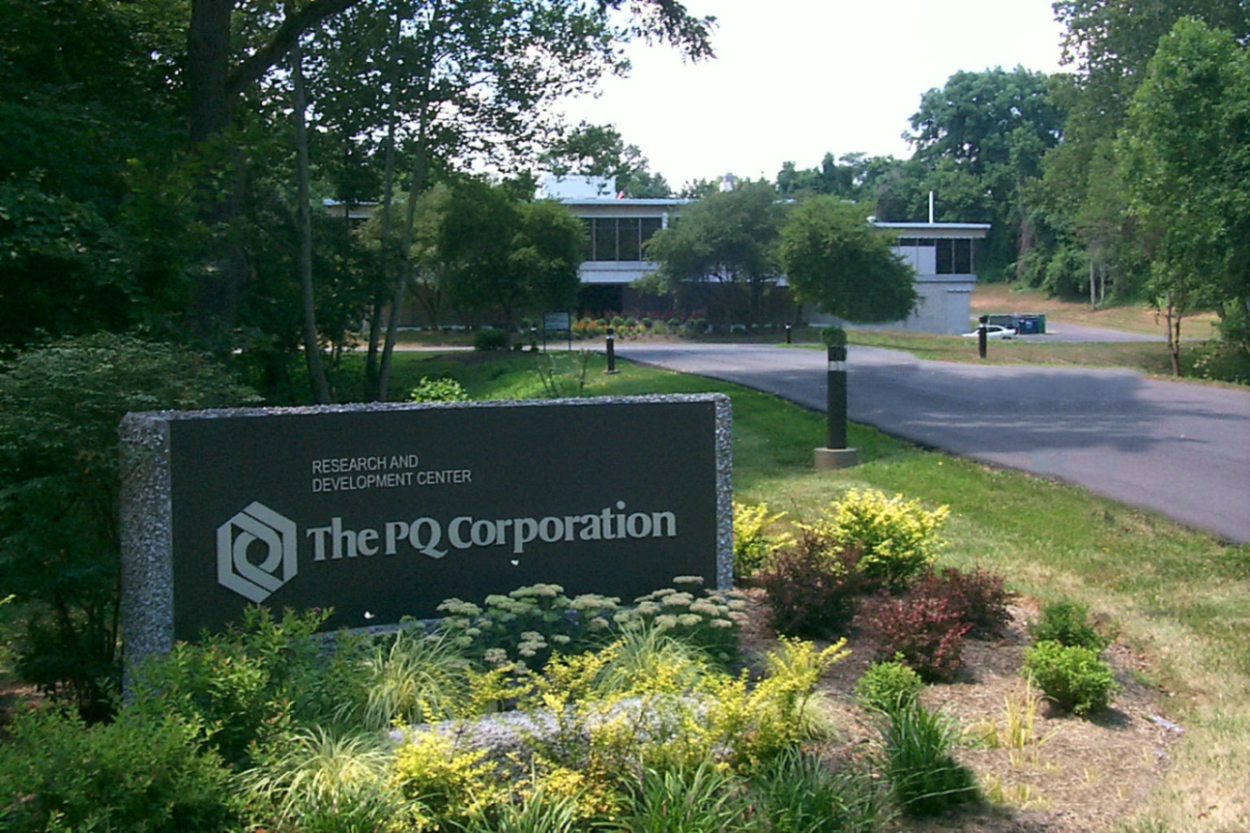
6th International Conference and Exhibition on
Analytical and Bioanalytical Techniques
Valencia, 2015
Computer modeling help in understanding molecular spectroscopic anomalies
Istvan Halasz

Slide 2
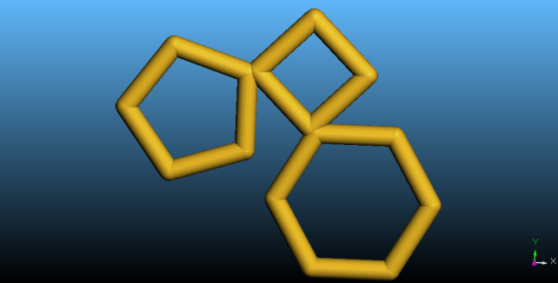
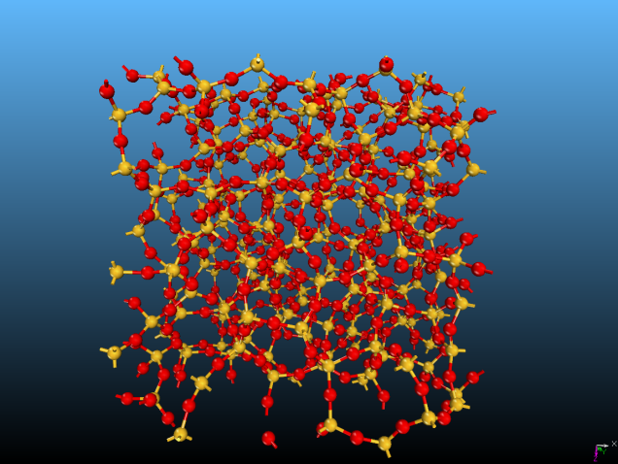
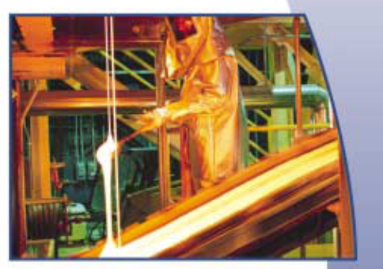
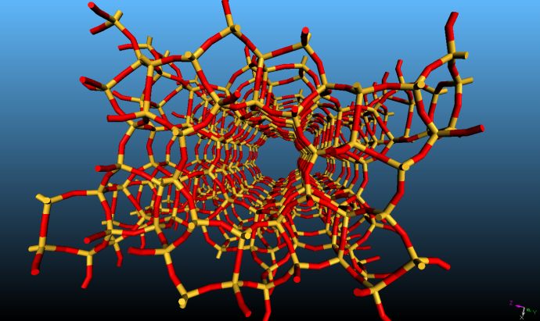
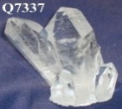
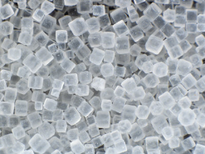
PQ is a major manufacturer of silica products
Alkaline silicate
solutions
gelling
dissolution
Nano, micro
particles
pores
Gels
Glasses
crystallization
melting
Crystals
Zeolites
Sand + alkaline salt

Slide 3
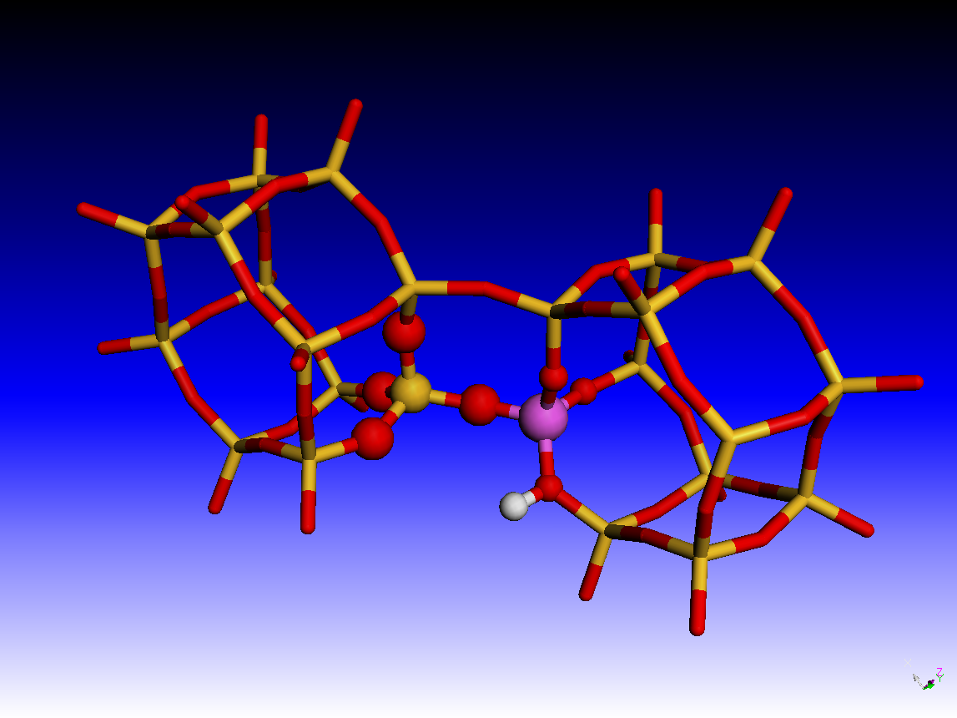
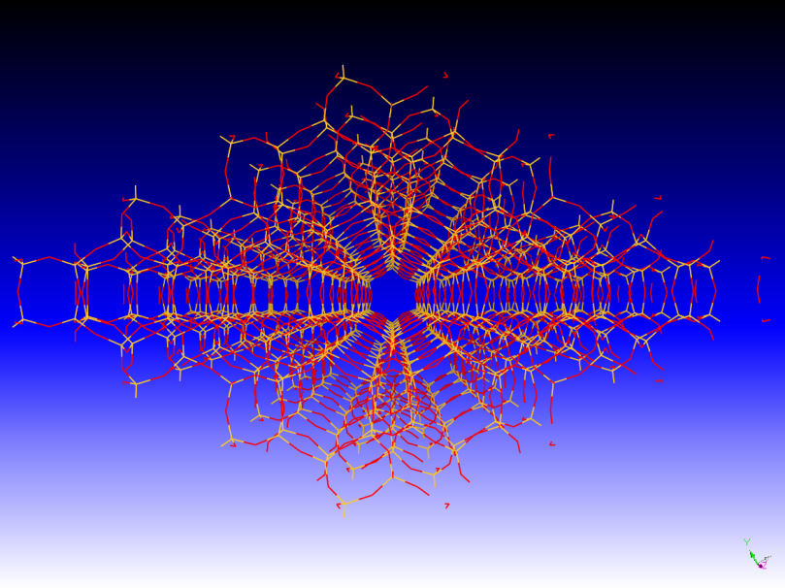
Zeolites: microporous (d < 2 nm) crystalline silicates; [SiO4] building blocks
Si⁴⁺ can be isomorphously substituted by Al³⁺ or other elements in lattice
=
O²⁺
Si⁴⁺
Al³⁺
H⁺
Exchangeable cation
Strong Brønsted acid!

Slide 4
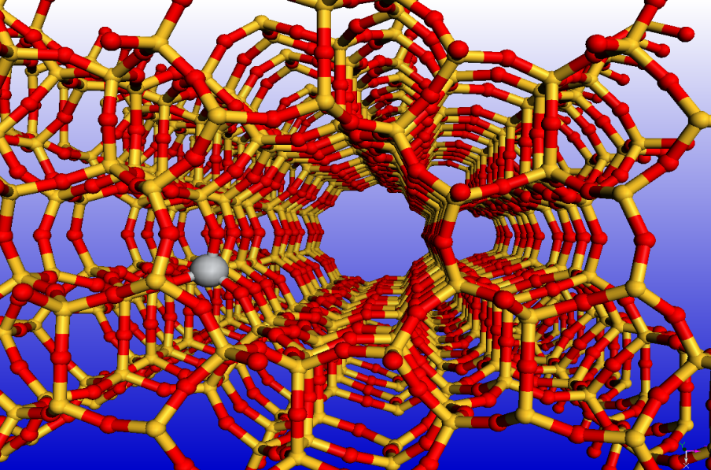
Modeling UV spectra of microporous titanium silicates
Quantum mechanical/molecular mechanical, QM/MM, approach
TDDFT spectrum calculations
TS-1 catalyst; MFI structure
Contains isomorphously inserted Ti⁴⁺
Commercialized:
Ammoximation of cyclohexanone to the oxime
O
NOH
TS-1
+ NH₃ + H₂O₂
+ H₂O
Epoxidation of olefins
TS-1
R CH₂ CH₃
+ 2 H₂O₂
R CH CH₂ + 3 H₂O
O

Slide 5
FTUV Absorption of TS-1 samples
3.0
TS-1-A Well prepared; hydrophobic
TS-1-C Poorly prepared; hydrophilic
211
206
222
TS-1-B What is this?; hydrophilic
TS-1-B What is this?; hydrophilic
270
2
Kubelka Munk units
1
Higher
coordinated Ti⁴⁺
0
Isolated tetrahedral Ti⁴⁺
200
250
300
350
Wavelength [nm]
I. Halasz, M. Agarwal, E. Senderov, B. Marcus, Stud. Surf. Sci. Catal. 145 (2003) 435.

Slide 6
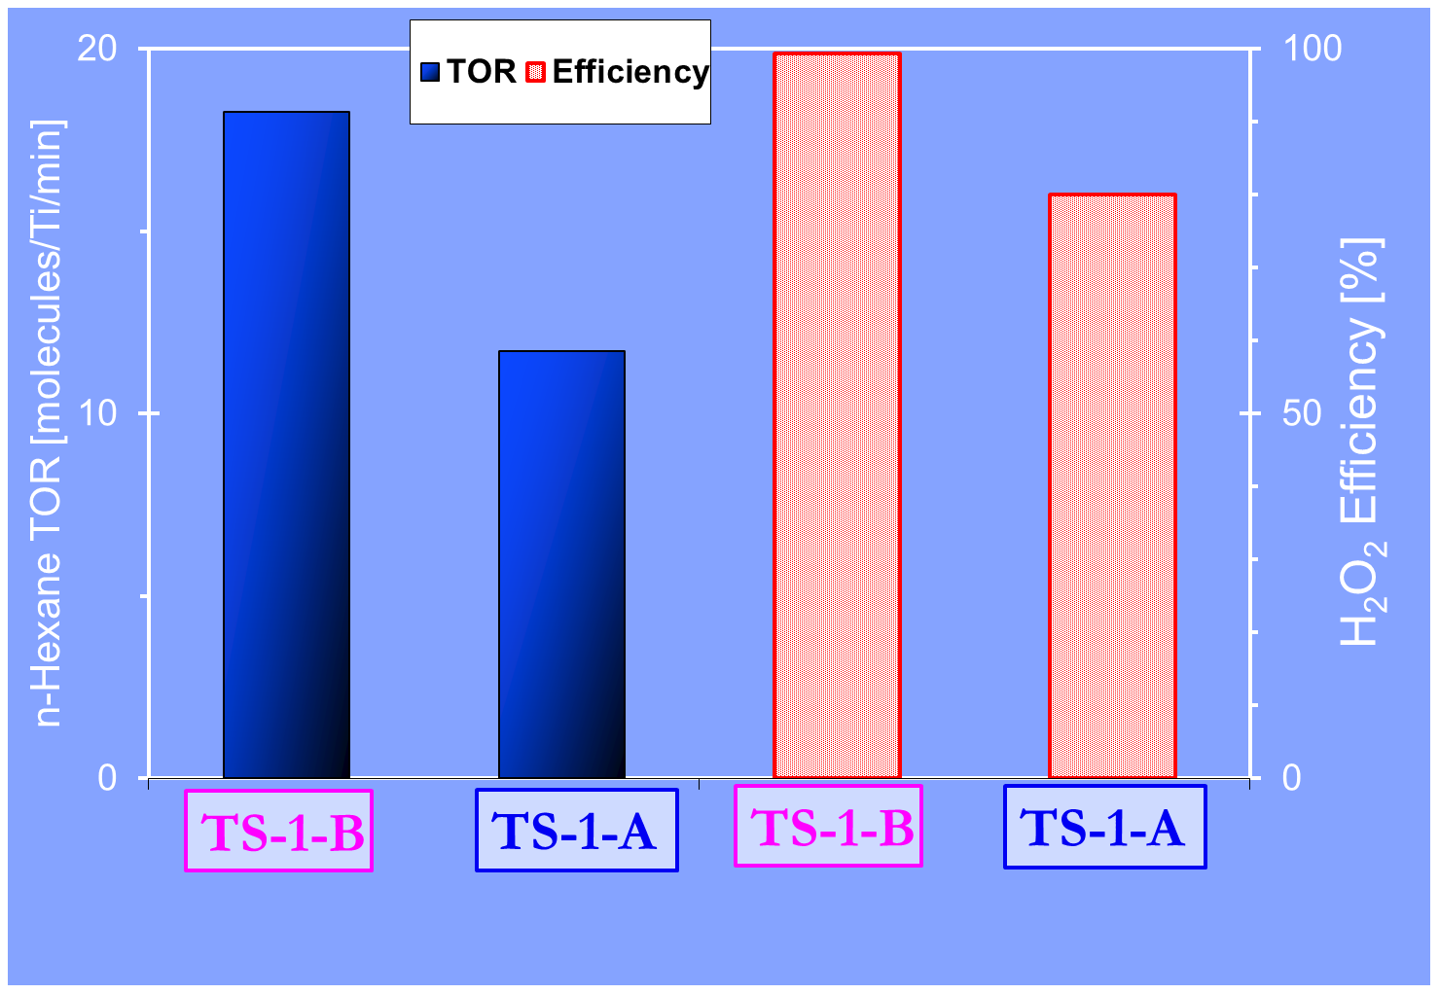
Selective catalytic oxidation of n-Hexane by H₂O₂
I. Halasz, M. Agarwal, E. Senderov, B. Marcus, Catalysis Today 81 (2003) 227.

Slide 7
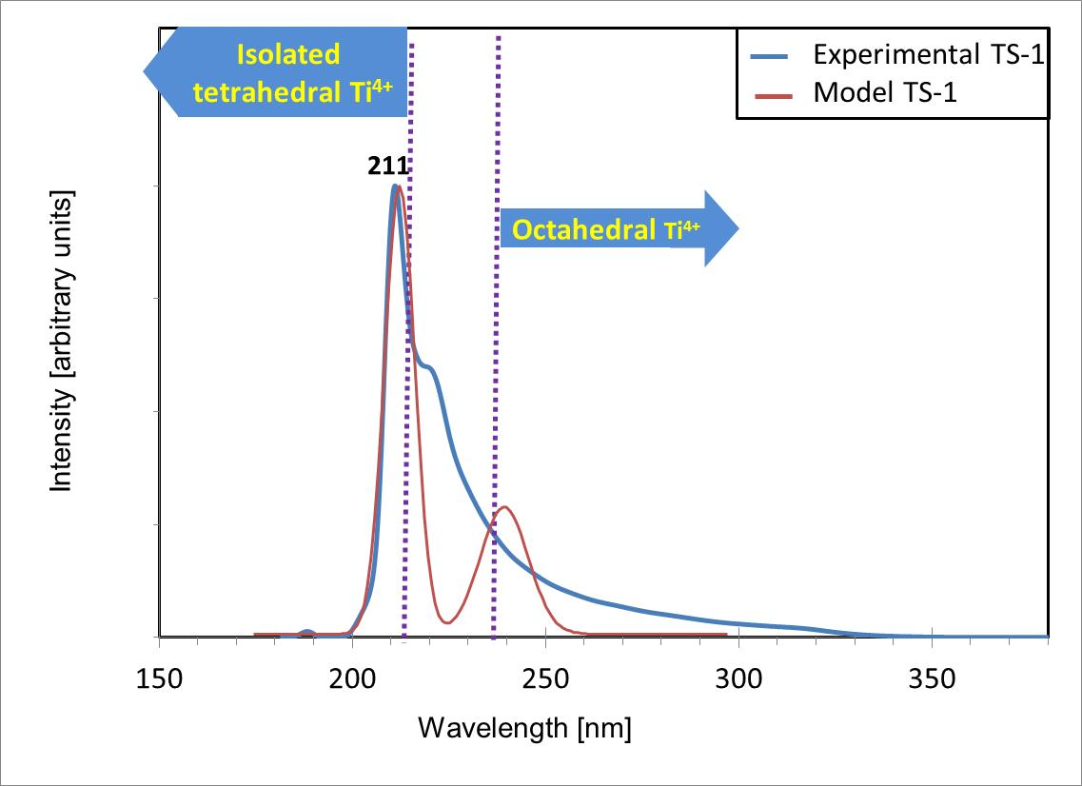
Modeling UV spectra of microporous titanium silicates
QM/MM & TDDFT
Works well forTS-1!
I. Halasz, J-J. Liang, G. Fitzgerald, Catal. Lett. 141 (2011) 948.

Slide 8
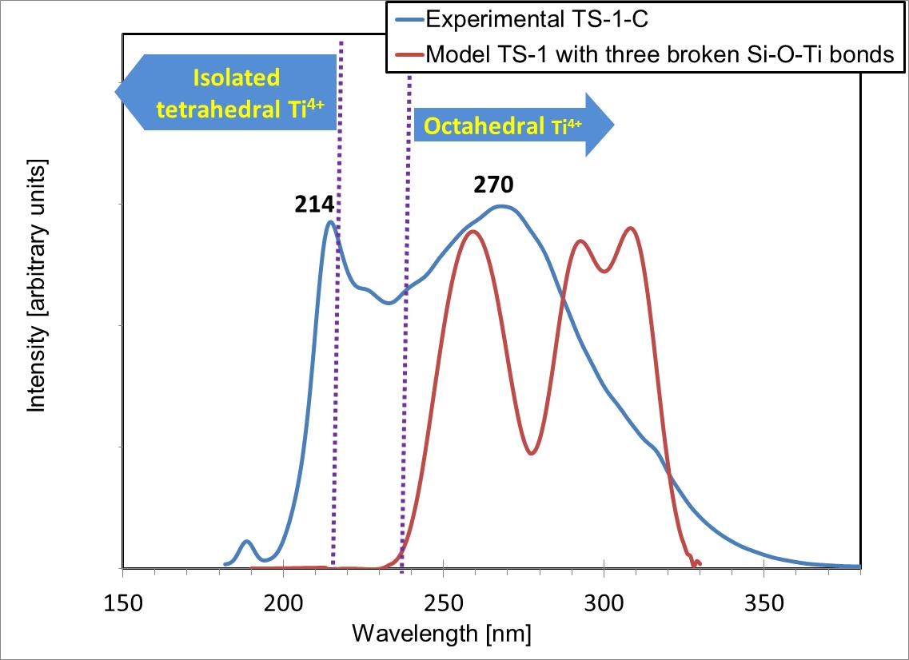
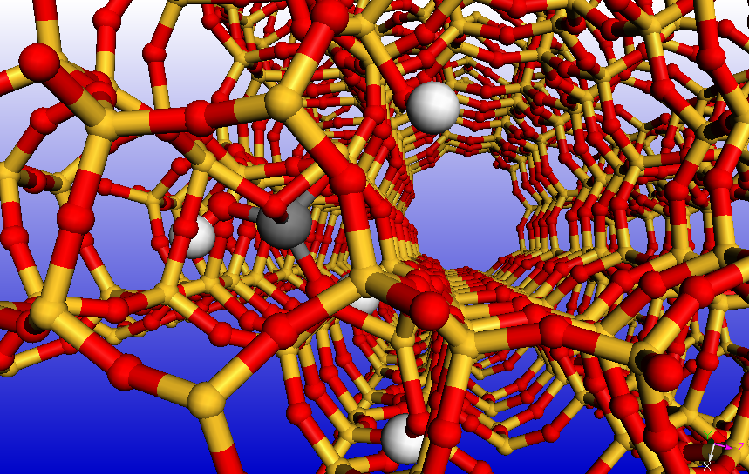
The UV of TS-1 with two broken Si-O-Ti bond defects
-Si-O
The Ti-(OH)₂ unit turns away from the main channel
-Si-O
Ti⁴⁺
OH group
I. Halasz, J-J. Liang, G. Fitzgerald, Catal. Lett. 141 (2011) 948.

Slide 9
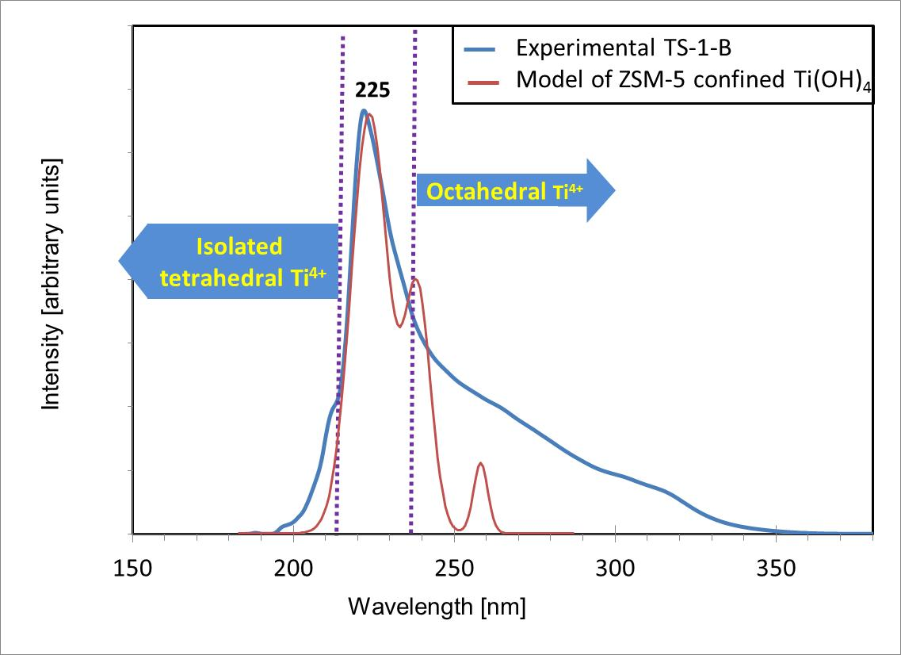
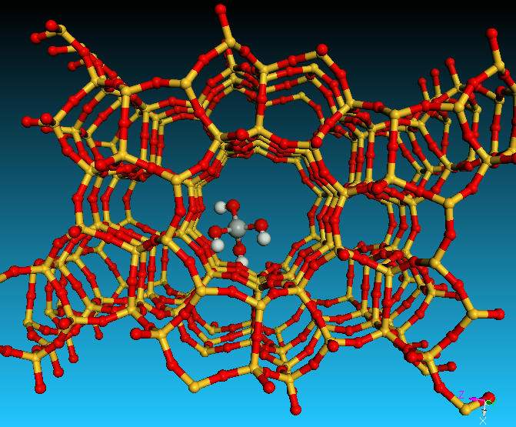
Model of extralattice Ti(OH)₄ confined in zeolite channel gives
perfect match with experimental UV spectra
I. Halasz, J-J. Liang, G. Fitzgerald, Catal. Lett. 141 (2011) 948.

Slide 10
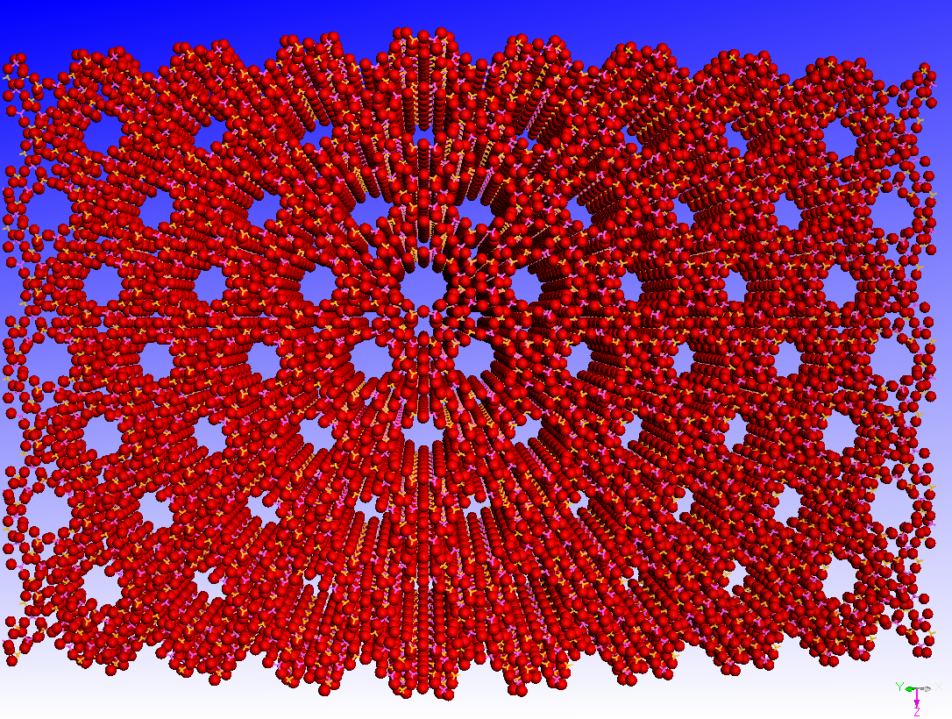
Y zeolite
Uniform, submicroscopic micro-channels (d ~ 7.5 A) in a zeolite particle
Key catalyst component in Fluid Catalytic Cracking (FCC) and other technologies

Slide 11

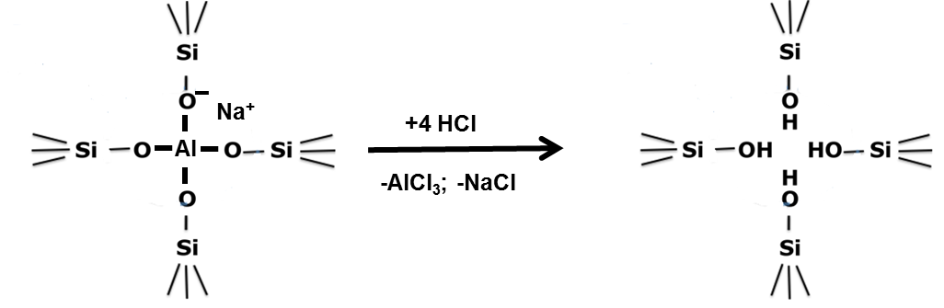
Are stable
OH-nests real?
Barrer, R. M.; Makki, M. B., Molecular Sieve Sorbents from Clinoptilolite, Can. J. Chem. 1964, 42, 1481
Acid leaching allows to change Si/Al ratio in zeolites.
Dissolved Al leaves hydroxyl nest behind.

Slide 12
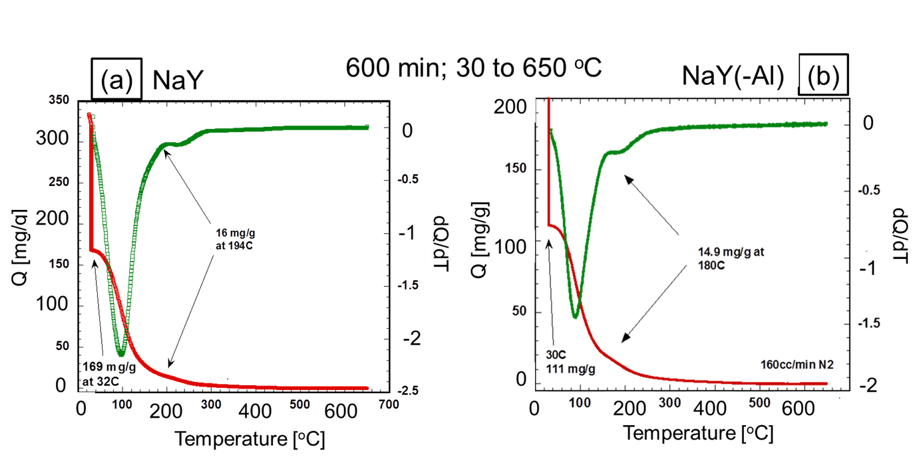
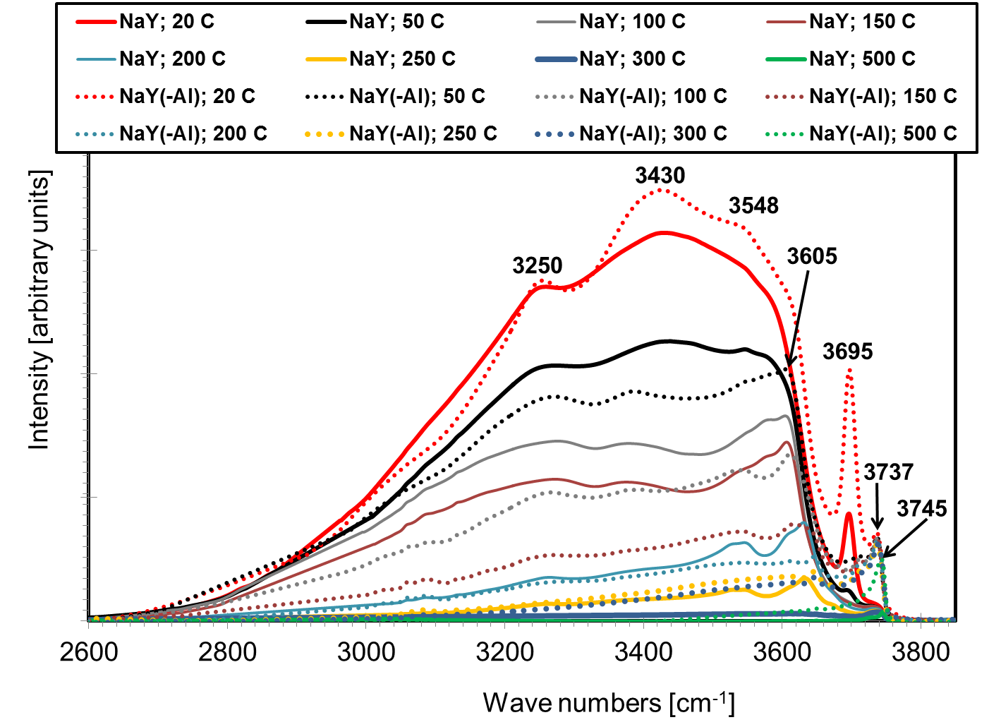
No desorption beyond 250 C
No specific vibration for OH-nest
E. Senderov, I. Halasz, D. H. Olson Microporous Mesoporous Materials 2014, 186, 94-100

Slide 13
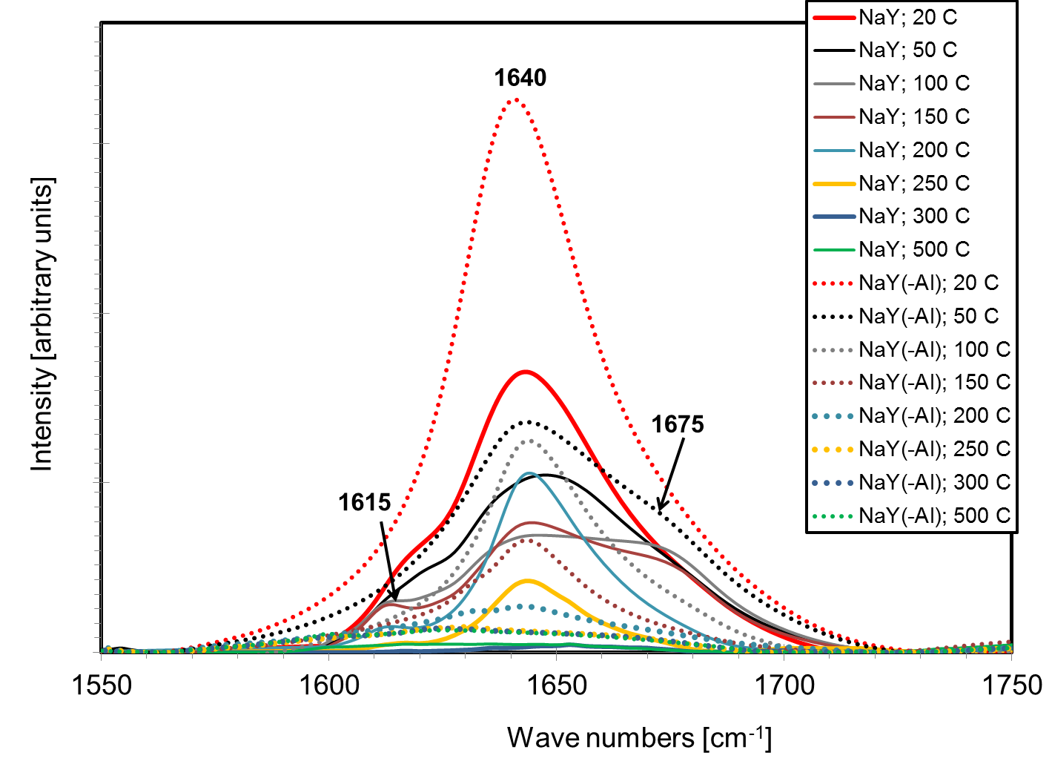
FTIR confirms that molecular water desorbs up to ~250 ºC

Slide 14
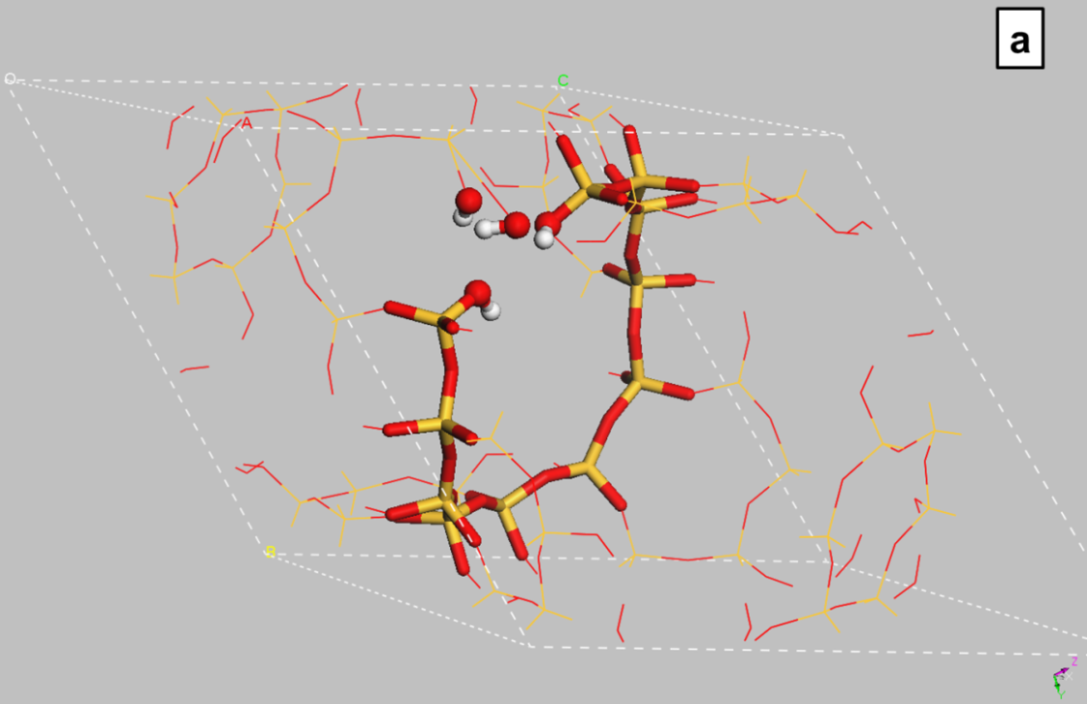
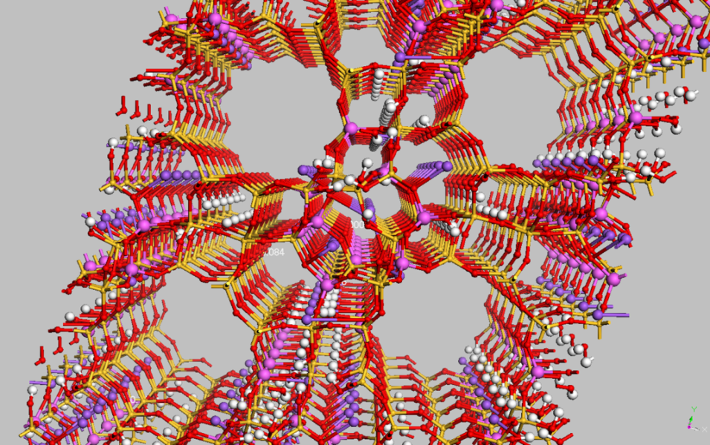
OH-nest in primitive cell
Realistic model with OH nests
Na₄₀Al₄₀(OH)₈₀Si₁₃₂O₃₀₄
I. Halasz, E. Senderov, D. H. Olson, J-J. Liang, J. Phys. Chem. C 2015, 119, 8619-8625

Slide 15
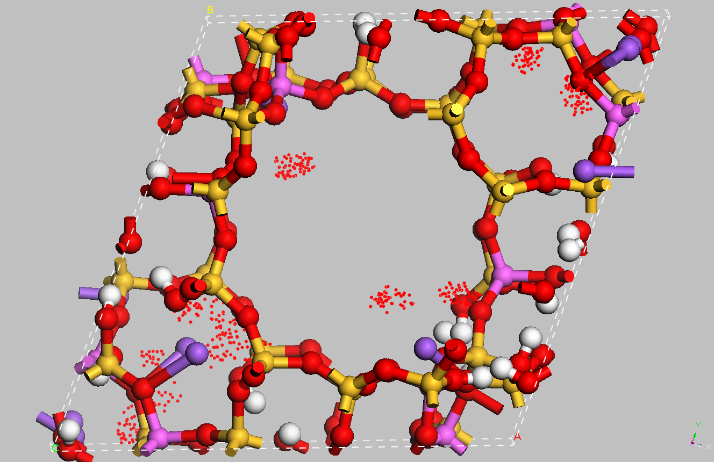
Hydrated Na₄₀Al₄₀(OH)₈₀Si₁₃₂O₃₀₄
Grand Canonical Monte Carlo computed
probability of H₂O sorption
I. Halasz, E. Senderov, D. H. Olson, J-J. Liang, J. Phys. Chem. C 2015, 119, 8619-8625

Slide 16
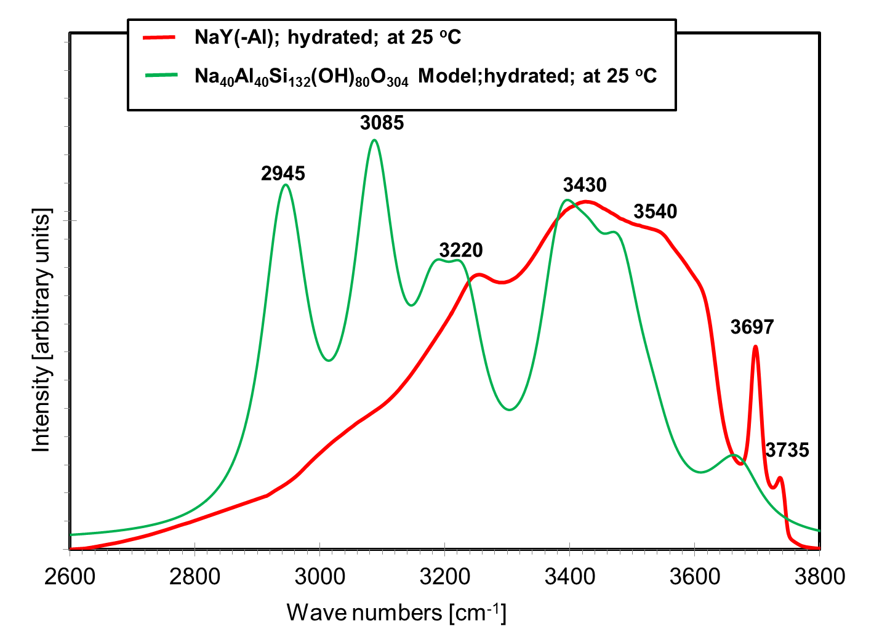
Experimental and computed FTIR spectra of dealuminated samples
Most intense (OH)₄ nest bands not found in experimental spectra!

Slide 17
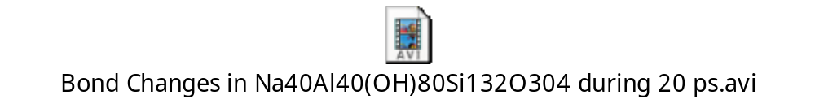
Realistic siliceous Y zeolite model with (OH)₄ nests
Reactive Forcefield Molecular Dynamics calculation at 25 ºC
Dehydration starts within < 20 ps at 25 ºC!
(OH)₄ nests can have only ephemeral existence even at room temperature
I. Halasz, E. Senderov, D. H. Olson, J-J. Liang, J. Phys. Chem. C 2015, 119, 8619-8625

Slide 18
Conclusion
Molecular modeling is a very useful tool
for interpreting spectroscopic results and
explaining material structures at the molecular level.

Slide 19
Many thanks to people who helped
in the experimental and modeling work presented
Jian-Jie Liang, Biovia Inc., San Diego, CA, USA
George Fitzgerald, Biovia Inc., San Diego, CA, USA
Mukesh Agarwal, PQ Corporation, Conshohocken, PA, USA
Runbo Li, PQ Corporation, Conshohocken, PA, USA
Eric Senderov, PQ Corporation, Conshohocken, PA, USA (retired)
Davis Olson, Rutgers University, Piscataway, NJ, USA

Slide 21
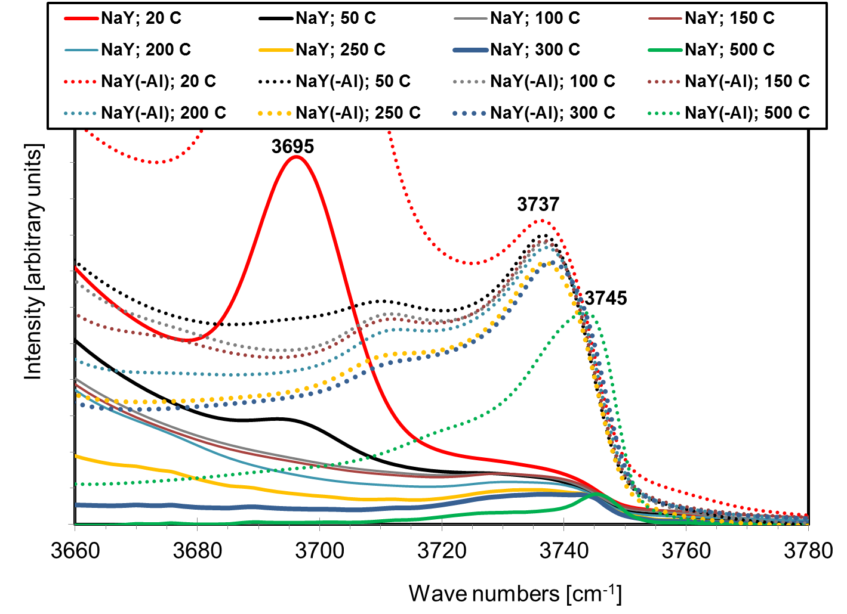
FTIR does not indicate new internal hydroxyls in dealuminated sample
The band near 3740 cm⁻¹ is well known as isolated terminal Si-OH

Slide 22

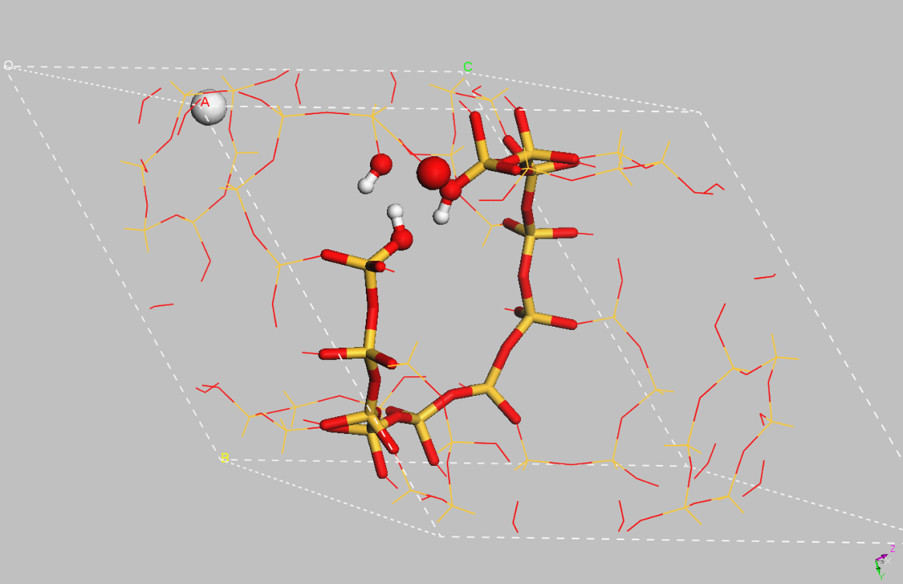
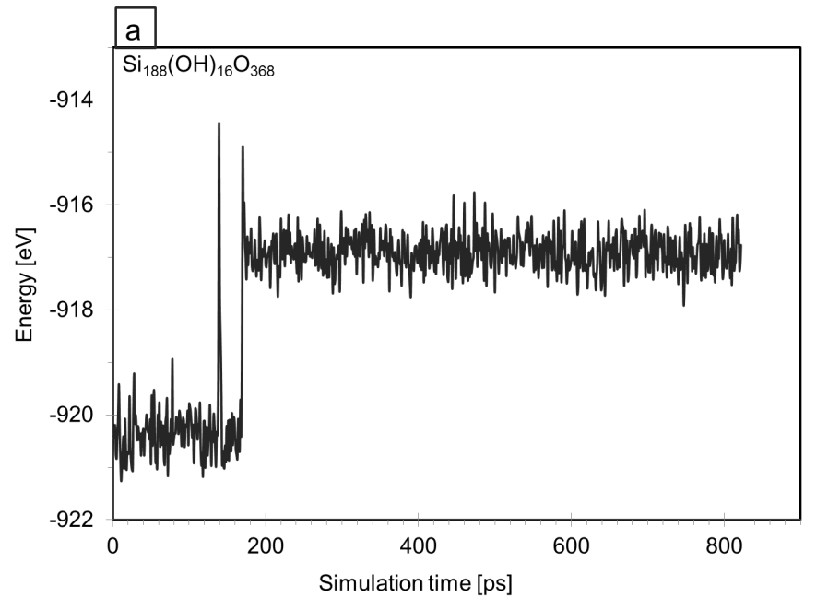
Static (OH)₄-nest model in Y primitive cell
Energy jumps with time during ReaxFF dynamic calculation;
50 ºC, fs step intervals
Model after dynamic excitement for 170 ps

Slide 23
Modeling UV spectra of microporous titanium silicates
Quantum Mechanical/Molecular Mechanical, QM/MM, approach
Time Dependent Density Functional Theory, TDDFT, based spectrum calculations

