Slide 1
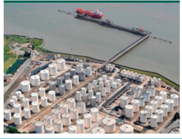
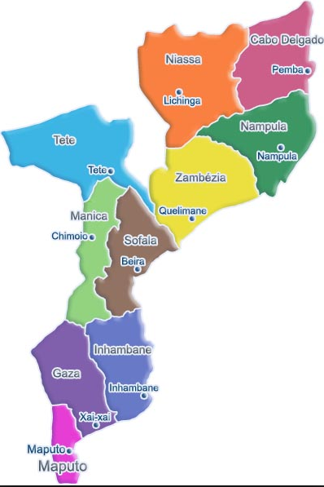
THE EFFECT OF GAS TO LIQUID FUEL ON GDP -
A CASE OF MOZAMBIQUE
Author and Presented by:
ISMAEL VALIGY
MBA in Oil & Gas Management
MA in Economics & Finance
Presentation Prepared for:
International Conference and Expo on Oil and Gas.
Dubai, Nov 2015
OMICS Group Inc

Slide 2
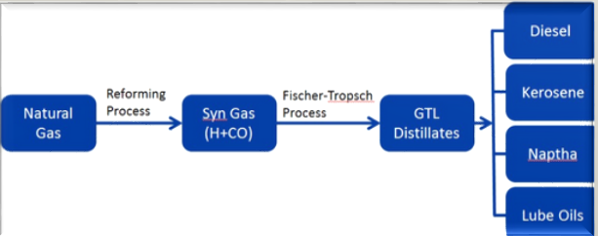
1. Introduction
The Study relates to Natural Gas to liquid fuels (GTL) and refers to the huge proved reserves discovered in Mozambique.
Gas-to-Liquid (GTL) process is a system that changes natural gas to liquid fuels, such, gasoline, jet fuel, and diesel using Fischer-Tropsch (F-T) synthesis.
  Ramesh Raman, (2014) describes the GTL process in the following simplified way:
Source: Ramesh Raman, (2014)

Slide 3
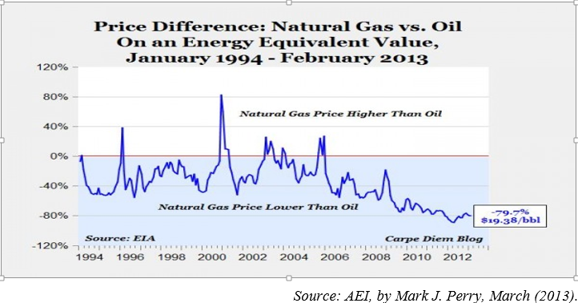
1.1. Crude Oil versus Natural Gas
Natural gas is 80% cheaper than oil on an energy-equivalent basis (Mark J. 2013)!
To compare oil ($/ barrel) and natural gas ($ / million BTUs) on an energy equivalent basis, natural gas prices have to be increased by a factor of 5.8, because one barrel of oil produces 5.8 million BTUs of energy (British Thermal Unit).

Slide 4
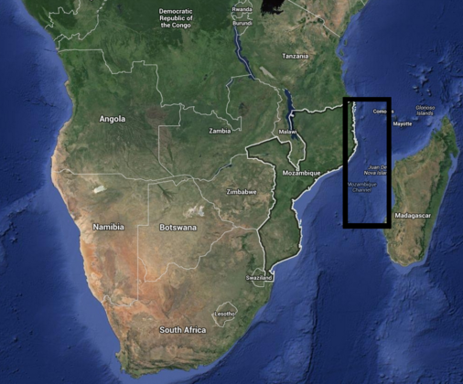
1.2. Research Objectives
The aims of study is to identify the effect on GDP when Mozambique use GTL Fuels to alleviates the dependence on imports traditional refined fuels derived from crude oil.
  Facts:
  Mozambique LNG is emerging as a leader in the global LNG industry, with around 180+ trillion cubic feet (tcf) proved reserve.
  Mozambican state Oil & Gas Company ENH agreed with Sasol and Italy’s ENI to carry out a pre-feasibility study for construction of a GTL plant with initial capacity to produce 96,000 barrels of liquid fuel per day.
  Royal Dutch Shell signed another agreement with ENH, which led to a pre-feasibility study being launched for a GTL unit
Due to this fact, arises the following research question:
  “What will be the effect on Mozambique economy when using GTL fuels instead of importing it?

Slide 5
2. Theoretical Framework
2.1. Strategic Justification
Opportunity to Mozambique start producing refined fuels products derived from local natural gas such gasoline, diesel and waxes.
In our days refined crude oil is the main source of automotive fuels and demand increases year-by-year. Crude oil is also a limited resource.
  Will be a stage in history that:
    The demand on crude oil exceeds the supply (peak oil), or
    New technology and alternative energy resources will be gradually necessary to replace the traditional crude oil, as a primary font of motor energy.
Gas-to-liquids conversion enables the production of similar products as are presently produced from crude oil.

Slide 6
  2.2. Economic Justification: There is an economic incentive for gas-to-liquids conversion when there is a meaningful price difference between natural gas and crude oil…..
TABLE 2. 1 Cost of GTL Fuel Unit Production
in US$/Barrel
TABLE 2.2 Price difference between natural gas and crude oil
Expense of GTL Fuel Unit Production in US$/Bbl
Fetched Component | Refinery | GTL
Natural Gas (@$0.50/MMBtu) |  | $4.00
+ Crude Oil (@$17/Bbl) | $17.00
+ Operating Costs | 2.5 | 3
Aggregate Cash Costs | 19.5 | 7
+ Capital Recovery, Taxes | 6.5 | 12
Aggregate Cost to Produce | $26.00 | $19.00
Feed Material | Feed Cost |  | Efficiency | Effective Cost
 | $/bbleqv | $/GJ | (%) a | $/bbleqv
Natural gas | 28 | 5 | 75 | 37
Crude oil | 100 | 18 | 89 | 113
a LPG, gasoline, jet fuel, diesel fuel and fuel oil products
Source: (Arno de Klerk, 01/2012
Source: (Shen et al, 2002)

Slide 7
2.3. Framework Diagram
Import Refined Fuels
Effects on GDP
(Net Export =
Export – Import)
GTL a Locally Produced Fuels
IV DV
Hypothesis
H0: There is no significant relationship between imported refined fuels and GDP
H1: There is a significant relationship between imported refined fuels and GDP
Note: Details in data analysis section at determination of Price and Quantity of Fuels Imported and Consumed in Mozambique.

Slide 8
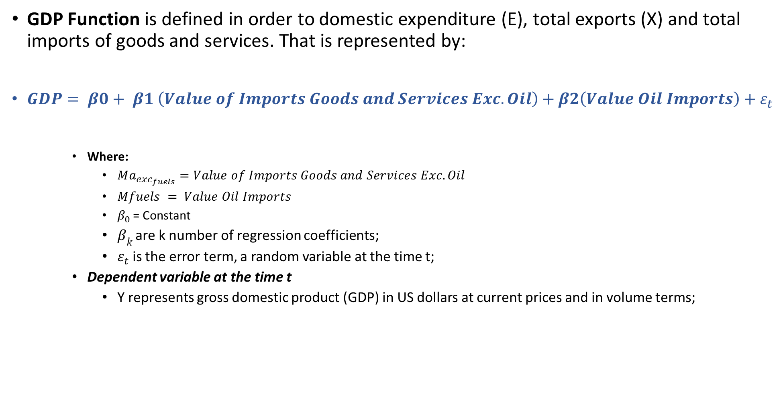
2.4. Economic Mathematic Equation a) Regression Model of Fuels Import:
GDP Function is defined in order to domestic expenditure (E), total exports (X) and total imports of goods and services. That is represented by:
$GDP= β0+ β1 \left(Value of Imports Goods and Services Exc. Oil\right)+β2\left(Value Oil Imports\right)+ε_{t}$
    Where:
      $Ma_{exc_{fuels}}=Value of Imports Goods and Services Exc. Oil$
      $Mfuels = Value Oil Imports$
      $β_{0 }$= Constant
      $β_{k }$are k number of regression coefficients;
      $ε_{t}$ is the error term, a random variable at the time t;
    Dependent variable at the time t
      Y represents gross domestic product (GDP) in US dollars at current prices and in volume terms;

Slide 9
3. Results of Data Analysis – 2000 to 2013.
3.1. Data Overview Analysis

Slide 10
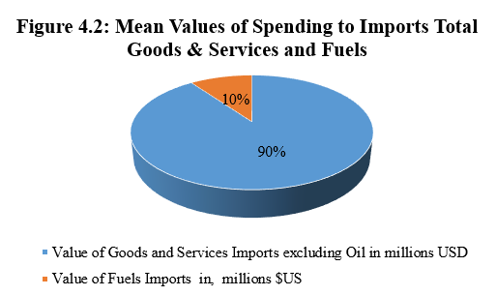
    3.2. Statistical Resume of Data Analysis - Period 2000 to 2013
 |  | Year | Gross Domestic Product in millions $US | Value of Goods and Services Imports excluding Oil in millions $US | Value of Fuels Imports in millions $US | Total Fuels Consumption (Millions Barrels/ Year)
N | Valid | 14 | 14 | 14 | 14 | 14
 | Missing | 0 | 0.00 | 0.00 | 0.00 | 0.00
Mean |  | 2007 | 8,367.07 | 4,014.43 | 442.00 | 5.231
a. Multiple modes exist. The smallest value is shown

Slide 11
    3.3. Model Validation: Regression Analysis Results
Multiple Linear regression has manipulated to ensure positive and negative effect between GDP and Value of Goods and services Imports (Including fuels imports).
Model Summary - Coefficient of determination for Regression Model
Model | R | R Square | Adjusted R Square | Std. Error of the Estimate
1 | .981ª | .962 | .955 | 826.36931
a. Predictors: (Constant), Value of Fuels Imports in millions USD, Value of Goods and Services Imports excluding Oil in millions USD
The value of coefficient of determination (R Square) is 0.962.
It means, both variables together explain 96.2% of the variance in GDP.
In other words, the model is 96.2% satisfactory and up to standard, which is high determinant.

Slide 12
3.4. ANOVA and Hypothesis:
H0: β0 = β1 = β2 = 0
H1: β0 ≠ β1 ≠ β2 ≠ 0
Table 3. 3 ANOVAª for Regression Model
Model |  | Sum of Squares | df | Mean Square | F | Sig.
1 | Regression | 188920506.402 | 2 | 94460253.201 | 138.325 | .000^{b}
a. Dependent Variable: Gross Domestic Product millions of U.S. dollars
b. Predictors: (Constant), Value of Fuels Imports in, millions $US, Value of Goods and Services Imports excluding Oil in millions USD
  The f-value (138.325) for this test is 0.00 which is highly significant and less than the standard value of 0.05.
  It implies that Null Hypothesis has rejected and alternative hypothesis has accepted.
  This means that there is a significant relationship between imported refined fuels and GDP.

Slide 13
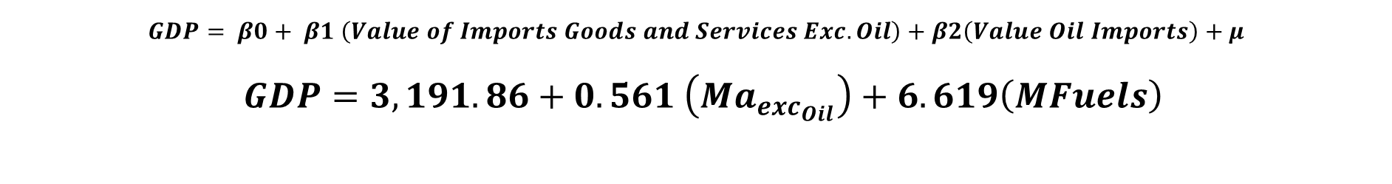
3.5. Coefficients ª for Regression Model
Table 3. 4 Coefficients ª for Regression Model
Model (millions $US) |  | Unstandardized Coefficients |  | Sig.
 |  | B | Std. Error
1 | (Constant) | 3191.086 | 398.626 | .000
 | Value of Goods and Services Imports excluding Oil | .561 | .251 | .047
 | Value of Fuels Imports | 6.619 | 2.034 | .008
$$GDP= β0+ β1 \left(Value of Imports Goods and Services Exc. Oil\right)+β2\left(Value Oil Imports\right)+μ$$
$GDP=3,191.86+0.561 \left(Ma_{exc_{Oil}}\right)+6.619\left(MFuels\right)$
Conclusions: increase in one unit of Fuels imports can increase GDP by 6.619 units or in other words, each increasing of 6.619 $US on GDP occurs when Mozambique spend 1 $US to import fuels

Slide 14
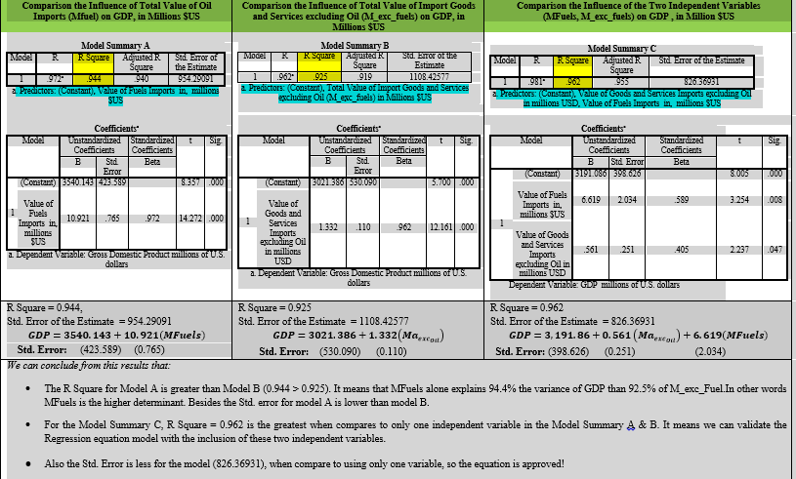
    3.5.1. Validation of Regression Model Equation

Slide 15
3.6. Price Determination and Fuels Imported in Moz.
Recalling the objective for this analysis, the research will assume:
  The capacity of GTL plant production at 96,000 bbl/day
  Mozambique will use in domestic market 25% of this production (local Petroleum Law) which represents:
    24,000 bbl/day, or 8.76 million bbl/year of GTL fuels available to local consumption.
    It means that can stop importing 8.76 million bbl/year of refined fuels and substitute with GTL bbl/ fuels equivalent.
  The effective cost production of GTL fuel per barrel is $37 (Arno de Klerk, 01/2012).

Slide 16
3.7 Assumed Effective Cost per BOE
Feed Material | Effective Cost per Unit
 | $/BOE
Moz Imported and Consumed Fuel (Statistical Mean Value) | 84.49
Moz GTL Fuel – Assumed Market Cost Price (locally Production Available) | 37.00
  Main Findings:
  The study will assume the average price of importing fuels and consumed at $84.493 / bbl
  In same period, the average in the world crude oil price was $65.34 / bbl, (McMahon, 2014).

Slide 17
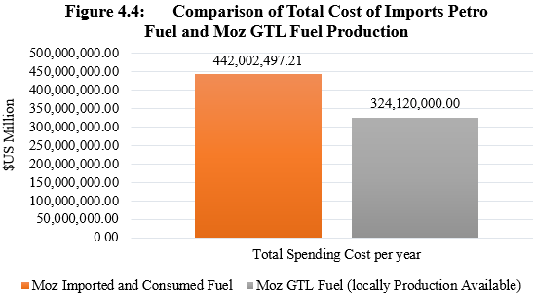
3.8. Summary of Fuel Prices and Quantities
In actual scenario and assume all economic factors remains the same, the quantity of GTL fuels produced exceed the average consumption of fuels imports per year in 3.529 millions of BOE.
Mozambique can stop importing fuels and save in 100% the spending value to import fuels for domestic consumption.

Slide 18
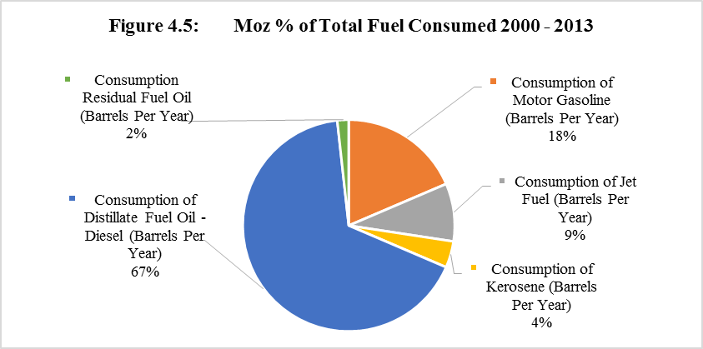
3.9 Analysis and Results of Fuels Consumption by Type

Slide 19
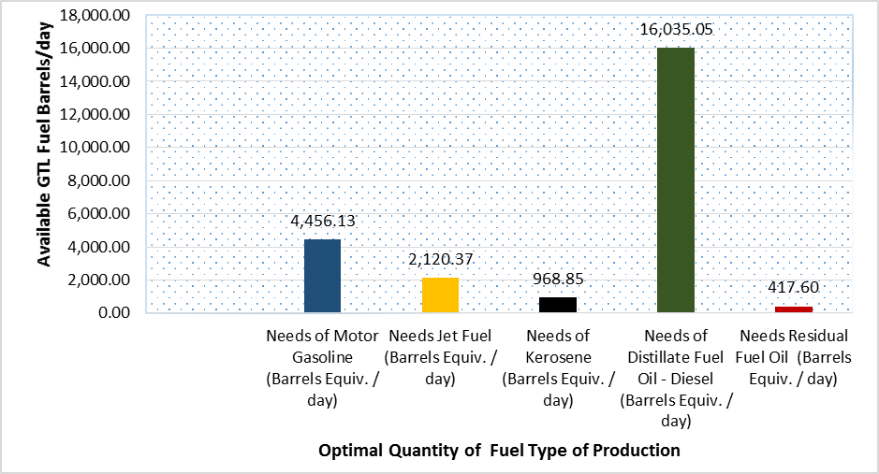
3.10 Optimal Expected Quantities of Fuels from Moz GTL Plant to Local Use
FIGURE 4. 6 Quantity of GTL Fuels by type Forecasted of 24.000 bbl / day Available (bbequiv)

Slide 20
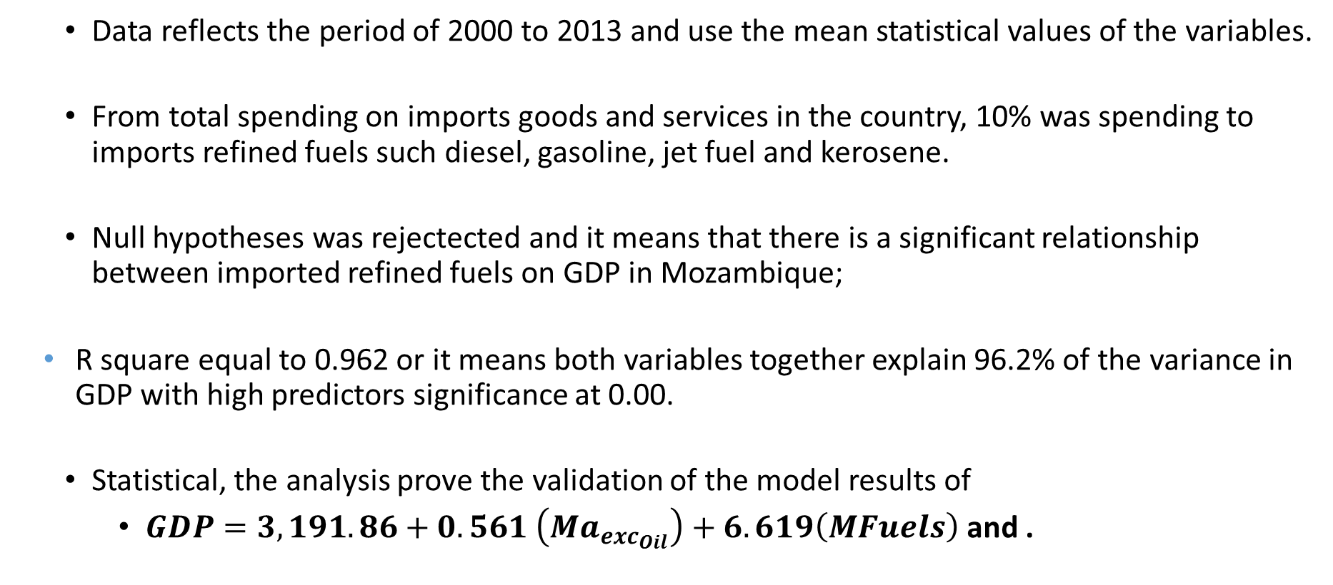
3.11. Major Findings and Results
  Data reflects the period of 2000 to 2013 and use the mean statistical values of the variables.
  From total spending on imports goods and services in the country, 10% was spending to imports refined fuels such diesel, gasoline, jet fuel and kerosene.
  Null hypotheses was rejectected and it means that there is a significant relationship between imported refined fuels on GDP in Mozambique;
    R square equal to 0.962 or it means both variables together explain 96.2% of the variance in GDP with high predictors significance at 0.00.
  Statistical, the analysis prove the validation of the model results of
    $GDP=3,191.86+0.561 \left(Ma_{exc_{Oil}}\right)+6.619\left(MFuels\right)$ and .

Slide 21
Cont.: 3.11 Summary of Findings and Results
The average price of BOE imported in period of analysis corresponds to $84.493;
The world average price per fuel barrel on the period cost in average $65.34 and one barrel of fuel equivalent derived from GTL, is equal to $37.
  It means that the country can save $47.49 per barrel of fuel equivalent in the future, if considers all economic factors remains the same.
Distillate fuel (diesel fuel) represents the major quantity consumed in the country and represents 66.81%, followed by gasoline at 18.57% and Jet fuel at 8.83 (figure 4.5).

Slide 22
4. Conclusion and Recommendations
When Mozambique starts the GTL fuels plant production and use 25% of total production as a source of fuels, the GoM have the option to stop import refined fuels and substitute it with the available fuels production.
This conclusion is supported from the fact found that the 25% of the GTL fuels production exceed in 167.46% annual barrels of oil equivalent imported by the GoM.
According to the costs of GTL fuels, also can annual save the value of $117.8 million on import refined fuels and relocate to other economic sectors to generate income.

Slide 23
  4.1. Recommendation and Limitation of the Study
Since this study come in with policies country implications and the fact that GTL plant not already in place (under studies and construction), further research’s needs to be undertake to validate these results.
The contribution of this study can be used as a started point of thinking to the country get as much competitive advantages in economic development and monetize the usage of the natural gas reserves discovered.
Note: More details can be viewed in the full paper!

Slide 24
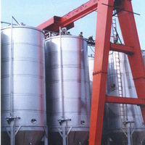
Thank You for
Your attention
Q & A

