Slide 1
About OMICS Group
OMICS Group International is an amalgamation of Open Access publications and worldwide international science conferences and events. Established in the year 2007 with the sole aim of making the information on Sciences and technology ‘Open Access’, OMICS Group publishes 400 online open access scholarly journals in all aspects of Science, Engineering, Management and Technology journals. OMICS Group has been instrumental in taking the knowledge on Science & technology to the doorsteps of ordinary men and women. Research Scholars, Students, Libraries, Educational Institutions, Research centers and the industry are main stakeholders that benefitted greatly from this knowledge dissemination. OMICS Group also organizes 300 International conferences annually across the globe, where knowledge transfer takes place through debates, round table discussions, poster presentations, workshops, symposia and exhibitions.

Slide 2
About OMICS Group Conferences
OMICS Group International is a pioneer and leading science event organizer, which publishes around 400 open access journals and conducts over 300 Medical, Clinical, Engineering, Life Sciences, Phrama scientific conferences all over the globe annually with the support of more than 1000 scientific associations and 30,000 editorial board members and 3.5 million followers to its credit.
OMICS Group has organized 500 conferences, workshops and national symposiums across the major cities including San Francisco, Las Vegas, San Antonio, Omaha, Orlando, Raleigh, Santa Clara, Chicago, Philadelphia, Baltimore, United Kingdom, Valencia, Dubai, Beijing, Hyderabad, Bengaluru and Mumbai.

Slide 3
Network Verification Challenge
(NVC)
Anita Iskandar, PhD
Philip Morris International R&D
The sbv IMPROVER project, the website and the Symposia are part of a collaborative project designed to enable scientists to learn about and contribute to the development of a new crowd sourcing method for verification of scientific data and results. The current challenges, website and biological network models were developed and are maintained as part of a collaboration with Selventa, OrangeBus and ADS. The project is funded by Philip Morris International.

Slide 4


3
The “bionet” Platform
1
Introduction to sbv IMPROVER
4
Jamboree and Outcomes
2
The Network Verification Challenge
(NVC)

Slide 5
3
The “bionet” Platform
1
Introduction to
sbv IMPROVER
4
Jamboree and Outcomes
2
The Network Verification Challenge
(NVC)

Slide 6
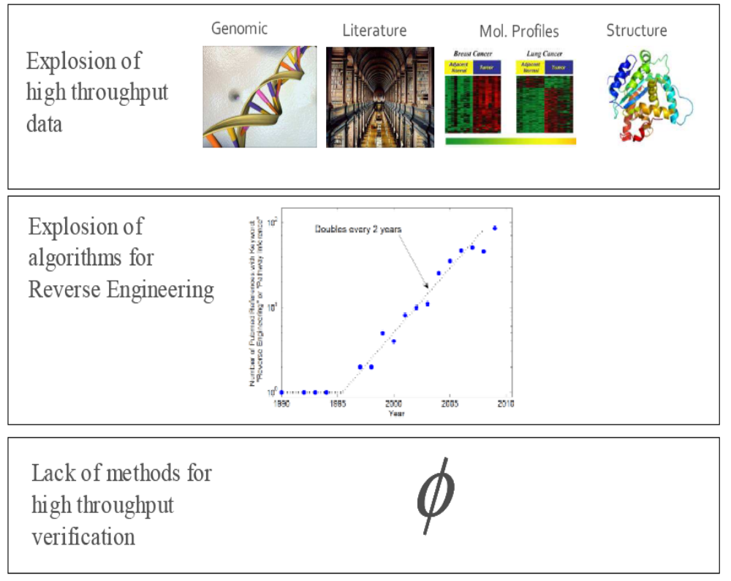
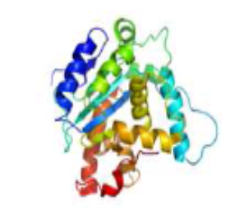
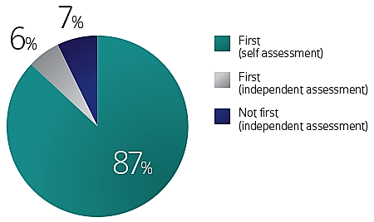
Why do we need sbv IMPROVER?
We are experiencing a data overload…
Genomic
Literature
Molecular Profiles
Structures
But we lack the corresponding validation tools…
The self-assessment trap: can we all be better
than average?
Mol Syst Biol. 2011 Oct 11;7:537. doi: 10.1038/msb.2011.70.
Develop a robust methodology that verifies systems biology-based approaches
Notes:
Explosion of algorithms for Reverse Engineering (double every 2 years)
Complexity of algorithms

Slide 7
Industrial Methodology for Process Verification in Research (IMProVeR): towards systems biology verification
IMProVER has commonalities with other crowd sourcing methods
The main concepts of IMProVER are :
  to formalize rigorours tests that determine a go or no-go decision for a systems biology research pipeline in an industrial context
  to inspire the development of enhanced methodologies by community participation
  to endow the community with datasets and benchmark to provide a means for continuous improvement in subsequent generation of builiding blocks
Successful implementation of IMProver will enable high credibility of a research pipeline
“Industrial Methodology for Process Verification in Research (IMProVeR): towards systems biology verification”
Pablo Meyer1, Raquel Norel1, Jörg Sprengel2, Katrin Stolle3, Thomas Bonk3, Stephanie Corthesy1, Ajay Royyuru, Julia Hoeng4, Manuel Peitsch4 and Gustavo Stolovitzky1, J. Jeremy Rice1
1 IBM Computational Biology Center, Yorktown Heights, NY, USA, 2 IBM Life Sciences Division, Zurich, Switzerland, 3 Phillip Morris International Research, Cologne, Germany, 4 Phillip Morris International Research, Neuchatel, Switzerland
Notes:
Replace with Peter’s slide

Slide 8
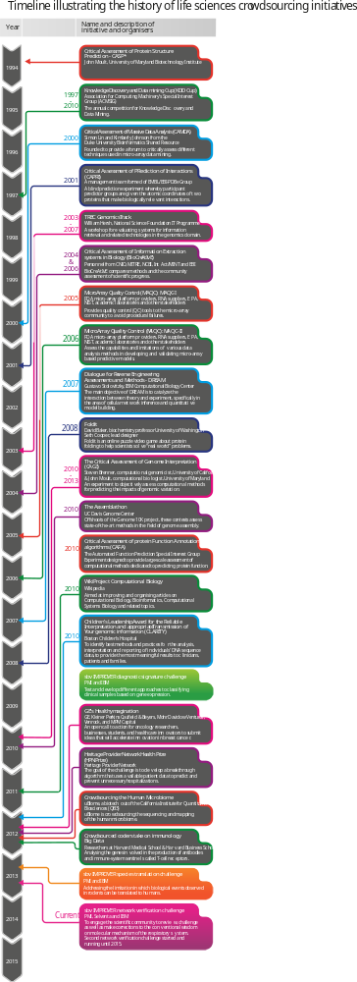



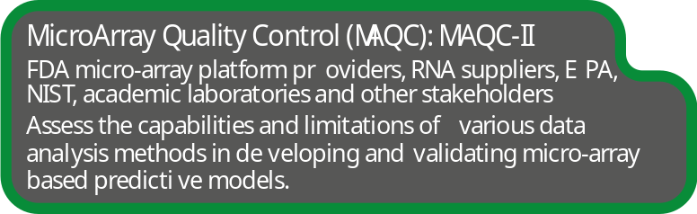
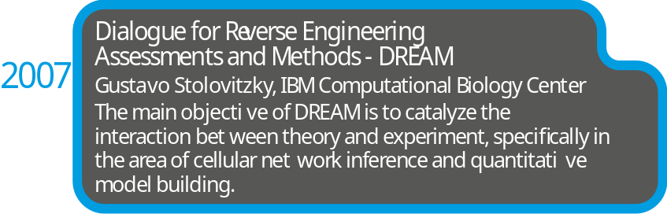


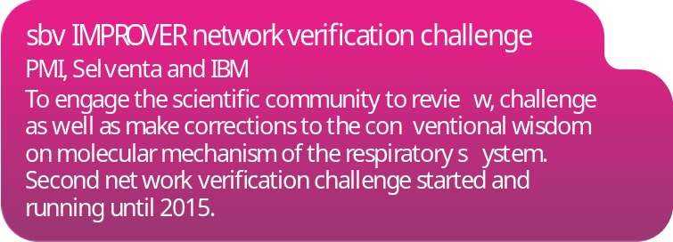
Crowdsourcing in Science
1994
2004 & 2006
2005
2006
2012
2007
2013
2013 - present

Slide 9
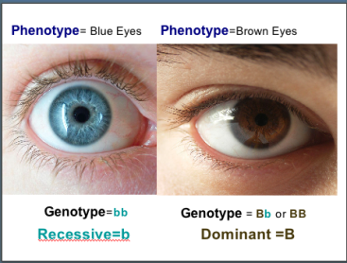
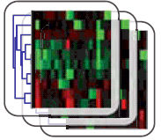
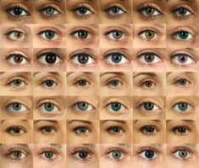

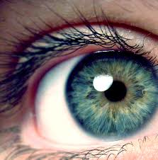
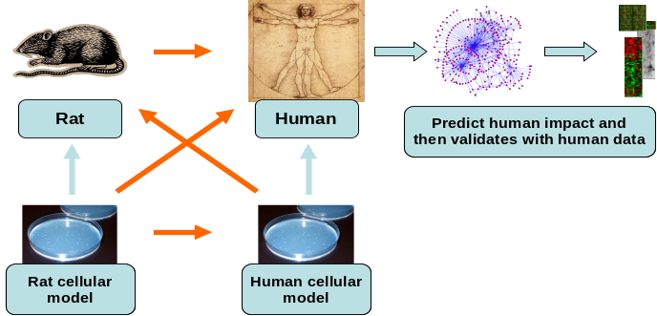
sbv IMPROVER Challenges
2012
2013
2014
2015
Q1
Q2
Q3
Q4
Q1
Q2
Q3
Q4
Diagnostic Signature: Best analytical approaches to predicting phenotype from
gene expression data
Corresponding phenotype
(known but not given)
Gene expression data (given)
+
Publicly available data: phenotype, gene expression, prior knowledge of the disease (given)
Phenotype prediction performance
Scoring
CHALLENGE
+
Many Phenotype prediction algorithms
Open
Benchmarking
Species translation: Accuracy and limitations of rodent models for human diseases
Open
Concept of « Translatabillity »
Network verification: Verify and enhance pulmonary biological network models
NVC1
NVC 2
Future Challenges: Being planned
Notes:
Diagnostic signature challenge
Even though diagnostic signature challenge is over, scientist can still benchmark their algorithms using the datasets on the sbvimprover website
Species translation challenege

Slide 10
3
The “bionet” platform
1
Introduction to sbv IMPROVER
4
Jamboree and Outcomes
2
The Network
Verification
Challenge
(NVC)

Slide 11
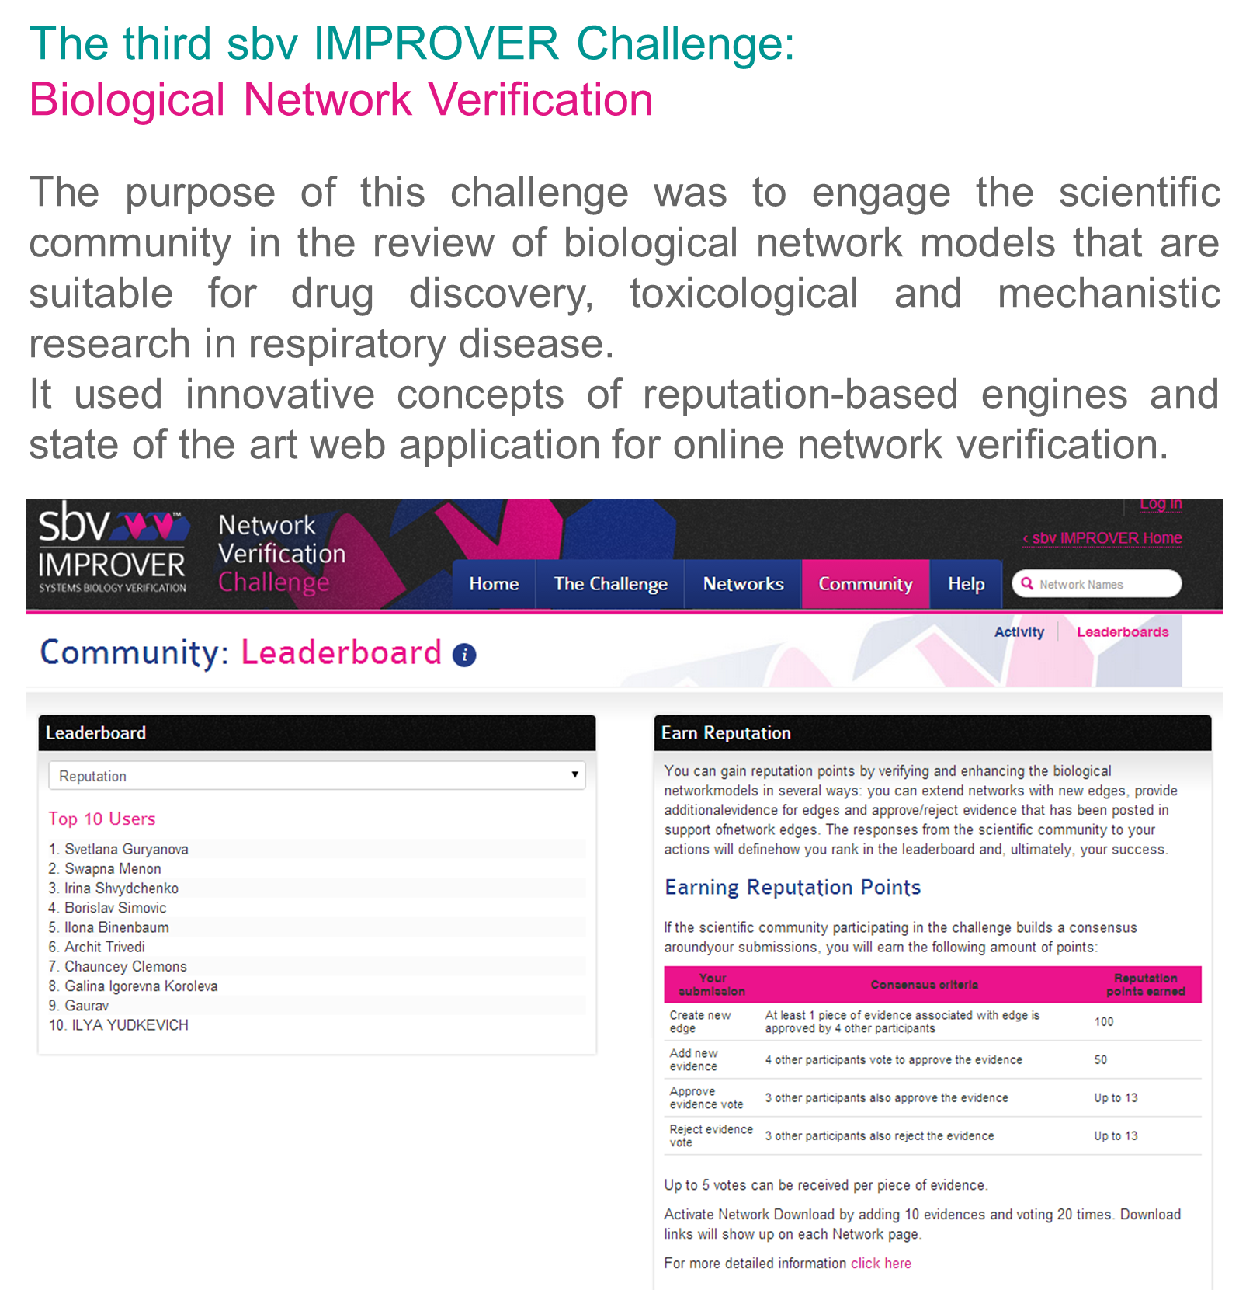
Challenge 3 – Biological Networks Verification
✓
✓
✓
sbv Improver team. 2013. On Crowd-verification of Biological Networks. Bioinformatics and biology insights 7: 307-325.

Slide 12
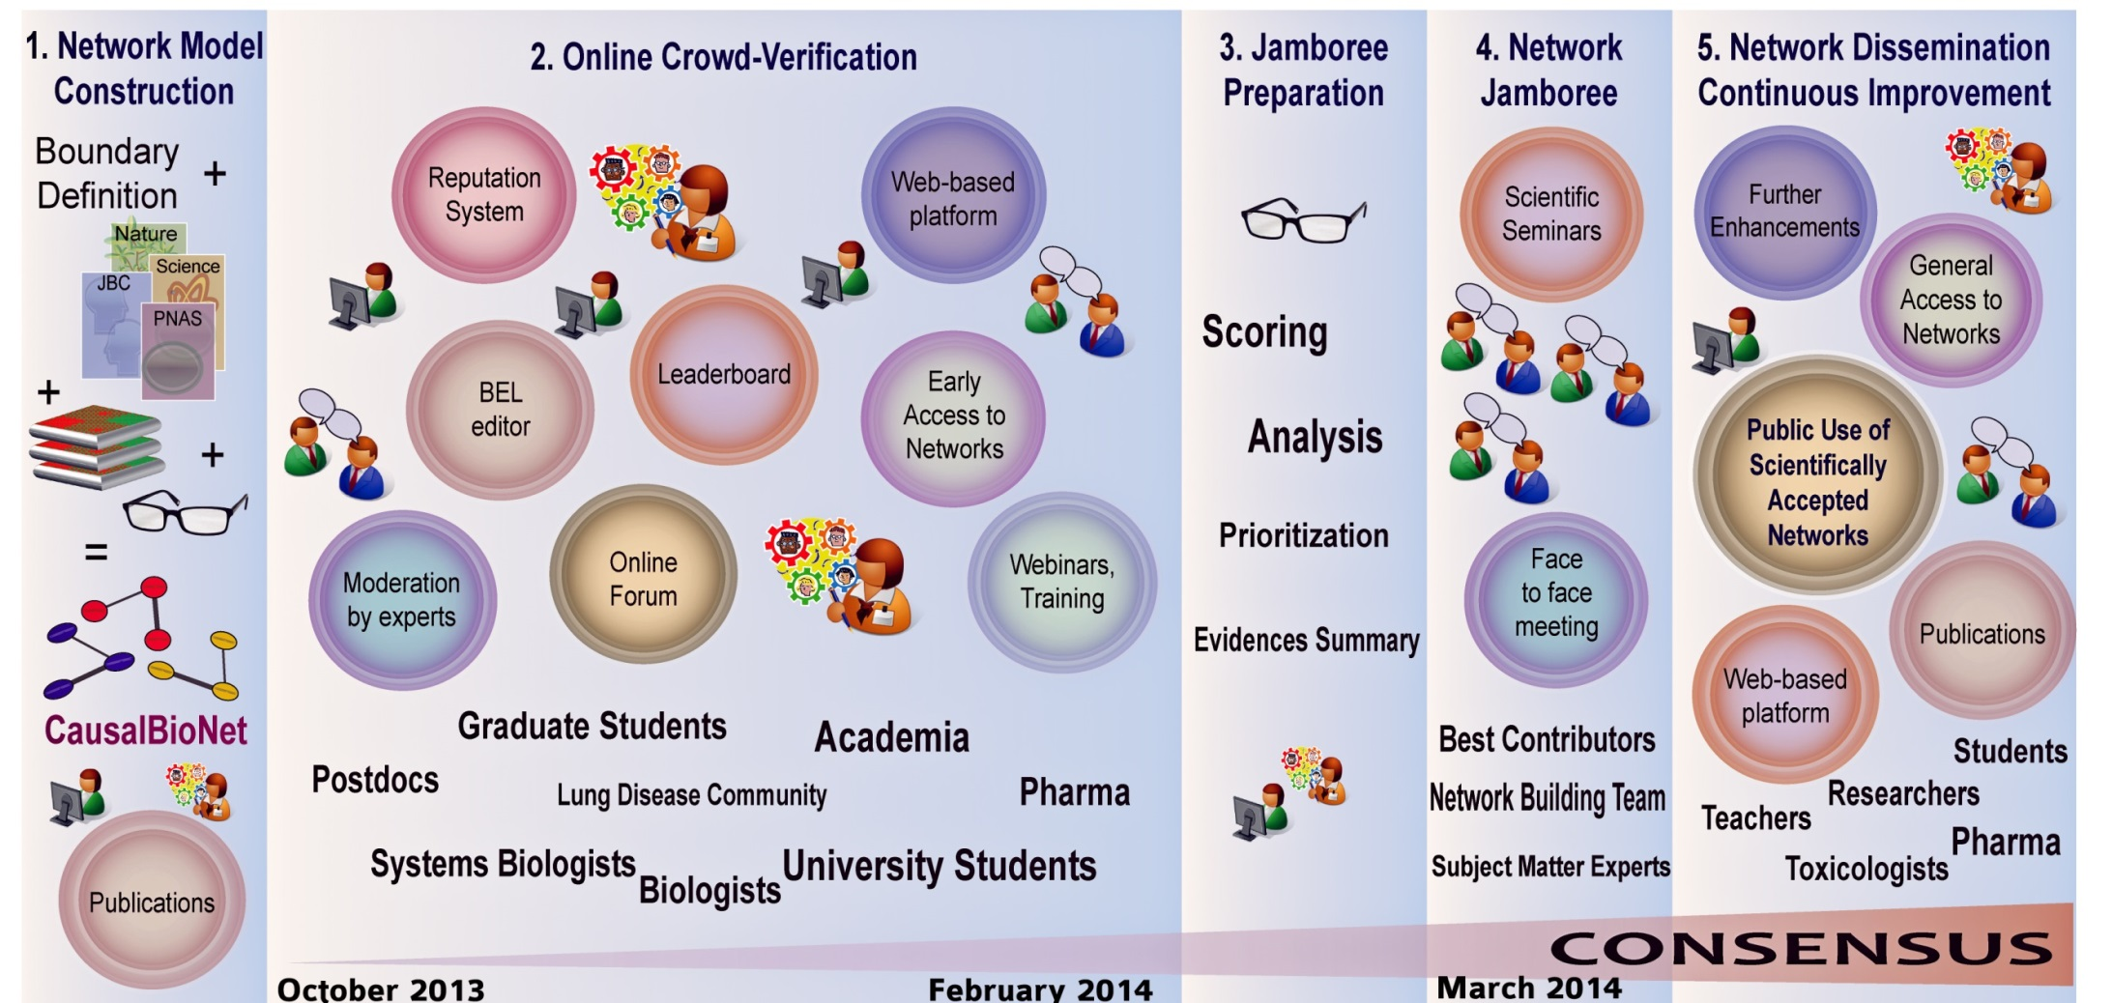


Steps in the sbv IMPROVER Network Veriﬁcation Challenge (NVC)
The sbv IMPROVER project team (2013). On Crowd-verification of Biological Networks. Bioinformatics and Biology Insights 2013:7 307-325.

Slide 13
Steps in the sbv IMPROVER Network Veriﬁcation Challenge (NVC)
The sbv IMPROVER project team (2013). On Crowd-verification of Biological Networks. Bioinformatics and Biology Insights 2013:7 307-325.

Slide 14
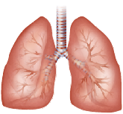
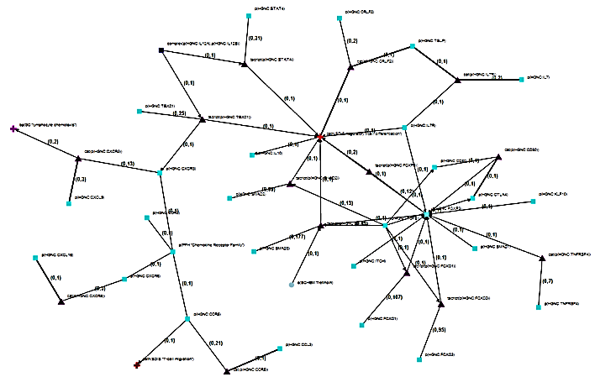



Model Types and Boundaries
Species: Human (primarily), although mouse and rat evidence was included when supporting literature from human context was not available.
Tissue: Respiratory tissue (primarily).
Disease: Non-diseased tissue (augmented with chronic obstructive pulmonary disease biology only (e.g. lung cancer context was excluded)).
Cell-specific Signaling
Example: Macrophage Signaling Network
Physiologic Signaling
Example: Oxidative Stress
Canonical Signaling
Example: MAPK Network
Notes:
In this challenge, you will have the opportunity to view and improve 50 biological networks that cover a wide range of pathways and processes relevant to lung biology. Each network describes the molecular mechanisms underlying a particular pathway, from cell type-specific pathways such as macrophage signaling, to physiological pathways such as oxidative stress, to canonical signaling pathways such as MAPK signaling.

Slide 15

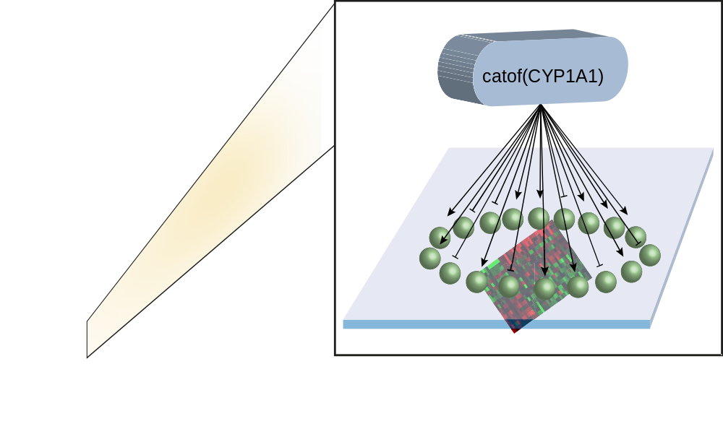


Networks Were Built Using Literature and Human Transcriptomic Data
Backward Reasoning is used to infer active mechanisms from transcriptomic data to enhance the literature model
Catlett NL, et al. (2013). BMC Bioinformatics, 14, 340.
PubMed
Data Set
Tissue
Stimulus
GSE 18341
Whole
lung
LPS
Lung neutrophil
Endotoxin
GSE 2322

Slide 16

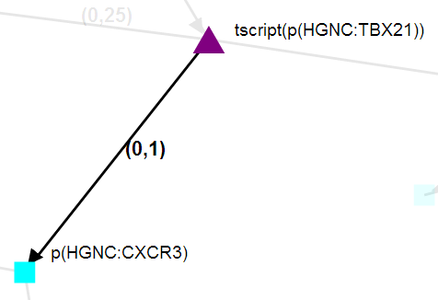

Network Models are Constructed with Nodes and Referenced Edges using BEL
(Biological Expression Language)
Literature Reference:
Quotation:
“T-bet (TBX21) transfection also induced…CXCR3 expression on human TH2 cells”
Context: Human TH2 cell
Edge:
TBX21 transcriptional activity increases CXCR3 protein abundance
The networks are supported by thousands of peer-reviewed scientific findings
http://www.openbel.org/
To learn more, watch the videos/webinars:
https://sbvimprover.com/challenge-3/tutorials
16
Notes:
27,811 statements
Over 2,000 unique PMIDs
Over 66% from human contexts
Contains different types: DNA, RNA, protein,

Slide 17
Steps in the sbv IMPROVER Network Veriﬁcation Challenge (NVC)
The sbv IMPROVER project team (2013). On Crowd-verification of Biological Networks. Bioinformatics and Biology Insights 2013:7 307-325.

Slide 18
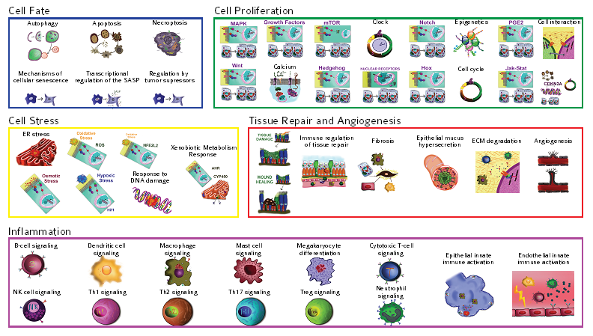
50 Network Models in the NVC:
Cell Fate
Cell Proliferation
Autophagy
Apoptosis
Necroptosis
MAPK
Growth Factors
mTOR
Clock
Notch
Epigenetics
PGE2
Cell Interaction
Mechanisms of
Cellular sensescence
Transcriptional
Regulation of the SASP
Regulation by
Tumor supressors
Wnt
Calcium
Hedgehog
Nuclear Receptors
Hox
Cell cycle
Jak-Stat
Cell Stress
Tissue Repair and Angiogenesis
ER Stress
Oxidative Stress
Xenobiotic Metabolism
Response
Tissue
Damage
Immune Regulation
of Tissue Repair
Fibrosis
Epithelial Mucus
Hypersecretion
ECM
Degradation
Angiogenesis
Osmotic
Stress
AHR
CYP450
Wound
Healing
Hypoxic
Stress
Response to
DNA Damage
Inflammation
B-cell signaling
Dendritic Cell
Signaling
Macrophage
Signaling
Mast Cell
Signaling
Megakaryocytes
Differentiation
Cytotoxic T-cell
Signaling
Endothelial Innate
Immune Activation
Epithelial Innate
Immune Activation
NK cell signaling
Th1 Signaling
Th2 Signaling
Th17 Signaling
Treg Signaling
Neutrophil Signaling

Slide 19
3
The ‘Bionet’ platform
1
Introduction to sbv IMPROVER
4
Jamboree and Outlook
2
Network
Verification Challenge
(NVC)

Slide 20


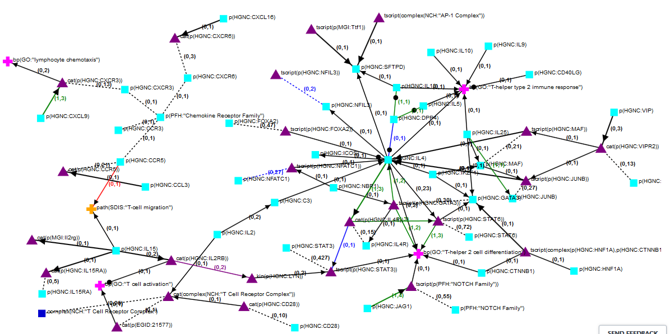
The Networks Page
Notes:
The open review of the networks was initiated by a challenge run as part of the systems biology verification (sbv) IMPROVER (Industrial Methodology for Process Verification in Research) project (37).

Slide 21
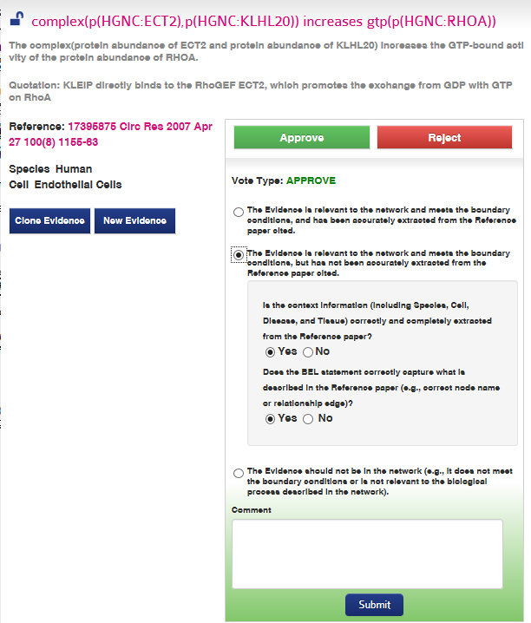


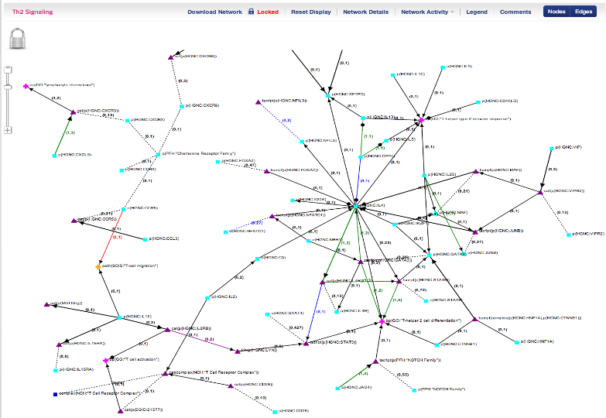
The Network Page
Notes:
The open review of the networks was initiated by a challenge run as part of the systems biology verification (sbv) IMPROVER (Industrial Methodology for Process Verification in Research) project (37).

Slide 22
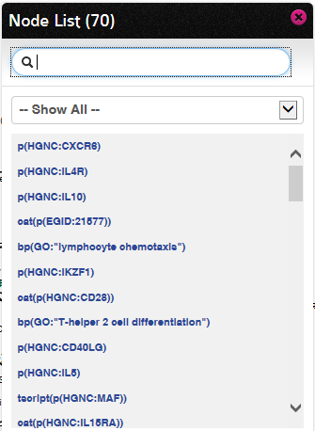
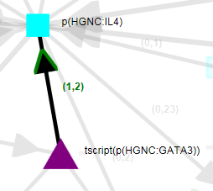
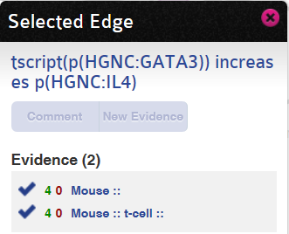
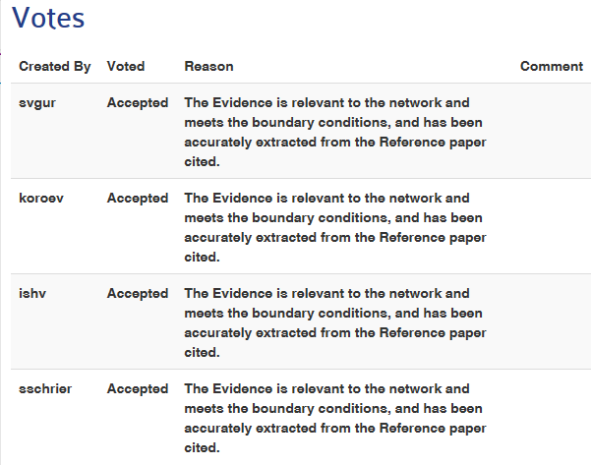
Full Display

Slide 23
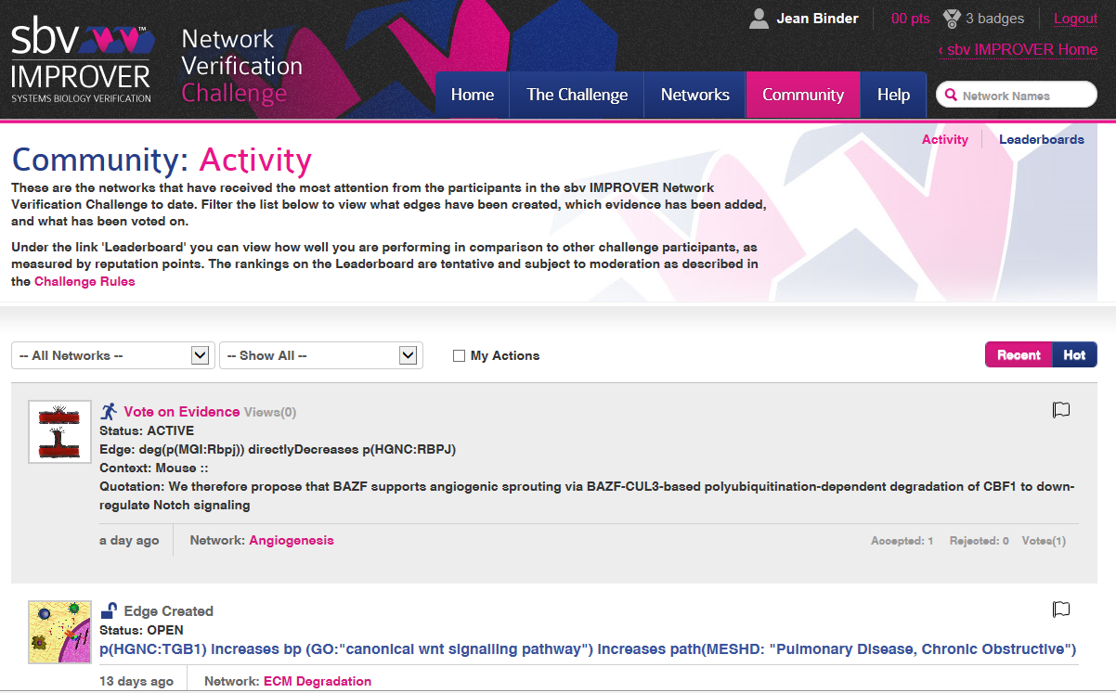
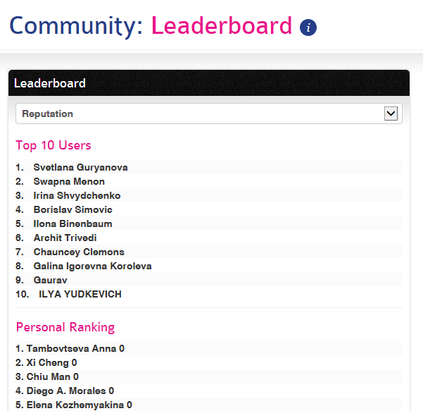
The Community Page

Slide 24
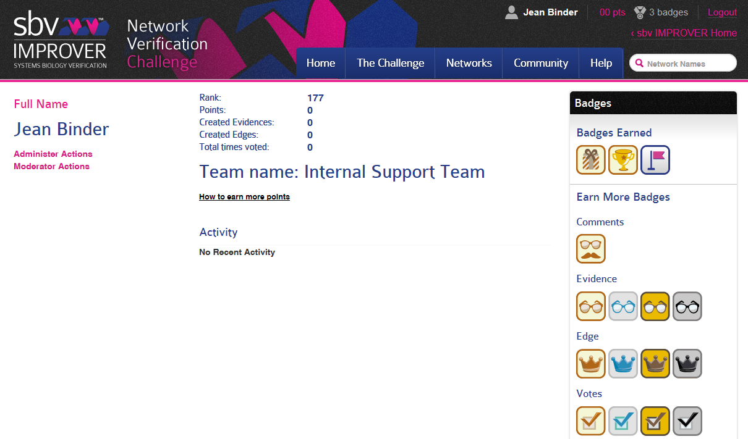
The Badges

Slide 25



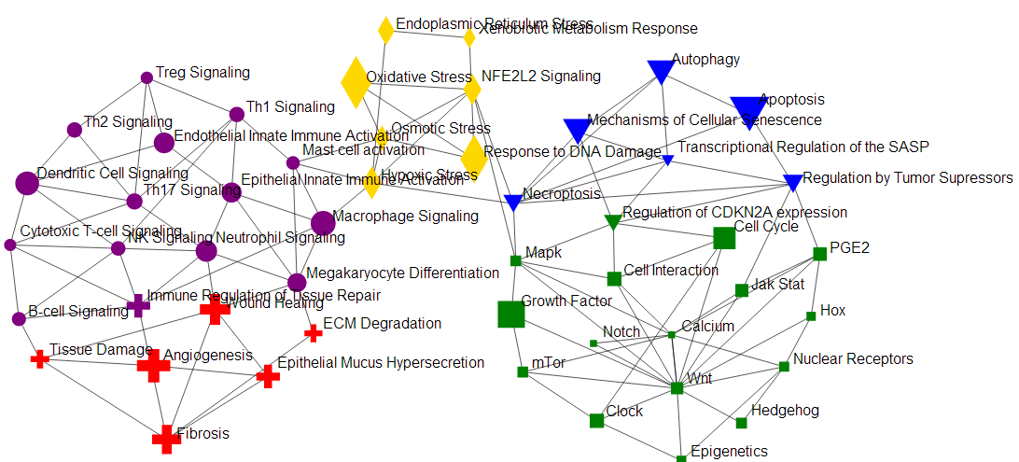



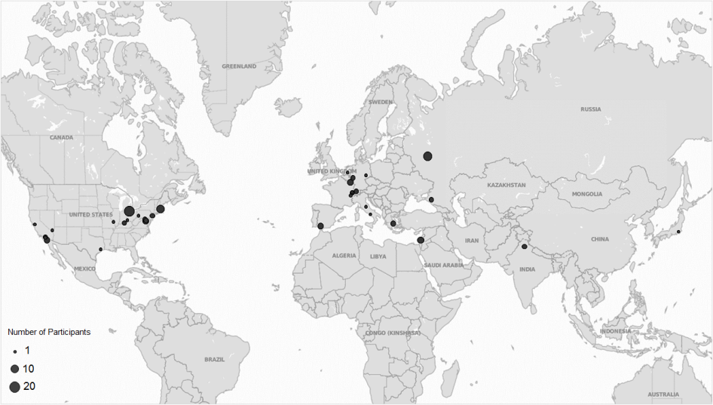
Open Phase of the NVC1
5 months
50 networks
2456 votes
Oct 7, 2013 –
Feb 23, 2014
451 new edges
885 new evidence
150 participants
from
18 countries

Slide 26
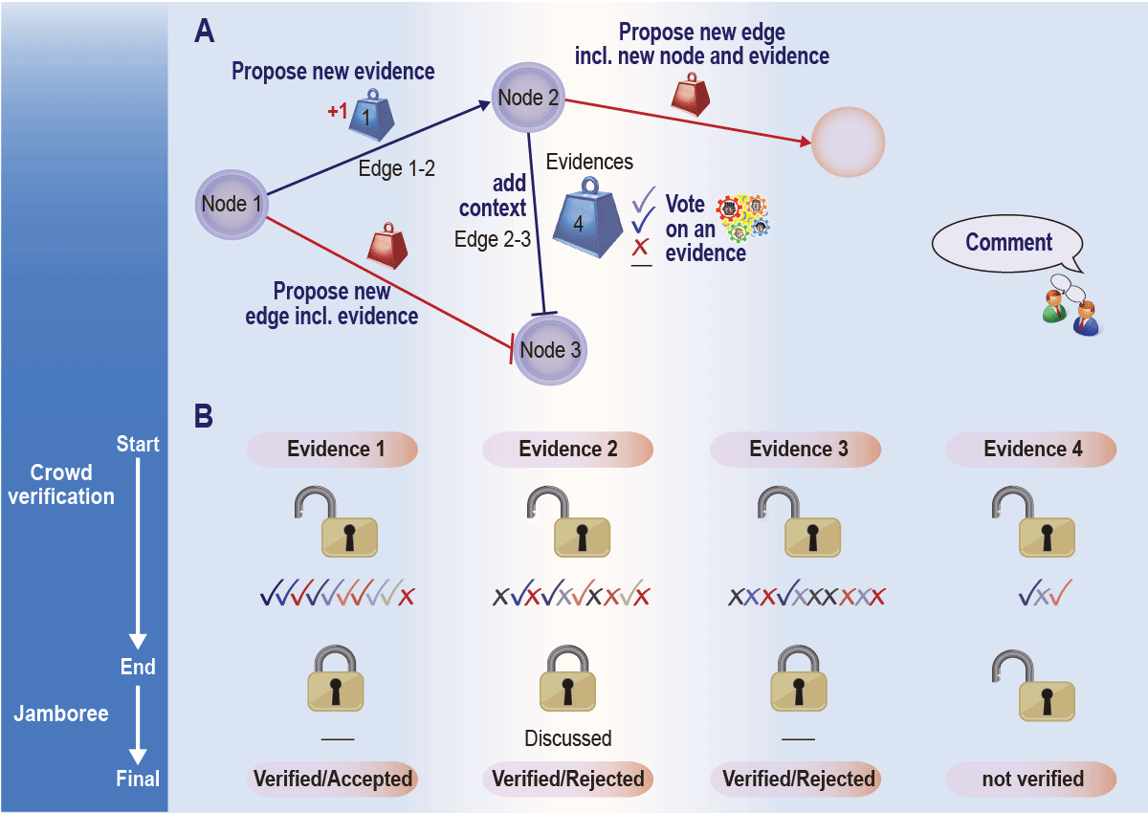
Overview of Actions in the Network Verification Challenge
The outcome of the online verification process is the result of the combination of submissions by different participants
Each edge can have four possible states at the end of the challenge:
Verified: There is at least one verified piece of evidence associated with the edge.
Ambiguous: Participants are divided on whether a piece of evidence supports the edge
Rejected: All evidence that has been suggested in favor of an edge has been rejected by the overwhelming majority of participants
Not verified: The evidence for an edge did not receive sufficient submissions from participants to be considered verified.

Slide 27
3
The “bionet” platform
1
4
Introduction to sbv IMPROVER
Jamboree
and
2
Outcomes
The Network Verification Challenge

Slide 28
Steps in the sbv IMPROVER Network Veriﬁcation Challenge
The sbv IMPROVER project team (2013). On Crowd-verification of Biological Networks. Bioinformatics and Biology Insights 2013:7 307-325.

Slide 29
50 Network Models in the NVC:
15 Discussed during NVC1 Jamboree
Cell Fate
Cell Proliferation
Autophagy
Apoptosis
Necroptosis
MAPK
Growth Factors
mTOR
Clock
Notch
Epigenetics
PGE2
Cell Interaction
Mechanisms of
Cellular
sensescence
Transcriptional
Regulation of the SASP
Regulation by
Tumor supressors
Wnt
Calcium
Hedgehog
Nuclear Receptors
Hox
Cell cycle
Jak-Stat
Cell Stress
Tissue Repair and Angiogenesis
ER Stress
Oxidative Stress
Xenobiotic Metabolism
Response
Tissue
Damage
Immune Regulation
of Tissue Repair
Fibrosis
Epithelial Mucus
Hypersecretion
ECM
Degradation
Angiogenesis
Osmotic
Stress
AHR
CYP450
Wound
Healing
Hypoxic
Stress
Response to
DNA Damage
Inflammation
B-cell signaling
Dendritic Cell
Signaling
Macrophage
Signaling
Mast Cell
Signaling
Megakaryocytes
Differentiation
Cytotoxic T-cell
Signaling
Endothelial Innate
Immune Activation
Epithelial Innate
Immune Activation
NK cell signaling
Th1 Signaling
Th2 Signaling
Th17 Signaling
Treg Signaling
Neutrophil Signaling

Slide 30
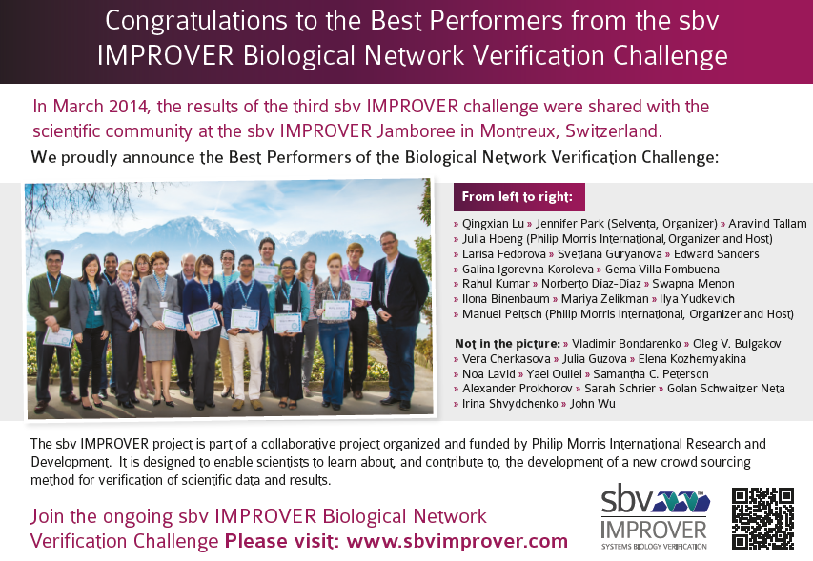
NVC1 Jamboree Meeting in Montreux, Switzerland
As published in Nature, 8 May 2014, page 127

Slide 31
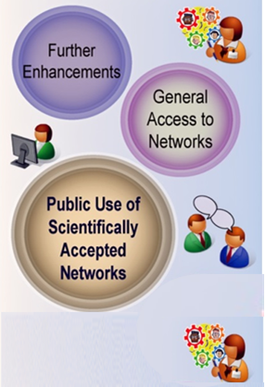
Steps in the sbv IMPROVER Network Veriﬁcation Challenge
The sbv IMPROVER project team (2013). On Crowd-verification of Biological Networks. Bioinformatics and Biology Insights 2013:7 307-325.

Slide 32


NVC2: Continue to Refine Networks Using the Crowd
Vote on evidence, create new edges, add missing nodes

Slide 33

Why should you participate?
NVC2:
Gain access to high quality and novel data
Enhance your visibility and gain recognition
Engage with peers to advance the field
Being invited to the Jamboree

Slide 34


NVC2 Important Dates
Open Phase
Jamboree Activities
Feb 2014 Jul 2014 Sept 2014 Dec 2014 Apr 2015 Mid-2015
NVC2 Started
ECCB workshop
NVC2 Open Phase Ends
Best Performer Invitation and Jamboree Preparation
Network Dissemination
Today:
Attend the European Conference on Computational Biology (ECCB) workshop Sunday Sept 7 in Strasbourg, France to learn about and discuss crowd engagement methods to advance research (W13 - sbv IMPROVER Workshop)
www.sbvimprover.com

Slide 35
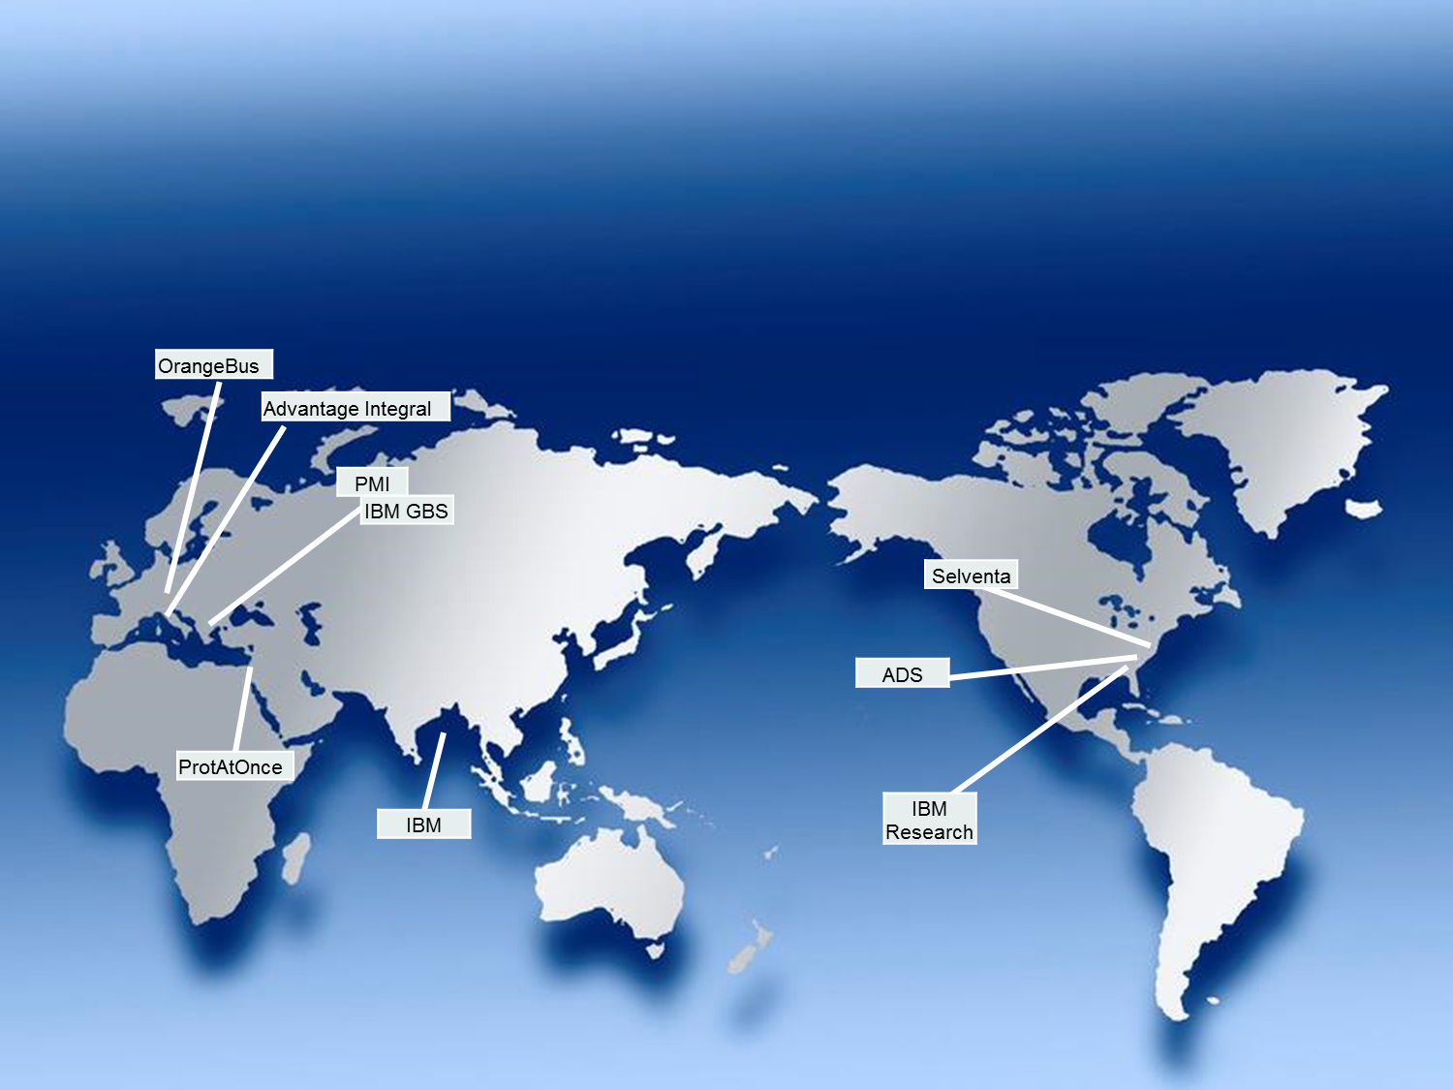
Acknowledgements to the Global Team

Slide 36
Institutes and Companies Represented
Advantage Integral
Biomedical Research Foundation of the Academy of Athens
Boston College
Cambridge Cell Networks Ltd
Clinical Research Management
CSIR-Institue of Microbial Technology
DSHS
Edward Sanders Scientific Consulting
ETH
Fraunhofer (SCAI)
Glenmark Pharma SA
Harvard University
Hubrecht Institute
IBCH
IBM
Kuban State University of Physical Education, Sport and Tourism
National Institutes of Health
Nestlé Institute of Health Sciences
Pablo de Olavide University
Philip Morris International
SBI
Selventa
SIB Swiss Institute of Bioinformatics
Solar Turbines, Inc.
Systems Bioengineering Group - National Technical University of Athens
University of Cincinnati
University of Louisville
University of Luxembourg
University of Perugia
University of Toledo

Slide 37
Thank You
The sbv IMPROVER project, the website and the Symposia are part of a collaborative project designed to enable scientists to learn about and contribute to the development of a new crowd sourcing method for verification of scientific data and results. The current challenges, website and biological network models were developed and are maintained as part of a collaboration with Selventa, OrangeBus and ADS. The project is funded by Philip Morris International.

Slide 38
Let Us Meet Again
We welcome you all to our future conferences of OMICS Group International
Please Visit:
www.omicsgroup.com
www.conferenceseries.com
www.pharmaceuticalconferences.com

