Slide 1


STINGLESS BEES ARE EFFICIENT POLLINATORS OF THE BIOFUEL PLANT Jatropha curcas WITHIN ITS NATIVE RANGE
UNIVERSIDAD AUTÓNOMA DE CHIAPAS
Centro de Biociencias
Isidro Ovando-Medina, Manuel Rincón, Lourdes Adriano, Sonia Ruiz, Alfredo Vázquez, Miguel Salvador-Figueroa
3rd International Conference on
Biodiversity & Sustainable Energy Development
June 24-26, 2014 Valencia, Spain

Slide 2
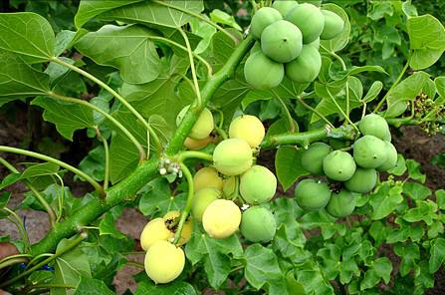
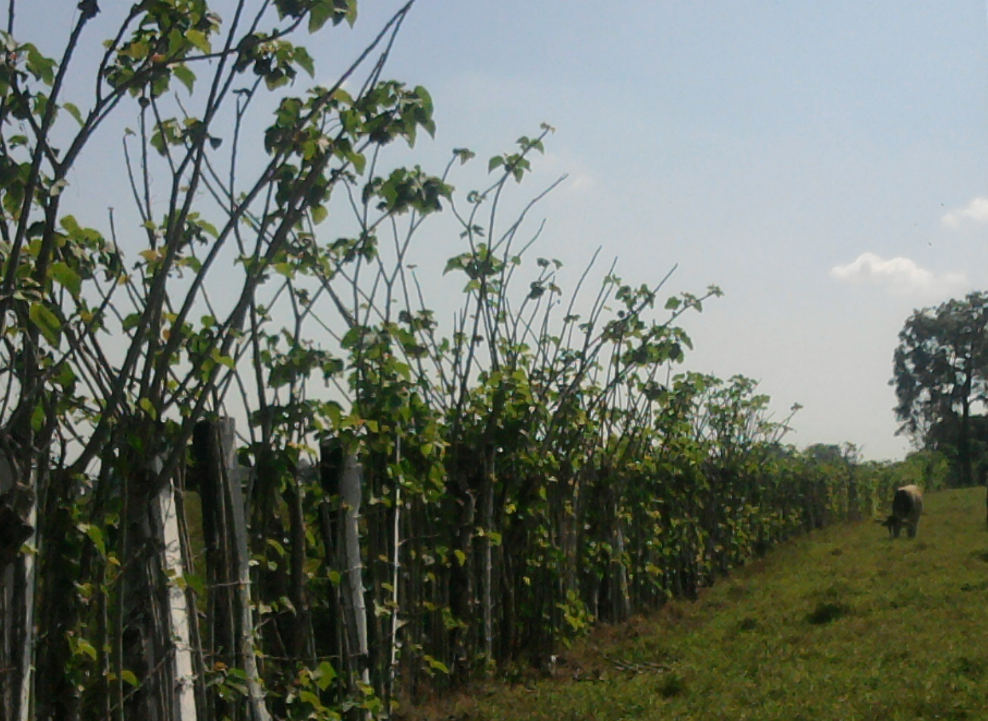
INTRODUCTION
Jatropha curcas L. is a plant of the family Euphorbiaceae known in the Mesoamerican region as "piñón".
Its seeds are toxic to mammals.
Its medicinal use may have a history of at least two millennia in southern Mexico.
Its main use has been as a living fence.

Slide 3


INTRODUCTION…
Aceite vegetal / Grasa animal / Desechos
J. curcas has gained economic importance in the last decade due to the extraction of seed oil for biodiesel production.
Metanol más Catalizador
Transesterificación
Biodiesel crudo
Refinación
Biodiesel
Glicerina cruda
Recuperación de metanol
Refinación de glicerina
Glicerina

Slide 4
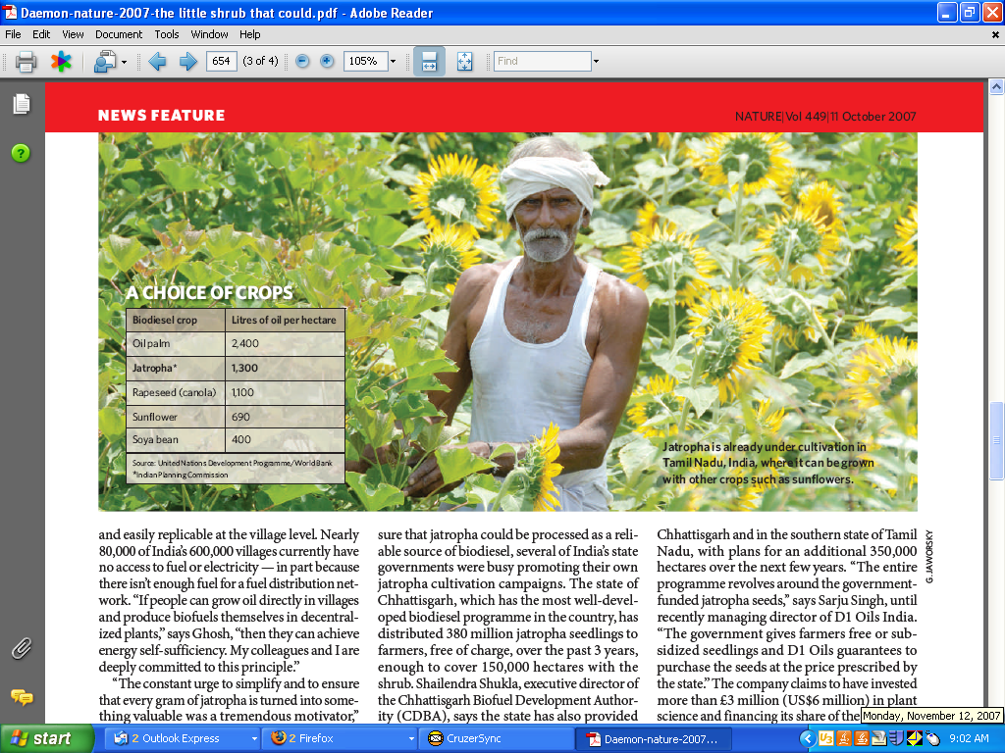
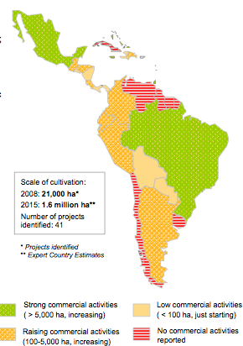
INTRODUCTION…
J. curcas is fast undergoing widespread cultivation and it is projected for 2015 that there will be about 15 million hectares planted worldwide, mainly in southern Asia and Latin America.
Notes:
For example, in India exists an governmental initiative to plant ten million hectares of J. curcas for 2020.

Slide 5
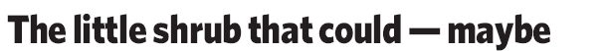
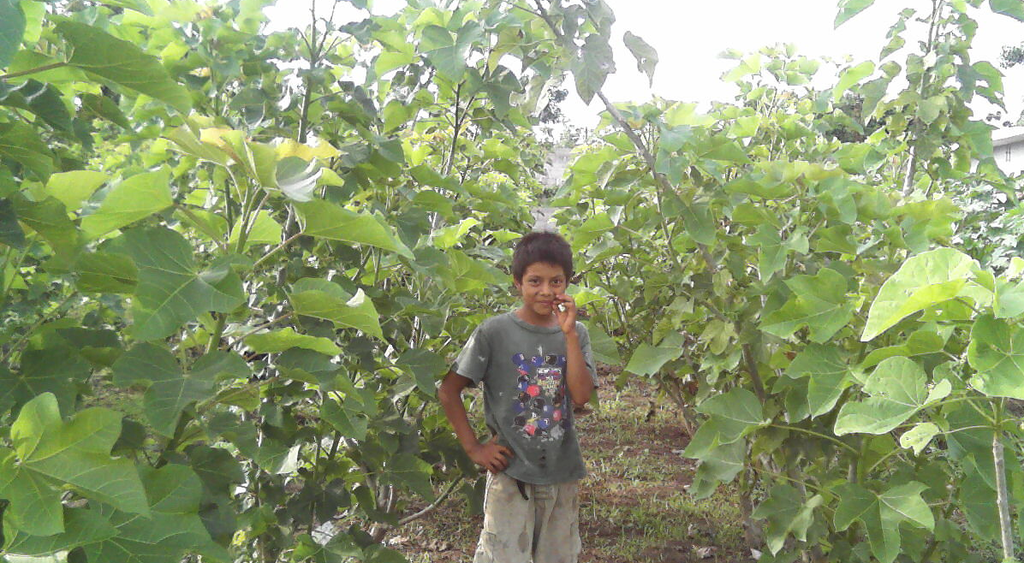

Slide 6
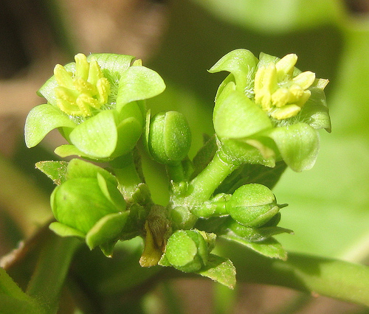
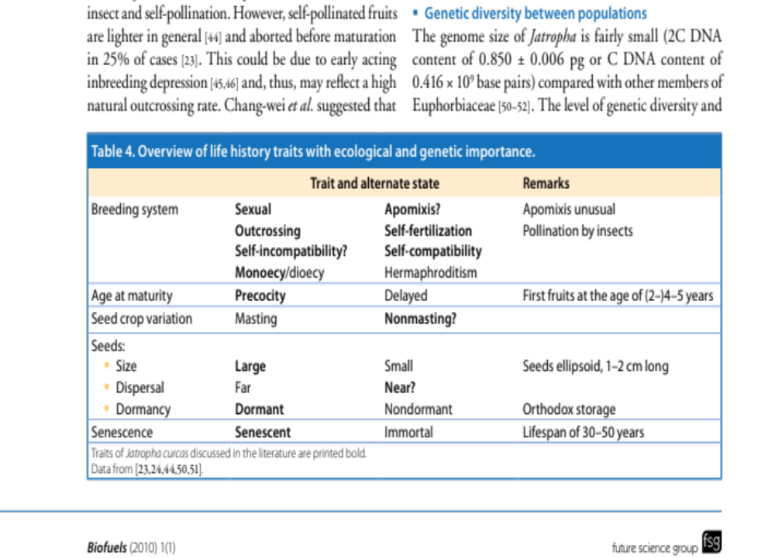
INTRODUCTION…
The are major technological challenges:
It is not a fully domesticated plant
It lacks an agronomic process
There is no selected genetic material
There is no precise knowledge either of its productive potential or its phenology
The very number of varieties remains unknown.

Slide 7
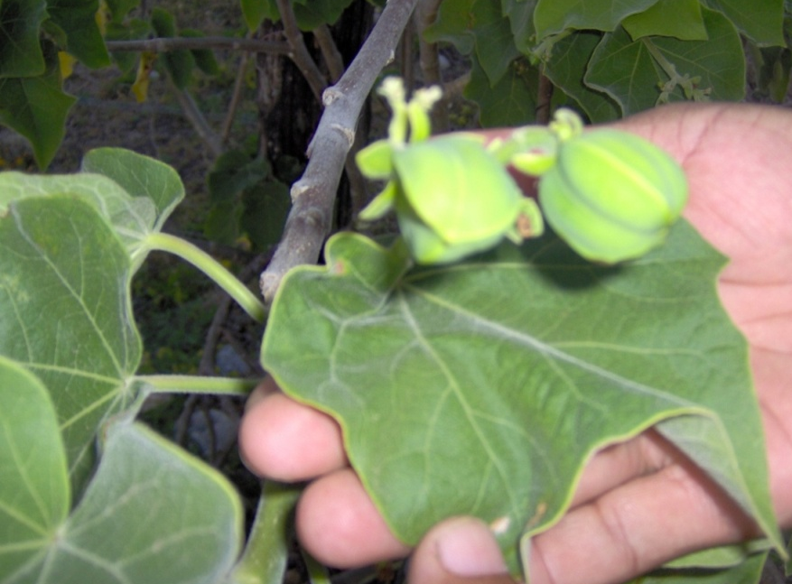
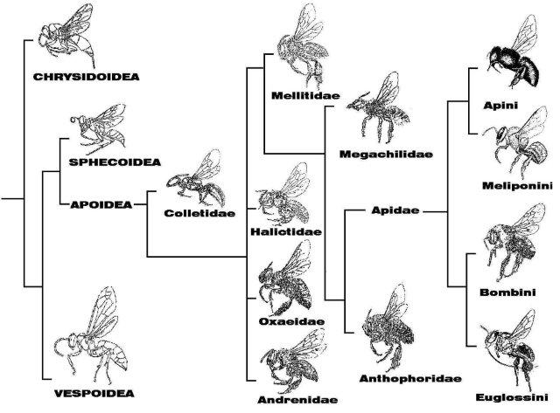
INTRODUCTION…
Parallel to the interest of economic use as a crop plant is the scientific interest in:
Biology and ecology of the species
Its genetic diversity
The geographic origin of populations.
The diversity of associated organisms.

Slide 8
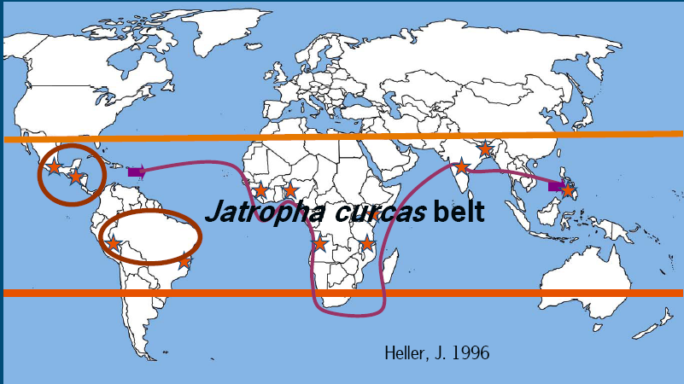
The center of origin of Jatropha curcas
It is possible that J. curcas originates in Mesoamerica (Southern Mexico and Central America) and many authors coincide with this idea. Nowadays this species is distributed throughout the tropical world as a result of European colonialism, the plant was introduced to Caribbean islands, Africa and Southeast Asia where it is grown as a hedge plant.
Nevertheless, there are disagreements and some authors considering Brazil as the origin of J. curcas, as suggested by Arruda et al. (2004), Bomfim-Gois et al. (2006) and
Oliveira et al. (2006).
In the same way, Basha et al., (2009), Sudheer-Pamidimarri et al. (2009b) and Sudheer et al. (2010b) mention that this plant is a native of South America.

Slide 9
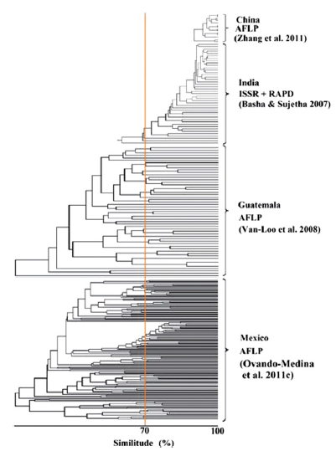
The center of origin of Jatropha curcas…
Molecular evidence…
In our investigations, high variation and moderate structure were found in populations of J. curcas of Southern Mexico.
Although clustering methods based on individuals are not useful to infer structure or other population attributes, we compared the Jaccard similarity index of accessions from Southern Mexico to that reported in other studies, finding the lowest value (0.107) reported so far, indicating a great diversity.
Data reported for Guatemalan accessions revealed similar values of diversity, strengthening the hypothesis that Mesoamerica is the center of diversification of J. curcas.

Slide 10
IMPORTANCE OF THE STUDY OF PLANT DIVERSITY IN CENTERS OF ORIGIN
It is assumed that variation between and within populations is highest in these areas in comparison to sites where a species is exotic.
Centers of diversity are places where evolution has had more time to lead the species, by means of genetic changes, to adapt itself to a variety of environments.
Co-evolution between a species and associated organisms can exists.

Slide 11
Objective
An accepted knowledge is that Apis mellifera (the honey bee) is an efficient pollinator for J. curcas (Negussie et al., 2013; Samra et al., 2014).
For that reason, we conducted an observational investigation to test the hypothesis of the pollination efficiency of that and other flower-visiting insects in a site within the J. curcas native range.
In the center of origin of J. curcas no such studies have been conducted, thus the sexual system and mode of pollination are unknown. Such knowledge could help design strategies to increase crop productivity.
The aim of this study was to evaluate the diversity of flower-visiting insects and to characterize the pollination process in J. curcas under field conditions at a site in southeastern tropical Mexico.

Slide 12
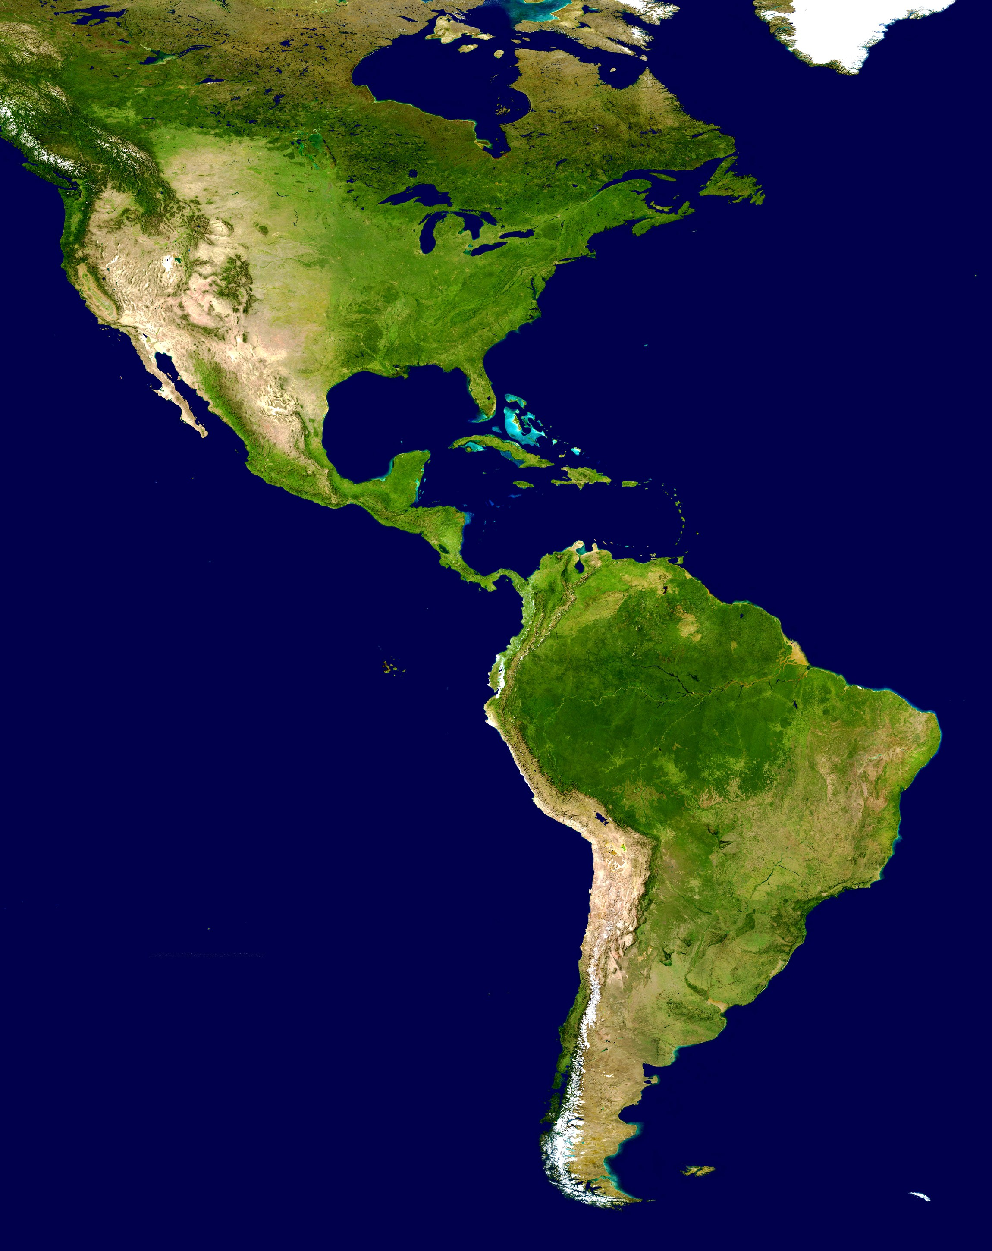

Materials and Methods
Study site and biological material
The study was conducted within the living fences of farm plots at Chiapas, Mexico (14.5036 N, 92.1704 W).
Plants were selected based on their appearance (healthy and abundant foliage) and location (in a sunny area), on 600 m transects. The living fences were 10 years old and underwent annual pruning.

Slide 13
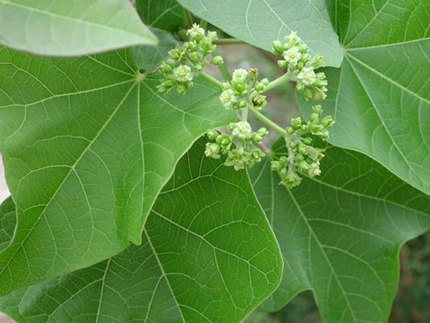
Floral phenology
Flowering and fruiting dynamics were studied in 100 plants every 14 days during 2011. We determined the average number of inflorescences per primary branch. In five inflorescences per plant, randomly selected, male and female flowers were counted.
To estimate the time of flower anthesis and stigma receptivity, in 100 plants, an inflorescence in the stage of flower buds was marked and observed daily (30 d) at intervals of every 10 min from 0700 h to 1200 h.
To estimate the production of pollen and ovules, inflorescences were collected from 100 plants with closed flowers, and 20 female flowers (FF) and 20 male flowers (FM) were randomly selected.
Pollen grains were extracted from FM and mounted in glycerinated gelatin on a slide. Pollen was quantified using a stereomicroscope and the average number of pollen grains was estimated per anther and per flower.
In FF the number of carpels and the number of ovules per carpel was counted. With these data the pollen to ovule ratio was estimated.

Slide 14
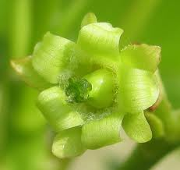
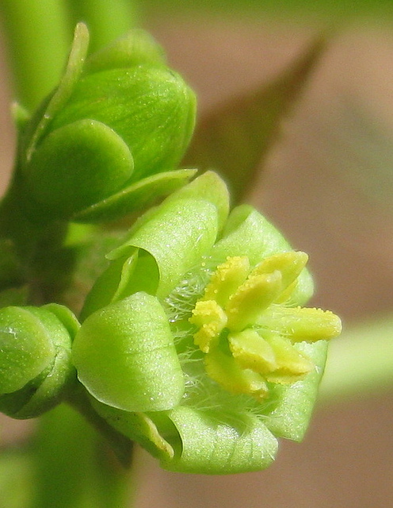
Reproductive process
In order to comprehend the reproductive process, five pollination treatments were established:
Geitonogamy or artificial pollination with pollen from the same inflorescence (GEI)
Xenogamy (XEN) or artificial pollination with pollen from another plant
Apomixis (APO), which was performed by removing the male flowers and placing non-toxic white glue (Resistol®, Mexico) on stigma
Excluding pollinators (ExP)
Open pollination (OpP).
For each of the treatments 20 inflorescences were employed, one per plant, which were covered, except in OpP, with tulle mesh bags of 1 mm mesh size.
Fertilization was checked 14 days after pollination and the number of mature fruits per treatment was quantified at 55 days.

Slide 15
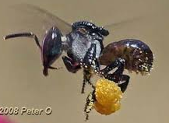
Flower visitors and pollinators
To determine insect pollinators and visitors, observations were made on ten inflorescences from different plants, from 0800 h to 1700 at intervals of 10 min. For this, the time of arrival at the flower was taken into account, the time they stayed, the resource used (nectar or pollen), and movement among flowers of the same inflorescence and between inflorescences of the same or another plant.
In addition insects visiting the flowers of J. curcas were. The insect collection was performed with entomological nets from 0600 h to 1800 h. All insects captured were examined under stereoscope, dissected into head and thorax, and identified using taxonomic keys. Moreover, the pollen adhered to the legs of the insects was identified by microscopy.
The visiting insects were classified as: a) efficient pollinators, b) occasional pollinators, c) accidental pollinators, or d) pillagers. We used the following criteria: 1) number of individuals collected during different times of the day, 2) recurrence and time of visit to the male and female flowers, 3) behavior observed on the flowers, and 4) presence of J. curcas pollen (pure or mixed) on different parts of the body.

Slide 16

Statistical analysis
To understand differences between visitor groups in the frequency and time of visit to male and female flowers, the Chi-square test was applied. The number of fruits, and the quality of these in the different treatments were compared by analysis of variance (ANOVA) and Tukey test (α = 0.05).

Slide 17
RESULTS

Slide 18
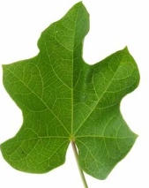
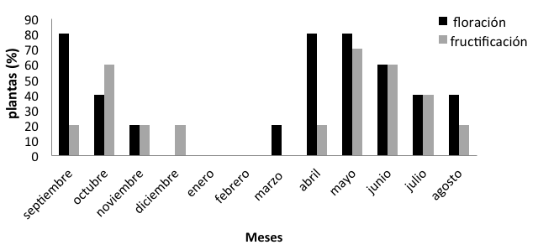
RESULTS…
Flowering pattern
The plants studied had three flowering peaks (80%) in the months of April, May and September. In the period from December to February the plants showed no flowering. Subsequent to that, there were three periods of peak fruiting in the months of May, June and October. There were no fruits in the months from December to March.
Flowering
Fruiting
The number of female flowers per inflorescence was 1-11. Male flowers ranged from 35-198 per inflorescence. Pollen production by anther ranged from 266-647 pollen grains and per flower was 3062-5016 pollen grains.
The proportion of pollen grains per ovule was 1408:1

Slide 19
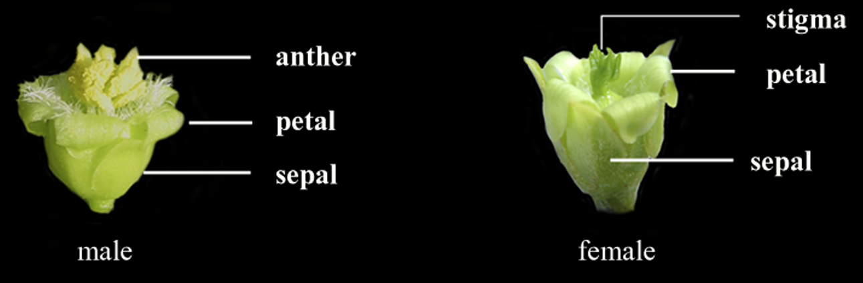
RESULTS…
Receptivity of the stigma
The male and female flowers begin to open at 0800 h, presenting the maximum aperture of female flowers (64.29%) and male (55.75%) at 0900 h.
The stigma was receptive at the time of 1000-1200 h.

Slide 20
RESULTS…
Pattern of flower opening
Flowers regularly opened over an average period of 15 days. The pattern showed that the female flowers are the first to open and this process continues for eight days. Male flowers started opening two days after the female flowers, and lasted up to 13 days, with the highest peaks between days 8 and 10.

Slide 21
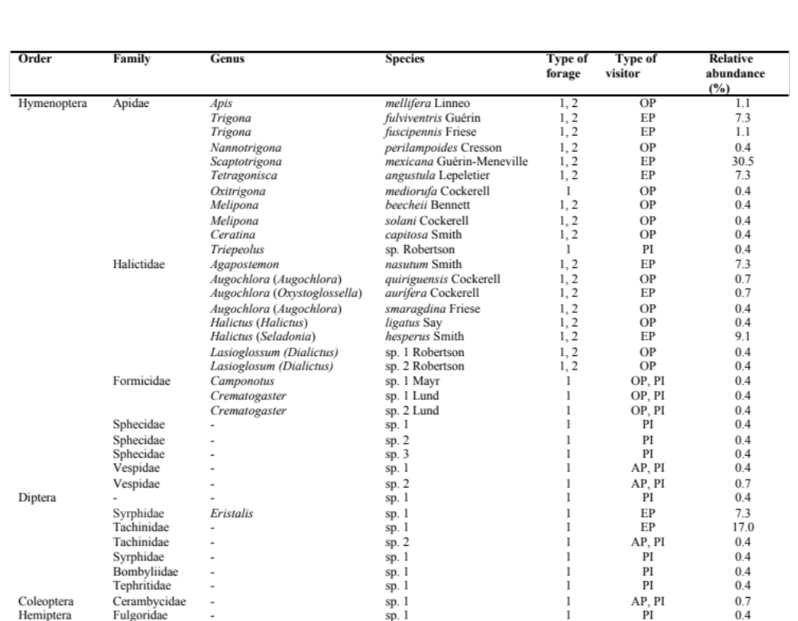
Diversity of insect visitors

Slide 22
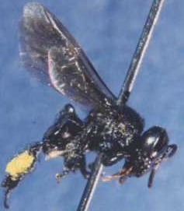
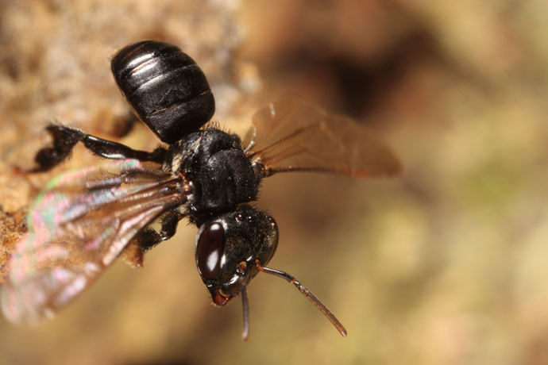
Diversity of insect visitors
The variety of insect visitors to the flowers of J. curcas came from 36 species, which were grouped into four orders, 12 families and 16 genera as recognized (Table 1). Hymenoptera were the most diverse (75 % of the species) and dominant (72.6 % of the relative abundance) group, followed by Diptera (diversity of 19.4 %; dominance of 26.3 %).
We found three types of pollinators:
Accidental, including the fly Thachinidae sp. 2, Vespidae sp. 1, Vespidae sp. 2 and one species of Cerambicidae
Occasional, comprising 14 species that included bees, ants, and wasps
Efficient, composed nine species, of which most were bees and two species of flies.
The remaining insects were considered pillagers or nectar robbers.
Some of the individuals were carrying pure pollen loads of J. curcas in different parts of the body, while others carried J. curcas pollen mixed with other pollen types [Ageratum aff. houstonianum (Mill.), Acacia aff. cornigera (L.) Willd., Tridax aff. procumbens (L.), Zea mays (L.)]. Pollen from other species represented less than 10% of the total loads.

Slide 23
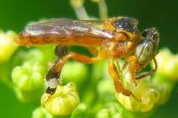
Frequency of visit
Compared with other groups, the bees visited more flowers (43.2%) and stayed longer in resource foraging (38%). The second most important group was the Diptera with 39.3% (frequency) and 31% (time of visit). Specifically, bees visited a larger number of female flowers (55.6%) than male flowers (46.4%). Both bees and flies spent more time to visiting female flowers, while Vespidae sp. 1 had a preference for the male flowers. The Diptera foraged exclusively nectar, while bees collected nectar and pollen.

Slide 24
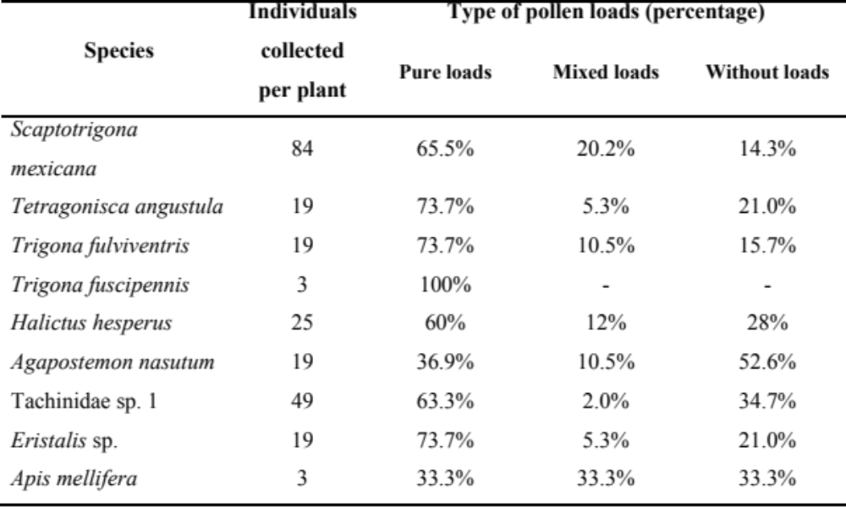
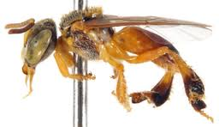

Slide 25
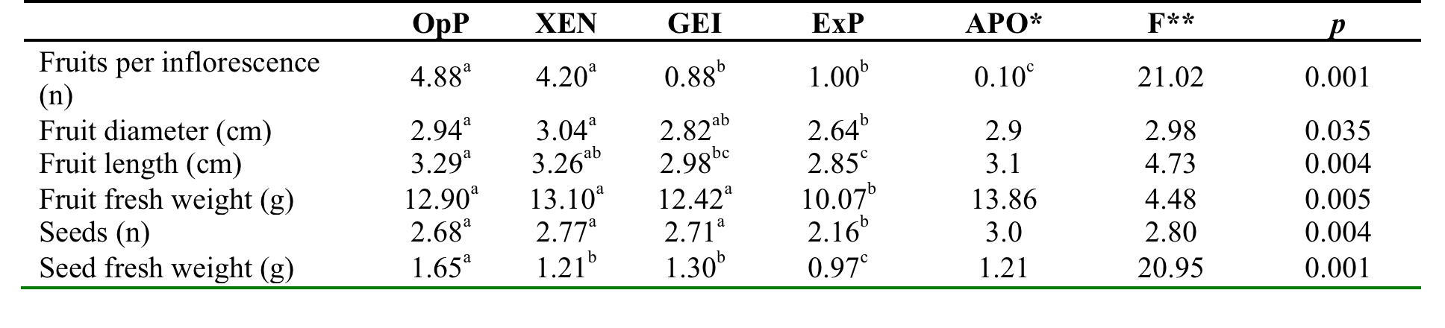
Jatropha curcas reproductive system
We found differences in the production and quality of fruits and seeds from the different reproductive systems of J. curcas (p <0.001). The highest percentage of fruit set was recorded in free pollination treatments (OpP: 86.3 ± 2.2) and in xenogamy (XEN: 84.3 ± 6.3),
Regarding the number of fruits that reached maturity, the OpP and XEN treatments were statistically superior to all other treatments (p < 0.001). The type of reproduction also influenced the quality of fruits and seeds, as the longest fruits were recorded in the OpP and XEN treatments (p < 0.001) and heaviest seeds occurred in OpP treatment .

Slide 26
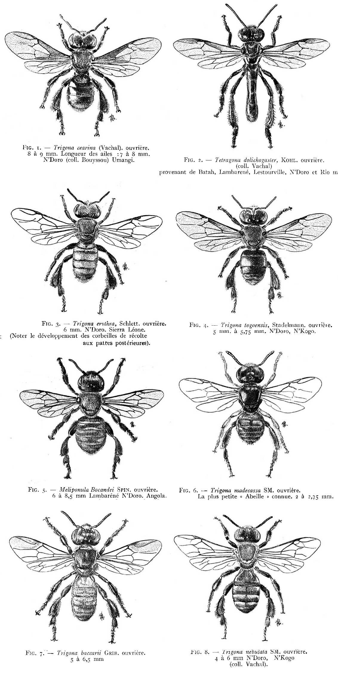
A high diversity of flower-visiting insects (36 species) was found, of which nine were classified as efficient pollinators.
The native stingless bees Scaptotrigona mexicana (Guérin-Meneville) and Trigona (Tetragonisca) angustula (Latreille) were the most frequent visitors and their presence coincided with the hours when the stigma was receptive.
Concluding remarks

Slide 27
In the present study, A. mellifera (L.) was infrequent in relation to other efficient pollinators (n = 3 individuals per plant) and recorded only between 0800 and 0900 h. Additionally, 66% of individuals transported J. curcas pollen in great abundance, in the head, chest and legs, while 33% of them transported pollen from different plant species.
This result is contrary to most previous studies where A. mellifera has been registered as the most efficient pollinator in J. curcas (Raju and Ezradanam 2002, Bhattacharya et al 2005, Dhillon et al 2006, Chang-Wei et al 2007b, Quin et al 2007, Rianti et al 2010, Kaur et al 2011).
We classify this species as occasional pollinator for J. curcas at this site in the Mexican tropics, and it can perform both geitonogamy and xenogamy.
Concluding remarks

Slide 28
It is noteworthy that the female flowers open before the male flowers, favoring xenogamy, which may explain the high genetic variability reported in J. curcas for this region of the world.
Concluding remarks

Slide 29
Thanks!
Proyecto Jatropha
del CenBio-UNACH
(www.biociencias.unach.mx)
Dr. Miguel Salvador Figueroa
Dr. Isidro Ovando Medina
Dra. Lourdes Adriano Anaya
MC. José Alfredo Vázquez Ovando
MB. Sonia Ruiz González
MC. Manuel Rincón Rabanales
MB. Gamaliel Velázquez Ovalle

