Slide 1
About OMICS Group
OMICS Group International is an amalgamation of Open Access publications and worldwide international science conferences and events. Established in the year 2007 with the sole aim of making the information on Sciences and technology ‘Open Access’, OMICS Group publishes 400 online open access scholarly journals in all aspects of Science, Engineering, Management and Technology journals. OMICS Group has been instrumental in taking the knowledge on Science & technology to the doorsteps of ordinary men and women. Research Scholars, Students, Libraries, Educational Institutions, Research centers and the industry are main stakeholders that benefitted greatly from this knowledge dissemination. OMICS Group also organizes 300 International conferences annually across the globe, where knowledge transfer takes place through debates, round table discussions, poster presentations, workshops, symposia and exhibitions.

Slide 2
About OMICS Group Conferences
OMICS Group International is a pioneer and leading science event organizer, which publishes around 400 open access journals and conducts over 300 Medical, Clinical, Engineering, Life Sciences, Pharma scientific conferences all over the globe annually with the support of more than 1000 scientific associations and 30,000 editorial board members and 3.5 million followers to its credit.
OMICS Group has organized 500 conferences, workshops and national symposiums across the major cities including San Francisco, Las Vegas, San Antonio, Omaha, Orlando, Raleigh, Santa Clara, Chicago, Philadelphia, Baltimore, United Kingdom, Valencia, Dubai, Beijing, Hyderabad, Bengaluru and Mumbai.

Slide 3



Protective Effect of Diltiazem and Fenofibrate Against Ischemia-reperfusion Induced Cardiac Arrhythmias in the Isolated Rat
Heart.
Ishfaq A. Bukhari, A.A. Almotrefi, Osama Yousaf
Dept of Pharmacology, college of medicine
King saud university, Riyadh, Saudi Arabia

Slide 4
Introduction
Fenofibrate is a peroxisome proliferator-activated receptor (PPAR)-α activator, that lowers triglycerides.
It also influences cytochrome P-450 (CYP-450) dependent arachidonic acid (AA) metabolism.
CYP-450 metabolizes AA to epoxyeicosatrienoic acids (EETs)
EETs are synthesized in the renal, vascular and cardiac tissues.
(Huang et al., 2007; Campbell et al., 1996; Campbell and Falck, 2007;

Slide 5
Introduction
EETs have coronary dilating, cardiac and renal protective properties.
Fibrates have shown to possess similar properties due to its CYP-450 inducing action and increasing the endogenous EETs production.
Larsen et al., 2005; Campbell and Fleming 2010;Fleming 2008).

Slide 6
Arachidonic
Acid
Fibrates
+
+
CYP 450
Chain elongation
β oxidation
DH-EETs
14,15-EET
11,12-EET
8,9-EET
5,6-EET
EHDD
Phospholipids
Extracellular
sEH
X
DHET
AUDA
Figure 1

Slide 7
Agonists
O
O
O
O
OH
OH
O
H
O
O
14,15-EET
11,12-EET
8,9-EET
O
O
O
O
O
H
OH
O
H
O
HO
OH
14,15-EE8ZE
11,12-DHET
5,6-EET
Agonist/sEH inhibitor
O
O
OH
N
H
N
H
14,15-Urea-E8ZE
Cl
Antagonists
O
Cl
Cl
O
H
O
O
O
N
N
NH
S
CH₃
O
O
O
Cl
14,15-EE5ZE
MS-PPOH
Miconazole
O
O
N
H
S
CH₃
O
O
Figure 2
14,15-EE5ZE-mSI

Slide 8
Introduction
Several reported physiological functions of EETs include:
dilatation of coronary, renal and cerebral arteries and anti-inflammatory effects in vascular tissue (Campbell and Falck, 2007; Larsen et al., 2007; Spector and Norris, 2007 and Bukhari et al.,2011).
up-regulation of sEH expression, leading to a decrease in EET availability, with the development of left ventricular (LV) Dysfunction (Monti et al., 2008)
Recent in vitro/in vivo studies in isolated cells and transgenic animal models have revealed potent cardiac protective effect of EETs and markedly reduce I/R induced heart injuries. (Nithipatikom and Gross 2010; Denga et al., 2010; Batchu et al., 2011).

Slide 9
Rationale of our study
Fibrates have previously been reported to increase CYP epoxygenase activity , EETs production and anti-hypertensive effects (Huang et al., 2007).
Increasing EETs bioavailability, by inhibition of soluble epoxide hydrolase (sEH), is a little explored but promising pharmacological target
Several in-vitro studies have shown the cardiac protective effect of EETs but studies related to increased production of endogenous EETs by fibrates and its cardiac protective effects are lacking (Nithipatikom and Gross 2010; Denga et al., 2010; Batchu et al., 2011)..

Slide 10
Aim of our study
The aim of our study was to investigate protective effect of fenofibrate (EETs inducer) against ischemia and re-perfusion (I/R) induced cardiac arrhythmias in isolated rat hearts.

Slide 11
Methods
Treatment protocol:
Male Wistar rats (250-350 g) were didvided into two groups.
Group 1 served as a control and was treated with vehicle only (peanut oil).
Group 2 was treated with fenofibrate (100 mg/kg p.o) for 5 days.
One hour After the administration of the last dose (5th dose) of fenofibrate, rats were anethetized with thipopental, hearts were isolated for mounitng on langendorff apparatus as described below.

Slide 12
Method: Ischemia-reperfusion-induced arrhythmia
Isolated Hearts were perfused with Krebs-Henseleit solution gassed with carbogen and at constant flow of 10 ml/ min (37⁰C.)
Isometric contractions recorded from left ventricle by Harvard UFI transducer.
Perfusion pressure was monitored with a pressure transducer.
Surface electrical records were obtained from electrodes placed on the right atrium and apex of left ventricle.
All signals were fed into Harvard transducer interfaces and then into PowerLab/8sp(ADInstruments).
All hearts were stabilized for 15 min. Coronary artery ligature was tightened and released after 10 min and Ventricular arrhythmias recorded for 30 min post-ligation.
Xi et al., 2009

Slide 13
Method
Following parameters were quantified during the ligation (10 min) and after release of ligature for 30 minutes:
Number of premature ventricular contractions (PVCs)
Incidence and duration of ventricular tachycardia (VT)
Incidence and duration of ventricular fibrillation (VF)
Perfusion pressure

Slide 14
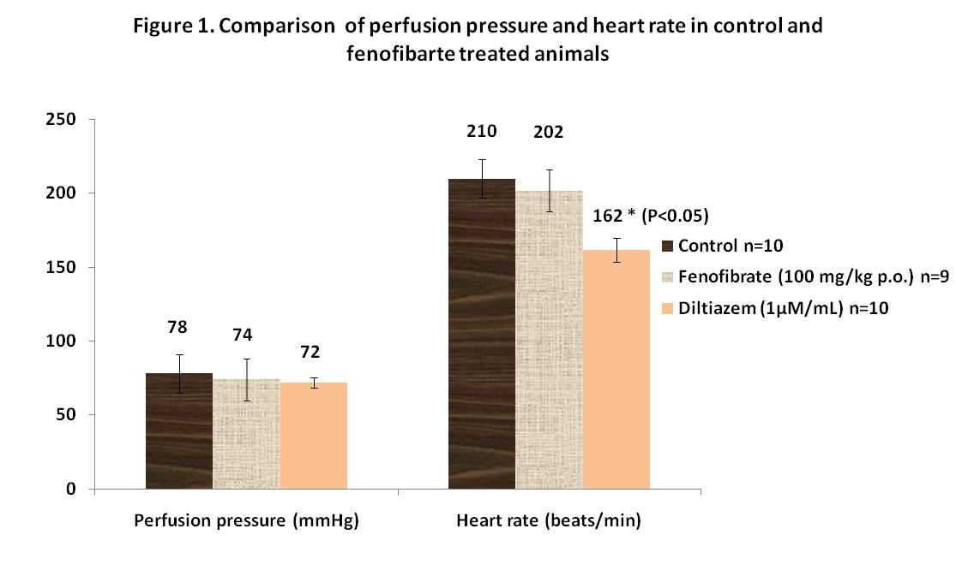
Results

Slide 15
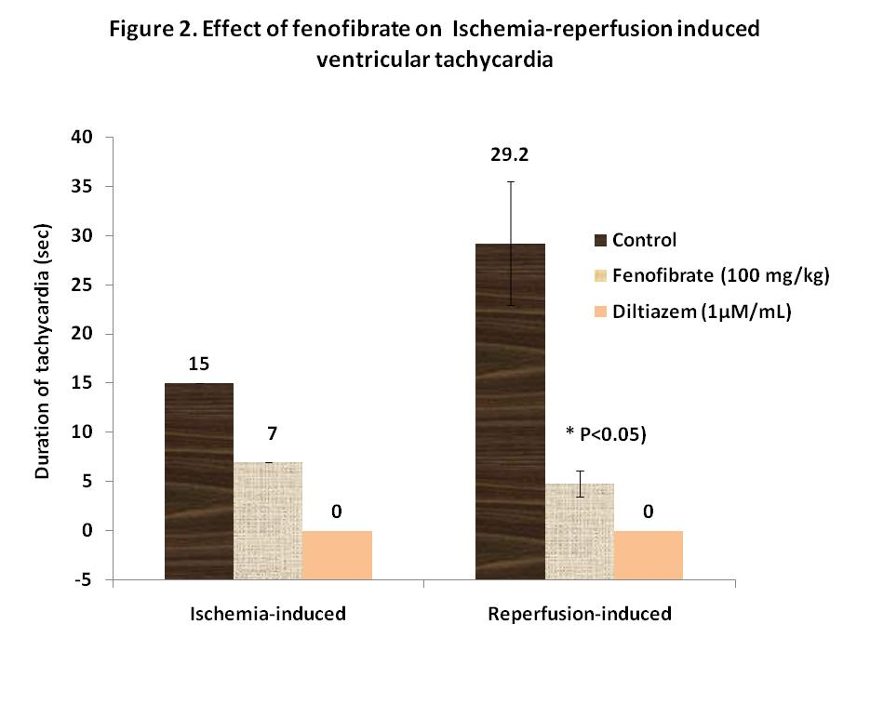
Results

Slide 16
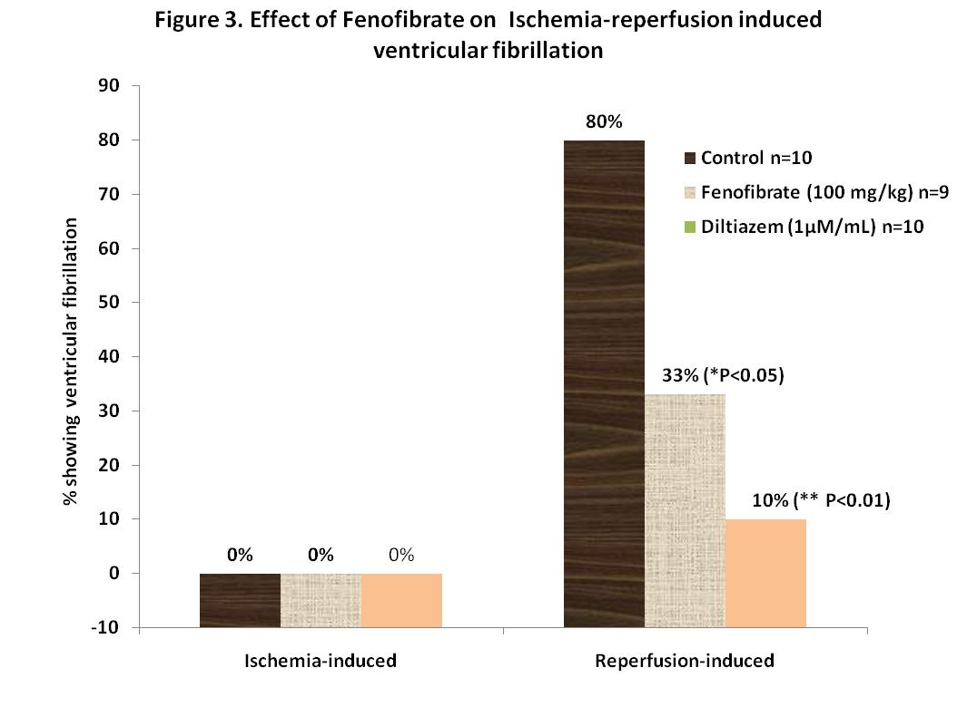
Results

Slide 17
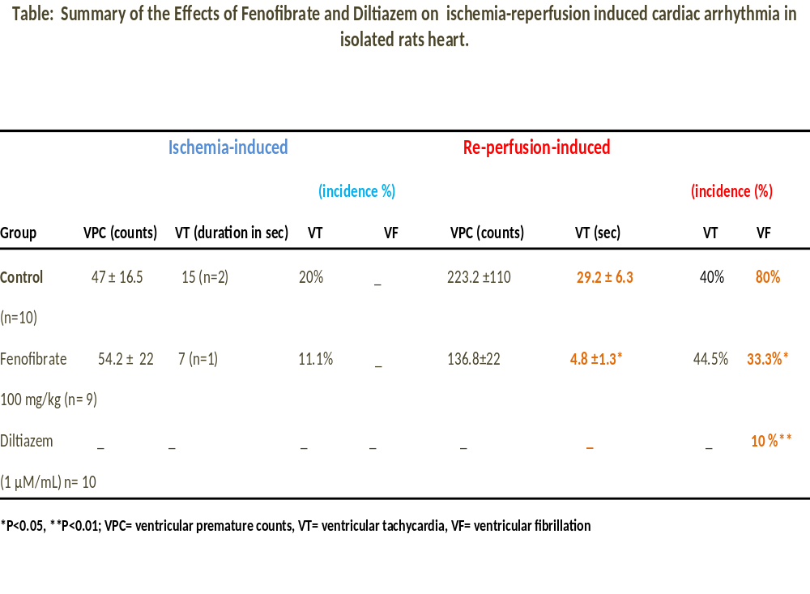

Slide 18
Discussion and conclusion
Fenofibrate significantly (P<0.05) decreased the number of PVCs, the incidence of VF and the duration of VT in isolated rat hearts.
Fenofibrate induces cytochrome P-450 (CYP-450) dependent arachidonic acid (AA) metabolism to EETs.
Fibrates have previously been reported to increase CYP epoxygenase activity , EETs production and anti-hypertensive effects (Huang et al., 2007).
The cardiac protective effect of fenofibrate may have occurred due to enhanced production of endogenous EETs.

Slide 19
Discussion and conclusion
EETs function as EDHF and dilate coronary arteries (Campbell et al., 1996), however in our study no significant difference was observed in the Perfusion pressure of control and fenofibrate treated animals.
Diltiazem produced marked anti-arrythmic effect , indicating the role of calcium channels in the I/R-induced arrythmia.

Slide 20
Conclusion
The findings from our pilot study indicate that fenofibrate protects ischemia-reperfusion-induced arrhythmia in isolated rat hearts.
Further studies are underway in our lab to further explore the role of EETs in the observed cardiac protective role of fenofibrate in rats.
Our ongoing research focused at exploring the effect of chronic treatment of fibrate on high fat diet induced cardiovascular and metobolic disorders in rats.

Slide 21
References
Batchu SN, Lee SB, Qadhi RS, Chaudhary et al.,. Br J Pharmacol. 2011 Feb;162(4):897-907.
Bukhari IA, Gauthier KM, Jagadeesh SG et al., J Pharmacol Exp Ther. 2011 Jan;336(1):47-55.
Campbell WB, Deeter C, Gauthier et al., Am J Physiol. 2002; 282:H1656-H1664.
Campbell WB, Gebremedhin D, Pratt et al., Circ Res 1996;78:415–23.
Campbell WB and Falck JR. Hypertension 2007; 49:590-596.
Huang, H,Christophe Morisseau et al.,Am J Physiol Renal Physiol 293: F342–F349, 2007.
Jiang H, Quilley J, Doumad et al., Am J Physiol Heart Circ physiol. 2011 Jun;300(6):H1990-6.
Larsen BT, Campbell WB and Gutterman DD. TIPS. 2007; 28:32-38.
Spector AA and Norris AW. AmJ Physiol 2007; 292:C996-C1012.
Nithipatikom K, Gross GJ., J Cardiovasc Pharmacol Ther. 2010 Jun;15(2):112-9.
Xi, J., McIntosh, R., Xiangjun Shen et al., J Mol Cell Cardiol. 2009 Nov;47(5):684-90.
Larsen BT, Miura H, Hatoum OA, Campbell WB et al., Am J Physiol 2005; 290:H491–H499
Ai D, Pang W, Li N, Xu M, Jones PD, Yang J, et al. Proc Natl Acad Sci U S A 2009;106:564–9.

Slide 22

Acknowledgments
King Saud University, Riyadh KSA
The National Plan for Science, Technology and Innovation and College of Medicine.

Slide 23
Thank you

Slide 24
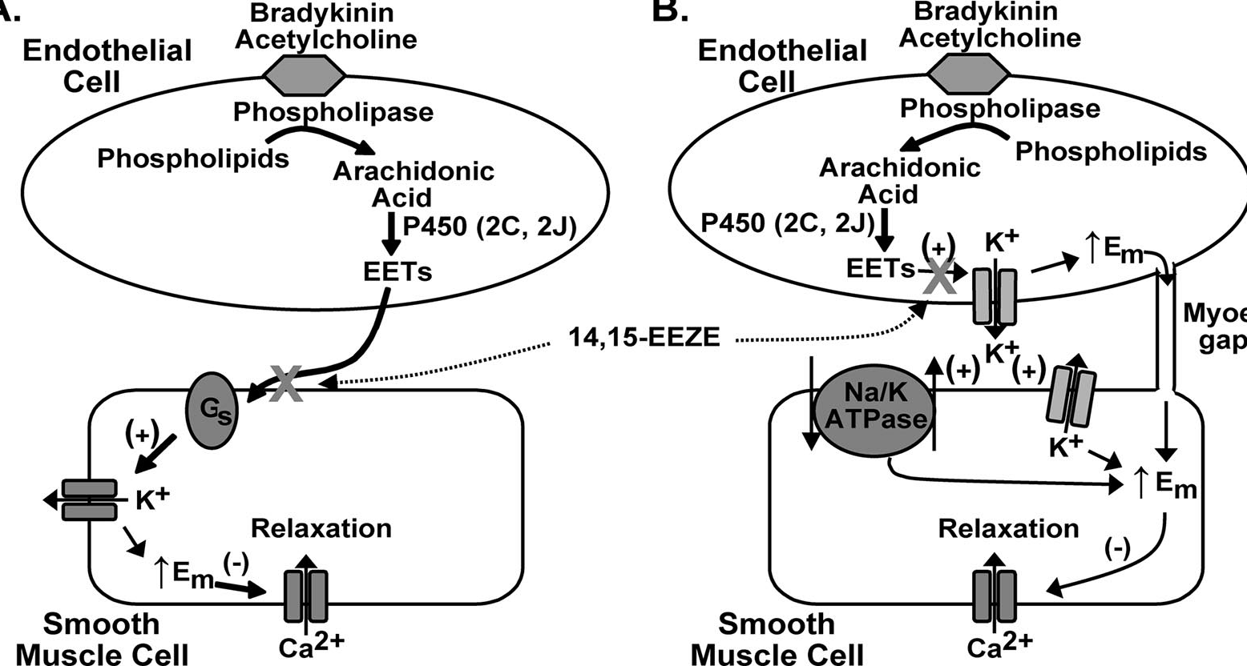
Molecular mechanism of EETs

Slide 25
Let Us Meet Again
We welcome you all to our future conferences of OMICS Group International
Please Visit:
www.omicsgroup.com
www.conferenceseries.com
www.pharmaceuticalconferences.com

