Slide 1

Uranocatharsis project: space debris as cloud-sculptures shading our planet
5th International Conference on Earth Science and Climate Change
Bangkok, Thailand
25th – 27th July, 2016
1
Dr. Ioannis Michaloudis, author
Dr. Peter Shaw, co-author
Ms. Isadora Mack, co-author

Slide 2
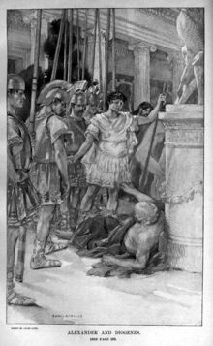
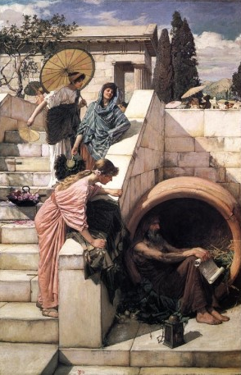
Alexander the Great & Diogenes the philosopher
Louis Loeb, “Alexander and Diogenes”, lithograph, published in Century Magazine, 1898.
John William Waterhouse, “Diogenes”, Oil on canvas, 208.3 x 134.6 cm., 1882. Art Gallery of New South Wales, Australia.
2
philosophy
technology
Notes:
Link
https://en.wikipedia.org/wiki/Diogenes_and_Alexander
Slide 2

Slide 3
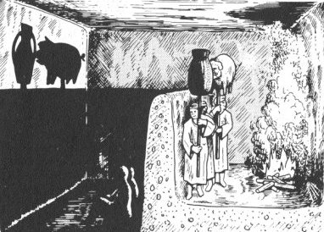
The Allegory of the cave – Plato
3
Reality or Truth?
Notes:
Video
https://www.youtube.com/watch?v=LTWwY8Ok5I0
Picture:
https://criticalthinking-mc205.wikispaces.com/Plato+%26+Socrates
Slide 3

Slide 4
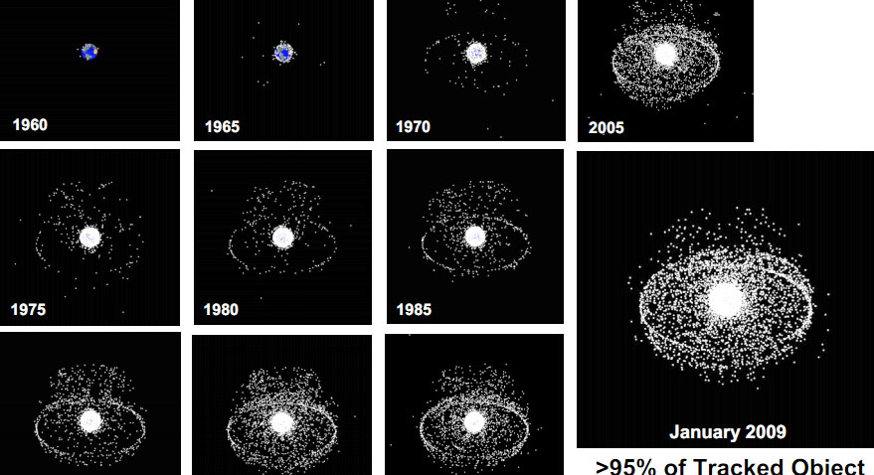
Space debris (1961 – 2013) http://dcc.umd.edu/portfolio/cklug/2015/11/23/first-blog-post/
4
Notes:
Link
Space Junk: The Arcade Game
What is space waste?
http://dcc.umd.edu/portfolio/cklug/author/cklug123/
http://dcc.umd.edu/portfolio/cklug/2015/11/23/first-blog-post/

Slide 5
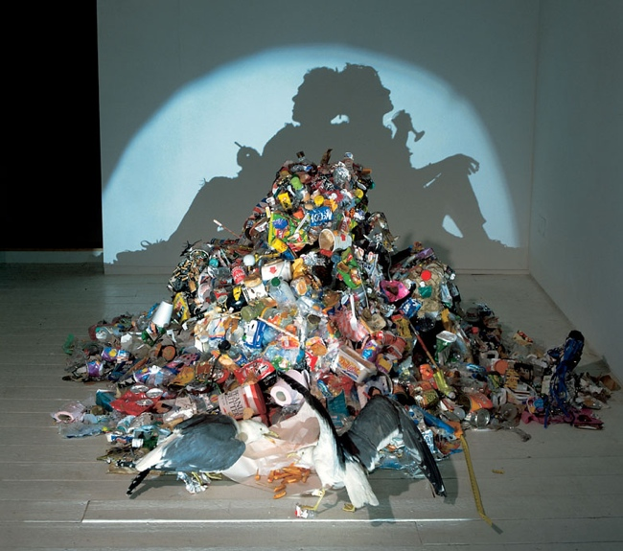
Junk sculpture by Noble and Webster
Artist’s self portrait made with trash, two stuffed seagulls and a light projector.
5
Notes:
http://www.dailymail.co.uk/news/article-2095624/Incredible-shadow-art-created-just-JUNK.html

Slide 6
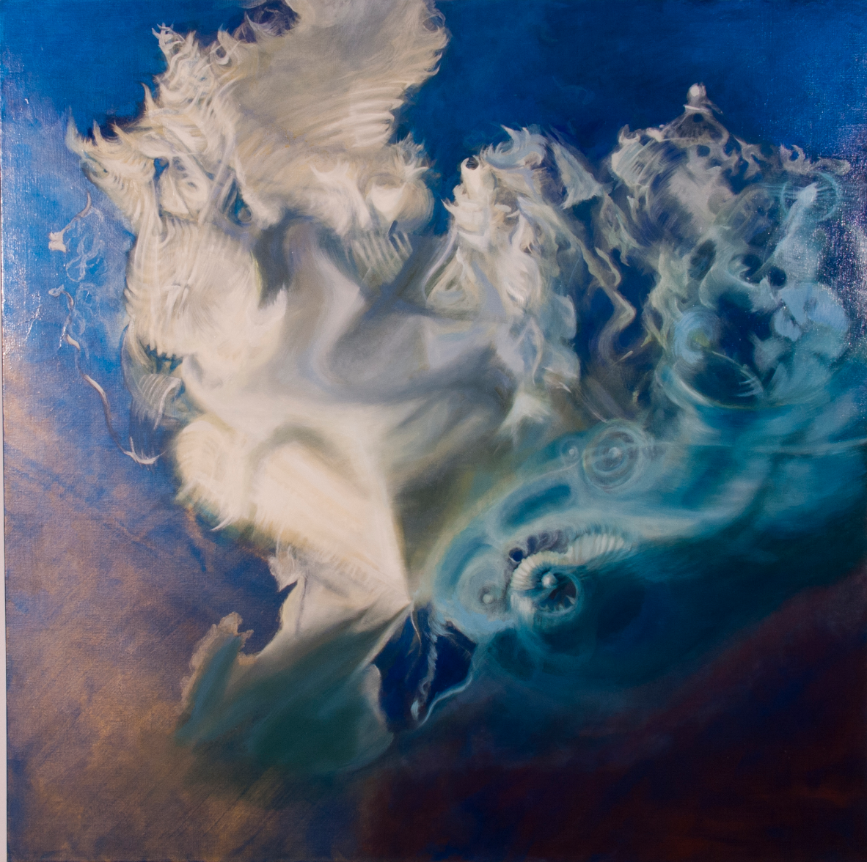
Mack, “The Spinning Top”
Acrylic and oil medium, 122 x 122cm, © Mack 2016.
6

Slide 7
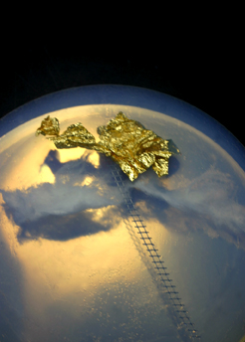
Michalous, “Stairway to heaven”
Silica aerogel, golden leaf, aluminium, © Michalous, 2011.
7
Free-Dimensional artworks

Slide 8
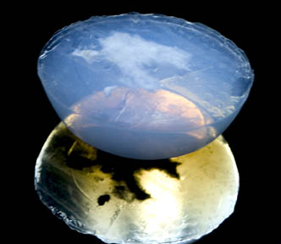
Rayleigh and Mie scattering phenomena on Silica Aerogel
Michalous, “Climatic Sculptureality”
Silica aerogel, LED light, glass, 20 x 20 x 10cm.
@ Michalous, 2009.
8

Slide 9
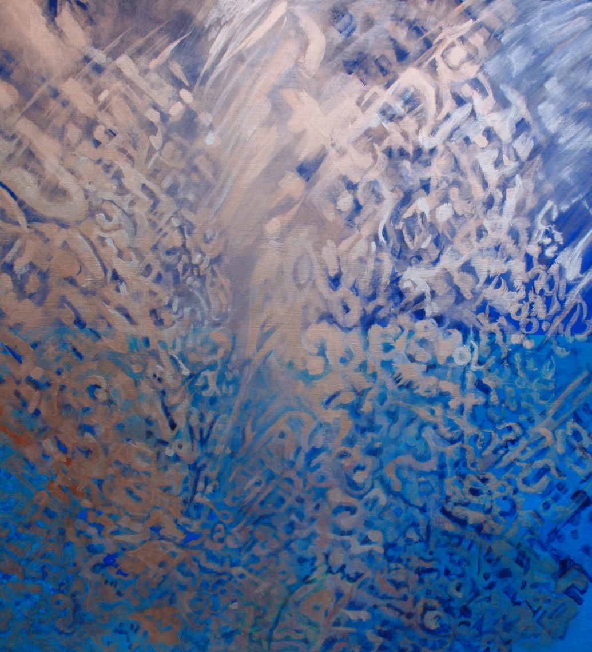
The aesthetics of ether – an ethereal beauty of light, air and the spirit
Mack, “From cirrus to storm”
Acrylic and oil medium, 122 x 122 cm, © Mack, 2016.
9

Slide 10
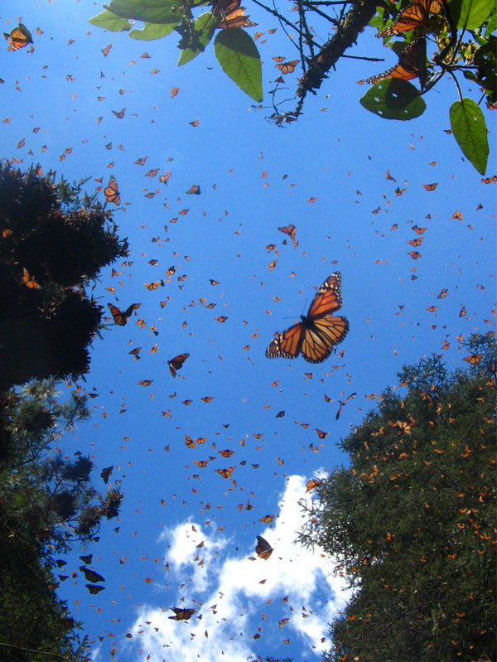
A cloud made of millions of Monarch butterfies
10
The Monarch butterfly migration

Slide 11
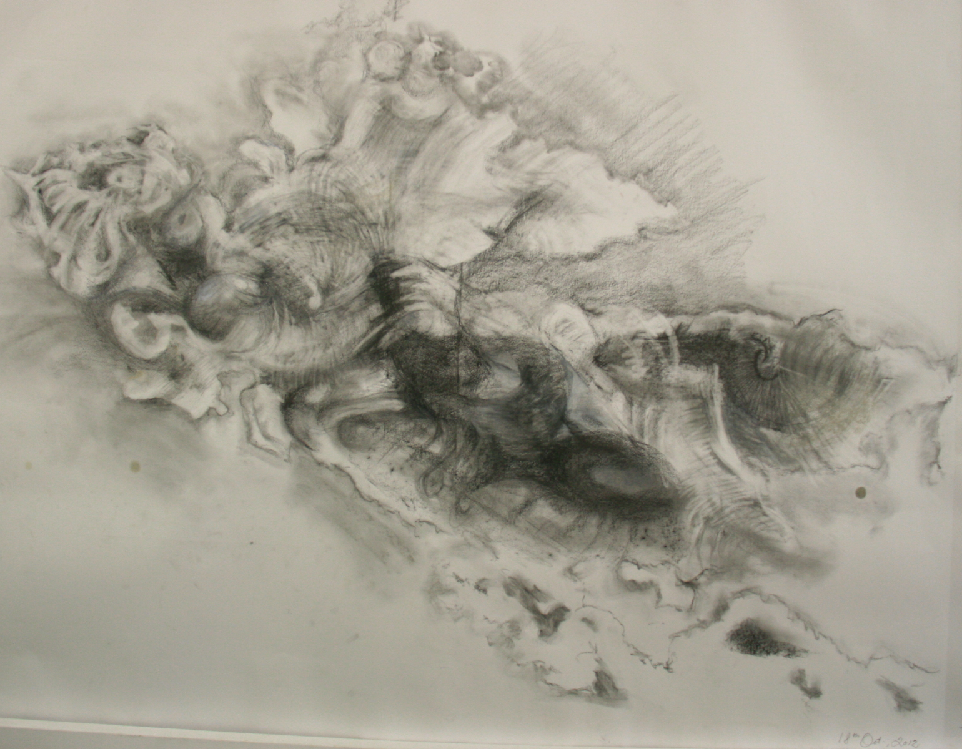
Mack’s ‘The Butterfly’s Dream’
Pencil, pastel and mixed media, © Mack, 2016.
It is depiction of a flying or reclining figure with wings. This is a drawing of an image taken in board daylight. It is an image of my shadow, or the self.
11

Slide 12
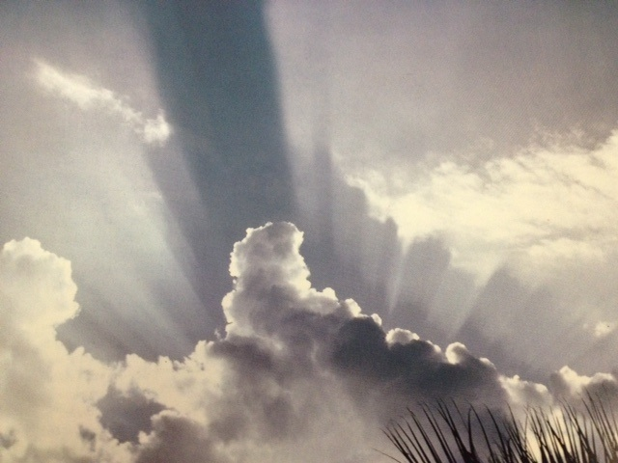
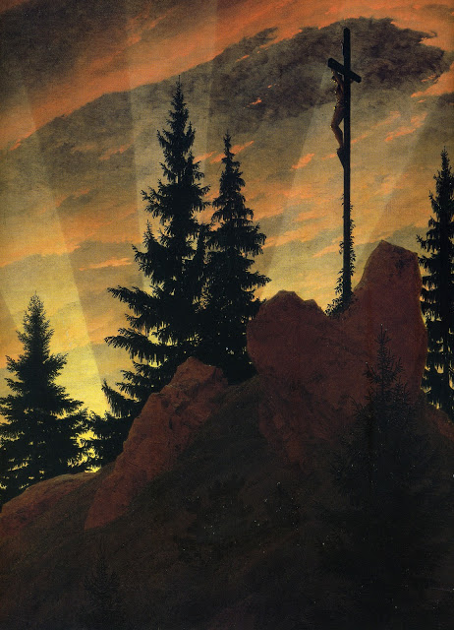
Crepuscular rays fan out from clouds when viewed toward the sun, Tuscon photo
Caspar David Friedrich, “Cross in the Mountain”, or “Tetschen Altar”
Oil on canvas, 115 x 110cm. Galerie Neue Meister, Dresden. 1809.
12
Notes:
Paintings of Romanticism in the visual arts
http://romanticisminthevisualarts.blogspot.com.au/2012/10/caspar-david-friedrich-pictured-world.html

Slide 13
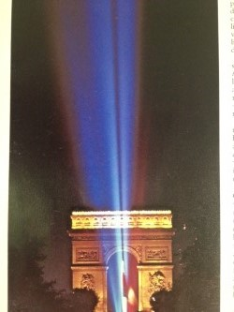
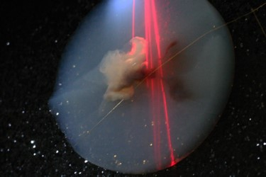
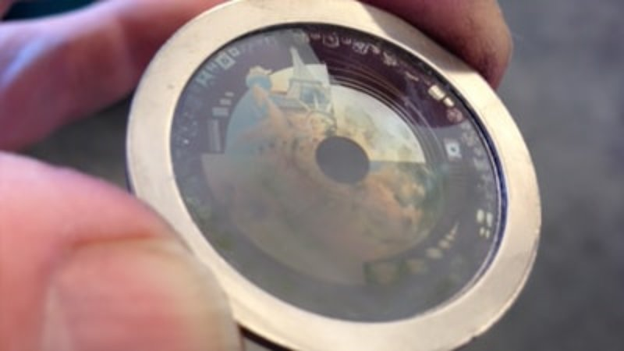
Lasers: the purest light
Michalous, “Noli me Tangere”
Silica aerogel, fabric, wooden box, LED and laser light, motor, remote controls, 120x50x20cm. © Michalous, 2010. Travels one way to the Moon as part of the MoonArts project.
13
Yani photo

Slide 14
14
Conclusion
Uranocatharsis project:
  space debris as cloud-sculptures shading our overheated
  planet
    2 problems of ecology + 2 unlimited artistic imaginations = A real solution?
    No answers by Art only questions
    Art offers Mythology and science offers methodology

