Slide 1

University of Wolverhampton, UK
Faculty of Education, Health and Wellbeing
Prediction of body mass index in old age to dementia risk:
A new cohort study from China and a systematic literature review
Isaac M Danat
MPH, MBA, PhD student in Epidemiology and global Health
Ruoling Chen
MBChB, MSc (Med Stats), PhD (Epid), FRSM
Reader in Public Health and Epidemiology, and PhD Supervisor

Slide 2
Background
Dementia affects older people worldwide, with nearly 10 million cases emerging annually (WHO, 2015).
Older people are affected by the global trends of the rising obesity epidemic ( Swinburne et al., 2011; WHO, 2015).
There are public health concerns of overweight and obesity related health complications at old age (WHO, 2015)

Slide 3
Background
There is evidence that middle age obesity and overweight predicts late-life dementia (Anstey et al., 2011; Emmerzaal et al., 2015; World Alzheimer Report, 2015).
However, it is unclear whether increased BMI in old age is also associated with the risk of dementia.
Several previous studies showed that large BMI in older age may reduce the risk of dementia. But the evidence is not strong.
There is less investigation on the impact of BMI measured at older age on dementia risk.

Slide 4
Study Aim
To assess the prediction of BMI measured at older age to dementia risk, through a new population-based study and a systematic literature review.
To examine data of a 10-year follow-up cohort of older people in China,
To carry out a systematic worldwide literature review and meta-analysis.

Slide 5
Study One
The Anhui cohort study, China (2001-2011).
  Included 3,336 community dwelling older people in Anhui Province.
    1736 participants aged ≥65 years were randomly recruited from Hefei city, and were interviewed using the GMS-AGECAT method, in 2001.
    1600 participants aged ≥60year from Yingshang County, in 2003.
Notes:
52% urban participants.

Slide 6
Methods
BMI and disease risk factors were recorded at baseline.
  The interviewers measured participant’s weight and height using standard methods. BMI was calculated in Kg/m².
Other variables, including
Sociodemographic, doctor-diagnosed cardiovascular diseases, medications, and lifestyle factors.
Notes:
Other variables included; age, sex, education level, urban-rural areas, smoking status, alcohol drinking, marital status, hypertension, diabetes, stroke and heart disease at baseline.

Slide 7
Methods
  At baseline
  Dementia was diagnosed: using the GMS-AGECAT
  GMS* Geriatric mental State questionnaire
  AGECAT* Automated Geriatric Examination for Computer Assisted Taxonomy
  257 people diagnosed with dementia at baseline (7.7%)
Notes:
The 257 diagnosed with dementia at baseline were excluded, leaving 3,079 for the study

Slide 8
Methods
  In the follow up
We monitored the vital status of the cohort until 2011.
We had completed 3 other waves of interviews until 2011 (each time interval of about 3 years from the baseline wave survey).
the 2nd wave using the GMS-AGECAT
the 3rd wave using the 10/66 algorithm dementia package
the 4th wave using the 10/66 algorithm dementia package

Slide 9
Cohort Data Analysis
Among 3,079 participants without baseline dementia, 2755 (89.5%) were followed up for 10 years.
We used a binary logistic regression model to examine incident dementia in relation to BMI at baseline
  adjusted for co-variates included: socio-demographic, medical co-morbidities and lifestyle factors.

Slide 10
Results
Among 2755 cohort members followed up, we diagnosed 313 dementia cases from waves 2, 3 and 4 re-interviews, and identified 7 dementia cases from the cause of death.
Total number of incident dementia cases was 320 (11.6%)
Notes:
Out of 3079 participants, 257 people were lost to follow up and 2755 were left at end line (Dec 2011)

Slide 11
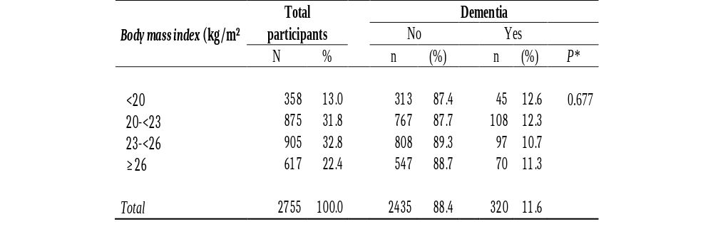
Results
Notes:
Out of 3079 participants, 257 people were lost to follow up and 2755 were left at end line (Dec 2011)

Slide 12
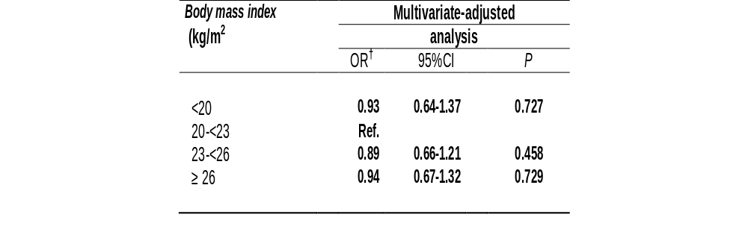
Results
†Adjusted for age, sex, education level, urban-rural areas, smoking status, alcohol drinking, marital status, hypertension, diabetes, stroke and heart disease at baseline.
Notes:
Out of 3079 participants, 257 people were lost to follow up and 2755 were left at end line (Dec 2011)
Findings suggested a reduction of dementia risk by 11%, 6% and 7% for overweight, obesity and underweight BMI respectively, compared to normal BMI.

Slide 13

Results
†
Notes:
Out of 3079 participants, 257 people were lost to follow up and 2755 were left at end line (Dec 2011)
Findings suggested a reduction of dementia risk by 11%, 6% and 7% for overweight, obesity and underweight BMI respectively, compared to normal BMI.

Slide 14
Worldwide systematic literature review

Slide 15
Methods
Electronic database searched included; PUBMED, Embase, Medline, PsycInfo, CINAHL and Cochrane library till 31st July 2016.
Search terms used.
Dementia- dementia, alzheimers, vascular dementia, cognitive decline and cognitive impairment
Body Mass Index – Body mass Index, overweight, obesity, waist circumference and adiposity

Slide 16
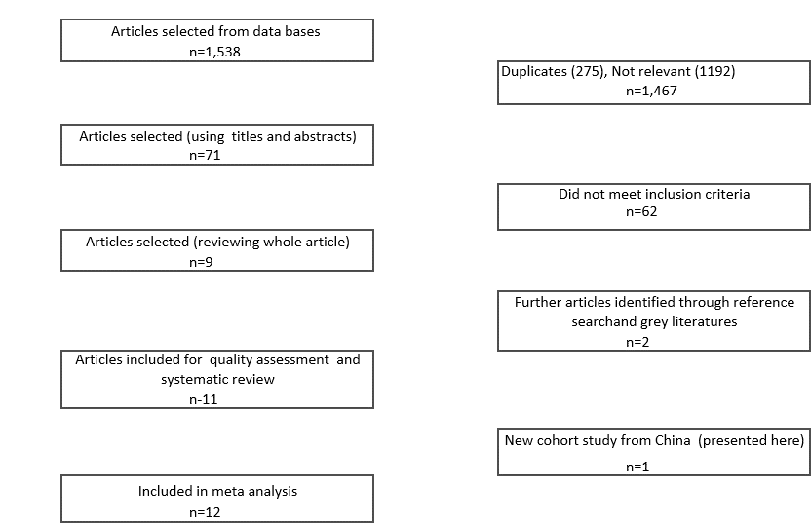
Methods
Notes:
Conference abstracts and unpublished sources were also searched.
References from those articles were manually searched to identify further papers.

Slide 17
Results
Eleven articles met inclusion criteria.
Selected studies covered the years 1971-2014.
Four were undertaken in USA, two in Finland, two in Sweden and one each in Denmark, Italy and Australia.
No study was from low and middle income countries.
Notes:
Hope that in future

Slide 18
Results
Study sample of the cohort studies ranged from 392 to 12,047.
Total dementia cases were 4,143 in 33,340 participants.

Slide 19
Results
Two of the eleven studies showed a significant prediction of large BMI to dementia development.
But 9 studies showed an inverse association of BMI with dementia, of which seven were statistically significant.

Slide 20
Results
First, the category BMI data meta-analysis.
  All available data were pooled according to different categorised BMI as reference for the analysis of obese people, overweight and underweight BMI.
Second, the continuous BMI data meta-analysis.
  Available data for continuous BMI and dementia risk were pooled.
  Also stratified data analysis according to cohort studies in short and long term follow-up.

Slide 21
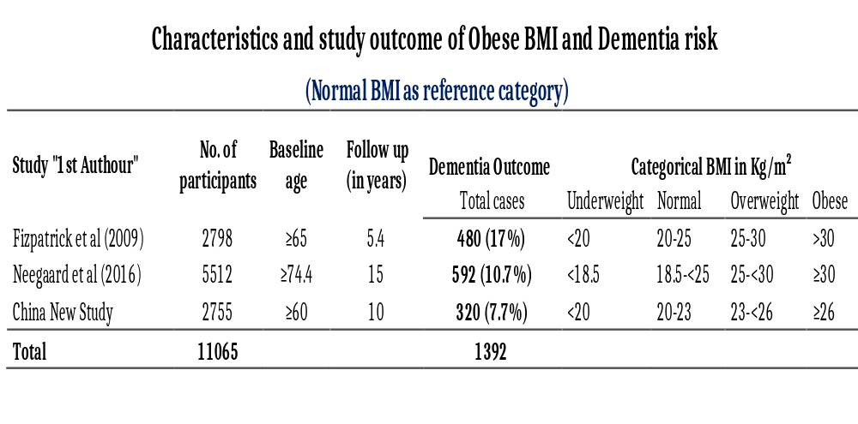
Results

Slide 22
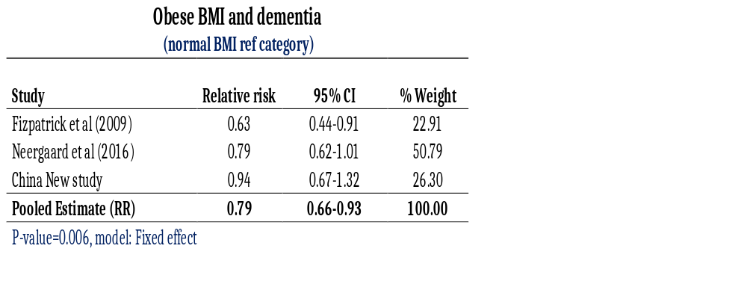
Results

Slide 23
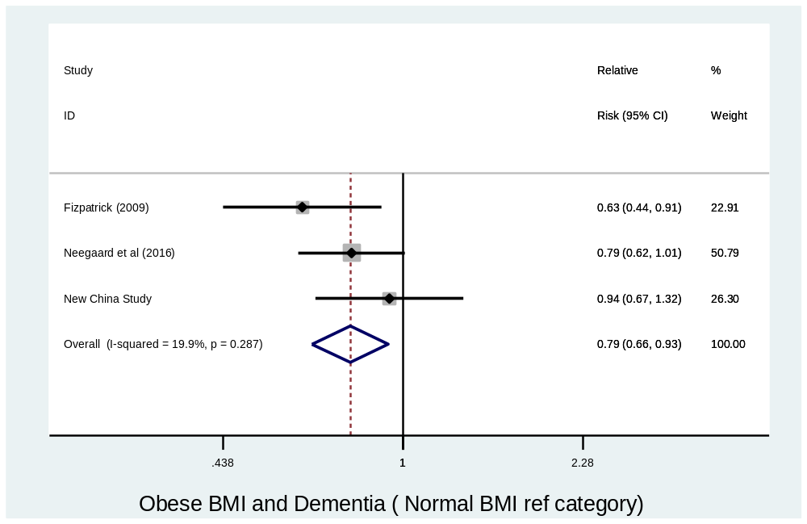
Results

Slide 24
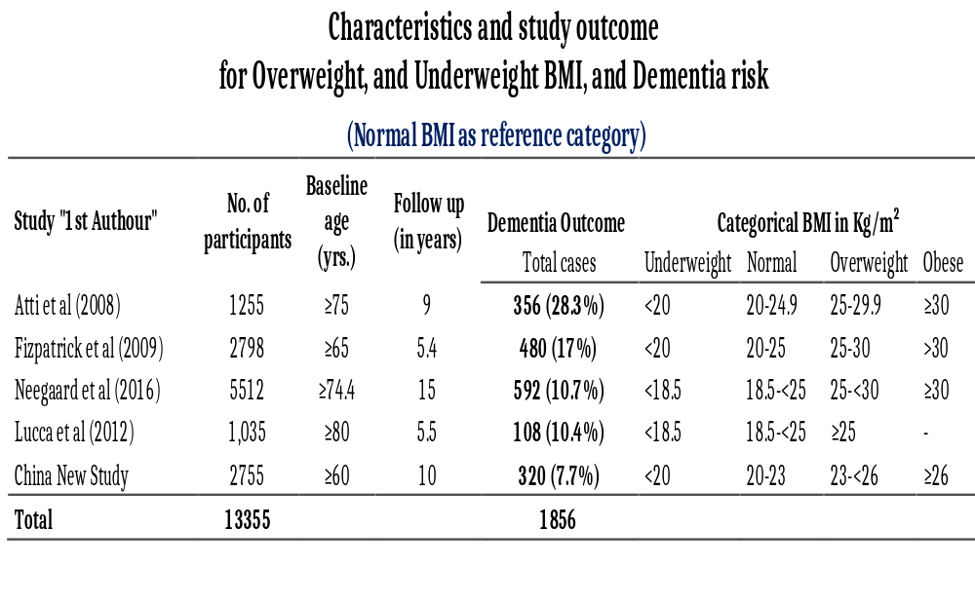
Results

Slide 25
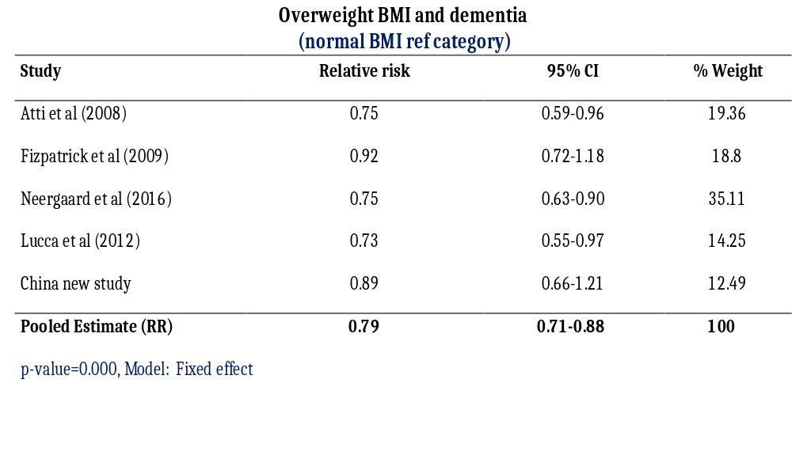
Results

Slide 26
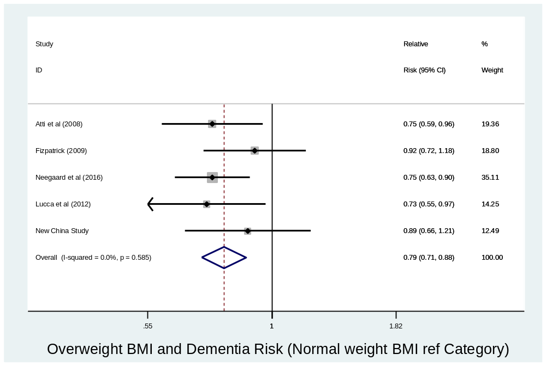
Results

Slide 27
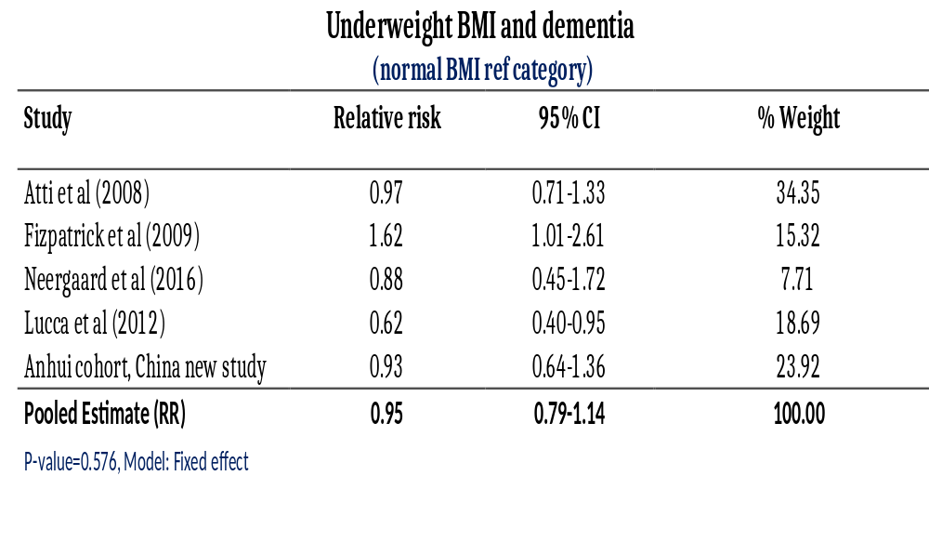
Results

Slide 28
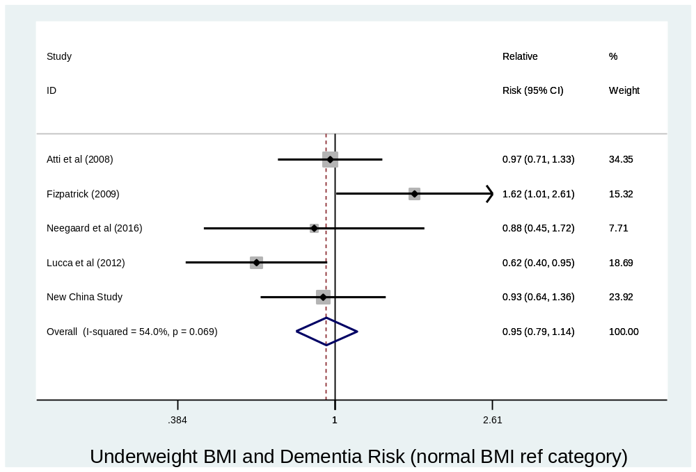
Results

Slide 29
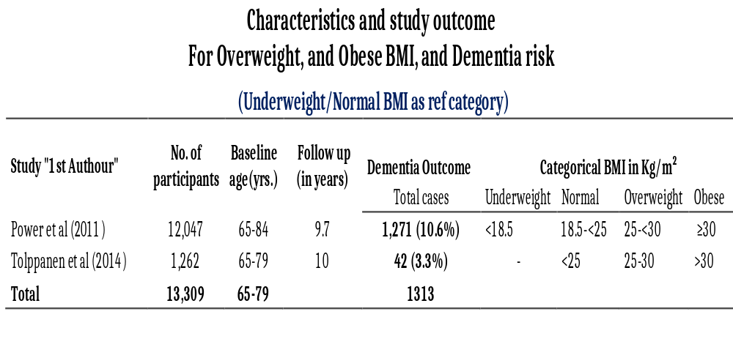
Results

Slide 30
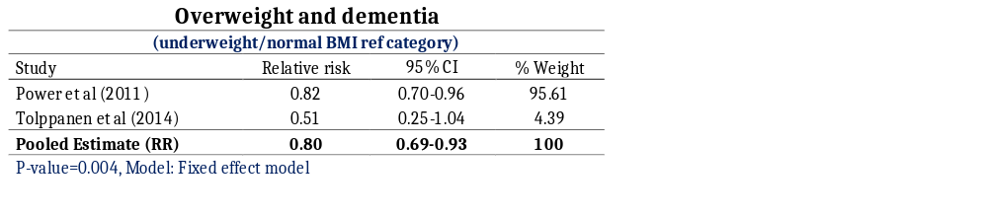
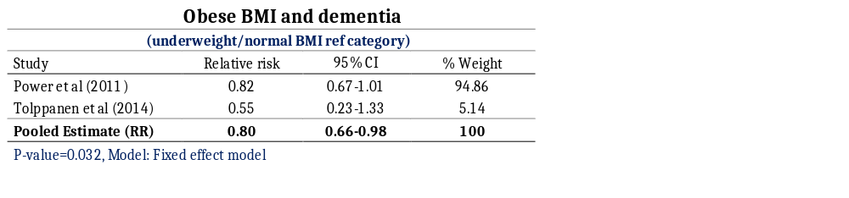
Results

Slide 31
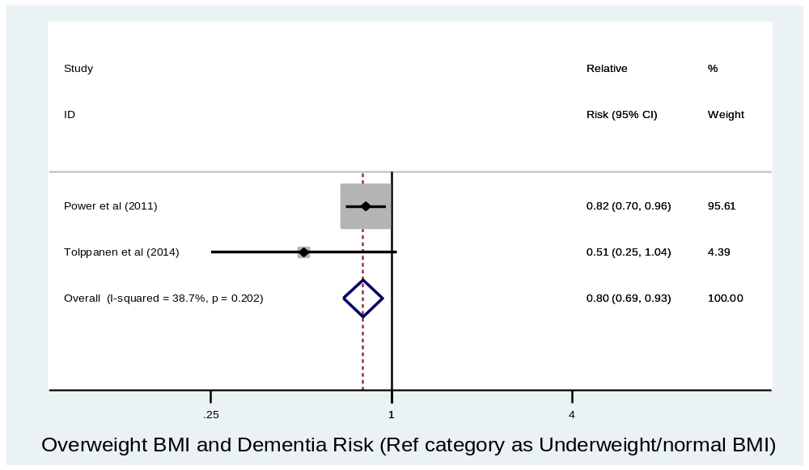
Results

Slide 32
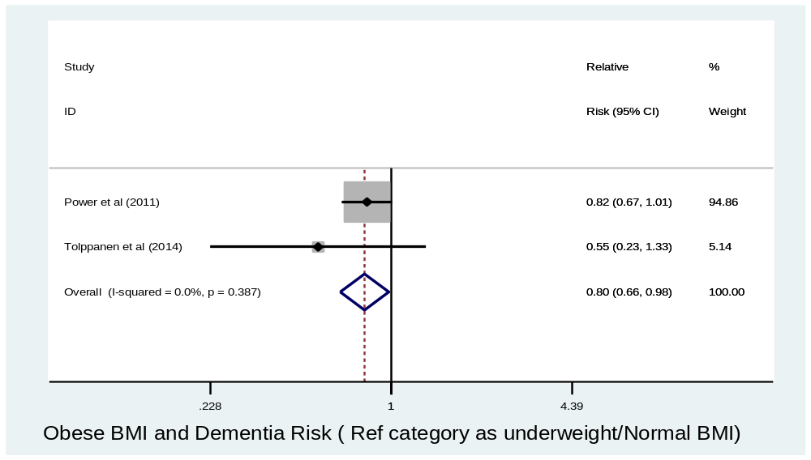
Results

Slide 33
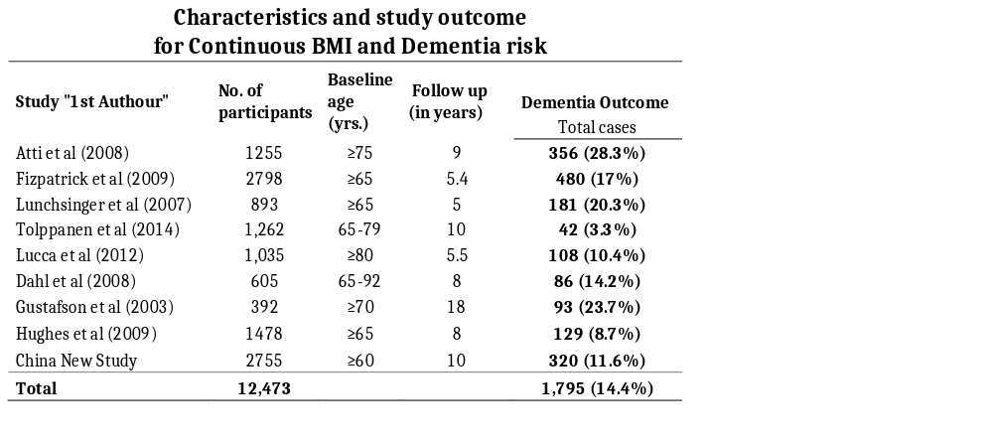
Results

Slide 34
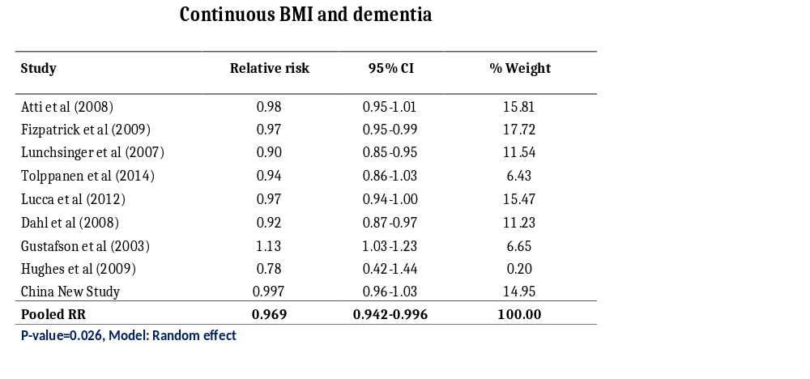
Results

Slide 35
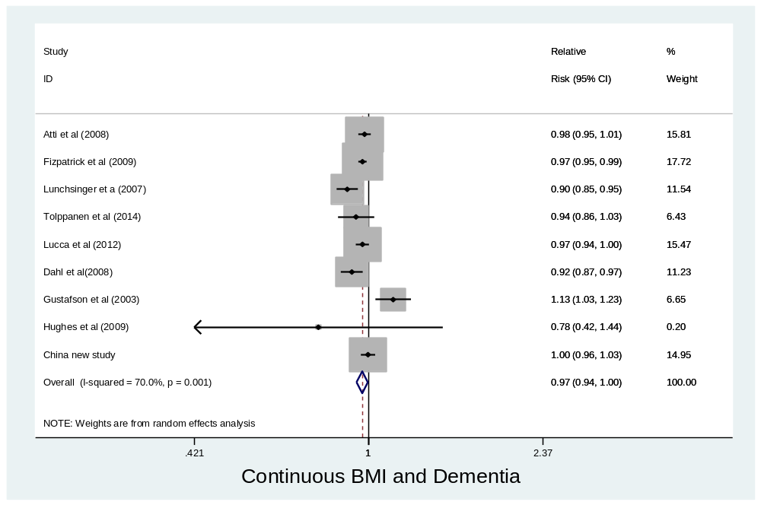
Results
Notes:
Two studies; Hayden et al (2007) and Lunchsinger et al (2007) had BMI reference categories different from all the other studies.
Hayden et al (2006) used underweight/Normal/overweight (all three) as reference category in a study of Obese BMI and dementia. Findings showed Obese BMI significantly predict dementia ( RR 1.76, 95%CI: 1.03-2.88)
Lunchsinger et al (2007) used underweight as reference category. Findings showed RR (95%CI) was 0.8 (0.5-1.2) in people with Obese BMI, 0.6 (0.4-0.9) in overweight and 0.7 (0.5-1.0) in those with normal BMI. Though it was only significant in people with Overweight BMI.

Slide 36
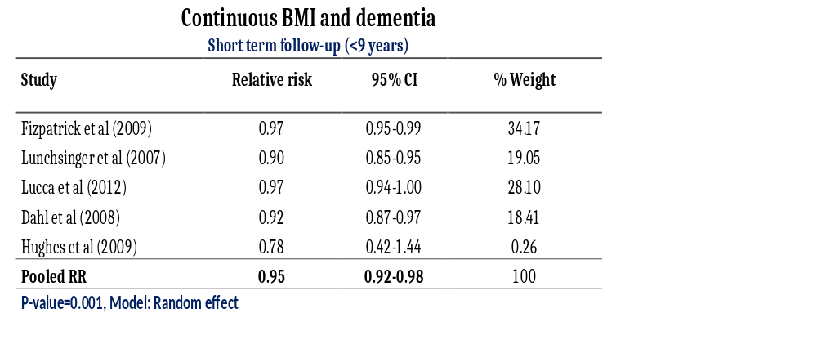
Results

Slide 37
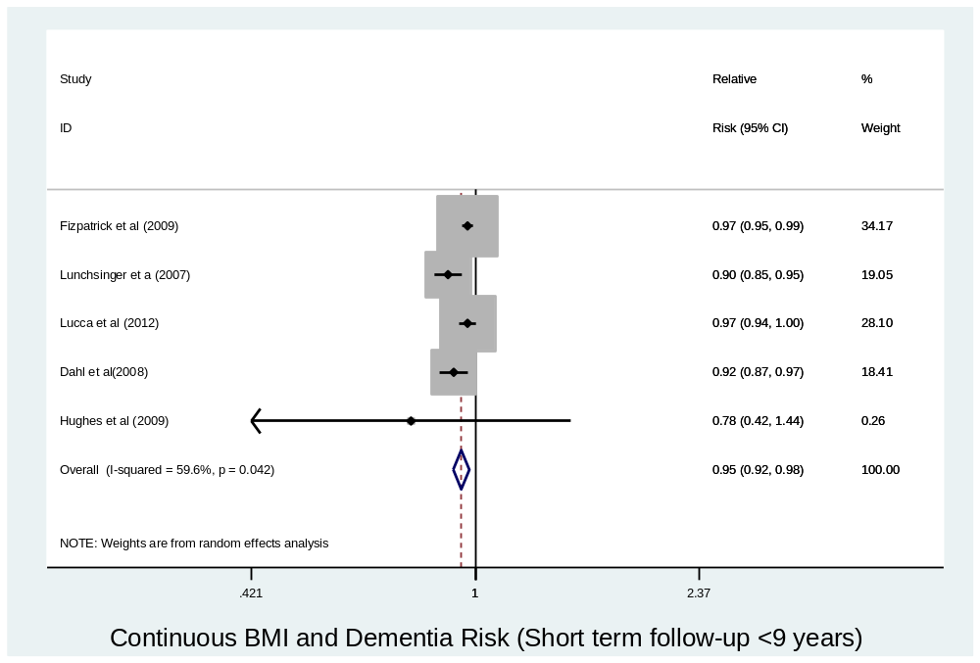
Results

Slide 38
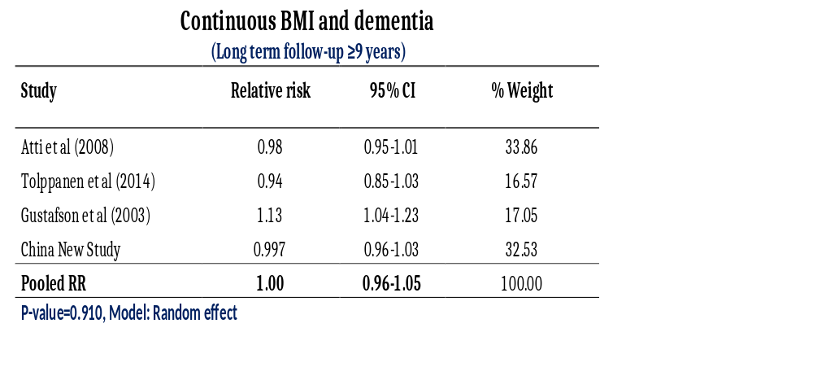
Results

Slide 39
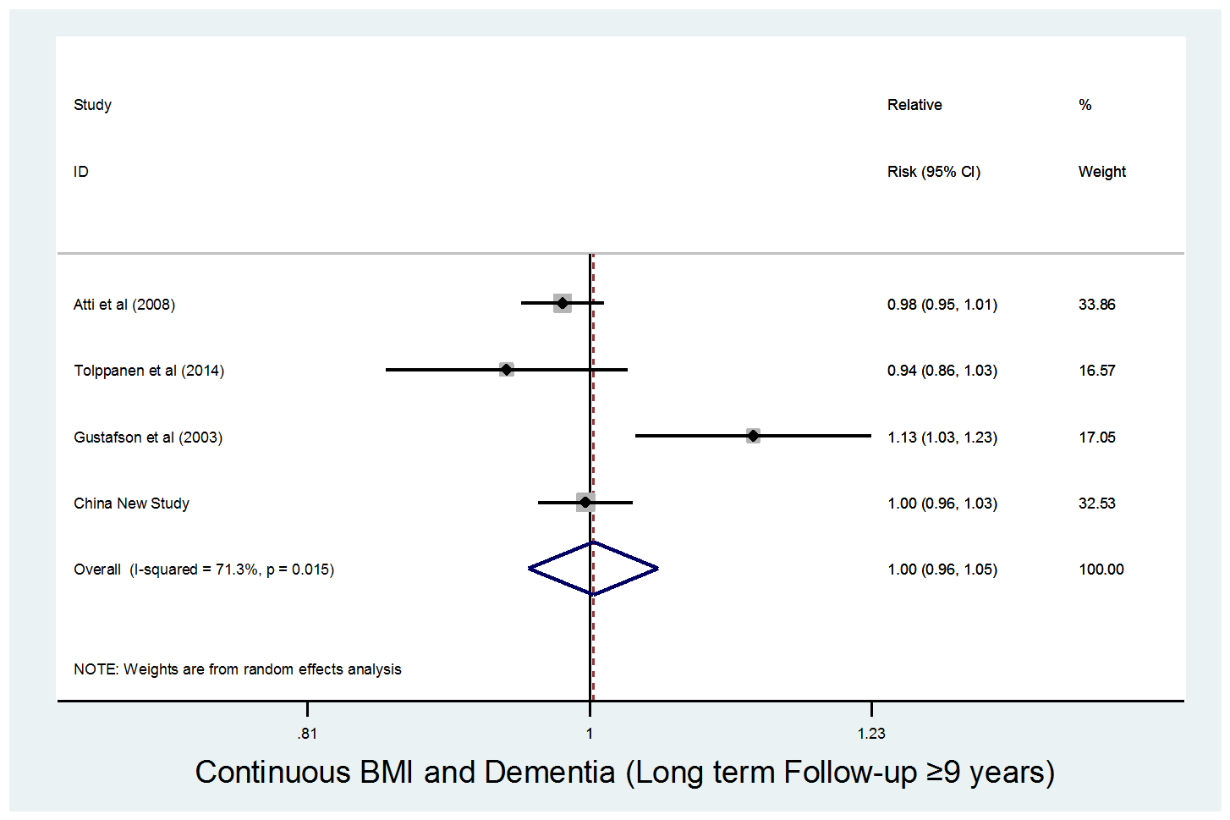
Results

Slide 40
Conclusions
In older people, overall BMI may inversely predict the risk of dementia.
The prediction was stronger in those studies with shorter-term
follow up. There was no significant effect in studied followed up
for longer time.
More research is required to assess the impact of BMI in old age on the risk of dementia.
Notes:
Long-term effect, probably due to long-term care

Slide 41
Thanks
Any questions?
I.M.Danat@wlv.ac.uk
Collaborators:
Prof Linda Lang, Faculty of Education, Health and Wellbing, University of Wolverhampton, UK
Dr Li Wei, Senior Lecturer in Epidemiology and Medical Statistics, Department of Policy and Practice, University College London, UK
Dr Harry HX Wang, Associate Professor in Public Health and Epidemiology, School of Public Health, Sun Yat-Sen University, Guangzhou, China

