Slide 1
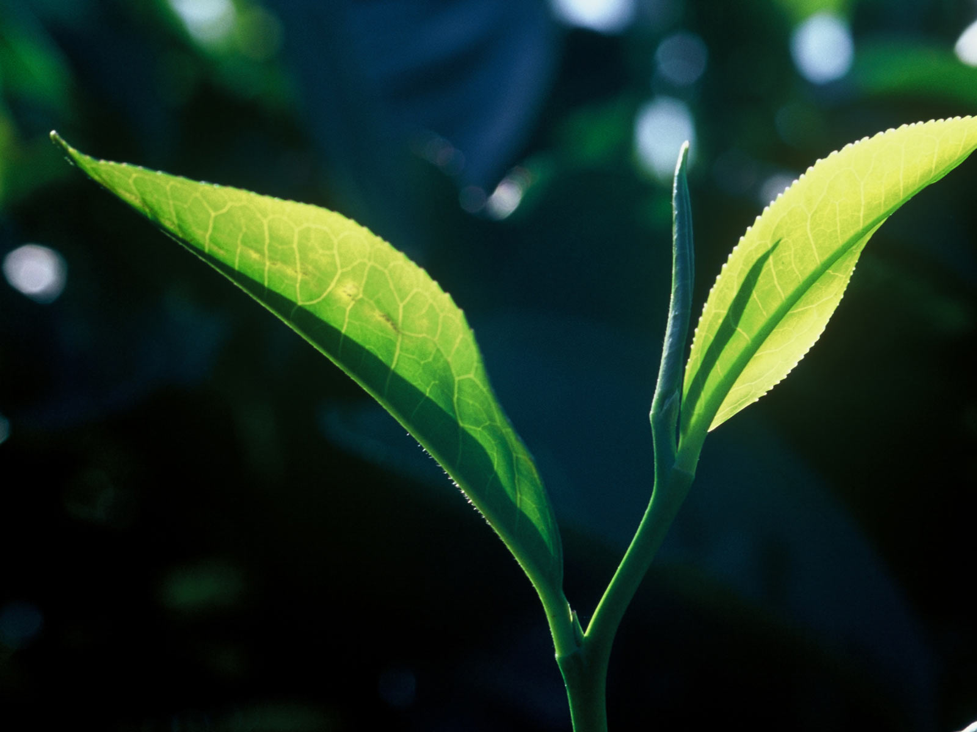

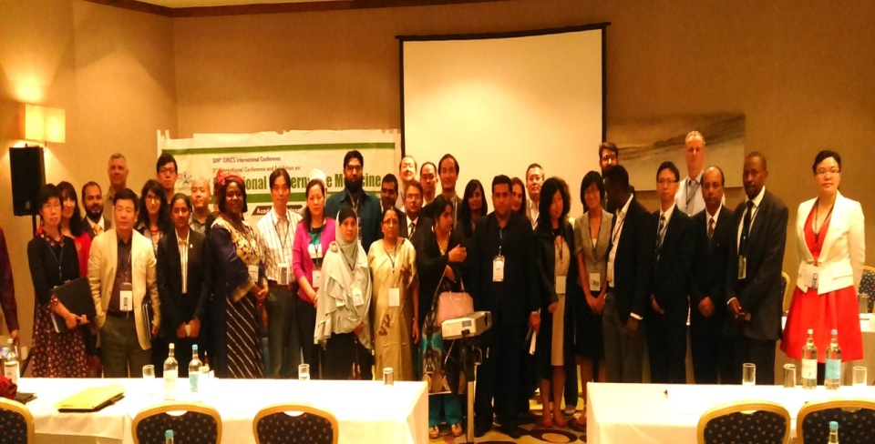
3rd International Conference and Exhibition on
Traditional & Alternative Medicine
August 03-05, 2015 Birmingham, UK
In Association with
Presented By
Name: Dr. Isa Adamu Imam
Country: Nigeria

Slide 2




Anti-oxidant, anti-inflammatory, antibacterial, total phenolic/flavonoids and cytotoxic activities of Cordia africana.
*Isa, Adamu Imam¹., Saleh, Malajiya Ibrahim Alhaji¹, Abubakar, Ahmad²., Dzoyem, Jean Paul³., Adebayo, Salman Adeniyi⁴., Musa Idris¹.,Sani Usman Fulatan¹ and Daru Peret Alexandra¹
¹Department of Human Physiology, Faculty of Medicine, Ahmadu Bello University, Zaria, Nigeria. ²Department of pharmacognosy and drug development, Faculty of Pharmaceutical Sciences, Ahmadu Bello University, Zaria, Nigeria ³Department of Biochemistry, Faculty of Science, University of Dschang, P.O. Box 67, Dschang, Cameroon³Faculty of Science, Department of Biomedical Sciences, Tshwane University of Technology, Private Bag X680, Pretoria, 0001, South Africa.
*Corresponding author: +2348035867084, E-mail: adamuisaimam@gmail.com

Slide 3
INTRODUCTION
It is well known that reactive oxygen species (ROS), such as superoxide anion (O2•-), hydroxyl radicals (OH•), singlet oxygen (1O2) and hydrogen peroxide (H2O2), play a major role in the development of oxidative stress that can lead to many illnesses including cardiovascular diseases, diabetes, inflammation, degenerative diseases, cancer, anemia, and ischemia (Cai et al., 2004).
Plant based antioxidant compounds play a defensive role by preventing the generation of free radicals and hence are extremely beneficial to alleviate the diseases caused by oxidative stress (Akinmoladun et al., 2010; Özen et al., 2010)

Slide 4
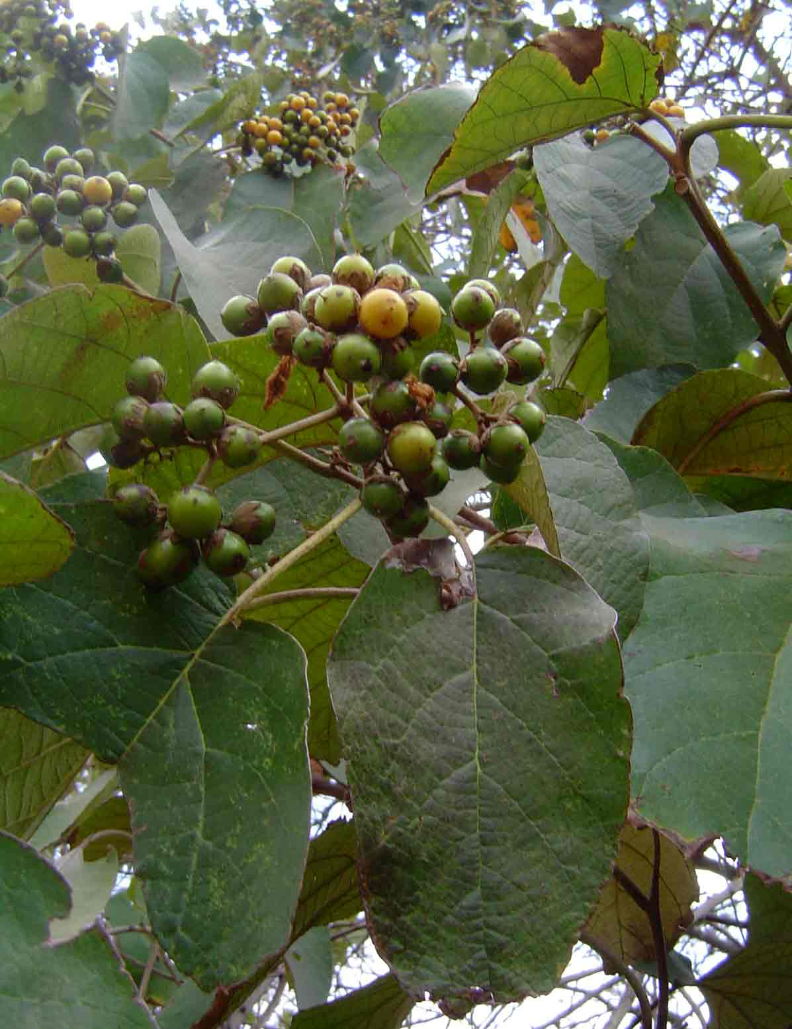
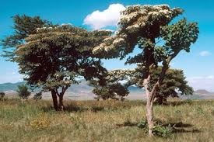
Introduction (Con’d)
Cordia africana is a small to medium-sized evergreen tree, 4-15 (30) m high, heavily branched with a spreading, umbrella-shaped or rounded crown.
Posses analgesic, anti-inflammatory, antimicrobial, antiviral and antifertility activities.
Compounds like flavonoids, triterpenes, tannins, alkaloids and fatty acids possessing wide range of bioactivities were isolated from different plant parts of Cordia species (Thirupathi et al., 2008).
C. africana is used traditionally to treat stomach ache, toothache, wound and cough (Reta, 2013).
Cordia africana in its natural habitat

Slide 5
INTRODUCTION (Con’d)
15-Lipoxygenase (15-LOX) belongs to the class of iron containing Lipoxygenases that catalyse the incorporation of dioxygen into unsaturated fatty acid (Feussner and Wasternack, 2002).
Lipoxygenases are the key enzymes in the biosynthesis of leukotrienes that play an important role In several inflammatory diseases (Funk, 2006).
Inflammation is one of the manifestations of oxidative stress, and the pathways that generate the mediators of inflammation, such as adhesion molecules and interleukins, are all induced by oxidative stress (Funk, 2006).

Slide 6
Aim
The aim of the study was to validate some of the numerous uses of C. africana leaf and stem bark extracts in traditional medicine.

Slide 7
Objectives
The objectives of the study were to
Establish effects of extracts on the lipid mediator of inflammation15-lipoxygenase (15-LOX)
Establish scavenging effect of extracts on some non biological free radicals - 2,2-diphenyl-1-picrylhydrazyl (DPPH) radical, the [2, 2 azinobis (3-ethylbenzothiazoline-6-sulfonic acid)] (ABTS) radical and the Ferric reducing antioxidant power (FRAP)
Evaluate the cytotoxicity of crude extracts and fractions of C. africana.
Establish the antimicrobial activities of C. africana extracts.

Slide 8
Materials and Methods
Plant material and extraction
Cordia africana was collected in January, 2014 in Bomo village, Zaria, Nigeria.
The plant was identified and authenticated by a taxonomist, (Mal Musa Muhammad) in the Herbarium section, Department of Biological Sciences, Ahmadu Bello University, Zaria as compared by a voucher specimen No. 055.
The collected plant material was dried at room temperature and ground. The powder obtained (100g) was extracted with methanol (250ml), and hexane (250ml) using soxhlet extractor.
It was then concentrated under reduced pressure using a rotary evaporator to obtain the crude extract.

Slide 9
Chemicals
All chemical used were of analytical grade and bought either from Sigma, USA or Highveld Biological, Johannesburg, South Africa.
LOX-inhibitor screening assay kit (Catalog No. ab133087) was obtained from abcam, UK.

Slide 10
Lipoxygenase inhibition assay
The anti-inflammatory activities of extract from the bark of Cordia africana were evaluated for LOX inhibitory activity using a LOX-inhibitor screening assay kit (Catalog No. ab133087, abcam, UK) according to the manufacturer's instructions.

Slide 11
ANTIOXIDANT ACTIVITY
ABTS radical assay
The ABTS radical scavenging capacity of the samples was measured with modifications of the 96-well micro titre plate method described by Re et al.(1999).
DPPH assay
The DPPH radical-scavenging activity was determined using the method proposed by Brand-Williams et al. (1995).
Ferric reducing antioxidant power (FRAP) assay
This was determined using the method of Berker et al. (2007)

Slide 12
Total phenolic content (TPC) determination
The total phenolic content of extracts was determined colorimetrically using a 96-well microplate Folin–Ciocalteu assay developed by Zhang et al. (2006).
Total flavonoids content (TFC) determination
Total flavonoid content was determined using the method of Ordonez et al. (2006).

Slide 13
Antimycobacterial Activity Assay
Mycobacterium species:
Mycobacterium smegmatis (ATCC1441), Mycobacterium aurum (NCTC 10437) and Mycobacterium fortuitum (ATCC6841),
Gram-positive bacteria:
Bacillius cereus (ATCC 14579), Staphylococcus aureus (ATCC 29213) and Enterococcus faecalis (ATCC 29212)
Gram-negative bacteria:
Pseudomonas aeruginosa (ATCC 25922) Salmonella typhimurium (ATCC 700720) Escherichia coli (ATCC 25922) were used in this study

Slide 14
Minimum inhibitory concentration (MIC)
The broth microdilution technique using 96-well micro-plates, as described by Eloff (1998) was used to obtain the MIC values of Cordia africana samples.

Slide 15
CYTOTOXIC ACTIVITY
The cytotoxicity of the extracts (dissolved in acetone) against Vero monkey kidney cells was assessed by the MTT reduction assay as previously described by Mosmann (1983) with slight modifications.

Slide 16
STATISTICAL ANALYSIS
All experiments were conducted in triplicate and values expressed as mean ± standard deviation. Statistical analysis was performed using one way ANOVA and results were compared using Fisher's least significant difference (LSD) at a 5% significance level.

Slide 17
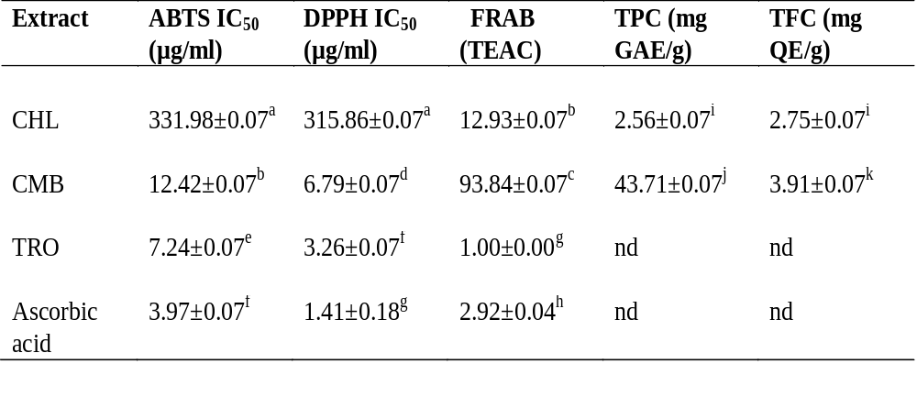
RESULTS AND DISSCUSSION
Table 1: Antioxidant activity, total phenolic and total flavonoid contents of extracts from hexane leave and methanol bark extracts of Cordia africana
CHL: Cordia hexane leaf , CMB: Cordia methanol bark, Tro: Trolox
Values with different letters are significantly different at p<0.05.

Slide 18
Fig. 1. 15-Lipoxygenase inhibitory activity of extracts from hexane leave and methanol bark of Cordia africana. Extracts were tested at (5 mg/ml).
CHL: Cordia hexane leaf , CMB: Cordia methanol bark

Slide 19
Table 2: IC₅₀ of extracts from hexane leave and methanol bark of Cordia africana
Extracts | IC₅₀ (µg/ml)
Asp | 19 ± 0.9ª
CMB | 55 ± 0.98^{b}
CHL | 105 ± 1.3^{c}
Values with different letters are significantly different at p<0.05.

Slide 20
Antimycobacterial activity
Table 4: Minimum inhibitory concentration (MIC in µg/mL) of extracts from hexane leave and methanol bark of Cordia Africana against fast growing mycobacterial strains.
Extracts MIC (µg/ml)
 | Ms | Mf | Ma
CHL | 1024 | 512 | 1024
CMB | 256 | 512 | >1024
Ciprofloxacin | 4 | 8 | 8
Rifampicin | 8 | 2 | 4
CHL: Cordia hexane leaf , CMB: Cordia methanol bark, M. smegmatis, M. fortuitum, M.aurum

Slide 21
Table 5: Minimal inhibitory concentration (MIC in µg/mL) of extracts from hexane leave and methanol bark of Cordia Africana against six bacterial strains
Extracts | MIC (µg/ml)
 | Sa | Ef | Bc | Pa | Ec | St
CHL | 512 | 256 | 512 | 256 | 512 | 32
CMB | 1024 | >1024 | >1024 | 1024 | 512 | 128
Cipro. | 4 | 16 | 8 | 16 | 8 | 2
CHL: Cordia hexane leaf , CMB: Cordia methanol bark, Cipro: Ciproxacilline Staphylococus aureus, Enterecocus faecalis, Bacillus cereus, Pseudonomos aeruginosa, Escherichia. coli, S. typhimurium

Slide 22
Table 6: Cytotoxicity of extracts from hexane leave and methanol bark of Cordia africana on Vero monkey kidney cells and their selectivity index (SI) against six bacterial strains
Extract | LC₅₀ (µg/ml) | Selectivity index (LC₅₀/MIC)
 |  | Sa Ef Bc Pa Ec St
 |  | 0.16 0.32 0.16 0.32 0.16 2.56
CHL | 81.79±13.31
CMB | 99.67±16.10 | 0.10 0.10 0.10 0.10 0.19 0.78
DOXO | 3.48±0.45 | nd nd nd nd nd nd
CHL: Cordia hexane leaf , CMB: Cordia methanol bark, Doxo: Doxorubucine, Staphylococus aureus, Enterecocus faecalis, Bacillus cereus, Pseudonomos aeruginosa, Escherichia. coli, S. typhimurium

Slide 23
Table 7: Cytotoxicity of extracts from hexane leave and methanol bark of Cordia africana on Vero monkey kidney cells and their selectivity index (SI) against mycobacterial strains
Extracts |  | Selectivity index (LC₅₀/MIC)
 | LC₅₀ (µg/ml) | Ms | Mf | Ma
CHL | 81.79±13.31 | 0.079 | 0.159 | 0.079
CMB | 99.67±16.10 | 0.389 | 0.194 | 0.097
DOXO | 3.48±0.45 | nd | nd | Nd
CHL: Cordia hexane leaf , CMB: Cordia methanol bark, Doxo, Doxorubucin, M. smegmatis, M. fortuitum, M.aurum

Slide 24
References
Berker, K.I., Guclu, K., Tor, I. and Apak, R. (2007). Comparative evaluation of Fe (III) reducing power-based antioxidant capacity assays in the presence of phenanthroline, batho-phenanthroline, tripyridyltriazine (FRAP), and ferricyanide reagents. Talanta 72, 1157–1165.
Brand-Williams, W., Cuvelier, M.E. and Berset, C. (1995). Use of a free radical method to evaluate antioxidant activity. LWT – Food Science and Technology, 28: 25–30.
Eloff, J.N. (1998). A sensitive and quick microplate method to determine the minimal inhibitory concentration of plant extracts for bacteria. Planta Medica 64: 711–713.

Slide 25
Acknowledgements
Nigerian Tertiary Education Training Fund (TETFund)..
Jean Paul Dzoyem and Salmon Adeniyi Adebayo

Slide 26



Slide 27


Meet the eminent gathering once again at
Traditional Medicine-2016
London, UK
October 03-05, 2016
Traditional Medicine-2016
Website: http://traditionalmedicine.conferenceseries.com/

