Slide 1

Probiotic Approach for Mitigation of Stress Adverse Effects
Iryna Sorokulova, Ph.D., D.Sc.
Department of Anatomy,
Physiology and Pharmacology
109 Greene Hall
Auburn University, AL 36849
Telephone: 334-844-5307
FAX: 334-844-5388
e-mail: sorokib@auburn.edu

Slide 2
‘‘Stress is any threat to the homeostasis of an organism’’
Selye H., Nature, 1936

Slide 3
Conditions Associated With Changes in Gut Microflora
Condition | References
Thermoregulation | Kent et al., 1992
Neuroendocrine control | Kent et al. 1992
Sleep | Kent et al. 1992
Social behavior | Bercik, et al., 2011; Li, 2009
Cognition | Kent et al. 1992
Gut neuro-motor function | Verdu et al., 2009
Muscular activity | Verdu et al, 2006
Memory | Li, 2009
Anxiety | Bercik, et al., 2010, 2011a

Slide 4
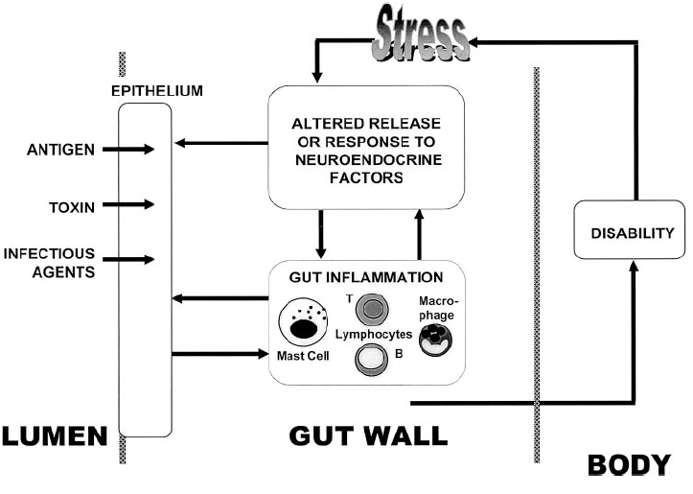

Impact of Stress on Intestinal
Barrier Function
Stress, via signals from the central nervous system, leads to the altered release of and response to neuroendocrine factors (acetylcholine, neurotensin) in the intestinal mucosa.
Such factors may act on the epithelium, inducing barrier dysfunction and the uptake of proinflammatory material from the gut lumen.
The resultant inflammation causes disability and increases stress, which further amplifies the defect.
Soderholm, Perdue, 2001

Slide 5
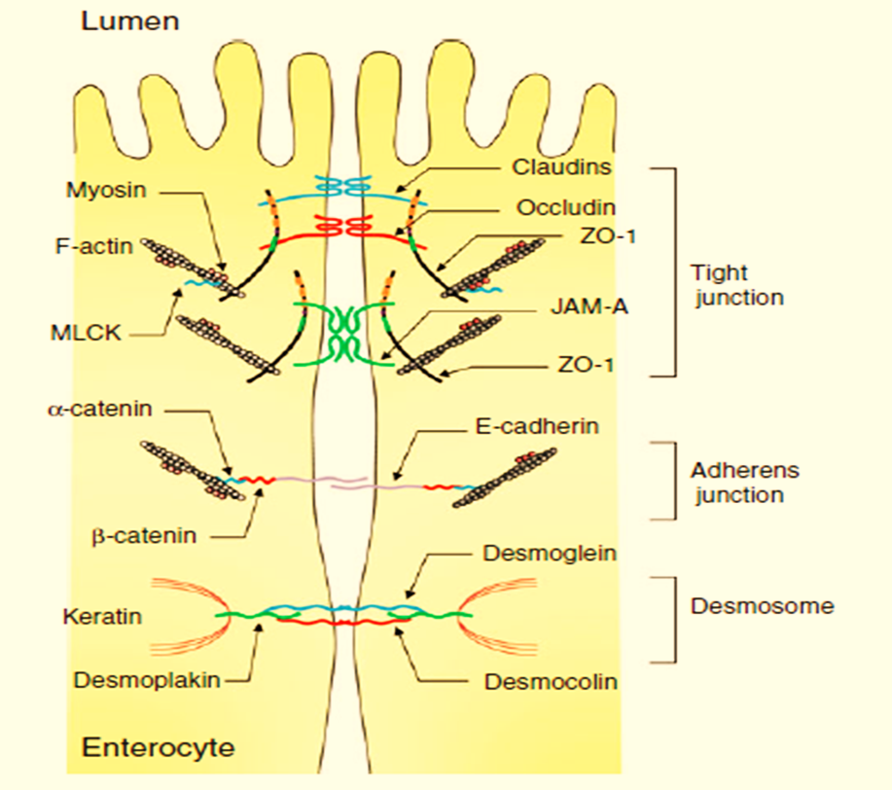
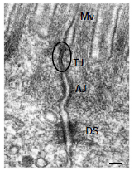
Intestinal barrier function - the ability to control uptake across the mucosa and to protect the gut from harmful substances present in the lumen. The intercellular junctions of intestinal epithelial cells are sealed by different protein complexes, including tight junctions (TJs), adherens junctions (AJs), and desmosomes. The TJs, multiple protein complexes, locate at the apical ends of the lateral membranes of intestinal epithelial cells and they act as a primary barrier to the diffusion of solutes through the intercellular space.

Slide 6
Tight Junction Integral Proteins
Claudin
a family of ≥24 members
the main structural components of intramembrane strands
determine ion selectivity of paracellular pathway
Occludin
regulates paracellular diffusion of small hydrophilic molecules
has been linked to the formation of the intramembrane diffusion barrier
regulates the transepithelial migration of neutrophils
Junctional adhesion molecule (JAMs)
JAM is involved in formation and assembly of TJs in intestinal epithelial cells

Slide 7
The intestinal TJ barrier is dynamically regulated by physiological and pathophysiological factors:
microorganisms (probiotics and pathogens)
cytokines
food factors

Slide 8
Downregulation of Intestinal Tight Junction by Pathogens
Vibrio cholerae
Enteropathogenic E. coli
Clostridium perfringens

Slide 9
Upregulation of Tight Junction Proteins by Probiotics
Streptococcus thermophilus
Lactobacillus acidophilus
Escherichia coli Nissle 1917
Saccharomyces boulardii

Slide 10
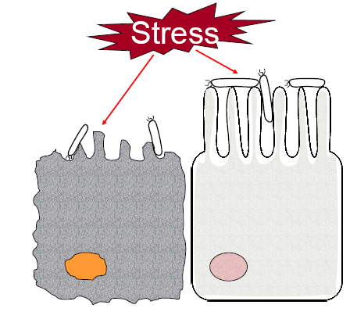
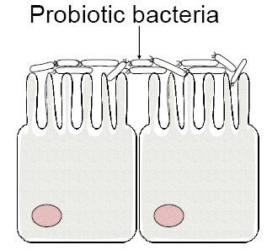
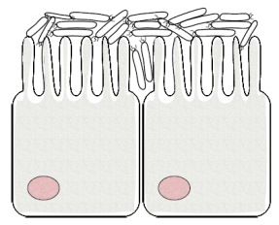
Effect of Probiotic Bacteria on
Stress-Inhibited Intestine
Pathogens
Enterotoxins
Normal microflora
Restored microflora
1
2
3
Intestinal epithelial cells
Healthy intestine (1):
Stress effects (2):
Effect of probiotic (3):
physical barrier to hinder invasion of pathogens
immune system development
activation of immune and inflammatory response
depression of mucosal barrier function
immune system depression
reduction of the bacteria of the normal microflora
restoration of normal microflora and mucosal barrier function
activation of immune system

Slide 11
Types of Stressors
Physical
Psychological
Chemical

Slide 12
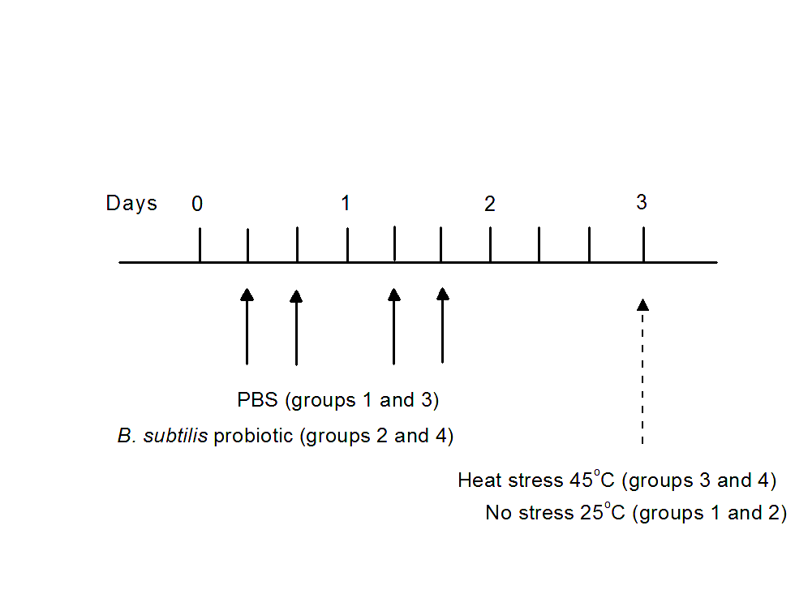
Experimental Design

Slide 13
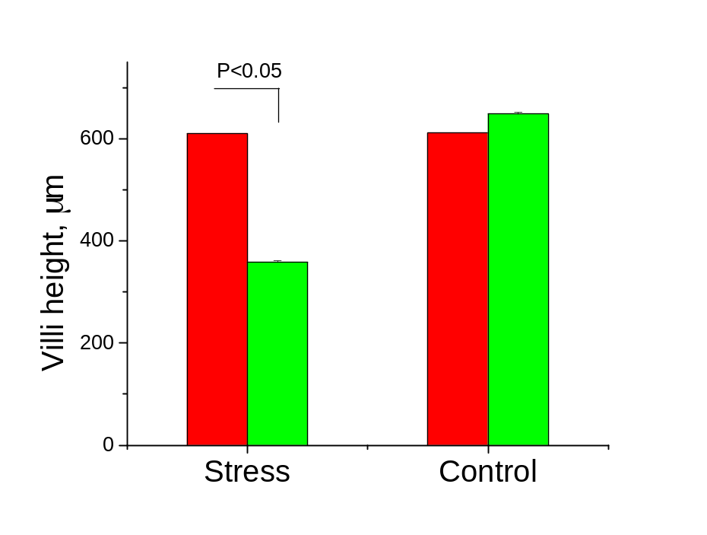
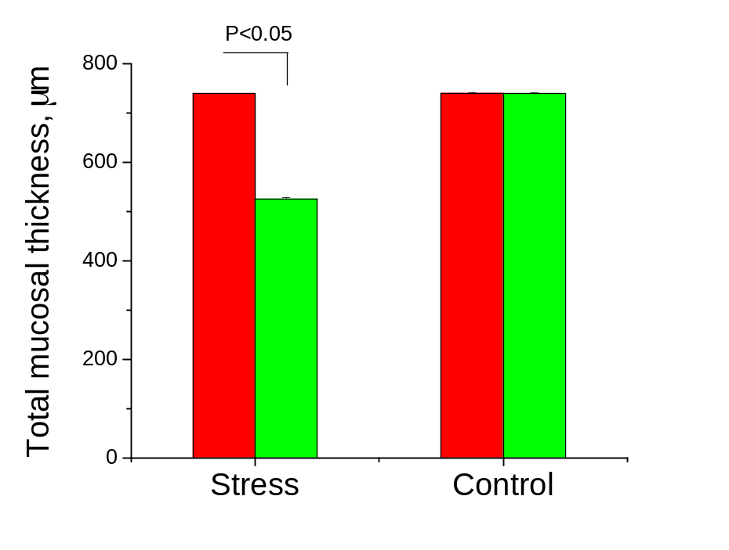
Protective Effect of Bacillus subtilis Probiotic on Gut Epithelial Cells
Probiotic
PBS

Slide 14
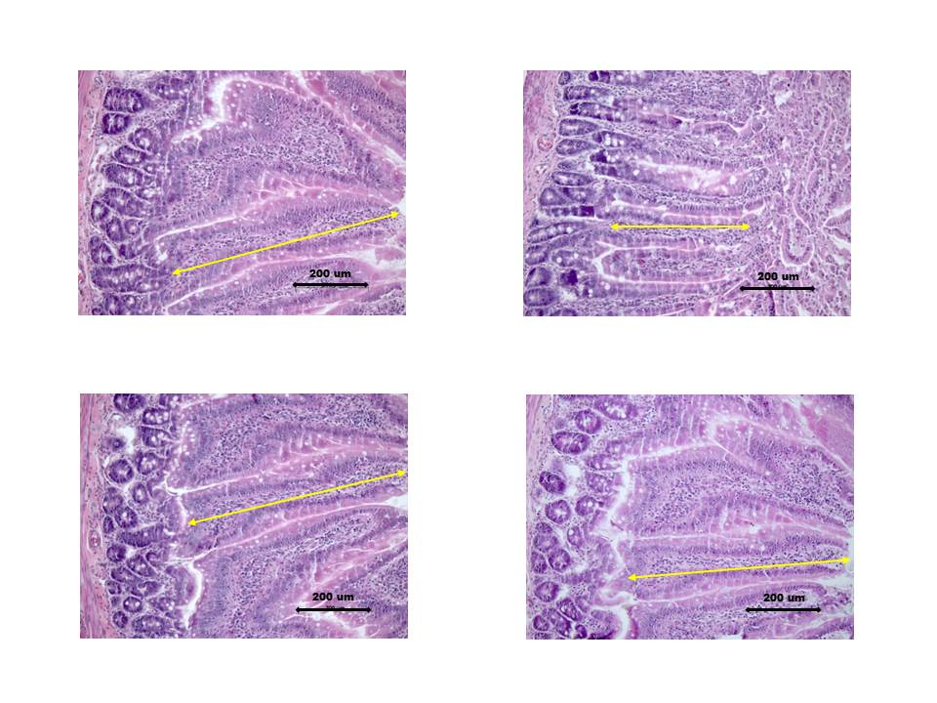
Histological images of intestinal mucosa
PBS/25ºC
PBS/45ºC
Probiotic/25ºC
Probiotic/45ºC

Slide 15
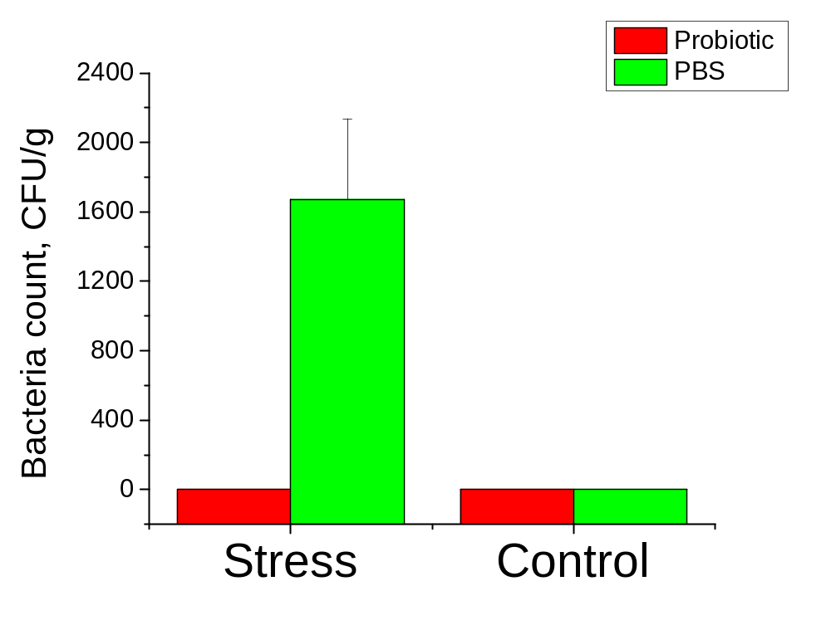
Prevention of Bacterial Translocation by Probiotic

Slide 16
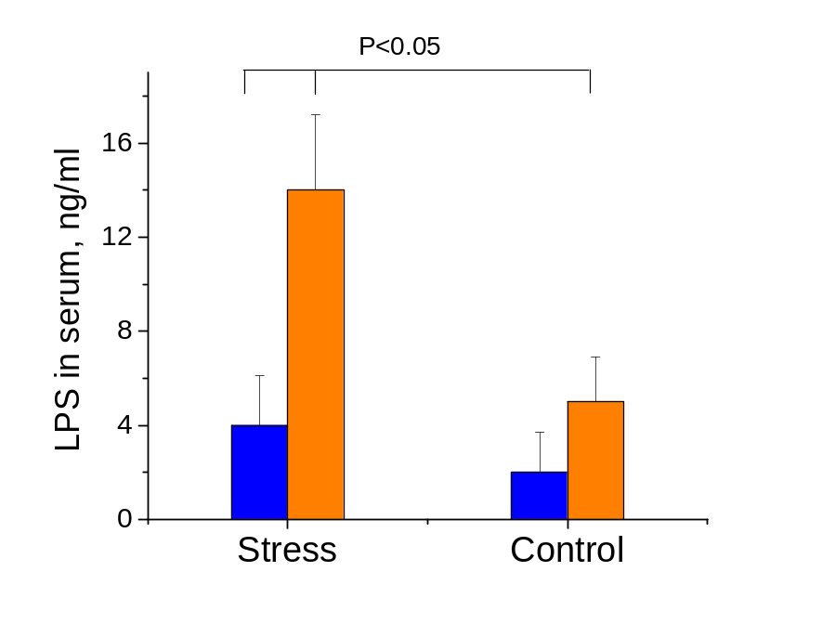
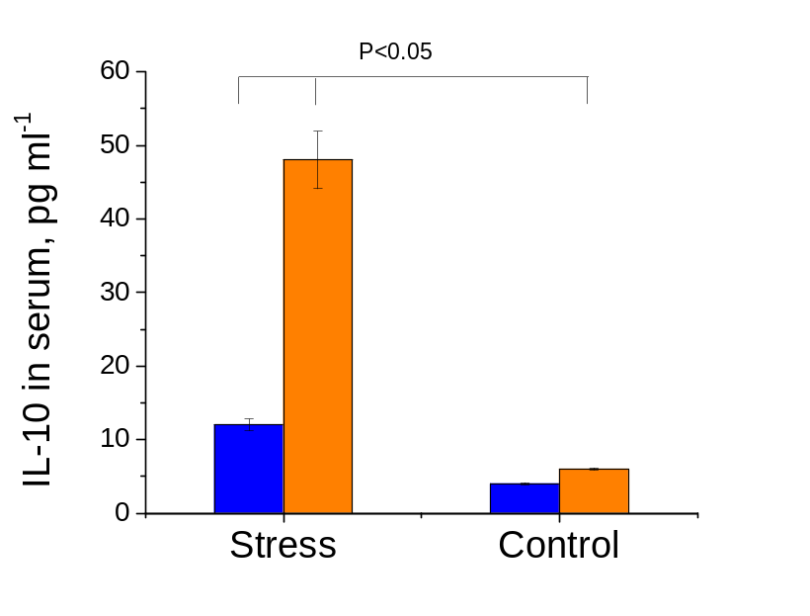
Protective Effect of Probiotic
Probiotic
PBS

Slide 17
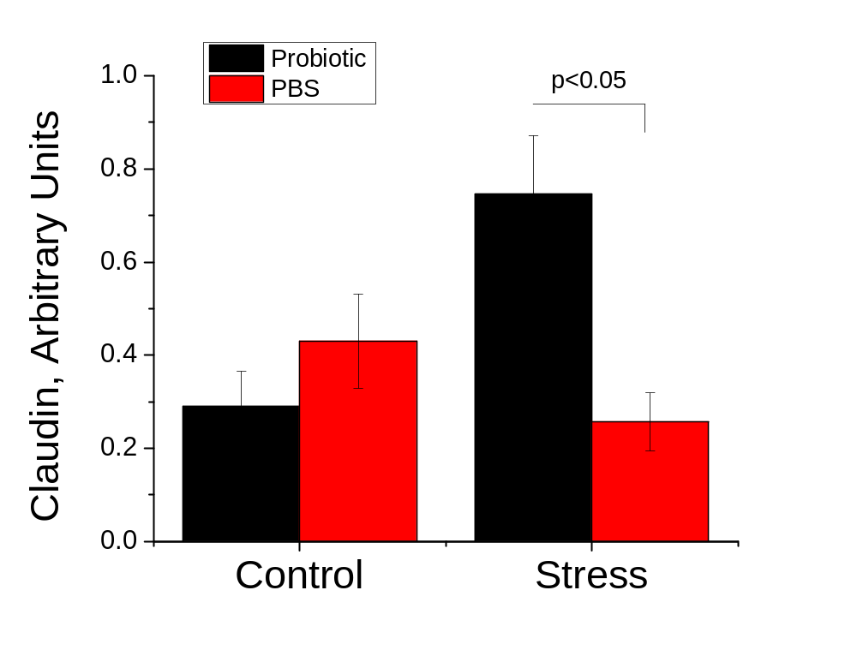
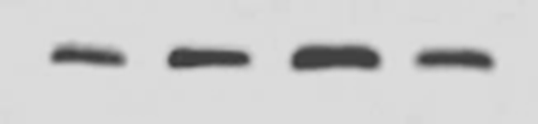
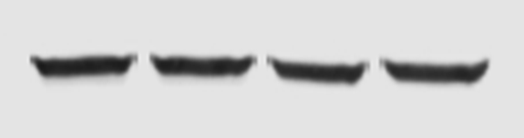
Beneficial Effect of Bacillus Probiotic on Intestinal Tight Junction
Claudin
Actin

Slide 18
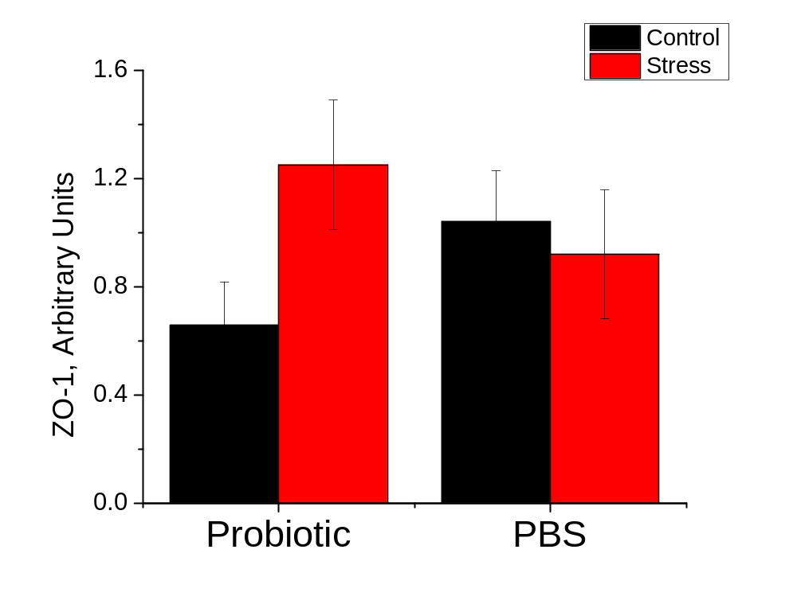

Beneficial Effect of Bacillus Probiotic on Intestinal Tight Junction
ZO-1
Actin

Slide 19
Mechanism of Action
Bacillus subtilis
Normalized
intestinal
microbiota
composition
Metabolic effects
Immunomodulation
Antibiotics,
biosurfactants
production
Quorum-sensing
peptides production
Balanced
immune
response
Protection of intestinal cells
against tissue damage and
loss of barrier function
Colonisation
resistance
Antiallergic effects
Strengthened
innate immunity
Control of stress-induced adverse
effects in the gut

Slide 20
Conclusion
Bacillus subtilis probiotic prevents heat stress- related complications:
changes in morphology of intestinal cells
translocation of bacteria into lymph nodes and liver
elevation of LPS level in serum
changes of serum cytokines composition
changes of TJ proteins composition
Upregulation of TJ proteins with probiotic in rats exposed to heat stress is one of the mechanisms of animal protection against stress-related adverse effects.

Slide 22
Probiotics:
“Live microorganisms which when administered in adequate amounts confer a health benefit on the host”
Joint FAO/WHO Expert Consultation, October 2001
http://www.who.int/foodsafety/publications/fs_management/en/probiotics.pdf
Notes:
22

Slide 23
Probiotic Microorganisms
Bifidobacterium breve
B.bifidum
B. adolescentis
B.infantis
B.lactis
B.longum
B. thermophilum
Lactobacillus acidophilus
L.delbrueckii subs.bulgaricus
L.casei
L.johnsonii
L. reuteri
L. crispatus
L. fermentum
L. Gasseri
L. brevis
L.plantarum
L. ramnosus
L. salivarius
Lactococcus lactis
Enterococcus faecium
Streptococcus salivarius
Pediococcus acidilactici
Bacillus cereus
B. clausii
B.coagulans
B. subtilis
B. licheniformis
Escherishia coli
Propionibacterium shermanii
Saccharomyces cerevisiae
S. boulardii

Slide 24
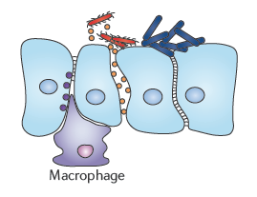
Modulation of tight junctions
Pathogen
Upregulation of tight junction proteins (occludin, claudin, and junctional adhesion protein) might help to limit the damage that is caused to epithelia by inflammatory processes or pathogens.
The probiotic-coated surface retains an intact junction.
Probiotic

Slide 25
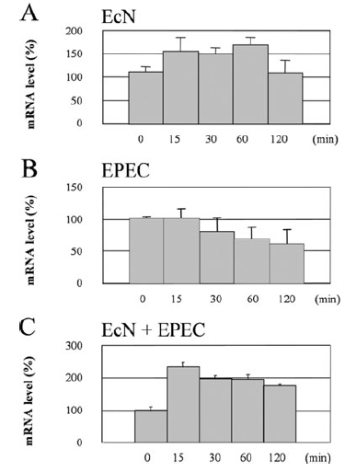
Beneficial Effect of Probiotic on Intestinal Tight Junction
Effect of probiotic bacteria Escherichia coli Nissle 1917 on changes in ZO-2 mRNA of T84 epithelial cell after infection with enteropathogenic E.coli (EPEC)
Zyrek，2006
ZO-2

Slide 26
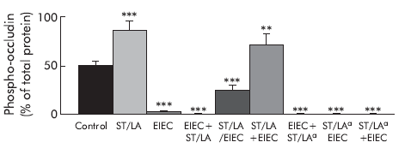
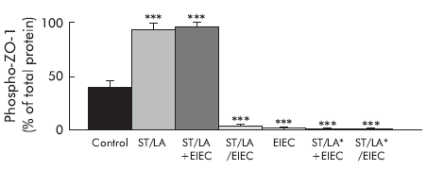
Beneficial Effect of Probiotic on Intestinal Tight Junction
ST/LA - Streptococcus thermophilus and Lactobacillus acidophilus
EIEC - enteroinvasive Escherichia coli
Resta-Lenert, 2003

Slide 27
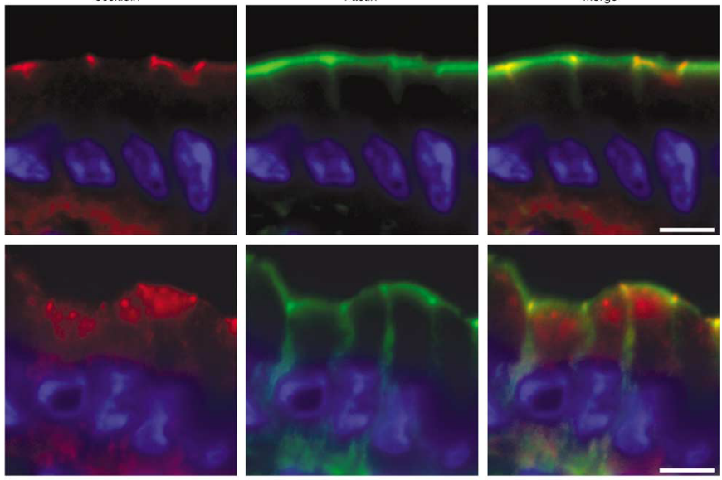
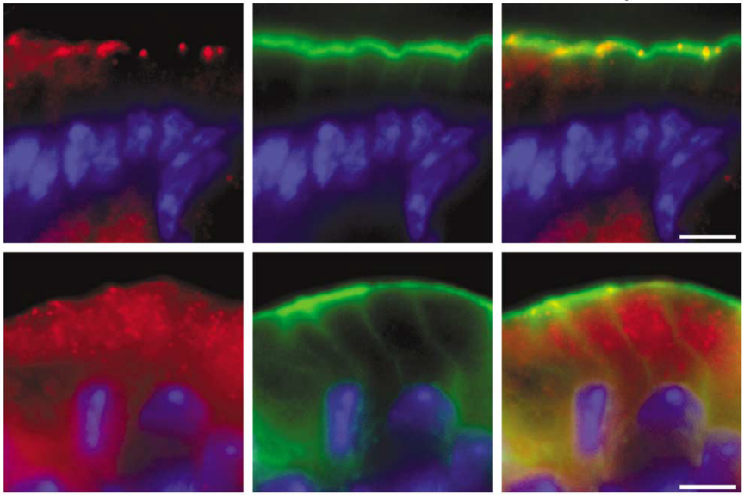
Occludin distribution after infection with enteropathogenic E. coli (EPEC)
Occludin Actin Merge
Occludin Actin Merge
Control
EPEC
a
b
Ileal (a) and colonic (b) epithelium
Shifflett, 2005

Slide 28
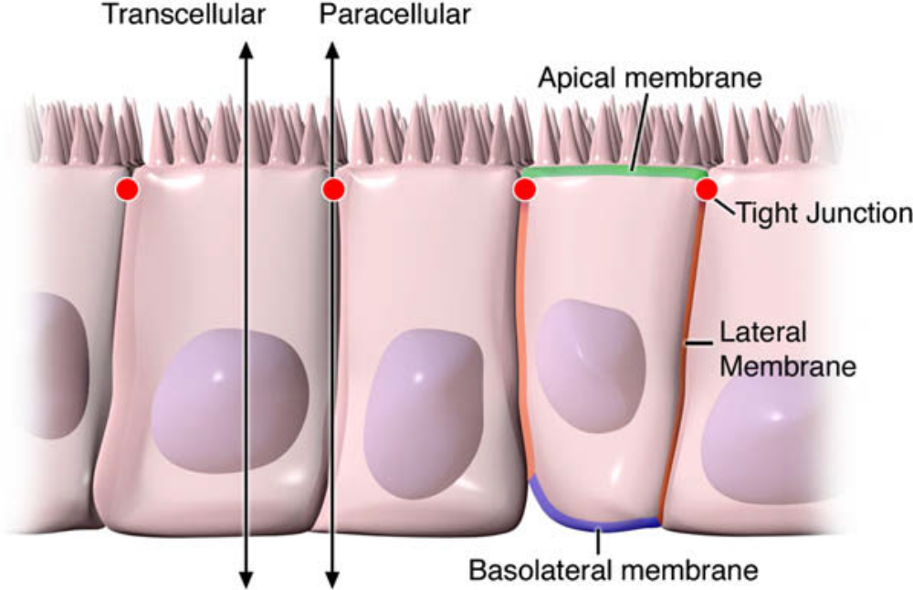
Pathways of epithelial permeability. Transcellular permeability is associated with solute or water movement through intestinal epithelial cells. Paracellular permeability is associated with movement in the intercellular space between epithelial cells and is regulated by TJs localized at the junction of the apical-lateral membranes.
Groschwitz and Hogan, 2009

Slide 29
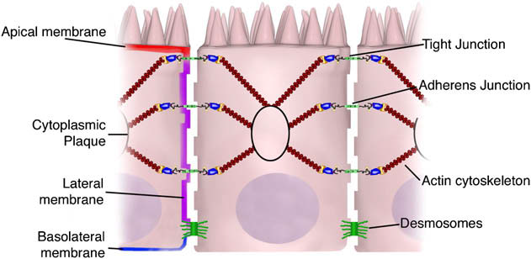
Overview of intestinal epithelial junctional complexes. The intestinal epithelium consists of a single layer of polarized epithelial cells. Adjacent cells are connected by 3 main junctional complexes: desmosomes, AJs,
and TJs. Desmosomes are localized dense plaques that are connected to keratin filaments. AJs and TJs both consist of transcellular proteins connected intracellularly through adaptor proteins to the actin cytoskeleton.
The collection of proteins in the junctional complexes forms cytoplasmic plaques.
Groschwitz and Hogan, 2009

Slide 30
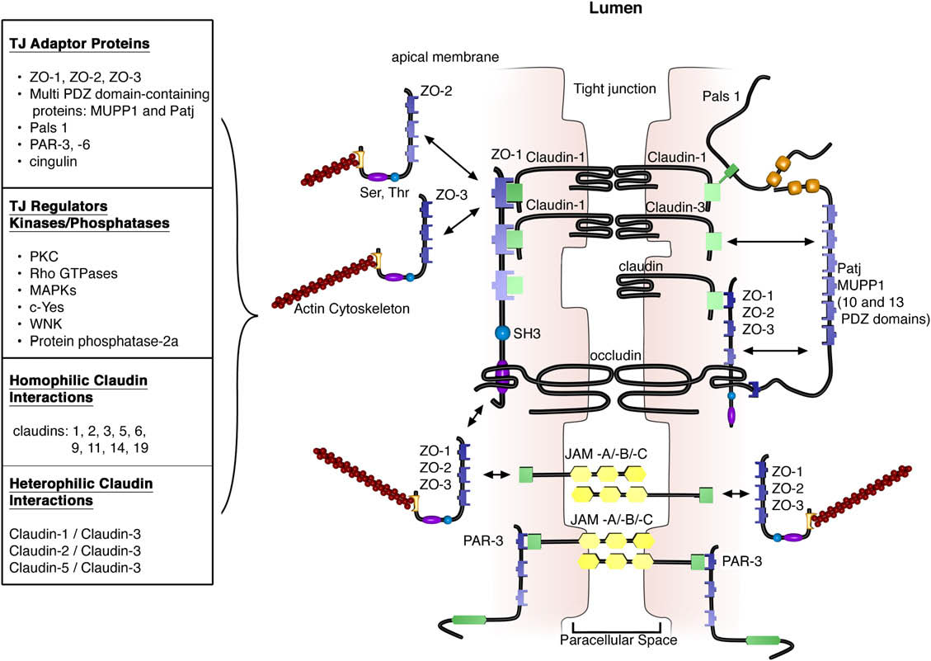
Groschwitz and Hogan, 2009
TJs are localized to the apical-lateral membrane junction. They consist of integral transmembrane proteins (occludin, claudins, and JAMs) that interact in the paracellular space with proteins on adjacent cells. Interactions can be homophilic (eg, claudin-1/claudin-1) or heterophilic (eg, claudin-1/claudin-3). The intracellular domains of transmembrane proteins interact with PDZ domain–containing adaptor proteins that mechanically link the TJ complex to the actin cytoskeleton. TJ proteins are regulated by means of phosphorylation by kinases, phosphatases, and other signaling molecules

Slide 31
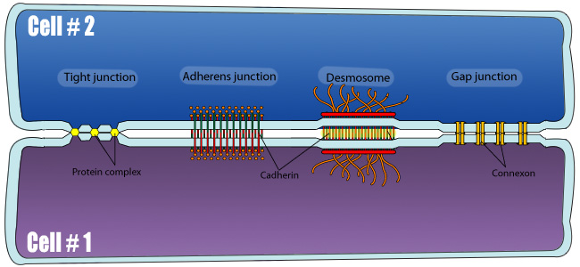
http://www.dbriers.com/tutorials/2012/12/junctions-between-cells-simplified/

Slide 32
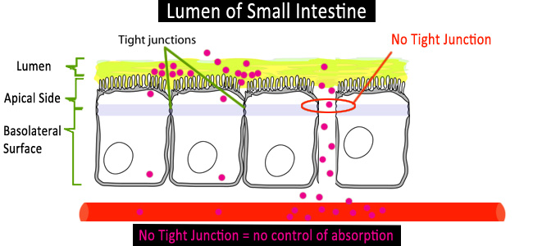
http://www.dbriers.com/tutorials/2012/12/junctions-between-cells-simplified/

Slide 33
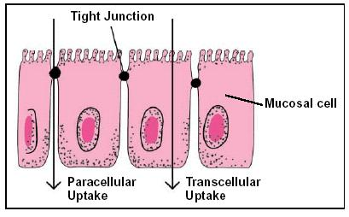
http://allnaturaladvantage.com.au/how_gastrointestinal_health_affe.htm

Slide 34
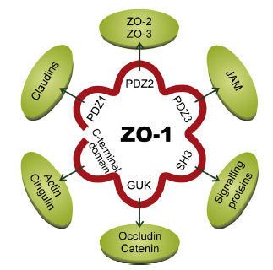
Schematic diagram of interactions of ZO-1 (zonula occludens-1)with transmembrane,
cytosolic and cytoskeletal proteins. JAM, junctional adhesion molecule; PDZ, Post synaptic
density 95, Disc large and ZO-1 domain; SH3, Src homology domain; GUK, guanylate kinase
domain.
Kosinska, 2013

Slide 35
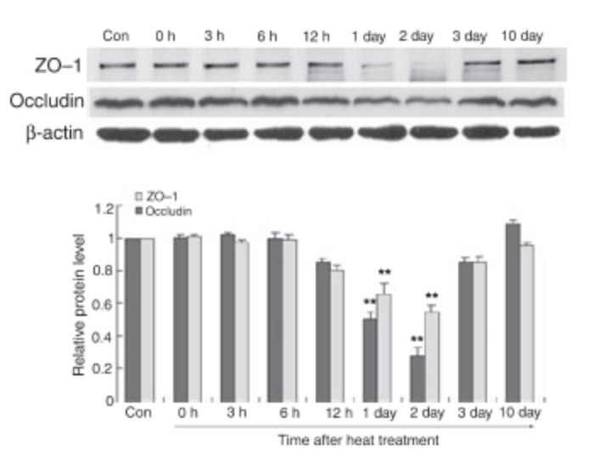
Cai, 2010

Slide 36
Acknowledgement
Dr. Vitaly Vodyanoy
Dr. Benson Akingbemi
Mrs. Ludmila Globa
Mr. Oleg Pustovyy

Slide 38
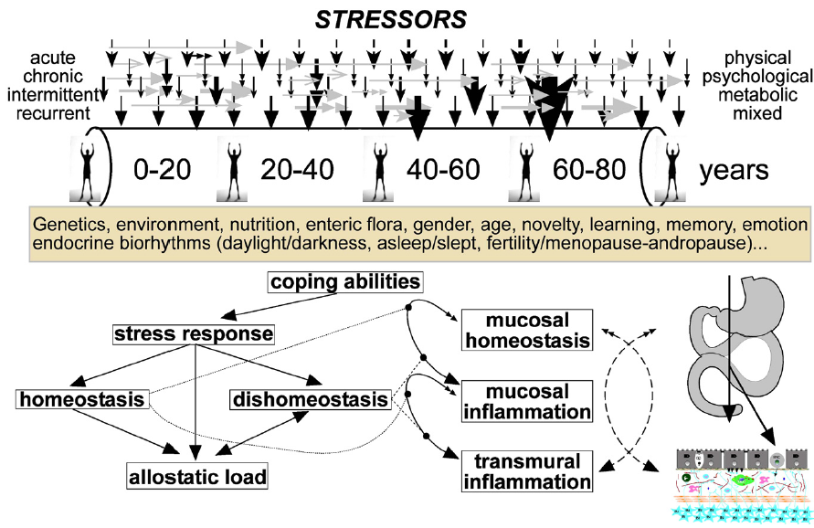
Santos, 2008

Slide 39
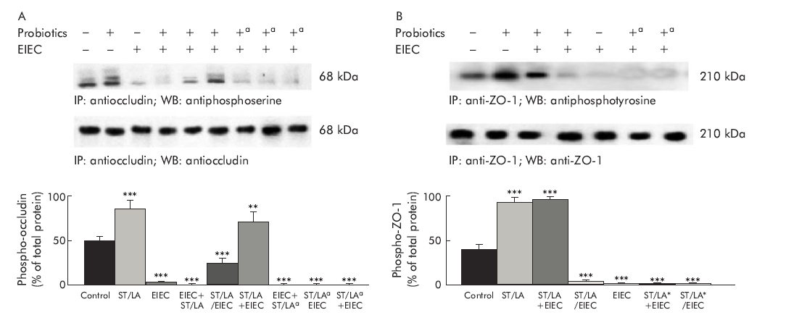
Live probiotics protect intestinal epithelial cells from the effects of infection with enteroinvasive Escherichia coli (EIEC)
Infection with EIEC alters phosphorylation of the tight junction proteins occludin and ZO-1.
Streptococcus thermophilus and Lactobacillus acidophilus (ST/LA) living and antibiotic killed (a) were tested
Resta-Lenert, 2003
Notes:
Cells were harvested at 12 hours after infection. Whole cell lysates were immunoprecipitated with specific antibodies against occludin (A) or ZO-1 (B), then blotted with the same antibody or with an antiphosphoserine (A) or antiphosphotyrosine (B) antibody. The upper panels are representative blots whereas the lower panels show means (SEM) for densitometric analyses, n=6. **p<0.01; ***p<0.001 compared with uninfected controls (by ANOVA).
Streptococcus thermophilus and Lactobacillus acidophilus separately increase basal TER in Caco-2 cells. Further, the combination of two probiotics attenuates the barrier disruption induced by enteroinvasive E. coli in intestinal HT29/cl.19A cells [226]. The promotion and maintenance of phosphorylation in ZO-1 and occludin seem to be involved in the protective effects of the combined probiotics, although they did not alter TJ protein expression

Slide 40
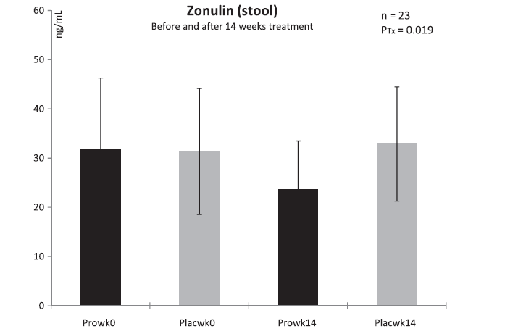
Zonulin is regarded as a phyiological modulator of intercellular tight junctions and a surrogate marker of impaired gut barrier.
Increased zonulin concentrations are related to changes in tight junction competency and increased GI permeability
Stool concentrations of zonulin in trained men before and after 14 weeks of treatment. Pro with probiotics supplemented group, Plac placebo group, Tx treatment, wk week; n = 11 (probiotic supplementation), n = 12 (placebo). Values are means ± SD. There was a
signficant difference between groups after 14 wk of treatment: PTx < 0.05.
Lamprecht, 2012

Slide 41
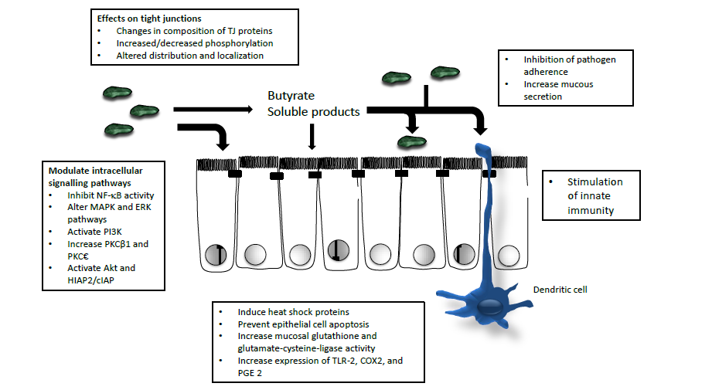
An overview of mechanisms involved in probiotic-induced enhancement of epithelial barrier function. These include direct modulation of epithelial cell signaling pathways and tight junctions, as well as effects on microbial ecology and innate and adaptive immune function
Madsen, 2012

Slide 42
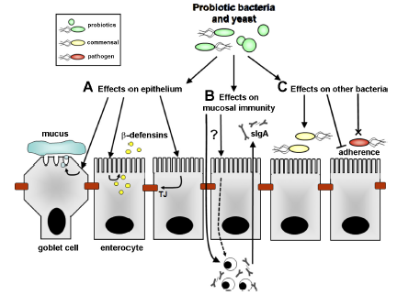
Ohland,2010

Slide 43
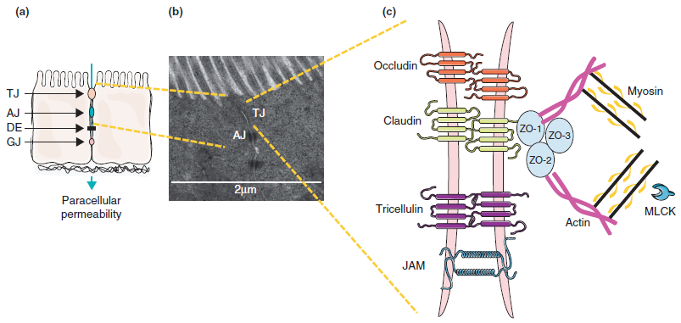
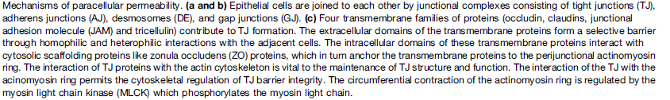
Barreau, 2014

Slide 44

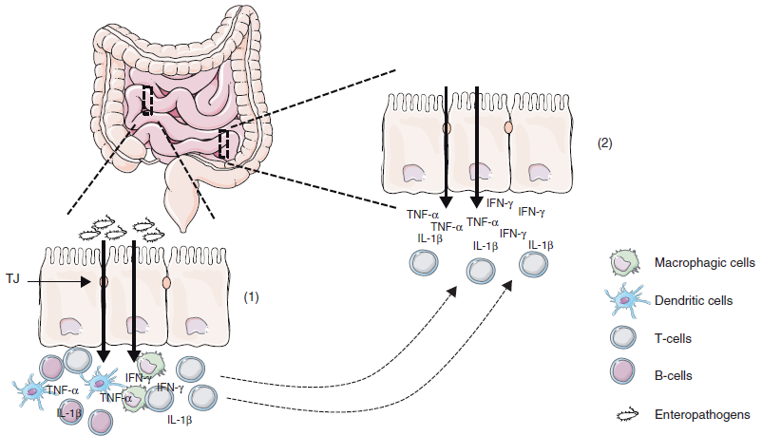
Barreau, 2014

Slide 45
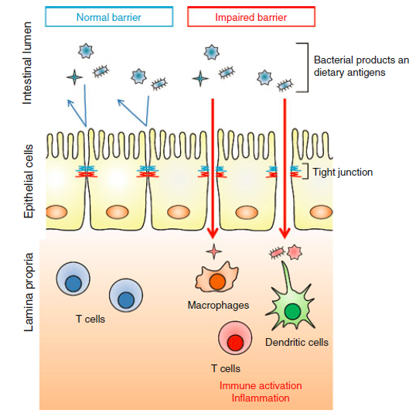
Gastrointestinal selective permeable barrier is achieved by intercellular tight junction (TJ) structures
Disruption of the intestinal TJ barrier, followed by permeation of luminal noxious molecules, induces a perturbation of the mucosal immune system and inflammation, and can act as a trigger for the development of intestinal and systemic diseases.
Suzuki, 2013

Slide 46
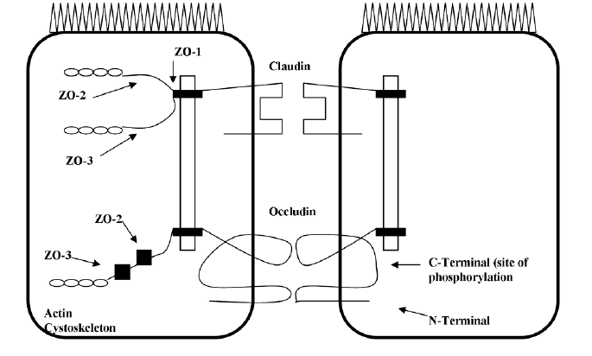
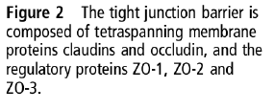
Tight Junction Proteins
Zuhl, 2014

Slide 47
Structure disruption/protection
gene expression alteration

Slide 48
Cytokines
Intestinal TJ regulation by

Slide 49
Intestinal TJ regulation by cytokines
The roles of cytokines in intestinal TJ regulation under pathophysiological conditions have been well investigated using cell cultures and animal models.
The cytokine mediated dysfunction of the TJ barrier, resulting in immune activation and tissue inflammation, is thought to be important in the initiation and/or development of several intestinal and systemic diseases . In contrast, some growth factors play roles in the protection and maintenance of TJ integrity.

Slide 50
Cytokines which increase intestinal TJ permeability
Cytokines | Cell lines | Mechanism
IFN-γ | T84 | Myosin II-dependent vacuolarization, internalization of JAM-A, occludin, claudin-1 and claudin-4 (Bruewer M, et al 2003; Bruewer M, et al.,2005)
TNF-α | Caco-2 | ZO-1↓ [Ma TY, et al., 2004] MLCK ↑, pMLC ↑ [Ma TY, et al.2005; Ye D, et al. 2006]
 | HT29/B6 | Claudin-2 ↑ (Mankertz J, et al. 2009)
TNF-α /IFN-γ | Caco-2 | MLCK ↑, pMLC ↑ (Wang F, et al. 2005; Wang F, et al.2006)
LIGHT /IFN-γ | Caco-2 | MLCK ↑, pMLC ↑, Caveolar endocytosis (occludin, ZO-1 and claudin-1) (Schwarz BT, 2007)
Notes:
Interferon γ
Tumor necrosis factor
Lymphotoxin-like inducible protein
Myosin light chain kinase
Phosphorylation
Claudin- 2

Slide 51
Cytokines which increase intestinal TJ permeability
Cytokines | Cell lines | Mechanism
IL-1β | Caco-2 | Occludin ↓ (Al-Sadi RM, Ma TY, 2007)
 | Caco-2 | MLCK ↑, pMLC ↑ (Al-Sadi R,2008)
IL-4 | T84 | Claudin-2 ↑ (Wisner DM,2008)
IL-6 | Caco-2, T84 | Claudin-2 ↑ (Kusugami K,1995)
IL-13 | T84 | Claudin-2 ↑ (Weber CR,2010)
 | HT29/B6 | Claudin-2 ↑ (Prasad S,2005)
 | Caco-2 | Potentiate oxidant (Rao R,1999)
Notes:
Immunoblot analysis and immunofluorescence microscopy reveal that IL-4 induces pore-forming claudin-2 expression and localization at the TJs. Claudin-2 is characterized as forming pores for cations, but not for macromolecules such as
dextran, suggesting the presence of additional mechanisms.
Interleukin

Slide 52
Cytokines which decrease intestinal TJ permeability
Cytokines | Cell lines | Mechanism
IL-10 | T84 | Decrease Neutralize IFN-c （Madsen KL, 1997）
IL-17 | T84 | Claudin-1 ↑, Claudin-2 ↑ (Kinugasa T, et al., 2000)
TGF-α antibody | Caco-2 | Neutralize hydrogen peroxide (Forsyth CB,2007)
TGF-β | T84 | Claudin-1 ↑ (Howe KL, et al, 2005)
 | HT29 / B6 | Claudin-4 ↑ (Hering NA,et al.,2011)
 | T84 | Neutralize EHEC, restoration of occludin, claudin-2 and ZO-1 expression (Howe KL, et al,2005)
Notes:
one study has demonstrated that this cytokine induces claudin expression. In intestinal T84 cells, IL-17 increases 2 claudin isoforms, claudin-1 and -2, which have opposing effects on TJ integrity: claudin-1 is categorized as a barrier-forming isoform, while claudin-2 forms cation-selective pores. As a consequence of the increases in claudin-1 and -2 induced by IL-17, the cells exhibit increased TER and decreased mannitol (甘露醇) permeability.
EHEC, Enterohemorrhagic Escherichia coli,
TGF---Transforming growth factor
EGF---Epidermal growth factor
the effects of TGF-a on the intestinal barrier are reportedly controversial
TGF-b decreases the paracellular permeability with increased claudin-4 expression.

Slide 53
Cytokines which decrease intestinal TJ permeability
Cytokines | Cell lines | Mechanism
TGF-β | T84 | Neutralize IFN-γ
 | T84 | Neutralize cryptosporidium parvum (Roche JK, et al.,2000)
EGF | Caco-2 | Neutralize hydrogen peroxide, restoration of occludin and ZO-1 distribution (Basuroy S, et al, 2006)
 | Caco-2 | Neutralize hydrogen peroxide, restoration of actin cytoskeleton assembly (Banan A, et al, 2001; Banan A, et al., 2004]
 | Caco-2 | Neutralize ethanol, restoration of microtubule assembly and oxidation/nitration of tubulin (Banan A, et al, 2007)
 | Caco-2 | Neutralize acetaldehyde, restoration of occludin and ZO-1 distribution (Suzuki T, et al., 2008; Samak G, et al. 2011)
Notes:
EGF: Epidermal growth factor
TGF: Transforming growth factor

Slide 54
Intestinal TJ regulation by
food factors

Slide 55
Nutrients and food factors decrease and restore intestinal TJ permeability
Amino acid | Cell | Mechanism ^{b}
Gln | Caco-2 | claudin-1← →
Gln | Caco-2 | Neutralize acetaldehyde, restoration of occludin and ZO-1 distribution
Trp | Caco-2 | Unknown

Slide 56
Nutrients and food factors decrease and restore intestinal TJ permeability
Fatty acid | Cell | Mechanism ^{b}
EPA, DHA, arachidonic acid, γ -LA, di-homo- γ -LA | T84 | Unknown
EPA, DHA, arachidonic acid, di-homo- γ -LA | T84 | Neutralize IL-4
Acetic acid | Caco-2，T84 | Unknown
Propionic acid | Caco-2，T84 | Unknown
Butyric acid | Caco-2 | Promotion of occludin and ZO-1 assembly in Ca-induced TJ reassembly

Slide 57
Nutrients and food factors decrease and restore intestinal TJ permeability
Vitamin | Cell | Mechanism ^{b}
Vitamin A | Caco2 | Neutralize Clostridium difficile toxin A (Maciel AA,2007)
Vitamin D | SW480, not determined permeability | ZO1 ↑, claudin-1 ↑, claudin-2 ↑, E-cadherin ↑ (Kong J,et al,2008)
 | Caco-2 | Neutralize DSS (Kong J,et al,2008)

Slide 58
Nutrients and food factors decrease and restore intestinal TJ permeability
Polyphenol | Cell | Mechanism ^{b}
Genistein | Caco2 | Neutralize hydrogen peroxide, occludin ← →, ZO-1 ← → (Rao RK,2002)
 | Caco2 | Neutralize acetaldehyde, occludin ← →, ZO-1 ← → (Atkinson KJ,2001)
Curcumin | Caco-2 | Neutralize TNF-a (Ye D,2006)
 | Caco-2 | Neutralize IL-1b (Al-Sadi RM,2007)
EGCG | T84 | Neutralize IFN-c (Watson JL,2004)
Quercetin | Caco-2 | Claudin-4 ↑, ZO-2 ← →, claudin-1 ← →, occludin ← → (Suzuki T, Hara H,2009)
Kaempferol | Caco-2 | ZO-2 ↑, claudin-4 ↑ occluidn ← →, claudin-1 ← →, claudin-3 ← →(Suzuki T,et al 2011)
Myricetin | Caco-2 | Unknown (Suzuki T, Hara H,2009)

