Slide 1



Devising the Progressions and Technologies in the field of Nephrology
Ioannis Griveas, MD, PhD

Slide 2
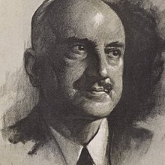
“those who cannot remember the past are condemned to repeat it”
.
George Santayana,
December 16, 1863 – September 26, 1952
philosopher, essayist, poet, and novelist

Slide 3
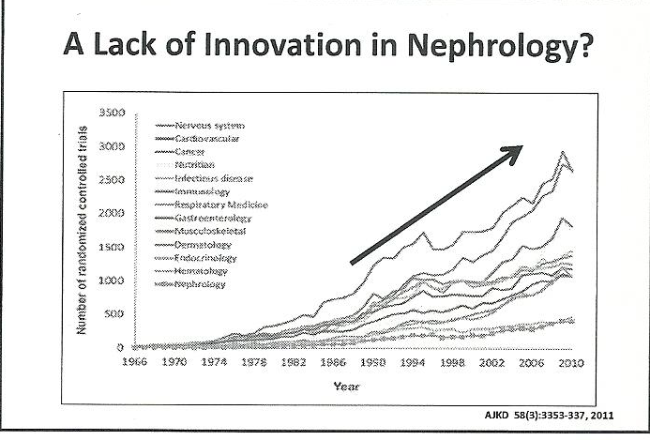
SECTION BREAK
With this in mind, the marketing department would inform the department to create a prototype.

Slide 4
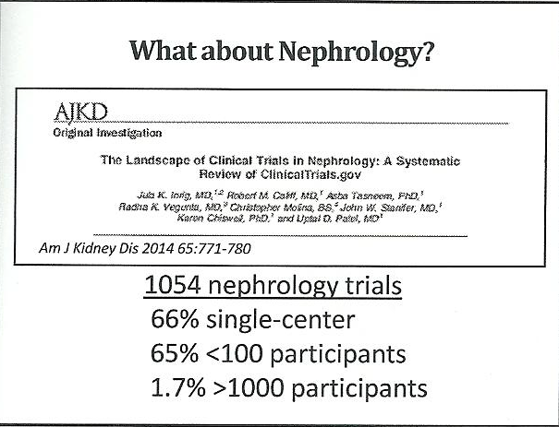
SECTION BREAK
With this in mind, the marketing department would inform the department to create a prototype.

Slide 5
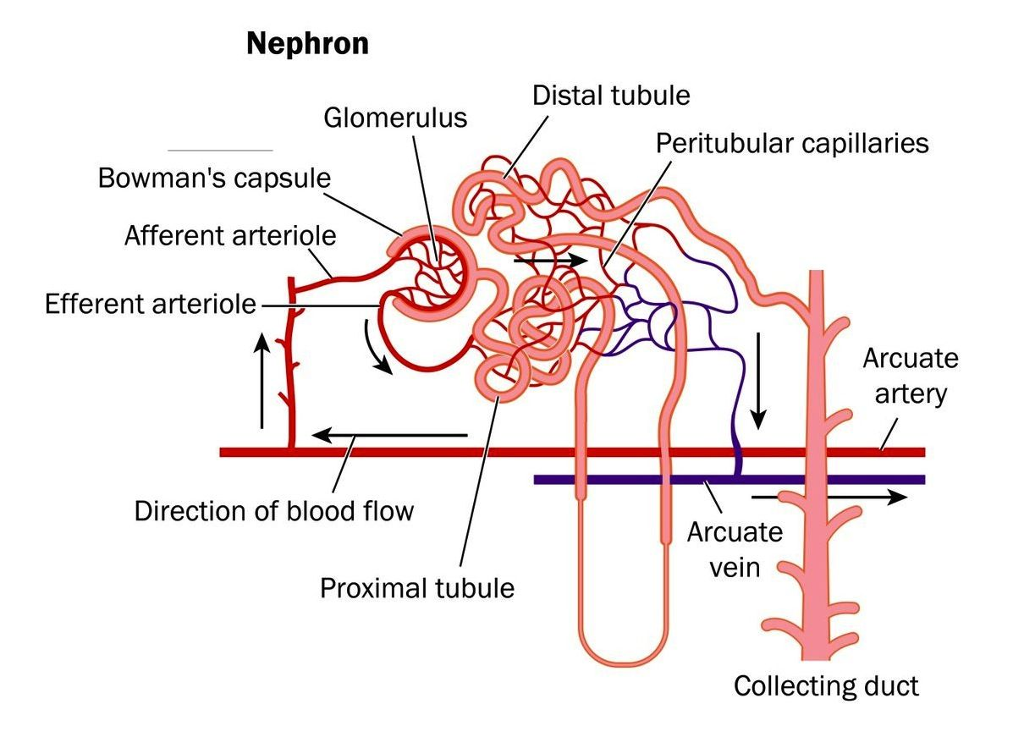
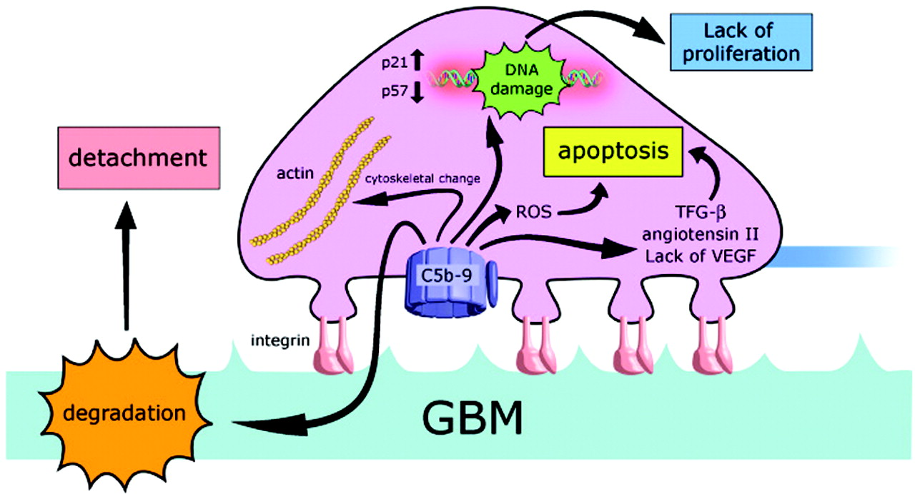
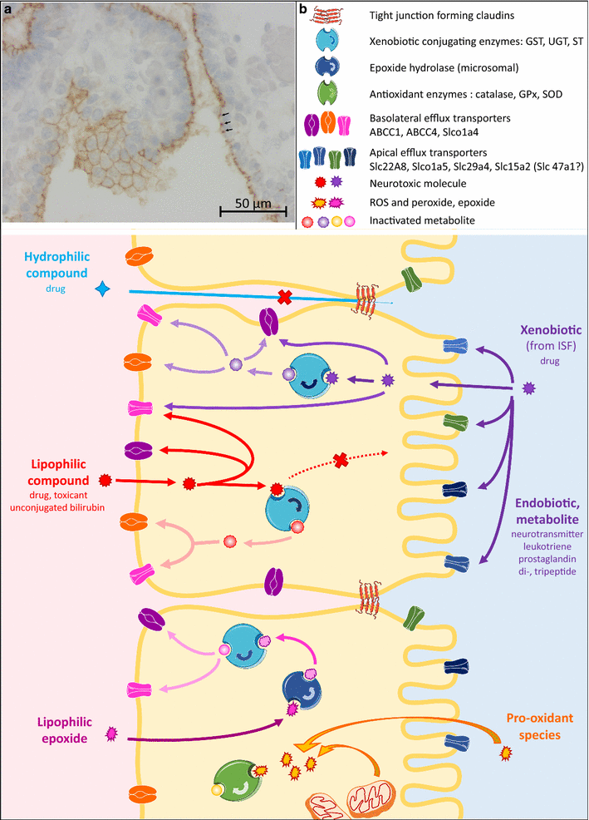
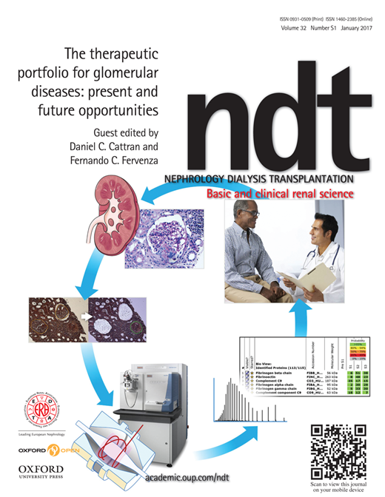
IN
PROJECT ONE
PROJECT THREE

Slide 6
electron microscopy,
immunofluorescence microscopy,
tubule micro-puncture and micro-perfusion,
tissue culture,
the renal biopsy needle,
metabolic balance studies,
imaging,
surgical innovation,
dialysis technology,
genetic analysis and modification,
randomized controlled trials and in-silico research using large data bases

Slide 7
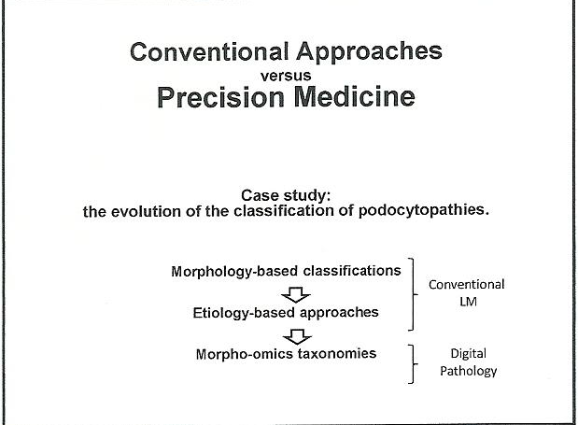

Slide 8
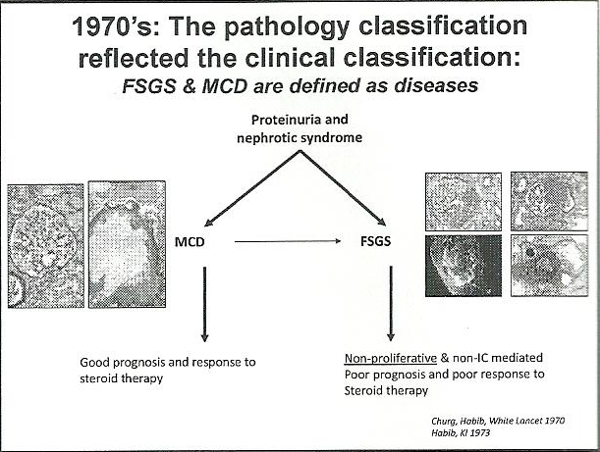

Slide 9
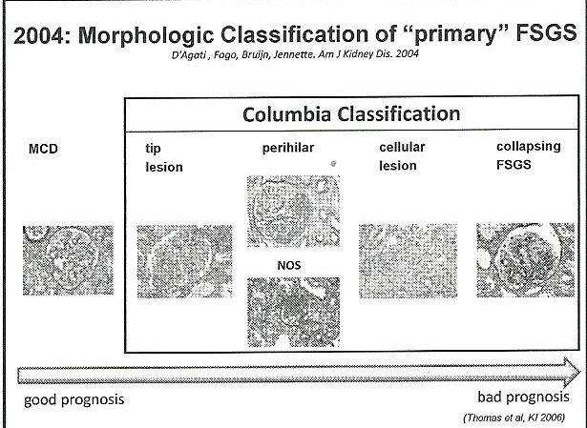

Slide 10
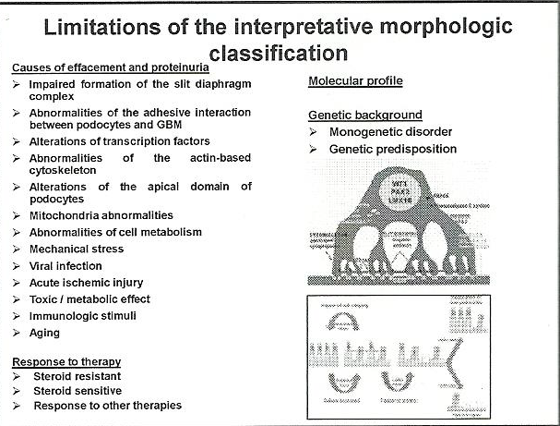

Slide 11
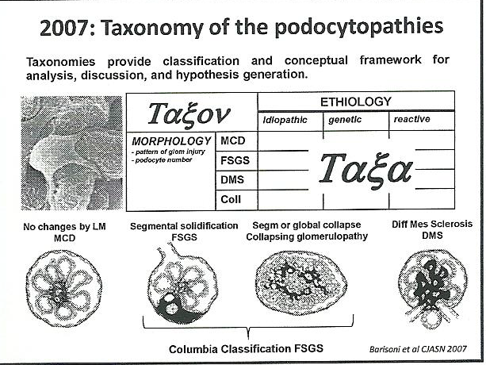

Slide 12
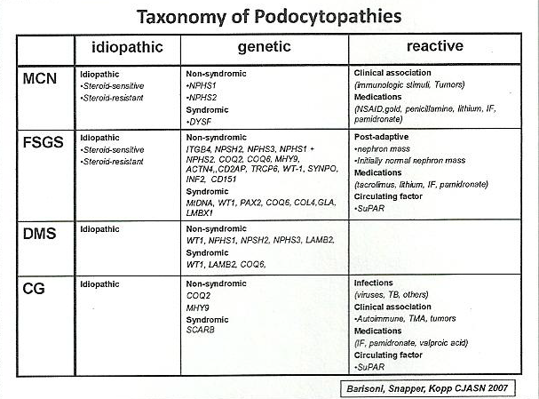

Slide 13
address the current sense of stagnation and angst
methodological discoveries
Clinical Practice
Academia
future

Slide 14
Academic Profile
Creative Research,
Teaching (Training)
Innovative Clinical Care.
CRISPR/ Cas9 technology for editing the genome,
sophisticated imaging,
expansion of computational capacities,
structural biology,
nanotechnology,
in-vitro modeling of human disease r
regenerative medicine
Popularity,
“deeply” phenotyped disorders genomics,
transcriptomics, proteomics and metabolomics-new name for old disease and new diseases identified
Tissue biopsy will evolve to a mechanistic rather than a morphologic interpretation Epidemiological research will broaden in scope
Advances in computational science and bio-informatics
relative lack of inspirational role models

Slide 15
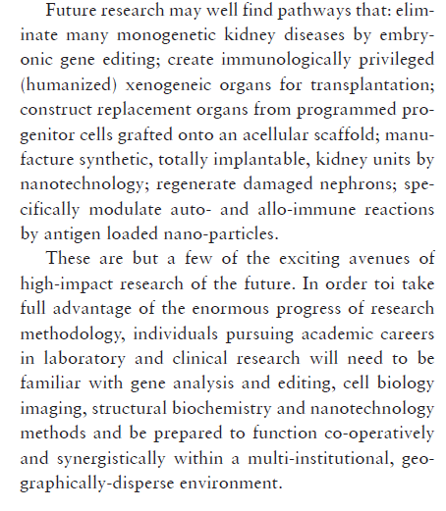



SMALL GROUPS
FUNDS
PRIORITIES
INDIVIDUALS

Slide 16
CLINIcAL PRAcTIcE
Obesity, diabetes, renovascular diseases, glomerulonephrities
greater use of telemedicine,
including internet-based consultations
A dispassionate examination of the potential impact of these changes on Nephrology practice leads to a conclusion that the incidence of newly treated ESRD patients will likely decline, at least in well-developed nations. If the mortality rate among dialysis-treated ESRD stabilizes, then the overall prevalence rate must also decline.

Slide 17
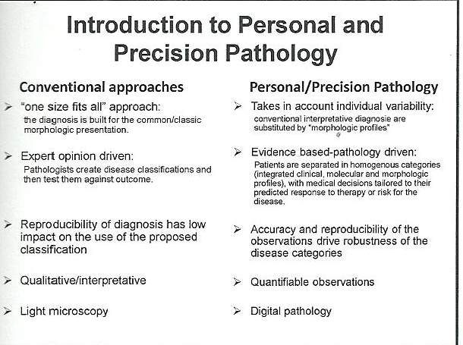
SECTION BREAK
With this in mind, the marketing department would inform the department to create a prototype.

Slide 18
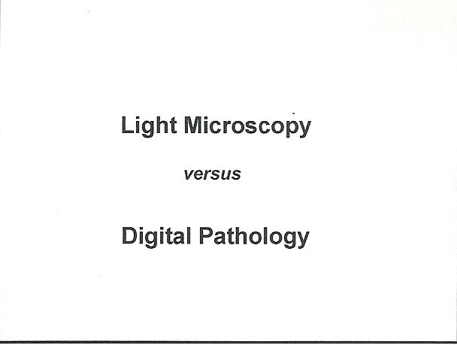
SECTION BREAK
With this in mind, the marketing.

Slide 19
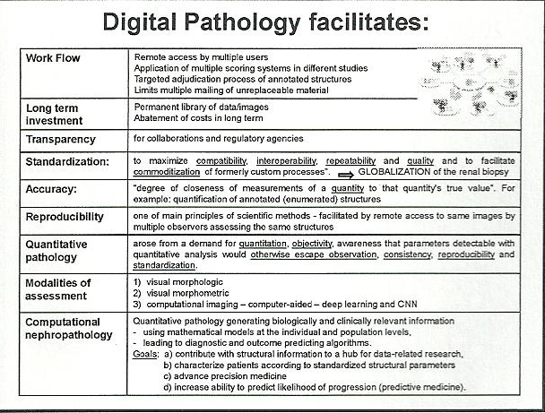
SECTION BREAK
With this in mind, the marketing department would inform the department to create a prototype.

Slide 20
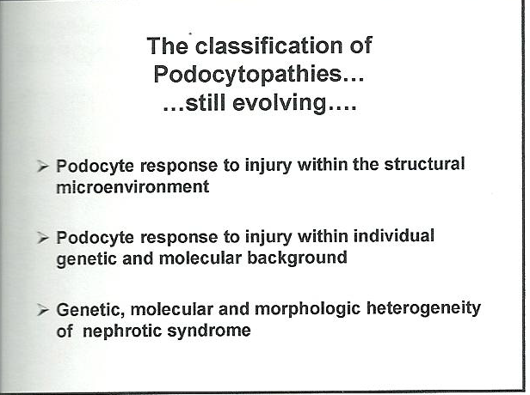
SECTION BREAK
With this in mind, the marketing department would inform the department to create a prototype.

Slide 21
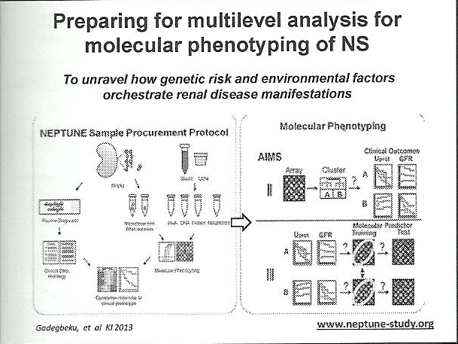
SECTION BREAK
With this in mind, the marketing department would inform the department to create a prototype.

Slide 22
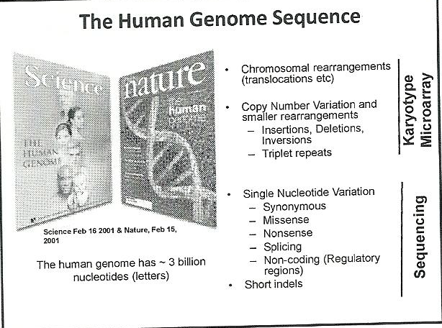
SECTION BREAK
With this in mind, the marketing department would inform the department to create a prototype.

Slide 23
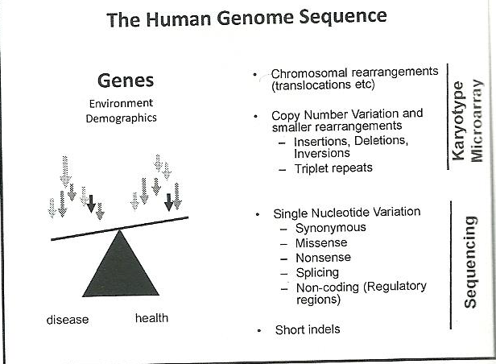
SECTION BREAK
With this in mind, the marketing department would inform the department to create a prototype.

Slide 24
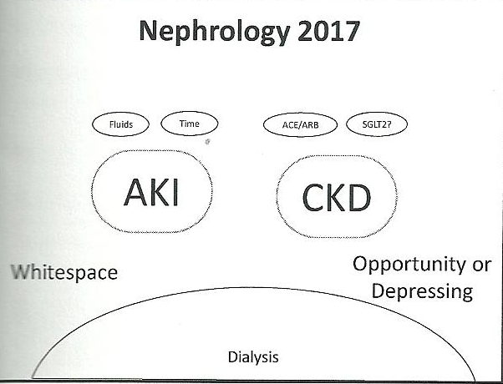
SECTION BREAK
With this in mind, the marketing department would inform the department to create a prototype.

Slide 25
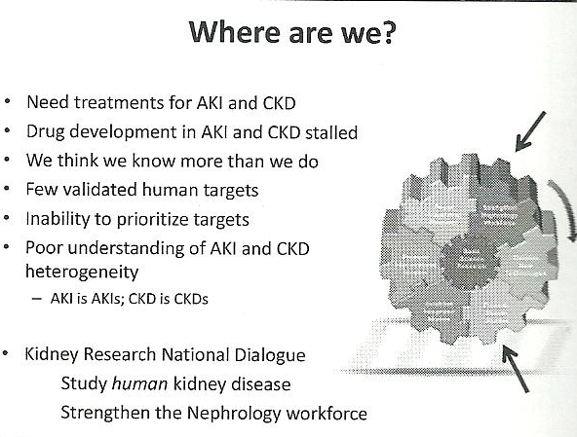
SECTION BREAK
With this in mind, the marketing department would inform the department to create a prototype.

Slide 26
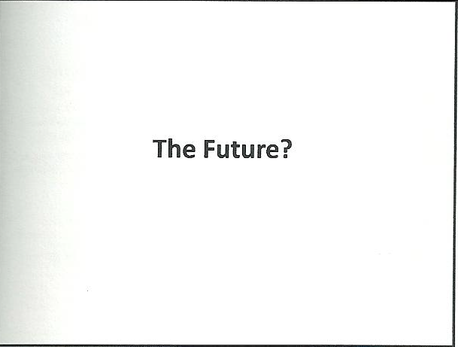

Slide 27
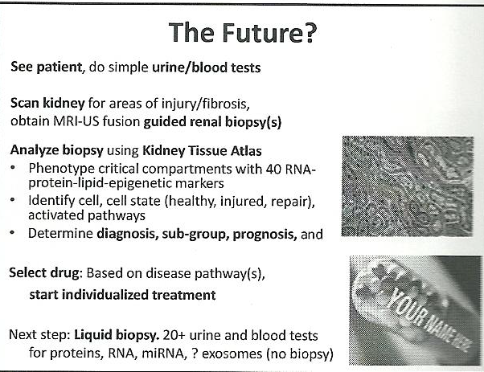
SECTION BREAK
With this in mind, the marketing department would inform the department to create a prototype.

Slide 28
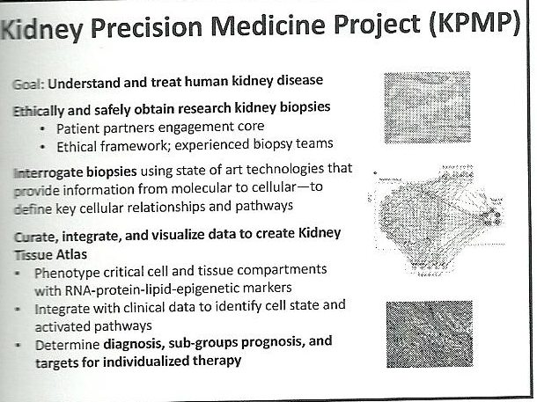
SECTION BREAK
With this in mind, the marketing department would inform the department to create a prototype.

Slide 29

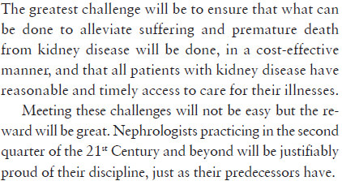

IPAD MOCKUP
Some and harder knocks.

Slide 30
THANK
YOU…

