Slide 1






















































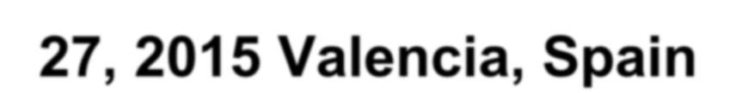

Epicardial adipose tissue in children is associated with an unfavorable cardiometabolic risk profile, but is not a stronger indicator than BMI
Schusterova I., Joppova E., Stromplova D., Fatulova N., Tohatyova A., Leenen, F.*
Department of pediatric and adolescent´s medicine, Medical Faculty, P.J. Safarik University and Children Faculty Hospital, Kosice, Slovakia
* Hypertension Unit, University of Ottawa Heart Institute, Ottawa, Canada
International Conference on Pediatric Cardiology August 25-27, 2015 Valencia, Spain

Slide 2






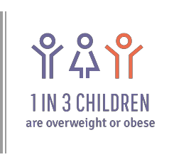

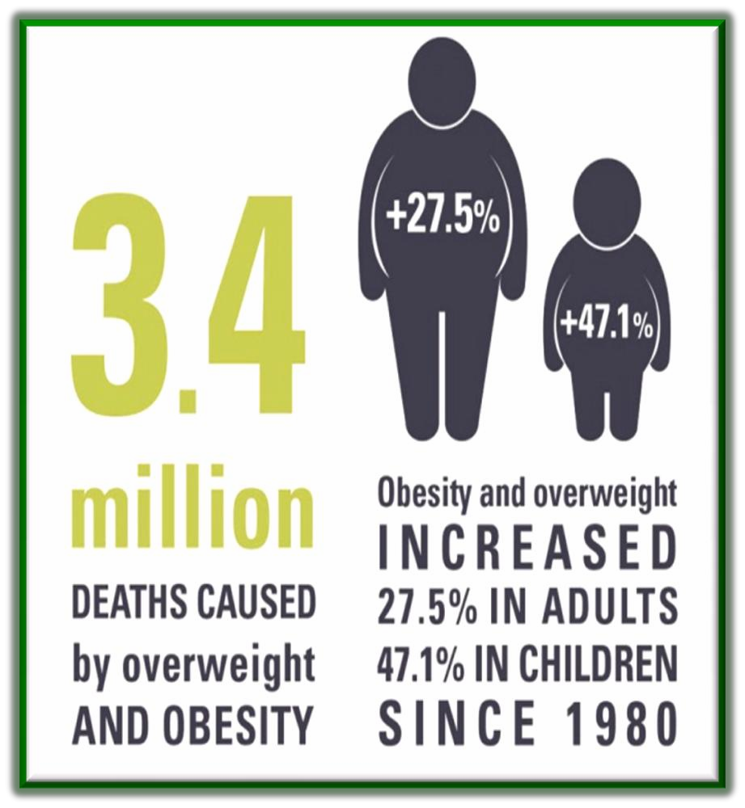

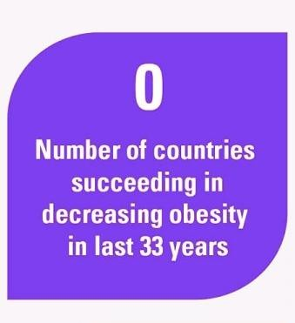


THE GLOBAL OBESITY THREAT

Slide 3




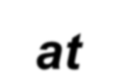







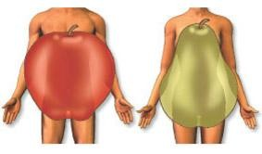

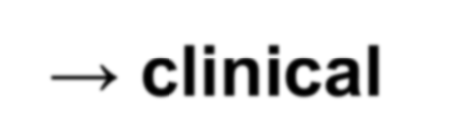







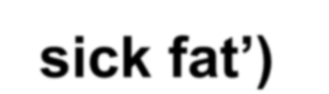
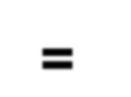
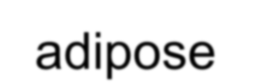


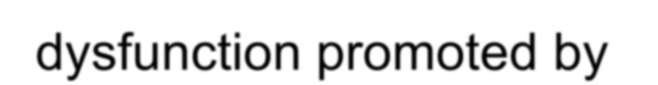






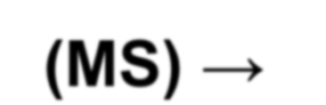








































ANDROID TYPE OF OBESITY
Fat excess primarily in abdominal wall and visceral mesentery
Central obesity → clinical marker for adiposopathy (‘sick fat’) = adipose
tissue dysfunction promoted by
positive caloric balance and sedentary lifestyle in genetically and environmentally susceptible individuals
DG criterion of metabolic syndrome (MS) → cluster of CV RF in association with insulin resistance (IR)
↑ mortality
Poirier P. et al. Arterioscler Thromb Vasc Biol 2006; Fang J. et al. JAMA 2000; Kuk J. L.
et al. Obes Res 2006; Bays, H.; Curr Opin Endocr Diabetes Obes, 2014.

Slide 4


























ASSESSMENT OF OBESITY
„WITH THE
BODY WEIGHT
NAKED EYE“
SUBCTUN. FAT
BMI =BODY MASS INDEX
BMI percentiles
WAIST CIRCU MFERE NCE
ADIPOSE TISSUE

Slide 5











































ASSESSMENT OF OBESITY
BMI = BODY MASS INDEX
= weight (kg)/height² (m²)
BMI
percentiles
- children
WAIST
CIRCUMFERENCE
EPICARDIAL ADIPOSE TISSUE (EAT)
indicator of
intraambdominal
adipose mass
predictor of cardio-metabolic risk
↓ sensitivity and specificity compare to EAT
?

Slide 6













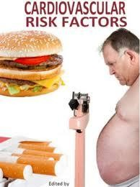



















































EPICARDIAL ADIPOSE TISSUE
Visceral fat deposit located between the heart and the pericardium
Correlation with traditional cardio-metabolic RF
Potential association with CAD and atherosclerosis (subclinical)
DOUBLE ROLE:
Unfavorable: proinflammatory and proatherogenic cytokines (TNF-α, monocyte chemoattractant protein–1,
interleukin-6, rezistin, visfatin, omentin, leptin...)
Protective: antiinflamatory and antiatherogenic adipokines (adiponectin and adrenomedulin)
Iacobellis a Pistilli a spol., 2005; Iacobellis a Barbaro a spol., 2008;
Natale a spol. 2009, Iacobellis a Pellicelli a spol., 2007

Slide 7





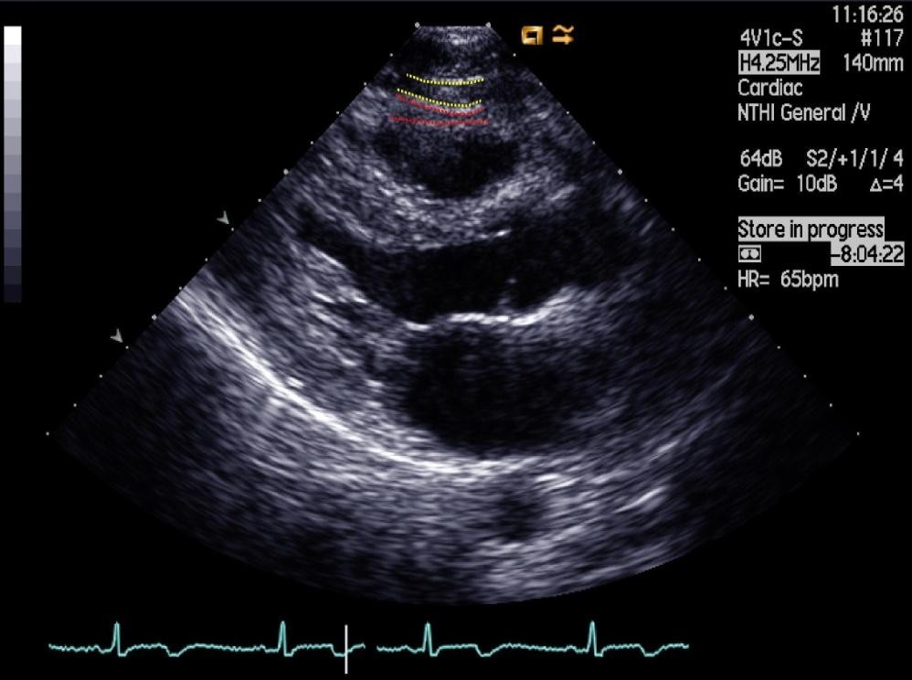
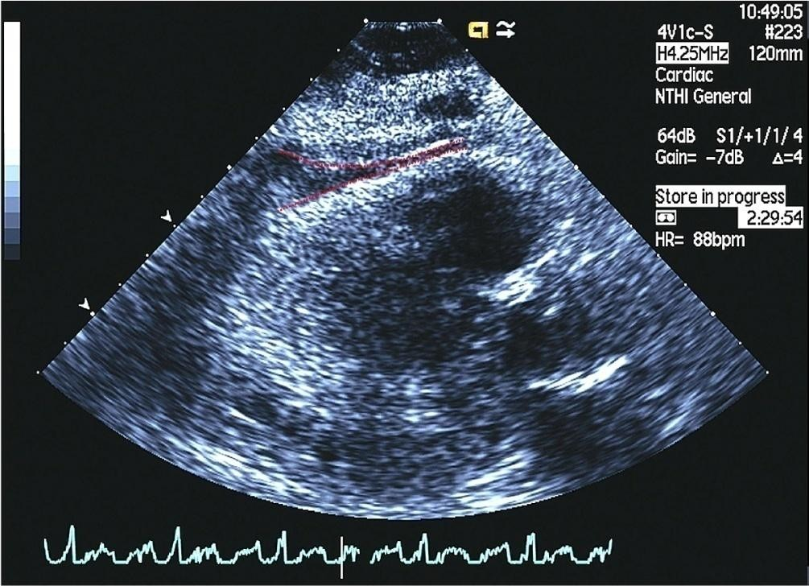




















EAT THICKNESS
Expression of the visceral adipose tissue quantity
Independent predictor of visceral adiposity
Echocardiographic measurement → correlation
with MRI measurement
Iacobellis G et al., Obes Res. 2003;11:304–10. Abaci A,. Et al., Int J Obes. 2009; Schusterova, I. et al., Pediatric Obesity, 2012.

Slide 8



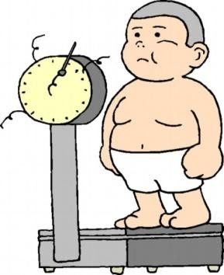







































EAT, WC, BMI
correlations
ADULTS
CHILDREN
EAT
correlates with WC, BUT not with BMI
EAT is ↑ with
↑ WC, BUT not with ↑ BMI
EAT correlates with WC and
with BMI
WC does not
correlate better than BMI with CV RF → BMI and WC
→ similar predictive
value of MS
Iacobellis G., Willens H.J.,Obesity (Silver Spring). 2008; Zimmet P, et al., Pediatr Diabetes.
2007; Iacobellis G., Leonetti F., Clin Cardiol. 2003; Ozdemir O. et al., J Pediatr. 2010

Slide 9
























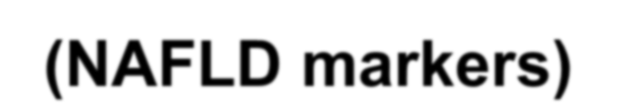

EAT and MS and IR and NAFLD
Adults
Confirmed correlations
Children
Not confirmed yet
EAT with IR
EAT with MS
EAT with AST and
ALT (NAFLD markers)
EAT and MS and IR
Not clarified
enough
EAT and NAFLD
Pellicelli A.M.,Obesity (Silver Spring). 2008; Iacobellis G, Willens H.J., Obesity (Silver Spring). 2008; Fernández J.R. et al., J Pediatr. 2004; Iacobellis G., Leonetti F. J Clin Endocrinol Metab. 2005; Barzin M, et al., Acta Paediatr. 2011; Abaci A,. At al.: Int J
Obes. 2009; Mazur A. et al.: Atherosclerosis. 2010

Slide 10



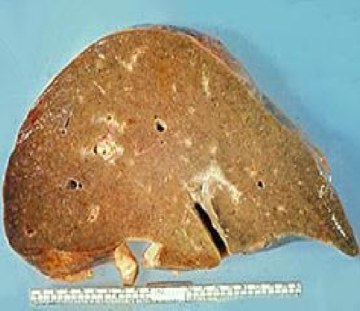

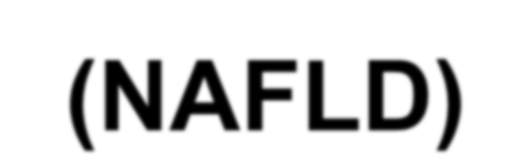





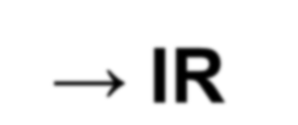

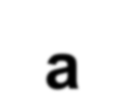




























NONALCOHOLIC FATTY LIVER DISEASE (NAFLD)
Fat accumulation in the liver
Associated with obesity
Hepatocytes damage and destruction → IR
a ↑ production of proinflammatory cytokines, oxidative stress and mitochondrial dysfunction
↑ mortality of patients with NAFLD compare
to other population
Barzin M. et al. : Acta Paediatr. 2011; Schmidt M. D. et al.: Int J Obes (Lond). 2011 ; Iacobellis G. et al.: J Am Soc Echocardiogr. 2009; Iacobellis G. Nat Rev Endocrinol. 2015

Slide 11


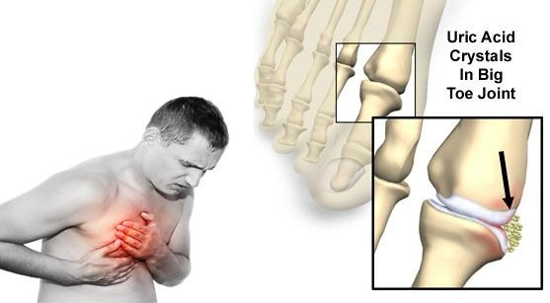


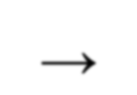











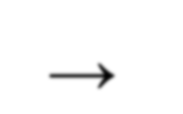


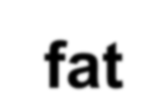


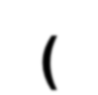














































URIC ACID (UA)
UA independent CV RF → NHANES I study (National
Health and Nutrition Survey)
UA → negatively affect the development and progression of CVD by stimulating inflammatory responses
Framingham Heart Study → CV risk ↑ with ↑ UA in
asymptomatic adults in all age
Hyperuricemia → related to body fat accumulation (confirmed correlation between UA and visceral adiposity in adults)
Zimmet P. et al.: Lancet. 2007; Fu J. F. et al.: World J Gastroen­terol. 2011; Fang J. et al. The NHANES I epidemiologic follow-up study, JAMA. 2000; Culleton B.F., et al.: The Framingham Heart Study. Ann Intern Med. 1999, Borghi, C. et al., Expert Rev Cardiovasc Ther. 2014

Slide 12


OUR STUDY

Slide 13









AIM OF OUR STUDY
Echocardiographic assessment of EAT thickness and its association with cardio-metabolic risk factors in overweight and obese children

Slide 14








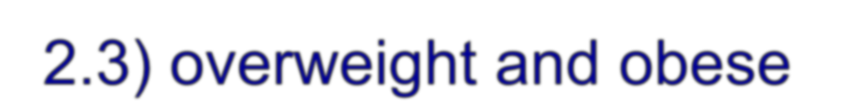


STUDY GROUPS AND METHODS
In 25 (mean age 13.0 ±2.3) overweight and obese subjects and 24 lean controls, blood pressure (BP), waist circumference (WC), fasting plasma glucose and insulin, lipids, uric acid (UA), and hepatic enzymes were measured. EAT thickness was measured by transthoracic echocardiography

Slide 15
RESULTS

Slide 16













The anthropometric and clinical characteristics of the study and control group
Variables | Overweight and obese | Normal body weight | p-value
Body weight (kg) | 72.3 ± 19.6 | 50.5 ± 14.3 | p < 0.01
BMI (kg/m²) | 27.4 ± 3.5 | 18.8 ± 3.1 | p < 0.01
BMI percentile | 94.3 ± 3.5 | 36.2 ± 2.83 | p < 0.01
BMI Z-score | -0.38 ±1.014 | 2.09 ± 0.51 | p < 0.01
Systolic BP (mmHg) | 133.4 ± 16.4 | 120.3 ± 17.4 | p < 0.05
Diastolic BP (mmHg) | 80.3 ± 11.5 | 69.7 ± 7.4 | p < 0.01
Waist circumference (cm) | 95.5 ± 12.6 | 73.1 ± 8.8 | p < 0.01
Schusterova, I. et al., Pediatric Obesity, Vol. 9, no. 1, p. 63-70. 2014

Slide 17














The biochemical characteristics of the study and control group
Variables | Overweight and obese | Normal body weight | p-value
Fasting insulin | 15.35 ± 7.2 | 8.01 ± 4.2 | p < 0.05
Total cholesterol (mmol/l) | 5.2 ± 1.2 | 4.2 ± 0. | p < 0.05
Triglyceride (mmol/l) | 1.9 ± 1.1 | 0.7 ± 0.3 | p < 0.01
HDL cholesterol (mmol/l) | 1.2 ± 0.2 | 1.5 ± 0.2 | p < 0.05
LDL cholesterol (mmol/l) | 3.1 ± 1.2 | 2.4 ± 0.7 | p < 0.05
Total Proteins (g/l) | 75.9 ± 4.5 | 72.8 ± 3.6 | p < 0.05
ALT (U/l) | 42 ± 30 | 18 ± 6 | p < 0.01
γGT (U/l) | 30 ± 18 | 18 ± 6 | p < 0.05
ApoB (g/l) | 0.9 ± 0.3 | 0.6 ± 0.2 | p < 0.01
HOMA index | 3.47 ± 1.97 | 1.9 ± 1.68 | P < 0.01
Schusterova, I. et al., Pediatric Obesity, Vol. 9, no. 1, p. 63-70. 2014

Slide 18





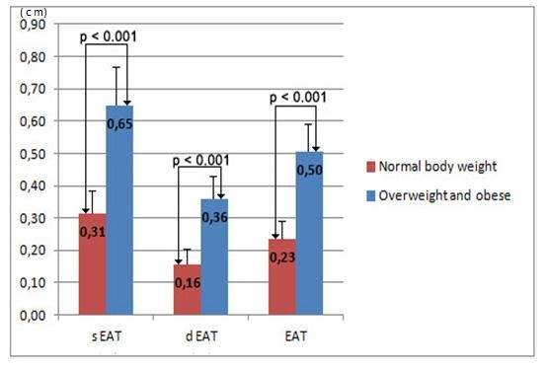








EPICARDIAL ADIPOSE TISSUE (EAT) THICKNESS
mean value
Schusterova , I. et al.: Circulation, 125:e741-e925; 2012;

Slide 19
































































EAT correlations with clinical and
biochemical parameters
Variable |  | Mean EAT
 | r | p-value
Body weight (kg) | 0.63 | p<0.0001
BMI – (kg/m²) | 0.80 | p<0.0001
BMI percentile | 0.72 | p<0.0001
Waist circumference (cm) | 0.68 | p<0.0001
Systolic BP (mmHg) | 0.40 | p<0.05
Diastolic BP (mmHg) | 0.43 | p<0.01
Triglyceride [mmol/l] | 0.68 | p<0.0001
HDL cholesterol (mmol/l) | -0.50 | p<0.001
Total proteins (g/l) | 0.37 | p<0.05
ApoB (g/l) | 0.37 | p < 0.05
Uric acid (umol/l) | ???
ALT (U/l) | ???
Schusterova I. et al.: JAHA, 4, 2012;

Slide 20



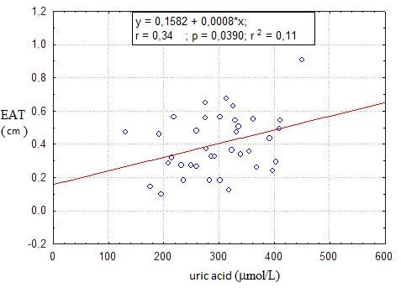







































NEW FINDINGS OF CURRENT STUDY I.
Confirmed relationship between hyperuricaemia and epicardial fat
Overweight and obese
Normal body weight
p- value
Variable
Uric acid (umol/l)
321.4 ± 67.5
281.9 ± 69.3
0.16
Schusterova, I. et al., Pediatric Obesity, Vol. 9, no. 1, p. 63-70. 2014

Slide 21


























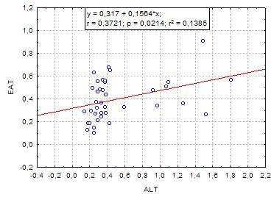


















NEW FINDINGS OF CURRENT STUDY II.
Variable | Mean EAT
 | r | p-value
AST (U/l) | 0.29 | 0.15
γGT (U/l) | 0.31 | 0.06
ALT (U/l) | 0.37 | p<0.05
Confirmed relationship between epicardial fat, a marker of visceral adiposity and ALT, marker of NAFLD
Schusterova, I. et al., Pediatric Obesity, Vol. 9, no. 1, p. 63-70. 2014

Slide 22
















Multiple regression analysis
of some metabolic variables
Variables | Mean EAT (cm)
 | r | tc | β coefficient | p value
Triglyceride [mmol/l] | 0.732 | 2.49 | 0.50 | p < 0.05
HDL cholesterol [mmol/l] |  | -1.04 | -0.16 | 0.30
Urea acid [μmol/l] |  | 0.79 | 0.11 | 0.43
Total proteins [g/l] |  | 1,26 | 0.17 | 0.21
ALT [U/l] |  | 0.44 | 0.06 | 0.66
ApoB [g/l] |  | -0.38 | -0.06 | 0.70
After adjusting for BW, BMI, BMI percentile, WC and systolic and diastolic BP
Schusterova, I. et al., Pediatric Obesity, Vol. 9, no. 1, p. 63-70. 2014

Slide 23







































































EAT AND MS a IR
Variables | Overweight and obese | Normal body weight | p-value
Fasting insulin | 15.35 ± 7.2 | 8.01 ± 4.2 | p < 0.05
Fasting glucose (mg/dL) | 89.45± 9.1 | 88.67 ± 8.2 | 0.42
HOMA index | 3.47 ± 1.97 | 1.9 ± 1.68 | P < 0.01
EAT and insulin resistance
Diastolic EAT and MS
HOMA index ≥ 3.16 0.49 ± 0,11
HOMA index ˂ 3.16 0.46 ± 0.12
MS yes 0.39 ± 0.18
MS no 0.34 ± 0.13
p = 0.27
p = 0.34
EAT 0.41 mm → predictive value of IR in children EAT 0.39 mm → 95. percentile
Abaci, A. Int J Obes 2009; Mazur A. et al.: Atherosclerosis. 2010;
Schusterova, I. et al., Pediatric Obesity, Vol. 9, no. 1, p. 63-70. 2014

Slide 24









Indicators of obesity and metabolic risk
Variable | BMI (kg/m²) |  | Mean EAT (cm) |  | WC (cm)
 | r | p-value | r | p-value | r | p-value
Systolic BP [mmHg] | 0.58 | p<0.001 | 0.40 | p< 0.05 | 0.43 | p< 0.05
Diastolic BP [mmHg] | 0.63 | p<0.001 | 0.43 | p< 0.01 | 0.65 | p<0.001
Triglyceride [mmol/l] | 0.63 | p<0.001 | 0.68 | p<0.001 | 0.51 | p< 0.01
HDL cholesterol mmol/l] | -0.49 | p< 0.01 | -0.50 | p<0.001 | -0.18 | 0.36
ApoB [g/l] | 0.33 | p< 0.05 | 0.37 | p< 0.05 | 0.14 | 0.49
Uric acid [μmol/l] | 0.41 | p< 0.05 | 0.34 | p< 0.05 | 0.37 | 0.06
Total proteins [g/l] | 0.36 | p< 0.05 | 0.37 | p< 0.05 | 0.36 | 0.07
ALT [U/l] | 0.51 | p< 0.01 | 0.37 | p< 0.05 | 0.38 | 0.06
γGT [U/l] | 0.52 | p<0.001 | 0.31 | 0.08 | 0.34 | 0.10
Metabolic risk
assessment
PREDICTORS
BMI ˃ EAT ˃ WC

Slide 25




















IN CONCLUSION...
Echocardiographic measurement of EAT is an easy and reliable method for assessing true visceral adiposity
The extent of EAT could identifies children
with an unfavorable cardio-metabolic risk profile including biochemical signs of NAFLD and hyperuricemia
EAT is a better predictor than WC, however, BMI and EAT have a similar predictive value for assessment of metabolic impairment
It is not clear whether the extent of visceral adipose tissue is also predictive for IR in pediatric patients

Slide 26











LARGER STUDIES...
Further standardization of the methodology for
echocardiographic assessment of EAT
Establish normal values by age and gender to
detect cardio-metabolic risk in early adulthood

Slide 27






Thank you for your attention !
KOSICE, SLOVAKIA - WINTER

