Slide 1



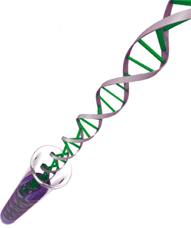
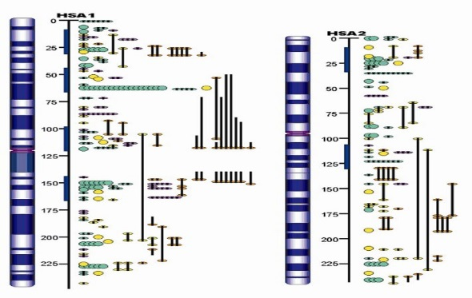
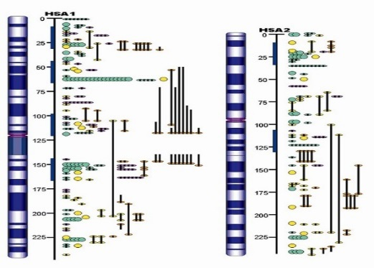
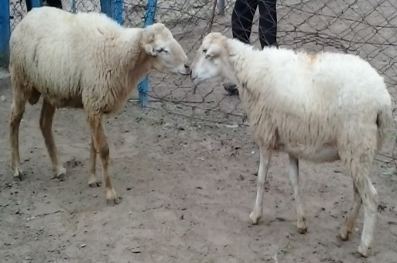
Genomic selection in animal breeding- A promising future for faster genetic improvement in livestock
Dr Indrasen Chauhan
Scientist, CSWRI, Avikanagar
Tonk-304501

Slide 2

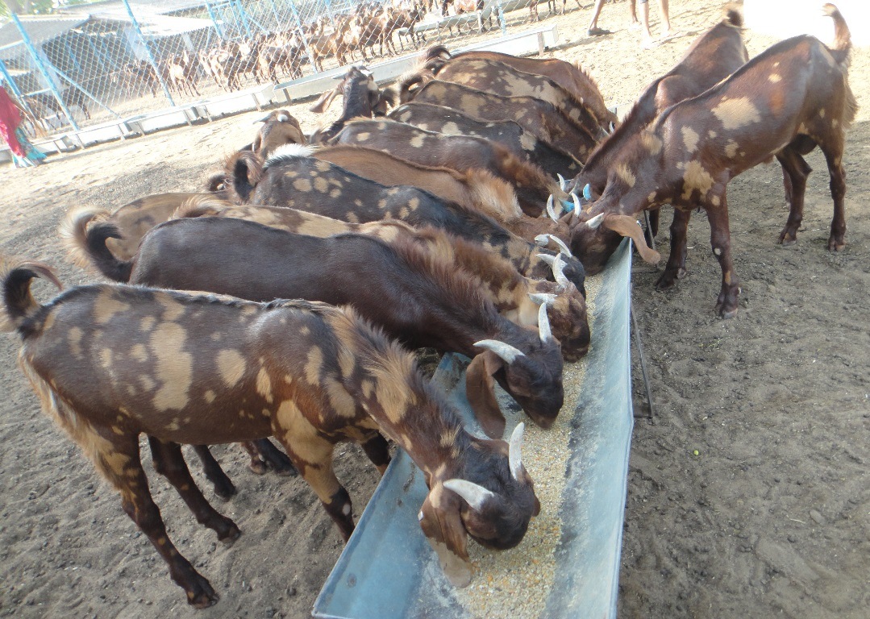
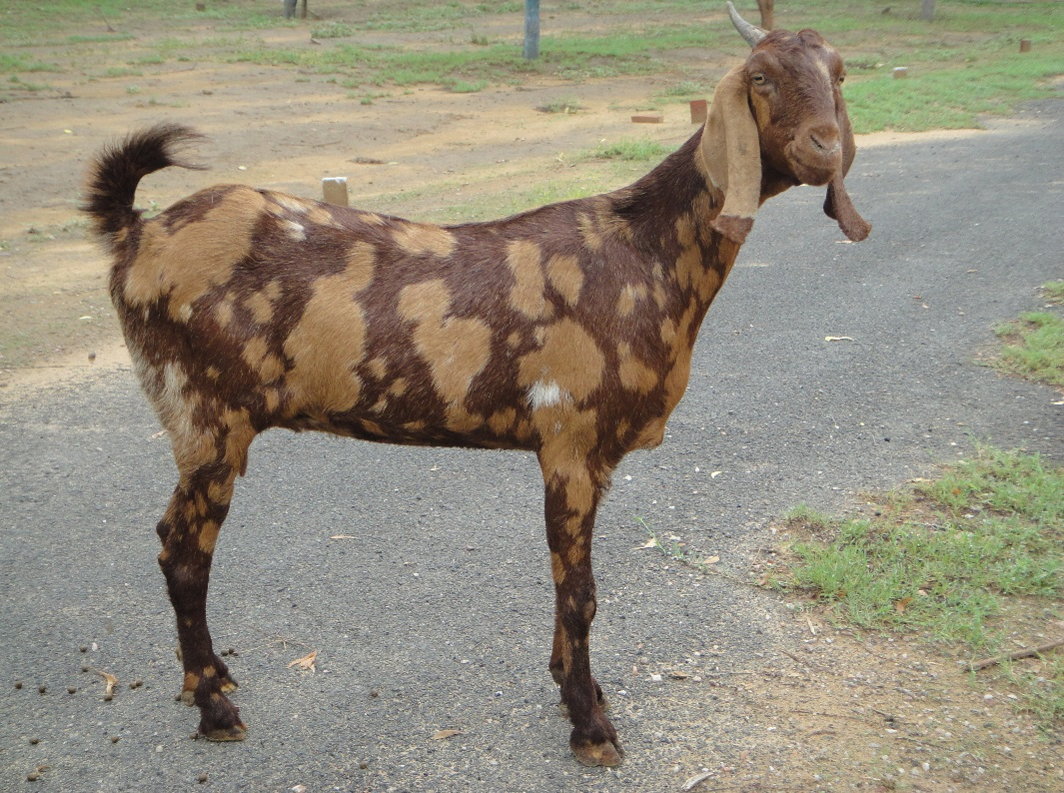
Conventional selection
– Based on individual records, pedigree or progeny performance or family performance.
SI=WT9 +1DMY90

Slide 3
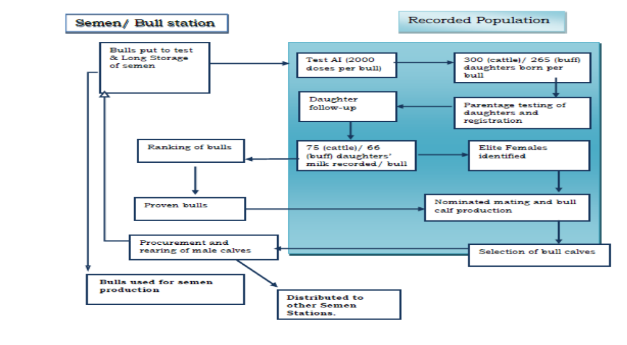
Progeny testing –Bulls evaluated on the basis of daughters performance
http://www.nddb.org/ndpi/English/AboutNDPI/Manuals-Guidelines/PDFDocuments/PIP-Vol-IV-A-Manual-on-Progeny-Testing.pdf

Slide 4
History of Genomics
1911-The gene map of Drosphila by Alfred Sturtevant.
1930s-Molecular Biology begins.
1965-Margaret Dayhoff's Atlas of Protein Sequences
1970-Sequencing techniques by Fredirick Sanger
Three disciplines Genetics, Molecular biology and Bioinformatics converged in 1980s and 1990s -Genomics

Slide 5
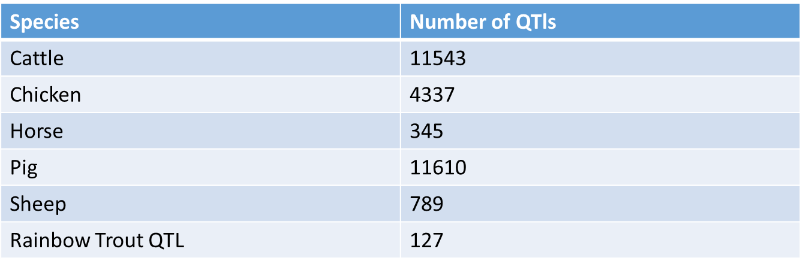
QTL Analysis
In the 1990s starts QTL analysis in in farm animals

Slide 6
1-Detect one or several QTLs
2-Fine mapping
3-Find the gene responsible
4-Introgression
Marker Assisted Selection (MAS)

Slide 7
1-The effect of individual Quantitative trait loci (QTL) on polygenic traits, such as milk yield, are likely to be small
2-Number of QTL required is quite large to sufficiently explain the genetic variation in these traits
Limitations of MAS

Slide 8
Genomic Breeding
In 1990 Human Genome project started and in 2003 human
genome was published. This was followed by sequencing of
farm animal genomes
Species | Year
Dog (Canis Familiaris) | 2003
Chicken (Gallus Gallus) | 2004
Cat (Felis sylvestris) | 2006
Sheep (Ovis Aries) | 2008
Cattle (Bos taurus) | 2009
Horse (Equus caballus) | 2009
Pig (Sus Scrofa) | 2009

Slide 9
Sequencing revolutionised development of large panels of SNPs in domestic animals
Genomic Selection was actually first introduced by Haley and Visscher at Armidale WCGALP in 1998
But the methodology for Genomic Selection was first presented by Meuwissen et. al.in 2001

Slide 10
Genomic Breeding
“Genomic Selection is defined as a technology for increasing the accuracy with which the genetic merit of young potential breeding animals can be determined". Wickham et al. ,2012
Two step process:
Estimate the effects of markers in a reference (training) populations (phenotyped and genotyped)
This information utilized to predict the breeding value of candidates to selection in a testing (evaluation) population (genotyped)

Slide 11
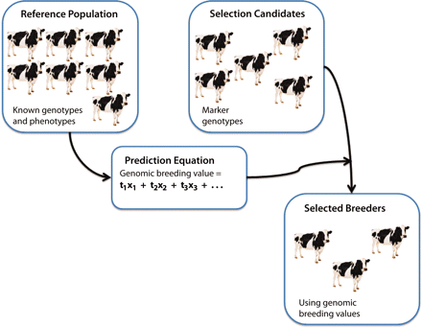
Methodology
Eggen,2012

Slide 12
Differences with MAS
MAS concentrates on few QTLs having association with markers
Genomic selection uses a genome-wide panel of dense markers

Slide 13
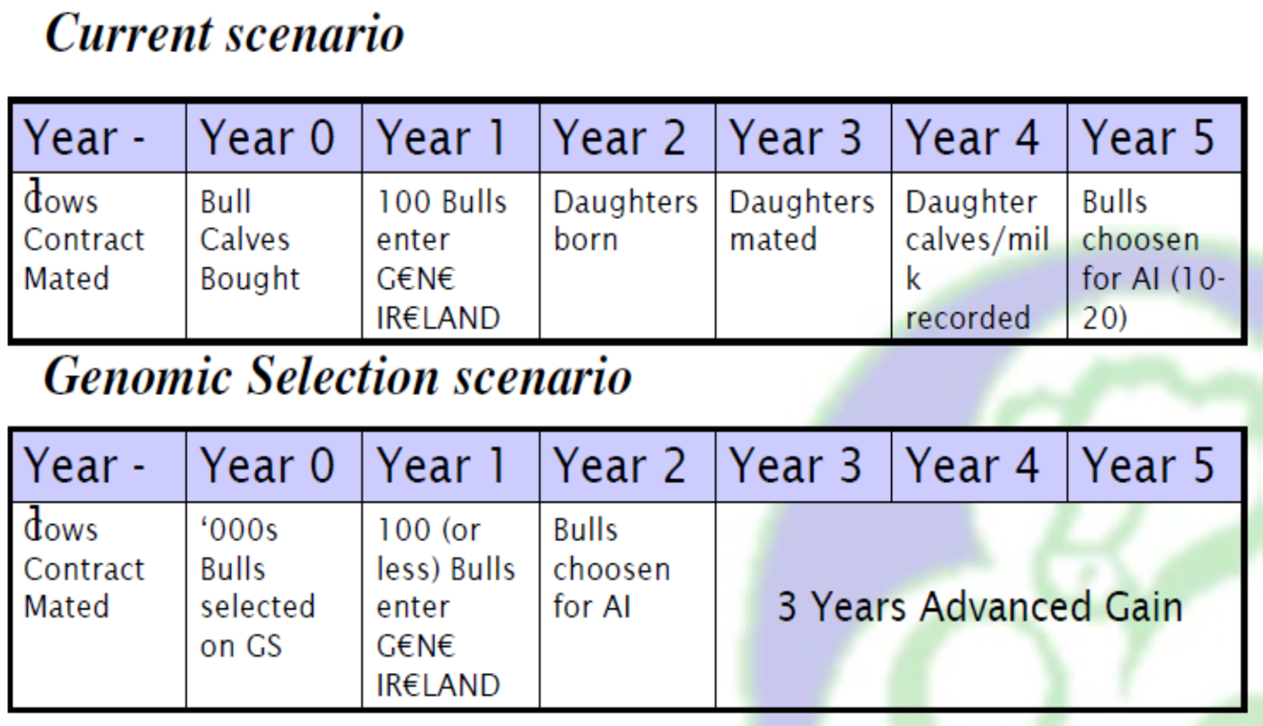
Advantages
Animals at an early age because breeding values can be
predicted with an accuracy of 0.8 for selection candidates at birth

Slide 14
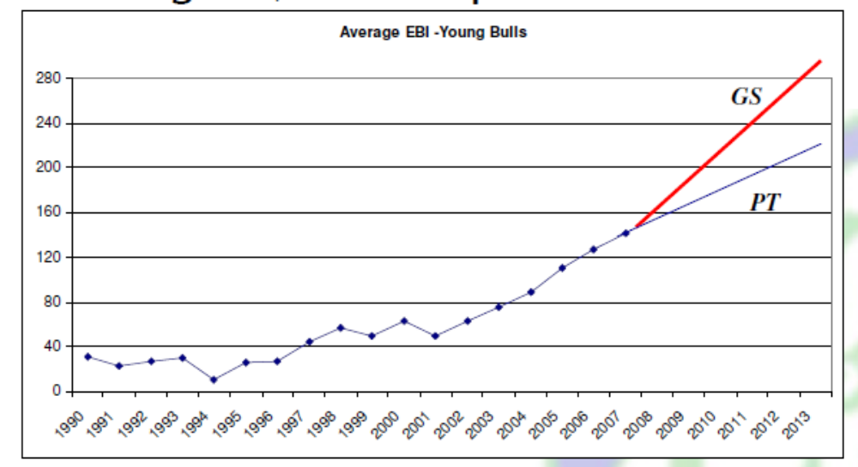
Higher rate of gain as compared to Progeny testing

Slide 15
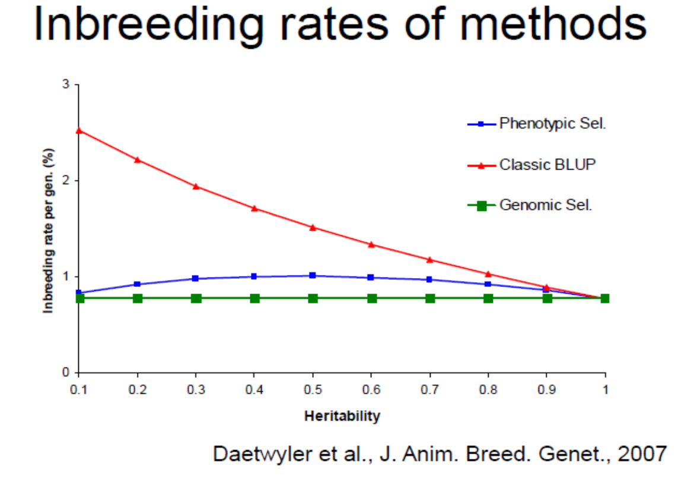
Lower rate of Inbreeding per generation

Slide 16
Genomic selection for future uses:
-Mitigation of effects of climatic change-select for lower GHG (green-house gas) emissions in species: "Eco friendly cattle”(Hayes et. al. , 2013)
Genomic selection is especially useful for
Traits with low heritability(fitness traits)
Traits difficult/expensive to measure(like wool quality in sheep
Disease susceptibility/resistance traits
Traits that take a lifetime to measure(longevity)

Slide 17
High-density SNP Chips available for
Cattle
Sheep
Goat
Pigs
Horses
Dogs
Chicken
Salmon
Human

Slide 18
Countries following Genomic Selection
USA & Canada (In Collaboration)
New Zealand
Netherlands
Australia
Denmark & Sweden
Brazil

Slide 19
Limitations
Genotyping requires sufficiently large set of
animals for accurate marker estimates
For Low heritable traits more records are needed
Between breed accuracy low-High Density chip
Marker estimates must be estimated in
population where they have to be used

Slide 20
Thank you

