Slide 1
About OMICS Group
OMICS Group is an amalgamation of Open Access publications and worldwide international science conferences and events. Established in the year 2007 with the sole aim of making the information on Sciences and technology ‘Open Access’, OMICS Group publishes 500 online open access scholarly journals in all aspects of Science, Engineering, Management and Technology journals.
OMICS Group has been instrumental in taking the knowledge on Science & technology to the doorsteps of ordinary men and women. Research Scholars, Students, Libraries, Educational Institutions, Research centers and the industry are main stakeholders that benefitted greatly from this knowledge dissemination. OMICS Group also organizes 500 International conferences annually across the globe, where knowledge transfer takes place through debates, round table discussions, poster presentations, workshops, symposia and exhibitions.

Slide 2
About OMICS International Conferences
OMICS International is a pioneer and leading science event organizer, which publishes around 500 open access journals and conducts over 500 Medical, Clinical, Engineering, Life Sciences, Pharma scientific conferences all over the globe annually with the support of more than 1000 scientific associations and 30,000 editorial board members and 3.5 million followers to its credit.
OMICS Group has organized 500 conferences, workshops and national symposiums across the major cities including San Francisco, Las Vegas, San Antonio, Omaha, Orlando, Raleigh, Santa Clara, Chicago, Philadelphia, Baltimore, United Kingdom, Valencia, Dubai, Beijing, Hyderabad, Bengaluru and Mumbai.

Slide 3

Organization of Avian Thymic Medullary Epithelial Cells and Surfactant Production
Imre Oláh, Ildikó Bódi, Krisztina Minkó and Katalin Kocsis
Semmelweis University, Faculty of Medicine, Department of Human Morphology and Developmental Biology, 1094 Budapest, Tűzoltó utca 58, Hungary
olah.imre@med.semmelweis-univ.hu
⁺

Slide 4
The thymic and lung epithelial anlage develop from the foregut endoderm, thus both thymus and lung have common epithelial progenitor cell.
It is known, that the thymus is capable of surfactant production like type II pneumocytes of the lung. Now, it is confirmed in avian and human thymus.
The purpose of this work was to determine the avian surfactant producing epithelial cells in thymus.

Slide 5
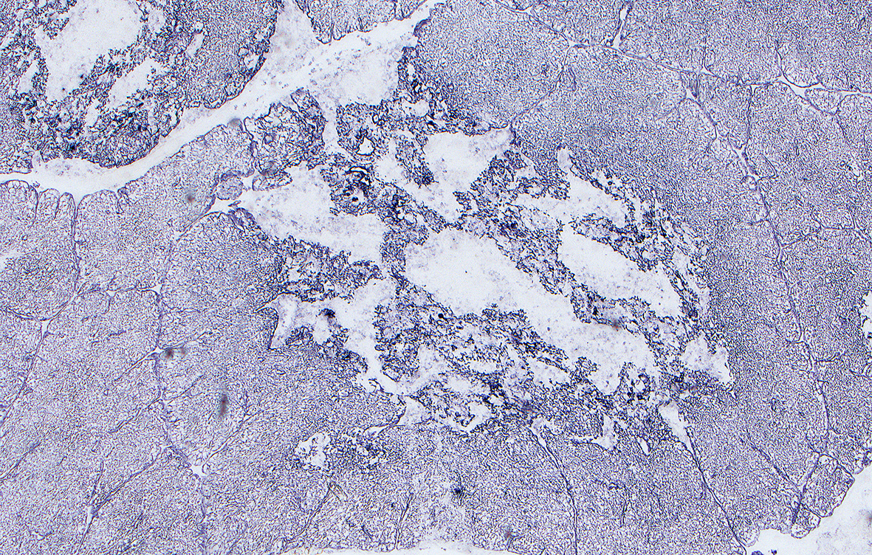
Anti-cytokeratin staining revealed two compartments in the thymic medulla: 1. Keratin positive network, 2. Keratin negative areas.
KNA
KNA

Slide 6
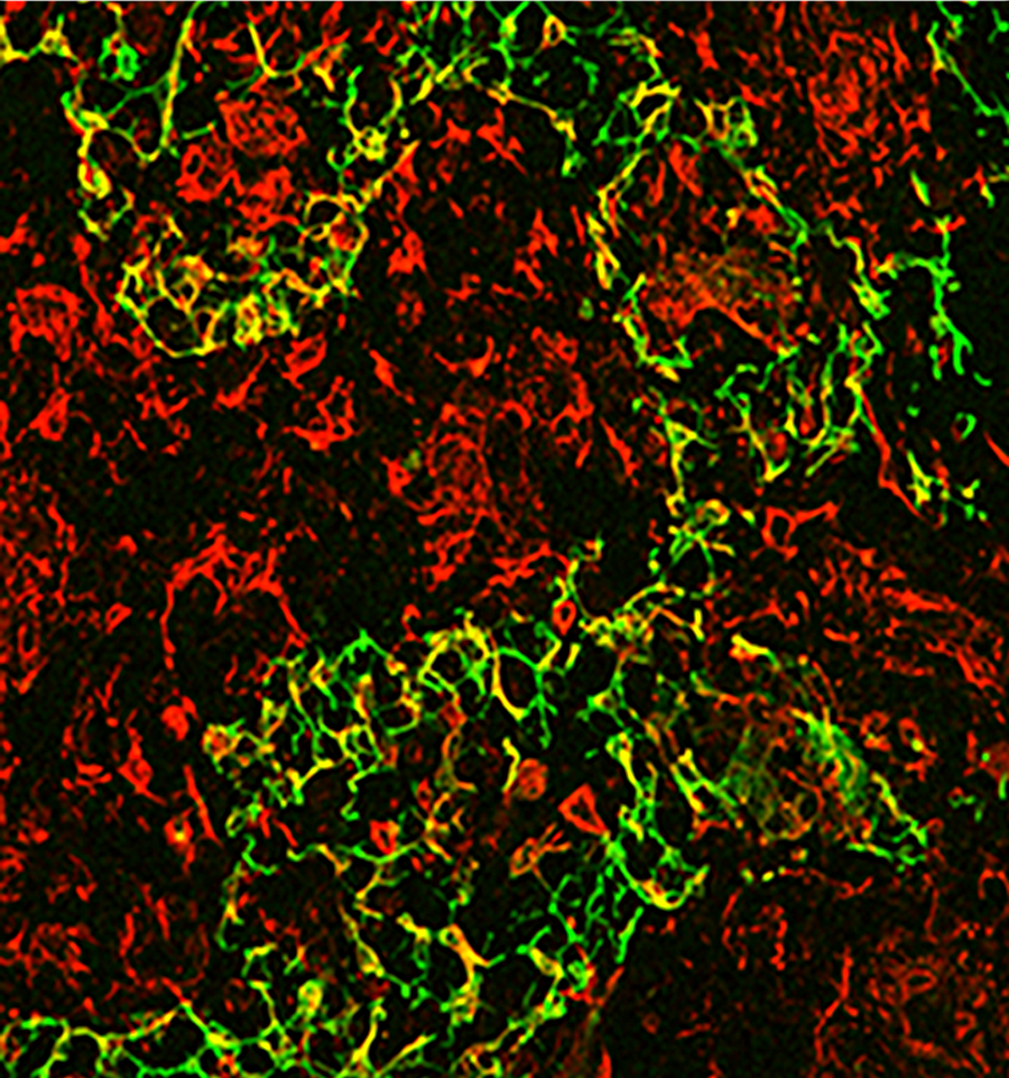
Keratin positive network (KPN). Double staining of cytokeratin and vimentin intermediate filaments. Marginal cells of KPN express vimentin.

Slide 7
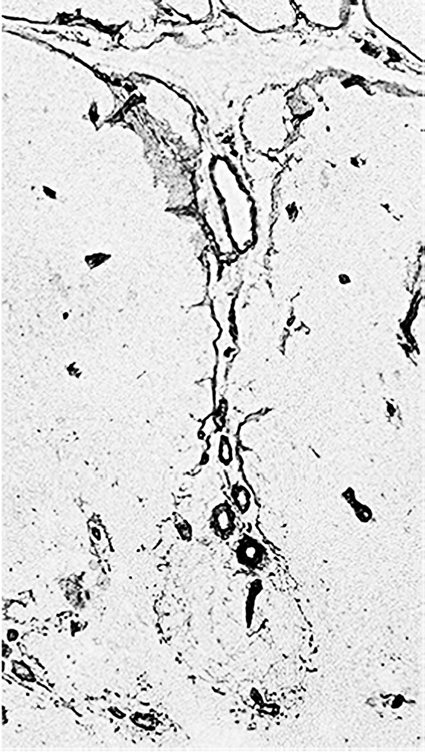
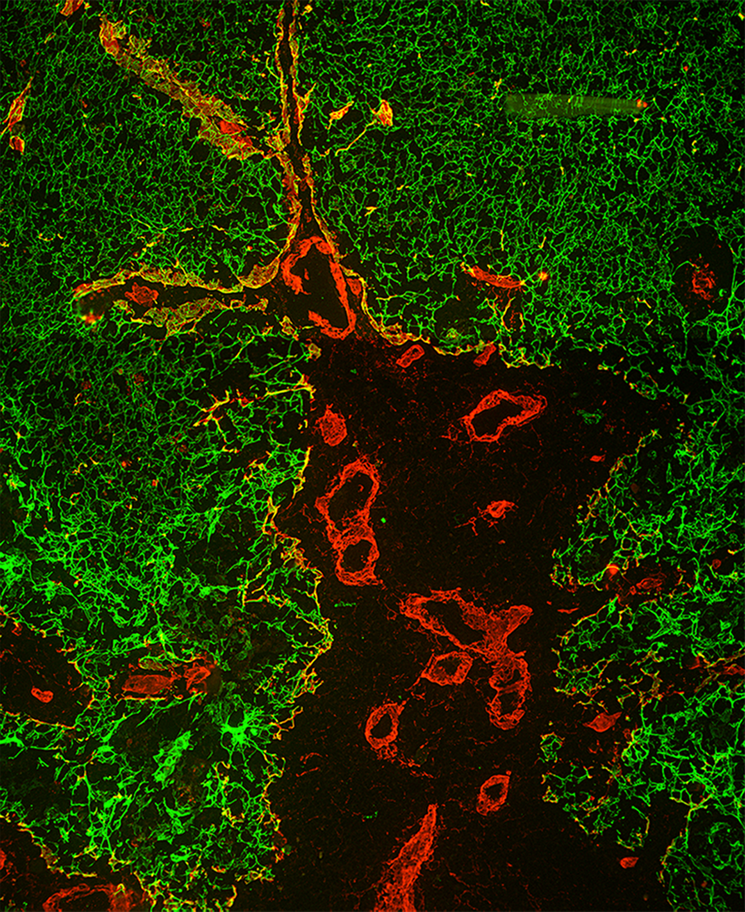
Basal lamina becomes interrupted at the corticomedullary border, which can contribute to the lack of blood-thymus barrier.

Slide 8
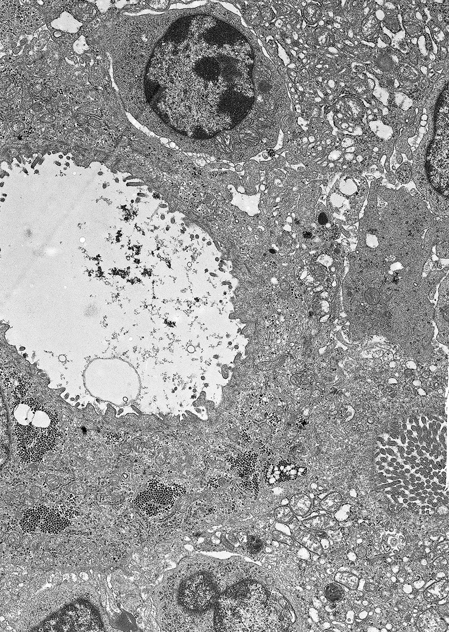
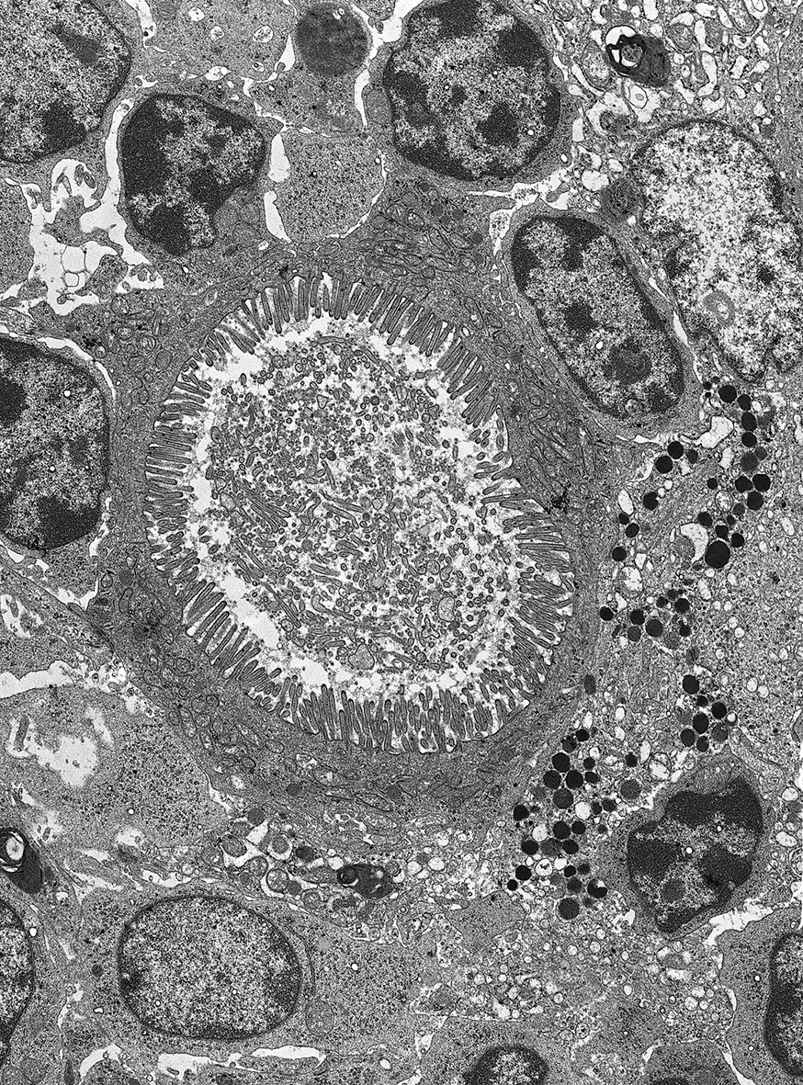
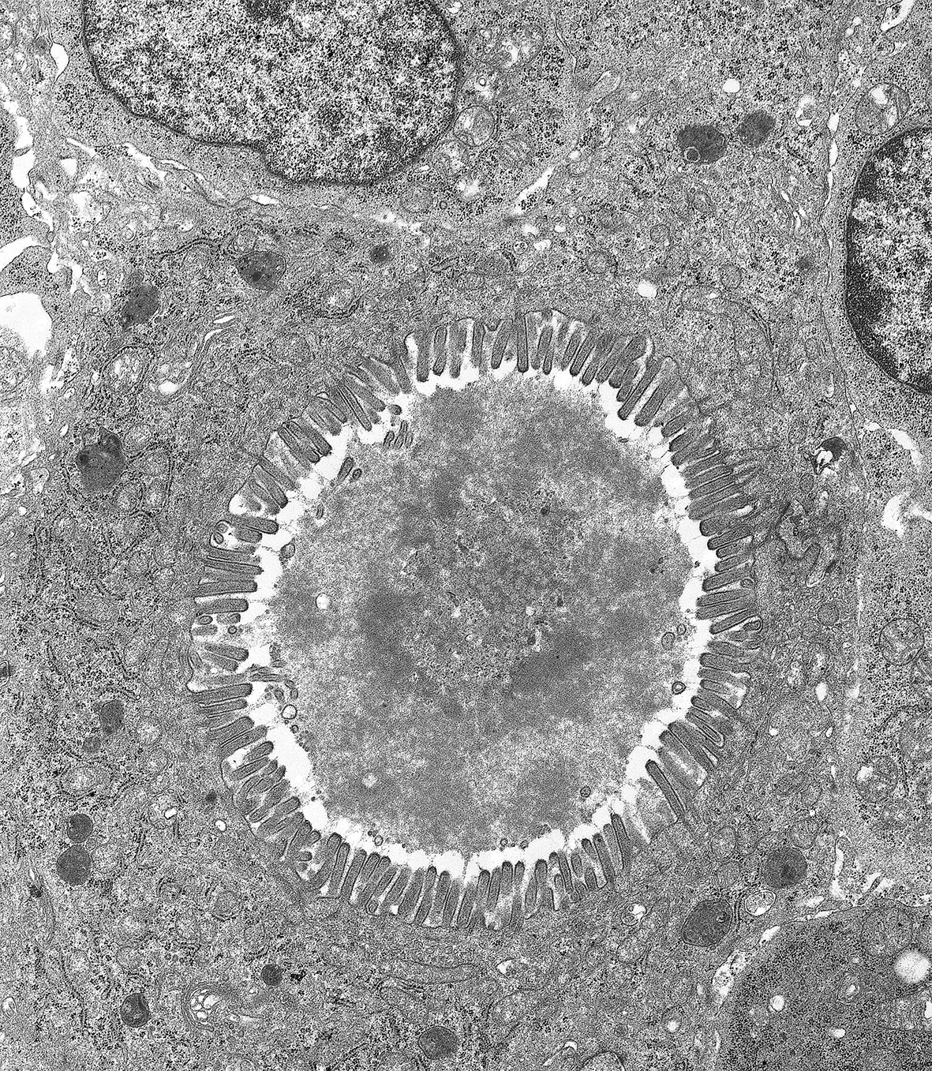
Cysts can contain different electron dense substance: 1. transparent fluid, 2. fine flocculated substance and 3. High electron dense material.

Slide 9
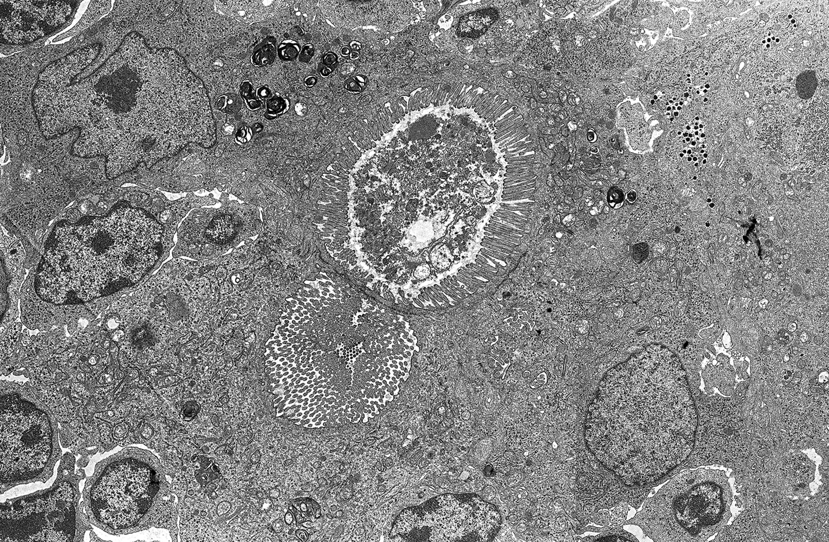
Two cysts: in one of them medium electron dense substance occurs. In the cytoplasm of one of the cyst-forming epithelial cells lamellated granules occur.

Slide 10
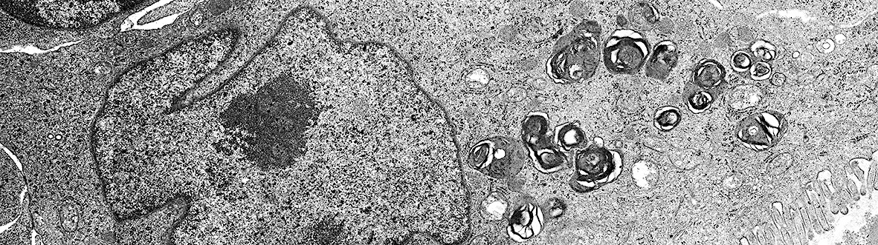
Two cysts: in one of them medium electron dense substance occurs. In the cytoplasm of one of the cyst-forming epithelial cells lamellated granules occur.

Slide 11
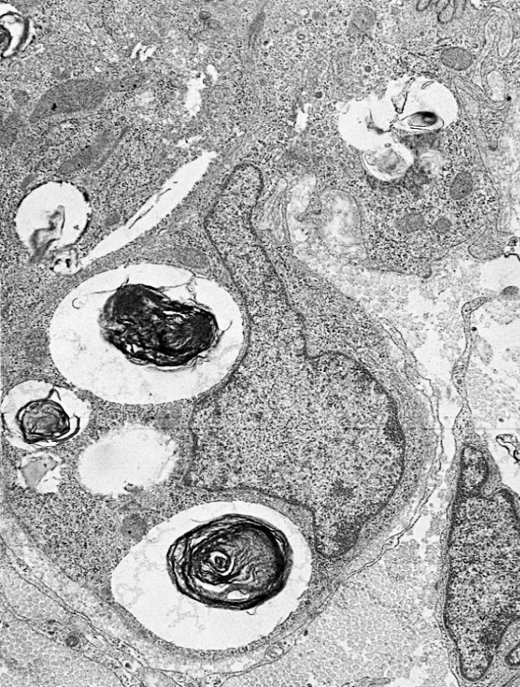
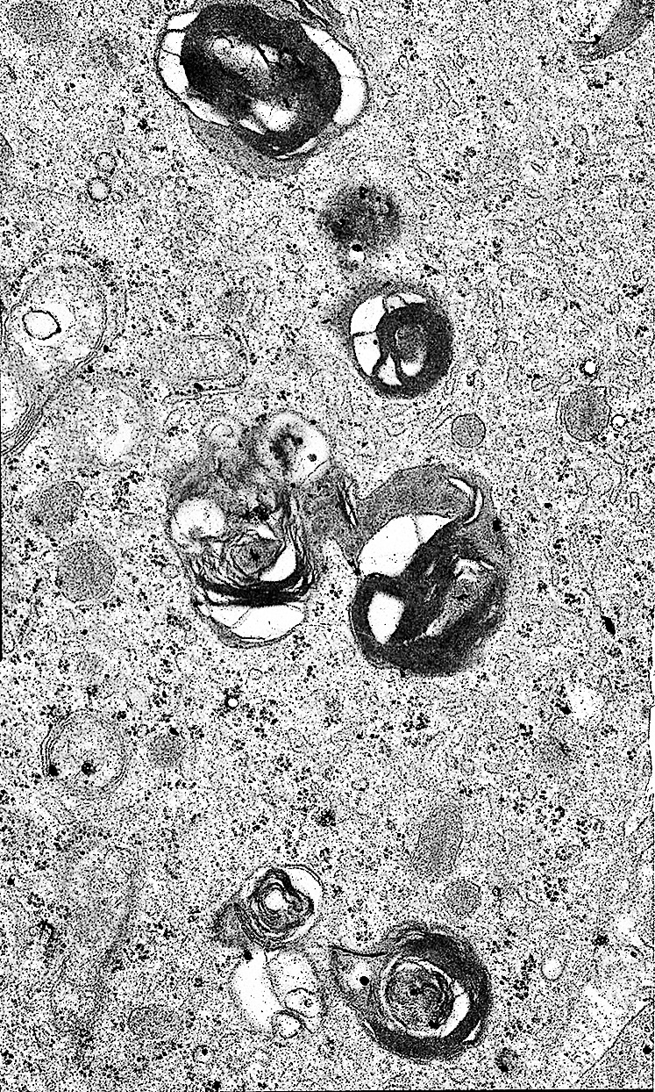
Higher magnification of lamellated granules of a thymic cyst epithelial cell and a type II pneumocytes.

Slide 12
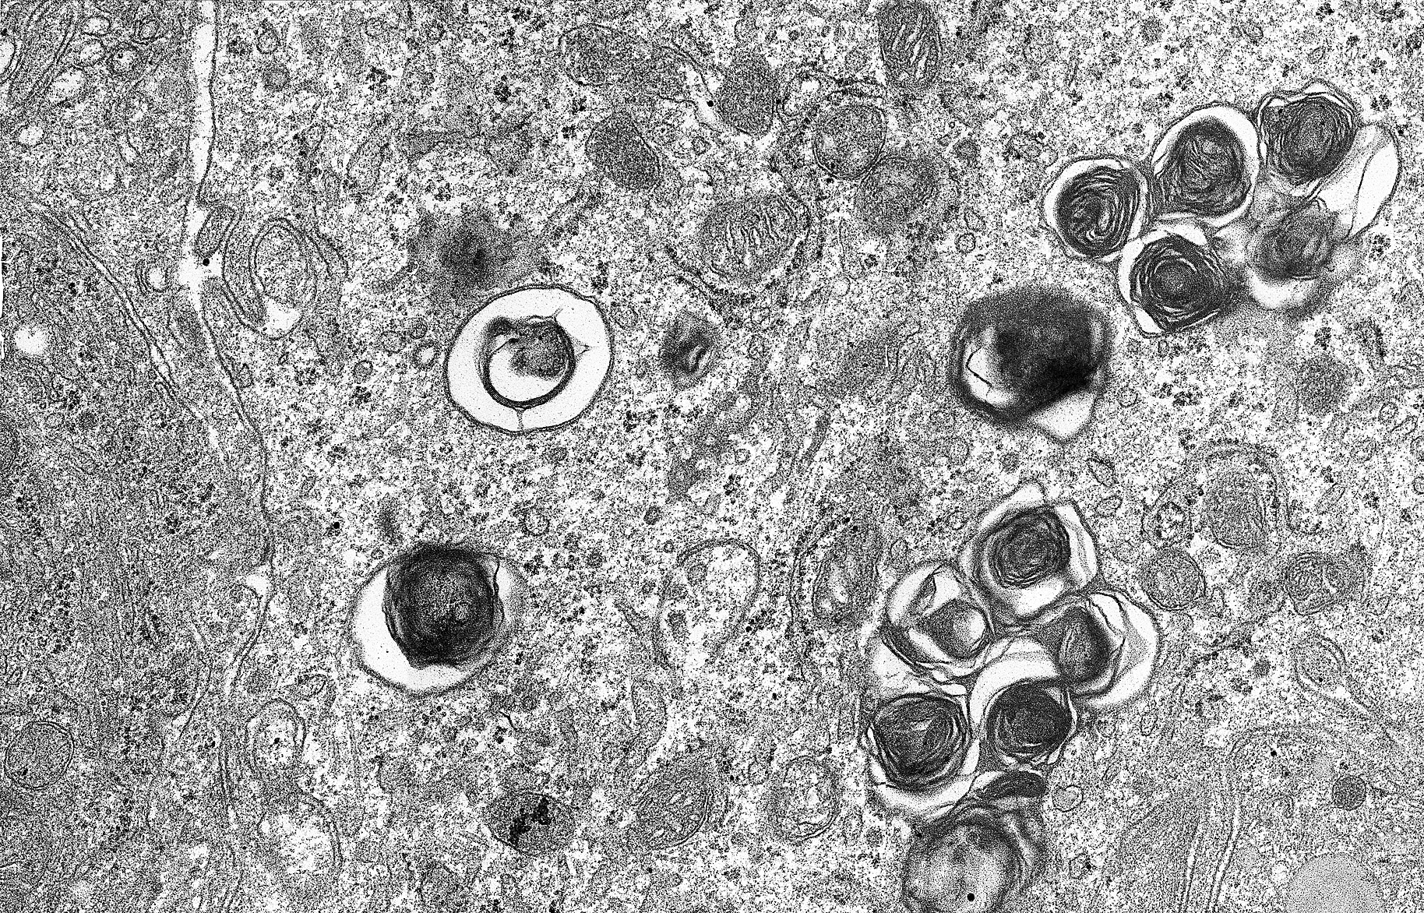
Individual thymic epithelial cell contains lamellated granules.

Slide 13
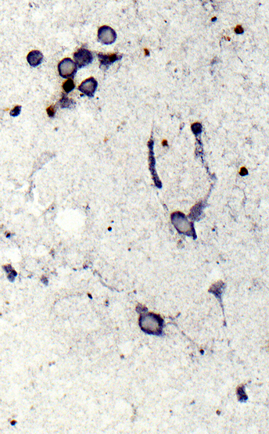
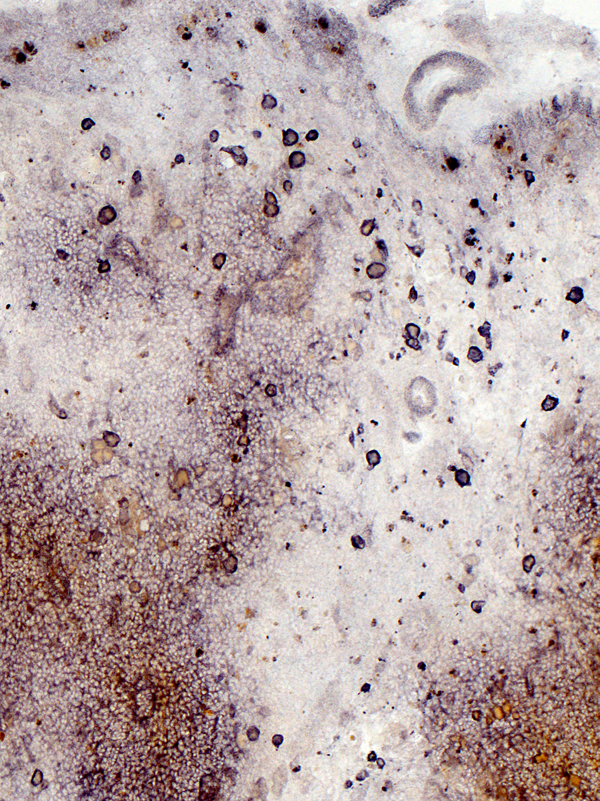
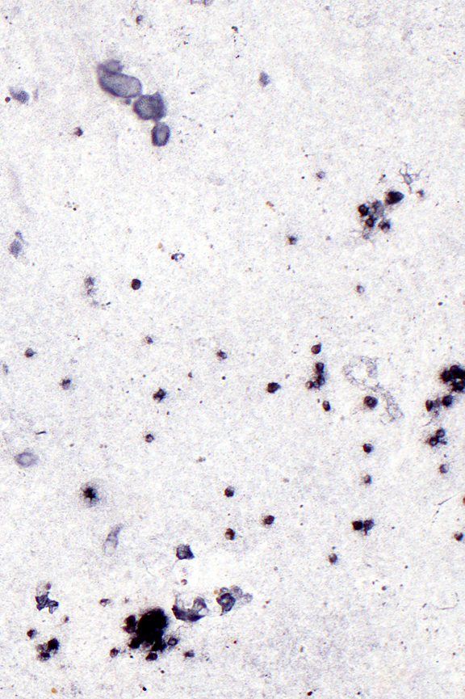
Cyst- forming cells express surfactant A and surfactant B proteins. Dexamethasone treatment eliminates the T-cells but not the surfactant production.
SPA SPB Dexa SPA

Slide 14
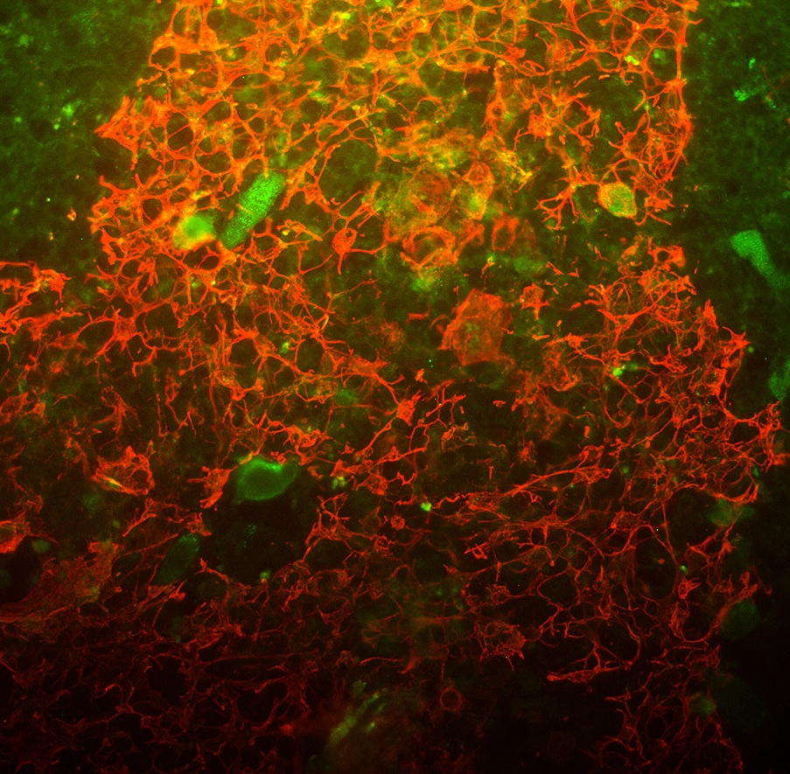
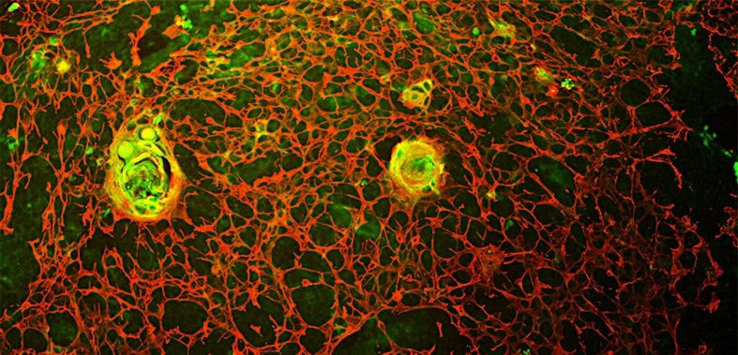
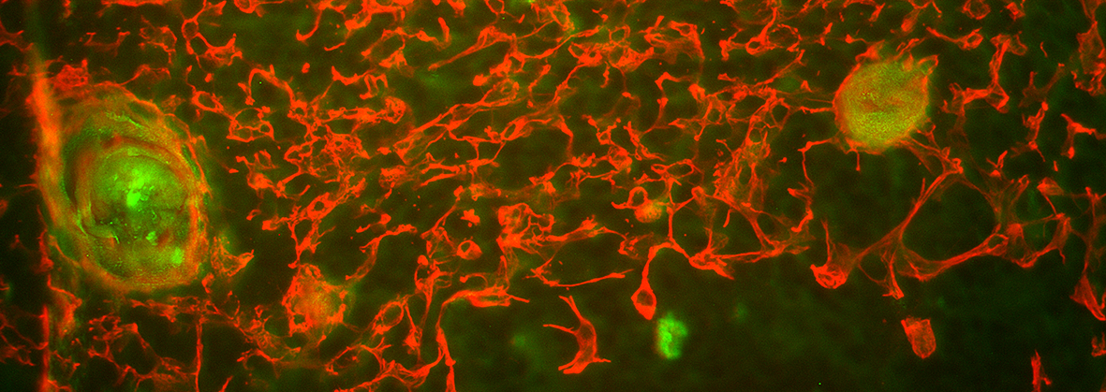
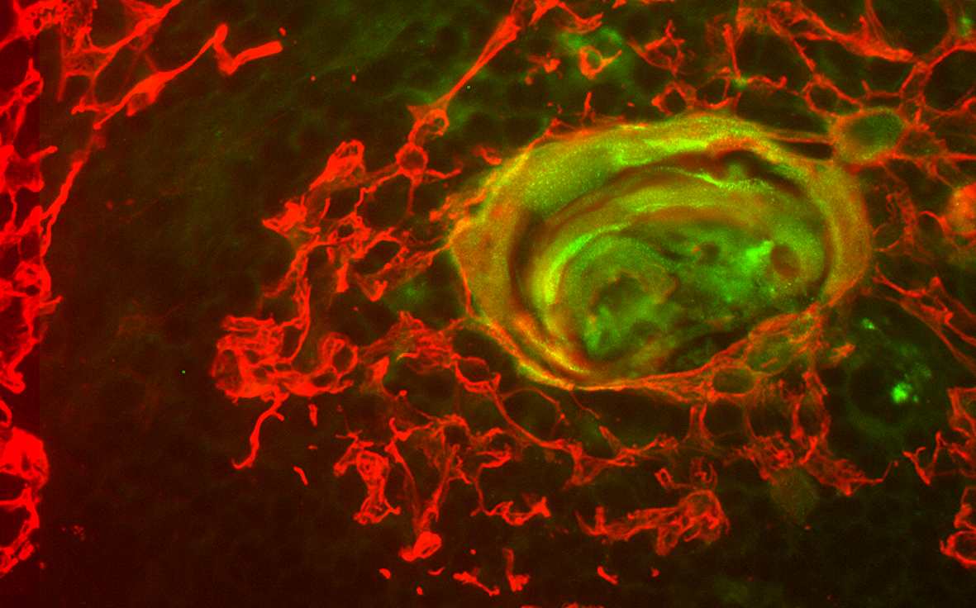
Double staining of thymus: both chicken and human thymus produces surfactant.
Chicken cytokeratin/SPB
Human cytokeratin/SPB

Slide 15
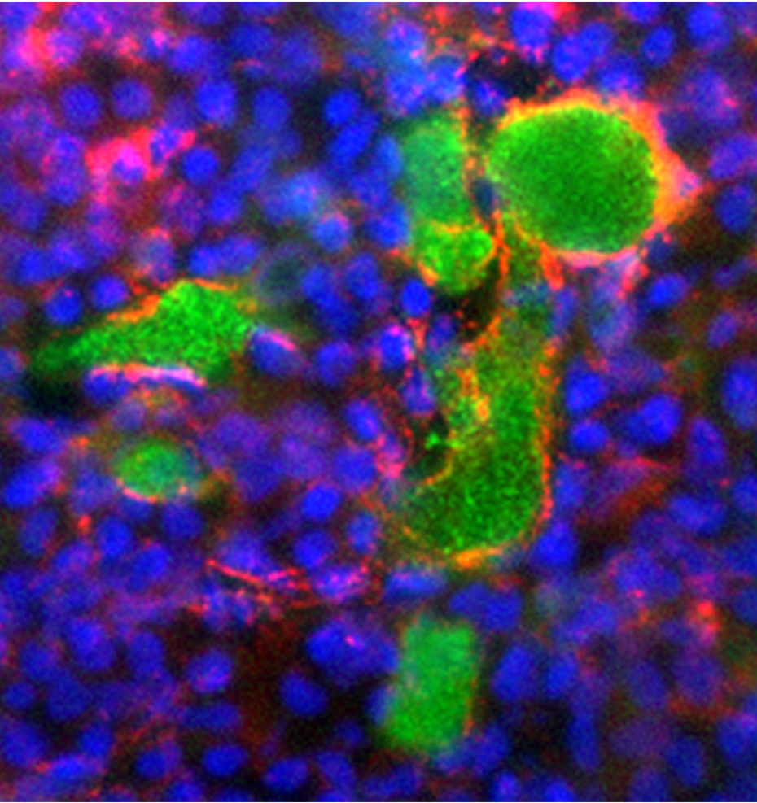
Double staining of thymus with anti-surfactant B and MHC class II antibodies. Cyst- forming cells express MHC class II antigen.

Slide 16
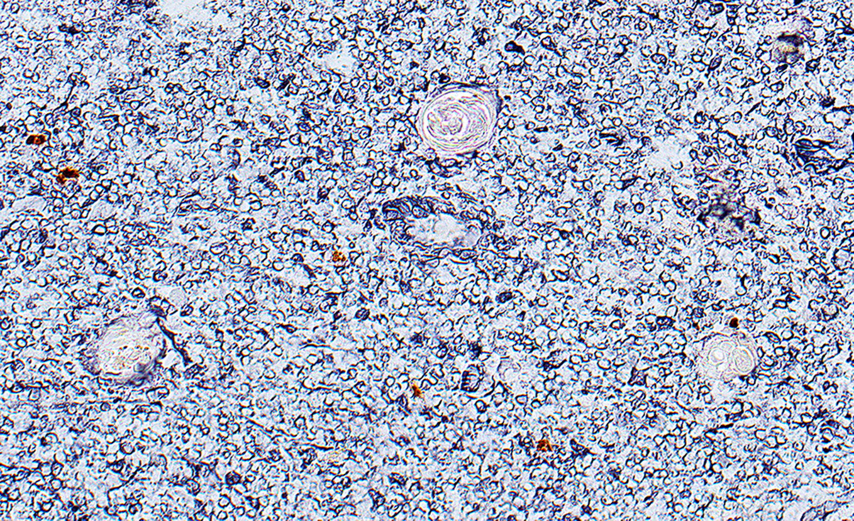
Hassall’s bodies consist of keratinized cells in the vimentin positive human thymic medulla.

Slide 17
Thymic medullary epithelial cells:

Slide 18
Conclusion :
Marginal cells of the Keratin Positive Network (KPN) express keratin and vimentin intermediate filaments; These cells possibly contribute to the negative selection of autoreactive thymocytes.
Cyst- forming cells are polarized with secretory function; enteroendocrine peptide and surfactant production. Their differentiation stopped in early developmental stages.
Hassall’s corpuscles are formed from the center cells of KPN, which does not express vimentin intermediate filaments. The differentiation of the cell of Hassall’s bodies stopped in late development.

Slide 19
To this work contributed:
Ildikó Bódi
Krisztina Minkó
Katalin Kocsis
Orsolya Fölker
Thank you for your attention!

Slide 20
Let Us Meet Again
We welcome you all to our future conferences of OMICS International
Please Visit:
http://integrativebiology.conferenceseries.com/
http://conferenceseries.com/
http://www.conferenceseries.com/genetics-and-molecular-biology-conferences.php

