Slide 1

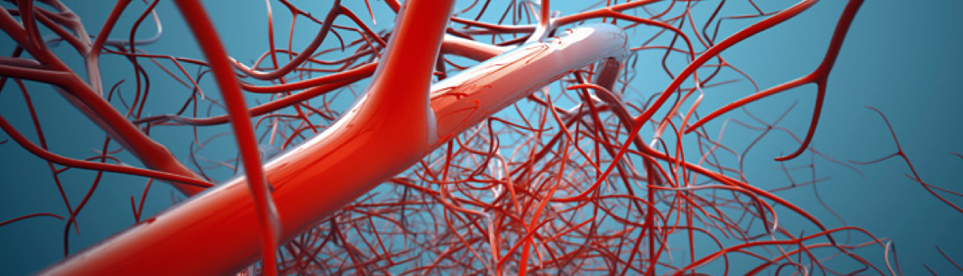
The Use of New Oral Anticoagulant in Cerebral Venous Sinus Thrombosis : Alternative Therapy with Excellent Result
Ima A. Kusuma, MD, FIHA
“JIH” Hospital, Yogyakarta, Indonesia
Notes:
Good afternoon. Today I would like to present a case in venous thrombosis, the title is ……

Slide 2
Disclosure
Nothing to declare
Notes:
There is nothing to declare about this presentation

Slide 3
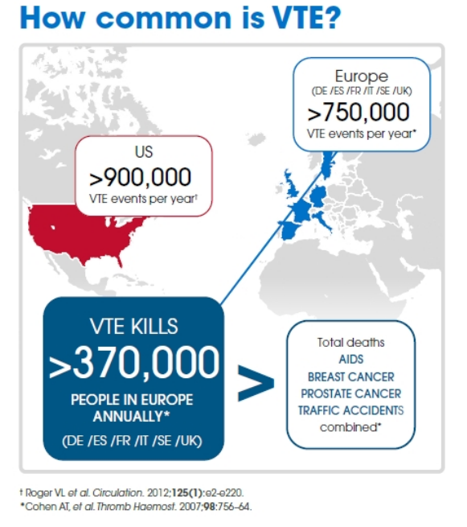
Introduction
CVST → thrombosis in cerebral veins
Rare case
CVST
2 – 5 / million / year
Coutinho JM, et al. Stroke 2012;43:3375-7
Khan M, et al. Stroke research and treatment 2010;1-7
Notes:
Cerebral venous sinus thrombosis or CVST is uncommon form of stroke. The thrombosis occur in cerebral veins. CVST affects approximately 2-5 people per million annually and accounts for 0,5 to 1% of all strokes.
If the prevalence of CVST compared to the prevalence of VTE, we can see that CVST is more rare than VTE. The precise number of people affected by DVT/PE is about 900,000 per year or could be affected (1 to 2 per 1,000) each year in the United States. The number in Europe is more than 750.000 per year.

Slide 4
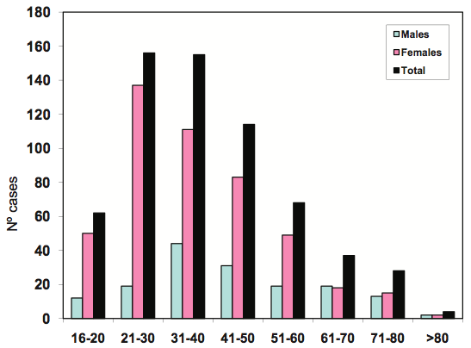
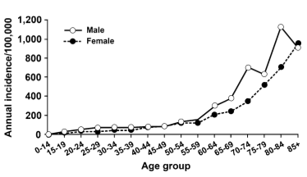
CVST
VTE
Saposnik G, et al. Stroke 2011;42:1158-92 Heit JA, et al. J Thromb Thrombolysis 2016;41:3-14
Khan M, et al. Stroke research and treatment 2010;1-7
Notes:
CVT is more commonly seen in young individuals. According to the largest cohort study (the International Study on Cerebral Venous and Dural Sinuses Thrombosis [ISCVT]), 78% cases occurred in patients < 50 years of age. And it’s more common occurred in women than men.
VTE is predominantly a disease of older age. Incidence rates increase markedly with age for both men and women. The overall age-adjusted incidence rate is higher for men (130 per 100,000) then women (110 per 100,000; male : female sex ratio is 1.2 :1)

Slide 5

Case Illustration
37 yo woman
Headache 2 months → normal brain CT scan
Mild weakness of right extremities
Dyslipidemia, history of taking oral contraceptives

Slide 6
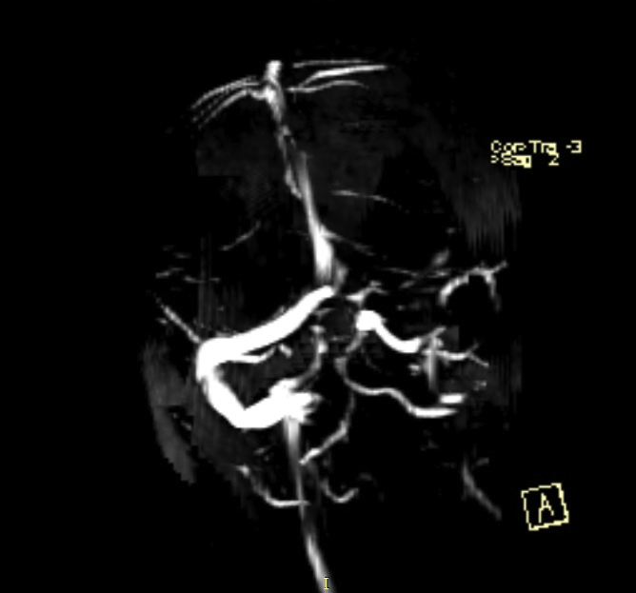
Physical examination → vital signs were normal
Brain CT scan → normal
MRI (MRA - MRV)
Notes:
On physical exam her vital signs were stable and within normal limits. Cerebral CT scan examination showed normal result, then MRI (MRA-MRV) was performed. MRV showed defect at left sinus tranversus.

Slide 7
Therapy → NOAC (rivaroxaban 15 mg twice daily)
5th day follow up → extremities weakness was revealed
Rivaroxaban 15 mg twice daily → 21 days
Followed 20 mg once daily
Notes:
Patient was given new oral anticoagulant, rivaroxaban. It started at dosages of 15 mg twice daily. On the fifth day follow up, the right sided weakness was revealed. Rivaroxaban then continued for 21 days, followed by rivaroxaban 20 mg once daily. On the third months follow up, there were no complications in this patient.

Slide 8
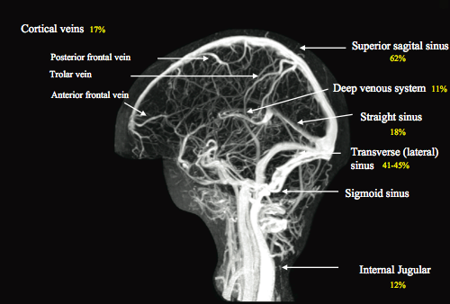
Discussion
Saposnik G, et al. Stroke 2011;42:1158-92.
Itrat A, et al. J Pak Med Assoc 2006:506-8.
Notes:
Cerebral venous thrombosis refers to complete or partial occlusion of either the main sinus/ sinuses or the feeding cortical veins leading to secondary effects of vascular congestion and focal or generalized neurological deficits. Thrombosis in venous channels draining the brain is a consequence of the characteristic risk factors under the heading of Virchow’s triad, which includes local trauma to vessel wall, stasis and hypercoagulable state.
The most frequent location of CVST, as reported in the International Study on Cerebral Venous and Dural Sinuses thrombosis, is at superior sagital sinus (62%) and transverse sinus (41-45%).
In our pts, the location of defect occording to MRV is at transverse sinus.

Slide 9
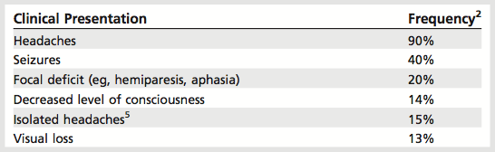
Clinical manifestation → variable
Isolated intracranial HT Headache Diplopia Visual impairment Decreased of consciousness 6th nerve palsy | Focal neurologic defisit Motor weakness Sensory deficit Aphasia
Encephalopathy | Seizures
Bushnell C, et al. Continuum 2014’20(2): 335-51
Mehta BSR, et al. MJAFI 2004;60:299-301.
Notes:
CVST is a great masquerader as it can present in various forms and confuse the clinician. It has variable clinical manifestations. It can manifests as a stroke with seizures, so confusing it with arterial strokes. It may present with headache and papilledema. It may also present with pleomorphic seizures occasionally with fever suggesting encephalitis.
The presentation of patients with CVT may be variable. It can be categorized into four clinical syndromes: (1) isolated intracranial hypertension (eg, patients may present with headache, diplopia, visual impairment [severe papilledema], decreased level of consciousness, or sixth nerve palsy), (2) focal neurologic deficit (eg, motor weakness, sensory deficit, aphasia), (3) encephalopathy, and (4) seizures (accompanied or not by a focal neurologic deficit).
Headache is the presenting symptom in 70–90% of cases. And in this case,our pts first came with headache as chief complain. Two months later, she came with focal defisit (hemiparesis), whichit’s occured in 20% of cases.

Slide 10
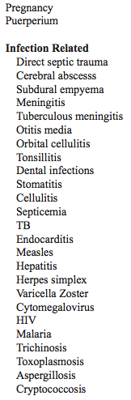
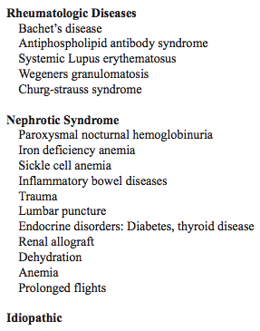
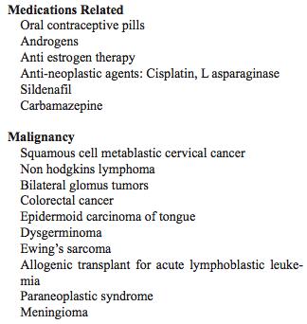
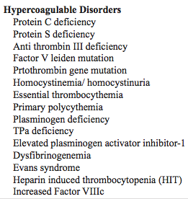
CVST’s risk factors
Yadollahikhales G, et al. GMJ 2016;5: 48-61
Notes:
CVST has many risk factors.......

Slide 11
Oral contraceptives
Martinelli, et al
Using oral contraceptives pill (OCP) → 22,1 fold increased odds of CVT (95% CI 5,9-84,2)
De Bruijn, et al
85% of CVT pts using OCP → adjusted OR of 13 (95% CI 5-37)
Metaanalysis 16 studies
Pts using OCP ⬆ risk CVT (OR 15,9; 95% CI 6,98-36,2)
Martinelli I,et al. N Eng J Med 1998;338:1793-7 Gillum LA, et al. JAMA 2000;284:72-8
De Bruijn, et al. BMJ 1998’316:589-92
Notes:
Oral contraceptives as risk factor
A 1998 study compared the prevalence of several risk factors, including use of oral contraceptives, among 40 female patients with CVT, 80 female patients with DVT of the lower extremities, and 120 female control subjects. Nearly all CVT case subjects were using oral contraceptives (96%), which conferred 22.1-fold increased odds of CVT (95% CI 5.9 to 84.2).
In this pts she has history of taking OCP

Slide 12
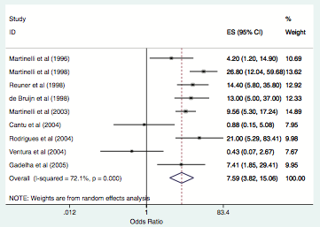
Amoozegar F, et al. Frontiers in Neurology 2015;6(7):1-11
Notes:
In this systematic review and meta-analysis, we found that the odds of CVST in women of reproductive age exposed to oral con- traceptives was about sevenfold higher than the odds of CVST in those not taking oral contraceptives. This estimate is compara- ble to a previous meta-analysis 7 years ago

Slide 13
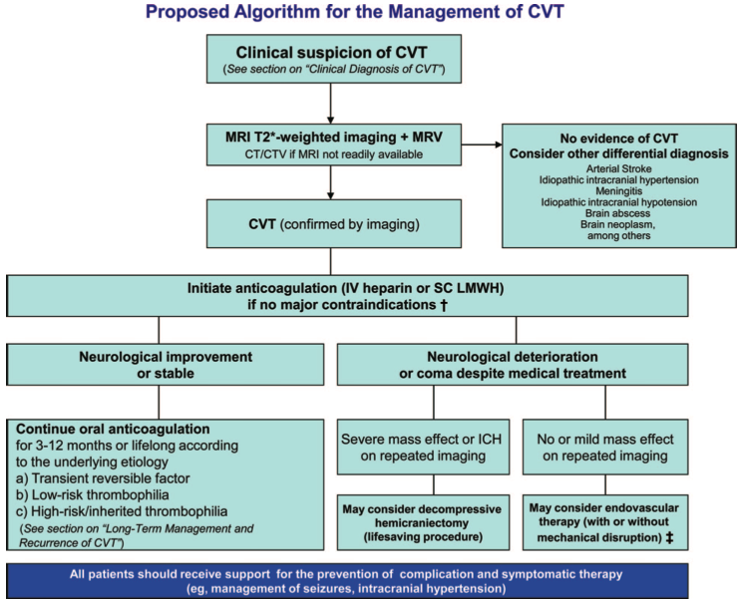
Management
Notes:
Due to consensus of American Heart association and American Stroke association ......

Slide 14
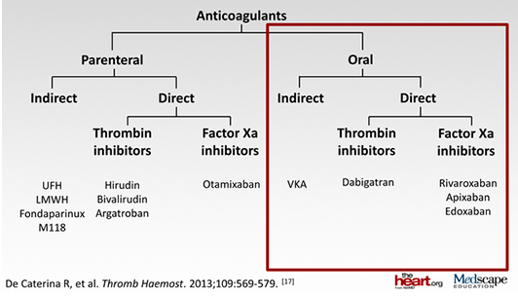
Current available anticoagulant

Slide 15
Warfarin
VKA → main therapeutic agent used to prevent thromboembolism
Narrow therapeutic window
Interaction with numerous drugs and dietary
Maintaining therapeutic range → challenging

Slide 16
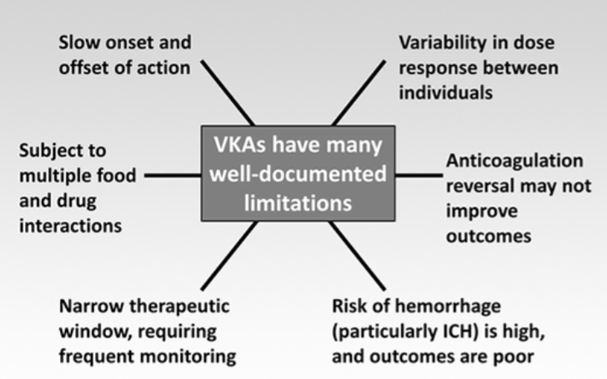
Challenges and limitations of VKA
Notes:
Vitamin K antagonists have many well-documented limitations. There is variability in dose response between individuals. Anticoagulation reversal may not necessarily improve outcomes. The risk of hemorrhage, particularly intracranial hemorrhage, is high, and when that happens, outcomes are poor. I have already highlighted the narrow therapeutic window, trying to keep patients within the INR of 2 to 3, therefore requiring frequent monitoring. Vitamin K antagonists have multiple food and drug interactions. Lastly, they have a slow onset and slow offset of action.

Slide 17
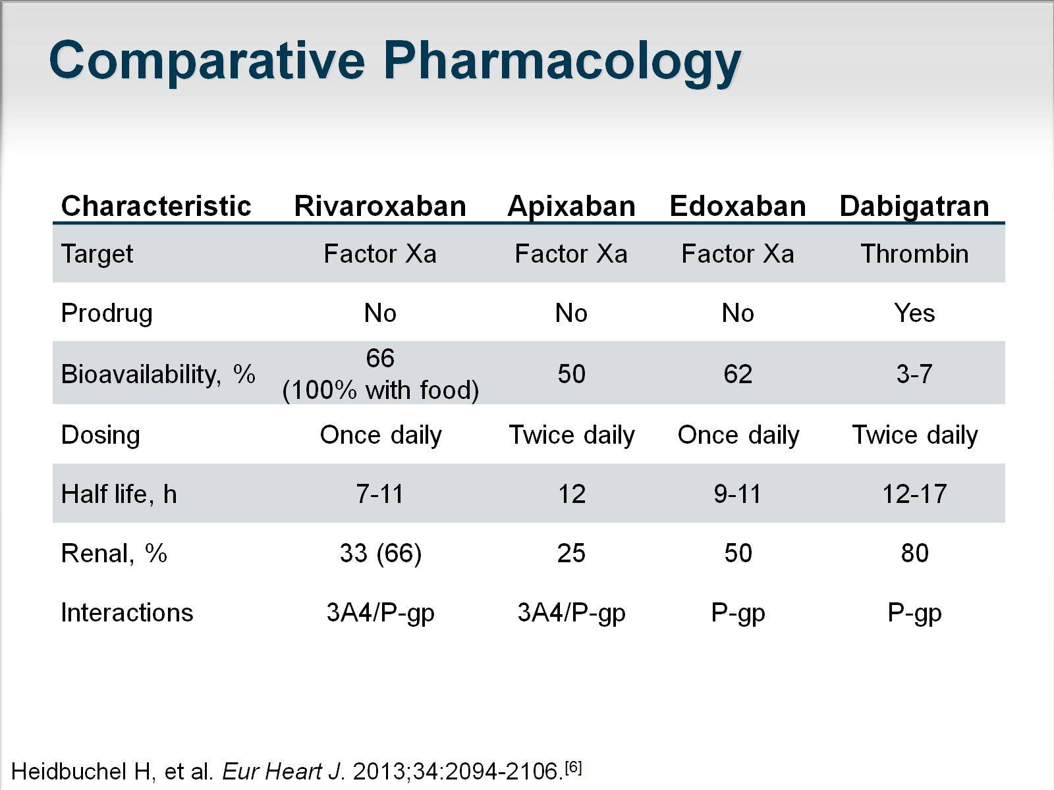
Pharmacological of NOACs

Slide 18
NOACs advantages
Rapid onset / offset of action
Few drug interactions
Predictable pharmacokinetics
Eliminating requirement for regular coagulation monitoring
Bauer KA. Hematology 2013: 464-70
Notes:
Unlike warfarin, which has a narrow therapeutic window and requires individualized dosing based on the international normalized ratio (INR), the NOACs have a wide therapeutic window, thereby facilitating fixed dosing in adults without the need for laboratory monitoring or dose adjustments for body weight.
NOACs are renally cleared and lower doses of rivaroxaban and apixaban were used in patients with atrial fibrillation and impaired kidney function (creatinine clearances between 25 and 49 mL/min)

Slide 19
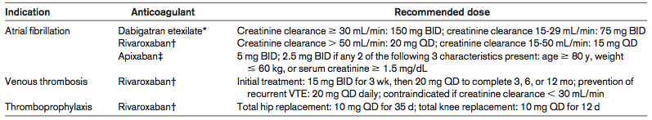
Recommended doses of NOACs for approved indications in US
Initial treatment : 15 mg BID for 3 wk,
then 20 mg OD to complete
Bauer KA. Hematology 2013: 464-70

Slide 20
Rivaroxaban
Direct, spesific, competitive factor Xa inhibitor
High oral bioavailability
Rapid onset of action
Dual mode of elimination
  1/3 excreted by the kidneys
  2/3 metabolized by liver → half excreted renally,half by fecal route
No dietary restrictions

Slide 21

Oral rivaroxaban
15 mg BID for 3 weeks
Followed by 20 mg OD
Subcutaneous enoxaparin
Followed by VKA
vs
in symptomatic DVT pts
EINSTEIN investigators. N Eng J Med 2010;363;2499-510
Notes:
The primary outcome : recurrent venous thromboembolism
Principal savety outcome : major bleeding or clinically relevant nonmajor bleeding

Slide 22
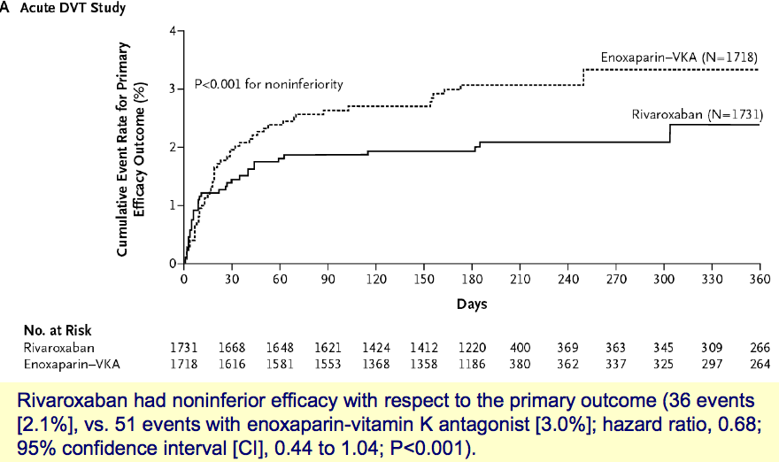
EINSTEIN investigators. N Eng J Med 2010;363;2499-510

Slide 23
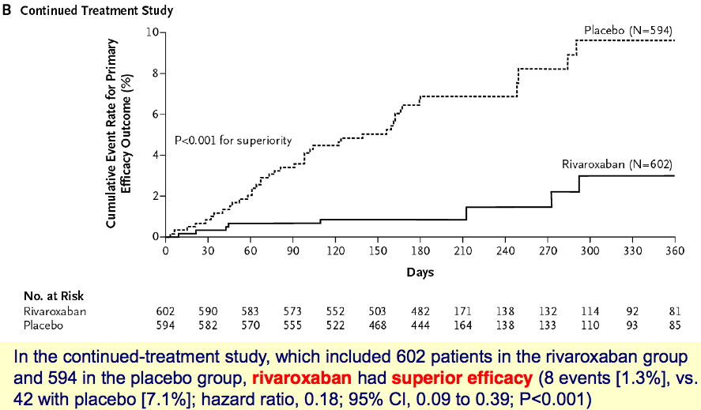
EINSTEIN investigators. N Eng J Med 2010;363;2499-510

Slide 24
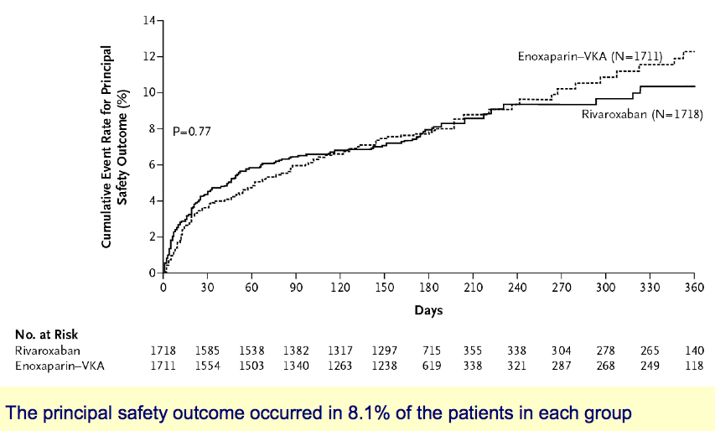
EINSTEIN investigators. N Eng J Med 2010;363;2499-510

Slide 25
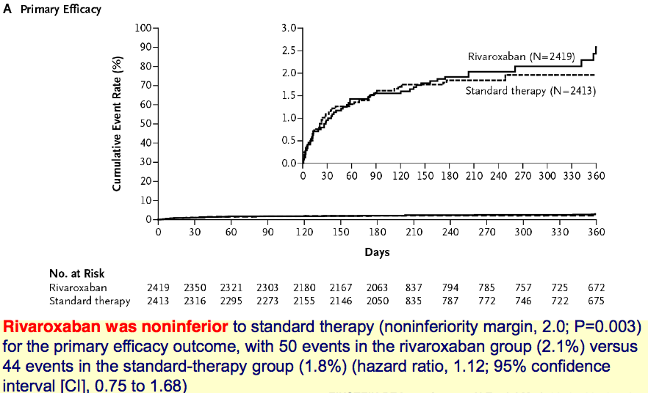
EINSTEIN investigators. N Eng J Med 2010;363;2499-510
Notes:
EINSTEIN study PE pts

Slide 26
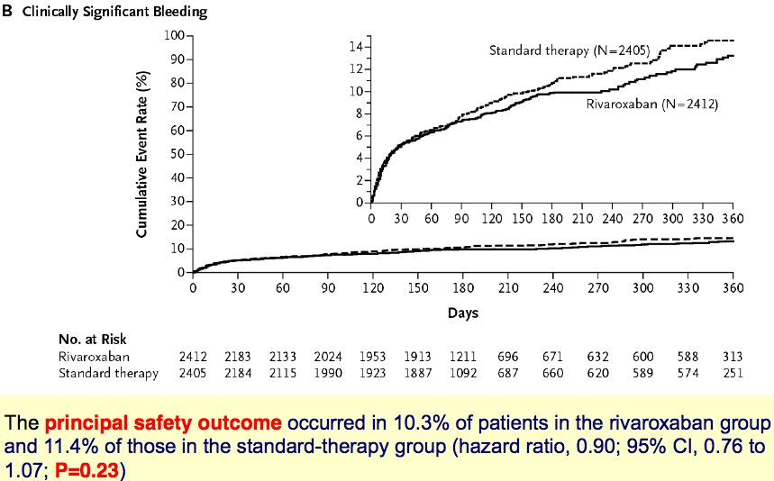
EINSTEIN investigators. N Eng J Med 2010;363;2499-510

Slide 27
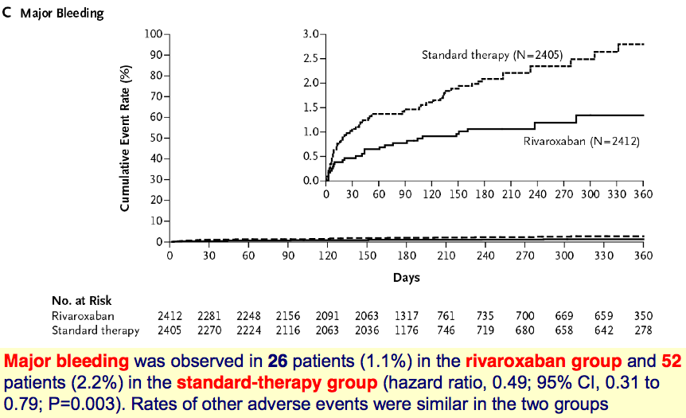
EINSTEIN investigators. N Eng J Med 2010;363;2499-510

Slide 28
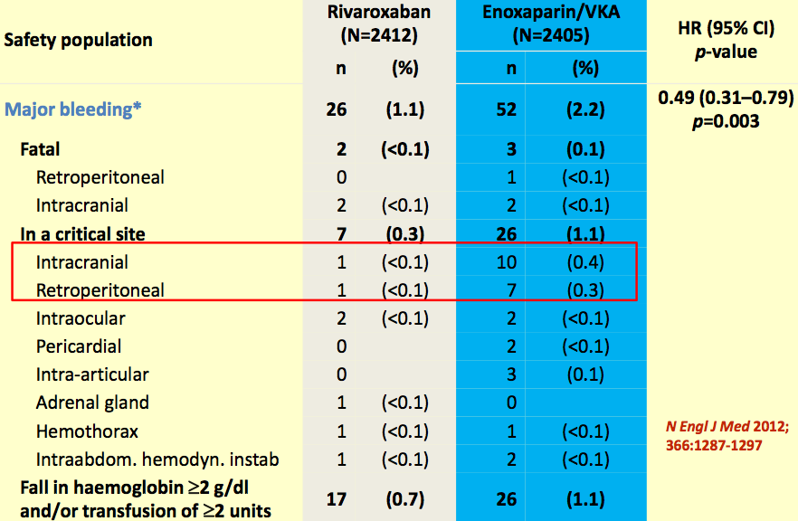
Notes:
Major bleeding

Slide 29
Rivaroxaban in CVST case
Geisbuch C,et al
16 pts CVST : 7 pts in rivaroxaban group vs 9 pts in VKA group
Similiar clinical benefit
Anticoli S, et al
6 pts CVST : 4 pts LMWH + rivaroxaban, 2 pts rivaroxaban
Excellent result, no bleeding complications, no thrombotic event
Geisbuch C, et al. Stroke 2014;45:2469-71.
Anticoli S,et al.Journalof Biomedical Sciences 2016;5(3):1-2
Notes:
Between January 2012 and December 2013, we recorded data from our patients with cerebral venous thrombosis.
The modified Rankin scale was used to assess clinical severity; excellent outcome was defined as modified Rankin scale
0 to 1. Recanalization was assessed on follow-up MR angiography. Patients were then divided into 2 treatment groups:
phenprocoumon (VKA) and a novel factor Xa inhibitor. Clinical and radiological baseline data, outcome, recanalization
status, and complications were retrospectively compared.
Results—Sixteen patients were included, and 7 were treated with rivaroxaban. Overall outcome was excellent in 93.8%, and
all patients showed at least partial recanalization. No statistical significant differences were found between the groups,
except the use of heparin before start of oral anticoagulation (P=0.03). One patient in the VKA and 2 patients in the factor
Xa inhibitor group had minor bleeding (P=0.55) within the median (range) follow-up of 8 months (5–26).
Conclusions—Factor Xa inhibitor showed a similar clinical benefit as VKA in the treatment of cerebral venous thrombosis.
Further systematic prospective evaluation is warranted.
In conclusion, these data suggest a potential role of
rivaroxaban in the treatment of CVT. Large, multicenter
prospective cohort studies are eagerly awaited to evaluate the
appropriateness and safety of novel oral anticoagulants for
CVT in the near future

Slide 30
Summary
CVST is a rare disorder and it is challenging in diagnose
Mainstay therapy of CVST with VKA is often difficult to reach target therapy
Rivaroxaban (NOAC) has potential role in the teatment of CVST

Slide 31

Thank you

Slide 32
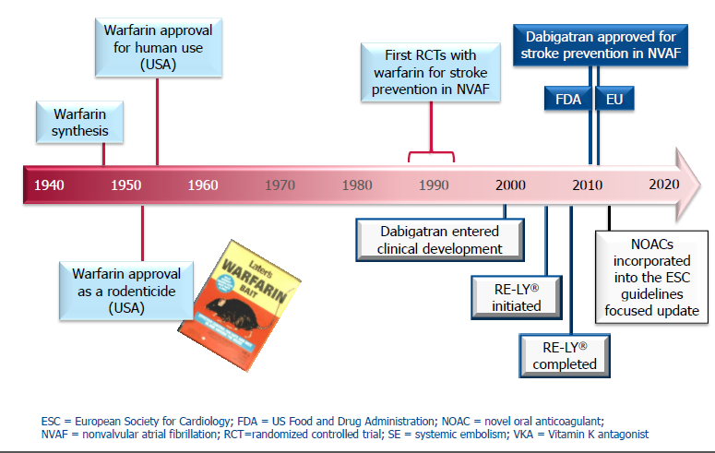
The Anticoagulant Journey

Slide 33
Main reasons for the underuse of VKA
Patient contraindications^{1,2}
  e.g. recent bleeding, active bleeding, recent haemorrhagic stroke
Physician decision^{1,2}
  Presumed low stroke risk / high bleeding risk
  Inability of patient to follow dosing or monitoring advice
Lifestyle factors^{1,3}
  Burden of monitoring, problems of food and drug interactions
  Perception of deterioration of quality of life
1. De Caterina R, Hylek EM. Am J Med 2011;124:793-9; 2. Camm AJ. Eur Cardiol 2011;7:187-95; 3. Lip GY, et al. Eur J Intern Med 2007;18:202-8.

