Slide 1
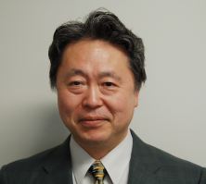


Development of Innovative Tool Using Taguchi-methods for the Near Future
Ikuo Tanabeª ªNagaoka University of Technology, 1603-1 Kamitomioka, Nagaoka, Niigata, 940-2188 Japan
* Corresponding author. Tel:+0081-258-47-9727; fax:+0081-258-47-9770
E-mail address: tanabe@mech.nagaokaut.ac.jp.

Slide 2
Background for research
Plan for development
Large cost・ Long time
Experiments・Investigation
Successful
Failure・
Mistake
Notes:
何度も失敗し，トライアルを繰り返す中でどんどん良い値が出てきて成功につながる．というのが一般的に行われている．
成功に至らないこともある．

Slide 3
Background for research
Short time・Easy
The software for innovative tool using Taguchi-methods is developed and evaluated. Because developments with short-term and lower cost are strongly required for shorten products life cycle.
Speedy・Cheapness
Notes:
品質工学を利用して，対象となる機能を最高水準にするための制御因子の組合せを，きわめて短時間・容易に探索し，迅速・安価に工業製品の開発を行うことが可能なソフトウエアの開発を目的としています．

Slide 4
Taguchi methods
SN ratio (db) = 10 log (μ ² ／σ² )
Sensitivity (db) = 10 log μ ²
More large
Compression of
the parameter by
orthoganal table
Trial for influence
of noise by CAE
or experiment
Decision of
optimum parameter
with high robustness
Many parameters
New methods
Next explanation is this
Compression of
the parameters by
orthoganal table
Decision of
optimum parameter
with high robustness
Many parameters
Trial with influence
of noise by CAE
Calculation of Properties, Standard
deviation, Total cost, Working time and
Non-defective unit rate for all parameter
Decision of the optimum combination of
Parameters for Properties（Accuracy),Standard
Deviation(Robustness), Total cost, Working time
and Their plural items
Notes:
☆ Next explanation is this.

Slide 5

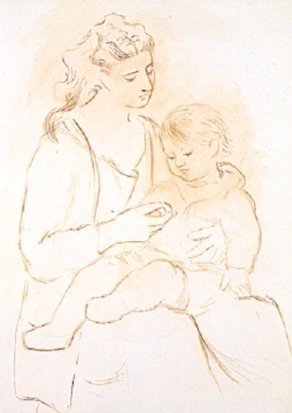
Cumulative distribution function and Order condition and cost table
Non-defective unit rate
G = f (η_{tol},μ ,σ)
Tolerance ( Spring back) 0.01
Order entry (unit) 1000
Delivery (hour) 24
Mat. M (yen/unit) 260
Magnesium Mat.O (yen/unit) 180
Sheet Mat.Ob(yen/unit) 180
Teflon (yen/unit) 50
Lubricant Lub. D (yen/unit) 0.00531
Lub. C (yen/unit) 0.304
Disposal cost (yen/unit) 2.16
Charge rate (yen/unit) 2000
Ordering
Condition
Frequency
Tolerance (η_{tol} )
_{Average：μ}
-σ_{η}
+σ_{η}
σ : Standard
deviation
Cost
Desired property
Non-defective unit rate G ＝ f ( η_{tol}，μ，σ ）
When η_{tol} :the tolerance , μ:Average，σ :Standard deviation
Number N of all products N ＝ N_{ord} ／ G
When N_{ord} : order entry
Working time for the product T_{ｍ} ＝ Σ(from 1 to final machine number) T_{V}
When T_{V} ：the working time for the machine tool V
Total working time T_{all} ＝ N T_{ｍ}
When Ｎ ：Numberof all products
Total cost C_{all} ＝ [ C_{mat}＋C_{was}＋C_{dis}(1－G ) ＋C_{m-pri} N ]＋T_{all}C_{ｍ}
When C_{mat}: unit cost of material, C_{was} :unit cost of consumption
article, C_{dis}, :waste cost for inferior goods, C_{m-pri} :amortize cost
of the used machine tools, C_{ｍ} :labor cost for one hour
Notes:
☆ This graph is a distribution for a property of a product.
☆ When the distribution is defined by the normal distribution, Cumulative distribution
functions for all combinations using all parameters are calculated using results of the
Taguchi methods. This is an example.
☆ This is order condition & cost table. When the tolerance was decided, Non-defective
unit rate decide.
☆ Then when the order entry was decided, Number of products, Cost, Time
can calculate by these equations

Slide 6
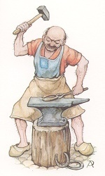
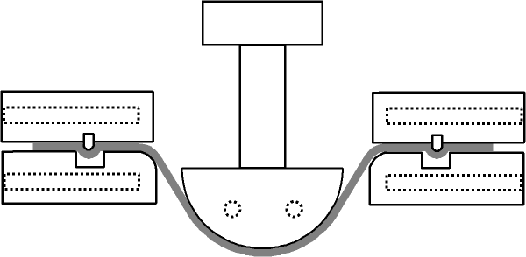
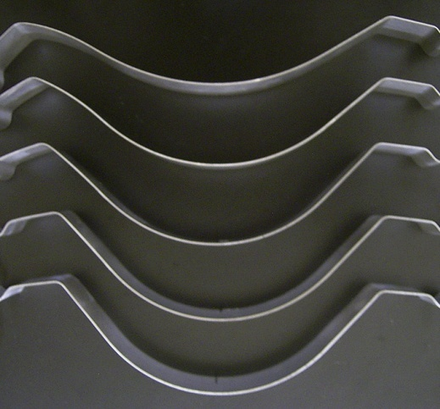
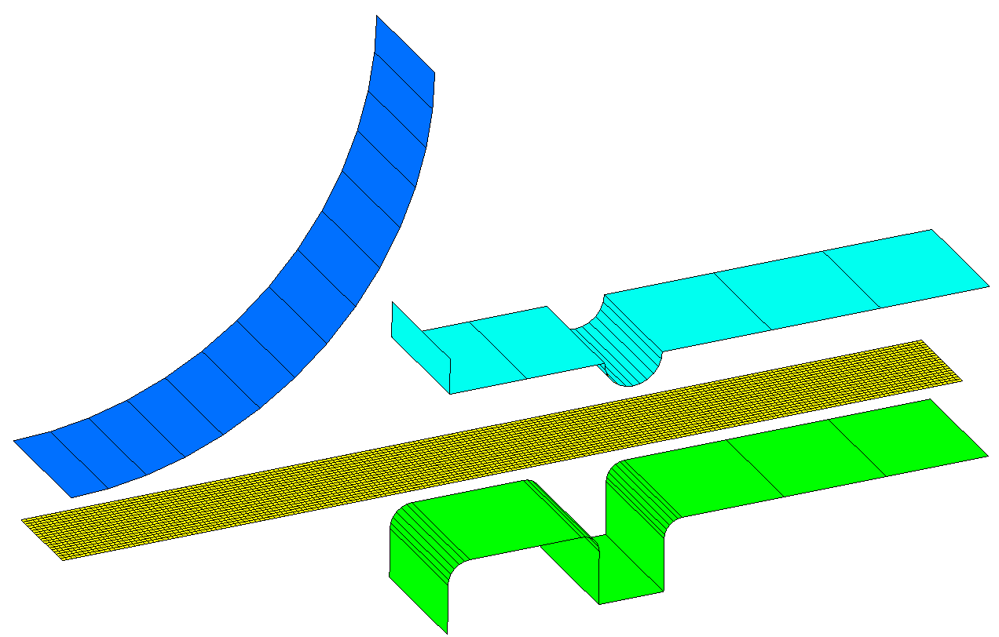
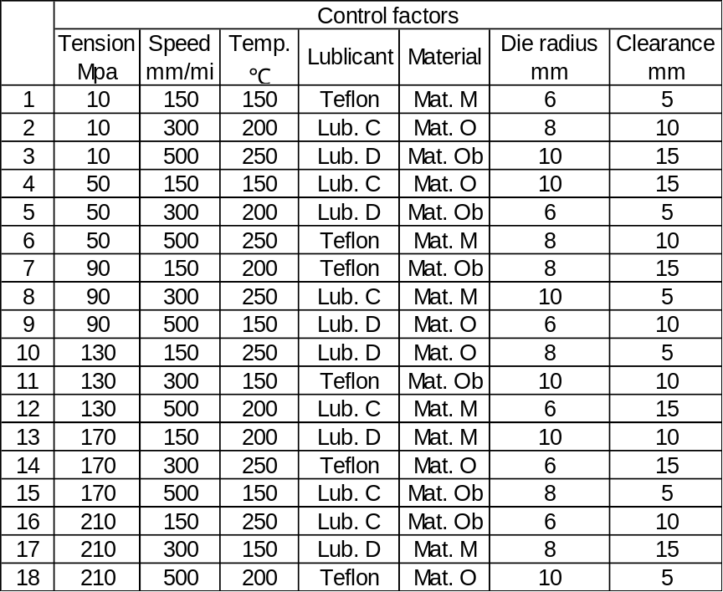

Experimental set-up for evaluation , Spring back and Simulation model for the CAE
Blank holding force
Blank holder
Spring back
Load cell
Punch
Blank holder
r’_{in}
Punch
0 ← Spring back → 1
r 100 mm
Punch radius r_{in}
Z
r 8 mm
10 mm
Die
Die
Test piece
Test piece
X
Heater
CAE model
Y
Experimental set-up
Spring back=│r’_{in}－r_{in}│/ r’_{in}
Orthogonal table
Control and noise factors
New method with five divisions was used for normal distribution of noise factors
Levels 1 2 3 4 5 6
Noise factors Control factors
Tension MPa 10 50 90 130 170 210
Levels 1 2 3
Speed mm/min 150 300 500
Temperature ℃ 150 200 250
Lubricant Teflon Lub. C Lub.D
Material Mat. M Mat. O Mat.Ob
Die radius mm 6 8 10
Clearance mm 5 10 15
Levels 1 2
Holding force % －10 ＋10
Temperature % －5 ＋5
Mat. M % －1.5 ＋1.5
Material
Mat. O % －3 ＋3
Mat. Ob % －10 ＋10
Notes:
☆ The example is the spring back
☆ Warm press forming consists of Die, Punch, Blank holder and Blank.
☆ Products are here. The product back a little after the forming, that is spring back. Blow 2 are good,
however upper 3 are not good.
☆ This CAE model was used for the trial. Commercial CAE used was Pam-stamp.
☆ These are control factors; Holding force, Punch speed, Temperature, Lubricant,
Material, Die radius and Clearance. Number of all combinations is 4374. Very big.
☆ Noise factors are here. Holding force, Temperature and Property of material are
distribute. Influences of noise factors were inputted by the bar graph with 5 divide
☆ 4374 combinations are compressed to 18 combinations by orthogonal table.
☆ Then the trials with influence of noise were performed by the CAE model

Slide 7

Results of evaluation for this system
Result Condition
Machining conditions for
confirmation experiment
Total Total Non-defective
cost time uinte rate
Call Tall G
Tension 5 5 5 5
2 2 3 2
2 2 2 2
Lubricant 1 3 1 1
Material 2 2 2 2
Die radius 3 3 3 3
Clearance 1 1 3 3
0.0039 0.0091 0.0071 0.0042
No-defective 100 87 93 100
unit rate %
Number of 1000 1152 1073 1000
forming unit
Total time h 7.8 9.0 5.0 7.8
Total cost 24.6 22.6 25.7 24.6
×1000 yen
Priority item
Accuracy
ηave
Best Worst
Spring back 0.09 0.45
Std. deviation 0.007 0.100
SN ratio db 22.18 13.03
Sensitivity db －20.92 －6.94
a: Tension 6 2
b: Punch speed 1 2
c: Temp. of die 3 3
d: Lubricant 2 1
e: Test piece 1 1
f: Die radius 2 2
g: Clearance 2 2
Predicted
results
Speed
Temperature
Conditions
Spring back
Best result
Comparison results between
prediction and experiment
Best condition Worst condition Gain
SN ratio Prediction 22.18 13.03 9.15
db Experiment 22.06 12.98 9.08
Sensitivity Prediction －20.92 －6.94 －13.98
db Experiment －20.92 －9.12 －11.80
Notes:
☆ This is results. For example, This is the optimum condition for accuracy, the spring back is 0.0039.
This is the highest accuracy. And this is the optimum condition for working
time, the time is 5.0 hours. This is the most first time. .
☆ This is results of calculation before the performance. Therefore I experiment for
evaluation regarding best and worst condition. Experimental results are similar to
calculated results. Therefore this system can calculate the optimum condition
before the performance.

Slide 8
Flow of my software
Next explanation is this
1st Trial
Using Taguchi-methods
The effective figures for SN ratio and Sensitivity
・ The effective figures were rewritten
for the physical image regarding the
influences of the control factors.
・ An operator can intutively understand
and judge the influences of the
control factors.
Estimation of optimum condion for 2nd trial
2nd Trial
Notes:
要因効果図をもっと物理的に大小関係がしっかり分かるような図に書き換えて，ソフトウエアの操作者に直感的・視覚的な判断を委ね，その判断結果で最適値を探るソフトウエア

Slide 9
Explanation for my software
Estimation for inside
Estimation for outside
Result of 1st trial
Result of 1st trial
●
Recommended levels for 2nd trial
●
Recommended levels for 2nd trial
●
●
●
●
●
●
●
Average of function (Desired property)
Average of function (Desired property)
●
Level 2’
Level 3’
●
●
Level 3’
Level 2’
Level 1’
●
●
Level 1’
↑
↑
↑
↑
↑
↑
Level 1
Level 2
Level 3
Level 1
Level 2
Level 3
Value of control factor
Value of control factor
Notes:
指数・線形・対数・多項式・累乗
カーブフィットにより，物理的な影響力がよりイメージしやすくなる．

Slide 10
Evaluation using a cooling system
Valve I
Hose (Innerφ8.5 mm)
Flow meter
Water pump
(Max. 2.1 MPa)
F1
2800 mm
Terminal of air
Valve II
Flow meter
F2
Compressor
(Max. 1.27 MPa)
Blender for air
1500 mm
Measuring device for heat transfer coefficient
1300 mm × Innerφ14 mm
Drain
Distance D
Intake
Micro bubble device
Vessel of strong alkali water (545×385×310mm)
Notes:
強制冷却能力を向上させるための条件探索の実験で本ソフトウエアの総合評価を行った．

Slide 11
Experimental parameters for 1st trial
Q
Sensor
D
L
P
Q
Control factors |  |  |  |  | Noise factor
Name of factors | Length of hose L [mm] | Air pressure P [MPa] | Quantity of flow for strong alkaline water Q [L/min] | Distance from outlet of nozzle D [mm] | Number of experiments: 9
Level 1 | 500 | 0.05 | 0.5 | 10
Level 2 | 1000 | 0.2 | 3.0 | 200
Level 3 | 5000 | 0.4 | 6.0 | 400
L
P
D
Notes:
制御因子は，空気混合器から吹き出し口までのホースの長さL [mm]，混合する空気の圧力P [MPa]，強アルカリ水の流量Q[l/min]，空気吹き出し口から熱伝達率測定器までの距離D[mm]の4因子．各機器・装置の仕様を考慮して，各3水準を設定した．L9直交表を使用．誤差因子は，9回の実験回数．
冷却効率を上げるためにマイクロバブルを常に8 .0[l/min]供給している．特性値は見かけ上の熱伝達率である．

Slide 12
Experimental results for 2nd trial
L
P
Average of function
(Heat transfer coefficient)
Average of function
(Heat transfer coefficient)
Q
Average of function
(Heat transfer coefficient)
Average of function
(Heat transfer coefficient)
D

Slide 13
Final evaluation
Optimum conditions
Optimum conditions
  At L=70 mm, D=200 mm constant
At P=0.2 MPa, Q=6 l/min constant

Slide 14
CONCLUSIONS
It is concluded from the result that;
The manufacture support system using Taguchi methods was made. This system could calculate the optimum condition for each target before the performance. This system was effective for the spring back.
(1)
(2)
Innovative tool using the Taguchi methods was useful for development with short-term and lower cost. This tool could quickly and exactly decide the optimum cooling condition. The cooling system with optimum condition using the innovative tool was very effective. And heat transfer coefficient of the proposed cooling system with optimum condition was 8490 W/m2K.
Notes:
☆ This is conclusions.
☆ (1) The manufacture support system using Taguchi method was made.
☆ (2) This system could calculate the optimum condition for each target before the performance.
☆ (3) This system was effective for the spring back.

Slide 15


Thank you !
Happy man

