Slide 1
The role of IL-17A
in postmenopausal inflammatory events,
such as in osteoporosis
¹ Ildikó Molnár, MD, CSc, ² Ilona Bohaty, MD, ¹Éva Somogyiné-Vári
¹Immunoendocrinology and Osteoporosis Centre,
²Regional Centre of Hungarian National Blood Transfusion Service,
Debrecen, Hungary
Summit 2015, Houston

Slide 2
IL-17 cytokine
IL-17 (called as IL-17A) is characterized by:
T-cell-derived cytokine
secreted from Th17 cells, which are distributed from other effector CD4+ T helper cells, such as Th1, Th2 and regulatory T (Treg) cells.
Sources of IL-17:
Cells of innate and adaptive immunity (T and B cells, NK,
NKT, γδ T cells, neutrophils, basophils, mast cells,
monocyte-macrophages, dendritic cells).
Epithelial, endothelial, vascular and stromal cells.
IL-17 initiated cytokine/chemokine productions:
IL-6, TNFα, IL-1β, IL-8, CXC1, CXC2, CXC8, CCL2,
MCP-1
Summit 2015, Houston

Slide 3
Increased IL-17 production-related diseases
Local inflammation
(cytokine interplay chemokine)
Bone loss
(osteoporosis)
Autoimmunity
Arteriosclerosis
(cardiovascular
diseases)
Allergy
Host defense mechanism
(infection, transplantation)
Tissue repair
Summit 2015, Houston

Slide 4
Immune dysfunction associated
with estrogen deficiency
Estrogen
Estrogen deficiency
T cell activation
IL-17↑
Th17
spleen
peripheral
mononuclear cells
TGFβ ↓ IFNγ ↑
neutrophil
recruitment
IL-6 secretion
IL-1↑ TNFα ↑
RANK ligand ↑
osteoclast
osteoblast
estrogen
receptor
BONE LOSS
IL-6 secretion
Summit 2015, Houston

Slide 5
Patients and methods
Pre- (n=22, mean age 41 yr) and postmenopausal
(n=72, mean age 65 yr) women were studied.
Serum levels of IL-17A, IL-6, MCP-1 (macrophage-
chemoattractant protein-1), sRANK (soluble receptor
activator of NF-κB) ligand and OPG (osteoprotegerin)
were measured by enzyme-linked immunosassay
(ELISA).
Serum levels of estradiol were measured by chemi-
luminescence assay in fully automatized manner.
Bone mineral density was detected by dual-energy
X-ray absorptiometry (DXA) using Hologic Discovery
equipment.
Summit 2015, Houston

Slide 6
We studied in pre- and postmenopausal women:
The relationship among serum IL-17A levels,
estrogen deficiency and postmenopausal period.
The relationships among serum IL-17A, sRANK
ligand, OPG levels and bone mineral densities.
The relationship between vitamin D₃ deficiency
and serum IL-17A levels.
The relationship between serum IL-17A and IL-6
or MCP-1 levels.
Synergism between bone loss and arteriosclerosis
via IL-17 cytokine.
Summit 2015, Houston

Slide 7
The relationship among serum IL-17A levels, estrogen deficiency and postmenopausal period.
Summit 2015, Houston

Slide 8
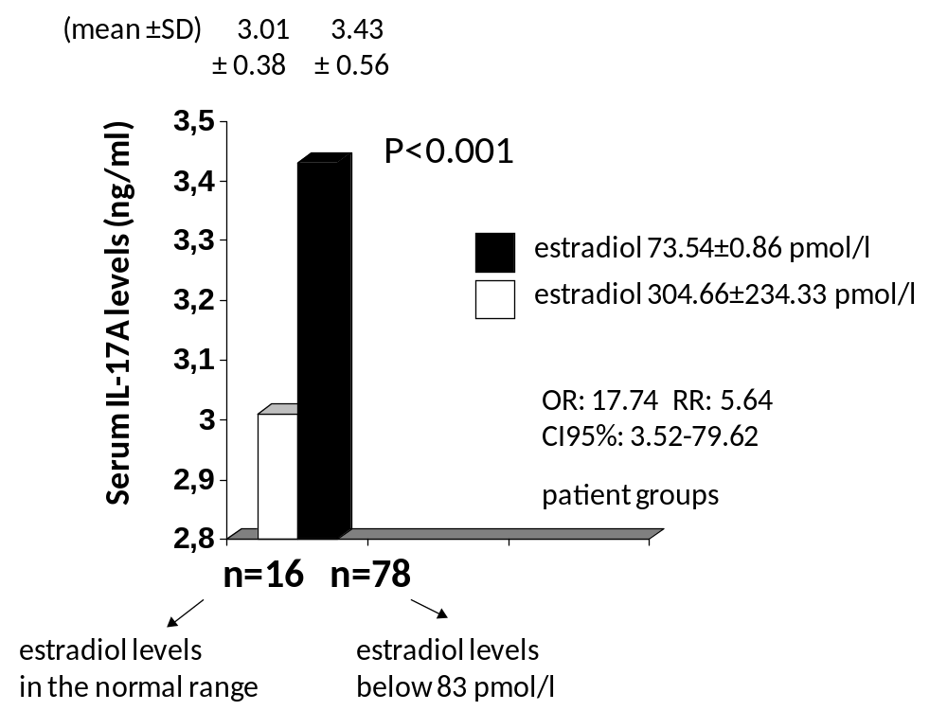
Serum IL-17A levels were significantly higher
in women with estrogen deficiency.
Figure 7
Summit 2015, Houston

Slide 9
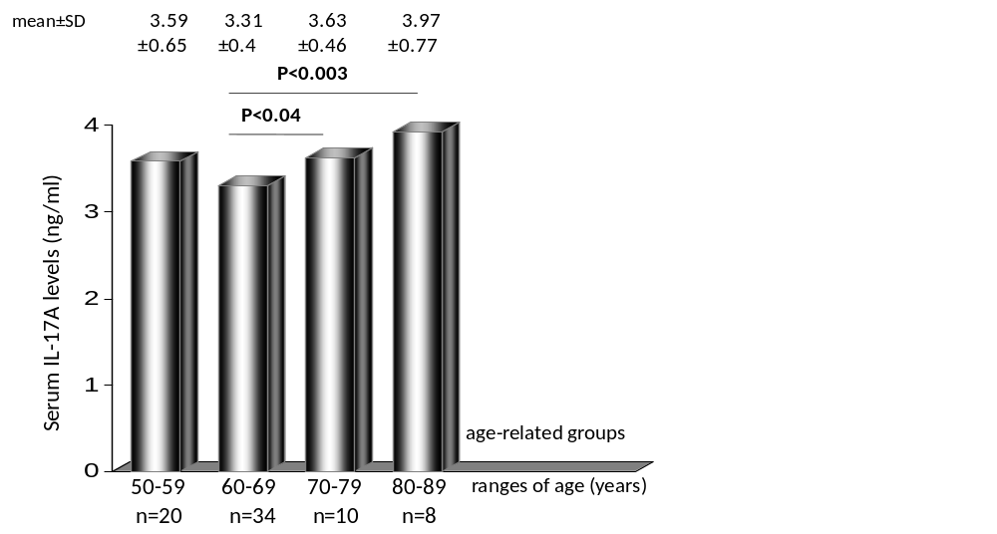
Inreased serum IL-17A levels showed an
age-related dependency in postmenopause.
Figure 8
Summit 2015, Houston

Slide 10
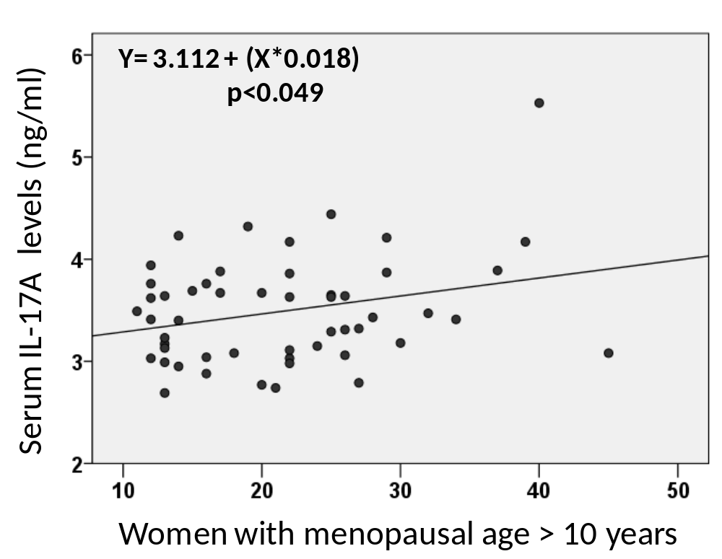
Correlation between serum IL-17A levels and the post-
menopausal period of women aged 60 to 89 years.
Figure 9
Summit 2015, Houston

Slide 11
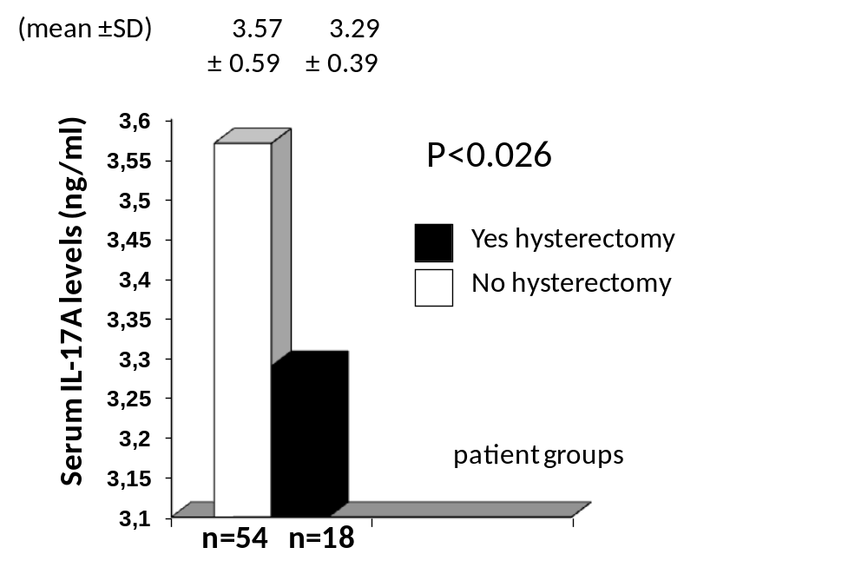
Inreased serum IL-17A levels showed a dependency
on the history of hysterectomy in postmenopause.
Figure 10
Summit 2015, Houston

Slide 12
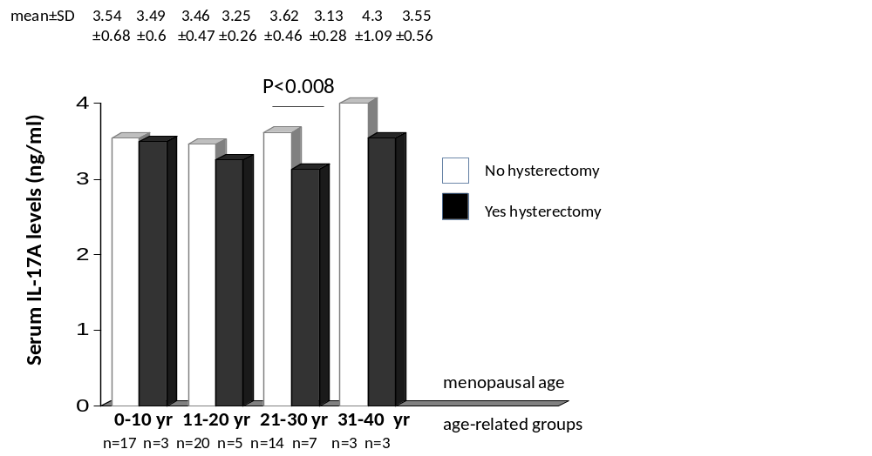
Inreased serum IL-17A levels showed a postmenopausal
age-related dependency on the history of hysterectomy.
Figure 11
Summit 2015, Houston

Slide 13
Relationship
between serum IL-17A levels and
bone mineral densities (BMDs).
Summit 2015, Houston

Slide 14
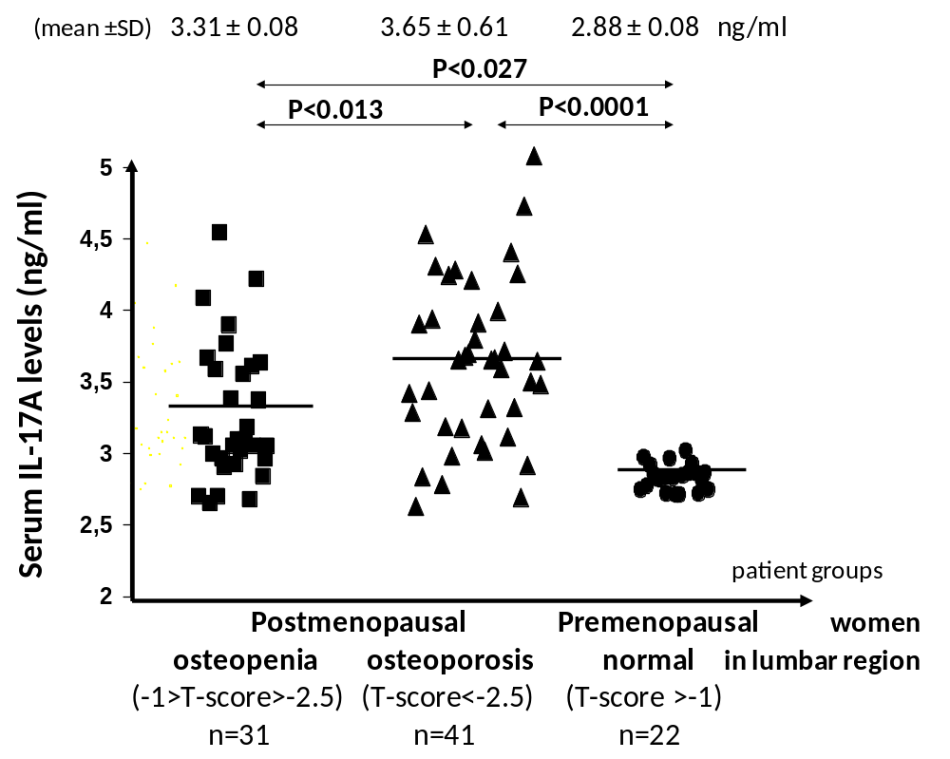
Increased serum IL-17A levels were associated with
relevant bone loss in postmenopause compared to
those in premenopause.
Figure 13
Summit 2015, Houston

Slide 15
Serum IL-17A levels were significantly higher in post-
menopausal osteoporotic women in the lumbar and
femoral total regions.
Figure 14
Summit 2015, Houston

Slide 16
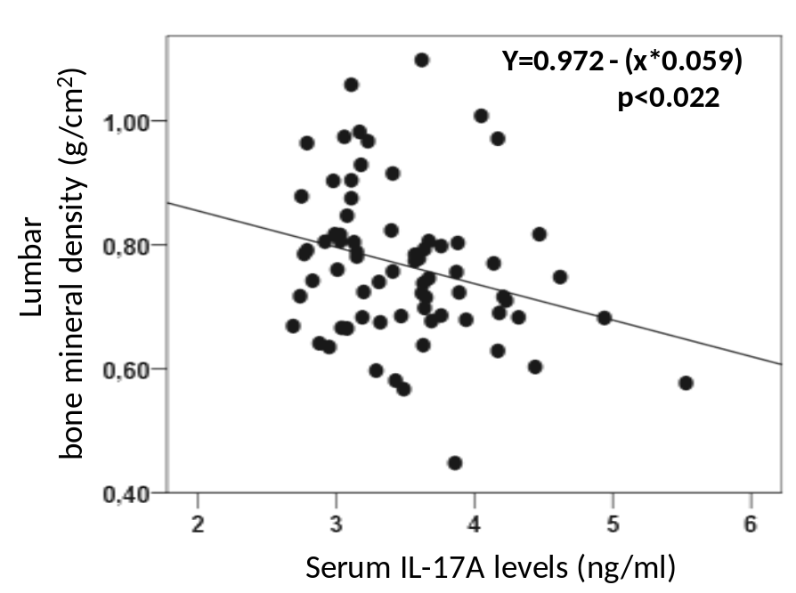
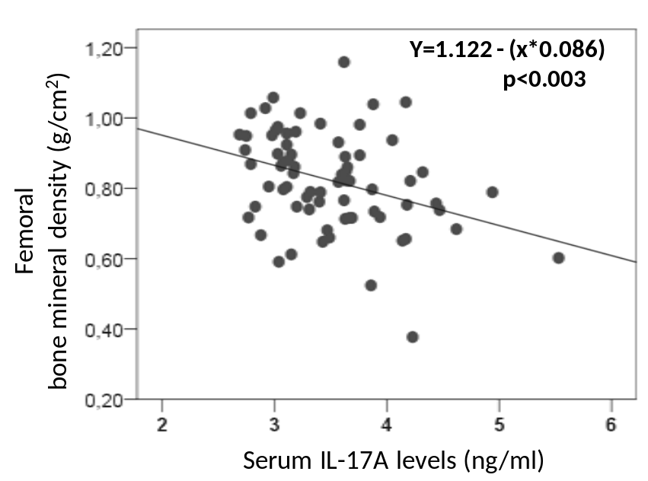
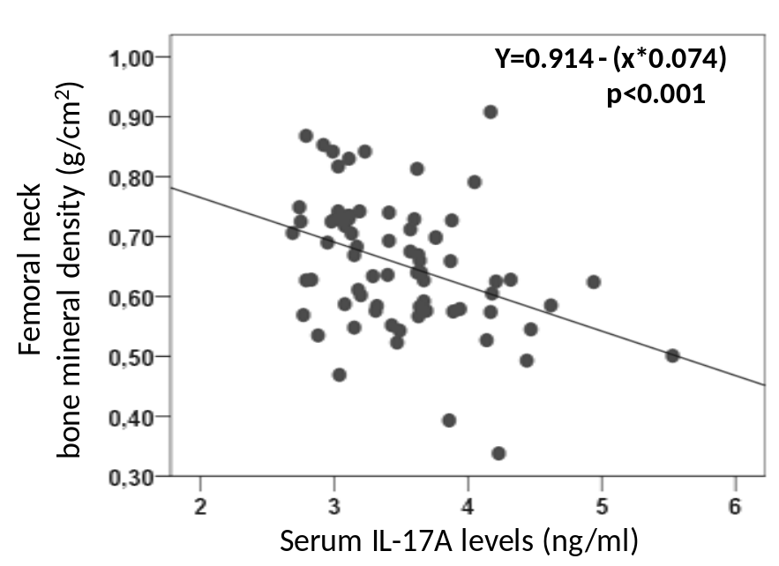
Serum IL-17A levels
correlated inversely with
bone mineral densities in
postmenopause.
Lumbar region
Femoral regions
Figure 15
Summit 2015, Houston

Slide 17
Relationship between serum IL-17A and sRANK ligand or OPG levels.
Summit 2015, Houston

Slide 18
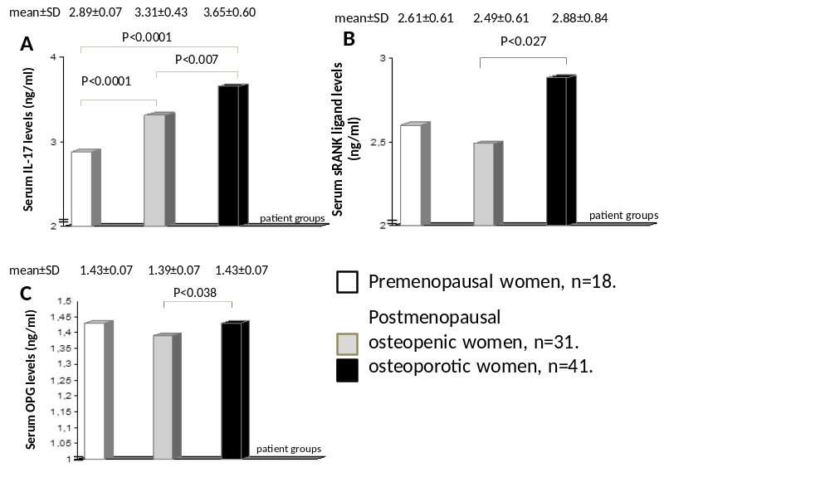
Increased serum IL-17A and sRANK ligand levels were detected in osteoporotic women.
IL-17A
sRANK ligand
OPG
Figure 17
Summit 2015, Houston

Slide 19
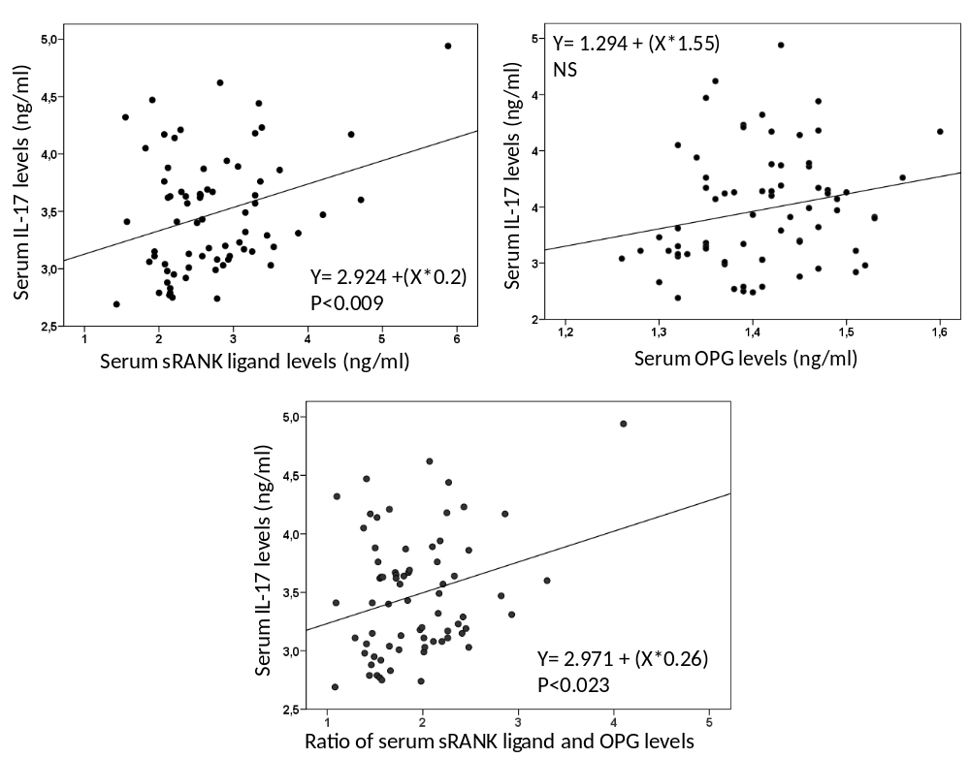
Serum IL-17A levels correlated positively with sRANK ligand and did not with OPG serum levels, but with the ratio of sRANK ligand and OPG serum levels.
sRANK ligand
OPG
Ratio of sRANK ligand and OPG
Figure 18
Summit 2015, Houston

Slide 20
Vitamin D₃ deficiency and
serum IL-17A levels.
Summit 2015, Houston

Slide 21
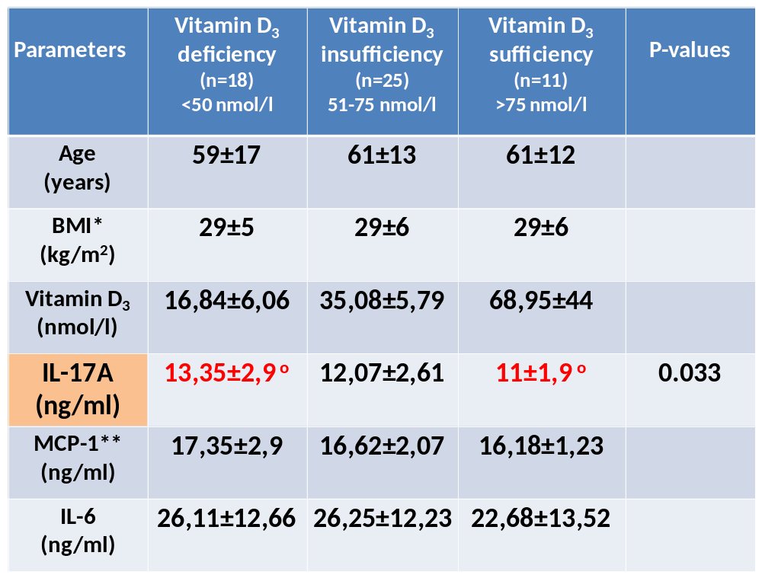
Serum IL-17A levels were significantly higher in post-
menopausal women with vitamin D₃ deficiency.
Table 1
*Body mass index (BMI) **Monocyte chemoattractant protein-1 (MCP-1)
Summit 2015, Houston
Parameters | D-vitamin deficiency (n=18) <50 nmol/l | D-vitamin insufficiency (n=25) 51-75 nmol/l | D-vitamin sufficiency (n=11) >75 nmol/l | P-values
Age (years) | 59±17 | 61±13 | 61±12
BMI* (kg/m²) | 29±5 | 29±6 | 29±6
D₃-vitamin (nmol/l) | 16,84±6,06 | 35,08±5,79 | 68,95±44
IL-17A (ng/ml) | 13,35±2,9 º | 12,07±2,61 | 11±1,9 º | 0.033
MCP-1** (ng/ml) | 17,35±2,9 | 16,62±2,07 | 16,18±1,23
IL-6 (ng/ml) | 26,11±12,66 | 26,25±12,23 | 22,68±13,52

Slide 22
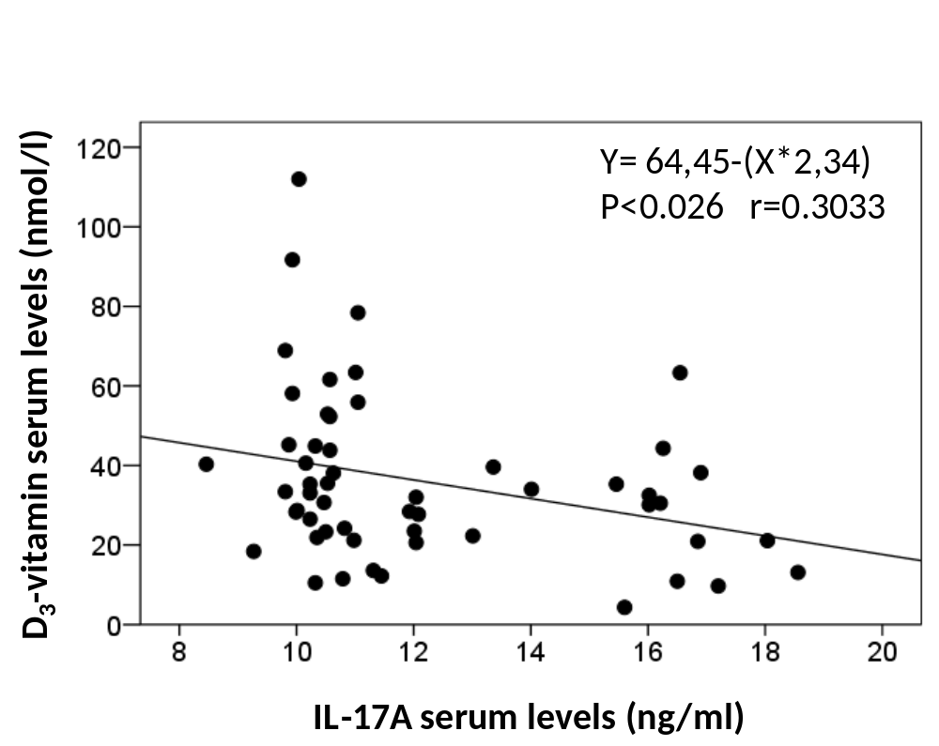
Serum IL-17A levels correlated inversely with vitamin D₃ serum levels in postmenopause.
Figure 20
Summit 2015, Houston

Slide 23
Relationship between serum
IL-17A and IL-6 or MCP-1 levels.
Summit 2015, Houston

Slide 24
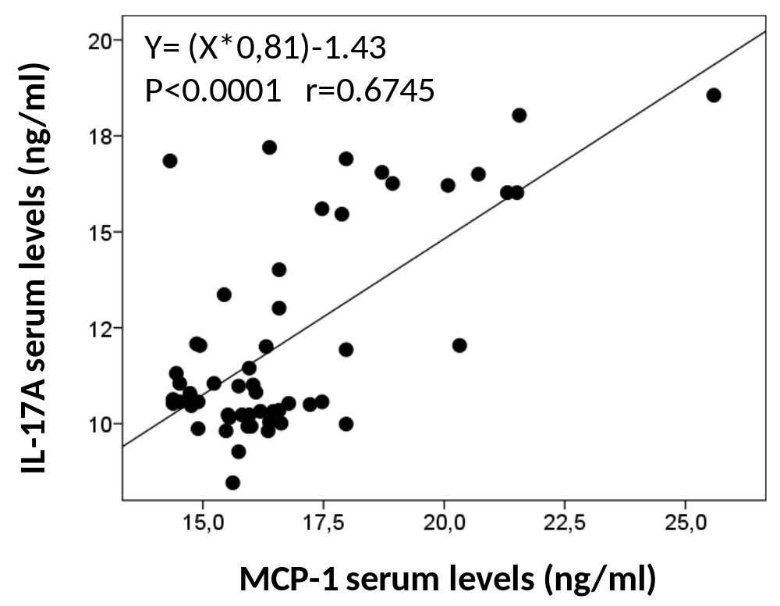
Serum IL-17A levels correlated positively with
serum MCP-1 levels in postmenopause.
Figure 22
Summit 2015, Houston

Slide 25
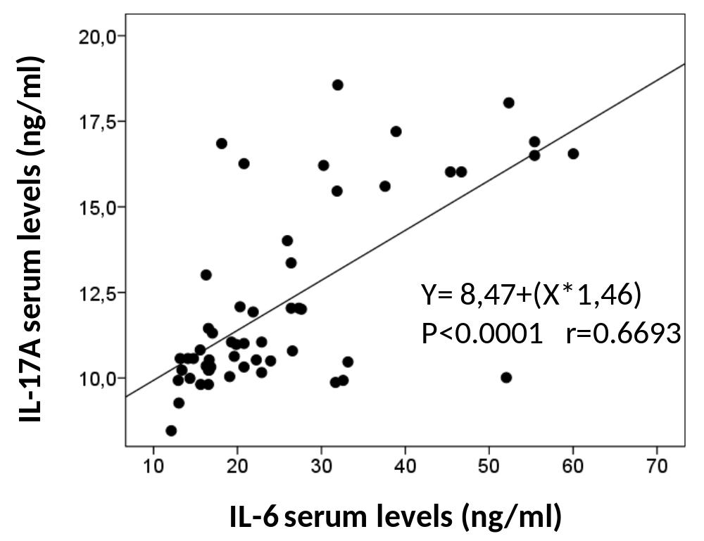
Serum IL-17A levels correlated positively with
serum IL-6 levels in postmenopause.
Figure 23
Summit 2015, Houston

Slide 26
Synergism between bone loss and arteriosclerosis
via IL-17 cytokine.
From Butcher M and Galkina EV ,
Thromb Haemost, 2011,
106(5): 787-795.
Figure 24
bone loss
arteriosclerosis
Summit 2015, Houston

Slide 27
Conclusions
The high prevalence of increased serum IL-17A levels
was connected to postmenopausal estrogen deficiency
and showed a postmenopausal period-related dependency.
Postmenopausal osteoporosis was associated with
increased serum IL-17A and sRANK ligand levels,
but only weakly increased serum OPG levels.
Vitamin D₃ deficiency was associated with higher
serum IL-17A levels in postmenopause.
The strong correlation between serum IL-17A and
IL-6 or MCP-1 highlighted the relationship between
osteoporosis and arteriosclerosis, as well as cardio-
vascular diseases.
Summit 2015, Houston

Slide 28

Thank you
for your attention!
Summit 2015, Houston

Slide 29
Participated in this work:
Regional Centre of Hungarian National
Blood Transfusion Service, Debrecen, Hungary
Ilona Bohaty MD
EndoMed, Immunoendocrinology
and Osteoporosis Centre
Éva Somogyiné-Vári

